Slide 1
Hybrid and Plug-in EVs
By Ben Scott

Slide 2
Introduction
Green energy storage is becoming a concern for the modern consumer
What direction is the best/ most viable as a consumer?
What's the difference?

Slide 3
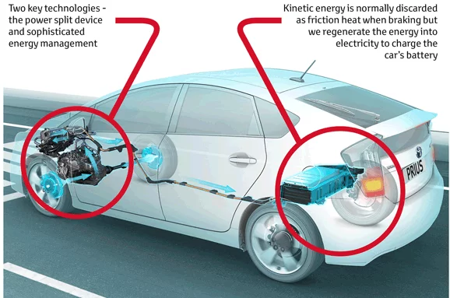
Hybrid Ev’s
Both Electric Battery and Gas Motor
Toyota, Hyundai, Honda, Kia, Chrysler, Ford, Lexus, Chevrolet, etc…
Uses standard fuel and drives the same when compared to other non-electric vehicles
Nickel Metal Hydride or Lithium Ion Battery
Can be charged due to regenerative braking

Slide 4
Types of Hybrids
Parallel hybrids: The transmission in wheels is connected to both engine and motor. However, the main source of power is the internal combustion engine. This hybrid vehicle can not operate in electric mode. This type can have a battery with lower capacity and is more efficient in high speed.
Series hybrid: Combustion engine serves to move a generator which supplies electric motor and batteries. Only the electric motor is connected to transmission which moves the vehicle. It is more efficient in low speed and situations where the car stops and starts with frequency.
Combined hybrid: Use the advantages of both types, is the majority of hybrid cars in market. Can operate in electric or combustion mode.

Slide 5
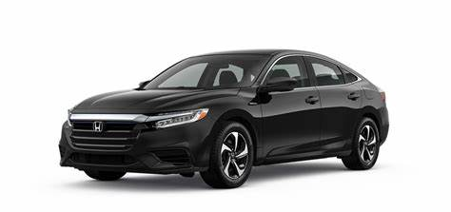
Example (2022 Honda Insight)
Fuel type
Regular unleaded
55/49 MPG city/highway
Range in miles (city/hwy)
583.0/519.4 mi.
Fuel tank capacity
10.6 gal.
$25,760

Slide 6
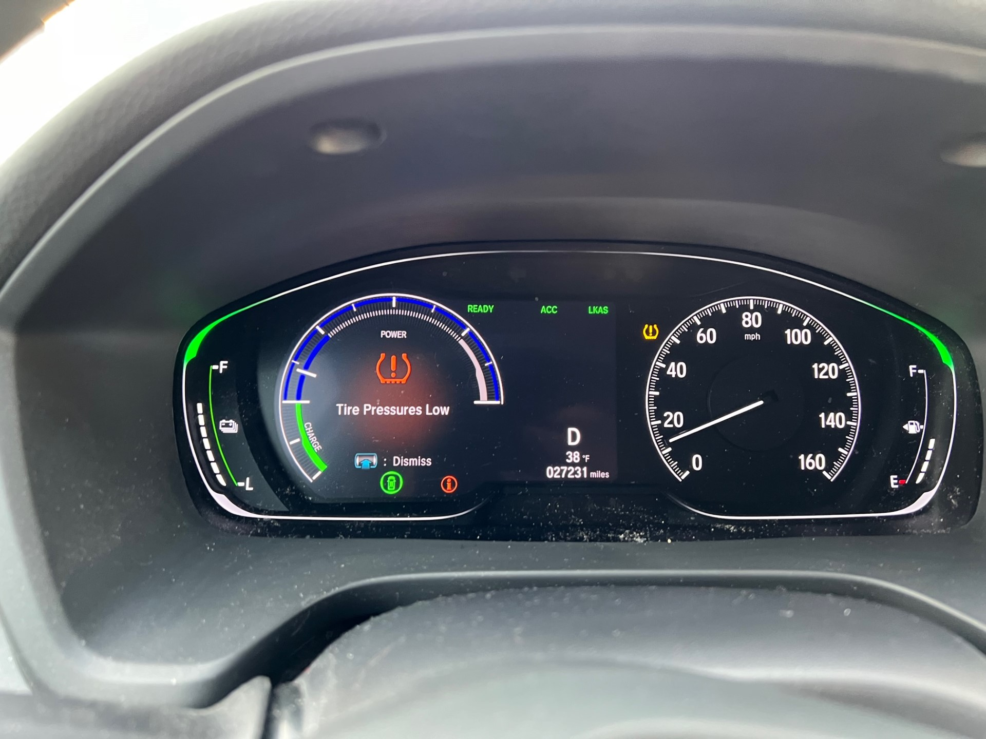
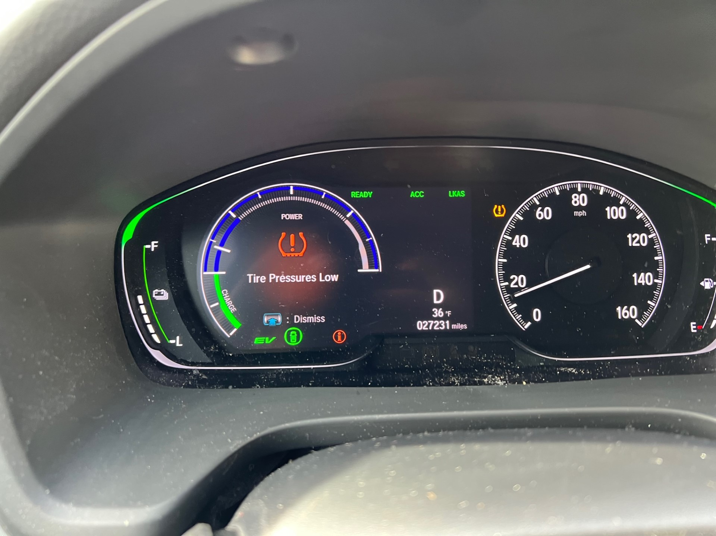
Using Hybrid Battery

Slide 7
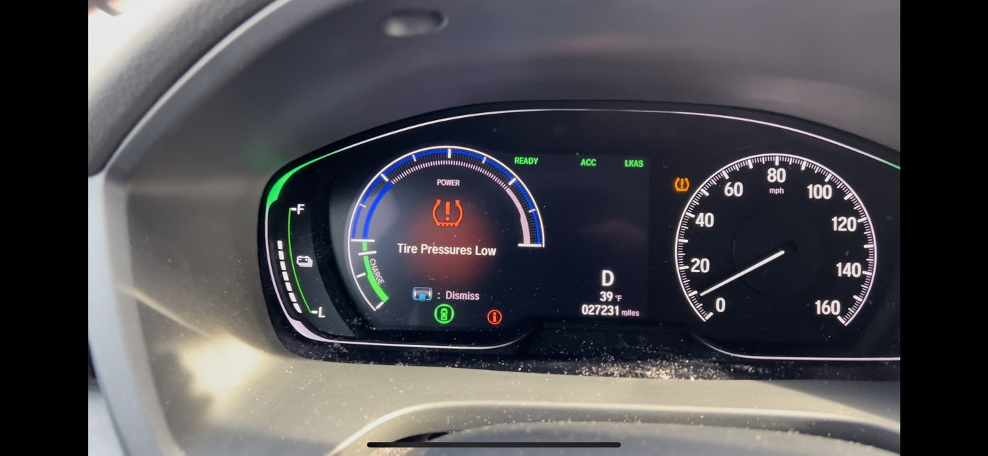
Charging the Battery

Slide 8
Advantages
Infrastructure is already available
Great MPG for Travel
Comparable and competitive distance and travel to normal gas vehicles
No learning curve
No additional costs to maintain when compared to non-electric vehicles

Slide 9
Disadvantages
Battery cannot be used at all speeds
If the battery is not charged it cannot be used
Small gas tank compared to typical gas vehicles
Initial cost is more compared to non-electric vehicles

Slide 10
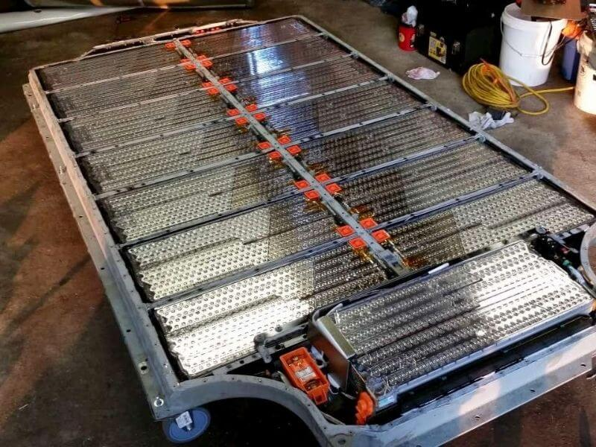
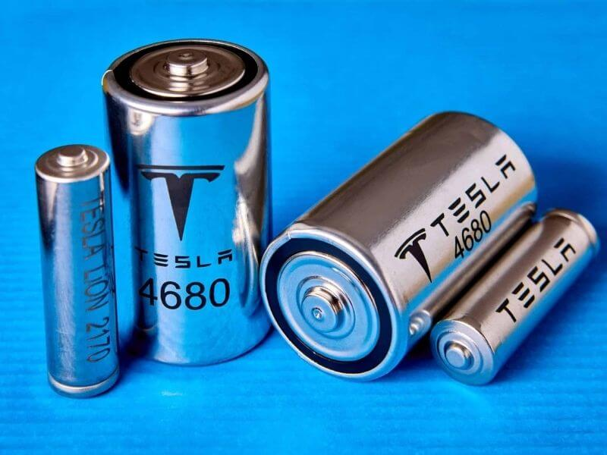
Plug-in Ev’s
Completely Electric
Tesla, Chevrolet, Ford, Nissan, Toyota, Volkswagen, BMW, Kia
Lithium Ion Battery Driven
Battery assembled in an array

Slide 11
Types of Batteries used in EVs
Lithium-Ion Battery
Hybrid Nickel-Metal (NiMH) Batteries
Solid State Batteries
Lead Acid Batteries
Aluminum-Ion Battery (Al-Ion)

Slide 12
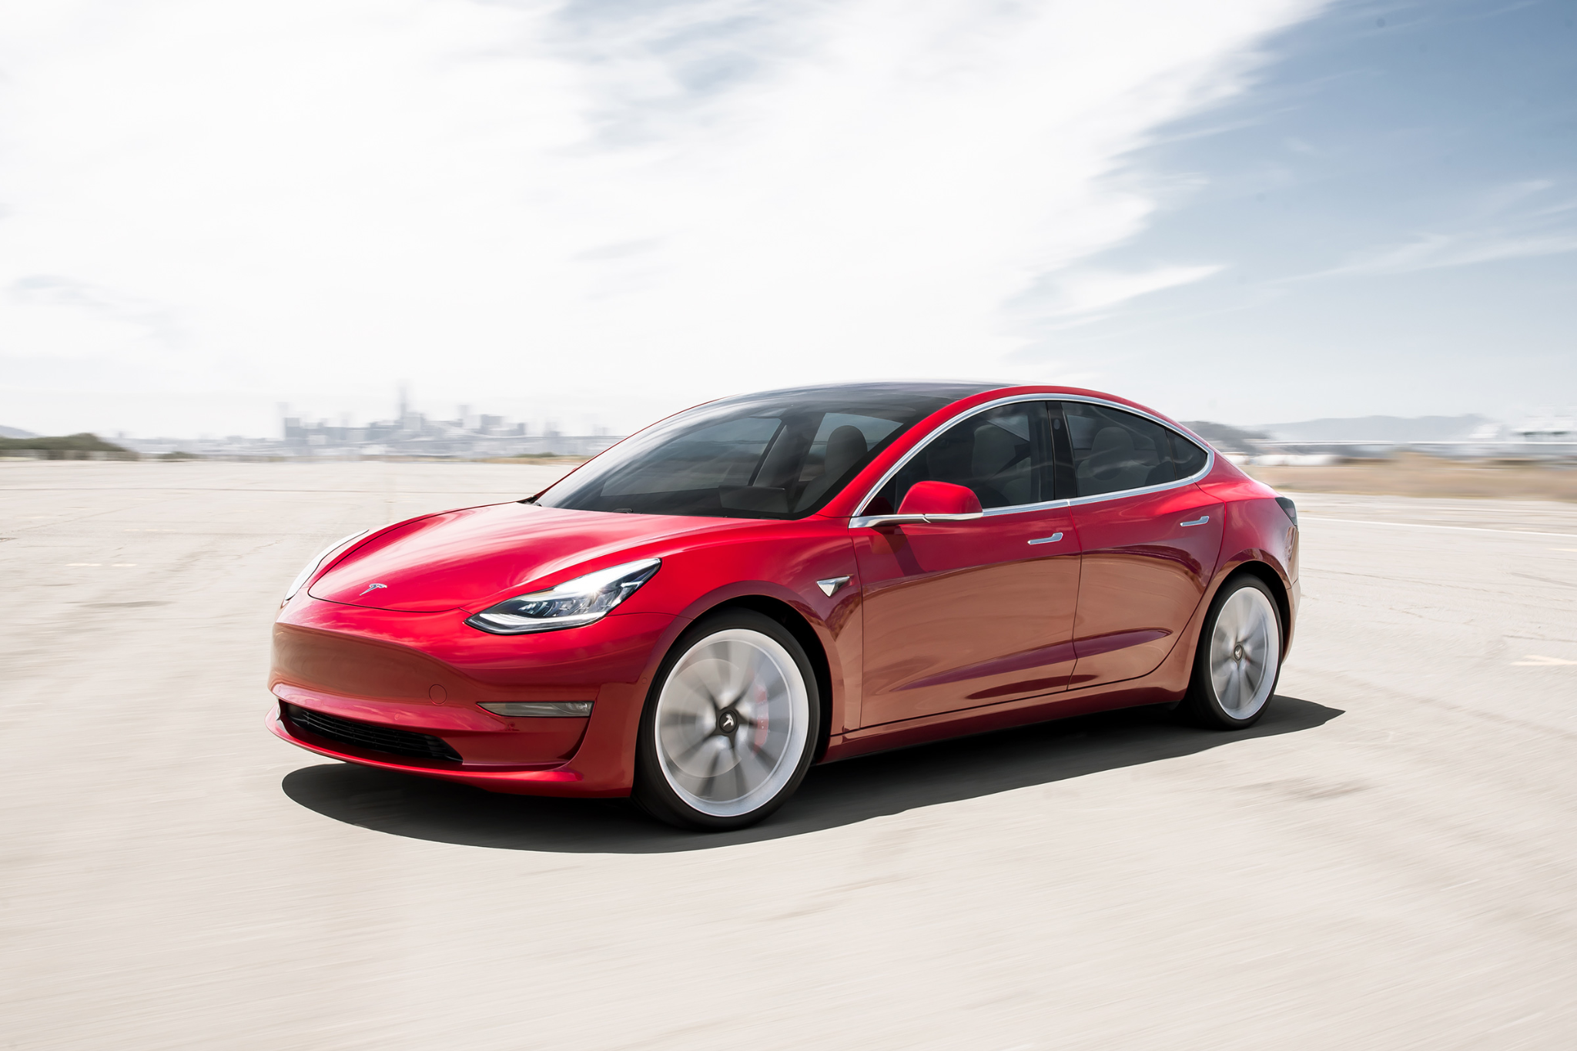
Example (2022 Tesla Model 3)
333 mile Range
15 min Recharge
50,000
Global Superchargers
$35,500

Slide 13
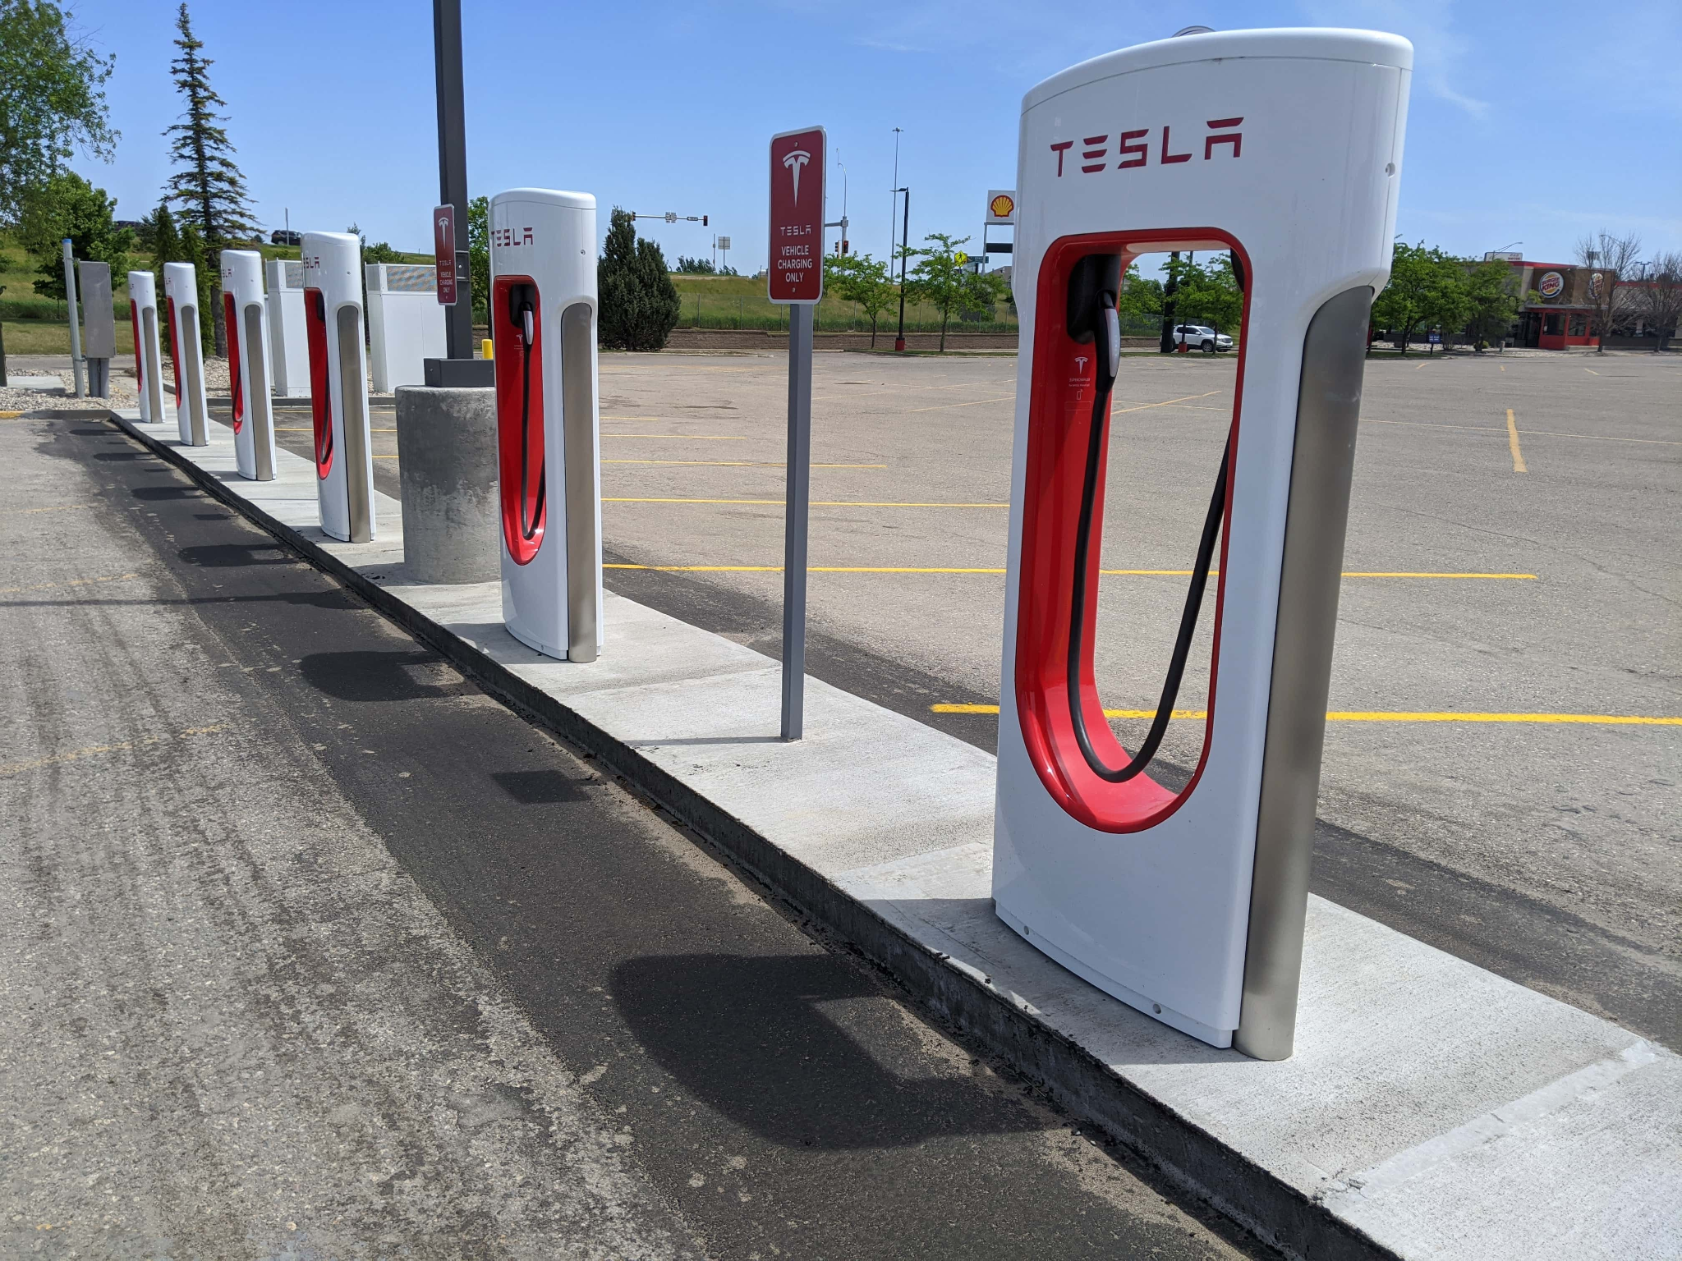
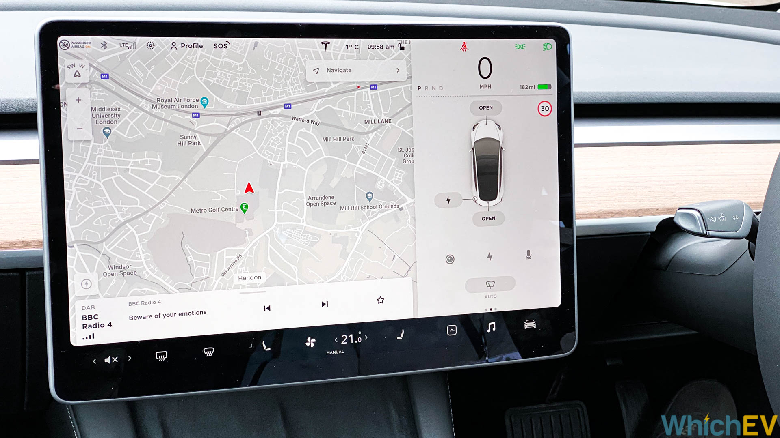
Features of Tesla

Slide 14
Advantages
333 miles without having to recharge
Only 15 minutes for a full charge
Quiet
Operator friendly (Touch screen/ Trip Planner)
Zero Carbon Emission
Cost less to Recharge Tesla than refuel a non-electric vehicle

Slide 15
Disadvantages
Infrastructure for charging is not complete
Long Lines
Only viable in certain areas
Chargers are not compatible with other EV companies
Expensive when compared to both hybrid and non-electric vehicles

Slide 16
Conclusion
Both options are great and very eco-friendly
Best option is one of personal opinion
In terms of eco-friendliness, both are a direct upgrade to standard non-electric vehicles

Slide 17
Sources
https://www.edmunds.com/honda/insight/2022/features-specs/
https://www.tesla.com/model3
https://hugnung.com/what-type-of-battery-does-tesla-use/#:~:text=Over%20the%20years%2C%20Tesla%20has%20mostly%20utilized%20two,potent%20than%20those%20of%20the%2018650%20type.%20
https://www.electricalelibrary.com/en/2019/02/13/operation-of-hybrid-vehicle/

