Slide 1
HYDROGEN PEROXIDE AS AN ENERGY STORAGE MEDIUM
NRPE 498
JULIAN HERRERA

Slide 2
01
BACKGROUND
Hydrogen Peroxide: Unstable Household Product

Slide 3
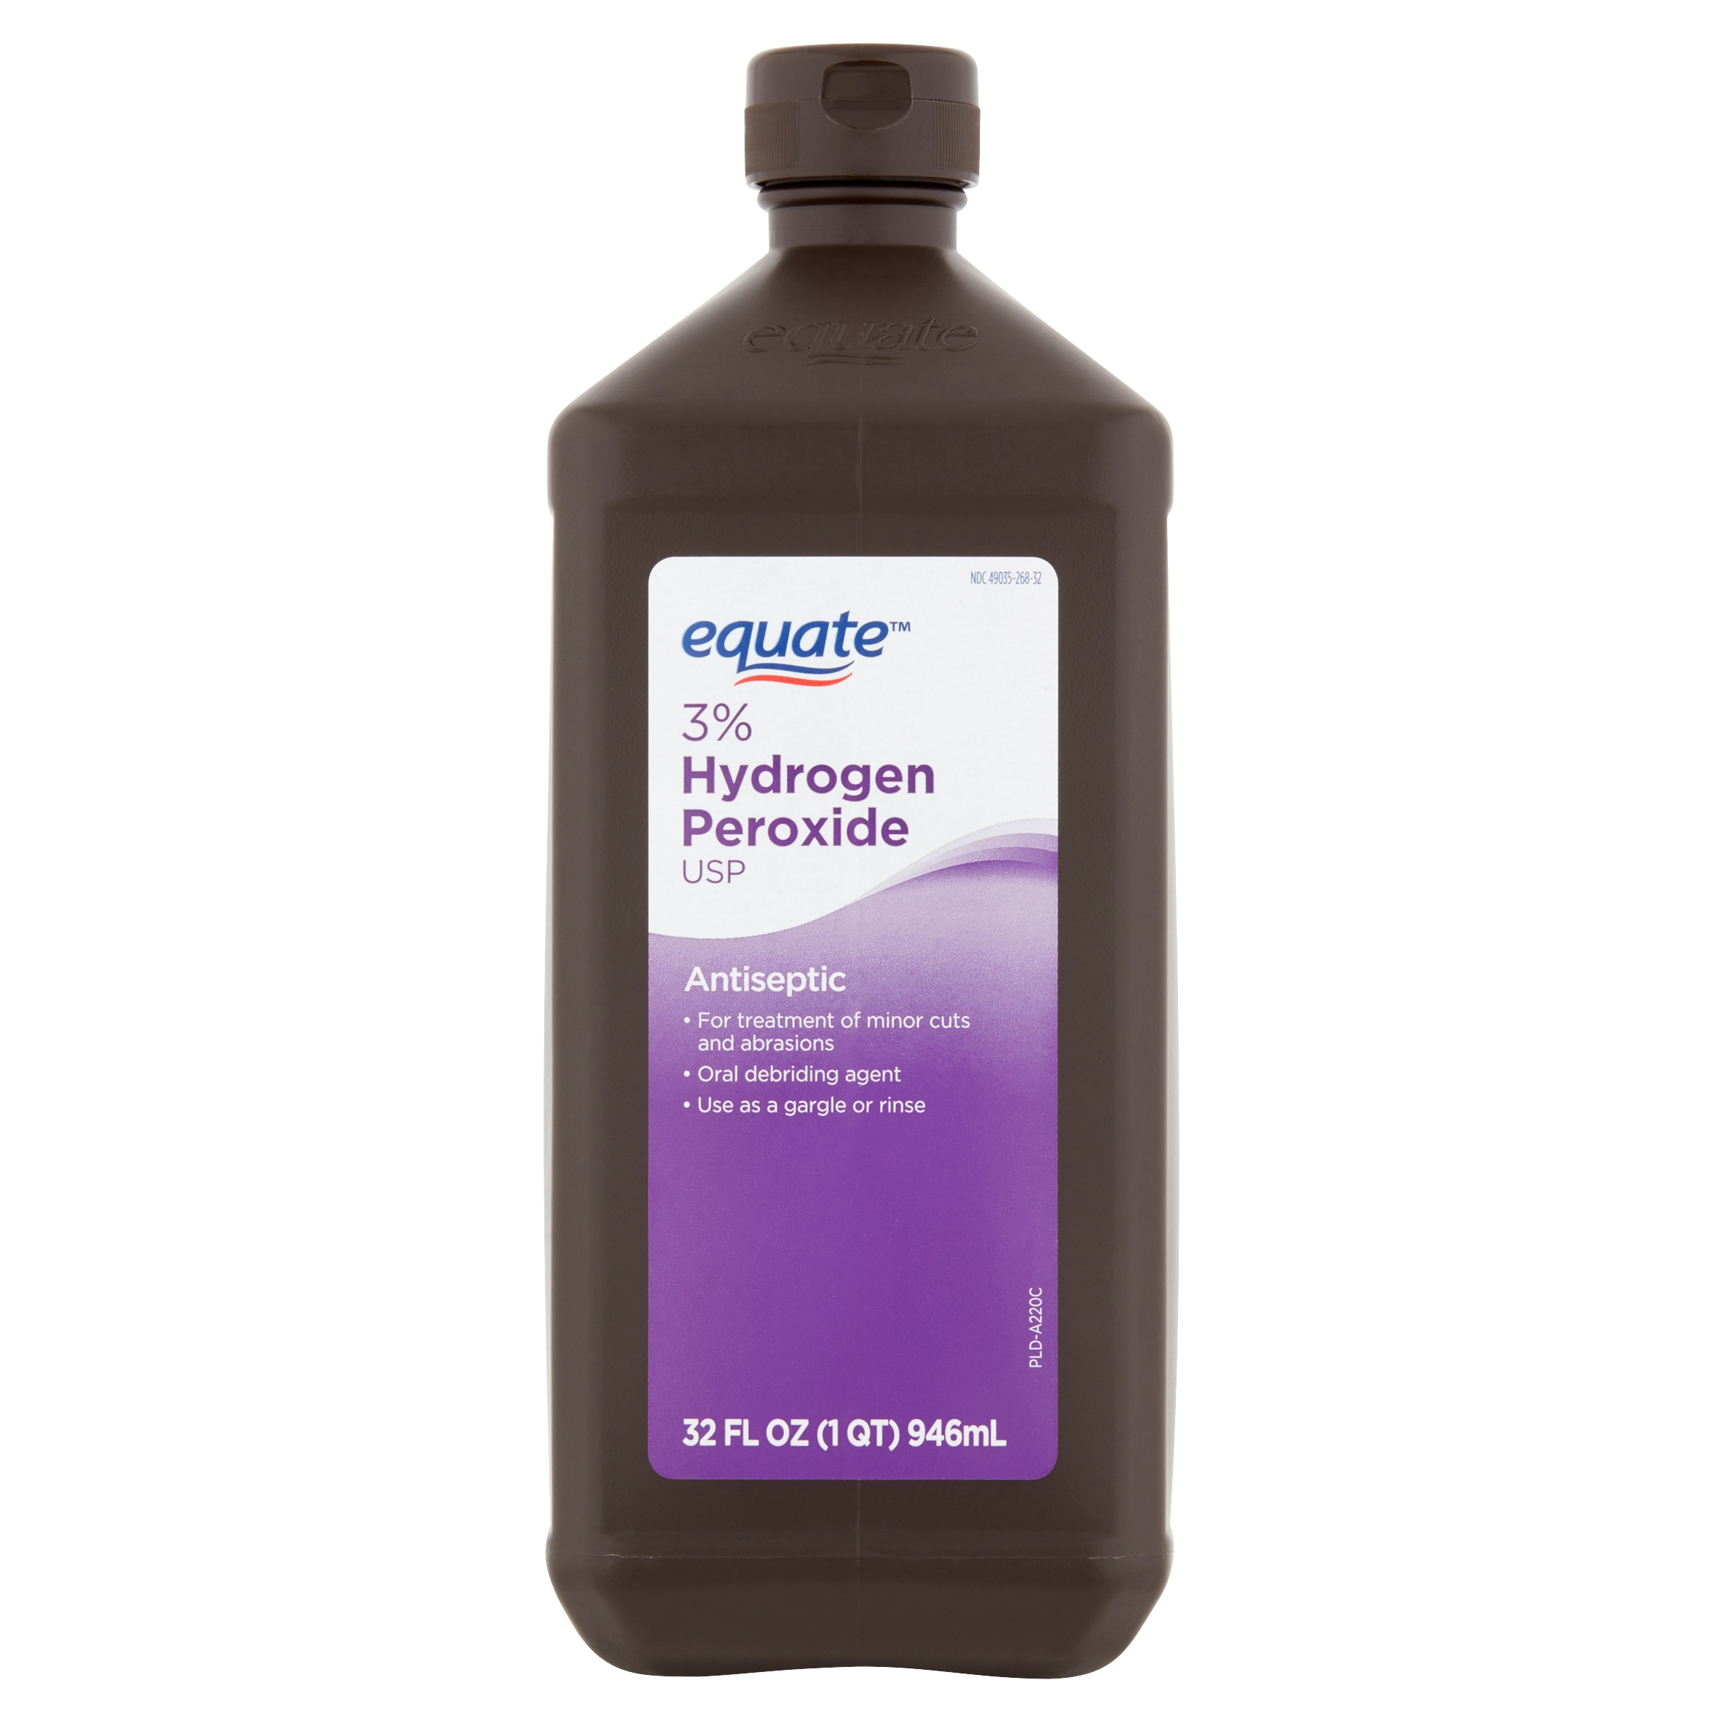
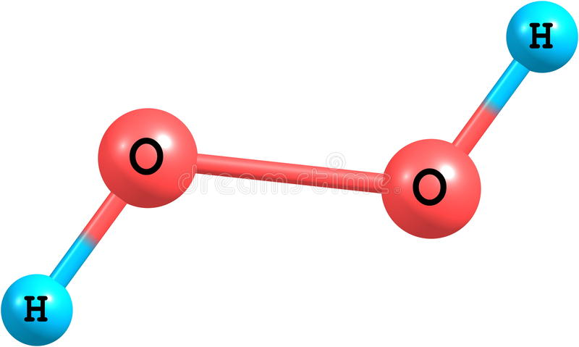
H₂O₂
Hydrogen Peroxide (H₂O₂) is a common, naturally unstable consumer and industrial chemical
Household usage includes antiseptics and bleaching agents, typically 3-6 wt% and stabilized with acids
Industrial concentrated H₂O_{2,} (High-test peroxide, 85-98 wt% typ.) decomposes into high temperature steam and oxygen
At above 67% concentration, the heat of decomposing H₂O₂ vaporizes remaining liquid at standard pressure.
Image credit: Walmart.com, iStock Photo

Slide 4
HTP INSTABILITY
H₂O₂ is unstable in an aqueous solution – water acts as a contaminant, promoting further degradation
2H₂O₂ → O₂ + 2H₂O
This reaction is dependent on pH, the concentration, and temperature.
Ideal conditions are acidic media, high concentration, and low temperature.

Slide 5
02
HISTORICAL BASIS
Historical and Modern Usage of Hydrogen Peroxide

Slide 6
HTP UTILIZATION TIMELINE
1818
1925
1933
1956
1985
2022+
DISCOVERY
WARTIME
OBSOLESCENCE
Louis-Jacques Thenard produces 100% pure H₂O₂
Uses it for bleaching
Used by Germany in WWII as Submarine, Torpedo, V-2 Rocket
HTP is almost entirely unused by this point, in favor of LOX and N₂O₄ as oxidizers
MANUFACTURE
POST-WAR
FUEL CELLS
H₂O₂ production explodes in the US and Europe for textile industry application
Further R&D on HTP for aircraft rocket assist. LR-40 notable result. Improving aircraft technology deemed HTP redundant
Increased interest in clean energy places H₂O_{2,}back on the table

Slide 7
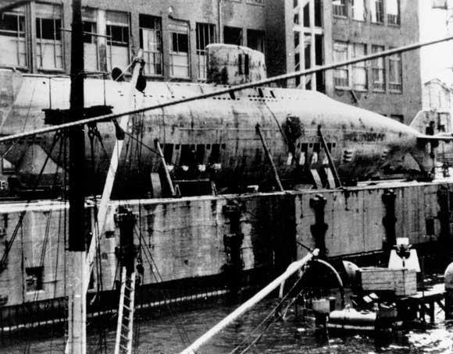
PERHYDROL SUBMARINE
High-Test Peroxide (HTP) has been used as a propellant by Germany in WWII.
Hellmuth Walter developed the “Perhydrol” submarine, taking advantage of the heat produced by the catalyzed splitting of H₂O₂ as well as the additional oxygen that can serve as auxiliary fuel
Pre- WWII submarines travelled 7 knots underwater and 11 knots above the surface, the Walter submarine travelled 23 knots submerged.
Germany was in no position to continue development of the boat, and by the end of the war, the nuclear age had begun.

Slide 8
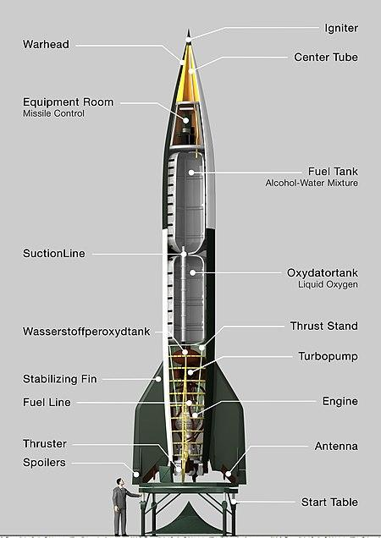
V2 ROCKET
The German V-2 rocket was the first long-range guided ballistic missile, developed during WWII.
It became the first artificial object to cross into space.
Fuel and oxidizer pumps were driven by a steam turbine, where the steam was produced with a reaction with HTP and sodium permanganate
The rocket was otherwise mostly powered by ethanol
Notes:
The direct descendant of the German V2 was the US PGM-11 Redstone, the first rocket to carry a live nuclear warhead

Slide 9
MODERN HTP
AS A PROPELLANT
Romanian company ARCAspace is developing their EcoRocket with steam-producing HTP known as the “Aerospike Engine”.
The first two stages are reusable and use steam-based propulsion, while the third high-altitude stage uses conventional means.
The rocket has been questioned heavily from an engineering perspective due to poor construction.

Slide 10
AEROSPIKE ENGINE

Slide 11
03
FUEL CELLS
A Promising Energy Delivery Technique

Slide 12
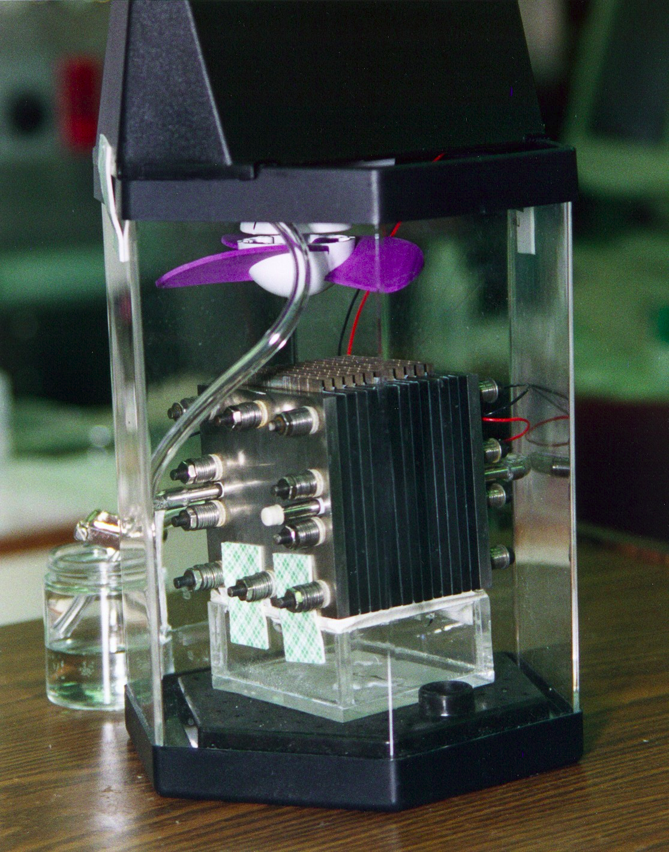
FUEL CELLS
Hydrogen Fuel Cells are a promising technology used in mobile, stationary, and portable power applications
Hydrogen has 3 times the specific energy of natural gas
Only emission is steam
Joins ethanol, biodiesel, and biofuel as a petroleum alternative
Hydrogen is not a fuel– it is a form of energy storage or energy transportation, and must be produced and transported before use

Slide 13
HYDROGEN ECONOMY

Slide 14
TRADITIONAL HYDROGEN STORAGE
LIQUEFACTION
COMPRESSION
SOLID STATE
Cryogenic liquefaction of hydrogen at -252.87°C
High pressure compression hydrogen tanks (3000-15000 psi)
Storage through solid media such as metal hydrides

Slide 15
HYDROGEN DISTRIBUTION
DISCRETE
CONTINUOUS
ON-SITE
Transportation in tanks located on trucks or trains
Transportation through integrated pipeline infrastructure
On-location production of Hydrogen through processes such as electrolysis

Slide 16
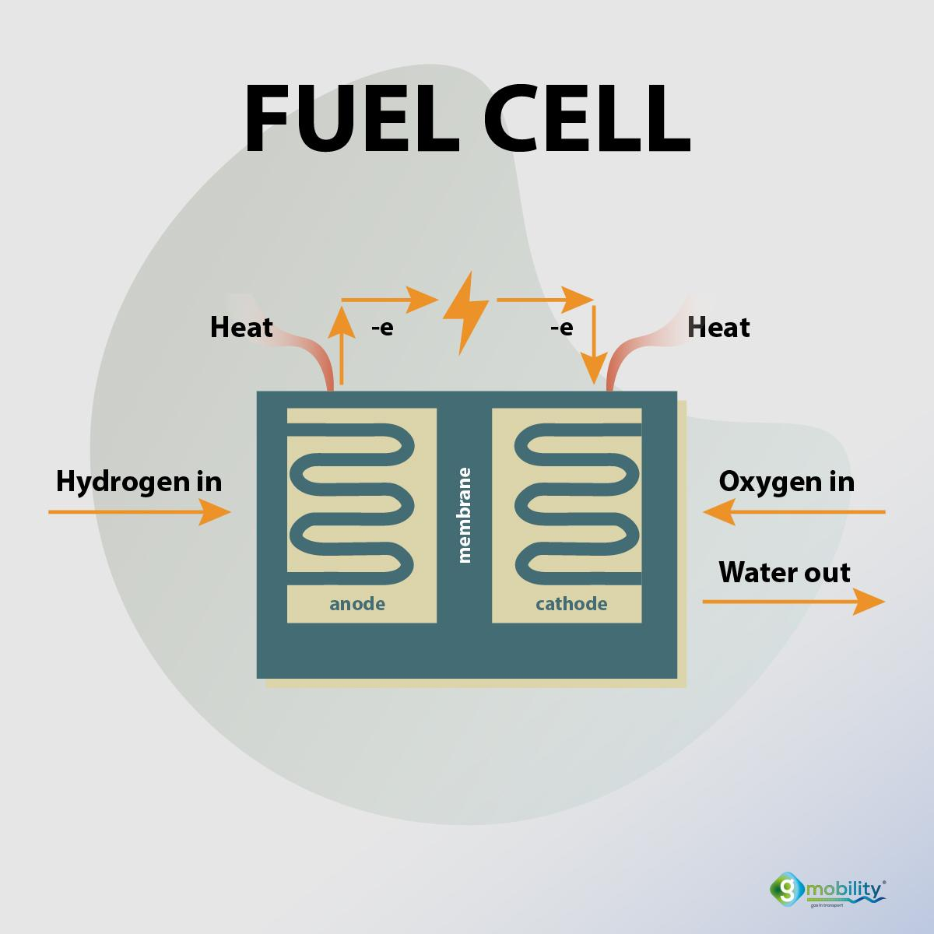
PROCESS
The fuel cell is constructed into two chambers, separated by a membrane
Hydrogen is fed from storage to fuel cell, where a catalyst (typ. Pt) oxidizes H₂ into H⁺ and e⁻
H⁺ ions cross through polymer membrane to cathode, e⁻ are left behind, creating a potential difference
Potential difference causes electrons to follow an external path (anode to cathode), which can then be inverted to AC power
Image credit: https://gmobility.eu/fuel-cell-running-on-methane/

Slide 17
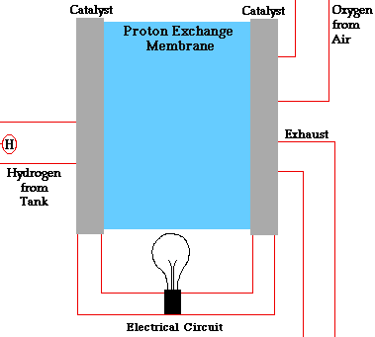
FUEL CELL PROCESS

Slide 18
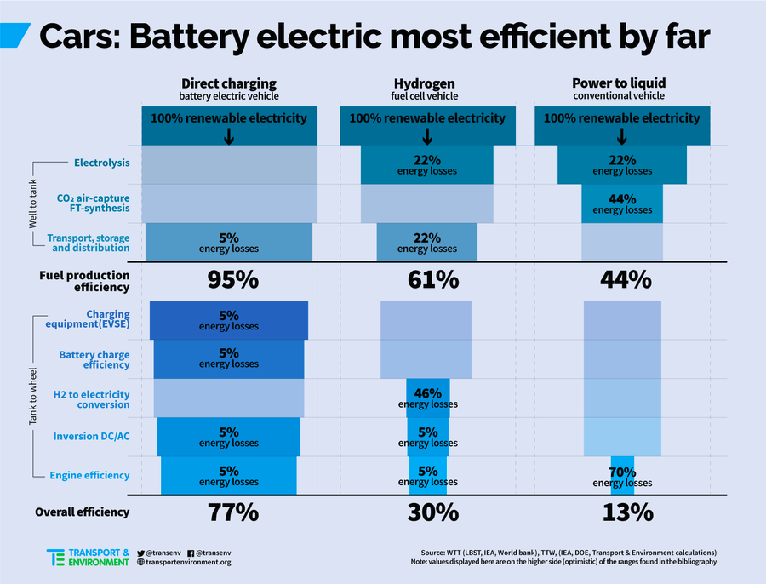
CURRENT DISADVANTAGES
Electrolysis is an inherently inefficient process
Full cycle only about 34% efficient
Resource problem: Platinum is expensive
Emerging technology, research still needs to be done

Slide 19
VEHICLE DISADVANTAGES
Vehicle Sticker Price
Toyota Mirai: $50,445 base model
Hydrogen Fuel ~$16/kg ($80 /400 mi)
2022 Honda Civic: ($50 / 400 mi)
Minimal current infrastructure makes refueling inconvenient
Hydrogen stations expensive to implement, companies anxious to invest in an unsupported market
Generally seen as “Second Rate” to EVs
Currently most useful in small-scale indoor operations; Amazon warehouses

Slide 20
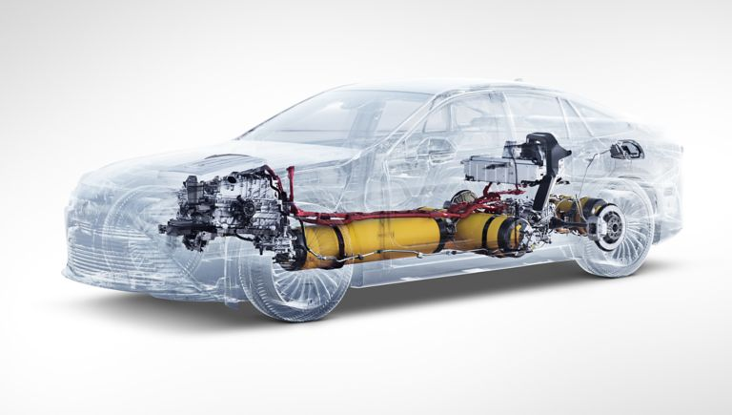
OPPORTUNITIES
Typically use oxygen from ambient air to oxidize necessary reactions
When utilized in airless environments (outer space, underwater), a large oxygen tank is typically needed
Hydrogen Peroxide (H₂O₂) is proposed as an upcoming material in fuel cells due to some important properties
The Toyota Mirai famously uses Fuel Cells. Image Credit: Toyota

Slide 21
04
HYDROGEN PEROXIDE: ENERGY CARRIER

Slide 22
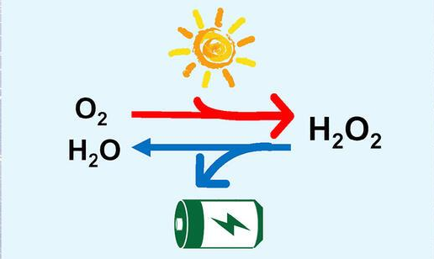
H₂O₂ AS FUEL
In the 1990s, a way to synthesize H₂O₂ from solar power was discovered.
This kickstarted research on the fuel potential of H₂O₂
Image Credit: Yale.edu

Slide 23
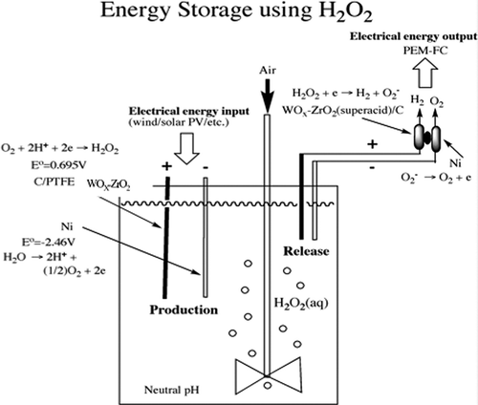
H₂O₂
NOVEL FUEL CELL
An experimental one-compartment fuel cell utilizes an H₂O₂ oxidizing Ni cathode and a reducing solid superacid anode.
This fuel cell is significantly simpler in architecture than traditional designs.
This initial prototype still has relatively low performance.

Slide 24
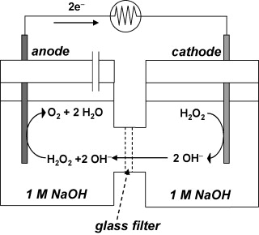
ENERGY
Aqueous hydrogen peroxide can be repeatedly synthesized and decomposed for storage
From H₂O₂ synthesis to electrical energy output, Disselkamp proposes this system operates with 35% efficiency
Utilizing a 50 wt% solution of aqueous H₂O₂ provides a specific energy of 0.49 MJ/ kg
Li-Ion batteries provide 1.04 MJ/kg
Note: No membrane, no external electron transport

Slide 25
H₂O₂ CHARGE-DISCHARGE CYCLE
Charge Sequence:
Water splitting at the anode:
H₂O → 2H⁺ + 0.5O₂ +2e⁻
Oxygen reduction reaction at the cathode:
O₂ + 2H⁺ + 2e⁻→ H₂O₂
Overall reaction:
H₂O + 0.5O₂→H₂O₂
Discharge Sequence:
Hydrogen Peroxide Reduction Reaction:
H₂O₂ + 2H⁺ + 2e⁻ → 2H₂O
E⁰_{C,1}=1.78 V

Slide 26
H₂O₂ DUAL ROLE
OXIDATION
FUEL
Hydrogen peroxide can be used as the oxygen source in the fuel cell reaction
Hydrogen peroxide can donate electrons in the oxidation reaction to act as a fuel

Slide 27
H₂O₂ AS AN OXIDANT
01
03
02
04
FLEXIBILITY
CHEMISTRY
H₂O₂ can operate in an oxygen-free environment
H₂O₂ requires less activation energy in reduction reaction
PERFORMANCE
PRACTICALITY
H₂O₂ can increase theoretical voltage and performance when compared to gaseous O₂
Less expensive than traditional O₂ sources, such as liquid oxygen

Slide 28
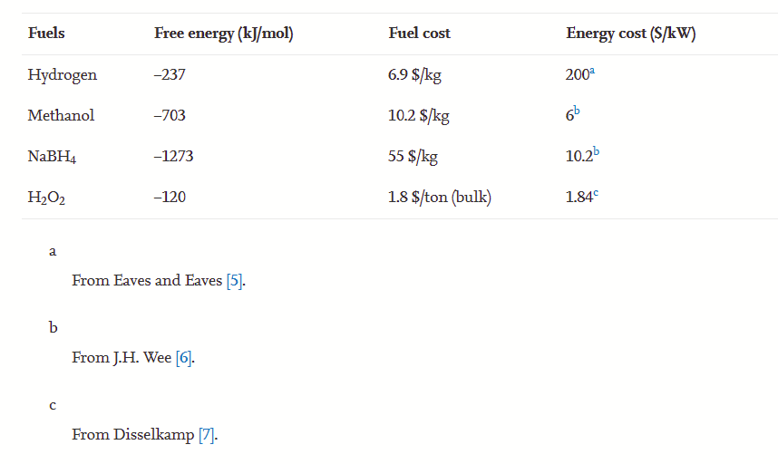

Slide 29
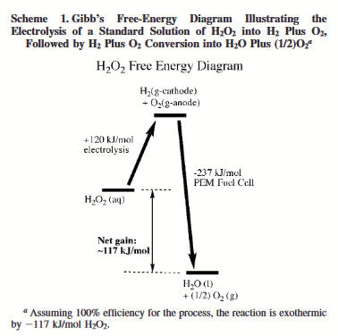
H₂O₂ FUEL CELLS
When operating at 100% efficiency, energy released by breaking apart H₂O₂ exceeds the energy used to break apart by a factor of 2:1
Disselkamp proposes a fuel cell with an operating efficiency of >35%

Slide 30
SPECIFIC ENERGY COMPARISON
 | Specific Energy (MJ/kg)
H₂O₂ Fuel Cell | 0.49
Gasoline | 45.0
Gasoline (ICE) | 9.0 (e)
Lithium Ion Battery | 1.04

Slide 31
CONCLUSIONS
HISTORY
OXIDATION
HTP historically has been used as a propellant for its steam generation
H₂O_{2,} is easier to manufacture, less dangerous, and less expensive than liquid O₂
ON FUEL CELLS
FUTURE
Fuel cells currently thrive best in short-range, indoor locations or as energy storage
Hydrogen Peroxide may have a permanent home in improving fuel cells after further research

Slide 32
05
APPENDIX

Slide 33
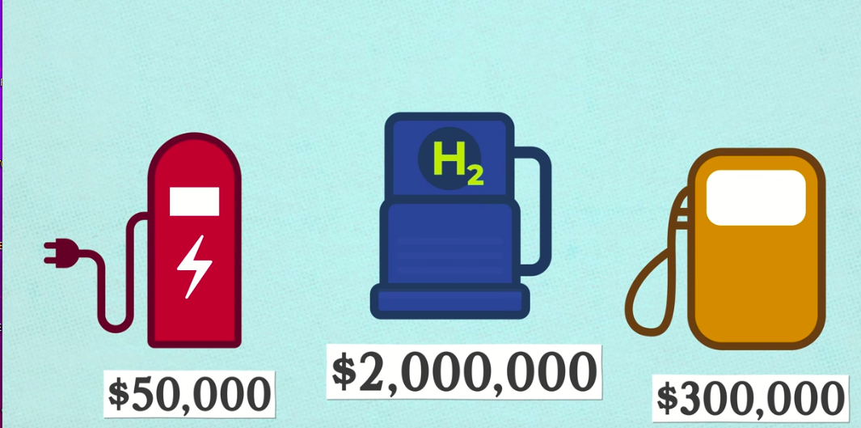
PUMP STATION COMPARISON
Cost of Electric Pumping (Left) vs Fuel Cell Station (Mid) vs Traditional Gas (Right) Credit: Donut Media

Slide 34
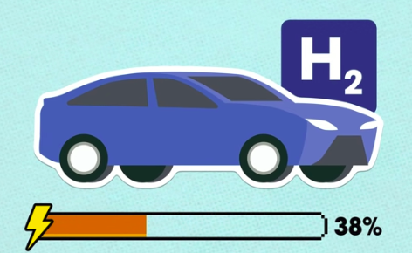
EFFICIENCY COMPARISON
Efficiency of ICE (Above) vs Fuel Cell (Top Right) vs EV (Right) Credit: Donut Media

Slide 35
REFERENCES
https://www.purdue.edu/uns/html4ever/1999/9912.Rusek.peroxide.html
https://www.sciencedirect.com/science/article/pii/S2095927316305357
https://www.hydrogen-peroxide.us/history-US-General-Kinetics/AIAA-1999-2739_A_Brief_History_of_Concentrated_Hydrogen_Peroxide_Uses-pitch.pdf
https://pubs.acs.org/doi/full/10.1021/ef800050t#
https://www.sciencedirect.com/science/article/pii/S0378775307027048
https://www.youtube.com/watch?v=b88v-WvqzeQ
https://www.youtube.com/watch?v=MQG87a8EwzY
https://www.youtube.com/watch?v=bFb5TKVPSiY
https://www.osti.gov/servlets/purl/1177376
https://gizmodo.com/how-the-bottle-of-hydrogen-peroxide-in-your-bathroom-co-5949168

Slide 36
THANK YOU!

