Slide 1
Graphene as energy storage of future
Raman Aggarwal
NPRE 498

Slide 2
What is Graphene.....?
Single thin layer of pure Carbon
Hexagonal Honeycomb Lattice
Bond Length of 0.142 nanometer
Interplanar spacing of 0.335 nanometer
Lightest and strongest material ever known
Highly conductive

Slide 3
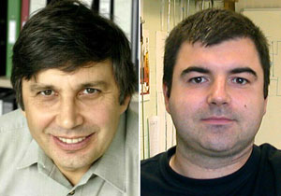
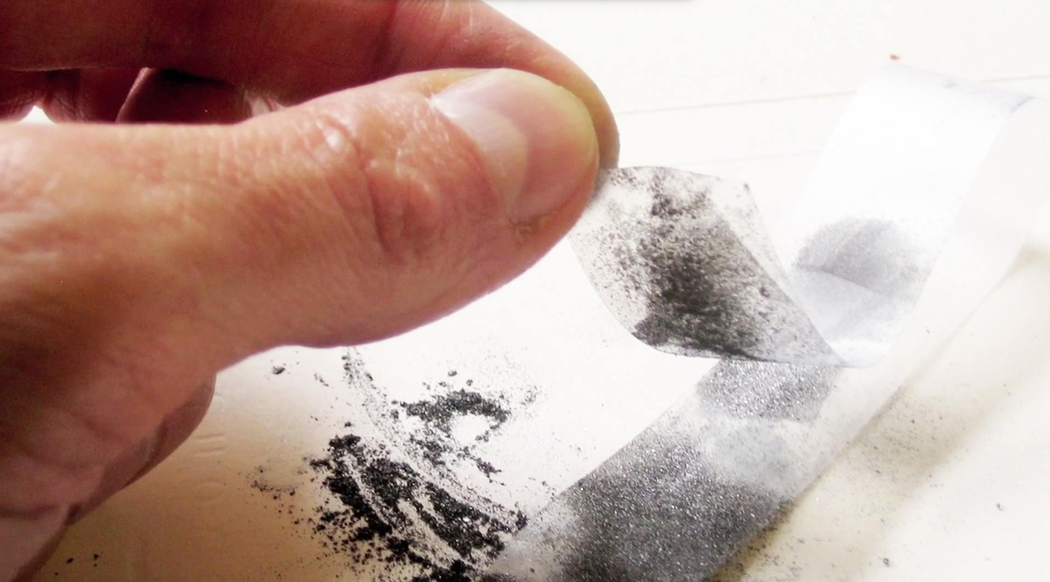
Discovery
Discovered by two scientist Prof. Andre Geim and Prof Kostya Novoselov at University of Manchester in 2004

Slide 4
Extraction process
Graphite treated with strong oxidizers like sulphuric acid
Electrons is removed due to oxidation
Interplanar spacing increases due to oxidation
Oxidized compound is dispersed in a base solution
Graphene oxide is produced

Slide 5
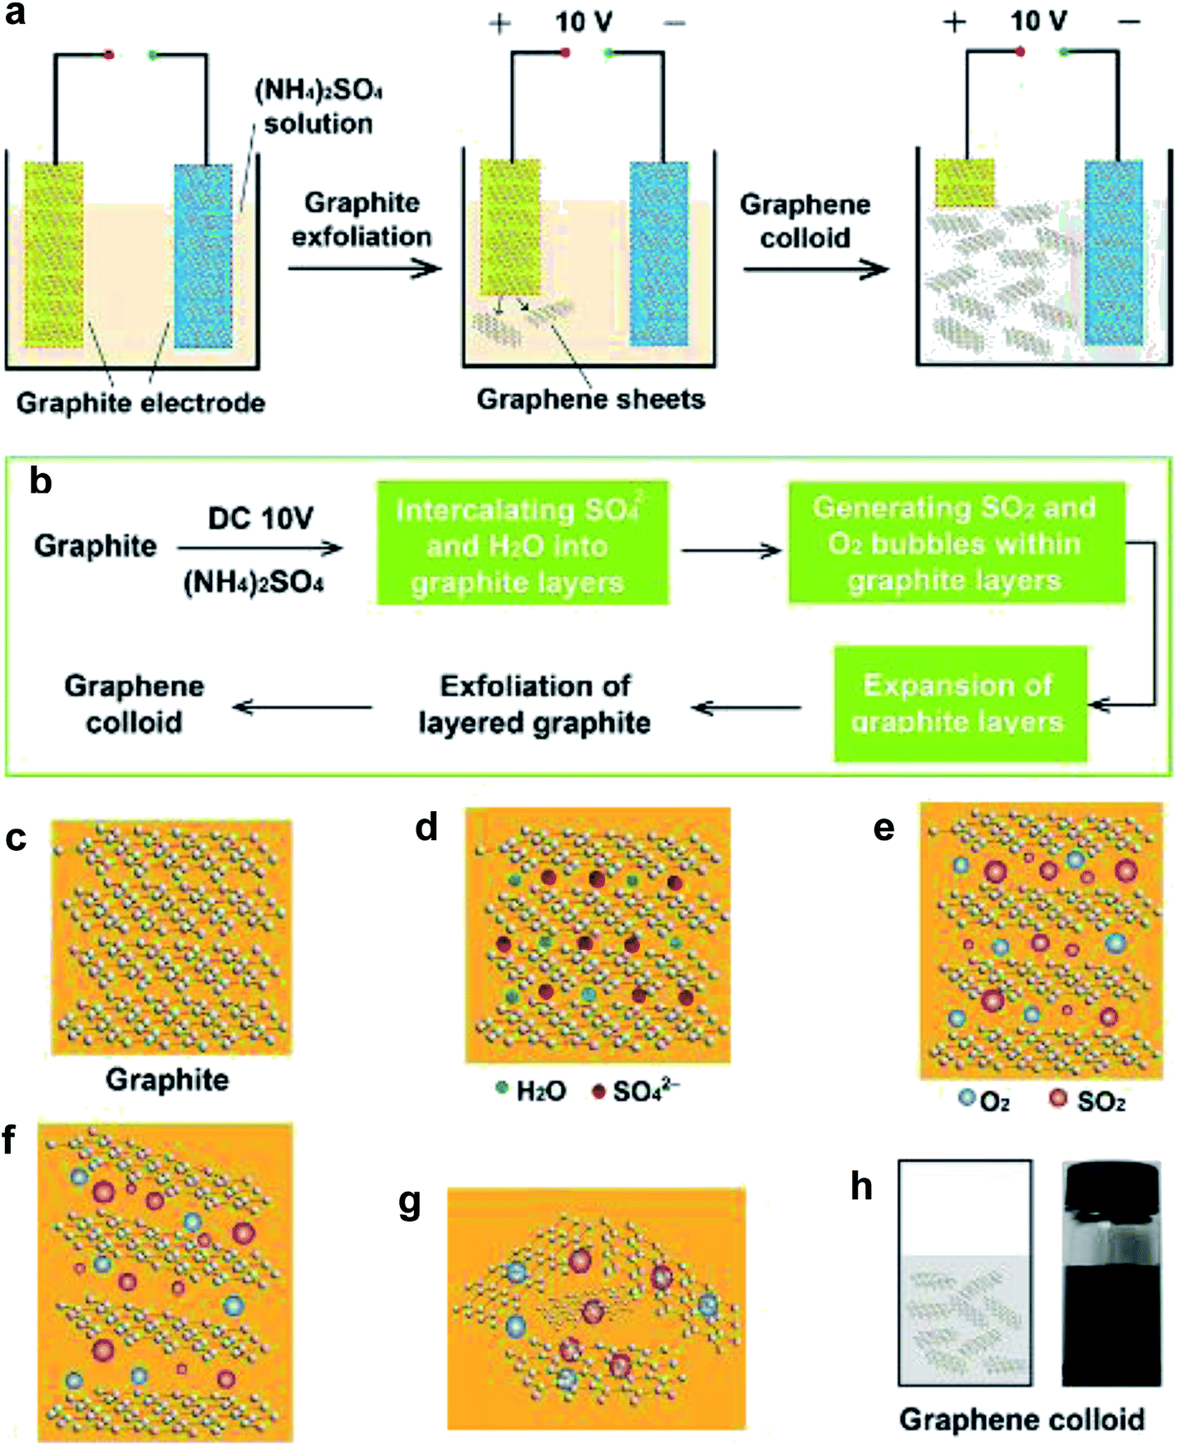
Extraction process

Slide 6
Chemical vapor Deposition
Deposition of gaseous reactant to substrate
Carrier gasses carry the material
Substrate is coated with small amount of material at slow speed
Highly pure and finely grained material

Slide 7
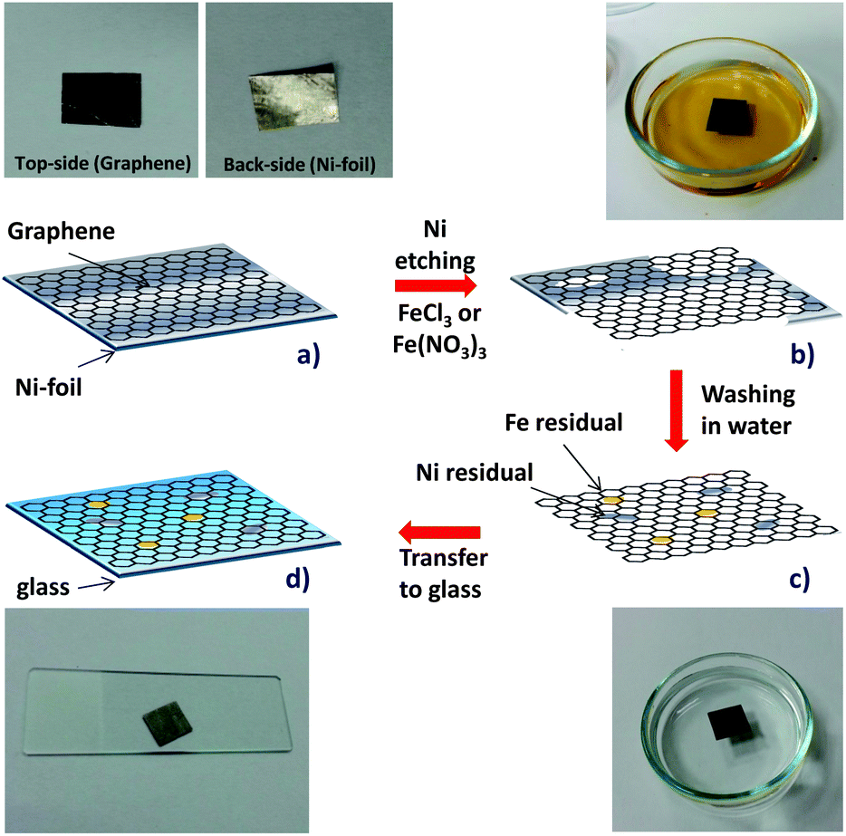
CVD process

Slide 8
Energy storage
Graphene Super capacitors
Super capacitors are seperated by two electrodes dipped in electrolyte
Conventional one uses activated carbon as electrodes to store static charge
Area of activated carbon to graphene is equal to 1:20
Larger area facilitating more energy storage

Slide 9
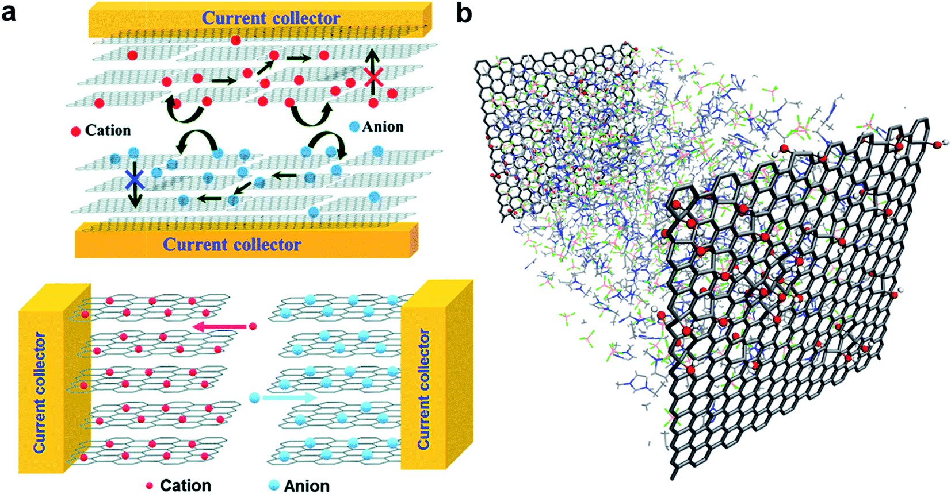
Supercapacitor

Slide 10
2. Graphene Batteries
Electrodes made of graphene and lithium polymer
Silicon is caged in graphene structure
Graphene being excellent conductor conducts electrons freely
Electrolyte resistance also reduced

Slide 11
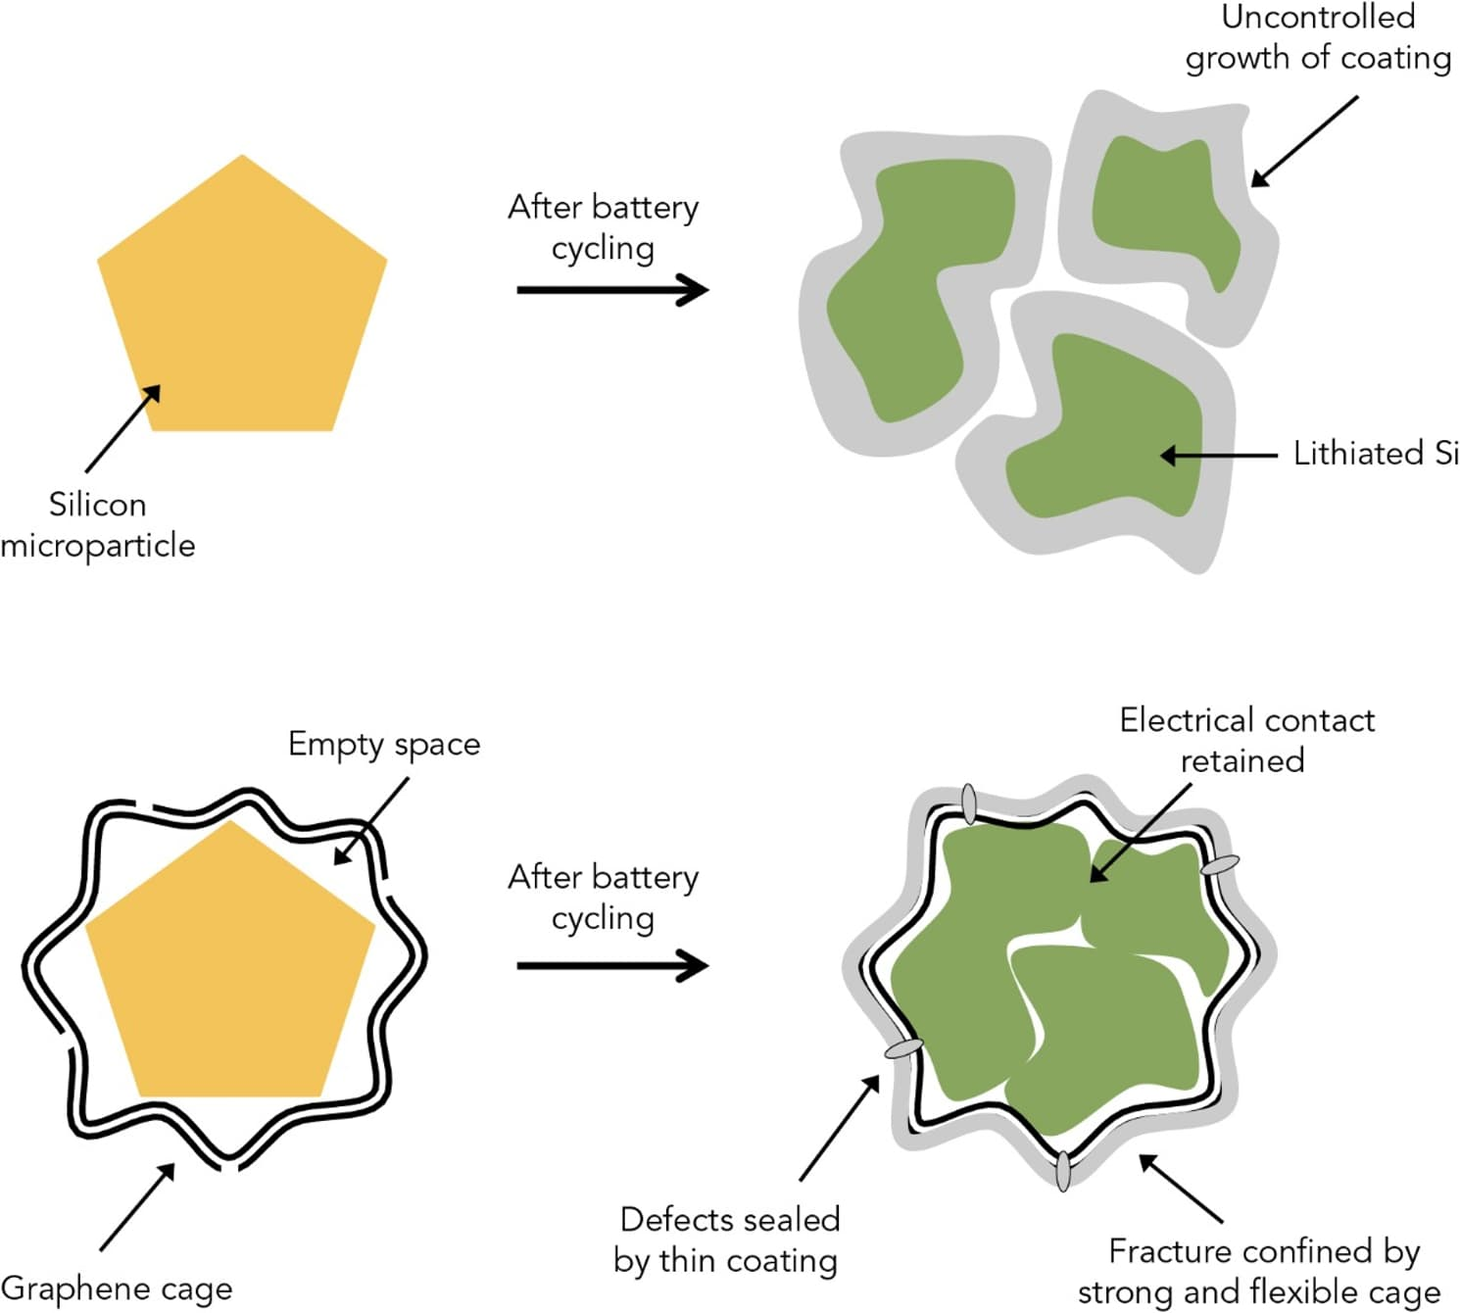
Battery

Slide 12
Development
Livermore research produced 3 D printed graphene aerogel
Oak Ridge National Laboratory declared in achieving foam like graphene battery structure
University of Glasgow announced in successfully producing commercial graphene sheets using Cu as reactant

Slide 13
Applications
Energy Storage
Microelectronics
Aero-bodies
Optical fiber
Composite material
Photovoltaic cells
Ultrafiltration

Slide 14
Setbacks
Prohibitively high cost-60$/inch for applications it needs to be 1$/inch.
Extremely complicated extraction process
Lack of right reactants as substrate
Demand for high purity
Instability of oxide after extraction

Slide 15
References
http://www.graphenea.com/pages/graphene-supercapacitors#.Vwm7pxMrLow
http://www.nature.com/nnano/journal/v9/n10/full/nnano.2014.225.html
http://www.gla.ac.uk/news/headline_433699_en.html
http://www.techradar.com/us/news/world-of-tech/future-tech/graphene-breakthrough-is-a-step-closer-to-a-phone-battery-that-lasts-for-a-week-1309253
http://www.graphenea.com/pages/graphene-uses-applications#.VxQZe5MrLow
http://www.graphene.manchester.ac.uk/explore/the-story-of-graphene/

