Slide 1


Graphene as a Next-Generation Material for Ultracapacitors
NPRE498: Energy Storage Engineering
Noor Ahmed
11/21/2025

Slide 2

Abstract
Overview of graphene for ultracapacitors
High conductivity and surface area
Potential to boost energy and power density
GRAINGER ENGINEERING
Notes:
We have rising computing requirements after much more after Covid.
Miniaturized designs leave less surface area for convection and conduction
Traditional air cooling (fans and aluminum heatsinks) struggles with:
Non-uniform temperature fields
Localized hot spots
Limited scalability for compact high-power systems
To overcome these challenges, several advanced cooling techniques have been developed

Slide 3
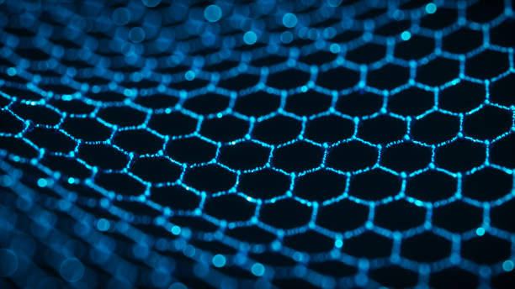
Introduction
Ultracapacitors bridge capacitors and batteries
Key advantages: fast charging, long cycle life
Exceptional properties
GRAINGER ENGINEERING
Notes:
We have rising computing requirements after much more after Covid.
Miniaturized designs leave less surface area for convection and conduction
Traditional air cooling (fans and aluminum heatsinks) struggles with:
Non-uniform temperature fields
Localized hot spots
Limited scalability for compact high-power systems
To overcome these challenges, several advanced cooling techniques have been developed

Slide 4
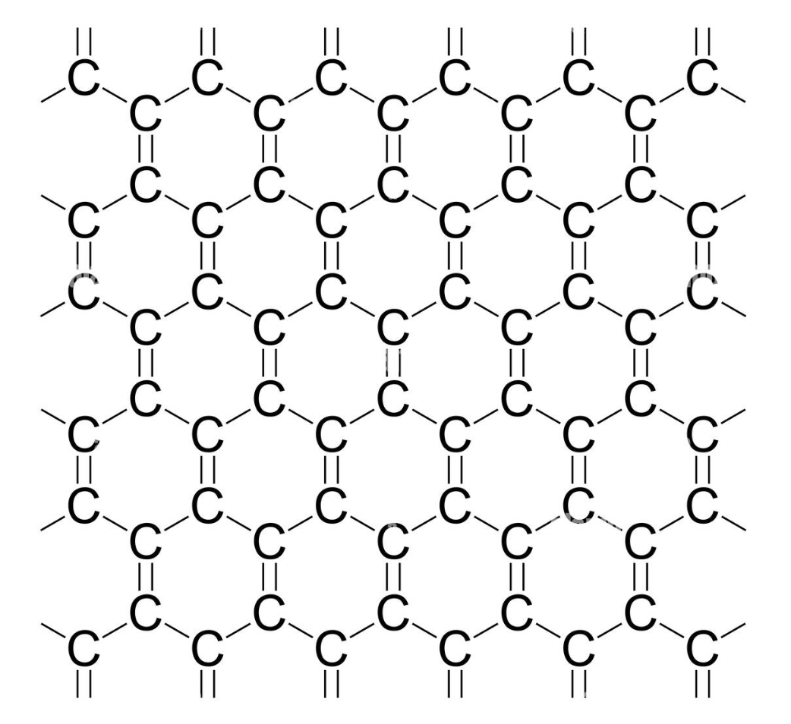
Key Properties of Graphene
Surface area ~2630 m²/g
Electrical conductivity up to 10⁶ S/m
Mechanically strong and chemically tunable
How Graphene Enhances Ultracapacitors
Boosts EDLC—electrostatic charge storage
Functionalized graphene adds pseudocapacitance
Short ion diffusion path increases speed
Figure. Hexagonal Carbon Lattice (Graphene Sheet)
GRAINGER ENGINEERING
Notes:
We have rising computing requirements after much more after Covid.
Miniaturized designs leave less surface area for convection and conduction
Traditional air cooling (fans and aluminum heatsinks) struggles with:
Non-uniform temperature fields
Localized hot spots
Limited scalability for compact high-power systems
To overcome these challenges, several advanced cooling techniques have been developed

Slide 5
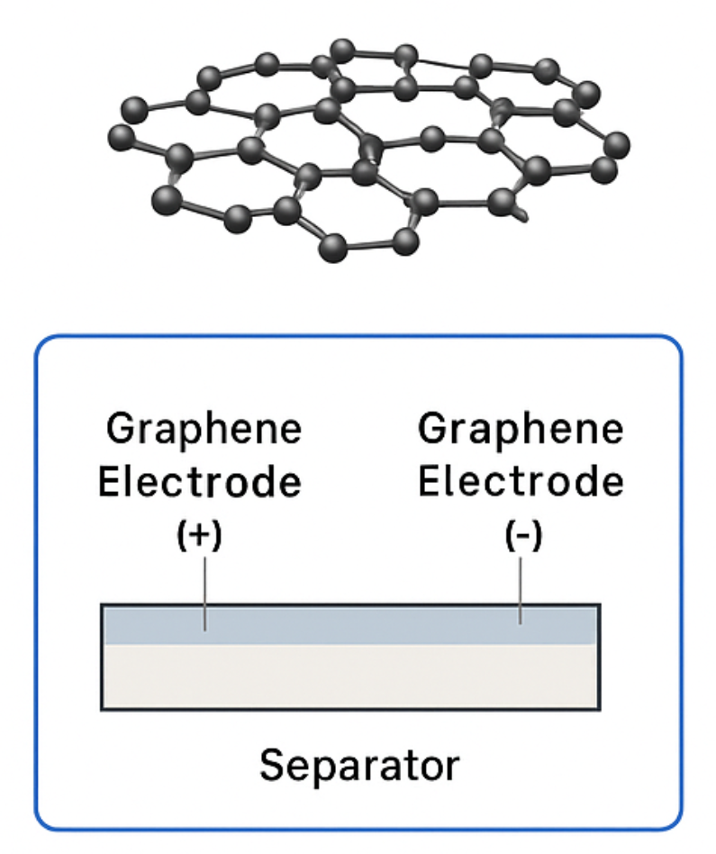
Graphene Electrode Architectures
Vertically aligned graphene
Graphene foams
Hybrid composites with metal oxides
GRAINGER ENGINEERING
Notes:
We have rising computing requirements after much more after Covid.
Miniaturized designs leave less surface area for convection and conduction
Traditional air cooling (fans and aluminum heatsinks) struggles with:
Non-uniform temperature fields
Localized hot spots
Limited scalability for compact high-power systems
To overcome these challenges, several advanced cooling techniques have been developed

Slide 6
Performance Improvements
Specific capacitance 200–300+ F/g
Energy density: 10–20 Wh/kg
Power density >10 kW/kg
Cycle life ~1,000,000+ cycles
GRAINGER ENGINEERING
Notes:
We have rising computing requirements after much more after Covid.
Miniaturized designs leave less surface area for convection and conduction
Traditional air cooling (fans and aluminum heatsinks) struggles with:
Non-uniform temperature fields
Localized hot spots
Limited scalability for compact high-power systems
To overcome these challenges, several advanced cooling techniques have been developed

Slide 7
Challenges & Limitations
High manufacturing cost
Aggregation reduces surface area
Scalability issues
Electrode uniformity difficulties
GRAINGER ENGINEERING
Notes:
We have rising computing requirements after much more after Covid.
Miniaturized designs leave less surface area for convection and conduction
Traditional air cooling (fans and aluminum heatsinks) struggles with:
Non-uniform temperature fields
Localized hot spots
Limited scalability for compact high-power systems
To overcome these challenges, several advanced cooling techniques have been developed

Slide 8
Applications
Electric vehicles
Grid stabilization
Portable electronics
Hybrid energy systems
GRAINGER ENGINEERING
Notes:
We have rising computing requirements after much more after Covid.
Miniaturized designs leave less surface area for convection and conduction
Traditional air cooling (fans and aluminum heatsinks) struggles with:
Non-uniform temperature fields
Localized hot spots
Limited scalability for compact high-power systems
To overcome these challenges, several advanced cooling techniques have been developed

Slide 9
Future Prospects
3D porous graphene structures
Heteroatom doping (N, B, S)
Hybrid graphene–MXene systems
Cost reduction & scalable synthesis
GRAINGER ENGINEERING
Notes:
We have rising computing requirements after much more after Covid.
Miniaturized designs leave less surface area for convection and conduction
Traditional air cooling (fans and aluminum heatsinks) struggles with:
Non-uniform temperature fields
Localized hot spots
Limited scalability for compact high-power systems
To overcome these challenges, several advanced cooling techniques have been developed

Slide 10
Conclusion
Graphene is a breakthrough material
Greatly enhances ultracapacitor performance
Future improvements could enable widespread adoption
GRAINGER ENGINEERING
Notes:
We have rising computing requirements after much more after Covid.
Miniaturized designs leave less surface area for convection and conduction
Traditional air cooling (fans and aluminum heatsinks) struggles with:
Non-uniform temperature fields
Localized hot spots
Limited scalability for compact high-power systems
To overcome these challenges, several advanced cooling techniques have been developed

Slide 11

Thank You

