Slide 1
Aluminum Utilization for Hydrogen Production
Gabriel Fraga
NPRE 498 Energy Storage and Conveyance

Slide 2
Agenda
Overview
Current Technologies for Hydrogen Production
Aluminum
Reactions with Water
Reaction with Alcohols
Waste Cans as a Low-Cost Feedstock
Summary

Slide 3
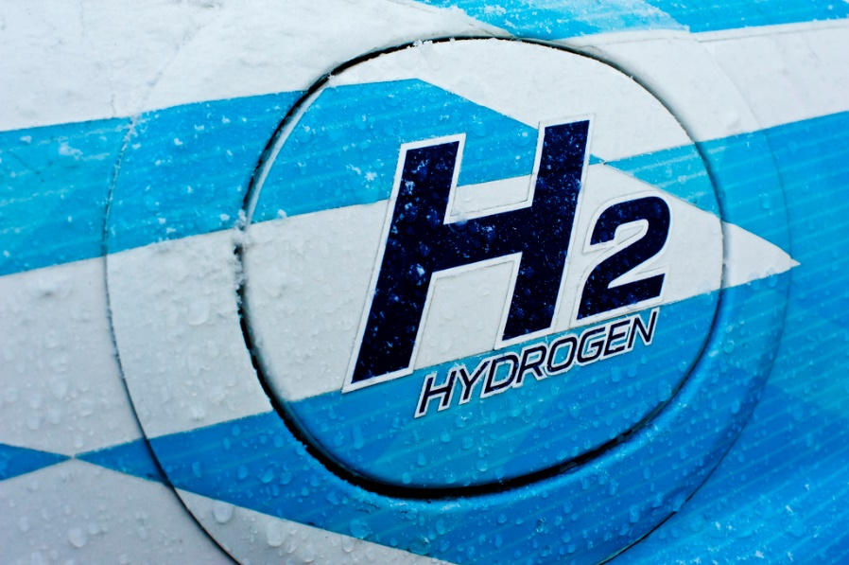
Overview
Hydrogen is considered the energy carrier of the future:
                High specific energy;
                Clean combustion (formation of water);
                Can be use used in fuel cells to generate electricity;
                Can store intermittent renewable energy from sources like solar or wind;
                It still needs improved technologies for storage and transportation.

Slide 4
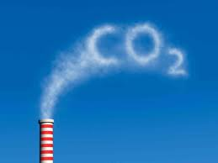
Current Technologies for Hydrogen Production
Fuels Processing:
  Steam reforming (catalytic, T usually > 500ºC):
  C_{m}H_{n} + mH₂O = mCO +(m + ½ n)H₂
  Most widely used in commercial scale
  Uses fossil fuels as source of hydrocarbons
  High emission of air pollutants

Slide 5
Current Technologies for Hydrogen Production
Biomass-Based Hydrogen:
  Pyrolysis
  Gasification
  Biochemical Processes: Direct Photolysis
  Dark Fermentation
    Problem of transport and storage of huge amount of biomass.
Water Electrolysis:
  Alkaline
  Proton Exchange Membrane (PEM)
Still expensive
Under development
Will reach maturity in a long-term
Can be combined with renewable sources such as wind or solar

Slide 6
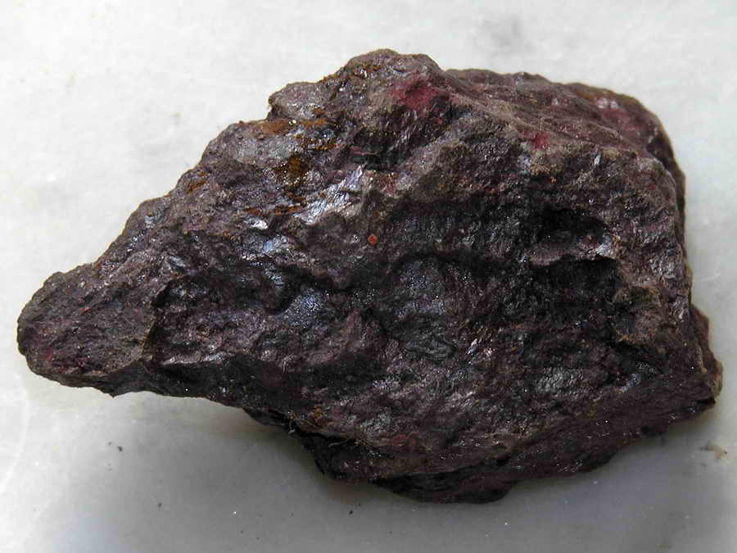
Aluminum
Most abundant metal in the Earth's crust;
Extracted from the mineral bauxite (Bayer Process);
It has low density (~ 2,700 kg / m³);
Valuable mechanical, electrical and thermal properties;
Uses in transportation, construction and packaging.

Slide 7
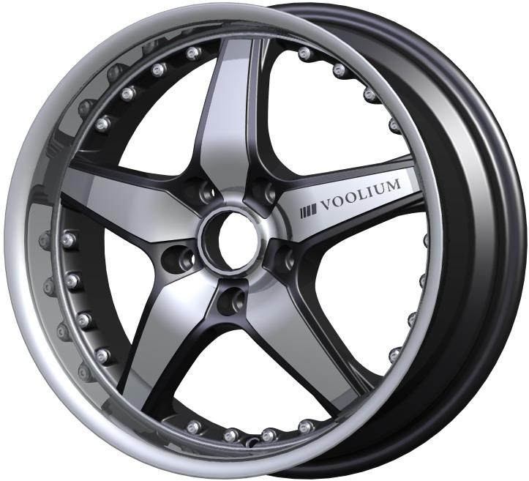
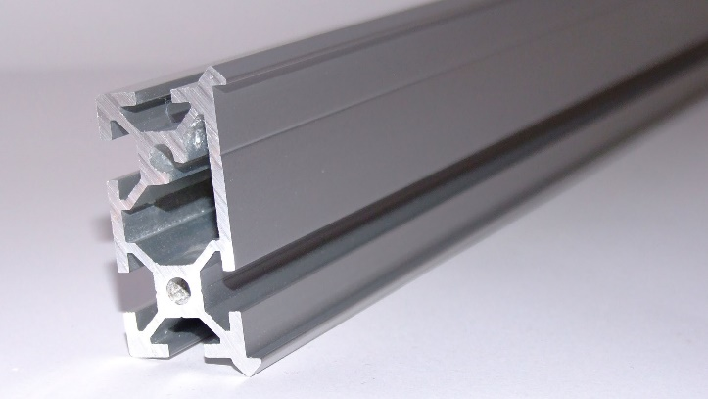
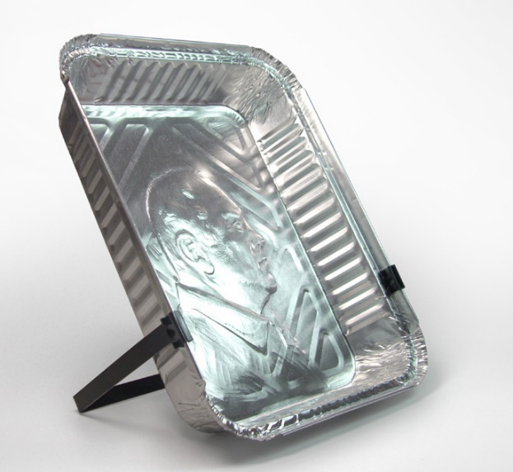
Aluminum
There are no restrictions on its conditions as a feedstock for H2;
Hydrogen production compared with conventional methods:
  Energy spent = 2% ;
  CO2 emissions = 4%;
Cars available can run 400 km with only 4 kg of hydrogen, which can be produced by 36 kg of aluminum.

Slide 8
Reactions with Water
1) Aluminum-water reaction with assistance of alkalis:
2Al + 6H₂O = 2Al(OH)₃ + 3H₂
Reaction at room temperature, catalyzed by NaOH, KOH or Ca(OH)₂;
NaOH provides best results but it is highly corrosive;
When using aluminum alloys, the composition is highly influent;

Slide 9
Reactions with Water
2) Aluminum-water reaction in neutral condition:
Same reaction;
It is safer, since there are no hydroxide ions;
Activity of the metal in water is extremely low;
Surface passivation occurs more easily;
The metal fresh surface needs to be exposed to the water.

Slide 10
Reactions with Water
3) Aluminum-water reaction at elevated temperatures:
2Al + 3 H₂O = Al₂O₃ + 3H₂
A mixture of aluminum and steam reacts at high temperature (2500ºC);
This technology has been studied for use in satellites and micro rocket propulsion systems.

Slide 11
Reaction with Alcohols
Arose during studies on the synthesis of aluminum alkoxides;
The hydrogen is produced by the reaction of an alcohol with aluminum activated by I₂, HgCl₂ or SnCl₄, under reflux conditions:
2Al + 6 ROH (excess) = 2Al(OR)₃ + 3H₂
Challenge: further separation of hydrogen from a gas mixture including vapors of alcohols and the catalyst.

Slide 12
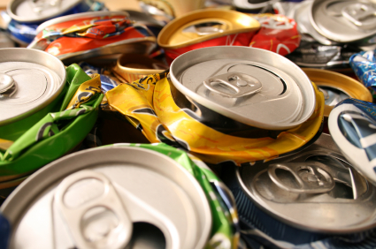
Waste Cans as a Low-Cost Feedstock
Global production of aluminum cans is 475 billion per year, including uses in food, drinks, industrial products and aerosols;
North America is the largest market with about 100 billion cans for drinks and about 30 billion for food, industrial products and aerosols (20% of the aluminum produced worldwide);

Slide 13
Waste Cans as a Cheap Feedstock
Basic estimative of hydrogen annual production from the North America used cans:
Considerations: 130 billion cans;
weight of a can: 15 grams;
9 kg of aluminum needed for each 1 kg of hydrogen;
overall efficiency of the process = 90%.
A total of 195,000 metric tons of hydrogen can be produced annually;
2% of the US current production of hydrogen.

Slide 14
Waste Cans as a Cheap Feedstock
Cars that could be fueled by hydrogen derived from aluminum in the US:
Considerations: 195,000 metric tons of H2;
1 kg of hydrogen run a car for 100 km;
each car runs 24,000 km per year;
235,000,000 cars in the US;
812,500 American cars per year (0.3%);
Small percentage, but is a low-cost alternative to complement other technologies of hydrogen production.

Slide 15
Waste Cans as a Cheap Feedstock
Pretreatment of the cans:
  Sulfuric acid to remove the paint and plastic cover;
  Cut into small stripes for increased contact with the sodium hydroxide;
Hydrogen is obtained with no energy addition (at room temperature) and without generation of air pollutants;
By-product Al(OH)3 is an intermediate in commercial production of aluminum from bauxite.

Slide 16
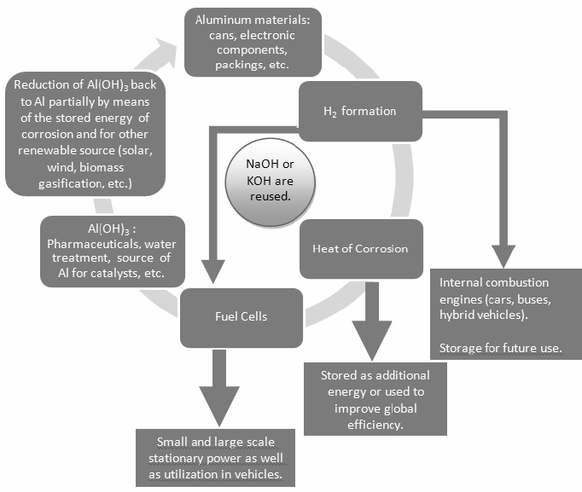

Slide 17
Summary
Hydrogen will play an important role in the future;
Aluminum can be used as feedstock to produce low-cost hydrogen;
The reaction is clean and the by-product Al(OH)₃ can be recycled;
Aluminum and water are simple and safe to store and transport, making them suitable for hydrogen production in situ;
No company is currently producing hydrogen from this method.

Slide 18
References
Holladay, J. D., Hu, J., King, D. L., Wang, Y. "An Overview of Hydrogen Production Technologies". Catalyst Today vol. 139 pp. 244-260 (2009).
Wang, H. Z., Leung, D. Y. C., Leung, M. Ni. “A Review on Hydrogen Production Using Aluminum and Aluminum Alloys”. Renewable & Sustainable Energy Reviews vol. 13 pp. 845-853 (2009).
Nutting, J. Frequently Asked Questions. (2011, January). Frequently Asked Questions. Can Maker by Sayers Publishing Group, Crawley, UK. [Online] Available: http://www.canmaker.com/news/index.php?option=com_content&view=article&id=1504&Itemid=126
Martínez, S. S., Benítes, W. L., Gallegos, A. A. A., Sebastián, P. J. "Recycling of Aluminum to Produce Green Energy". Solar Energy Materials & Solar Cells vol. 88 pp. 237-243 (2005).
Porciúncula, C. B., Marcilio, N. R., Tessaro, I. C., Gerchmann, M. “Production of Hydrogen in the Reaction between Aluminum and Water in the Presence of NaOH and KOH”. Brazilian Journal of Chemical Engineering vol. 29 pp. 337-348 (2012).

Slide 19

Thank you for your attention.
Gabriel Luiz Lopes Fraga
lopesfr2@illinois.edu

