Slide 1

ENERGY SYSTEMS | NPRE
NPRE 498 - TERM PROJECT
Mitigating Risks in Compressed Hydrogen Energy Storage
A Quantitative Risk Assessment Approach
Ami Nicodemus
November 17, 2025

Slide 2


Objectives
Be familiar with Hydrogen
Compressed Storage Method using Storage Vessels
Risks of Hydrogen Storage using Storage Vessels
Risk Analysis on Hydrogen Energy Storage System
Critically analyze a Research Article
Supplement its gaps through Quantitative Risk Analysis
Provide mitigation measure
ENERGY SYSTEMS | NPRE
2

Slide 3









Outline of the Presentation
Introduction
What is Hydrogen?
Why Hydrogen Storage is Important?
What is Compressed Hydrogen Storage?
Why Risk Analysis?
Risks Involved in Compressed Storage Vessels
Why Risk Analysis is Crucial?
Critique of the Research Article
Methodology & Results
Observations
QRA Methodology
Event Tree / Fault Tree Analysis
Fussell-Vesely Importance Measure
Impact Assessment
Key Takeaways
Risk Mitigation Strategies
Synthesis
ENERGY SYSTEMS | NPRE
3

Slide 4
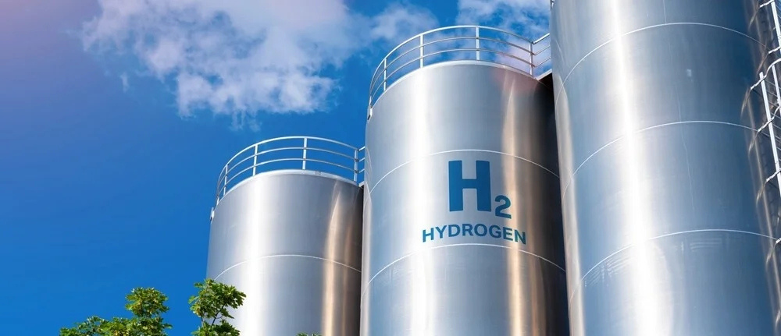
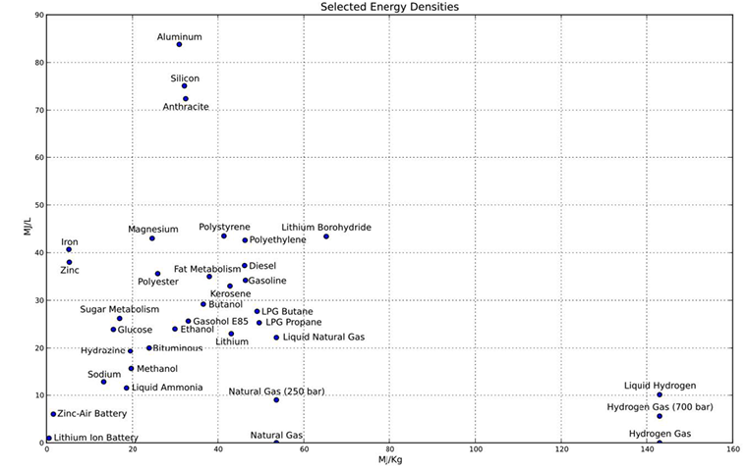

Introduction
What is Hydrogen?
Hydrogen as an Element
'hydro' and 'genes' meaning water forming
Most abundant element in the universe
Lightest of all gases
https://www.rsc.org/periodic-table/element/1/hydrogen
Hydrogen as a Fuel
High energy density
Clean-burning Fuel
Versatile energy
https://ieeexplore.ieee.org/document/9740444
Hydrogen as Growing Economy
Fuel cell in Transportation
Energy Carrier in Power generation
Industry refining & production processes
https://www.iea.org/reports/the-future-of-hydrogen
ENERGY SYSTEMS | NPRE
ENERGY SYSTEMS | NPRE
4

Slide 5

Introduction
Why is Hydrogen Storage Important?
Energy Storage & Supply Stability
Enables hydrogen to be produced during periods of excess renewable energy generation
Seasonal Storage
Long period storage for energy produced in surplus months for use during high demand
Flexibility in Energy Systems
Can be converted back to electricity using fuel cells or directly as fuel
Economic Benefits
Production can take advantage of the low electricity price during off-peak times
Abomazid, A. M., El-Taweel, N. A., & Farag, H. E. Z. (2022). Optimal energy management of hydrogen energy facility using integrated battery energy storage and solar photovoltaic systems. IEEE Transactions on Sustainable Energy, 13(3), 1457-1468.
ENERGY SYSTEMS | NPRE
ENERGY SYSTEMS | NPRE
5

Slide 6
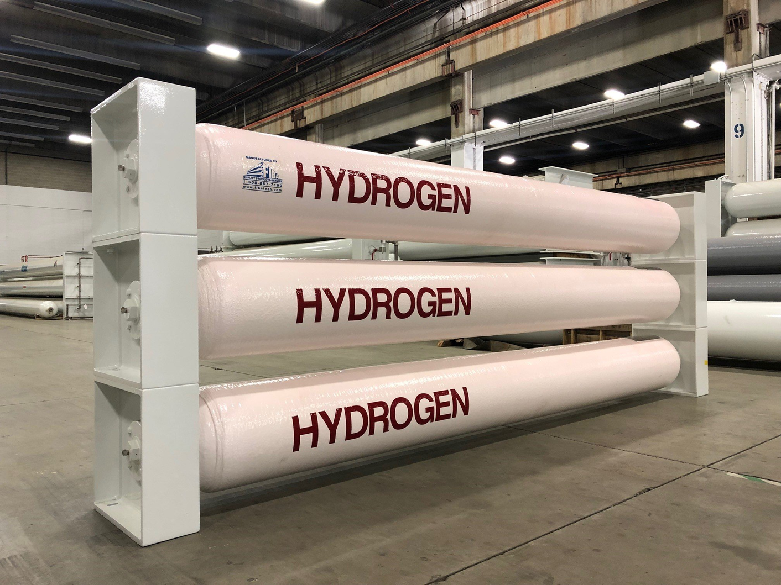


Introduction
What is Compressed Hydrogen Energy Storage?
Elberry, A. M., Thakur, J., Santasalo-Aarnio, A., & Larmi, M. (2021). Large-scale compressed hydrogen storage as part of renewable electricity storage systems. International Journal of Hydrogen Energy, 46(29), 15671–15690. https://doi.org/10.1016/j.ijhydene.2021.02.080
Used in various sectors, including automotive (for fuel cell vehicles), industrial (for chemical processes), and energy storage (to balance intermittent renewable energy sources).
Engineered to hold hydrogen gas under pressure, allowing for efficient storage and transportation
Enable the storage of hydrogen in a compact form
Typically cylindrical with spherical ends, which helps distribute stress evenly and enhances structural integrity
Designed to withstand high pressures, often ranging from 35 MPa to 82.5 MPa
Equipped with safety mechanisms such as pressure relief devices, valves, and sensors to monitor pressure and detect leaks
Advantages:
Disadvantages & Limitations:
High Storage Density
Cost
Hydrogen Embrittlement
Limited volume
Safety monitoring Challenges
Design and Development Costs
Scalability
Versatility
ENERGY SYSTEMS | NPRE
4
6

Slide 7

Why Risk Analysis?
Risks Involved with Compressed Storage Vessels
Le, S. T., Nguyen, T. N., Linforth, S., & Ngo, T. D. (2023). Safety investigation of hydrogen energy storage systems using quantitative risk assessment. International Journal of Hydrogen Energy, 48(7), 2861–2875. https://doi.org/10.1016/j.ijhydene.2022.10.082
Fire and Explosion Hazard
Hydrogen is highly flammable
Leaks and ruptures poses significant risks of fires and explosions
Jet fires and vapor cloud explosions are critical hazards
Lethality
Jet and flash fires are the primary cause of lethality
Can result from hydrogen leaks
System Design Parameters
Higher storage capacities and pressures are associated with increased risks
Storage size, mass flow rate, storage pressure, and storage temperature significantly influence the risk profile
ENERGY SYSTEMS | NPRE
7

Slide 8
Why Risk Analysis?
Why Risk Analysis is Crucial?
Le, S. T., Nguyen, T. N., Linforth, S., & Ngo, T. D. (2023). Safety investigation of hydrogen energy storage systems using quantitative risk assessment. International Journal of Hydrogen Energy, 48(7), 2861–2875. https://doi.org/10.1016/j.ijhydene.2022.10.082
Identification of Hazards & Assessment of Consequences
Identify potential hazards associated with hydrogen storage, such as leaks, fires, and explosions
Assessment of the potential consequences of various failure scenarios
Informed-Decision Making
Data-driven insights that inform decision-making regarding the design, operation, and management of hydrogen storage systems
Cost-Effective & Enhance Safety Culture
By identifying and mitigating risks early in the design process, organizations can avoid costly accidents and liabilities
Encourages continuous monitoring and improvement of safety practices
Public Safety & Acceptance
Ensure public safety and gain community acceptance
ENERGY SYSTEMS | NPRE
8

Slide 9






Critique of the Research Article
Le, S. T., Nguyen, T. N., Linforth, S., & Ngo, T. D. (2023). Safety investigation of hydrogen energy storage systems using quantitative risk assessment. International Journal of Hydrogen Energy, 48(7), 2861–2875. https://doi.org/10.1016/j.ijhydene.2022.10.082
Methodology Used for Risk Analysis
Risk Analysis
Findings are integrated to assess the overall risk associated
Frequency Analysis
Consequence Analysis
Analyzes the likelihood of different hazardous events occurring (Event Tree Analysis)
Assess the potential consequences of identified hazards using Miller model for jet fire hazards and the TNO multi-energy model for explosion hazards
Data Collection & Hazard Identification
Impact Assessment
Evaluates the lethal effects of accidental scenarios, including heat radiation and overpressure from explosions
Gathering relevant data and identifying potential hazards associated
ENERGY SYSTEMS | NPRE
9

Slide 10
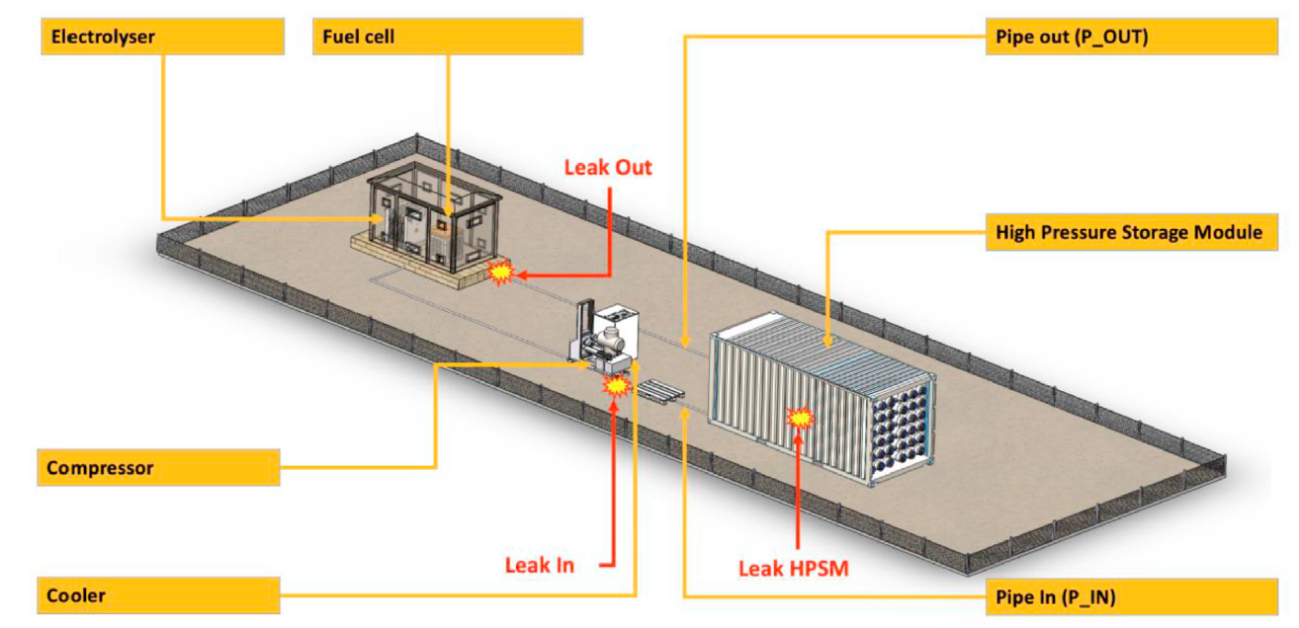
Critique of the Research Article
Le, S. T., Nguyen, T. N., Linforth, S., & Ngo, T. D. (2023). Safety investigation of hydrogen energy storage systems using quantitative risk assessment. International Journal of Hydrogen Energy, 48(7), 2861–2875. https://doi.org/10.1016/j.ijhydene.2022.10.082
ENERGY SYSTEMS | NPRE
10

Slide 11

Critique of the Research Article
Le, S. T., Nguyen, T. N., Linforth, S., & Ngo, T. D. (2023). Safety investigation of hydrogen energy storage systems using quantitative risk assessment. International Journal of Hydrogen Energy, 48(7), 2861–2875. https://doi.org/10.1016/j.ijhydene.2022.10.082
Findings of the Research
1
Significant Impact
Storage capacity and storage pressure, have a significant impact on the risk
As storage capacity and storage pressure increase, leakage or rupture probability also increase
Design Parameters
2
Unacceptable & Needs Mitigation
Large storage capacities or high storage pressures could exceed acceptable risk threshold
1E-6 risk contours result could not be contained within the boundaries of the hydrogen storage system
Risk Levels
3
Need for QRA
Further Research
Crucial for identifying and effectively mitigating safety risks
ENERGY SYSTEMS | NPRE
11

Slide 12
Critique of the Research Article
Le, S. T., Nguyen, T. N., Linforth, S., & Ngo, T. D. (2023). Safety investigation of hydrogen energy storage systems using quantitative risk assessment. International Journal of Hydrogen Energy, 48(7), 2861–2875. https://doi.org/10.1016/j.ijhydene.2022.10.082
Observations
1
Do not address all potential hazards associated (Other factors, such as equipment failure, human error, and external threats (e.g., random accidents)
Treated the failure probabilities of the system components (like pipes, valves, and joints) and the likelihood of hydrogen leakage as the same thing.
Limited Scope of Hazards
2
While individual risk contours are mentioned, visual representations of these contours could enhance understanding.
More explicit connections between the results and their implications for safety measures would strengthen the research.
Presentation of Results
3
Risk Mitigation Discussion
Needs more detailed discussion of specific strategies or technologies that could be implemented to reduce identified risks.
4
Future Research Directions
It could offer more specific recommendations or areas of focus for studies.
ENERGY SYSTEMS | NPRE
12

Slide 13
QRA Methodology
Methodology Used for Risk Analysis
Risk Analysis
Findings are integrated to assess the overall risk associated
Frequency Analysis
Consequence Analysis
Analyzes the likelihood of different hazardous events occurring (Event Tree Analysis)
Assess the potential consequences of identified hazards using Miller model for jet fire hazards and the TNO multi-energy model for explosion hazards
Data Collection & Hazard Identification
Impact Assessment
Evaluates the lethal effects of accidental scenarios, including heat radiation and overpressure from explosions
Gathering relevant data and identifying potential hazards associated
ENERGY SYSTEMS | NPRE
13

Slide 14
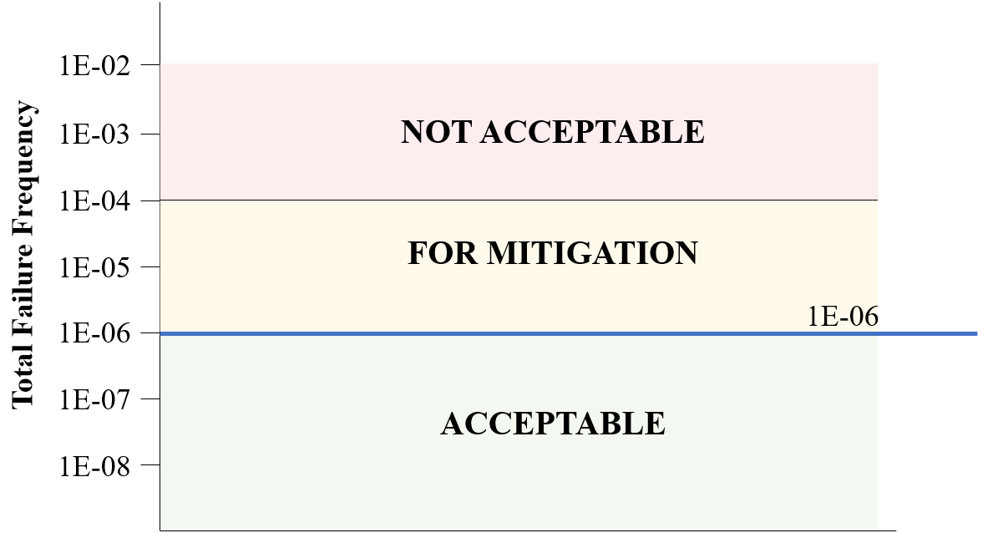

QRA Methodology
Calculated Risk on Critiqued Research Article
Le, S. T., Nguyen, T. N., Linforth, S., & Ngo, T. D. (2023). Safety investigation of hydrogen energy storage systems using quantitative risk assessment. International Journal of Hydrogen Energy, 48(7), 2861–2875. https://doi.org/10.1016/j.ijhydene.2022.10.082
ENERGY SYSTEMS | NPRE
14

Slide 15
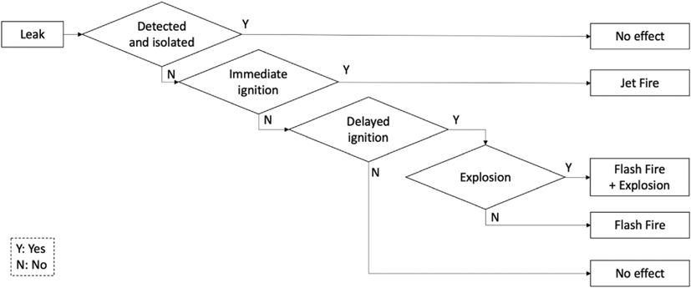
QRA Methodology
Event Tree Analysis (ETA)
1
Limited Scope of Hazards
Do not address all potential hazards associated
All component and hydrogen leakage failure probabilities are the same
Pr(Failure) = 1E-6
Figure 1. ETA from research article Le et al. 2023
ENERGY SYSTEMS | NPRE
15

Slide 16
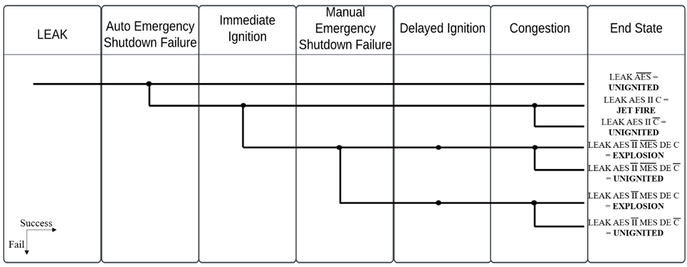
QRA Methodology
Event Tree Analysis (ETA)
Zarei et al. (2017), "Dynamic Safety Assessment of Natural Gas Stations Using Bayesian Network," Journal of Hazardous Materials 321: 830 – 840
Figure 2. Term paper’s ETA based on Zarei et al. (2017)
Accident scenario modeling based on the worst-case scenario and examines the properties and behavior of hydrogen gas during a leakage
ENERGY SYSTEMS | NPRE
16

Slide 17
QRA Methodology
Fault Tree Analysis (FTA)
Figure 2. Term paper’s ETA based on Zarei et al. (2017)
ENERGY SYSTEMS | NPRE
17

Slide 18
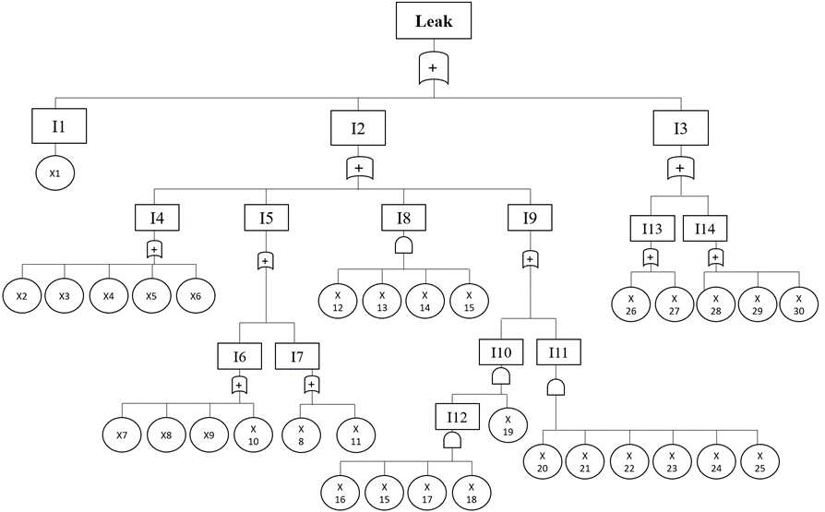
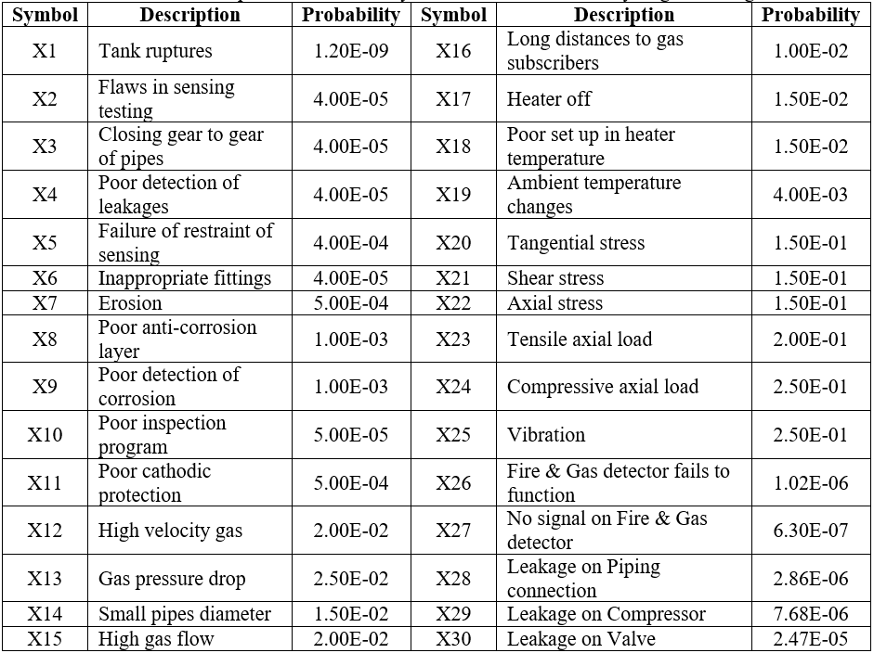
QRA Methodology
FTA of Hydrogen Leakage as Initiating Event
Correa-Jullian, C., & Groth, K. M. (2022). Data requirements for improving the quantitative risk assessment of liquid hydrogen storage systems. International Journal of Hydrogen Energy, 47(6), 4222–4235 [11] and Zarei et al. (2017), "Dynamic Safety Assessment of Natural Gas Stations Using Bayesian Network," Journal of Hazardous Materials 321: 830 – 840.
Table 1. Probability of the Basic Events for Hydrogen Leakage
Figure 3. FTA of Leak Top Event
ENERGY SYSTEMS | NPRE
18

Slide 19
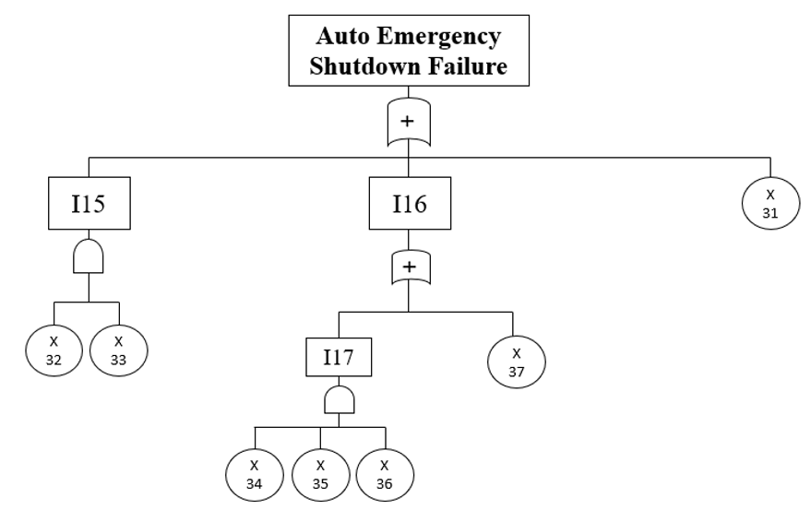
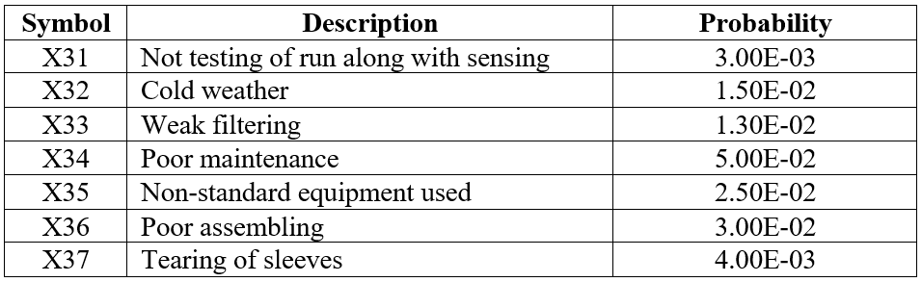
QRA Methodology
FTA of Auto Emergency Shutdown Failure as Top Event
Zarei et al. (2017), "Dynamic Safety Assessment of Natural Gas Stations Using Bayesian Network," Journal of Hazardous Materials 321: 830 – 840.
Table 2. Probability of the Basic Events for
Auto Emergency Shutdown Failure
Figure 4. FTA of Auto Emergency Shutdown Failure Top Event
ENERGY SYSTEMS | NPRE
19

Slide 20
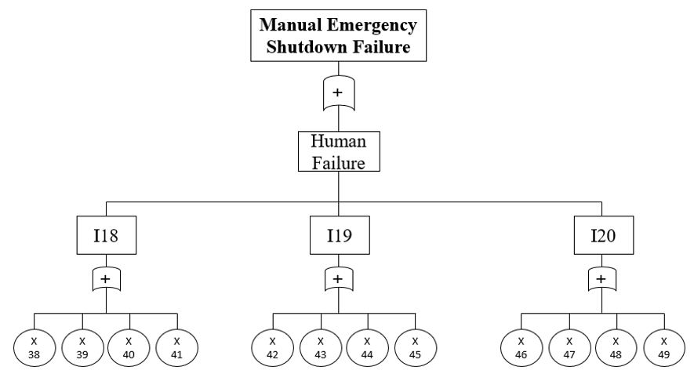
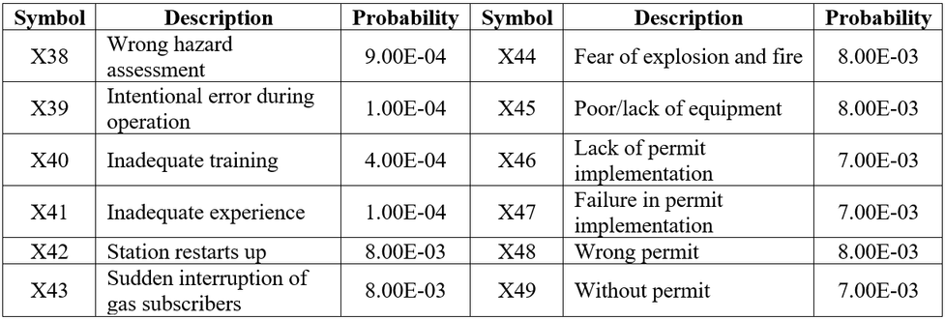
QRA Methodology
FTA of Manual Emergency Shutdown Failure as Top Event
Zarei et al. (2017), "Dynamic Safety Assessment of Natural Gas Stations Using Bayesian Network," Journal of Hazardous Materials 321: 830 – 840.
Table 3. Probability of the Basic Events for
Manual Emergency Shutdown Failure
Figure 5. FTA of Manual Emergency Shutdown Failure Top Event
ENERGY SYSTEMS | NPRE
20

Slide 21
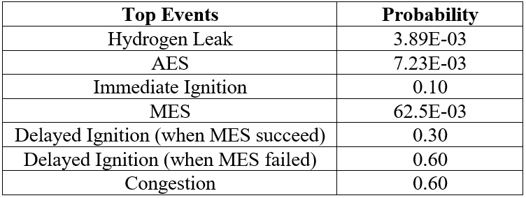
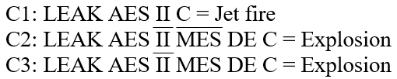
QRA Methodology
Frequency of Event Tree Failure Scenarios
Zarei et al. (2017), "Dynamic Safety Assessment of Natural Gas Stations Using Bayesian Network," Journal of Hazardous Materials 321: 830 – 840.
Table 4. Failure probabilities of Top Events
Failure Scenarios based on ET:
ENERGY SYSTEMS | NPRE
21

Slide 22




QRA Methodology
Total Failure Frequency
To calculate the total failure frequency, the three scenarios above must be summed:
=
Modarres, M., Kaminskiy, M. P., & Krivtsov, V. (2016). Reliability engineering and risk analysis: A practical guide (3rd ed.). CRC Press
ENERGY SYSTEMS | NPRE
22

Slide 23
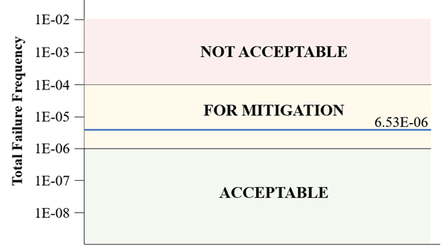
Impact Assessment
Key Takeaways
According to ISO 19880-1:
Risk for workers inside a facility should not exceed 1E-04 per year
Risk for third parties outside the facility should not exceed 1E-06 per year
Figure 7. ISO 19880-1 Third Party Risk vs. Computed Risk
ISO. (2020). ISO 19880-1: Gaseous hydrogen – Fueling stations – Part 1: General requirements. International Organization for Standardization
ENERGY SYSTEMS | NPRE
24

Slide 24

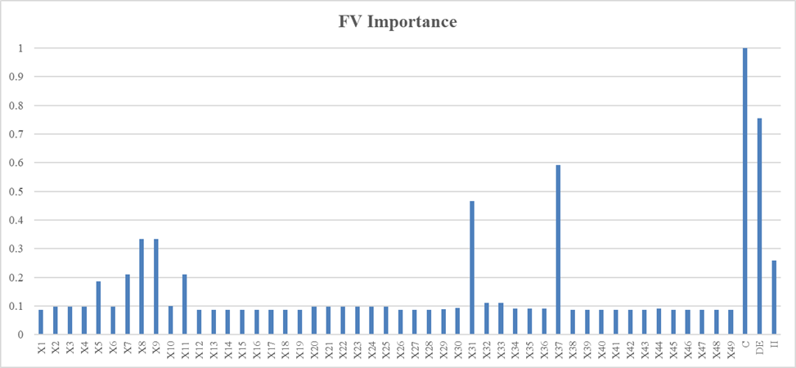
QRA Methodology
Fussell-Vesely Importance Measure
Assess the contribution of each individual cut set to the overall system failure probability where each basic event is varied individually, and the resulting change in system risk is evaluated.
Figure 6. Fussell-Vesely Importance Measure of Basic Events
Modarres, M., Kaminskiy, M. P., & Krivtsov, V. (2016). Reliability engineering and risk analysis: A practical guide (3rd ed.). CRC Press
ENERGY SYSTEMS | NPRE
23

Slide 25
Risk Mitigation Strategies
Synthesis
ISO. (2020). ISO 19880-1: Gaseous hydrogen – Fueling stations – Appendix B: Further Guidance on Risk Management.
International Organization for Standardization.
Hydrogen Gas Accumulation Mitigation Measures
1. Passive ventilation
2. Active ventilation
3. Hydrogen gas detection system
4. Integrity testing of isolated piping sections
5. Other means of leak detection, such as ultrasonic gas detection
Automatic Emergency Shutdown Failure Mitigation Measures
For Basic Event X37: Tearing of Sleeves
Install pressure relief devices, such as spring-loaded, pressure-actuated safety valves or non-resealable pressure-actuated safety devices
For Basic Event X31: Not Testing of Run along with Sensing
Proper maintenance, regular testing, and reliable sensing
ENERGY SYSTEMS | NPRE
25

Slide 26
References
[1] Royal Society of Chemistry. (n.d.). Hydrogen – Element information, properties and uses. https://periodic-table.rsc.org/element/1/hydrogen
[2] Rivero, R., Jefferson, K., & … (2022). Optimal energy management of hydrogen energy facility using integrated battery energy storage and solar photovoltaic systems. IEEE Journals & Magazine. https://ieeexplore.ieee.org/document/9740444
[3] International Energy Agency. (2019). The future of hydrogen: Seizing today’s opportunities. https://www.iea.org/reports/the-future-of-hydrogen
[4] Elberry, A. M., Thakur, J., Santasalo-Aarnio, A., & Larmi, M. (2021). Large-scale compressed hydrogen storage as part of renewable electricity storage systems. International Journal of Hydrogen Energy, 46(29), 15671–15690. https://doi.org/10.1016/j.ijhydene.2021.02.080
[5] International Energy Agency. (2019). The future of hydrogen—Analysis. International Energy Agency. https://www.iea.org/reports/the-future-of-hydrogen
[6] Abomazid, A. M., El-Taweel, N. A., & Farag, H. E. Z. (2022). Optimal energy management of hydrogen energy facility using integrated battery energy storage and solar photovoltaic systems. IEEE Transactions on Sustainable Energy, 13(3), 1457–1468. https://doi.org/10.1109/TSTE.2022.3161891
[7] Ananthachar, V., & Duffy, J. J. (2005). Efficiencies of hydrogen storage systems onboard fuel cell vehicles. Solar Energy, 78(5), 687–694. https://doi.org/10.1016/j.solener.2004.02.008
[8] Møller, K. T., Jensen, T. R., Akiba, E., & Li, H. (2017). Hydrogen - A sustainable energy carrier. Progress in Natural Science: Materials International, 27(1), 34–40. https://doi.org/10.1016/j.pnsc.2016.12.014
[9] Bossel, U., & Eliasson, B. (n.d.). Energy and the hydrogen economy. Alternative Fuels Data Center. https://afdc.energy.gov/files/pdfs/hyd_economy_bossel_eliasson.pdf
[10] de Miranda, P. E. V. (Ed.). (2019). Hydrogen storage and transport technologies. In Science and engineering of hydrogen-based energy technologies (pp. 221–228). Academic Press.
[11] Ade, N., Wilhite, B., & Goyette, H. (2020). An integrated approach for safer and economical design of hydrogen refueling stations. International Journal of Hydrogen Energy, 45(56), 32713–32729. https://doi.org/10.1016/j.ijhydene.2020.08.232
[12] Abohamzeh, E., Salehi, F., Sheikholeslami, M., Abbassi, R., & Khan, F. (2021). Review of hydrogen safety during storage, transmission, and applications processes. Journal of Loss Prevention in the Process Industries, 72, 104569. https://doi.org/10.1016/j.jlp.2021.104569
[13] Hadef, H., Negrou, B., González Ayuso, T., Djebabra, M., & Ramadan, M. (2020). Preliminary hazard identification for risk assessment on a complex system for hydrogen production. International Journal of Hydrogen Energy, 45(20), 11855–11865. https://doi.org/10.1016/j.ijhydene.2019.10.162
[14] Correa-Jullian, C., & Groth, K. M. (2022). Data requirements for improving the quantitative risk assessment of liquid hydrogen storage systems. International Journal of Hydrogen Energy, 47(6), 4222–4235. https://doi.org/10.1016/j.ijhydene.2021.10.266
[15] LaChance, Jeffrey L, Houf, William G, Fluer, Inc., Paso Robels, CA, Fluer, Larry, & Middleton, Bobby. Analyses to support development of risk-informed separation distances for hydrogen codes and standards. United States. https://doi.org/10.2172/983689
[16] Zarei et al. (2017), "Dynamic Safety Assessment of Natural Gas Stations Using Bayesian Network," Journal of Hazardous Materials 321: 830 – 840.
[17] Modarres, M., Kaminskiy, M. P., & Krivtsov, V. (2016). Reliability engineering and risk analysis: A practical guide (3rd ed.). CRC Press.
[18] ISO. (2020). ISO 19880-1: Gaseous hydrogen – Fueling stations – Part 1: General requirements. International Organization for Standardization.
[19] ISO. (2020). ISO 19880-1: Gaseous hydrogen – Fueling stations – Appendix B: Further Guidance on Risk Management. International Organization for Standardization.
ENERGY SYSTEMS | NPRE
26

Slide 27
ENERGY SYSTEMS | NPRE
NPRE 498 - TERM PROJECT
Mitigating Risks in Compressed Hydrogen Energy Storage
A Quantitative Risk Assessment Approach
Ami Nicodemus
November 17, 2025

