Slide 1
Comparison of Hybrid and
Plug-in Hybrid Electric Vehicles (EVs)
Aniket Kute

Slide 2
Introduction
Why Compare HEVs and PHEVs?
Growing demand for eco-friendly vehicles
Need to reduce emissions and reliance on fossil fuels
HEVs and PHEVs offer different benefits for drivers
Objectives
Understand key differences between HEVs and PHEVs
Analyze pros and cons of HEVs and PHEVs
Help to make informed decisions as a consumer
Nuclear, Plasma and Radiological Engineering,
University of Illinois at Urbana-Champaign

Slide 3
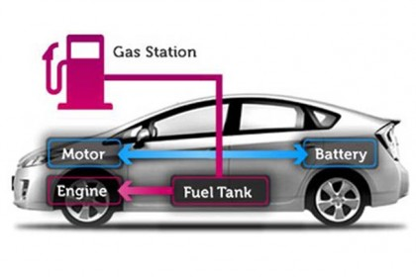
What is Hybrid Electric Vehicles (HEVs)
Powered by an internal combustion engine (ICE) and one or more electric motors
Runs on standard fuel like petrol and diesel
Cannot be plugged in to charge the battery
Battery is charged through regenerative braking
https://www.autoeurope.com.au/hybrid-cars/
Nuclear, Plasma and Radiological Engineering,
University of Illinois at Urbana-Champaign

Slide 4
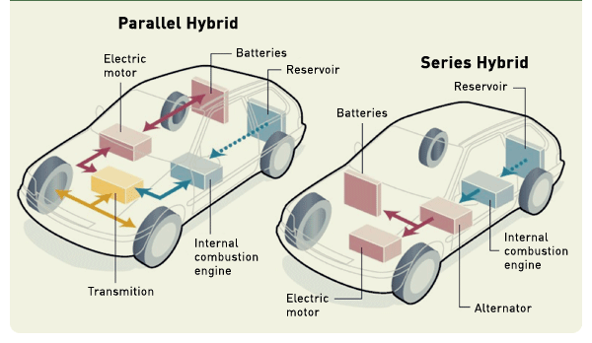
Types of Hybrid Electric Vehicles (HEVs)
Parallel Hybrids:
Transmission is connected to both engine and motor
Main source of power is the internal combustion engine
Cannot operate in electric-only mode
Uses a battery with lower capacity
More efficient at high speeds
Series Hybrids:
Combustion engine powers a generator that supplies the electric motor and charges the batteries
Only the electric motor is connected to the transmission to move the vehicle
More efficient at low speeds
Ideal for situations with frequent stops and starts
https://www.oica.net/hybrid/
Nuclear, Plasma and Radiological Engineering,
University of Illinois at Urbana-Champaign

Slide 5
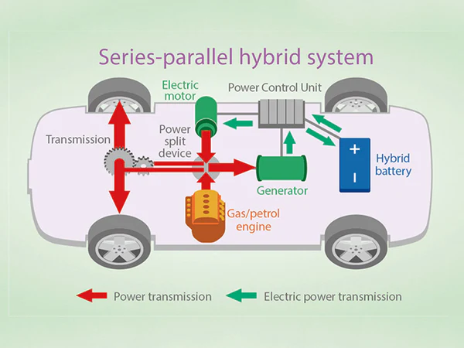
Types of Hybrid Electric Vehicles (HEVs)
Series - Parallel Hybrids:
Combines features of both series and parallel hybrids
Can run on electric motor or internal combustion engine
Electric motor can also power the wheels independently
Allows the vehicle to optimize fuel efficiency by switching between electric and engine power based on driving conditions
Widely used in popular hybrid models from major manufacturers (e.g., Toyota Prius, Honda Accord Hybrid)
https://www.tycorun.com/blogs/news/what-is-a-series-parallel-hybrid-power-system
Nuclear, Plasma and Radiological Engineering,
University of Illinois at Urbana-Champaign

Slide 6
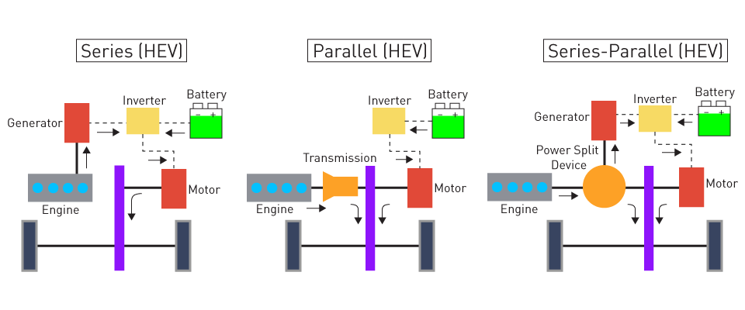
Types of Hybrid Electric Vehicles (HEVs)
https://www.monolithicpower.com/en/learning/mpscholar/automotive-electronics/electric-vehicles-and-hybrid-power-systems/intro-to-evs-and-hybrid-systems
Nuclear, Plasma and Radiological Engineering,
University of Illinois at Urbana-Champaign

Slide 7
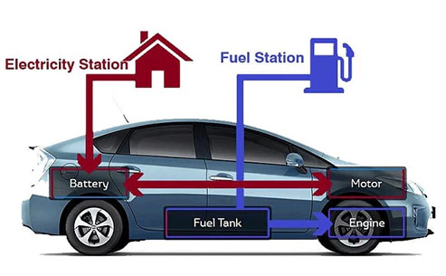
What is Plug-In Hybrid Electric Vehicles (PHEVs)
Powered by an internal combustion engine (ICE) and one or more electric motors
Runs on standard fuel like petrol and diesel
Cannot be plugged in to charge the battery
Battery is charged through regenerative braking
https://www.autoeurope.com.au/hybrid-cars/
Nuclear, Plasma and Radiological Engineering,
University of Illinois at Urbana-Champaign

Slide 8
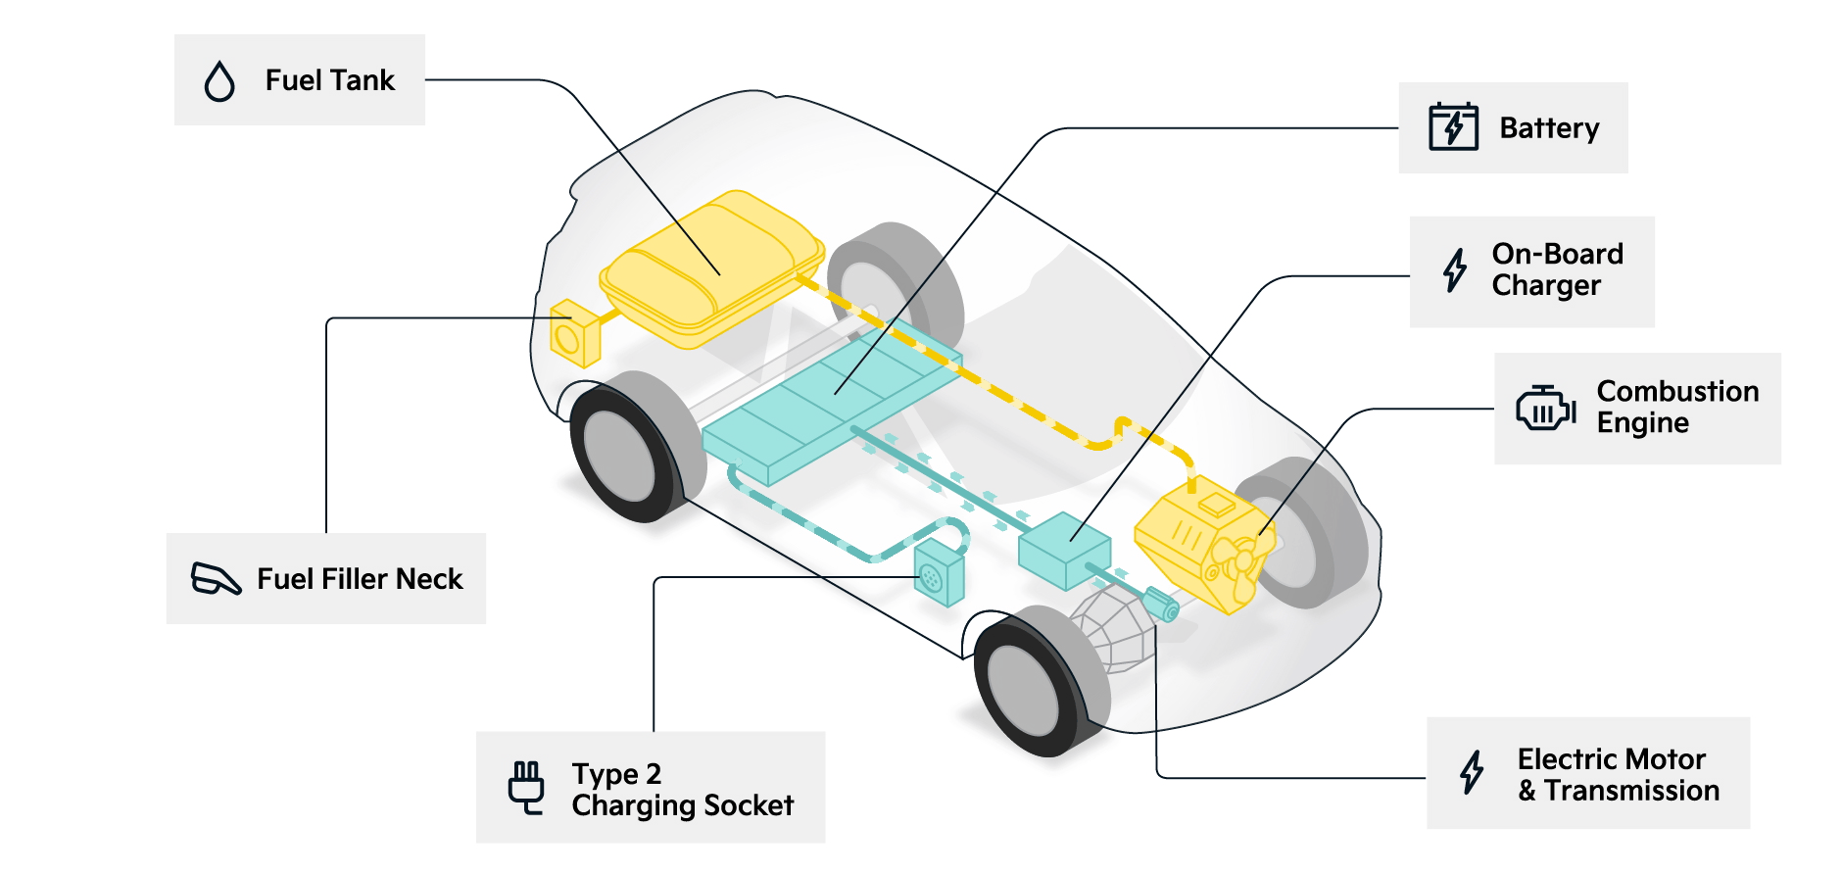
What is Plug-In Hybrid Electric Vehicles (PHEVs)
https://www.kia.com/uk/dealers/leslieskia/electric-hybrid-cars/plug-in-hybrid-cars/
Nuclear, Plasma and Radiological Engineering,
University of Illinois at Urbana-Champaign

Slide 9
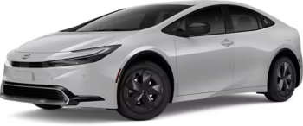
Toyota Prius LE HEV (2024)
Motor: Permanent magnet AC synchronous motor (83 kW, 111 hp)
Engine: 150hp @6000rpm, 2L
Hybrid system net power: 194 hp
MPG (city/highway): 56/57
Fuel Tank Capacity: 10.6 gal.
Total Range in miles (city/hwy): 640
Cost: $27,950
Nuclear, Plasma and Radiological Engineering,
University of Illinois at Urbana-Champaign

Slide 10
Toyota Prius Prime SE PHEV (2024)
Motor: Permanent magnet AC synchronous motor (120 kW, 161 hp)
Engine: 150hp @6000rpm, 2L
Hybrid system net power: 220 hp
MPG Hybrid mode(city/highway): 52/53
MPGe (electric mode only): 127
Fuel Tank Capacity: 10.6 gal.
All-electric driving range in miles: 44
Total Range in miles (city/hwy): 640
Battery Capacity (kWh): 13.6
Charging time (hr.) (120V/240V): ~11:00/~4:00 hr.
Cost: $32,975
Nuclear, Plasma and Radiological Engineering,
University of Illinois at Urbana-Champaign

Slide 11
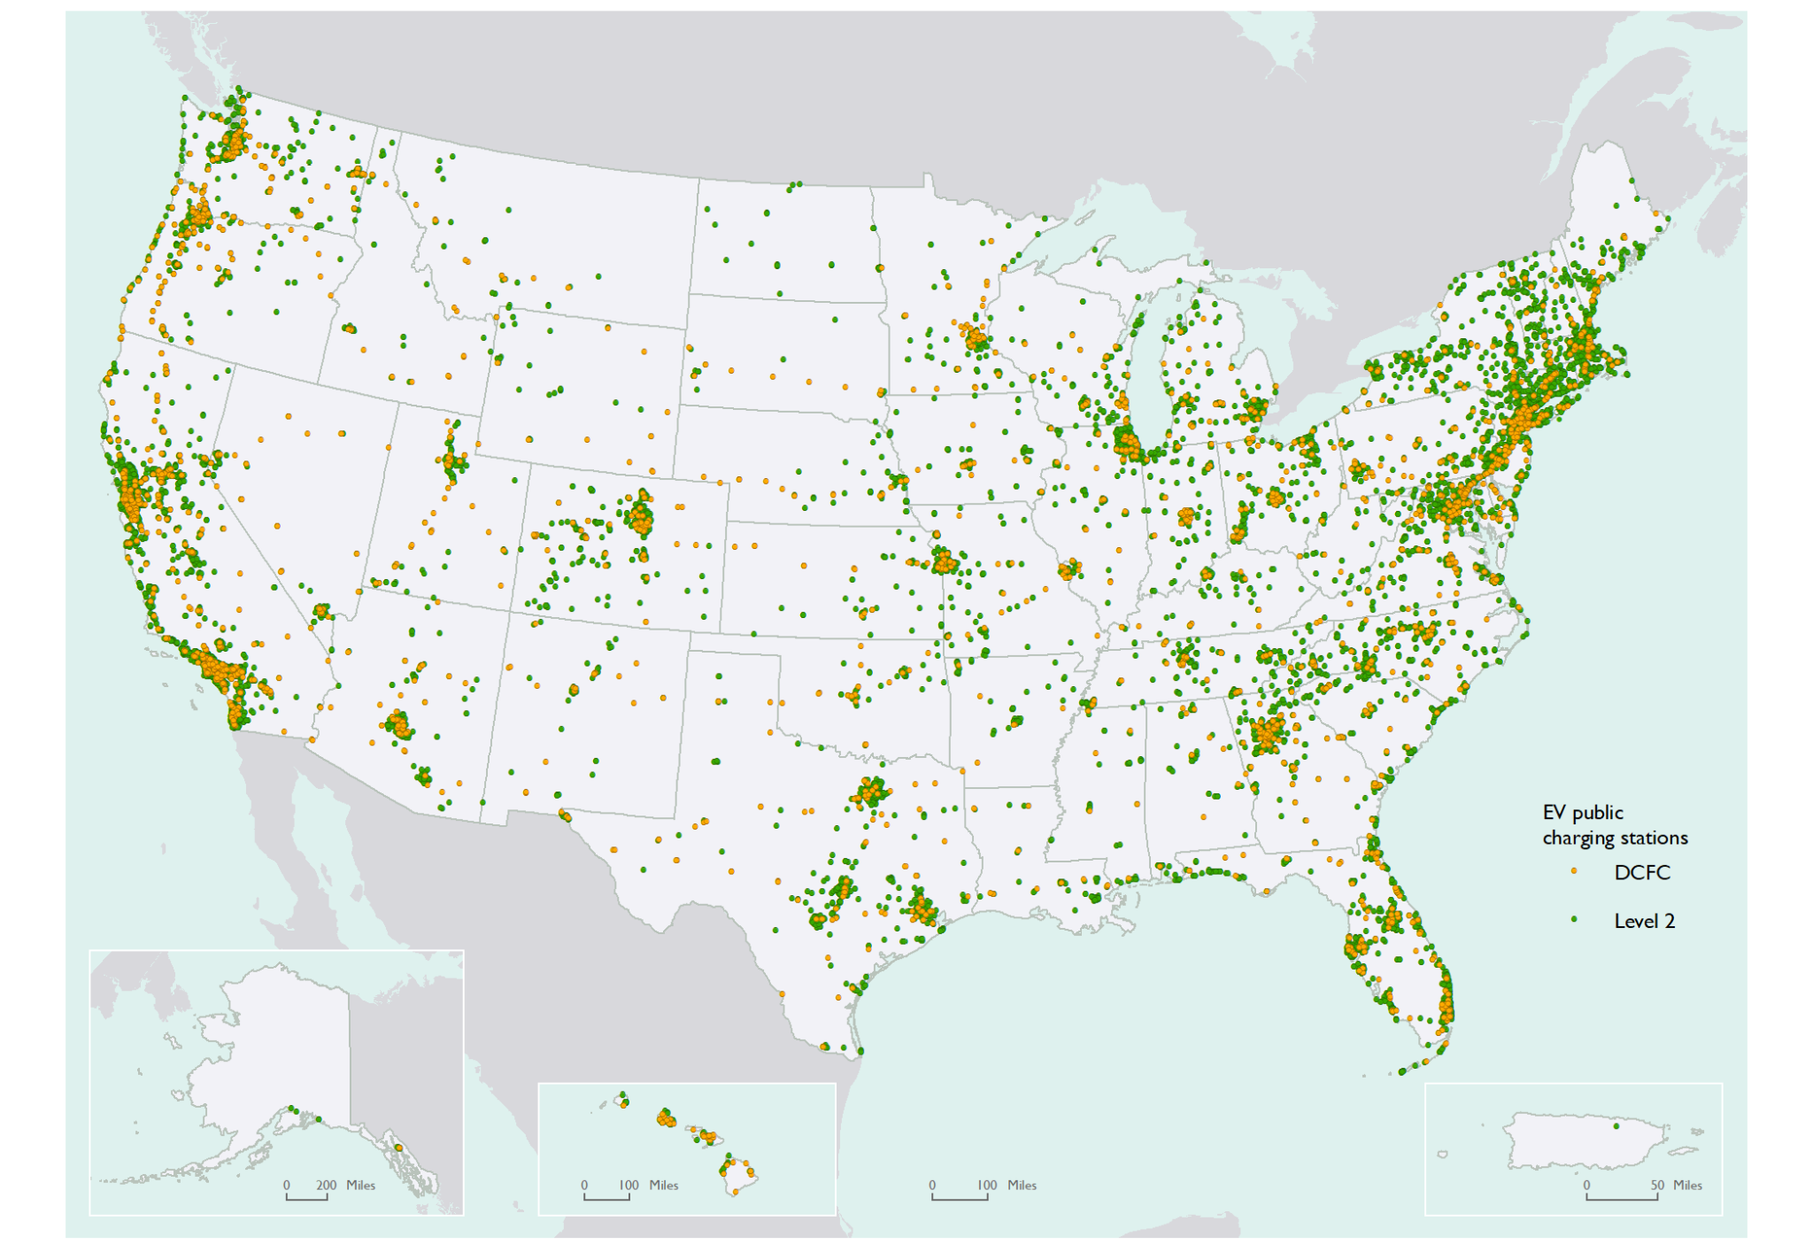
EV Charging Stations in the US (2019)
https://www.bts.gov/geography/geospatial-portal/electric-vehicle-public-charging-stations-united-states-2019
Nuclear, Plasma and Radiological Engineering,
University of Illinois at Urbana-Champaign

Slide 12
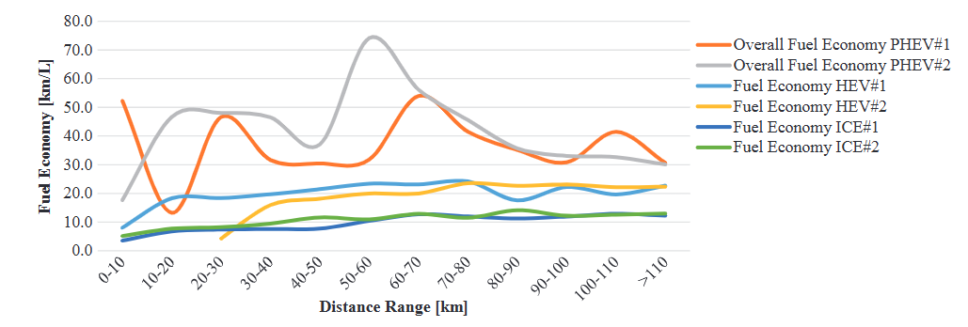
Fuel Economy of HEVs vs PHEVs
https://www.researchgate.net/publication/348990526_Analysis_of_behavior_in_the_use_of_plug-in_hybrid_electric_vehicle_and_hybrid_electric_vehicle_in_the_tropics
Nuclear, Plasma and Radiological Engineering,
University of Illinois at Urbana-Champaign

Slide 13
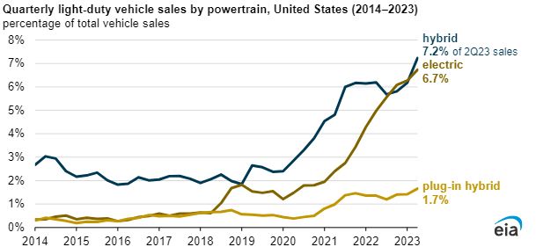
Trends in the U.S. Vehicle Sales (2014–2023)
https://www.eia.gov/todayinenergy/detail.php?id=60321
Nuclear, Plasma and Radiological Engineering,
University of Illinois at Urbana-Champaign

Slide 14
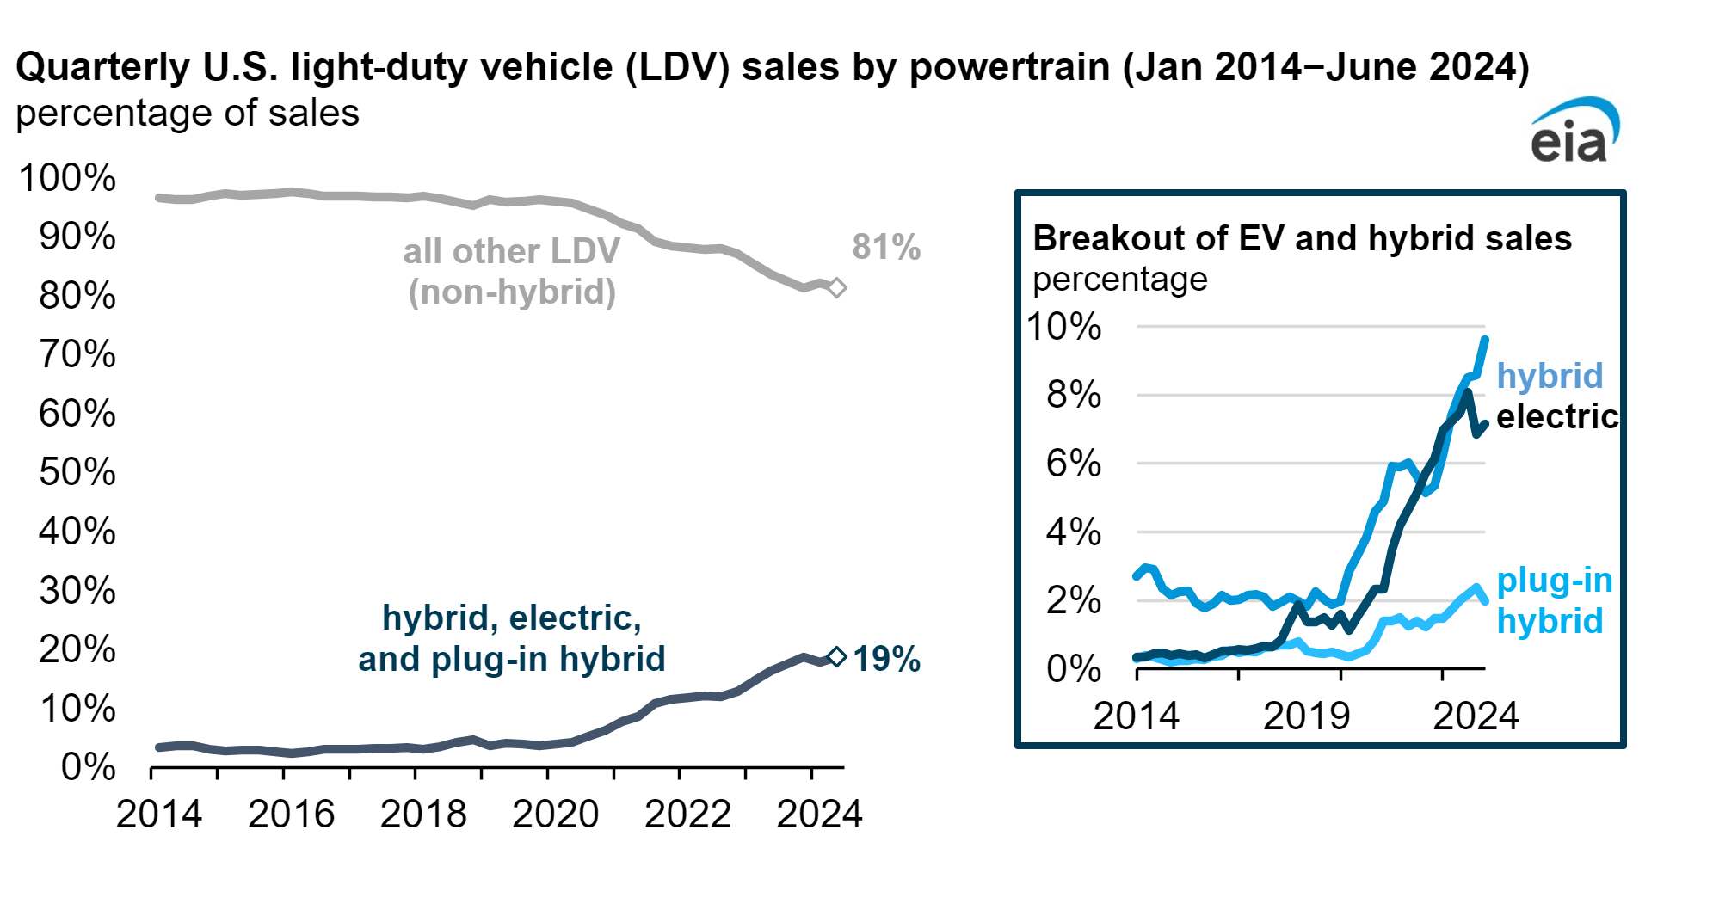
Trends in the U.S. Vehicle Sales (2014–2024)
https://www.eia.gov/todayinenergy/detail.php?id=62924
Nuclear, Plasma and Radiological Engineering,
University of Illinois at Urbana-Champaign

Slide 15
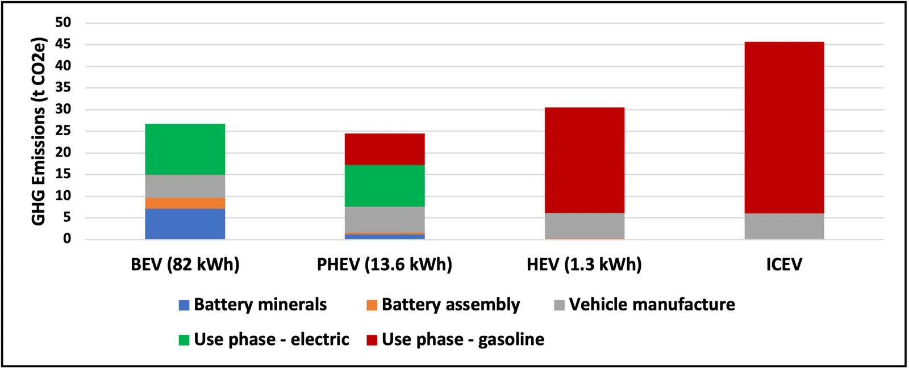
Carbon footprint of HEVs vs PHEVs at 125,000 miles
https://illuminem.com/illuminemvoices/why-plugin-hybrids-are-better-for-climate-than-full-evs-today
Nuclear, Plasma and Radiological Engineering,
University of Illinois at Urbana-Champaign

Slide 16
Advantages and Disadvantages of HEVs
Advantages
Lower emissions compared to conventional vehicles
No external charging as the battery charges through regenerative braking
Reduced fuel dependency optimizes gasoline use for better mileage
Disadvantages
Can not run on electric mode only
Higher initial cost than conventional vehicles
Complex systems can lead to higher maintenance costs
Nuclear, Plasma and Radiological Engineering,
University of Illinois at Urbana-Champaign

Slide 17
Advantages and Disadvantages of PHEVs
Advantages
Fuel-efficient with lower fuel use in electric mode
Tax benefits available due to lower emissions
Flexible uses electric for daily drives, gasoline for long journeys
Reduced emissions that lower environmental impact
Disadvantages
Charging needed requires access to external charging stations
Higher initial cost more expensive than conventional vehicles
Complex maintenance due to dual systems
Battery replacement cost can be high
Nuclear, Plasma and Radiological Engineering,
University of Illinois at Urbana-Champaign

Slide 18
Summary
HEVs use engine and regenerative braking while PHEVs add charging for longer electric range
HEVs provide range as long as fuel is available while PHEVs have limited electric range before switching to hybrid mode
PHEVs lower emissions compared to HEVs and maximize fuel savings with charging
HEVs dominate the market while PHEVs grow with charging access
PHEVs generally have a higher upfront cost due to larger batteries and charging systems compared to HEVs
Both significantly reduce carbon footprints compared to non-hybrid vehicles
Nuclear, Plasma and Radiological Engineering,
University of Illinois at Urbana-Champaign

Slide 19
References
Auto Europe. (n.d.). Hybrid cars. Retrieved from https://www.autoeurope.com.au/hybrid-cars/
International Organization of Motor Vehicle Manufacturers. (n.d.). Hybrid. Retrieved from https://www.oica.net/hybrid/
TycoRun. (n.d.). What is a series-parallel hybrid power system. Retrieved from https://www.tycorun.com/blogs/news/what-is-a-series-parallel-hybrid-power-system
Monolithic Power Systems. (n.d.). Introduction to EVs and hybrid systems. Retrieved from https://www.monolithicpower.com/en/learning/mpscholar/automotive-electronics/electric-vehicles-and-hybrid-power-systems/intro-to-evs-and-hybrid-systems
Kia UK. (n.d.). Plug-in hybrid cars. Retrieved from https://www.kia.com/uk/dealers/leslieskia/electric-hybrid-cars/plug-in-hybrid-cars/
Bureau of Transportation Statistics. (2019). Electric vehicle public charging stations in the United States. Retrieved from https://www.bts.gov/geography/geospatial-portal/electric-vehicle-public-charging-stations-united-states-2019
ResearchGate. (n.d.). Analysis of behavior in the use of plug-in hybrid electric vehicle and hybrid electric vehicle in the tropics. Retrieved from https://www.researchgate.net/publication/348990526_Analysis_of_behavior_in_the_use_of_plug-in_hybrid_electric_vehicle_and_hybrid_electric_vehicle_in_the_tropics
U.S. Energy Information Administration. (n.d.). Today in Energy. Retrieved from https://www.eia.gov/todayinenergy/detail.php?id=60321
U.S. Energy Information Administration. (n.d.). Today in Energy. Retrieved from https://www.eia.gov/todayinenergy/detail.php?id=62924
Illuminem. (n.d.). Why plug-in hybrids are better for climate than full EVs today. Retrieved from https://illuminem.com/illuminemvoices/why-plugin-hybrids-are-better-for-climate-than-full-evs-today
Toyota. (2024). Prius Prime. Retrieved from https://www.toyota.com/priusprime/2024/features/mpg_other_price/1235/1237/1239
Toyota. (2024). Prius. Retrieved from https://www.toyota.com/prius/features/mpg_other_price/1223/1225/1227
Nuclear, Plasma and Radiological Engineering,
University of Illinois at Urbana-Champaign

Slide 20
Thank You

