Slide 1
From Waste to Algae
Viability of carbon dioxide and wastewater utilization for algae biofuel production

Slide 2
Benefits of Using Algae
Efficient land use
  Biomass produced per acre
Utilize marginal land
Removal of anthropogenic CO₂ and certain water pollutants
  Biological scrubber
  Estimated over 65 Gt carbon per year
  The amount of carbon produced by 65,000 – 500 MW generating plants
Notes:
Efficiency of algae is based on energy content of biomass produced

Slide 3
Current Commercial Viability
Commercial algal biofuel production is not yet cost competitive
  Crude oil $100/barrel
  Algal biodiesel >$200/barrel
Capital Cost
Water and nutrients > 30% of cost
Algae processing is energy intensive
Algal biofuel as a co-product of waste management may be most cost effective
  Wastewater as nutrient
  CO2 increases productivity
Notes:
Currently, commercial algae production does not seem to be economically viable
This is due to many factors, including the high capital cost of closed bioreactors, high cost of nutrient delivery, and energy intensive algae processing
By utilizing waste streams, algae production systems can eliminate at least part of their operating costs with wastewater effluent and increase productivity with a cheap source of CO2, bringing costs down and increasing yields

Slide 4
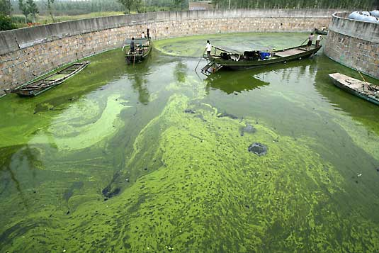
Factors in Algae Production
Sunlight
Temperature
Carbon Dioxide
Biological
Competition

Slide 5
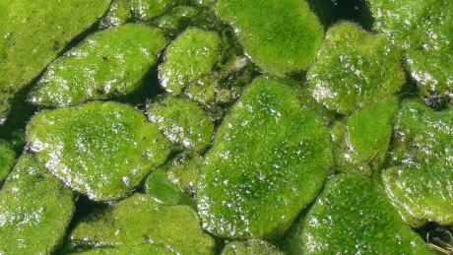
Sunlight
Photosynthesis increases with increased sunlight
  Solar saturation at
  200 µmol/m2/s
Too much increases evaporative losses
  California versus Virginia
    17% more land = 112% decrease in water use
    Net evaporative losses were negative in Virginia
Notes:
(Clarens, 2010)
Only require about 20% of direct sunlight, so greenhouse cover is possible to protect from evaporative losses

Slide 6
Factors in Algae Production
Sunlight
Temperature
Carbon Dioxide
Biological
Competition

Slide 7

Temperature
Optimal temp 28-35°C
  Varies with algal strain
University of Nevada – Cold tolerant strain
Ohio company –
  use waste heat
  to grow year
  round

Slide 8
Factors in Algae Production
Sunlight
Temperature
Carbon Dioxide
Biological
Competition

Slide 9
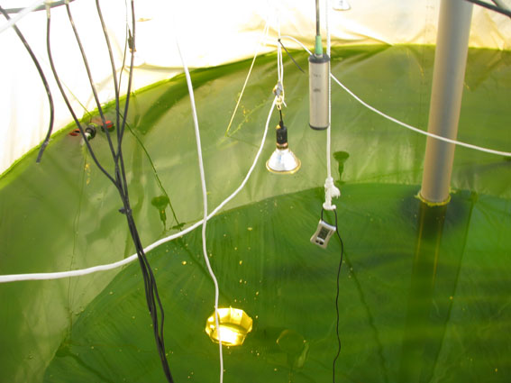
Carbon Dioxide Addition
Wastewater does not provide enough carbon
>30% increase in algae productivity
in pilot plant
CO₂ has been shown to
help algae maintain pH
  increases
  nutrient absorption
Notes:
Carbon dioxide has been shown to regulate the pH levels in algae ponds and also increases
nitrogen recovery by 19%

Slide 10
CO₂ Supply
Availability
  Coal plants – 2,400 MMT/yr
  Ethanol Plants – 25 MMT/yr
Cost of CO₂ capture:
  Coal - $21.23-90/tonne CO₂
  Corn Ethanol - $6-12/tonne CO₂
Extra cost due to scrubbing and separation
Notes:
Concentration of CO2 in flue gas of coal is only 12%, concentration in ethanol gas is 99%
Million Metric Tons
CO2 from ethanol fermentation is the cheapest source of CO2
Only 12 out of 140 ethanol plants in the United States currently capture and utilize carbon dioxide

Slide 11
CO₂ from Ethanol Fermentation
1 gallon – 2.85 kg CO₂
34.4 MMT/yr estimated 2020
2 tons algae fixes 1 ton CO₂
Location of algae farm is important!
Transport cost:
  $0.013 tonne CO₂/km
Example: 1000 acre facility Virginia
  Illinois to Virginia – 1163 km
    $15 tonne/CO₂
  CO₂ fixation – 160 tonne/acre/year
  $2.5 million year
Notes:
For every 1 gallon of ethanol produced, approximately 2.85 kg of carbon dioxide are released
By the year 2020, CO2 emissions from ethanol production should reach 34.4 MMT per year, providing a cheaper and easier to obtain source of carbon dioxide
Transport of CO2 is an issue over long distances…under one estimate, in order to provide a Virginia
Algae farm with the maximum amount of CO2, it would cost nearly $2.5 million/year
This example was used because the cost of capturing CO2 from coal fire plants, is still more expensive than capturing CO2 from ethanol plants and transporting it from Illinois to Virginia

Slide 12
Factors in Algae Production
Sunlight
Temperature
Carbon Dioxide
Biological
Competition

Slide 13
Case # 1: Algae Combined with WWT
Reduces water footprint
Wastewater contains nutrients for algae cultivation
Urine is roughly 1% of flow volume
  But provides 80% of Nitrogen and 50% of Phosphorus in wastewater
Nutrient removal accounts for 60-80% of energy use at WWT facilities
Excess N+P causes algal blooms
Notes:
Reduces the water footprint because the water is going to be treated anyway, and no additional water source is needed as with a stand alone algae production system
Sewage contains 3-7 C-N ratio
Nutrient removal requires energy and water inputs due to LCA of chemicals used in the nutrient removal

Slide 14
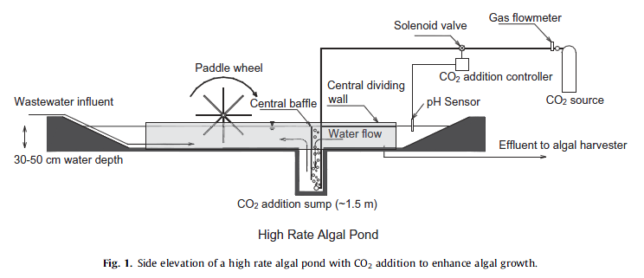
Open Pond System
Requires more land than bioreactors
More efficient
  35 million kWh over 30 year lifespan
Notes:
High rate algal ponds do require more land as compared to more common treatment methods, but they require less maintenance and lower initial capital investment
example of UK town of 25,000 people, saving 35 million kWh over 30 year life span
or nearly $5.5 million in electrical costs
This reduction in energy use would divert 500 tonnes of CO2 each year because of average of 0.43 kg CO2 per kWh in Europe

Slide 15

Current Developments
Victor Valley, California
Low-lipid algae – 45 g/m²/d
Biogas through AD
Electricity + Heat generation
Capital investment recovery in 6.5 years
  $800,000/yr energy costs
Notes:
A proposed project in VV, CA, believes that by using a low-lipid algae, they would be able to produce enough algal biomass, which would be converted to biogas through anaerobic digestion
this would combusted in a combined heat and power unit to generate electricity and heat for use on site, but it would also produce CO2 for algae production
They believe the project cost of $11 million would be recovered in 6.5 years, due to energy savings
Saving over $800,000 year in energy costs

Slide 16
Case #2: Integrated Biorefinery
Sioux City, Iowa – 50 mgy ethanol
1,000 acre pond size
  60% CO₂ abatement (100% at 2000 acres)
8.6 million gallons biodiesel
$30/gallon
75% of operating costs -> heating
Study did not address co-products
  Biomass -> biogas -> heating
Notes:
One study looked at the feasibility of an integrated biorefinery in Sioux City, Iowa in order to eliminate the need to capture and transport the carbon dioxide
This study decided on using a 1000 acre pond size would be able to fix 60% of carbon dioxide
Although a 2000 acre pond size could have a 100% abatement
Waste heat would provide some of the heat needed, but heating costs still make up the largest operating costs – nearly 75% of operating costs – dropping potential price to $7.50/gallon
This type of facility would be able to produce 8.6 million gallons of biodiesel, but at a price of $30/gal
The major issue is heating costs, if the algae would require less heat, there would be significant cost reduction
The study also did not address co-products from the biomass left after oil extraction
The study used a lipid content of 60% dry weight, leaving 40% dry weight – this could potentially be used to produce biogas through anaerobic digestion, which could then be combusted to produce heat and electricity for the facility

Slide 17
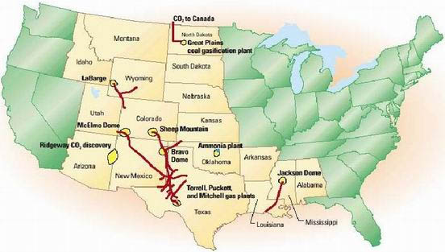
Prospects to increase viability
Carbon tax
  Increased investment
Carbon dioxide pipeline
Notes:
There are many future developments that could potentially increase the viability of algae for biofuels production
One of those could be carbon taxes which would provide emitters with another reason to invest in algal farms in order to prevent paying for their carbon emissions
A carbon dioxide pipeline would also be a very interesting possibility for the future because algae require carbon dioxide and warm weather

Slide 18

A Proposed CO₂ Pipeline
Algae Corridor
Notes:
A proposed pipeline system such as this would allow for the ethanol and coal plants in the midwest to send the CO2 produced at the locations to areas where algae production would be most cost effective
In the long run, a pipeline system would allow for cheaper transport of carbon dioxide, increasing the economic viability of commercial algae production
This would improve the economic viability of the algal production system by eliminating at least part of the heating requirements for algal growth
Not to mention help with drying the algal biomass for processing

Slide 19
Conclusion
Currently, algae biofuel production is only viable on a local scale
  WWTP for biogas -> electricity and heat
Significant capital investment will be required
  Carbon Dioxide pipeline
Co-products may offer best future
  Biomass -> biogas
  Feed - $20,000/ton compared to $100/ton
Notes:
Looking at current studies, the only economically viable use of waste for algae production is on a small scale at wastewater treatment facilities in order to produce biomass for biogas combustion in order to generate electricity and heat
The significant capital costs, as well as nutrient and CO2 delivery costs, are also a large barrier to the economic viability of algal biofuel production
As with the issues concerning the solar and wind corridors, there is also an algae corridor
If there is significant public investment in a CO2 pipeline, CO2 delivery costs would be reduced, making all forms of algal production more economically viable

