Slide 1
Quantum Glass Battery Technology
Arthur Mazzeo
amazzeo2@illinois.edu
Department of Nuclear, Plasma, & Radiologial Engineering
University of Illinois at Urbana-Champaign

Slide 2
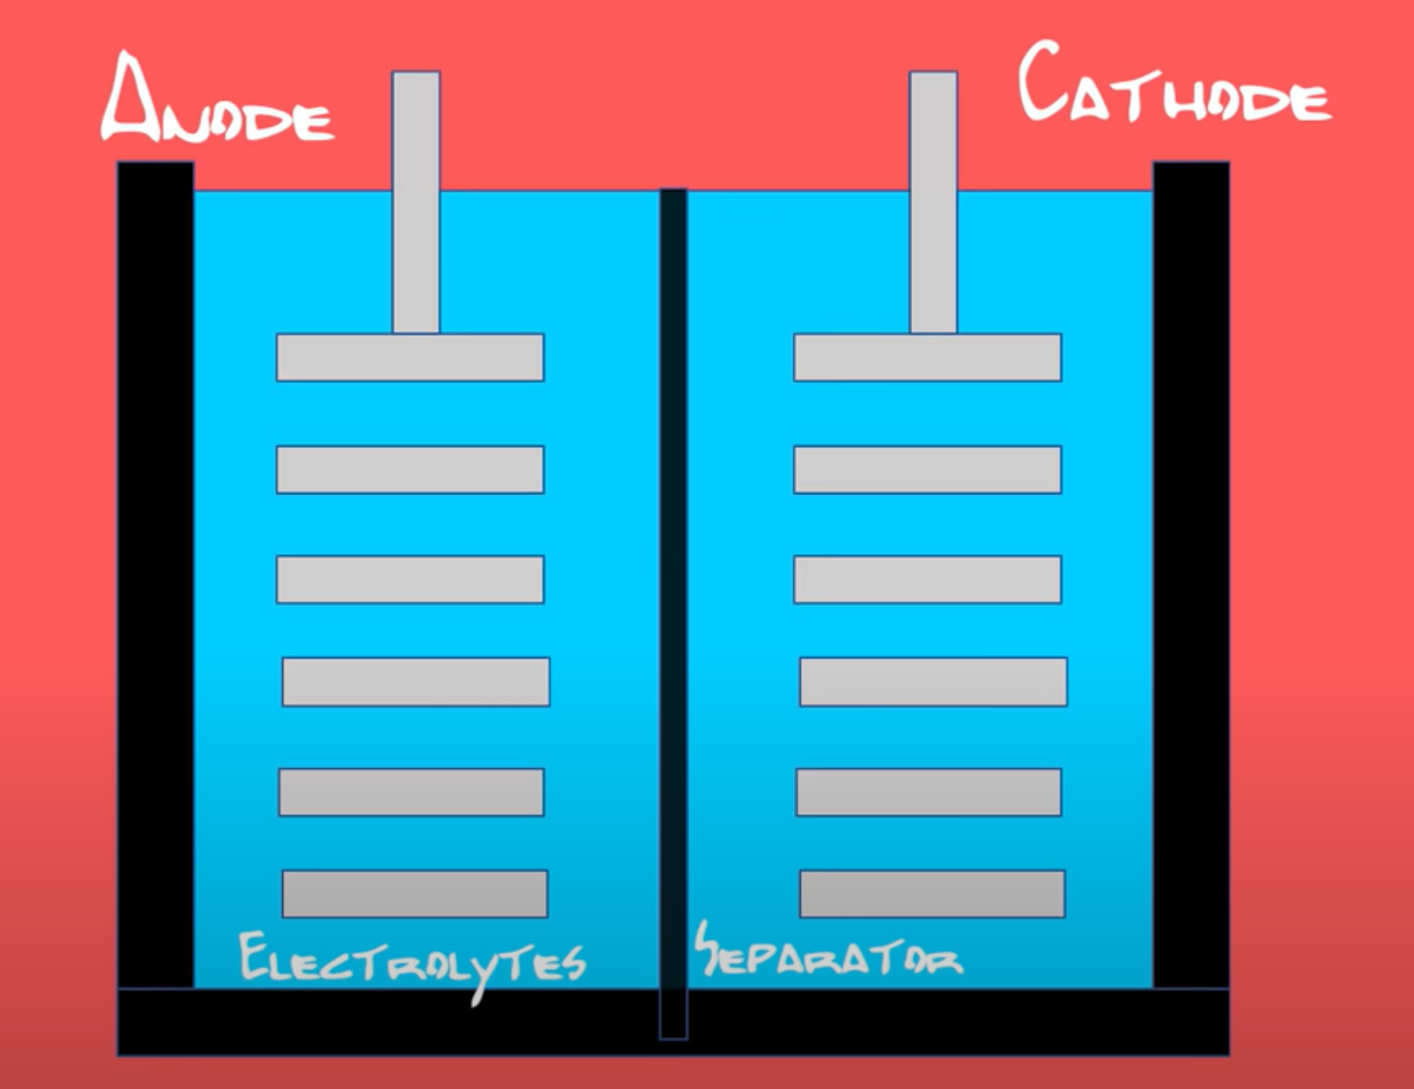
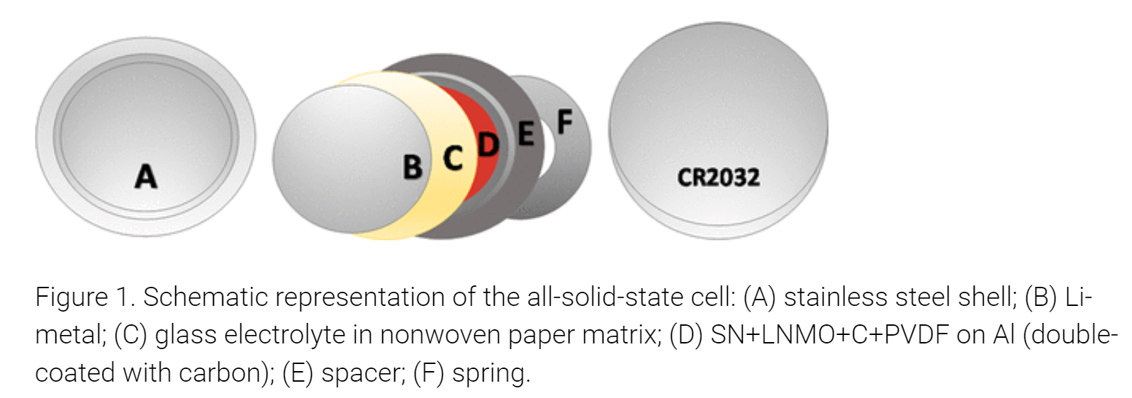
Structural Comparison:
Li-ion vs Quantum Glass
Lithium metal oxide cathode
Graphite anode
Liquid/polymer electrolytic solution
Lithium/sodium cathode
Alkali metal anode
Glass electrolyte

Slide 3
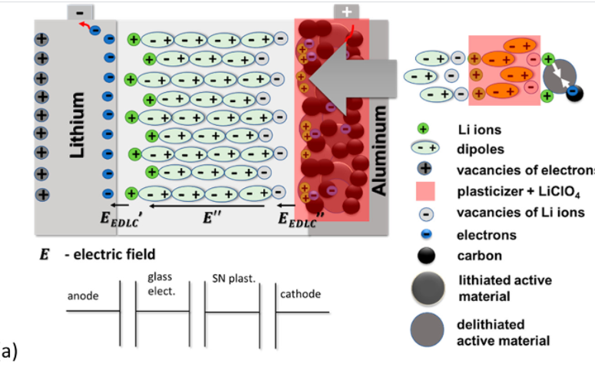
Advantageous Properties: Energy Density
In John Goodenough’s original 2017 paper:
  Energy density 3 TIMES GREATER than contemporary Li-ion batteries
  The battery has significantly more surface area for ions to pass through at a faster rate than traditional batteries, resulting in the increased storage space within similar space

Slide 4
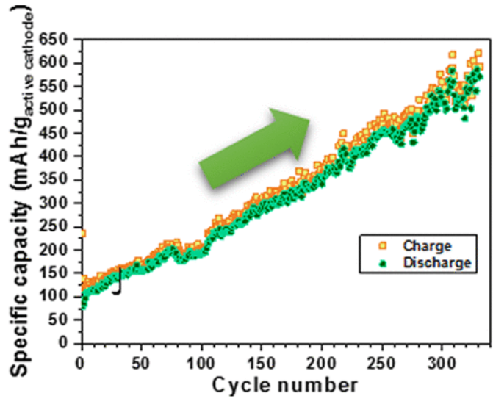
Advantageous Properties: Charging/Lifetime
Goodenough and Maria Braga’s successive paper reported that:
  Their latest battery increases its capacity over 300 cycles
    “their glass electrolyte is a ferroelectric material—a material whose polarization switches back and forth in the presence of an outside field. So charge-discharge cycles are effectively jiggling the electrolyte back and forth and perhaps, over time, finding the ideal configuration of each electromagnetic dipole”
  Capable of 23,000 charging/discharging cycles!
    Contemporary Li-ion batteries can charge for a few thousand cycles before seeing problems
    23,000 cycles is equivalent to charging your phone to 100% every night for 63 years

Slide 5
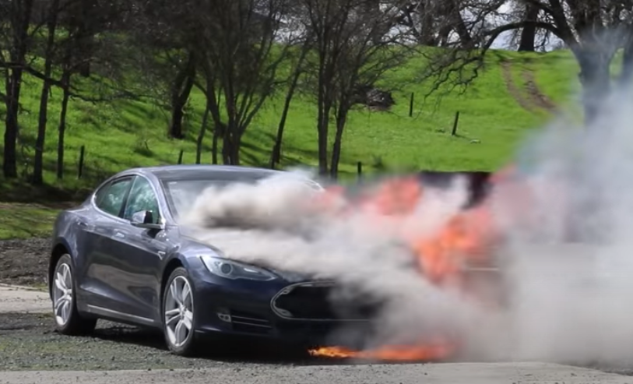
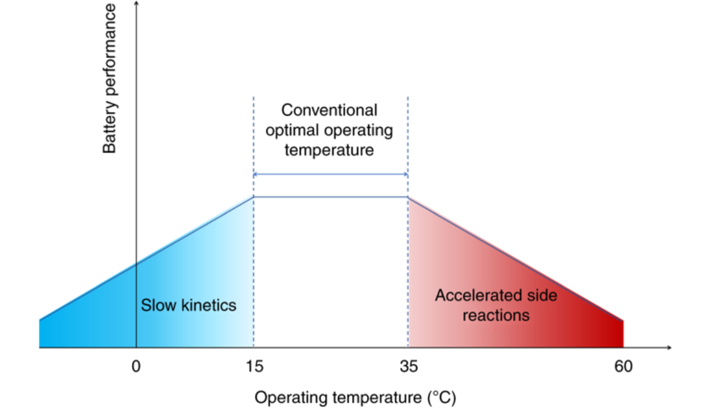
Advantageous Properties: Safety & Operation
Liquid electrolyte solution in Li-ion batteries is flammable
  Lithium dendrites grow from cathode into electrolyte
  If exposed to enough heat, dendrites can combust in the liquid electrolyte
Quantum glass batteries get rid of this risk altogether by eliminating the liquid with a solid (the glass is non flammable)
Operating temperature of a quantum glass battery goes as low as -20ºC
  Significantly lower than Li ion batteries (10ºC – 55ºC)

Slide 6
Skepticism
The latest results from Goodenough and Braga have seen criticism for 2 main reasons
  Problem 1: The batteries defy the laws of thermodynamics
    In the paper, both cathode and anode were covered in the same, pure alkali metal, which shouldn’t be able to make a reaction, so energy is appearing from nothing
    Goodenough corrected this criticism by stating the lithium on the cathode is thin enough to prevent this problem
  Problem 2: The battery shouldn’t increase in capacity over time
    The battery doesn’t really get better over time, it already has a set max capacity that it eventually reaches

Slide 7
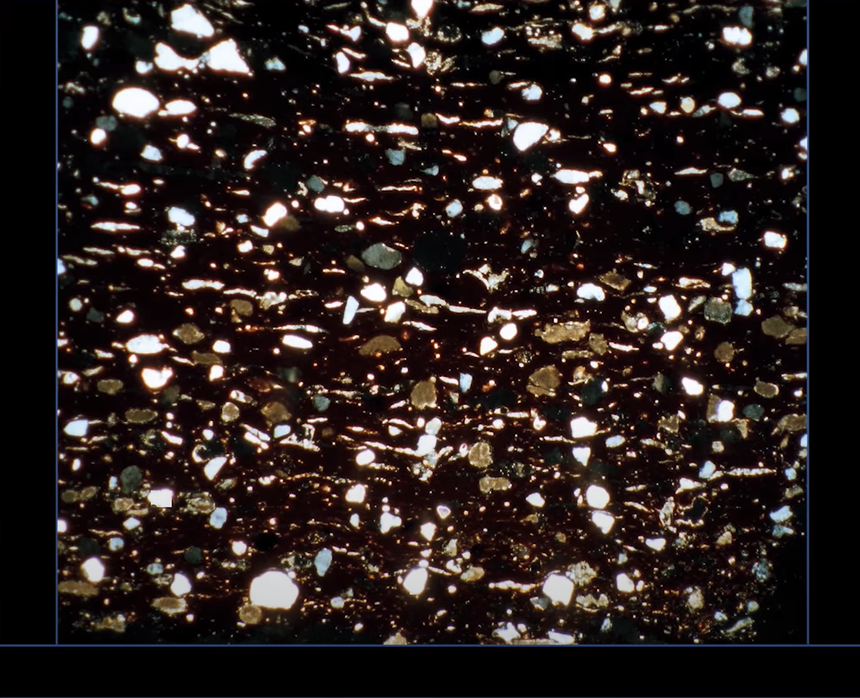
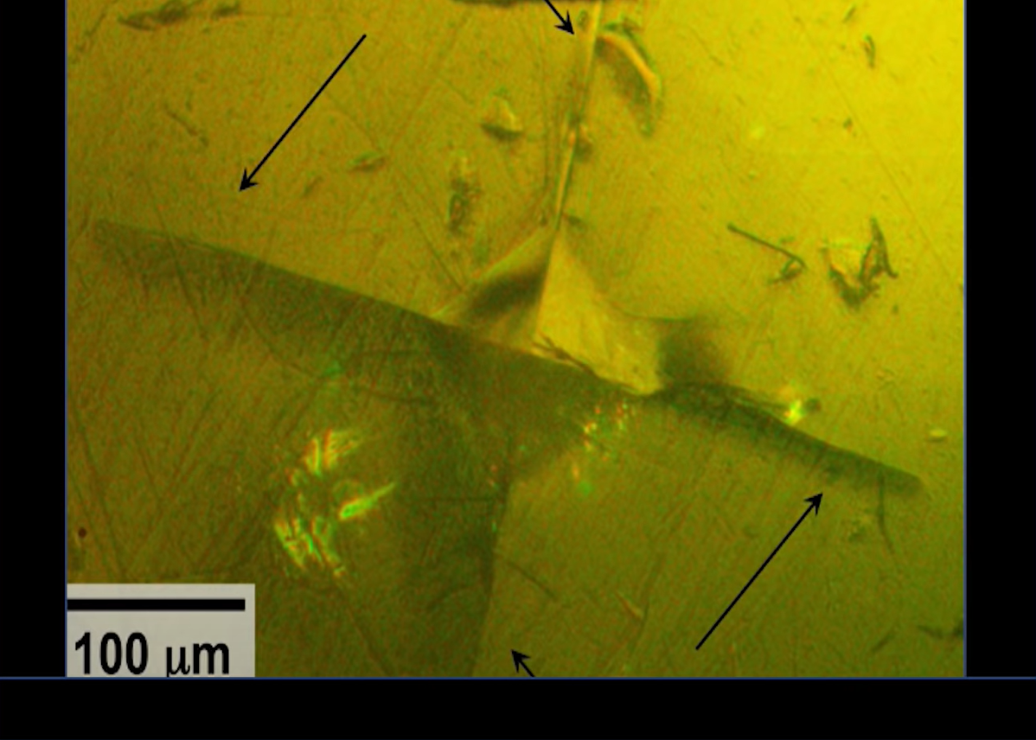
Alternative Solid-State Batteries
Other solid materials can be used as the electrolyte, the 2 most popular being:
  Ceramics
  Lithium sulfide
Both retain the same properties as the glass battery, but not to the same extent

Slide 8
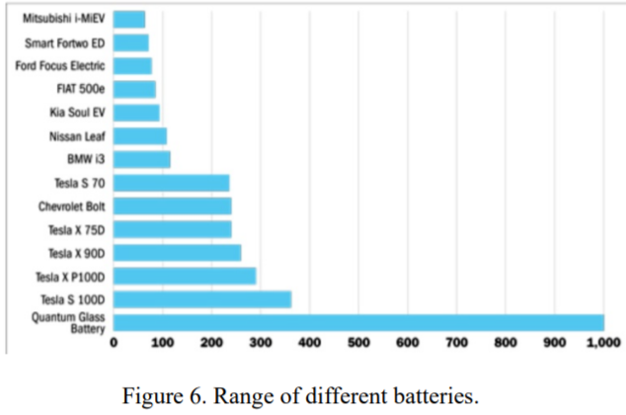
Electric Vehicle Applications
Reports say that the quantum glass battery can take an EV 1,000 miles on a single charge (which can then be recharged in about 60 seconds)
Range is also increased through wider range of operation temperatures
EVs won’t have the risk of exploding due to heat exposure
  No temperature monitoring system required = less weight of car
Glass batteries cam become cheaper to make and can be produced at a faster rate, which will be reflected in EV prices

Slide 9
Future of Quantum Glass Batteries
Many companies (Dyson, Samsung, QuantumScape, Toyota, Panasonic…) are investing billions of dollars into developing quantum glass/solid-state batteries
Braga predicted glass batteries to be used in the first commercial products by 2022
Braga/Goodenough also predict that large battery banks will have higher capacities with less weight
Global race to develop solid-state battery technology across many industries
Mass production (and thus cheaper prices) are most likely a few years down the line as the manufacturing process for solid-state batteries is very different
Quantum Glass batteries most likely to come after 1st generation of solid-state

Slide 10
Sources
https://www.mragheb.com/NPRE%20498ES%20Energy%20Storage%20Systems/Quantum%20Glass%20Battery.pdf
https://spectrum.ieee.org/energywise/energy/environment/a-glass-battery-that-keeps-getting-better
https://pubs.acs.org/doi/full/10.1021/jacs.8b02322
https://news.utexas.edu/2017/02/28/goodenough-introduces-new-battery-technology/
https://www.x-mol.com/paper/5749547
https://www.youtube.com/watch?v=oPh2879pyw0&t=770s

