Slide 1
Innovations and Challenges in Wind Energy for Sustainable Development
By: Ato Barnes

Slide 2
Agenda
Introduction
Development of wind markets
Driving Factors in Wind Energy Growth
Risk Management in Distributed Wind Energy
Conclusion and Recommendations
Q&A

Slide 3
Introduction
Global need for renewable energy to combat climate change.
Wind energy as a frontrunner due to scalability, cost efficiency, and environmental benefits.
Focus of the presentation:
Growth of wind energy markets.
Key drivers of wind energy adoption.
Risks and challenges in distributed wind systems.

Slide 4
Development of Wind Energy Markets
(Historical Trends)
Significant growth in the European Union (EU) from 2000 to 2017.
Leading contributors: Germany, Spain, and the United Kingdom.
Average annual installed capacity in Germany: 2,953 MW.

Slide 5
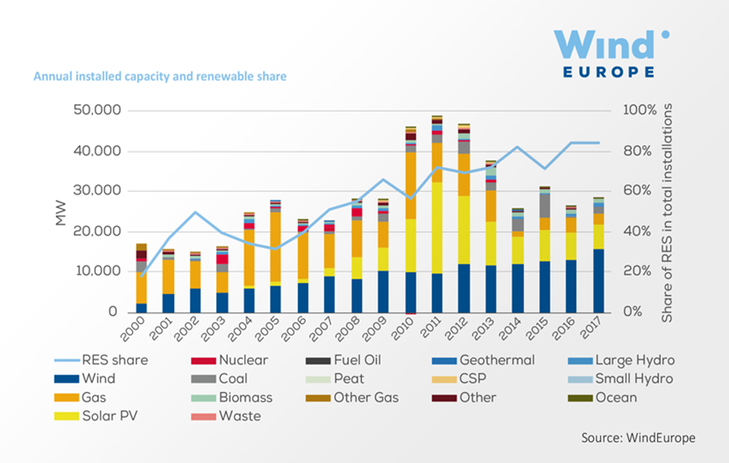
Development of Wind Energy Markets
(Policy and Technological Contributions)
EU renewable energy directives and subsidies.
Advancements in wind turbine technology:
Higher capacity turbines.
Offshore wind farms reducing costs.

Slide 6
Driving Factors in Wind Energy Growth
(Economic and Policy Drivers)
Strong policies in Denmark and Portugal led to high renewable energy shares.
Rapid expansions in China and India driven by increasing energy demands.
Declining generation costs enhancing adoption globally.

Slide 7
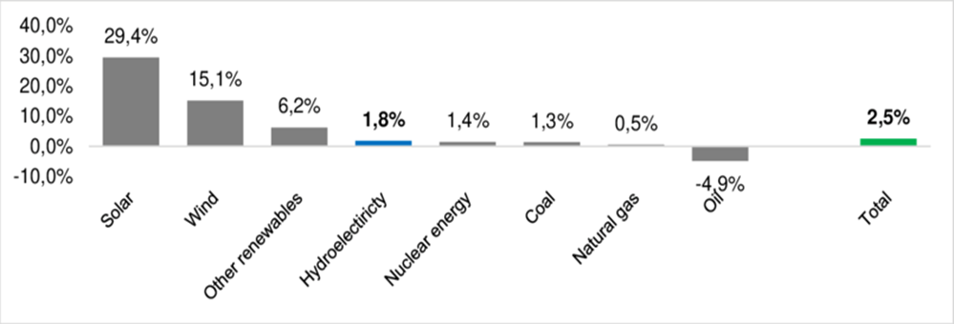
Driving Factors in Wind Energy Growth
(Technological Innovations)
Larger rotor diameters and offshore capabilities.
Decline in Levelized Cost of Energy (LCOE).
Improved competitiveness of wind energy compared to fossil fuels.

Slide 8
Importance of Recent Trends
CAGR highlights the significant role of wind energy in recent years.
Reflects dynamic growth patterns and technological advancements.
Ensures wind energy’s position as a key player in global energy transitions.

Slide 9
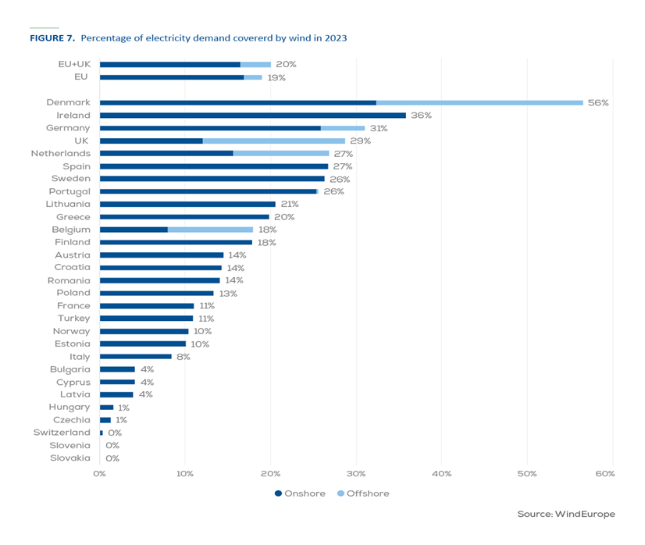
Percentage of Electricity Covered by Wind
Key insights:
Denmark and Portugal leading with a cumulative average of over 40% of electricity demand met by wind.
Highlights disparity between developed and developing regions.
Emphasis on storage technologies for consistent energy supply.

Slide 10
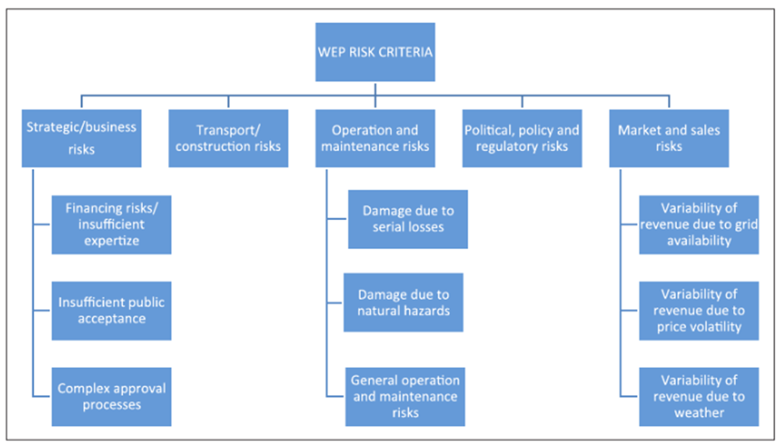
Risk Management in Distributed Wind Energy
Categories of Risks
Political Risks: Uncertainty in subsidies and regulations.
Economic Risks: High initial costs and electricity pricing variability.
Technical Risks: Grid integration and maintenance challenges.
Social Risks: Public resistance (e.g., noise, aesthetics).

Slide 11
Addressing Risks
Mitigation Strategies
Implement long-term pricing policies.
Invest in community engagement programs.
Develop cost-effective and reliable technical solutions.
Enhance maintenance frameworks and environmental planning.

Slide 12
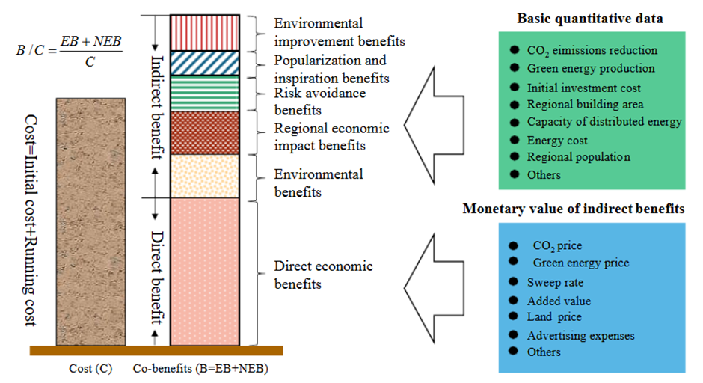
Cost-Benefit Analysis
Evaluating distributed wind systems for localized energy access.
Balancing initial costs with long-term benefits.

Slide 13
Conclusion
Wind energy is vital for a sustainable energy future.
Key drivers include supportive policies, technological advancements, and environmental priorities.
Risks can be managed through strategic planning and collaboration.

Slide 14
Recommendations
Strengthen international and regional policies to attract investments.
Promote technological innovation for distributed systems.
Engage communities to foster public support.
Establish robust risk management frameworks.

Slide 15
Q&A
Questions?
Thank you for your attention!

