Slide 1
Solar Powered Methane Production
Augy Cirame
© of Augy Cirame

Slide 2
Agenda
Solar Collector
Carbon Capture
Methane Production

Slide 3
Introduction
Solar power represents a lucrative free heat source, but has yet to be fully harnessed for humanity’s benefit.
© of Augy Cirame

Slide 4
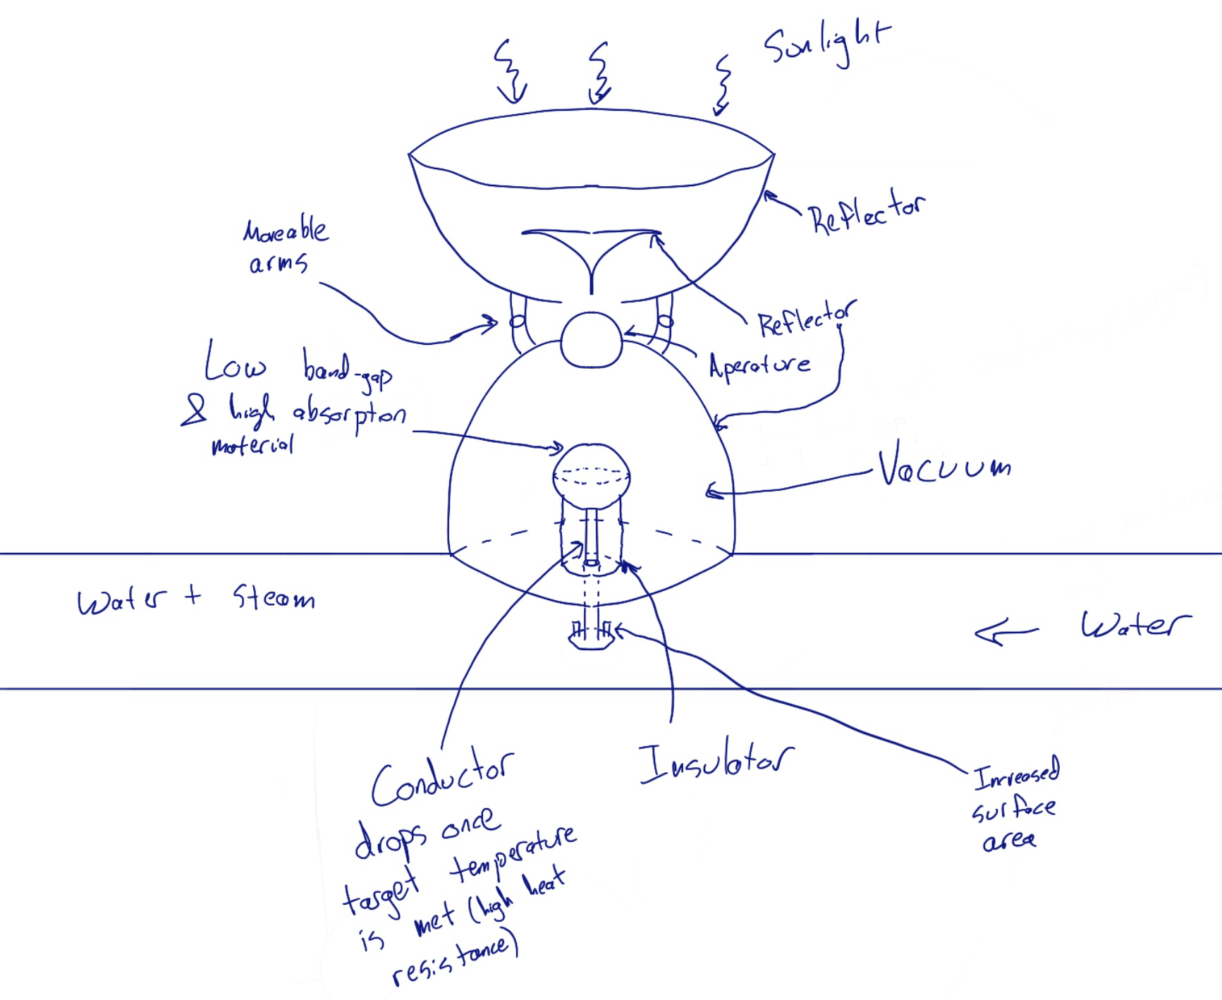
Solar Energy Collection
Focuses energy on target area
Target area temporarily stores energy
Convection, Conduction, and Radiation minimized
Reintroduce conduction for heat transfer
Increased heat exchange due to high temperature gradient
© of Augy Cirame

Slide 5
Passive Carbon Capture
© of Augy Cirame

Slide 6
Carbon Chemistry
Oxidation state of carbon
Sabatier Reaction
Lots of energy required to reduce carbon
© of Augy Cirame

Slide 7
Proposed Reaction for Carbon Reduction
© of Augy Cirame

Slide 8
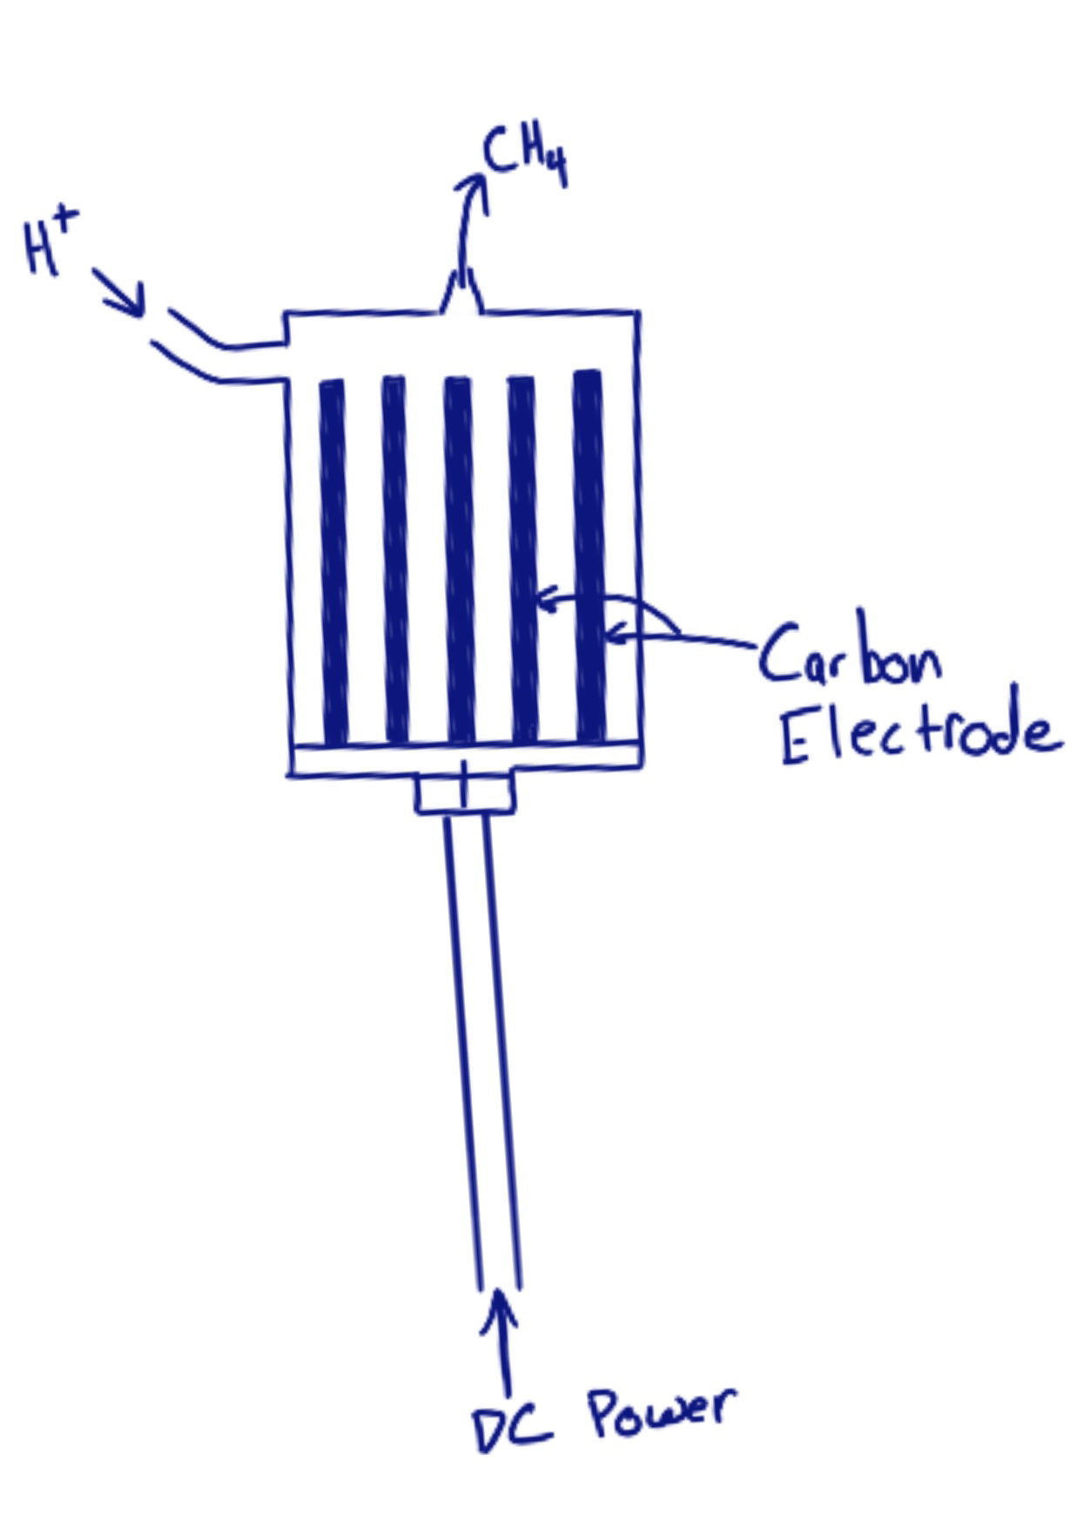
Methane Production
About 200 kJ/mol for Q — rough estimate
© of Augy Cirame

Slide 9
Schematic
Solar Energy
Grid
Steam
Turbine
Water
Heat
Electricity
Magnesium and Methane Combustion
Methane Production
© of Augy Cirame

Slide 10
Efficiency
Assuming 200 kJ/mol of methane produced, and about 900 kJ/mol of energy released upon burning
450% efficiency is obtained by this process
If the energy (800 kJ/mol) from the combustion of magnesium is factored into the efficiency, it gets bumped up to 850%

Slide 11
Economic Analysis
Material | Molar Ratio | Kg/mol | Cost/mol
NaOH | 1 | 40 | -$616
HCl | 1 | 36 | -$1,130
Magnesium | 2 | 48 | -$48
NaCl | 1 | 58 | +$613
Magnesium Oxide | 1 | 40 | +$357
Short term analysis is difficult due to no precedent, can assume high capital cost
In the long run when the cost of production approaches the cost of operation, the analysis looks promising.
The cost of producing one mol of methane is about $800, which will have to be offset by selling excess electricity (800 kWh at 10 cents per kWh)

Slide 12
Conclusion
Methane production is not necessarily economic by itself, secondary revenue streams must be leveraged to sufficiently drive the cost of production down, about 1 MW of electricity needs to be produced for every one mol of methane produced
Other carbon capture techniques could be more cost effective than the one outlined, the technique used does not matter as long as the carbon dioxide or carbon black are sourced from the carbon in the atmosphere, buying CO2 directly is one option
Using magnesium to reduce carbon significantly reduces the energy required to produce methane

Slide 13
Thank You! Questions?

Slide 14
The way to get started is to quit talking and begin doing.
Walt Disney

Slide 15
Team
Name
Name
Name
Name
Title
Title
Title
Title

Slide 16
Timeline
Title
To start a presentation, go to the Slide Show tab, and select From Beginning.
Title
To display Presenter view, in Slide Show view, on the control bar at the bottom left select the three dots, and then Show Presenter View.
Title
During your presentation, the speaker notes are visible on your monitor, but aren't visible to the audience.
Title
Title
If you don’t see the Notes pane or it is completely minimized, click Notes on the task bar across the bottom of the PowerPoint window.
The Notes pane is a box that appears below each slide. Tap it to add notes.

Slide 17
Content
Subtitle
Subtitle
Add text, images, art, and videos.
Add transitions, animations, and motion.
Save to OneDrive, to get to your presentations from your computer, tablet, or phone.
Open the Design Ideas pane for instant slide makeovers.
When we have design ideas, we’ll show them to you right there.

Slide 18
Content 2
Subtitle
subtitle
subtitle
Add text, images, art, and videos.
Add transitions, animations, and motion.
Save to OneDrive, to get to your presentations from your computer, tablet, or phone.
Open the Design Ideas pane for instant slide makeovers.
When we have design ideas, we’ll show them to you right there.
Add text, images, art, and videos.
Add transitions, animations, and motion.
Save to OneDrive, to get to your presentations from your computer, tablet, or phone.
Open the Design Ideas pane for instant slide makeovers.
When we have design ideas, we’ll show them to you right there.
Add text, images, art, and videos.
Add transitions, animations, and motion.
Save to OneDrive, to get to your presentations from your computer, tablet, or phone.
Open the Design Ideas pane for instant slide makeovers.
When we have design ideas, we’ll show them to you right there.

Slide 19
Summary
With PowerPoint, you can create presentations and share your work with others, wherever they are. Type the text you want here to get started. You can also add images, art, and videos on this template. Save to OneDrive and access your presentations from your computer, tablet, or phone.

Slide 20
Thank You
Presenter name
Email address
Website address

