Slide 1


Gravitational Potential Energy Storage
Presented by Austin Lenzi
04/30/2021

Slide 2

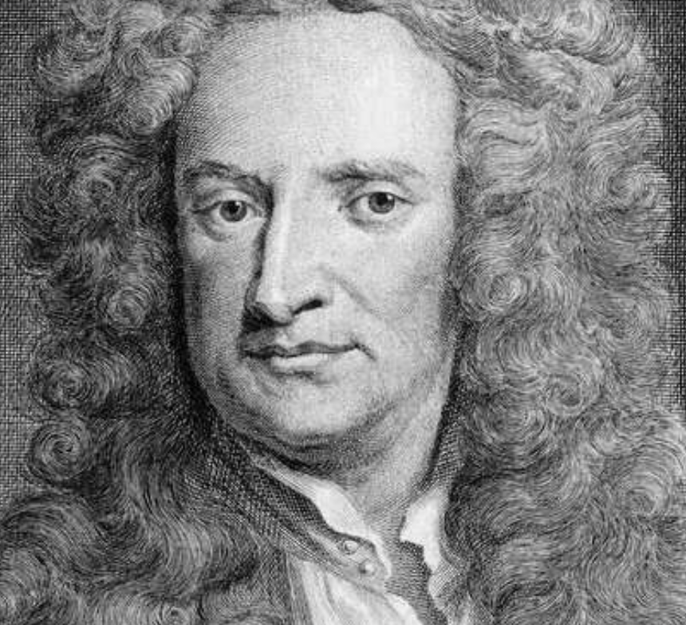
Introduction
Solar and Wind Power
  Solar equipment prices dropped by 89% since 2010
  Wind Turbine prices decreased by ~$1,000 since 2010
  Main issue: intermittency
Gravitational Potential Energy
  Inspired by hydropower
  Long-duration storage method based on gravitational and kinetic energy
  Crane system with concrete bricks
DEPARTMENT / UNIT NAME
GRAINGER ENGINEERING

Slide 3
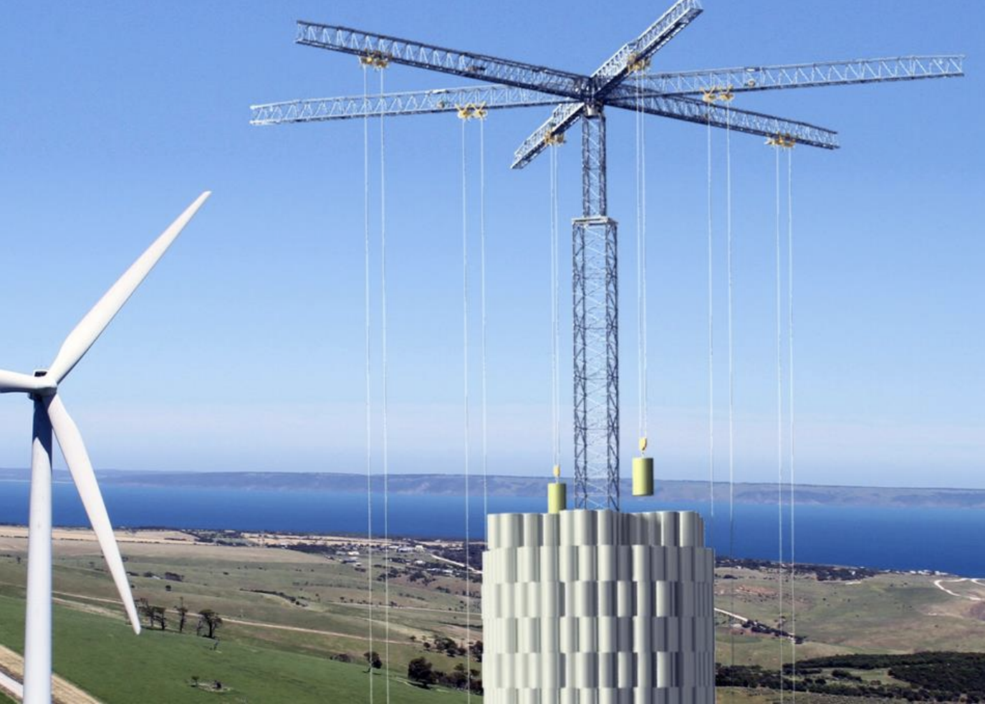
How it Works
Similar to hydropower
6 arm crane
5,000 concrete blocks
35 tonnes total
33 stories
Potential and Kinetic
Energies
DEPARTMENT / UNIT NAME
GRAINGER ENGINEERING

Slide 4
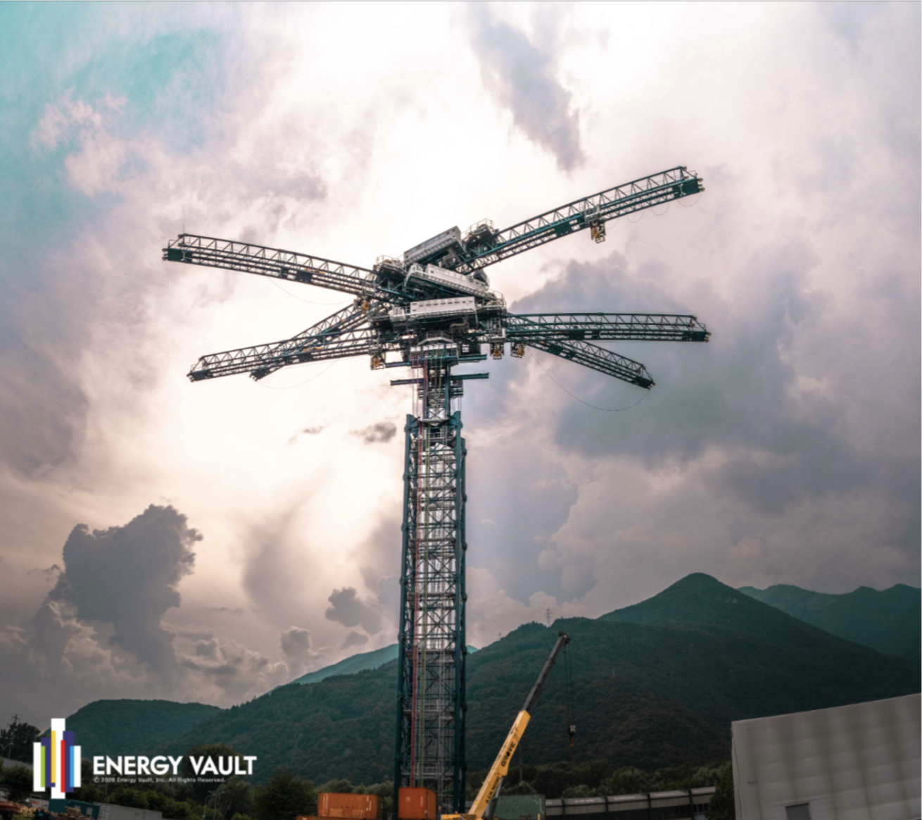
Energy Vault
Switzerland-based
20-80 MWh storage capacity per system
Commercial Demonstration Unit completed 2020
DEPARTMENT / UNIT NAME
GRAINGER ENGINEERING

Slide 5
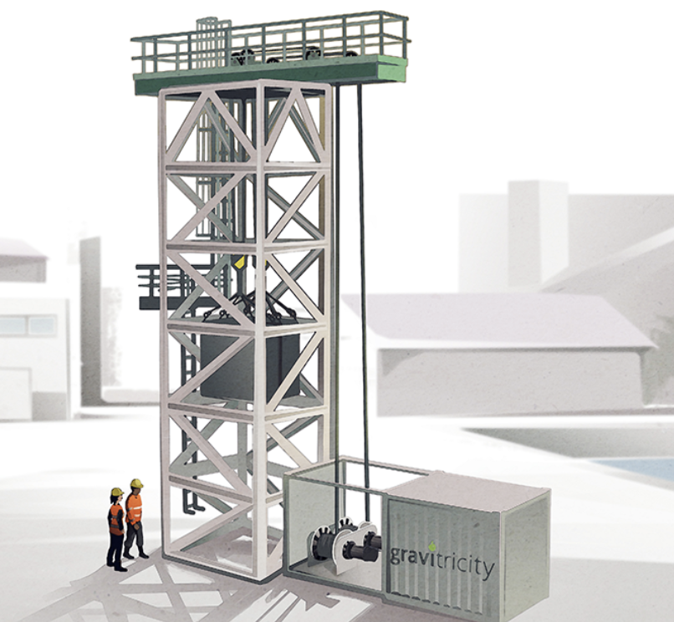
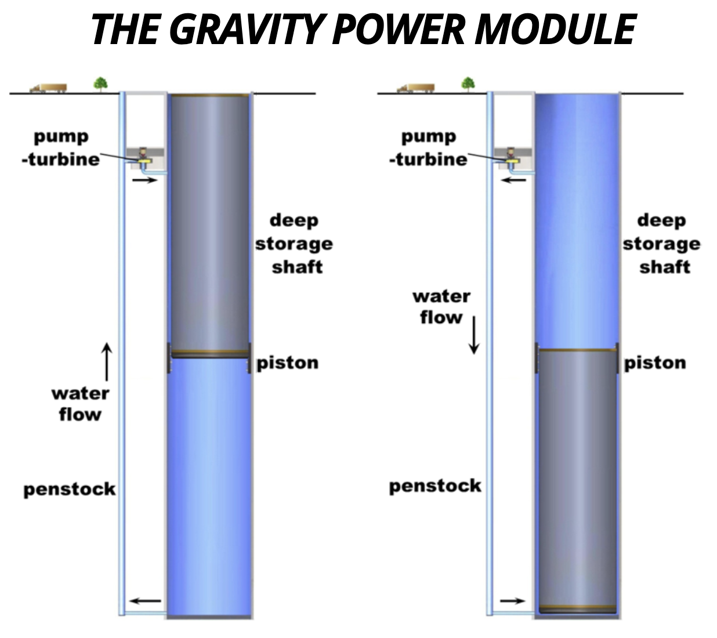
Gravitricity and Gravity Power
DEPARTMENT / UNIT NAME
GRAINGER ENGINEERING

Slide 6
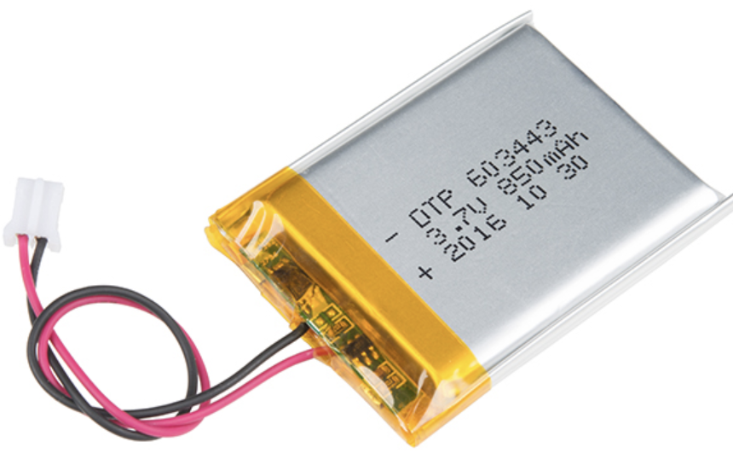
Comparison to Other Technologies
Lower cost than pumped hydro plants
50% cheaper than lithium-ion batteries
Shorter ramp rate
~90% round-trip efficiency
DEPARTMENT / UNIT NAME
GRAINGER ENGINEERING

Slide 7

Future Prospects
Still relatively new technology
Tata Power in India
Future mostly depends on economics
  LCOS of $0.05/kw hr in gravitational methods
  LCOS of $0.17/kw hr in pumped hydro methods
  LCOS of $0.30/kw hr in lithium-ion batteries
DEPARTMENT / UNIT NAME
GRAINGER ENGINEERING

Slide 8
References
http://ragheb.co/NPRE%20498ES%20Energy%20Storage%20Systems/Gravitational%20Potential%20Energy%20Storage.pdf
https://energyvault.com/commercial-demonstration-unit/
https://gravitricity.com/
http://www.gravitypower.net/technology-gravity-power-energy-storage/
https://www.tatapower.com/
DEPARTMENT / UNIT NAME
GRAINGER ENGINEERING

