Slide 1


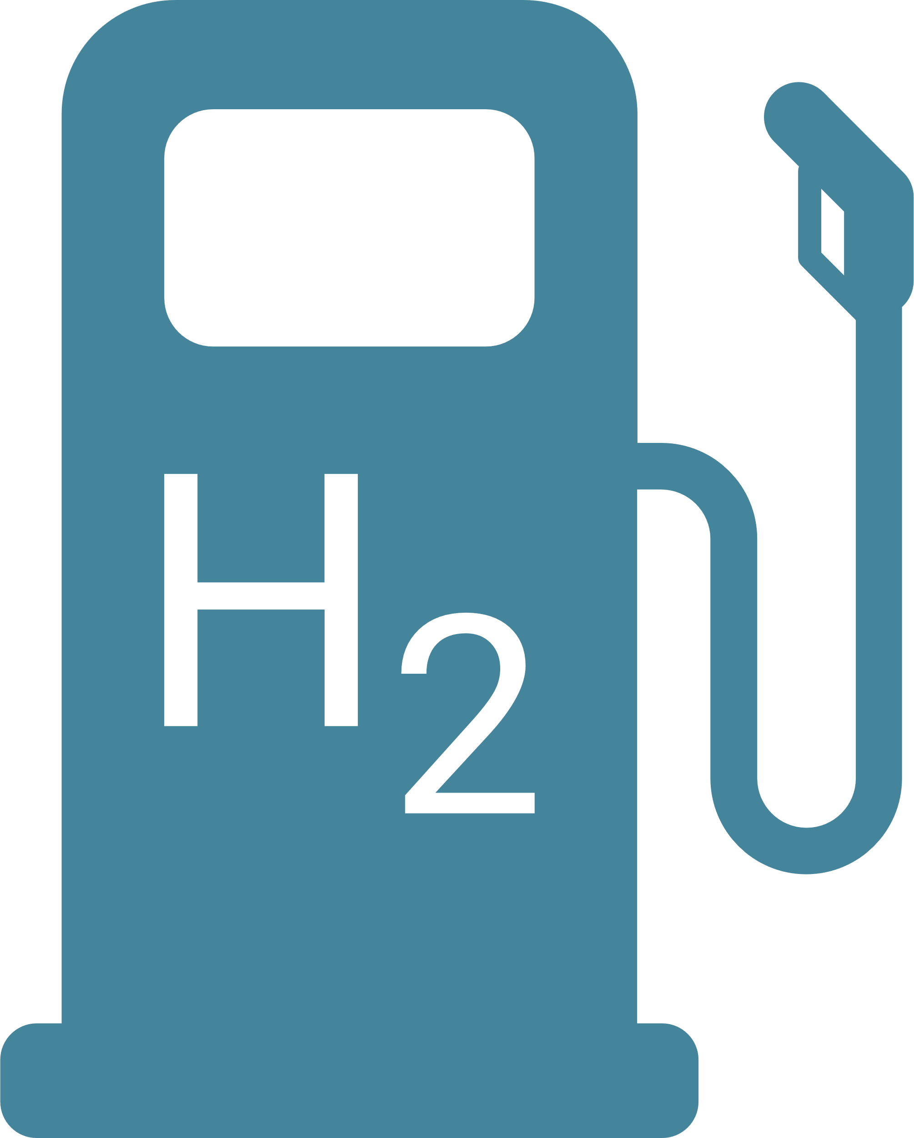
Nuclear Hydrogen Production
Binish Fatima Basathia - MEng Energy Systems

Slide 2



Nuclear Power: The Advantages
High-capacity factor
The specific energy produced by nuclear fission of U-235 is 79,390,000 MJ/kg
High reliability
High energy density
Fuel type
Specific Energy [MJ/kg]
Coal
30
High specific energy
Oil
42
Natural Gas
53.5
Clean fuel
Lithium
43
  https://www.energy.gov/ne/articles/nuclear-power-most-reliable-energy-source-and-its-not-even-close
  https://whatisnuclear.com/energy-density.html

Slide 3
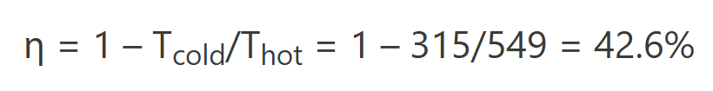















Carnot efficiency for a heat engine:
(IDEAL)
  Higher hot reservoir temperature?
  Boiling of primary coolant!!
  High pressure!!
  Metallurgical limits!
REAL Heat Engine
Not done infinitely slowly
Frictional losses
Other heat losses
Can we increase efficiency somehow?
  https://www.nuclear-power.com/nuclear-engineering/thermodynamics/laws-of-thermodynamics/thermal-efficiency/thermal-efficiency-of-nuclear-power-plants/
Hot reservoir
Super Critical Water Reactors (SCWR)
> 22.1 MPa
Typical steam temperature: 275.6C = 549K
Cold reservoir
Typical condenser temperature: 41.5C = 315K

Slide 4

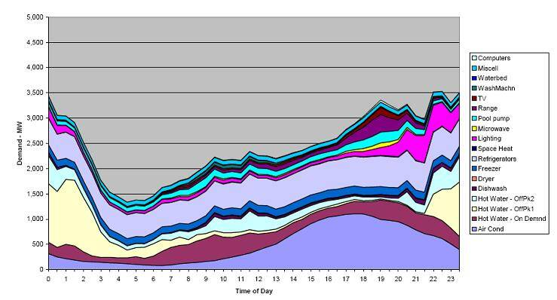
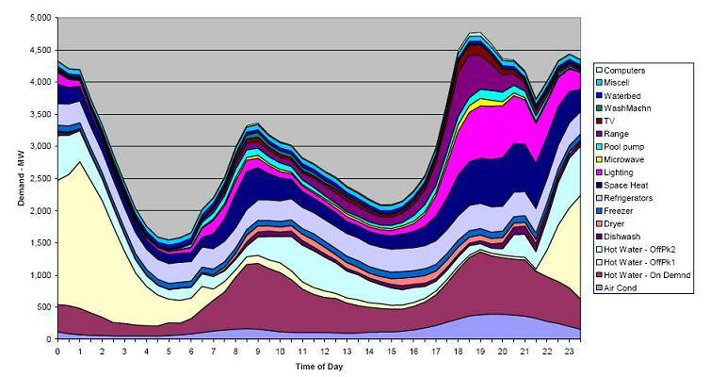
Nuclear Power Plants: The Challenges
Low Efficiency
No load following
Shutdown time
Summer load curve for houses in NSW
Fuel is expensive
Fuel safety
Winter load curve for houses in NSW
  https://www.solarchoice.net.au/blog/how-do-i-use-electricity-throughout-the-day-the-load-curve/

Slide 5



The hydrogen economy
Hydrogen fuel-cell based vehicles
Energy storage medium
Energy transmission medium

Slide 6

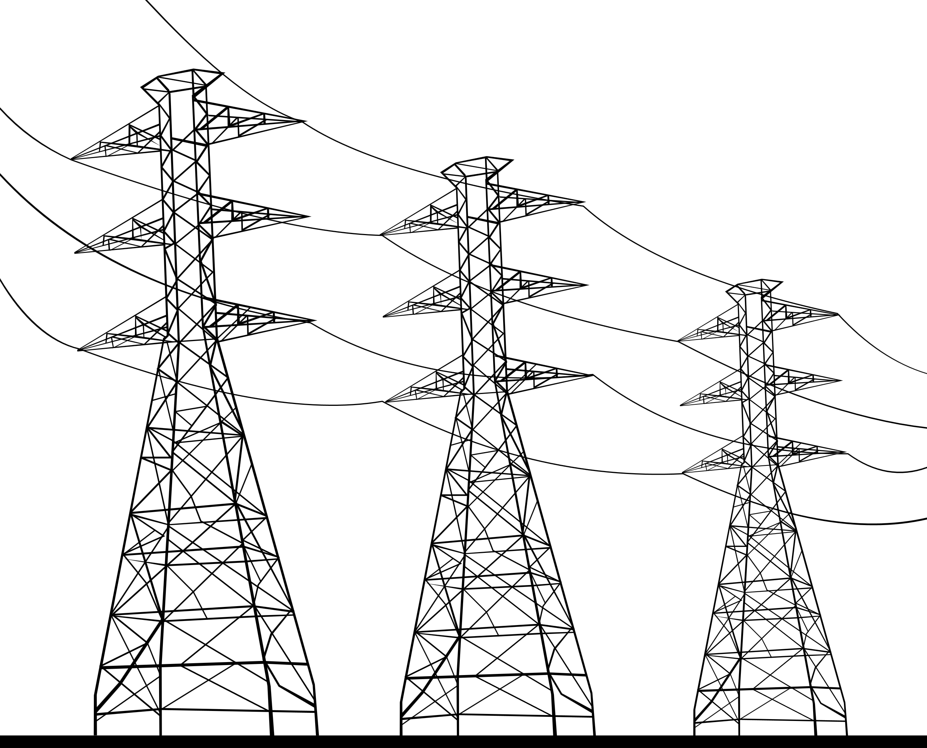



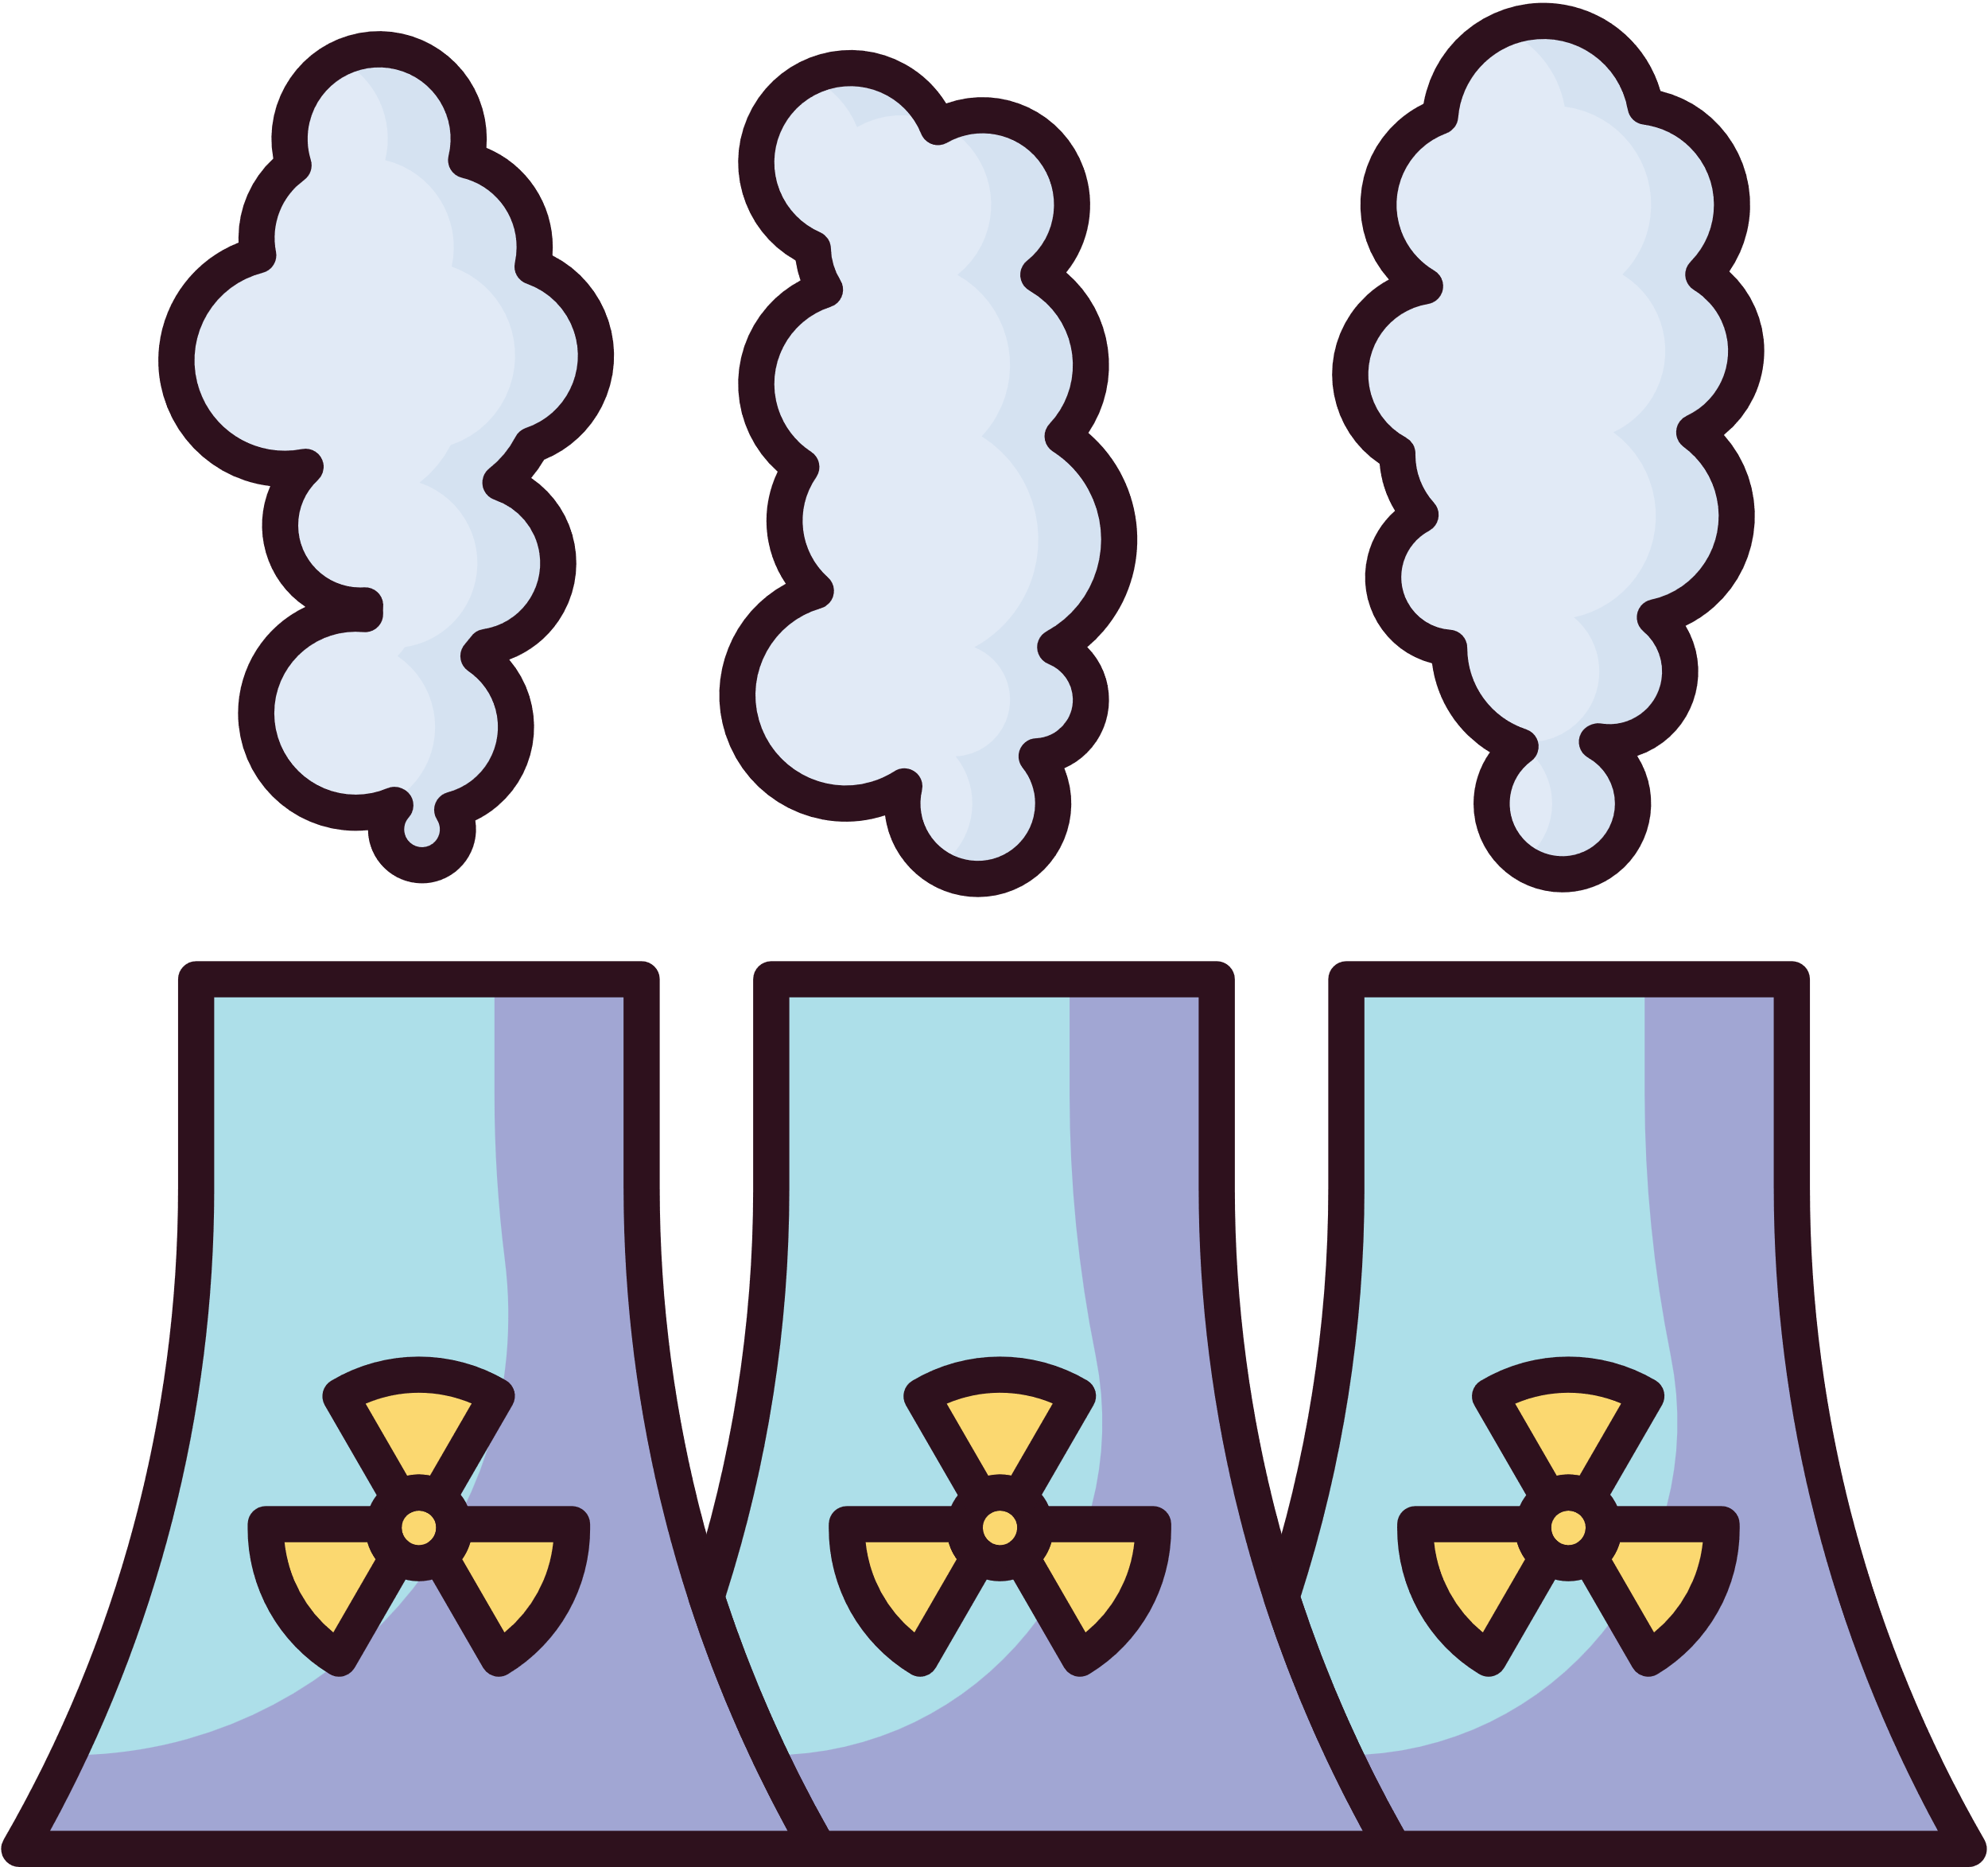






Potential of Hydrogen and Energy cogeneration at Nuclear Power Plants
Steam
Electricity
Grid
Steam Turbine
Nuclear reactor
Steam
High Temperature Electrolyzer cell
Produced Hydrogen
Energy production flexibility
Capitalizing Hydrogen Market
Increased power plant efficiency
Around 10% increase in net energy efficiency[2]
  Frick, Konor, et al. "Technoeconomic assessment of hydrogen cogeneration via high temperature steam electrolysis with a light-water reactor." Applied Energy 306 (2022): 118044.
  Kowalczyk, Tomasz, Janusz Badur, and Mateusz Bryk. "Energy and exergy analysis of hydrogen production combined with electric energy generation in a nuclear cogeneration cycle." Energy Conversion and Management 198 (2019): 111805.

Slide 7
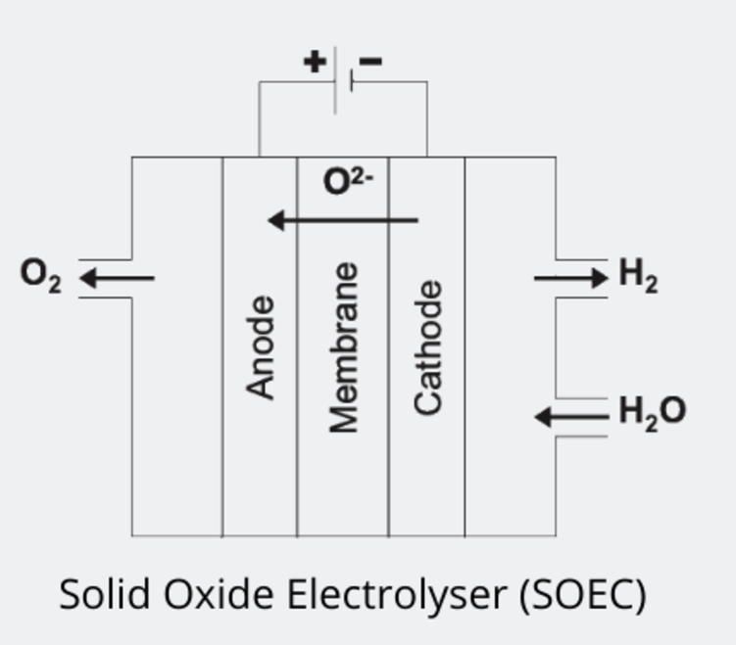

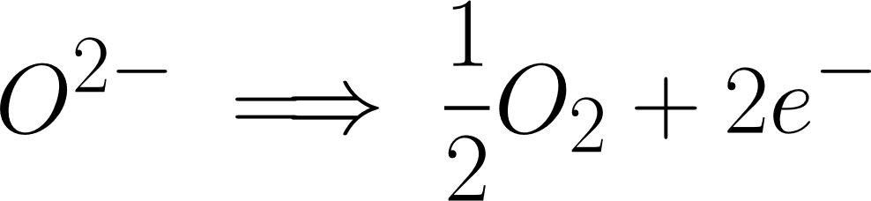
Operating temperature: 600 - 900C
Solid Oxide Electrolysis Cells for High Temperature Electrolysis
Pure
Hydrogen
Oxide ions pass through the membrane
Steam
Cathode:
Solid Oxide Electrolyte
Anode:
  https://www.youtube.com/watch?v=fLm0SA1gfWY
  https://www.youtube.com/watch?v=5XFQeHJHWJY

Slide 8

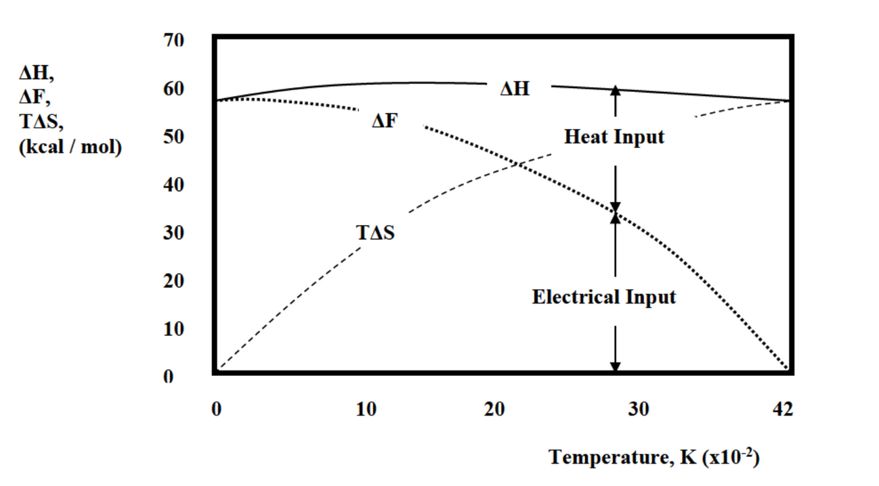



Energy breakdown for electrolysis
Thermal energy provided
Entropy change
Energy required for electrolysis
Required Electrical Energy
  Magdi M. Ragheb and Behzad Salimi, “Catalyzed Deuterium-Deuterium and Deuterium?Tritium Fusion Blankets for High Temperature Process Heat Production,” Nuclear Technology/Fusion, Vol. 2, pp. 55-72, Jan. 1982.

Slide 9

If we could create higher temperatures
  Different primary coolant gas
  Heat exchangers for steam
  Materials are expensive??
  High efficiency of electrolysis
  Maybe use waste heat to increase efficiency even more??
Grid
Electricity
Steam
Steam
Nuclear reactor
High Temperature Electrolyzer cell
Steam Turbine
Produced Hydrogen

Slide 10
