Slide 1

Energy Storage Options in Conjunction with Nuclear Power Generation
Carly Romnes
Department of Nuclear, Plasma, and Radiological Engineering
Department of Materials Science and Engineering
NPRE 498 Presentation
April 26, 2021

Slide 2
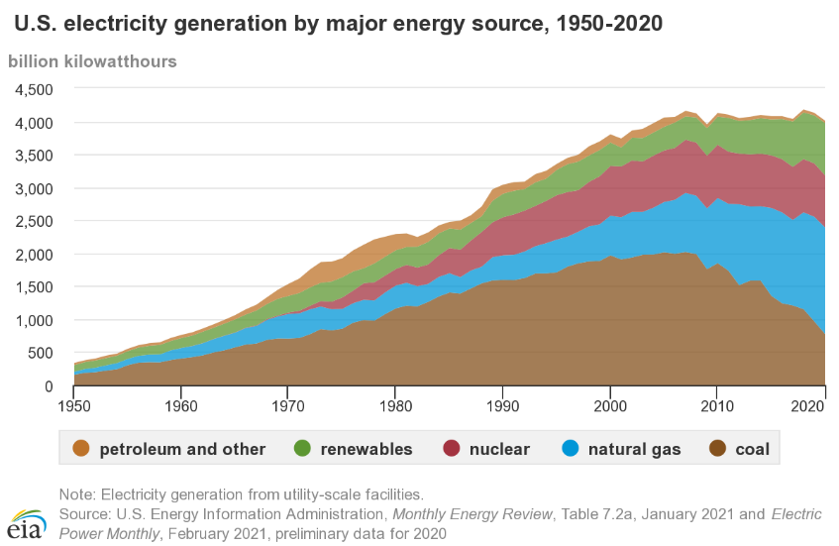
Nuclear energy will be essential to reduce emissions and achieve a carbon free economy
Nuclear power is a clean source of energy and is a great compliment to renewables
Consistent and reliable source of energy (current capacity factors of 90% and greater)
Used for base-load energy supply
Can be effectively integrated with renewable energy systems
Nuclear technology applications extend beyond low-carbon energy production
Helps control spread of disease (detection, imaging, prevention, vaccine development)
Assists doctors in diagnosis and treatment of patients
Powers difficult missions and space exploration
https://www.eia.gov/energyexplained/electricity/electricity-in-the-us.php
Current issues with implementing nuclear power on a larger scale include high capital costs that are complicated by:
Cheap natural gas; no carbon tax
Market liberalization
Over-subsidy of renewable sources (without offering these subsidies to nuclear)
Political campaigning
Notes:
With more utilities, cities, and states adopting goals of net-zero carbon emissions by 2050, and Biden’s announcement of new goals for fighting climate change, nuclear energy will be essential to achieve the goal of carbon-free energy generation
Nuclear power is a clean source of energy and is a great compliment to renewables
Consistent and reliable source of energy (current capacity factors of 90% and greater)
Used for base-load energy supply
There is some stigma against nuclear energy, particularly due to weapons programs and previous accidents, but The uses of nuclear technology extend well beyond the provision of low-carbon energy and this should be recognized. It helps control the spread of disease, assists doctors in their diagnosis and treatment of patients, and powers our most ambitious missions to explore space. These varied uses position nuclear technologies at the heart of the world's efforts to achieve sustainable development.
Current issues with implementing nuclear power on a larger scale include high capital costs that are complicated by:
Cheap natural gas
Market liberalization
Over-subsidy of renewable sources (without offering these subsidies to nuclear)
Political campaigning

Slide 3
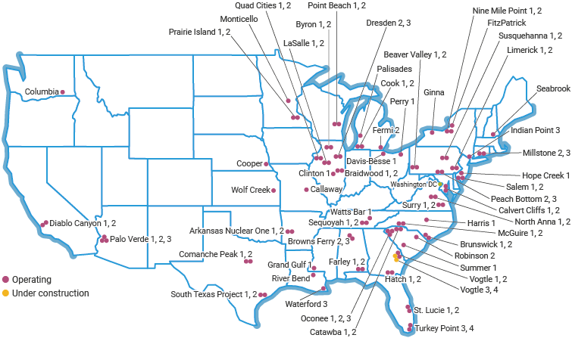
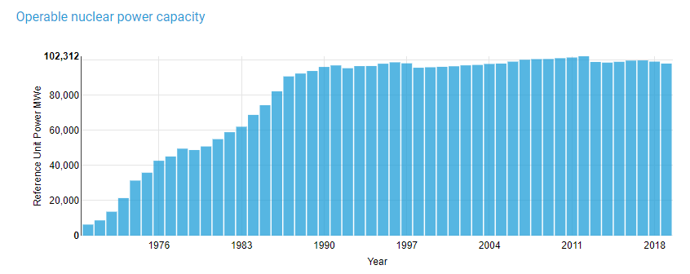
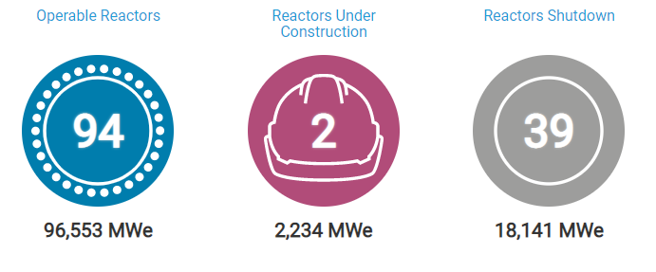
New reactor designs and energy storage will help overcome capital costs
A consistent amount of our energy has come from nuclear over the past several decades
There are few reactors being built in the US and many more are being retired early
Including four reactors in our state (Byron and Dresden)
Result of cheap natural gas and declining energy prices
Energy storage and new reactor designs will help us break this trend
https://www.world-nuclear.org/information-library/country-profiles/countries-t-z/usa-nuclear-power.aspx

Slide 4
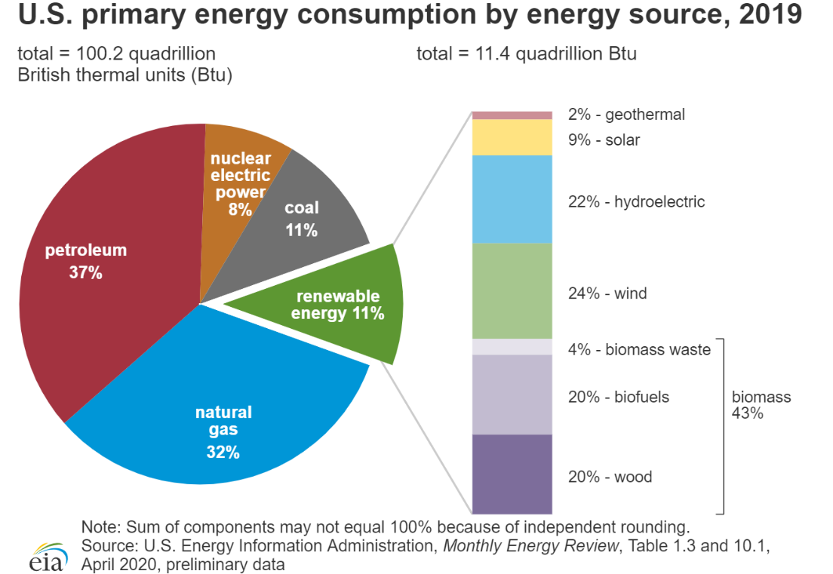
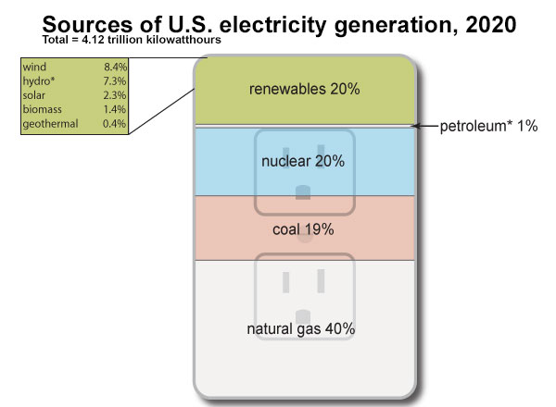
Need to reduce emissions from both the energy and transportation sectors
Additional issue of high gas/petroleum consumption
Can address with electric vehicles, but this adds to current energy demands
Promotes need for energy storage and energy sources that are consistent but flexible
https://www.eia.gov/energyexplained/electricity/electricity-in-the-us.php
https://www.eia.gov/energyexplained/us-energy-facts/

Slide 5
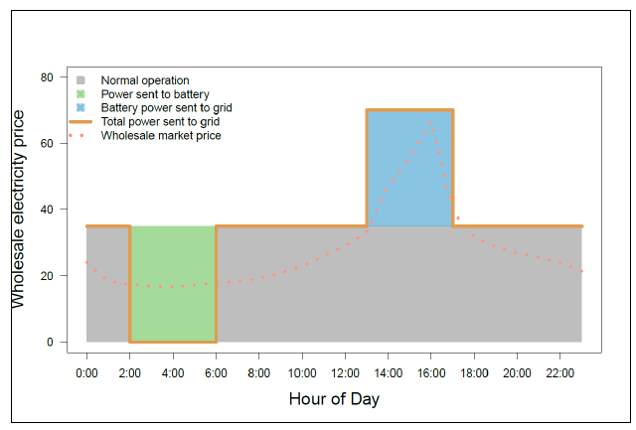

Increasing flexibility of the grid requires load following and energy storage
Nuclear reactors in France are load following, allowing greater use of nuclear energy (~71% nuclear energy)
In the US, nuclear reactors are not load following (~20% nuclear energy)
Not cost competitive for light water reactors (LWRs)
If we do not take the route of load following, energy storage options will be needed
Nuclear power systems with energy storage could provide a larger percentage of our energy and eliminate the need for coal and natural gas plants
This would also promote use of wind and solar energy, and hybrid systems
Reduces intermittency issues associated with renewables
Increases flexibility of energy sources
https://www.nrel.gov/docs/fy16osti/66073.pdf
https://www.eia.gov/energyexplained/electricity/electricity-in-the-us.php

Slide 6
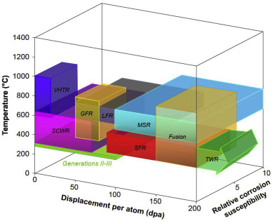
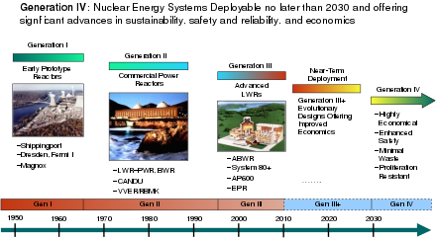
Various energy storage options can be used in conjunction with nuclear reactors
LWRs and next gen reactors operate at significantly different temperatures
LWRs operate at ~300C, MSRs operate at over 700C
This affects which energy storage approaches are most applicable for the different designs
Viable options are dependent on the type of nuclear reactors:
Current nuclear reactor designs based on light-water technology, LWRs (Gen. I-III)
Next generation/advanced reactors (Gen. IV)
https://commons.wikimedia.org/wiki/File:GenIVRoadmap-en.svg
G. Was et. al., JNM 527 (2019).

Slide 7
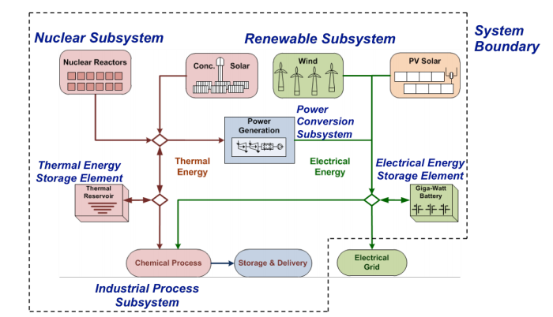
Next gen reactors will allow easier implementation of energy storage and hybrid systems
Advanced/next gen (Gen. IV) reactors are based on very different technology from LWRs
Designs tend to be smaller and tend to go to higher temperatures
Increases flexibility and allows for more possibilities
Absorbed heat of Molten Salt Reactors (MSRs) can be used as thermal energy for a variety of applications
Load following to help the grid deal with intermittent renewable energy
Ability to provide power when not connected to external transmission lines (black start capability)
Heat for industrial processes
These additional capabilities help the economics of implementing nuclear reactors and a flexible grid
Promotes hybrid systems
https://www.nrel.gov/docs/fy16osti/66073.pdf
Notes:
https://www.nrel.gov/docs/fy16osti/66073.pdf

Slide 8
Effective energy storage options are dependent on a variety of factors
Energy storage needed when energy demands are low
Helps nuclear be cost-competitive with other energy sources
Several energy storage options can be used with nuclear power:
Mechanical energy storage systems
Chemical energy storage systems
Thermal energy storage systems
Electrical energy storage systems
Electrochemical energy storage systems
Mechanical energy storage and hydrogen production are well-suited for current nuclear technology
Thermal energy storage systems are additional options allowed by next gen reactors
https://www.nrel.gov/docs/fy16osti/66073.pdf

Slide 9
Mechanical Energy Storage Systems
Pumped storage hydropower
Flywheels
Compressed air energy storage

Slide 10
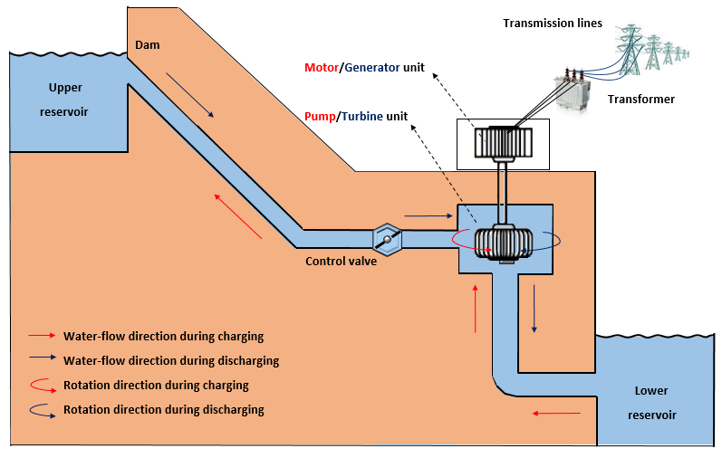
Pumped Storage Hydropower (PSH) is well developed but can have large environmental impact
Most prevalent (~99% worldwide, ~97% in US) and most developed form of energy storage in the world
PSH facilities offer better ramp rates than natural gas power plants, increasing flexibility of the grid
Prevents energy wasted when it isn’t being used and demands are low
Can be used for seasonal energy management and as critical backup reserves due to large energy capacity
Has significant environmental impacts and can only be implemented if the site meets the geography requirements
Difficult to retire facilities
Expensive if a man-made reservoir is required
Installations are larger than any other storage technology except compressed-air energy storage
P. Nikolaidis, A. Poullikkas, Journal of Power Technologies 97 (3), 2017, pgs. 220-245.
Notes:
Most prevalent (~99% worldwide, ~97% in US) and most developed form of energy storage in the world
Converts electrical energy to potential energy
Store energy by pumping water from a lower reservoir to a higher reservoir using electricity that is generated during off peak hours
During peak hours, water allowed to flow back down into the lower reservoir and energy is generated similar to conventional hydropower
PSH facilities offer better ramp rates than natural gas power plants, incrasing flexibility of the grid
Has significant environmental impacts and can only be implemented if the site meets the geography requirements
Difficult to retire facilities
Cost expensive if a man-made reservoir must be made
Installations are larger than any other storage technology except CAES
Prevents energy wasted when it isn’t being used and demands are low
Can be used for seasonal energy management and as critical backup reserves due to large energy capacity
Black start compatible

Slide 11
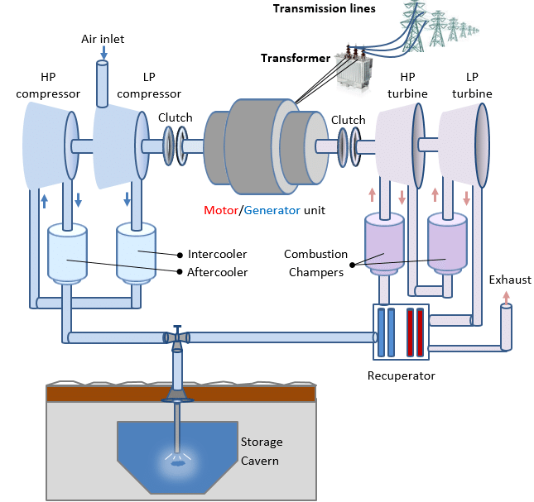
Compressed air energy storage (CAES) contributes to emissions, which reduces how “clean” the energy is
Few of these installations exist, only 2 in the world, but technology fairly well understood
Generally, requires specific geographic formations to work and be cost competitive (underground reservoir, caverns, etc.)
Quick ramp rates but low energy storage and conversion efficiencies compared with other energy storage approaches
Slow response to disruptions in the grid
One of the biggest energy storage options available
Extracting stored energy requires natural gas, increasing emissions
P. Nikolaidis, A. Poullikkas, Journal of Power Technologies 97 (3), 2017, pgs. 220-245.
Notes:
Few of these installations exist, only 2 in the world
Generally, requires specific geographic formations to work and be cost competitive (underground reservoir, caverns, etc.)
Off-peak energy is used to compress air and store it in a reservoir
Compressed air is heated, expanded, and released to a combustor in a gas turbine during peak demand periods
Big issue that this requires natural gas, increasing emissions
Quick ramp rates but low energy storage and conversion efficiencies compared with other energy storage approaches
Slow response to disruptions in the grid
Similar size to pumped hydro storage, doesn’t have as significant of an effect on the surface environment

Slide 12
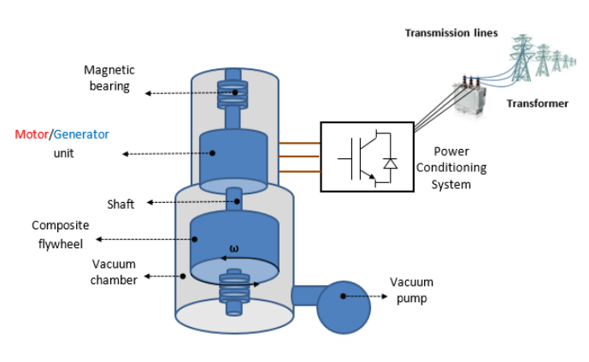
Flywheel kinetic energy storage is still developing but has minimal environmental impacts
Can be used to stabilize the grid and for synchronization of different energy sources
Great option for frequency regulation
Have very low energy capacities but can deliver more power per unit mass
Durable, modular, scalable, quick responding, and highly efficient
High charging and discharging rates
Excellent cycle life and power density compared to other energy storage options
Minimal environmental impacts; small enough to have little to no impact on the surrounding ecosystem, no emissions
Not as well developed as CAES and PSH
P. Nikolaidis, A. Poullikkas, Journal of Power Technologies 97 (3), 2017, pgs. 220-245.
Notes:
Can be used to stabilize the grid and for synchronization of different energy sources
Kinetic energy stored within a spinning rotor that is typically surrounded by vacuum to minimize frictional losses
Energy released by applying resistance to the spinning rotor
Have very low energy capacities but can deliver more power per unit mass
Durable, modular, and quick responding
Highly efficient
High charging and discharging rates
Great option for frequency regulation
Excellent cycle life and power density compared to other energy storage options
Minimal environmental impacts; small enough to have little to no impact on the surrounding ecosystem, no emissions
Not as well developed as CAES and PSH

Slide 13
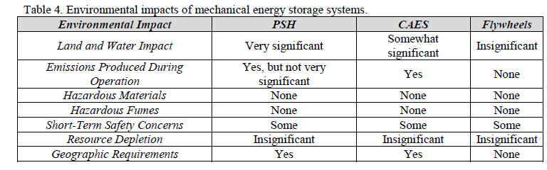
Mechanical Energy Storage Systems
PSH and Flywheels are likely best mechanical energy storage options for use with nuclear power and to reduce emissions
PSH does have a fairly large environmental impact
PSH and Flywheels
https://www.nrel.gov/docs/fy16osti/66073.pdf

Slide 14
Chemical Energy Storage Systems
Hydrogen Energy Storage
Conventional Fossil Fuels
(what we want to avoid, so this won’t be discussed here)

Slide 15
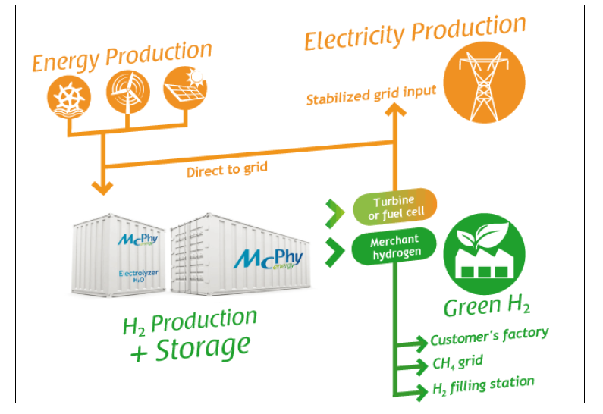
Hydrogen production is currently not very efficient, but current and future technologies can be used with nuclear reactors
Current electrolysis technologies generally operate at relatively low temperatures (<100C)
Can be used with current nuclear technology by diverting energy to run these processes
High temp electrolysis (700-900C) is currently being researched
Next generation nuclear power plants will be particularly useful for this technology
Scalable, versatile, compact, easily integrated into a power plant’s generation cycle
Still under development; high capital costs, durability of system components, and safety concerns still are limitations
Can cost more energy to produce than other methods due to the fact that hydrogen is bonded to other elements; low efficiency (20-30%)
Can be used to reduce transportation emissions
https://www.nrel.gov/docs/fy16osti/66073.pdf
Notes:
During periods of low energy demand, energy from nuclear power plants can be diverted to produce hydrogen
Hydrogen then stored for future energy needs or can be used for an alternative need (e.g. transportation)
Hydrogen typically produced by the electrolysis of water
Current electrolysis technologies generally operate at relatively low temperatures (<100C)
High temp electrolysis (700-900C) is currently being researched
Scalable, versatile, compact, easily integrated into a power plant’s generation cycle
Still under development (TRL 6); high capital costs and durability of system components still are limitations
Can cost more energy to produce than other methods due to the fact that hydrogen is bonded to other elements; low efficiency (20-30%)
Quieter than fossil fuels
Low temp electrolysis for current nuclear plants
High temp electrolysis for next generation nuclear power plants

Slide 16
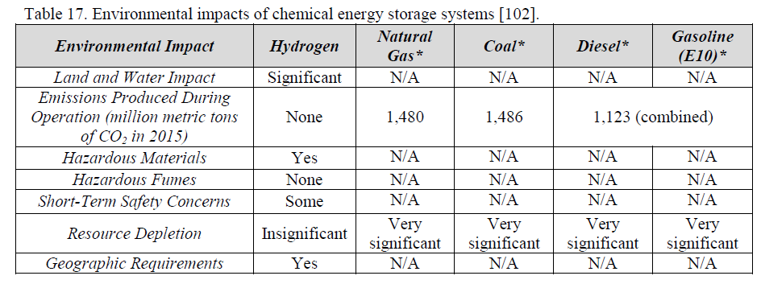
Chemical Energy Storage Systems
Hydrogen energy storage is a clean option to reduce carbon emissions in both the energy and transportation sectors
Some issues still need to be addressed, but this approach could work well with nuclear power
https://www.nrel.gov/docs/fy16osti/66073.pdf

Slide 17
Thermal Energy Storage Systems
Sensible Thermal Energy Storage
Underground Thermal Energy Storage
Hot and Cold Water Storage
Solid Media Storage
Latent Thermal Energy Storage
Thermochemicals
Molten Salts
Liquid Air
Phase Change Materials

Slide 18
Thermal energy storage systems are particularly well-suited for use with nuclear energy
Thermal energy storage can require fewer energy conversions for storage and discharge to the grid
Potential to be more efficient than some of the other energy storage technologies
Sensible Thermal Energy Storage attempts to prevent a phase change of the storage medium
Tend to use water, rocks, concrete; helps minimize environmental impact
Storage mediums typically have somewhat low energy densities
Latent Thermal Energy Storage incorporates a phase change of the storage medium
This allows more energy to be stored per unit mass
Energy can be discharged at a consistent temperature
These qualities make latent thermal energy storage particularly useful for integration with industrial process heat applications
More expensive than sensible thermal energy storage

Slide 19
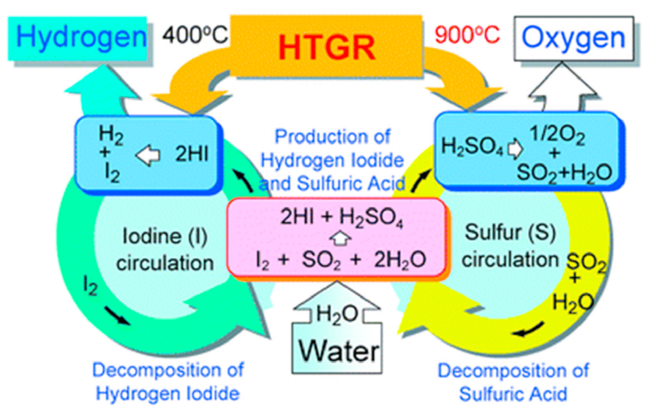
Thermochemical energy storage can be implemented with next generation nuclear reactor designs
Can be used with next generation, high temperature gas cooled (HTGR) nuclear power plants
Brayton cycle must be used in this case
Energy used to drive endothermic reaction, reverse exothermic reaction is initiated to extract the energy
Superior energy density
Low self-discharge rates
Most useful for high temp applications
Very compact, particularly useful for energy transportation
More cost effective than many other energy storage options that are compatible with high temp applications
Large amount of research currently in this area
L.C. Juarez-Martinez, et. al., Nuclear Engineering and Technology (2021? In press)

Slide 20
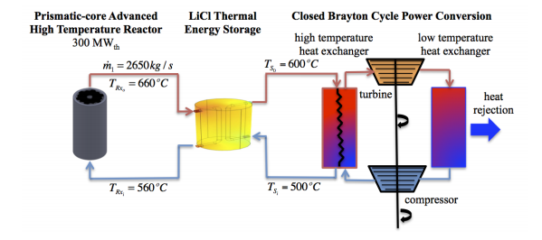
Molten salt thermal energy storage is very compatible with next gen reactors
                Can be used with next gen, high temp nuclear power plants
                Particularly useful for MSR designs
Work on concentrated solar energy thermal storage systems can be used as a building block for this technology
One of the most developed thermal energy storage approaches
Excess heat is diverted to the storage molten salt (typically 60% sodium nitrate and 40% potassium nitrate)
Excellent for energy storage due to high boiling points
Efficient and low-cost
Compatible with current high-temperature, high-pressure steam turbines
Some molten salts are non-flammable and non-toxic
S. Alameri, J. King, 2013 International Nuclear Atlantic Conference - INAC 2013.
Notes:
“Coupling the nuclear reactor to a thermal energy storage block enhances the load following characteristics of the nuclear reactor as well as providing additional safety margin in the case of an unplanned shutdown. During normal operation, the TES block stores thermal energy during the night for use in the times of peak demand during the day. In this case, the nuclear reactor stays at a constant thermal power level.”

Slide 21
Additional thermal energy storage systems are available, but have issues
Liquid Air Energy Storage: similar to CAES except liquid air is stored in above ground, insulated tank
Has same issue as CAES, utilizes natural gas for energy extraction
Has potential to use waste heat or cold to prevent need for natural gas
Currently the biggest setback/research issue for this approach
Phase Change Materials: (molten salts and liquid air are specific forms of this approach that are more advanced than other phase change materials)
Still under development and research is being done to identify different phase change materials to be used for specific applications
Some materials currently used can be quite expensive
The phase-transition temperatures of some materials are not useful for the various applications of interest
Currently requires advanced equipment that is pricey

Slide 22
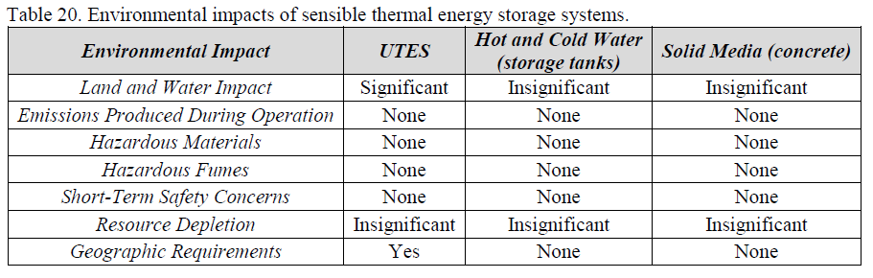
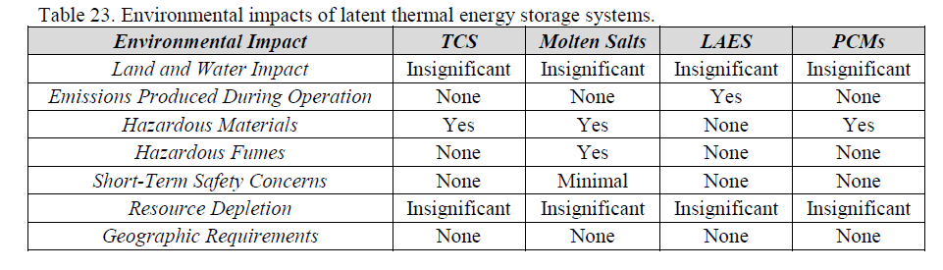
Thermal Energy Storage Systems
Thermochemical and molten salt
Latent thermal energy storage systems are more compatible with nuclear power
Of the designs discussed, molten salt and thermochemical energy storage are applicable to nuclear energy, especially next gen reactors

Slide 23
Electrical Energy Storage Systems
Supercapacitors
Superconducting Magnetic Energy Storage

Slide 24
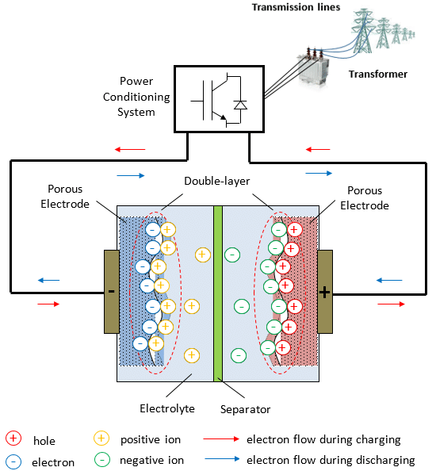
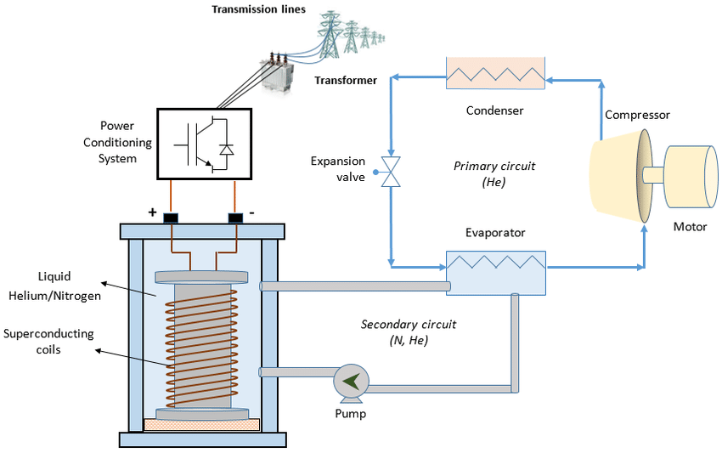
Electrical energy storage systems could be useful in hybrid systems
Supercapacitors
Fast charging and discharging; can be cycled more times than batteries
Best for high power applications
Lower environmental impact than batteries; largely available materials
Superconducting Magnetic Energy Storage: energy stored in a magnetic field generated by DC current travelling through a superconducting coil
Superconducting coil has low resistance and allows the system to store energy for a longer period of time
Very efficient energy storage option
Magnetic fields affect health of human and animals in immediate vicinity
Both have fast response times and high power density, but low energy density
P. Nikolaidis, A. Poullikkas, Journal of Power Technologies 97 (3), 2017, pgs. 220-245.

Slide 25
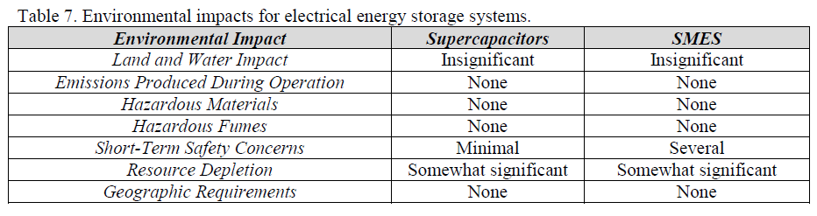
Electrical Energy Storage Systems
Not as well developed as some of the other energy storage systems
Tend to have high power density but low energy density, best for use in conjunction with other approaches
https://www.nrel.gov/docs/fy16osti/66073.pdf

Slide 26
Electrochemical Energy Storage Systems
Conventional Batteries
Lithium-Ion Batteries
Sodium-Sulfur Batteries
Lead-Acid Batteries
Nickel-Cadmium Batteries
Flow Batteries
Zinc-Bromine Flow Battery
Vanadium Redox

Slide 27
Electrochemical energy storage systems are a well-developed technology but have short lifetimes compared to other options
Conventional Batteries store charge in solid electrodes
Lithium-Ion, Sodium-Sulfur, Lead-Acid, Nickel-Cadmium
Lithium-ion tends to be a primary option for energy storage technology
Flow batteries depend on storing charge in at least one liquid; store energy in the electrolyte instead of the electrodes, modular
Zinc-Bromine, Vanadium Redox
Tend to be more complex and expensive than conventional batteries
Battery technology is fairly well developed which is why they are a common energy storage option
Battery lifetimes and cost compared with other energy storage options tend to reduce favorability of this approach
Environmental impact, safety concerns, and resource depletion are an issue
Notes:
(Li 7, NaS 8, Pb-acid 9, NiCd 7)
(Zn-Br 6, VRB 7)

Slide 28
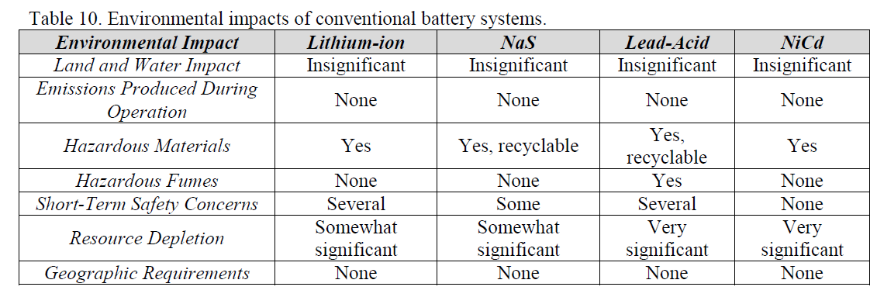
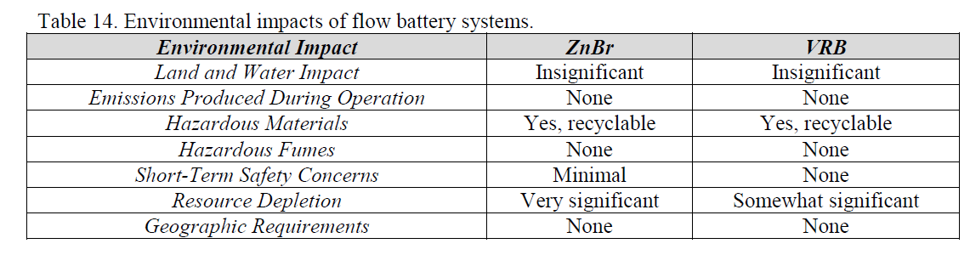
Electrochemical Energy Storage Systems
Battery technology is well developed, allowing for immediate use as desired
Lifetime and cost tends to reduce largescale use, particularly for electrical energy storage
Environmental impacts, safety concerns, and depleting resources are also issues for this technology
https://www.nrel.gov/docs/fy16osti/66073.pdf

Slide 29
Current next gen reactor designs under development
NuScale Power is developing a load-following small modular reactor, light-water
Currently, doesn’t make much economic sense to ramp down a light-water reactor due to the low operating temps
Results in operational inefficiencies and reduced revenue which makes covering capital costs even more difficult
Moltex’s stable salt reactor includes molten salt tanks to store thermal heat – prevents having to ramp down the reactor
Could store energy for around 8 hours but up to 24 hours (much longer than the 4-hour duration period of Li-ion batteries)
TerraPower’s Molten Chloride Fast Reactor – design intended to create heat for industrial uses and thermal energy storage, as well as electricity
Terrestrial Energy’s Integral Molten Salt Reactor (IMSR) – transports thermal energy to sites up to 5 miles away
Designed to be used for black start capability or renewable load-following
Can also be used for chemical production
Studying prospects of using heat to produce hydrogen more cleanly and efficiently
Notes:
For example, Moltex has a deal with New Brunswick Energy Solutions Corp. to build a 300-MW demonstration reactor for the Canadian province. The developer’s concept for the Stable Salt Reactor involves a molten salt coolant for the reactor, accompanied by a set of additional molten salt tanks that store the reactor’s thermal energy. The heat trapped in the tanks can then be used to drive a turbine to generate electricity.
The storage element is supposed to give the reactor-and-turbine project additional flexibility to ramp up or down, fitting with a cleaner grid dominated by variable wind and solar energy. Conventional reactors are typically run as close to around-the-clock as possible to maximize revenue to cover high capital costs and avoid operational inefficiencies that come with cycling up or down.

Slide 30
Issues and Future Outlook
Next gen reactors are a developing technology, any reactor designs using non-water coolant likely won’t be implemented until at least 2050
Those based on LWR technology (NuScale Power) will be ready for commercialization within the decade
Costs can be an issue; next gen designs are attempting to address these issues several ways
Moltex believes their design could have capital costs of under $1,000 per kW
Reactors currently being built in Georgia cost more than $11,000 per kW
Energy storage, use of heat in industrial processes, and load following all help improve the competitiveness of nuclear energy

Slide 31
Summary and Conclusions
As new reactors are developed and built, we will need to change our energy storage approaches and develop new approaches
The best energy storage options for a specific project are highly dependent on the reactor type and where it is being built (availability of certain geological formations)
Several energy storage options should be considered to ensure flexibility of the grid and to determine the most useful approach for the situation
Flywheels, pumped storage hydropower, hydrogen production, thermochemical processes, and molten salt thermal energy storage are the most applicable to current and future nuclear power designs
Energy storage and nuclear energy are essential to achieve a carbon-free economy; we need to implement all carbon-free production and storage options
Energy storage can help nuclear energy reach its full capabilities in the US

Slide 32
Questions?

Slide 33
References
https://www.iaea.org/bulletin/infectious-diseases/infectious-diseases-and-how-nuclear-science-can-help
https://www.world-nuclear.org/information-library/current-and-future-generation/nuclear-power-in-the-world-today.aspx
https://www.world-nuclear.org/information-library/country-profiles/countries-t-z/usa-nuclear-power.aspx
https://www.utilitydive.com/news/nuclear-energy-storage-advanced-reactor-developers-trying-to-expand-nuclea/573570/
https://www.eia.gov/energyexplained/electricity/electricity-in-the-us.php
https://www.eia.gov/energyexplained/us-energy-facts/
https://commons.wikimedia.org/wiki/File:GenIVRoadmap-en.svg
M. Ruth,, et. al., The Economic Potential of Two Nuclear-Renewable Hybrid Energy Systems, NREL Technical Report NREP/TP-6A50-66073, 2016, https://www.nrel.gov/docs/fy16osti/66073.pdf
G. Was et. al., Materials for Future Nuclear Energy Systems, Journal of Nuclear Materials (527), 2019.x
L.C. Juarez-Martinez, et. al., Energy Optimization of a Sulfur-Iodine Thermochemical Nuclear Hydrogen Production Cycle, Nuclear Engineering and Technology, 2021? (in press).
P. Nikolaidis, A. Poullikkas, A Comparitive Review of Electrical Energy Storage Systems for Better Sustainability, Journal of Power Technologies 97 (3), 2017, pgs. 220-245.
S. Alameri, J. King, A Coupled Nuclear Reactor Thermal Energy Storage System for Enhanced Load Following Operation, 2013 International Nuclear Atlantic Conference - INAC 2013, 2013.
J. Coleman, S. Bragg-Sitton, and E. Dufek, :An Evaluation of Energy Storage Options for Nuclear Power. United States, 2017, Web. doi:10.2172/1372488., https://www.osti.gov/servlets/purl/1372488

Slide 34
Back up slides

Slide 35
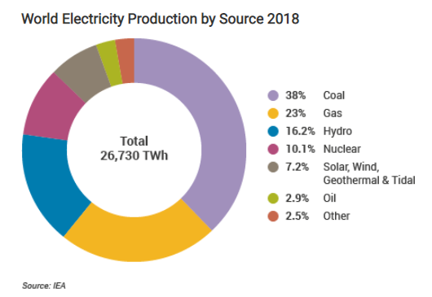
US lags many other countries in use of nuclear energy
Country | % of Electricity from Nuclear
France | 71%
Slovakia | 54%
Ukraine | 54%
Hungary | 49%
Belgium | 48%
Bulgaria | 38%
Slovenia | 37%
Finland | 35%
Czech Republic | 35%
Sweden | 34%
Armenia | 28%
South Korea | 26%
Switzerland | 24%
Spain | 21%
USA | 20%
Russia | 20%
Romania | 19%
UK | 16%
Canada | 15%
Germany | 12.5%
Japan | 8% (30% before Fukushima)
Pakistan | 7%
South Africa | 7%
China | 5%
Mexico | 4.5%
India | 3%
In 2019, 12 countries produced at least 1/4 of their electricity from nuclear
Japan relied on nuclear power for 30% of its electricity before the Fukushima accident
Germany is currently trying to phase out nuclear energy but has struggled to achieve their carbon emission goals
UK has started building new nuclear reactor designs
China is leading world in construction of new reactors to improve urban air quality and reduce greenhouse gas emissions
Much of the world is recognizing the need for nuclear energy and are building new plants
https://www.world-nuclear.org/information-library/current-and-future-generation/nuclear-power-in-the-world-today.aspx
https://www.eia.gov/energyexplained/electricity/electricity-in-the-us.php

