Slide 1
Future Batteries
Christian Zircher
NPRE 498

Slide 2
Downsides of Current Batteries
Generally you can only have lots of power or lots of energy, but not both
This is bad since most technology nowadays needs both (ex. smartphones)
In 2012, The DoE called for a chemical battery to be created with five times the current energy storage within the next 5 years (2017)
Recharging the battery can take time, which is a limiting factor in electric cars

Slide 3
UIUC’s New Battery (Stats)
Here at University of Illinois at Urbana-Champaign, a new battery has been developed
Lithium-ion battery
2,000 times more powerful than similar batteries
Can be recharged 1,000 times faster than current Li-ion batteries
This can be used to make a wireless device transmit a signal 30 times farther than the current distance
It can also be used to create a battery 30 times smaller

Slide 4
UIUC’s New Battery (Technology)
It works by utilizing a new cathode-anode structure
Most Li-ion batteries use a 2D anode made of graphite and a Li-salt anode
This new battery uses a porous 3D anode and cathode
This structure is created by building a Styrofoam structure on a glass substrate and then electrodepositing nickel onto the Styrofoam. Next, the anode is electrodeposited with nickel-tin and the cathode with manganese dioxide. This can be seen in the following slide.

Slide 5
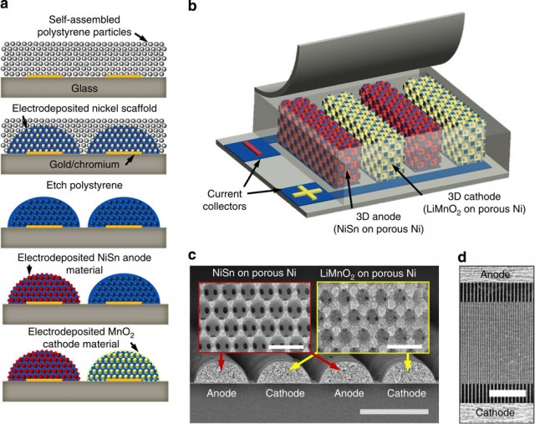

Slide 6
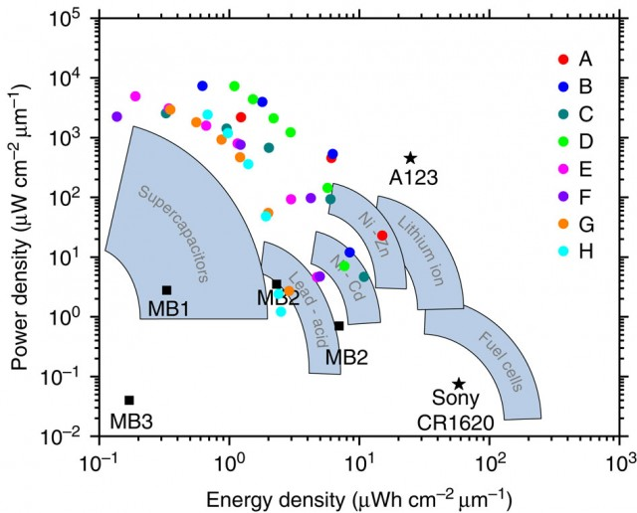
UIUC’s New Battery (Technology Part 2)
This structure creates more surface area, allowing more chemical reactions to occur.
This increases the discharge and charging speed.
The graph to the right compares the UIUC battery (A123) to other battery types.

Slide 7
UIUC’s New Battery (Usage)
Can be used to create much smaller and lighter batteries
Example, a smartphone with a battery as thick as a credit card and can be recharged in only a few seconds.
To begin the using this technology for commercial use, UIUC needs to first show that the technology can be applied to larger battery sizes and that the production process isn’t too expensive.
Currently they have created a button sized battery which is the one being compared in the previous slide (A123).

Slide 8
Nanyang Technological University’s (Singapore) Li-Ion Battery
This is an improvement on previous Li-ion technology
Uses a cheap titanium dioxide gel (used in sunscreen) instead of graphite for the anode
This allows the battery to be charged to 70% in only 2 minutes
The battery will have a lifetime of 20 years, much larger than the current batteries
It will be able to last over 10,000 charging cycles which is 20 times more than the current 500 cycles of today’s batteries

Slide 9
Nanyang Technological University’s (Singapore) Li-Ion Battery (Part 2)
This could be implemented in electric cars so that it only takes 15 or maybe even only 2 minutes to recharge it
The problem with electric cars is that they typically only have a range of about 80 miles, and if someone needs to make a 300 mile trip, the recharge time could become a problem
But now with this new technology, that 300 mile trip isn’t so troublesome if you only need to stop and recharge for 2 minutes every 80 miles
Can be on the market in only two years.

Slide 10
Aquion Energy’s Battery
Aquion Energy is a company created at Carnegie Mellon University
Long lived battery that is used for solar, wind, and other renewable power sources
Will hopefully drive the price of renewable energy down
Recently has been delivered to operators of microgrids

Slide 11
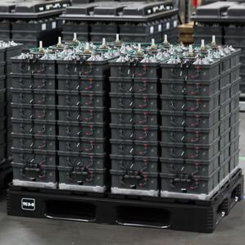
Aquion Energy’s Battery (Part 2)
Uses the sodium ions from saltwater as the electrolyte and Manganese oxide for the anode and carbon for the cathode
These batteries are large and cheap, but operate slowly
Cost around as much as lead-acid batteries, but last twice as long

Slide 12
References
"DoE Calls for a Chemical Battery with 5x Capacity, within 5 Years – Can It Be Done? | ExtremeTech." ExtremeTech. N.p., n.d. Web. 30 Nov. 2014.
"A Much Cheaper Grid Battery Comes to Market | MIT Technology Review." MIT Technology Review. N.p., n.d. Web. 30 Nov. 2014.
Nanyang Technological University. "Ultra-fast charging batteries that can be 70% recharged in just two minutes." ScienceDaily. ScienceDaily, 13 October 2014. <www.sciencedaily.com/releases/2014/10/141013090449.htm>.
"New “Groundbreaking Battery” Lasts 20 Years & Recharges In 2 Minutes." CleanTechnica. N.p., n.d. Web. 30 Nov. 2014.
"New Li-Ion Batteries Charge 70 Percent in 2 Minutes, Last for 20 Years." Gizmodo. N.p., n.d. Web. 30 Nov. 2014.
"New Lithium-ion Battery Design That’s 2,000 times More Powerful, Recharges 1,000 times Faster | ExtremeTech." ExtremeTech. N.p., n.d. Web. 30 Nov. 2014.
"News Bureau | University of Illinois." Small in Size, Big on Power: New Microbatteries a Boost for Electronics. N.p., n.d. Web. 30 Nov. 2014.

