Slide 1
Fisher Tropsch Process
Constandinos Mitsingas

Slide 2
Content
Overall Process
Syngas Production
Fischer Tropsch Process
Fischer Tropsch Reactors
Chemical Reaction Catalysts
Products
Benefits
Disadvantages
Current Research Areas

Slide 3
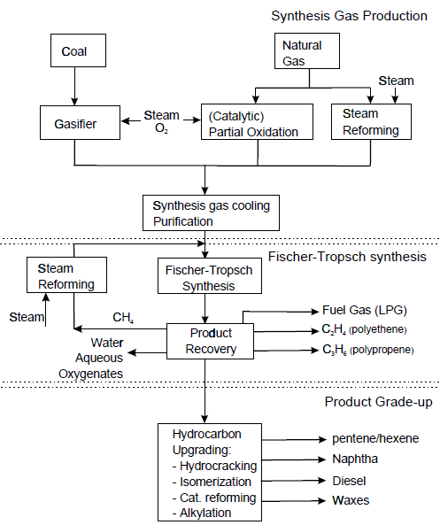
Overall Process
Notes:
66% of Cost is syngas production
The FT synthesis section consisting of FT slurry reactors, CO2 removal, synthesis gas
compression and recycle, and recovery of hydrogen and hydrocarbons is 22 % of the
total costs.
Finally, the upgrading and refining section of hydrocarbons is about 12
%.

Slide 4
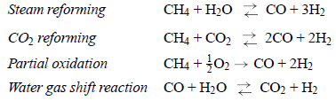
Syngas Production
60-70% of total cost
Natural gas has 20% CO2, more efficient and cost effective
Coal, has 50% CO2, more abundant
Notes:
Synthesis gas can be obtained by steam reforming or (catalytic) partial oxidation of
fossil fuels: coal, natural gas, refinery residues, biomass or industrial off-gases.
Usually, a combination of synthesis gas production processes is used to obtain synthesis
gas with a stoichiometric ratio of hydrogen and carbon monoxide.
New ceramic membranes might become interesting for significant cost reduction
of synthesis gas production by 30-50 %
• Requires:
- Drying (using heat from Fischer-Tropsch process)
- Gasification (air blown or pressurized and at 900 °C)
- Gas cleaning (150 °C, filtration, acid gasses removed)
- Gas Compression to 25 bar
- Water-gas shift (330 °C, CO2 converted to CO)
- F-T synthesis (240 °C, Co catalyst, α = 0.95, 80% conversion)
- Workup (separation and cracking of product

Slide 5

Fischer Tropsch Process
Input Materials
  Coal
  Natural Gas
  Biomass
Process Chemistry:
Temperature:150-300°C
Formation of methane is unwanted
$$\left(2n+1\right)H_{2}+nCO→C_{n}H_{(2n+2)}+nH_{2}O$$
Notes:
A set of Chemical reactions that convert a mixture of carbon monoxide and hydrogen into liquid hydrocarbons
high reaction heats
and the large number of products with varying vapor pressures
Creates Petroleum Substitute
Most of the alkanes produced tend to be straight-chain alkanes
particularly when methane is the primary feedstock used to produce the synthesis gas

Slide 6
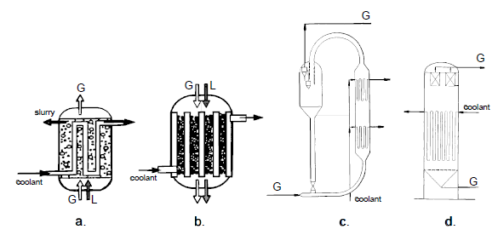
Reactors
a. Slurry bubble column reactor; b. Multitubular trickle bed reactor; c. Circulating fluidized bed reactor; d. Fluidized bed reactor.
Two Most favored reactor types:
  Multitubular fixed bed reactor with internal cooling
  Slurry bubble column reactor with internal cooling tubes
Notes:
1) Low pressure drop over the reactor. 2) Excellent heat transfer
characteristics resulting in stable reactor temperatures. 3) No diffusion limitations.
4) Possibility of continuous refreshment of catalyst particles.
Disadvantages of the
multitubular reactor are the larger catalyst particles, the required equal distribution of
gas and liquid streams over all tubes, and the large reactor weight due to a large number
of tubes for effective heat transfer area. However, the most important disadvantage of
the multitubular reactor probably is in the high costs of 10 to 100,000 tubes, typical
for commercial scale.

Slide 7
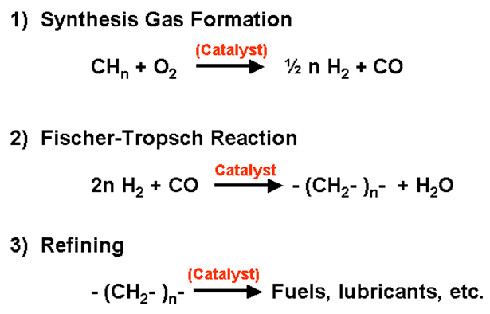
Fischer Tropsch Process
Notes:
The benefit of this process lies in converting a relatively inflexible energy source, such as coal or biomass into a variety of products that meet specific needs.

Slide 8
Catalysts
Transition Metal
  Cobalt
    Highly active
    Feedstock is natural gas
  Iron
    Suitable for low-hydrogen-content synthesis gases
    Lower quality feedstock, coal or biomass
  Ruthenium
    Very Expensive
    Hardly used in FT
  Nickel
    Favors methane formation
Notes:
Catalysts formulations are poisoned by sulfur
5,000 tonnes

Slide 9
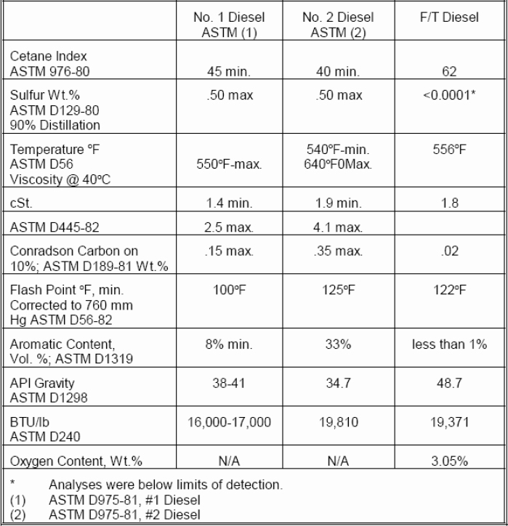
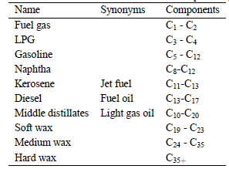
Products
Table 1: Conventions of produced fuel names and compositions
Table 2: Comparison of FT Diesel with two ASTM approved Diesels
Notes:
FT Diesel: 0.17$/gallon
FT gasoline: 0.24$/gallon more expensive than transportation fuels derived from crude oil.
The diesel fraction has a high cetane number resulting in superior combustion
properties and reduced emissions
Also, other products besides fuels can be manufactured
with Fischer-Tropsch in combination with upgrading processes, for example, ethene,
propene, O -olefins, alcohols, ketones, solvents, specialty waxes, and so forth.

Slide 10
Benefits
No Nitrogenous compounds
No Sulfur compounds
Cetane rating (energy stored) 75-90% higher than that required for petrochemical derived diesel fuel

Slide 11
F-T Disadvantage
Heat removal from the process
Syngas Clean-Up
Catalyst deactivation rate
Change in feedstock
Notes:
The complexity of the FT reaction mechanism and the large number of species involved
is the major problem for development of reliable kinetic expressions. Most
catalyst studies aim at catalyst improvement and postulate empirical power law kinetics
for both the carbon monoxide conversions and the carbon dioxide formation rate

Slide 12
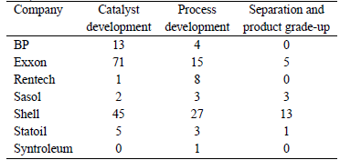
Current Research Areas
Table 3:Estimate of patents of the major companies active in Fischer-Tropsch

Slide 13
References
"Fischer–Tropsch Process." Wikipedia, the Free Encyclopedia. Web. 29 Nov. 2010. <http://en.wikipedia.org/wiki/Fischer–Tropsch_process>.
Boerrigter, H., and A. Van Der Drift. "LARGE-SCALE PRODUCTION of FISCHER-TROPSCH DIESEL FROM BIOMASS." (2004). ECN. Web.
"Alternative Fuels and Advanced Vehicles Data Center: What Is Fischer-Tropsch Diesel?" EERE: Alternative Fuels and Advanced Vehicles Data Center Program Home Page. Web. 29 Nov. 2010. <http://www.afdc.energy.gov/afdc/fuels/emerging_diesel_what_is.html>.

Slide 14
Questions ?

