Slide 1
Conventional and Advanced Flywheel Energy Storage
Daniel Schultz

Slide 2
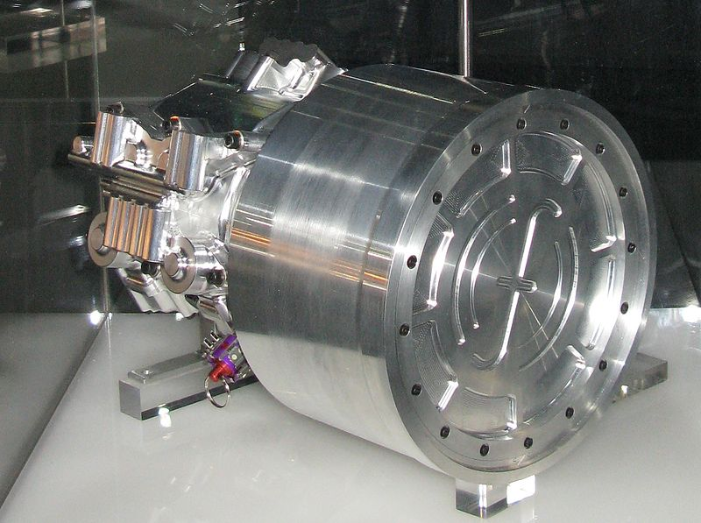
Content Overview
Theory/Process
  Energy Storage
  Specific Energy
Advantages
Disadvantages
Advancements
Modern Day Implementation

Slide 3
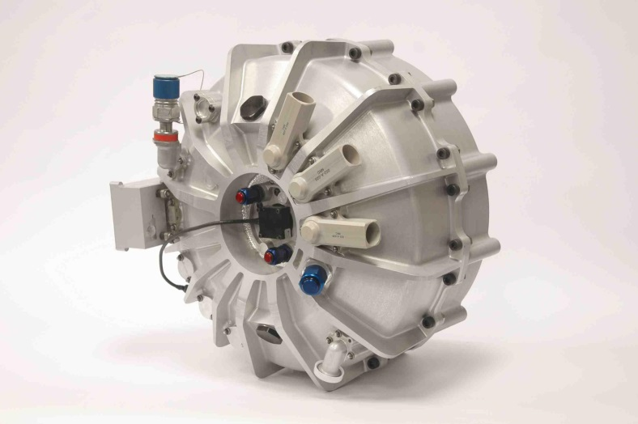
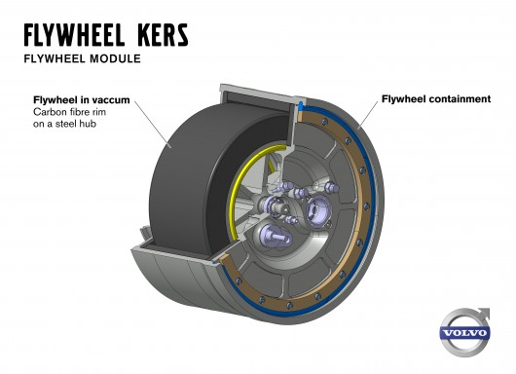
Energy Input and Extraction
Works by accelerating a rotor (flywheel) to a very high speed and maintaining the energy in the system as rotational energy
When energy is extracted from the system, the flywheel's rotational speed is reduced as a consequence of conservation of energy
Addition of energy to the system correspondingly results in an increase in the speed of the flywheel

Slide 4
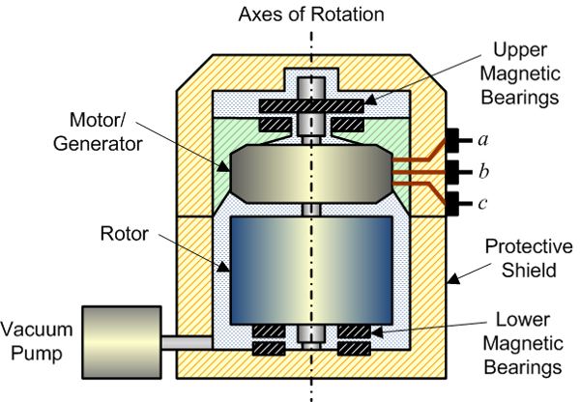
Energy Storage System
Flywheel typically constructed of carbon fiber or steel alloy
Magnetic bearings commonly used to reduce friction
Vacuum created to eliminate air resistance
Motor used to add and extract rotational energy

Slide 5
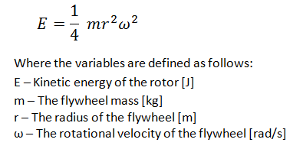
Flywheel Stored Energy
Dependent on shape, mass, and rotational speed
Most common shape today is flat disc
High rotational speed is necessary for efficient storage
Advanced flywheels can have efficiency of 80%-95%

Slide 6
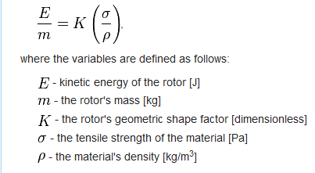
Flywheel Specific Energy
Typical values for specific energy 90-120 J/kg
Higher that most current forms of energy storage
Inferior only to Lithium-Ion (175 J/kg) and Zinc-Air (470 J/kg)

Slide 7
Advantages of Flywheel Storage
Efficiency – charge and discharge are made with very small losses; can have efficiencies up to 95%
Fast Response - flywheels can promptly store huge bursts of energy and equally rapidly return them
Lifetime – flywheels built in the XVIII century for the early rail industry still work today
Maintenance – flywheels are kept in vacuum containers, functioning with zero material wear in modern designs
Decommission - do not pose the chemical recycling/decommission issues of conventional batteries.

Slide 8
Disadvantages of Flywheel Storage
Weight – alloy flywheels can easily weigh several tonnes; for transport applications this can be a serious issue
Failure – if a flywheel fails by some reason at high rotation, it disintegrates, sending shrapnel as fast as bullets in random directions
Bearings – alloy bearings proved to wear out quite rapidly, at first reducing efficiency and later rendering the flywheel useless
Angular Momentum – the momentum stored in the flywheel will act against direction changes, which in transport can make turns a complex task

Slide 9
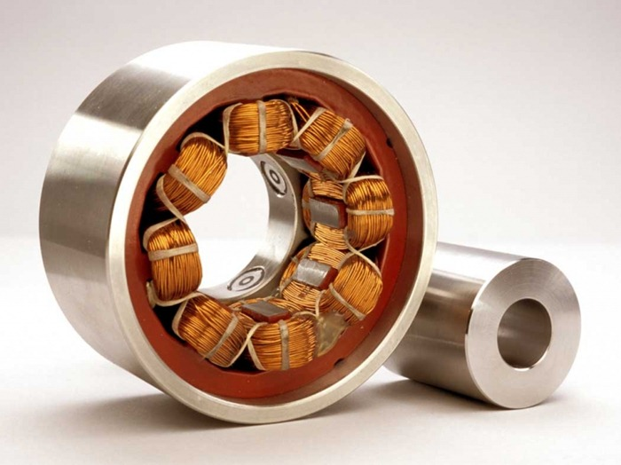

Advancements
Improved Materials - Advance materials such as carbon fiber, glass fiber, and super hard alloys
  Flywheel construction
  Flywheel protective casing
Magnetic Bearings – Reduce frictional loss and prevent material wear

Slide 10
Modern Day Applications
Automotive Industry
Uninterruptible Power Supplies
Military/Defense
Grid Energy Storage
Wind Turbines

Slide 11

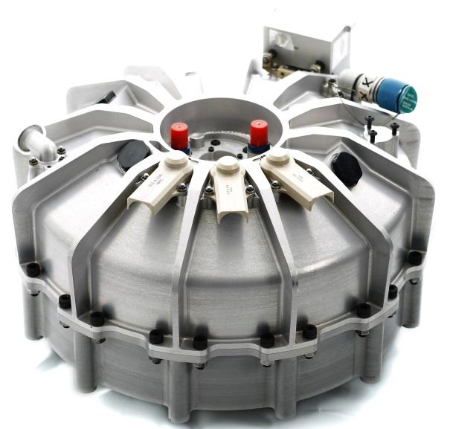
Automotive Industry
Regenerative braking systems
  Commercial automobiles
  Racing Vehicles
Gyrodrive hybrid buses – Flywheel takes place of battery in hybrid system

Slide 12
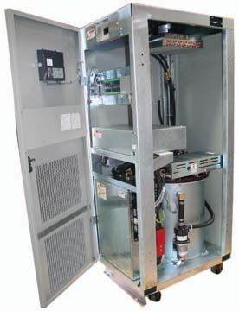
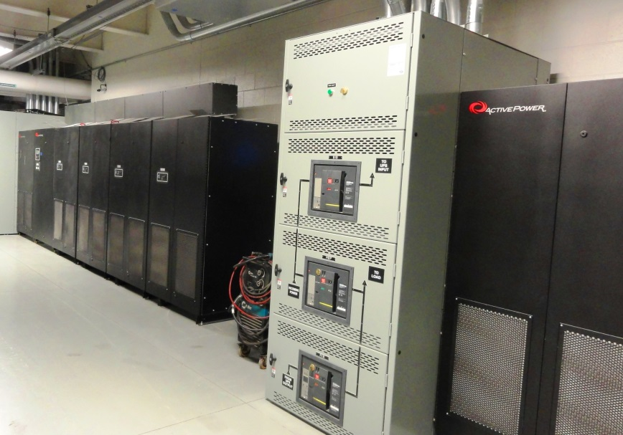
Uninterruptible Power Supplies
Used in data centers to provide axillary power if main power fails
Flywheel about half the cost of traditional battery UPS systems

Slide 13


Military/Defense
Use in aircraft launch systems aboard aircraft carriers
Accumulates energy from the ship's power supply, for rapid release to launch system
Currently in use on USS Gerald R. Ford

Slide 14

Grid Energy Storage
Lower carbon emissions, faster response times and ability to buy power at off-peak hours
Beacon Power - 5MWh flywheel energy storage plant in Stephentown, New York
A 2MW flywheel storage facility opened in Ontario, Canada in 2014 Developed by NRStor

Slide 15
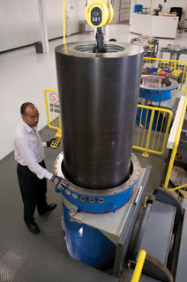

Wind Turbines
Used to store energy generated by wind turbines during off-peak periods or during high wind speeds
Beacon Power Smart Energy 25 (Gen 4) flywheel energy storage system

Slide 16
Conclusions
Flywheel energy storage offers a efficient alternative to traditional energy storage methods
Advances in materials and bearing technology has made it possible to mitigate inherent disadvantages
Flywheels have a wide variety of uses in commercial and industrial sectors

Slide 17
Questions?

Slide 18
References
http://energystorage.org/energy-storage/technologies/flywheels
http://www.theoildrum.com/node/8428
http://mragheb.com/NPRE%20498ES%20Energy%20Storage%20Systems/Kinetic%20Energy%20Flywheel%20Energy%20Storage.pdf
http://en.wikipedia.org/wiki/Flywheel_energy_storage
http://beaconpower.com/grid-balancing/

