Slide 1
NPRE 498
HYBRID CSP DESALINATION SYSTEMS: SUSTAINABLE SOLUTIONS FOR WATER AND ENERGY
CYRIAC MONACHAN
(UIN: 672162684)

Slide 2
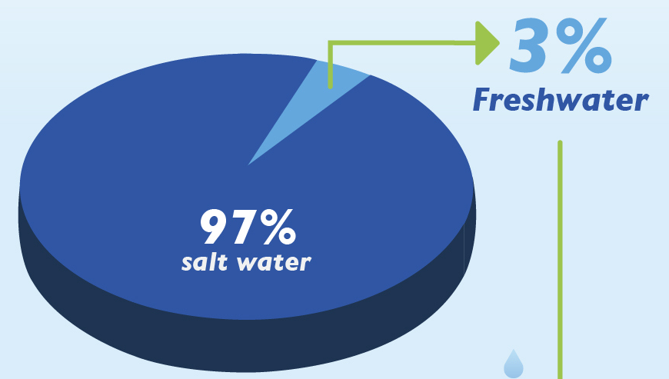
Water Energy Nexus
2 Billion
3%
Number of people facing water scarcity around the world
Availability of Freshwater
70%
Percentage of Freshwater frozen in ice

Slide 3
Water energy Nexus
The United Nations warns of a global water crisis with a predicted 40% shortfall in freshwater resources by 2030, affecting agriculture, industry, and daily life.
Environmental Impact: In 2023, the world's rivers experienced their driest year in over three decades, leading to significant reductions in water flow and extended droughts globally.

Slide 4
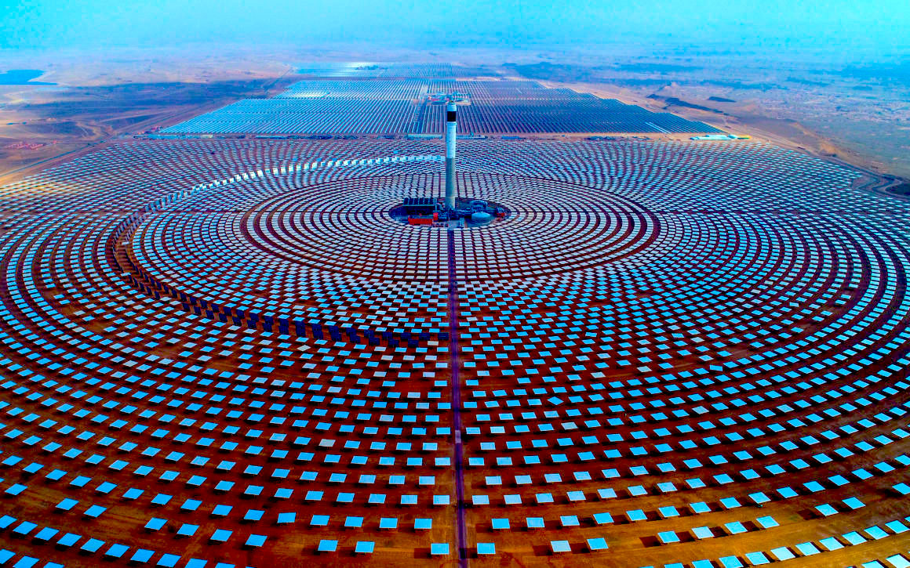
What is CSP?
CSP refer to Concentrated solar Power.
Renewable energy technology that uses mirrors or lenses to concentrate sunlight onto a receiver, converting solar energy into high-temperature heat.
Heat Generated
Steam Produced
Generates Electricity
Drives turbine

Slide 5
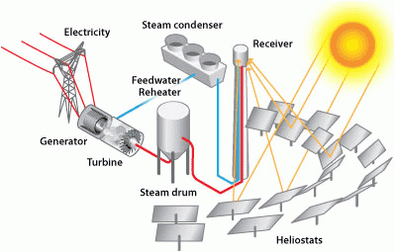
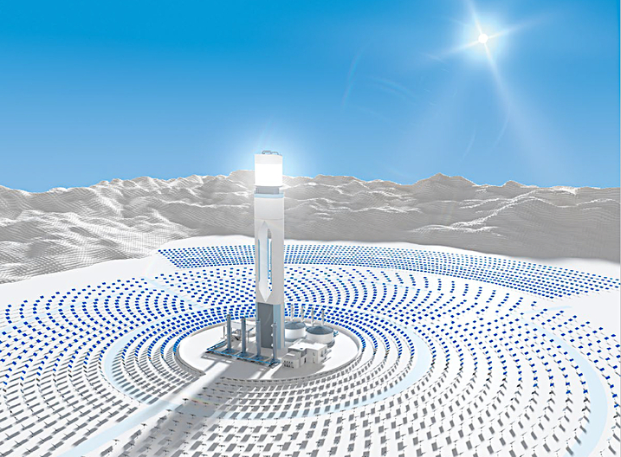
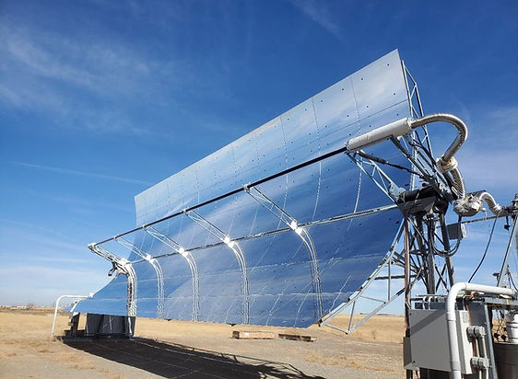
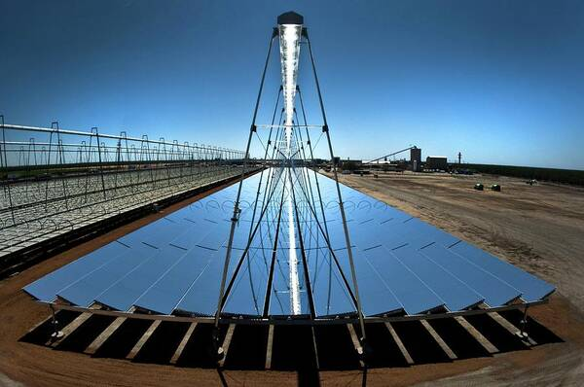
Key CSP technologies
Major CSP Technologies
Solar Power towers
Parabolic Troughs
Linear Fresnel Reflectors
https://www.eia.gov/todayinenergy/detail.php?id=530

Slide 6
Key Differences
Solar Power Towers
Compact Differences Between CSP Technologies
Parabolic Troughs
Parabolic mirrors focus sunlight onto a tube; temperatures ~300–400°C.
Linear Fresnel Reflectors
Central receiver with heliostats; temperatures >550°C.
High efficiency; ideal for large-scale projects.
Requires extensive land for heliostat fields.
Supports advanced thermal storage systems.
Moderate efficiency; widely deployed commercially.
Suited for medium-to-large projects.
Lower heat loss compared to Fresnel systems.
Flat mirrors focus sunlight onto a linear receiver; temperatures ~250–300°C.
Lower efficiency; cost-effective and simple design.
Ideal for small-scale or supplementary systems.
Compact land use compared to solar towers.

Slide 7
Advantages of CSP
Continuous Power: TES achieves 98% efficiency, enabling up to 15 hours of operation without sunlight.
Large-Scale Output: Plants like Noor (Morocco) generate 580 MW, powering 1.3 million homes.
Emission Reduction: A 50 MW CSP plant offsets 40,000 tons of CO₂ annually.
Sun-Rich Optimization: Requires DNI > 5.5 kWh/m²/day; ideal for arid, sunny regions.

Slide 8
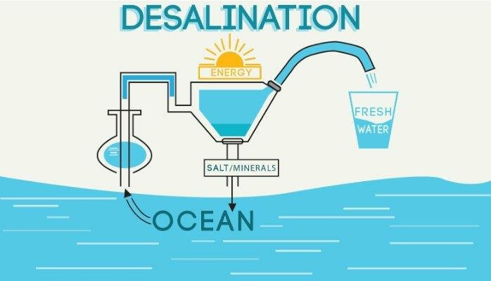
What is Desalination?
Definition: process of converting seawater or brackish water into freshwater by removing dissolved salts and impurities.
Purpose: provides potable water in regions facing freshwater scarcity, especially coastal and arid areas.
Primary Inputs: Requires energy (thermal or electrical) to separate salt from water, making it resource-intensive.
Global Use: Over 16,000 desalination plants worldwide produce ~100 million cubic meters of freshwater daily.

Slide 9
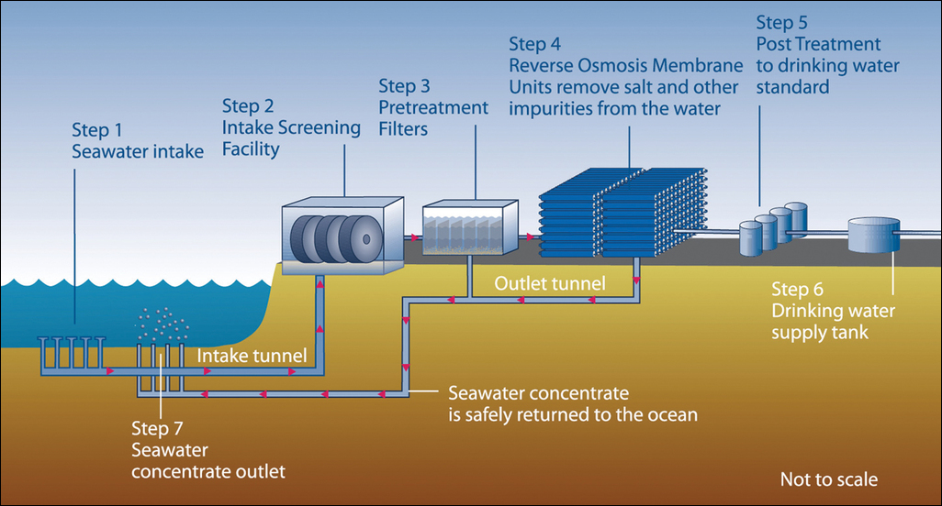
70%
Desalination plants globally operate using FOSSIL FUELS
Traditional Desalination Process

Slide 10
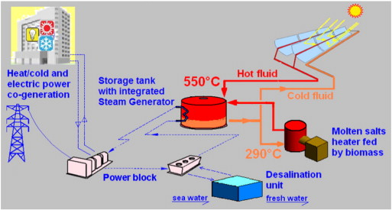
Why Hybridise CSP with Desalination?
Sustainable Water: CSP integration provides renewable-powered desalination for reliable clean water.
Quality Assurance: Stable solar energy enhances desalination efficiency for consistent water purity.
Eco-friendly: Reduces pollution by replacing fossil fuels with solar energy in water production.
Scalability: Meets increasing water demands sustainably without environmental compromise.

Slide 11
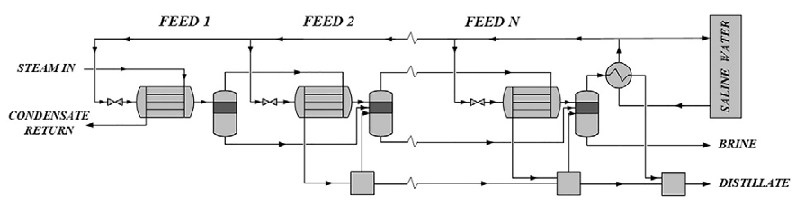
MED (Multi Effect distillation) technology
Energy Efficiency:
Utilizes thermal energy to evaporate seawater in multiple stages, each at a slightly lower temperature and pressure than the previous one.
The cascading effect allows for efficient reuse of energy, making it one of the most energy-efficient desalination technologies.
Quality of Distillate:
Output distillate from MED is of high purity as the process effectively removes salts and other impurities through successive stages of evaporation and condensation.
This results in clean, potable water.
Scalability:
Highly scalable, suitable for both small and large-scale operations.
Particularly effective in industrial settings where large volumes of fresh water are required.
Operational Cost:
While MED systems are capital intensive due to their complexity and the need for significant infrastructure, their operational costs can be competitive when integrated with low-cost heat sources, such as waste heat from power plants or renewable energy sources like CSP.

Slide 12
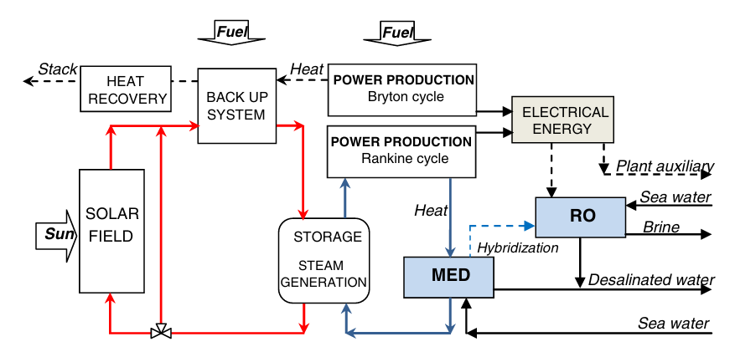
CSP – MED Mechanics

Slide 13
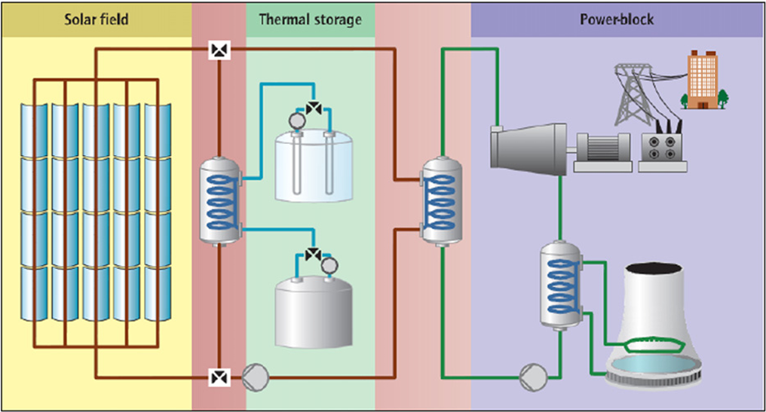
TES in Hybrid Systems
TES Phases
Heat collection phase
Storage Phase
Release Phase
Regeneration Phase
Solar energy is concentrated to heat a transfer fluid, typically during sunlight hours.
After energy use, the fluid cools and cycles back to be reheated the next day.
The heated fluid is stored in insulated tanks, preserving the energy for later use
Molten salt provide up to 98% storage efficiency.
The stored heat is released to generate steam or heat for the MED process, used during non-sunlight hours.

Slide 14
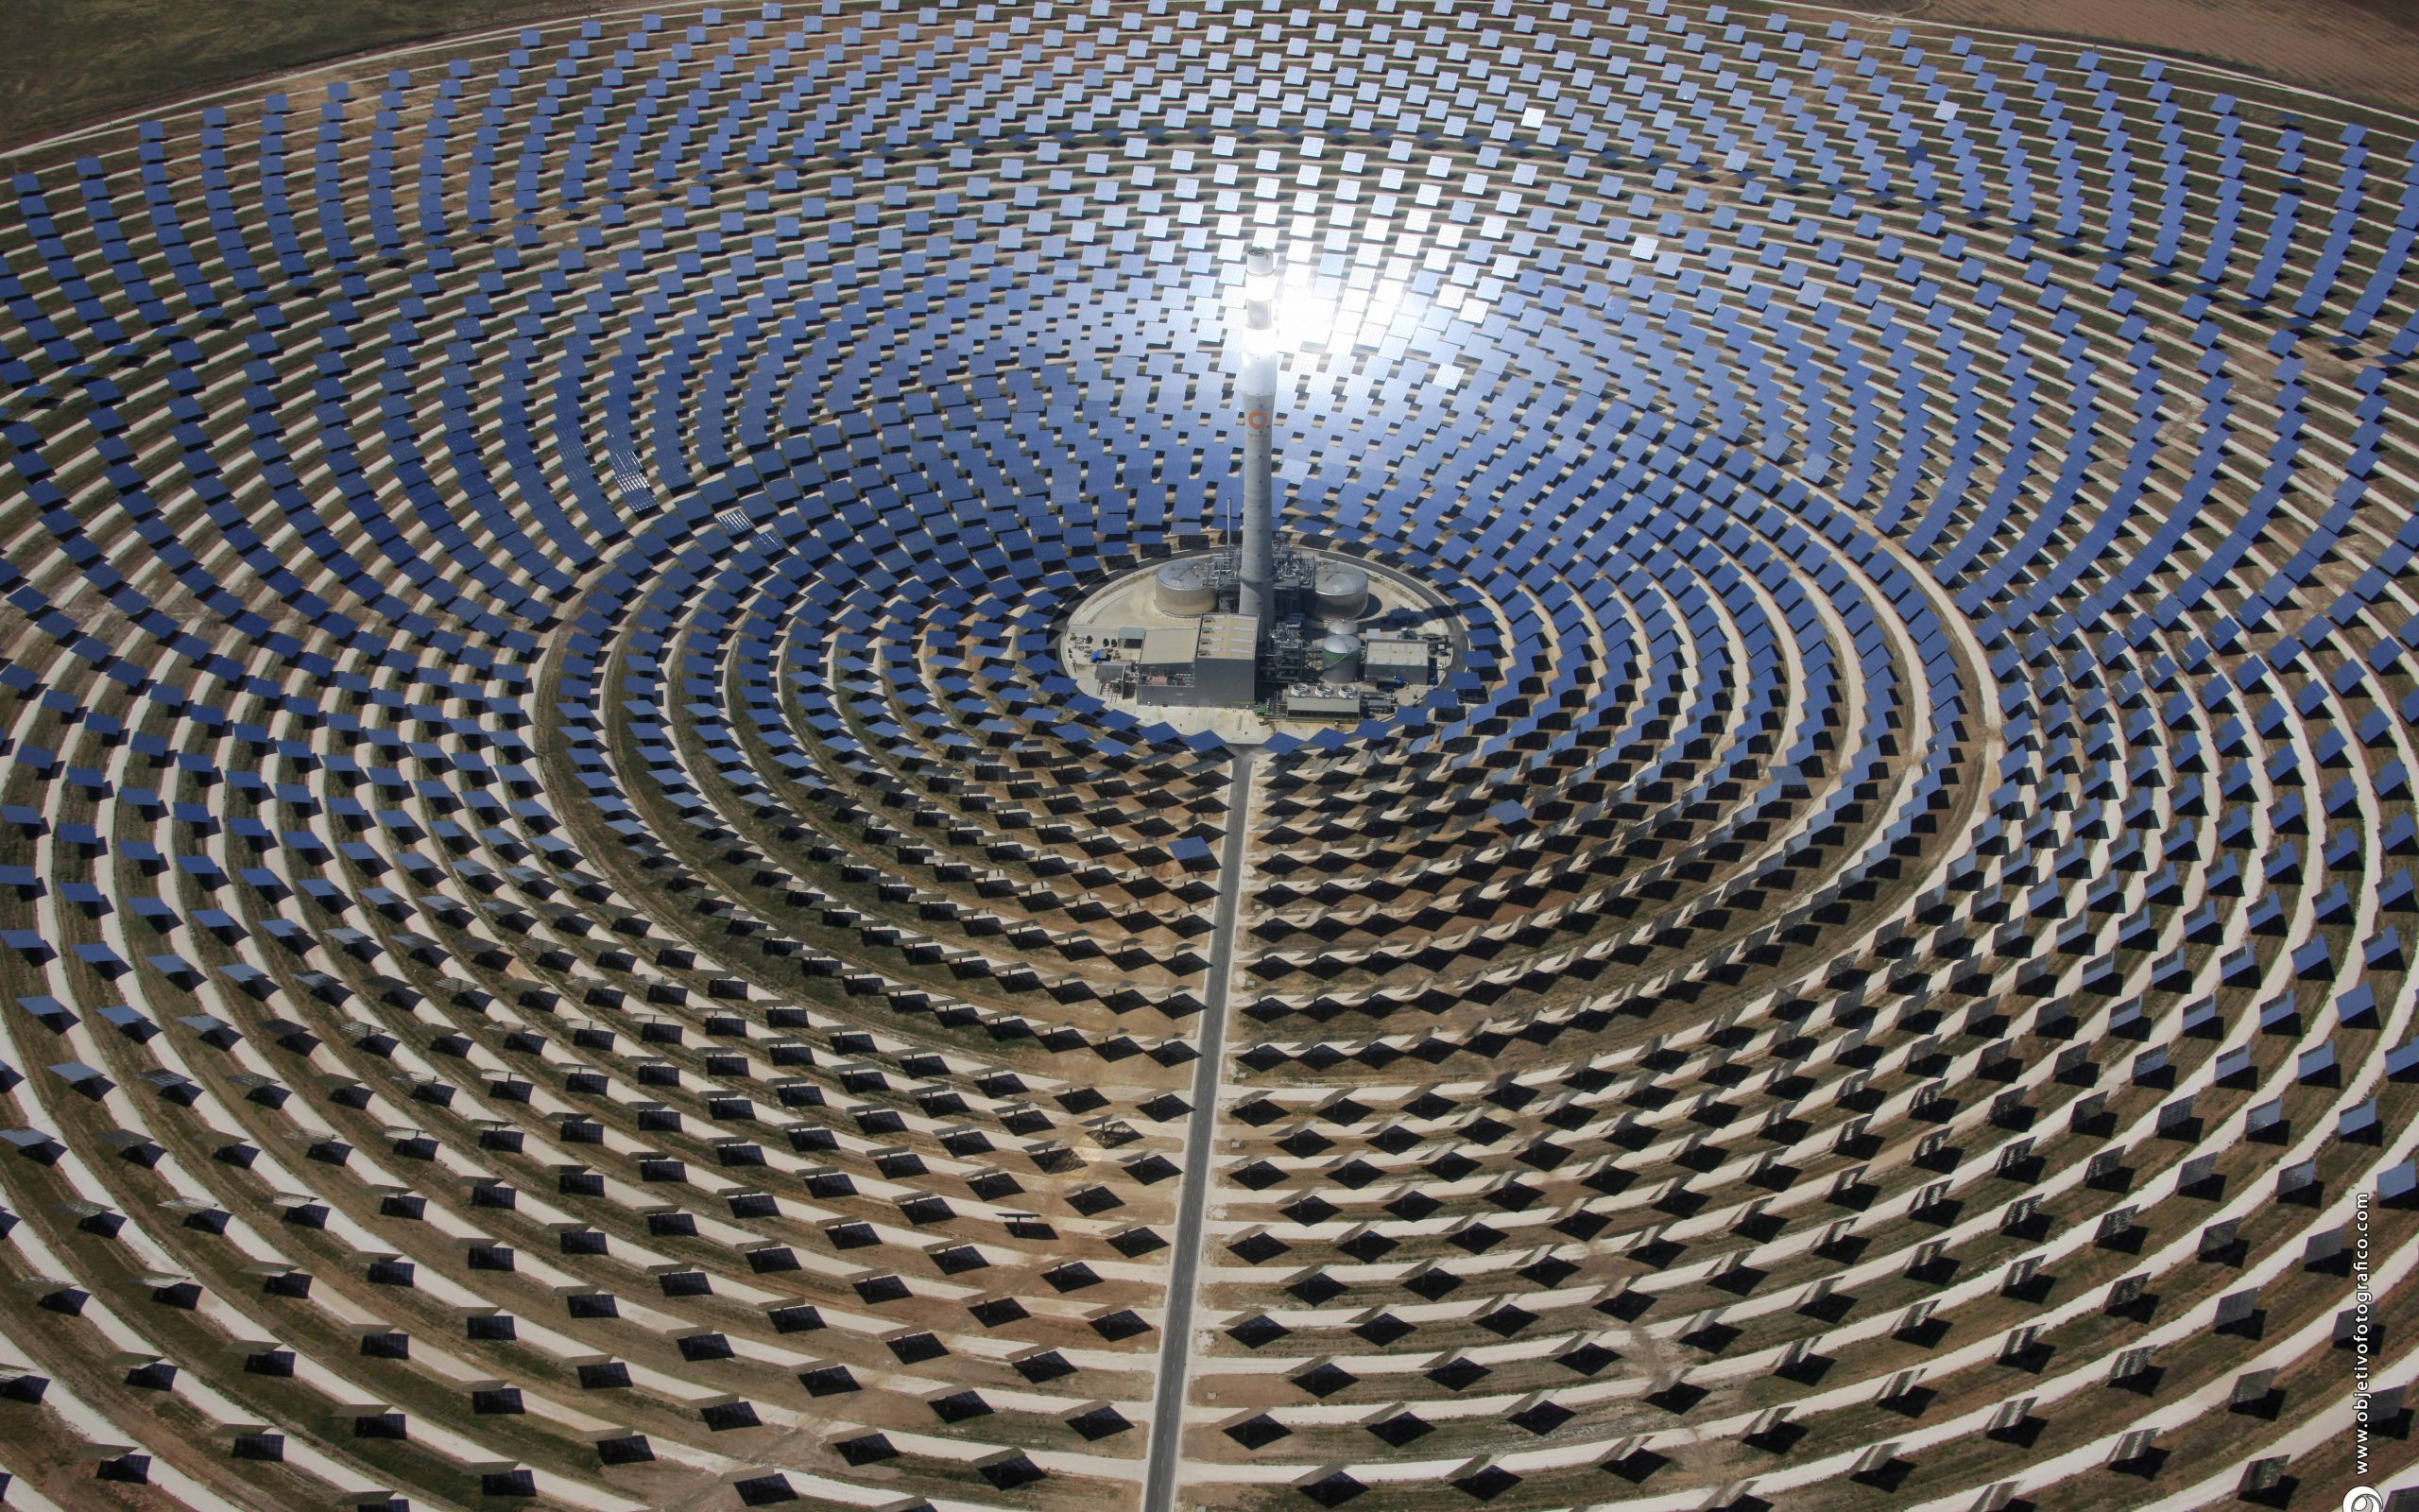
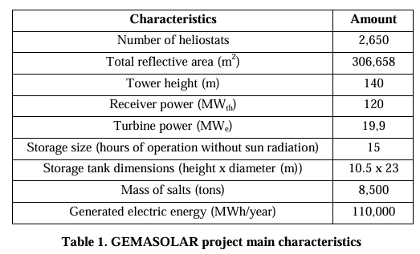
Case study
Gemasolar Thermosolar Plant (Spain)
Location and Size: Gemasolar Plant spans 185 hectares in Fuentes de Andalusia, Seville, Spain.
Energy Production: Capable of generating 110 GWh/year.
Transmission: Energy transmitted via high voltage line to Villanueva del Rey substation.
End Use: Supplies electricity to 25,000 homes via Seville Electricity Company (ENDESA).
Environmental Impact: Saves 30,000 tons of CO2 annually compared to conventional coal-fired stations in Spain.

Slide 15
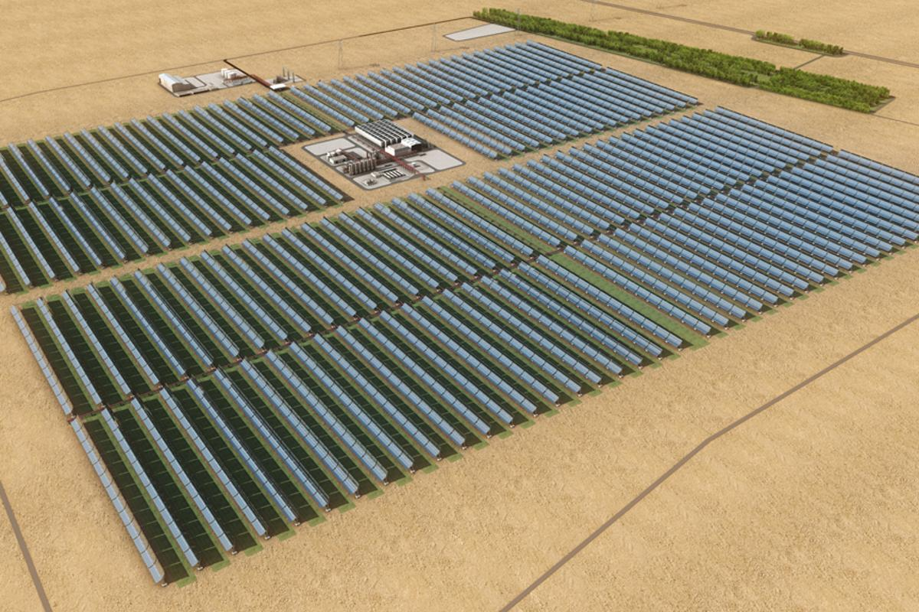
Case study 2: Shams 1, UAE
Location | Madinat Zayed, Abu Dhabi, UAE
Operational Since | Mar-13
Installed Capacity | 100 MW
Annual Electricity Generation | 210 GWh
Area Covered | 2.5 km²
Number of Parabolic Trough Collectors | 768
Number of Mirrors | Over 258,000
Number of Solar Collector Assembly Loops | 192
Number of Absorber Pipes | 27,648
Solar Field Aperture Area | 627,840 m²
Solar Field Inlet Temperature | 300°C
Solar Field Outlet Temperature | 400°C
Steam Turbine Capacity | 125 MW
CO₂ Emissions Displaced Annually | 175,000 tons
Equivalent Trees Planted | 1.5 million
Equivalent Cars Removed from Roads | 15,000
Number of Homes Powered | Over 20,000
Construction Cost | US$600 million
Ownership Structure | Masdar (60%), Abengoa Solar (20%), Total S.A. (20%)
Start of Construction | Jul-10
Commissioning Date | March 17, 2013

Slide 16
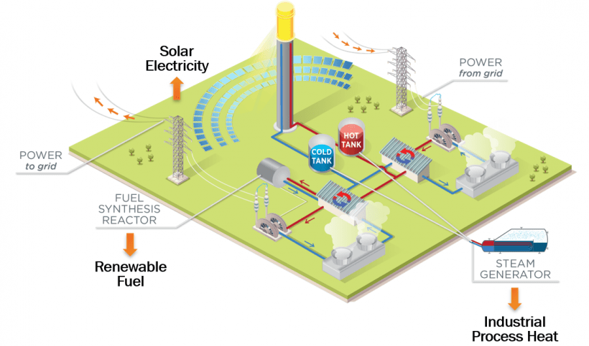

Technical / Economical advantages
Technical Advantages | Economical Advantages
Efficient resource use: Direct solar to heat conversion. | Cost-effective over time: Low operational costs.
Reliable water supply: Continuous operation via thermal storage. | Reduction in fuel dependency: Decreased reliance on imported fuels
Reduced environmental impact: Lower greenhouse emissions | Potential for revenue generation: Sell excess electricity
Scalability and flexibility: Adaptable to local conditions | Long-term price stability: Predictable costs vs. fossil fuels.

Slide 17
Challenges/ Limitations
High Initial Costs and Complexity: CSP desalination requires significant upfront investment and sophisticated system integration, making initial setup complex and costly.
Intermittency and Maintenance: The variability of solar energy and the high maintenance requirements for systems using thermal storage technologies pose operational challenges.
Resource and Land Requirements: CSP plants require substantial water for cooling and large tracts of land, which can lead to conflicts in water-scarce and ecologically sensitive areas.
Technical and Operational Challenges: Integrating fluctuating solar energy with power grids and managing thermal pollution demand advanced technical expertise and can impact local ecosystems.
Economic Competitiveness: Despite low operational costs, the competitiveness of CSP desalination is hindered by high initial expenses and scaling difficulties, especially compared to traditional energy sources and desalination methods.
Department / Unit

Slide 18
Future innovations in CSP- Desalination
Advanced Thermal Energy Storage: Development of more efficient and cost-effective thermal storage materials and technologies, such as phase change materials or thermochemical storage, to extend the operational hours of CSP plants beyond daylight.
Hybrid Desalination Systems: Integration of CSP with multiple desalination technologies, such as combining Multi-Effect Distillation (MED) with Reverse Osmosis (RO), to optimize water production rates and energy usage.
Enhanced Heat Transfer Fluids: Innovation in heat transfer fluids that operate at higher temperatures and with better thermal properties to improve the efficiency and scalability of CSP systems.

Slide 19

Environmental Impact
ADVANTAGES | DISADVANTAGES
Reduces dependency on fossil fuels and emissions. | Large land requirements can disrupt habitats.
Provides sustainable fresh water in arid regions. | Uses significant water and materials, impacting local resources.
Minimal air pollutants during operation. | Discharged heat can affect local climates.
Allows for agricultural activities beneath arrays. | Production and disposal of components can generate waste.

Slide 20
Conclusion
Sustainability: CSP desalination reduces reliance on non-renewable resources, aligning with global sustainability goals.
Innovation: Advances in technology, such as improved thermal energy storage and hybrid desalination systems, continue to enhance the efficiency and feasibility of CSP desalination.
Challenges and Opportunities: While there are hurdles, such as high initial costs and technical complexities, the ongoing innovations and economic incentives are paving the way for broader adoption.
Environmental Benefits: Beyond just providing renewable energy, CSP desalination offers significant environmental benefits, reducing greenhouse gas emissions and minimizing ecological impacts compared to traditional desalination and power generation methods.

Slide 21
References
Zhang, Huili & Baeyens, J. & Degrève, Jan & Cáceres, Gustavo. (2013). Concentrated solar power plants: Review and design methodology. Renewable and Sustainable Energy Reviews. 22. 466-481. 10.1016/j.rser.2013.01.032.
Iaquaniello, G. & Salladini, Annarita & Mari, A. & Mabrouk, Abdel Nasser & Fath, Hassan. (2014). Concentrating solar power (CSP) system integrated with MED–RO hybrid desalination. Desalination. 336. 121–128. 10.1016/j.desal.2013.12.030.
Mohammadi, Kasra & Saghafifar, Mohammad & Ellingwood, Kevin & Powell, Kody. (2019). Hybrid concentrated solar power (CSP)-desalination systems: A review. Desalination. 468. 114083. 10.1016/j.desal.2019.114083.
next https://thewaterproject.org/water-scarcity/?utm_campaign=long_tail&utm_source=googlegrant&utm_medium=cpc&utm_term=water%20scarcity&gad_source=1&gclid=CjwKCAiA3Na5BhAZEiwAzrfagNMlf41YtlXnJdOve9oX7TE7PAkjWo0NiprZY_U6CCc3CVb6maNgxBoCfxsQAvD_BwE
https://apnews.com/article/water-united-nations-world-meteorological-organization-86183afa4d917fe9777f730159849c8f
https://www.ft.com/content/aa0c75b6-524e-4090-9dfc-0d40ef8bccbd?utm_source=chatgpt.com
https://www.google.com/url?sa=i&url=http%3A%2F%2Fprismgroup.co%2Fwater%2Fdesalination%2F&psig=AOvVaw3lGmbCGvNnAVh1EXs0q7IX&ust=1731884448374000&source=images&cd=vfe&opi=89978449&ved=0CBQQjRxqFwoTCPj5gr764YkDFQAAAAAdAAAAABAI

Slide 22
Q & A?

