Slide 1

Thermal Sand Storage
Daeho Chang
NPRE 498 Special Topics: Energy Storage Systems
Nuclear Plasma Radiological Engineering
University of Illinois Urbana-Champaign
Dec. 2nd, 2024

Slide 2
Overview
Heat energy
Energy Usage in the US
Thermal Energy Storage (TES)
Sand Based TES
Basic Idea
Advantages
Disadvantages
Applications
Case Study
Alaska Home
Conclusion
Conclusion
Reference
UNIVERSITY OF ILLINOIS URBANA-CHAMPAIGN
GRAINGER ENGINEERING

Slide 3

Heat energy
Why are we trying to storage heat and reuse
UNIVERSITY OF ILLINOIS URBANA-CHAMPAIGN
GRAINGER ENGINEERING

Slide 4
Heat Energy
Heat Energy
More than 50% of global energy consumption in 2018
Contributes 40% of global carbon dioxide emission.
About 50% of total heat produced was used for industrial processes, while another 46% was used for buildings with space and water heating
Since most of the heat generation comes from fossil fuels, reducing the amount of heat generation required by reusing wasted heat could be helpful.
Heat Energy storage can be used for industrial processes using heat and renewable energy source use for heat.
Renewable energy sources such as bioenergy, solar thermal, and direct geothermal makes use of heat produced by renewable sources.
UNIVERSITY OF ILLINOIS URBANA-CHAMPAIGN
GRAINGER ENGINEERING

Slide 5
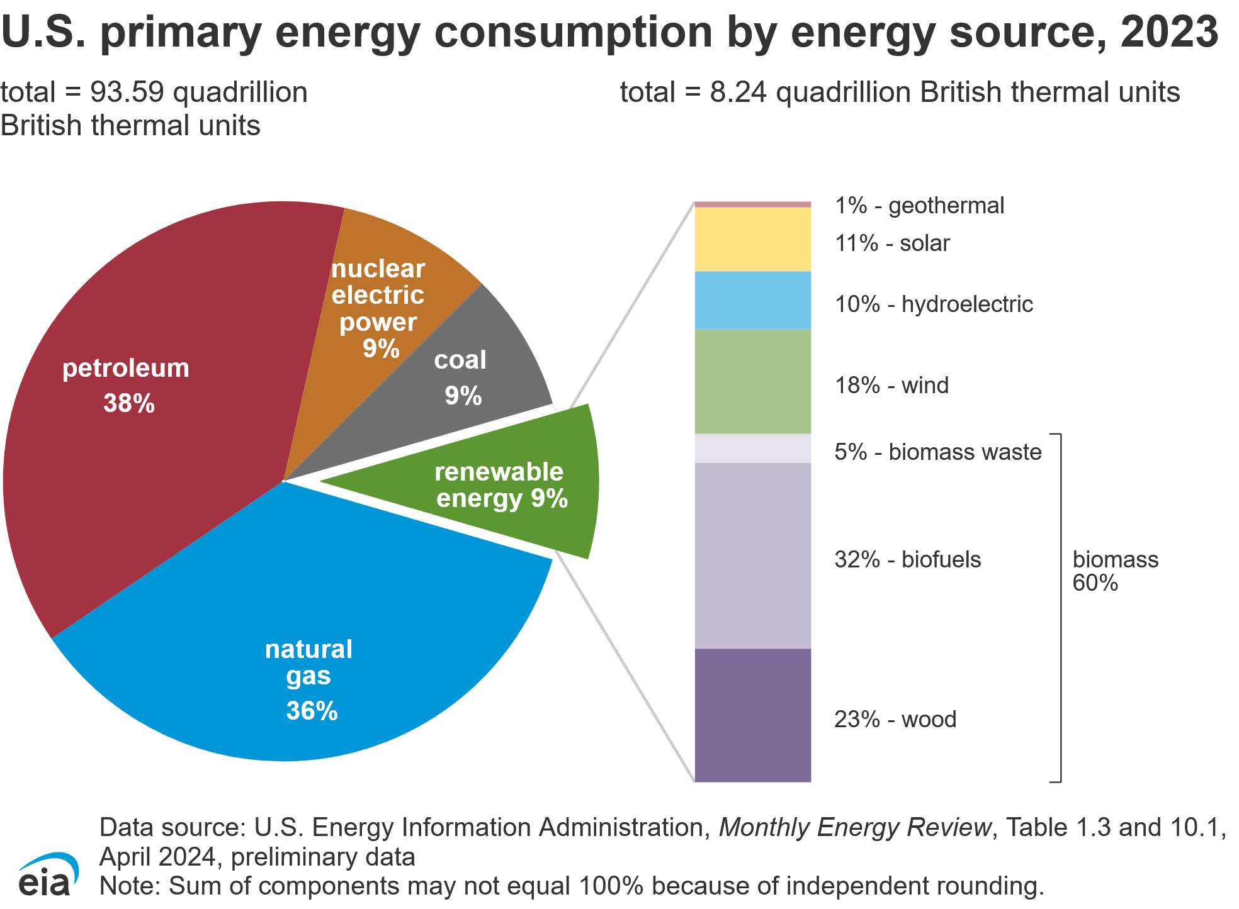
Heat Energy
According to the US energy information administration, about 52% of energy are used for heating in the US.
91% of Energy produced in the US is produced by non-renewable energy fuel.
In the process of electricity conversion, around 58% of energy produced are wasted from power plants, vehicles, and inefficient lighting.
UNIVERSITY OF ILLINOIS URBANA-CHAMPAIGN
GRAINGER ENGINEERING

Slide 6
Thermal energy Storages
Heat Storages
Sand possesses favorable thermal properties such as high thermal conductivity and stability at elevated temperatures, making it suitable for thermal energy storage systems.
Thermal energy storages (TES) store excess thermal energy for later use, enhancing flexibility and efficiency of heat based renewable energy systems.
Energy storage systems allow to buffer for the changes in supply and demand of the peak usage during the day and year.
Low Heat temperature applications
200-400 ℃ are Often used for applications like industrial process heat or low-temperature thermal energy storage systems.
High Heat temperature applications
500-1000 ℃ are suitable for concentrated solar power plants and advanced industrial applications requiring high-grade heat
UNIVERSITY OF ILLINOIS URBANA-CHAMPAIGN
GRAINGER ENGINEERING

Slide 7
Sand-based TES
Thermal Energy Storage
UNIVERSITY OF ILLINOIS URBANA-CHAMPAIGN
GRAINGER ENGINEERING

Slide 8
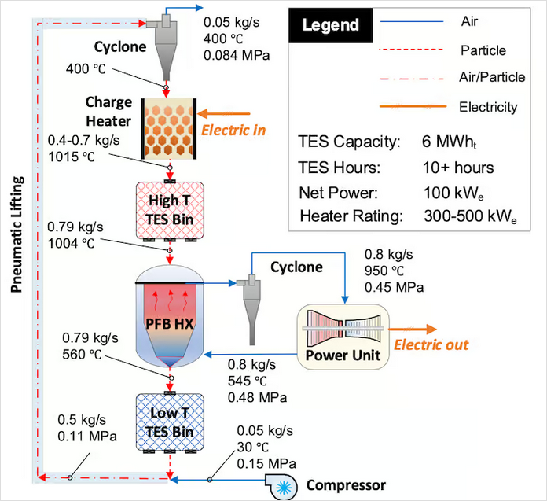
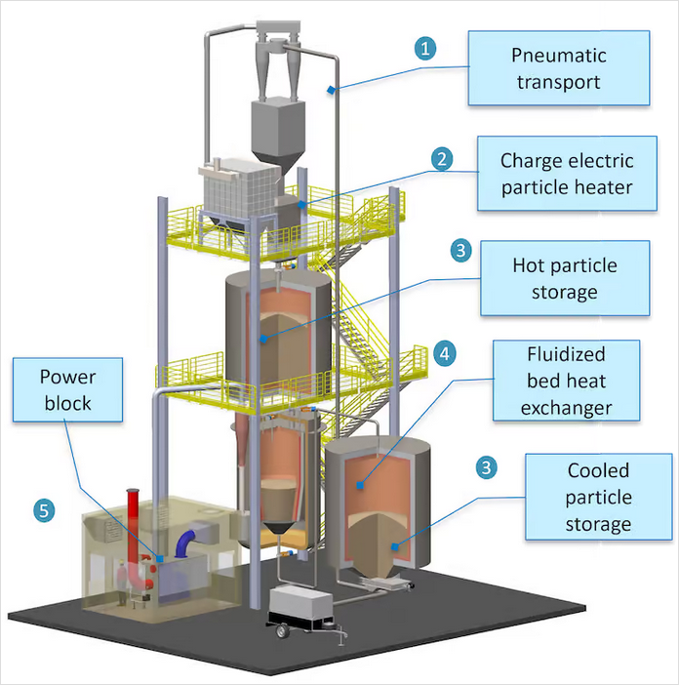
Thermal Energy Storage
IMAGE / GRAPHIC
Sand Based long-duration thermal energy storage (demonstration scale) NREL
Long-duration thermal energy storage Demo (NREL)
UNIVERSITY OF ILLINOIS URBANA-CHAMPAIGN
GRAINGER ENGINEERING

Slide 9
Thermal Energy Storage
Advantages of Sand based TES
Cost-effective : sand is abundant and inexpensive, reducing material cost compared to other systems requiring specialized materials.
High temperature stability: capable of storing heat at temperatures suitable for various industrial processes.
Scalability: easily scalable for large scale applications, including district heating systems.
Applicability: Thermal energy storage is applied to different renewable energy systems such as concentrated solar power, PV solar panels, geothermal etc.
UNIVERSITY OF ILLINOIS URBANA-CHAMPAIGN
GRAINGER ENGINEERING

Slide 10
Thermal Energy Storage
Disadvantages of Sand based TES
Upfront initial cost: it may have high initial investment for the infrastructure, and operational maintenance cost.
Space requirements: storing significant amount of sand for storage requires physical space.
Thermal efficiencies: Technology for the efficient energy conversion are still in research, plausible methods are considered in use. Thermal conversion efficiencies would be mission critical for the storage system to be viable option.
Levelized Cost of Storage: Competing with other Thermal storage systems and traditional batteries, Sand based TES systems require cost reduction through innovation and mass production.
UNIVERSITY OF ILLINOIS URBANA-CHAMPAIGN
GRAINGER ENGINEERING

Slide 11
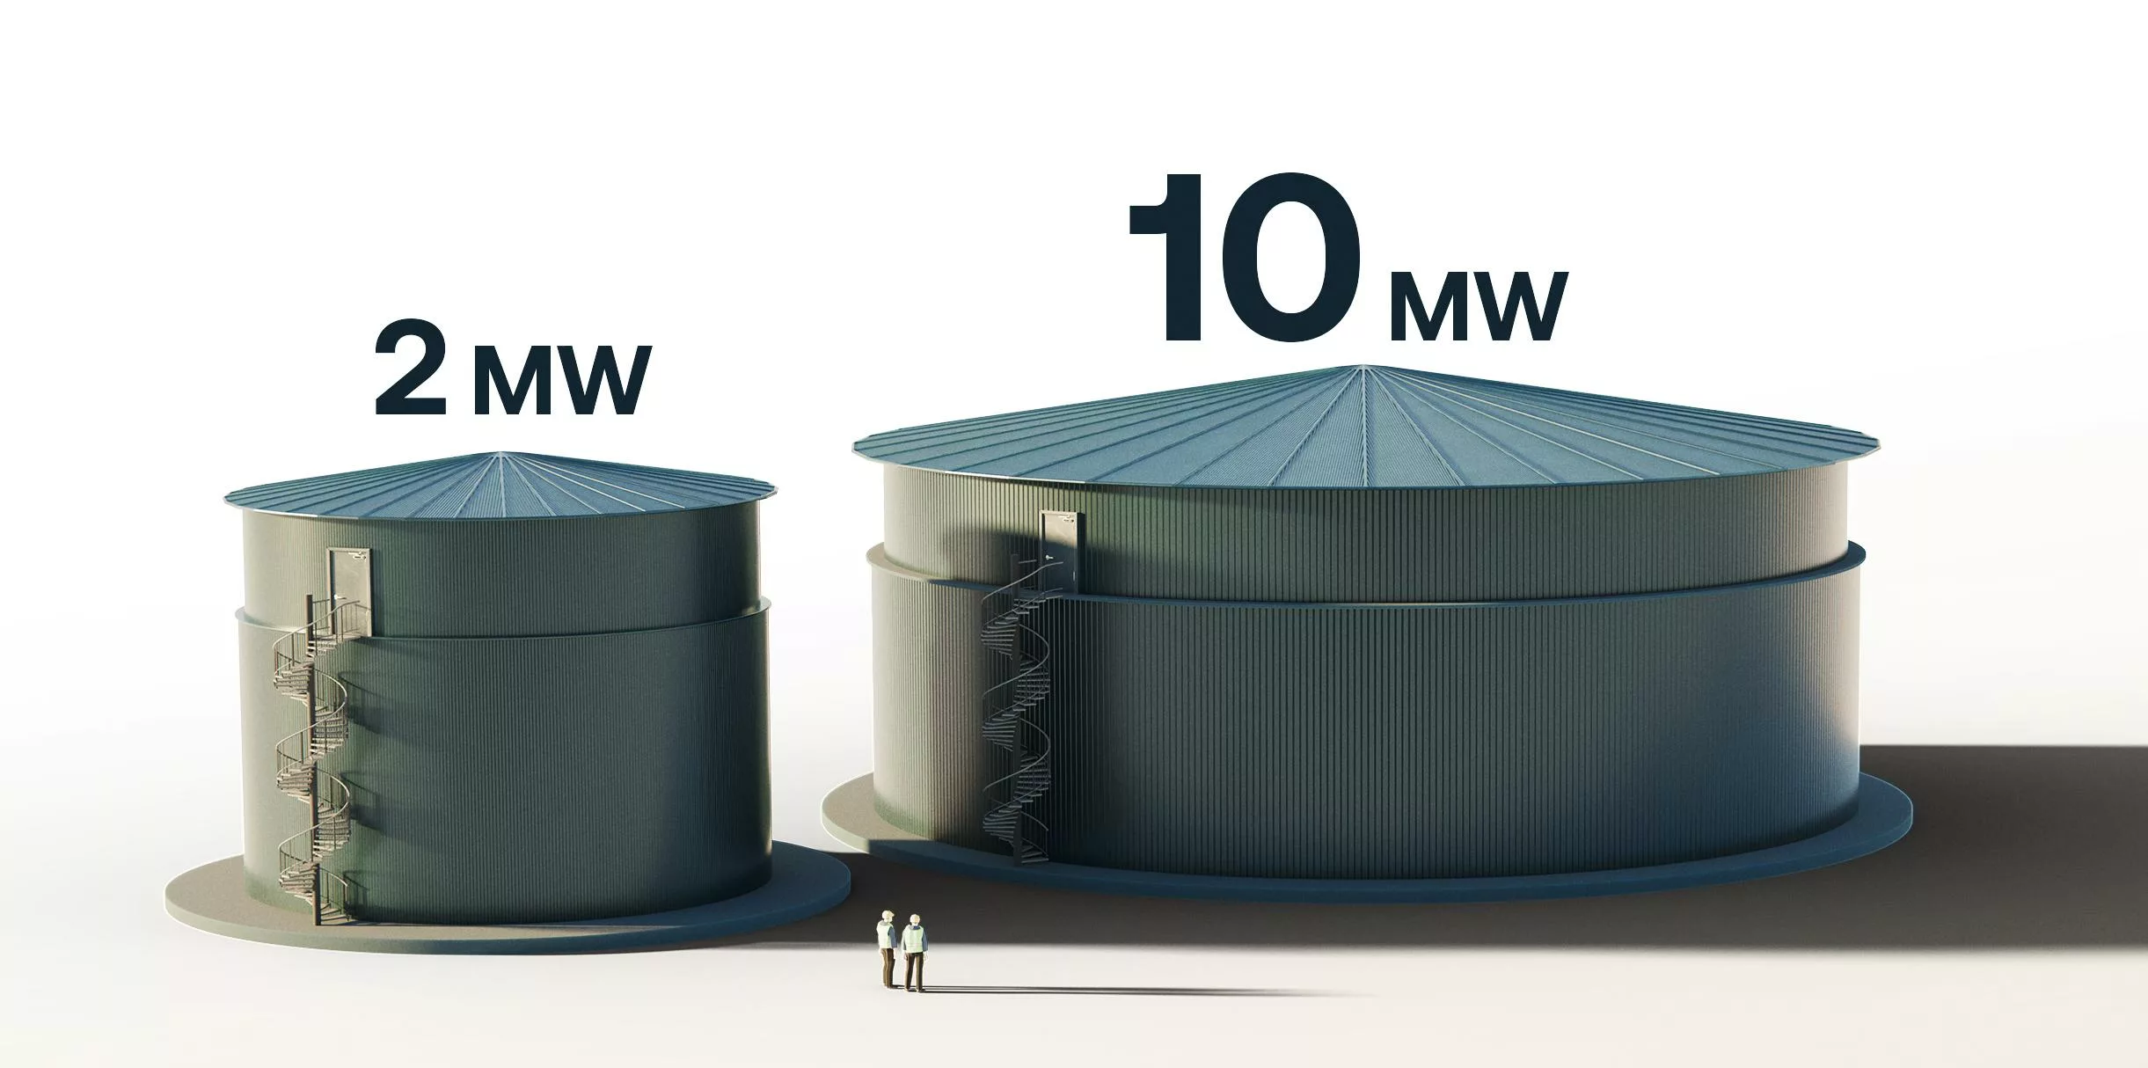

Thermal energy storages – Sand based
Waste Foundry Sand
Operation temperature is usually up to 600 ℃ to accommodate phase change materials like sodium nitrate.
Energy density is around 628 kJ/kg
Thermal conductivity is around 1.38 W/mK which is significantly higher than pure sodium nitrate.
Reusing foundry sand is good for upcycling and reduce landfill waste.
Reduced greenhouse gas emission by recovering industrial waste heat and diverts significant amounts of waste.
Upcycling waste sand can provide more pros
WFS contains 90% silica, offering high thermal stability and heat retention suitable for high-temperature TES applications.
WFS acts as a matrix material, preventing leakage from Composite Phase change materials (CPCMs)
IMAGE / GRAPHIC
IMAGE / GRAPHIC
UNIVERSITY OF ILLINOIS URBANA-CHAMPAIGN
GRAINGER ENGINEERING

Slide 12
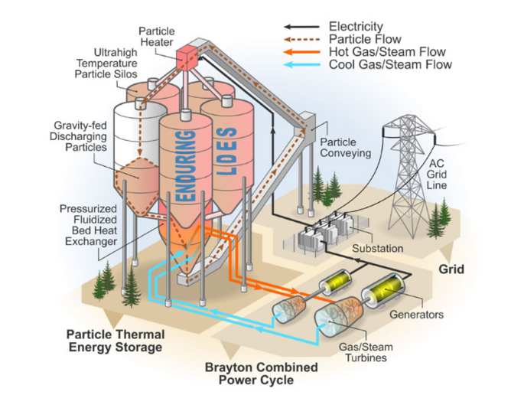
Thermal Energy Storage in Commercial Scale
Thermal Sand Storage by Polar Night Energy
Finnish Startup, Polar night Energy’s sand battery is a commercial scale application example of the thermal energy storage.
This system heats sand to approximately 600°C
Stored heat can be utilized in space heating, air and steam heating for industrial processes and planned “Power to heat to power”, converting stored heat to electricity by 2026.
Polar Night Energy, the company behind this technology, estimates that their high-temperature seasonal heat storage systems Contributes to significant carbon reductions, with potential to cut over 100 million metric tons of CO₂ annually in the EU by 2030, accounting for about 3% of current EU emissions, or double the emissions of NYC
NREL Thermal Energy Storage Technology
UNIVERSITY OF ILLINOIS URBANA-CHAMPAIGN
GRAINGER ENGINEERING

Slide 13
Thermal Energy Storage in Applications
Water
Provides hot water and space heating for district systems, reducing energy cost and carbon emissions
Air
Deliver space heating, drying, and other industrial processes, improving efficiency and sustainability
Steam
Generate hot steam for industrial processes like manufacture, power generation, replacing fossil fuel-based systems
Electricity
Future planned for power to heat to power conversion products
UNIVERSITY OF ILLINOIS URBANA-CHAMPAIGN
GRAINGER ENGINEERING

Slide 14
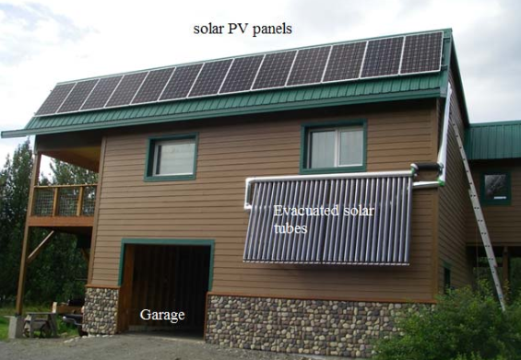
Thermal Energy Storage in SubZero Environments
CHART / GRAPH
Experimental Home with solar PV panels and sand-bed thermal energy storage system in Palmer, Alaska
The study was conducted to see if sand-bed storages were viable in sub-zero environments.
UNIVERSITY OF ILLINOIS URBANA-CHAMPAIGN
GRAINGER ENGINEERING

Slide 15
Conclusion
Sand based TES is a viable option for sustainable energy systems
Cost-Effective and Abundant materials: Sand is low-cost, widely available material, making it economically viable
Environmentally Friendly: utilizes sustainable materials and able to reuse and upcycle materials such as Waste Foundry sand.
Thermal efficiencies: operates efficiently at higher temperatures over 500℃, suitable for various applications.
Versatility and Scalability: Easily integrates with renewable energy sources and scales to meet various needs
Promotes Circular Economy: able to repurpose waste materials such as Waste Foundry Sand, and upscaling for minimizing environmental impact.
UNIVERSITY OF ILLINOIS URBANA-CHAMPAIGN
GRAINGER ENGINEERING

Slide 16
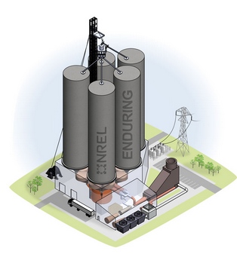
Reference
[1]. Anagnostopoulos, Argyrios, et al. “From waste to value: Utilising waste foundry sand in thermal energy storage as a matrix material in composites.” Solar Energy, vol. 268, Jan. 2024, p. 112294, https://doi.org/10.1016/j.solener.2023.112294.
[2]. Ellis, Dominic. “Can Sand Batteries Be Scaled Commercially?” Energy Magazine, Bizclik Media Ltd, 11 July 2022, energydigital.com/renewable-energy/can-sand-batteries-be-scaled-commercially.
[3]. Hailu, Getu, et al. “Seasonal solar thermal energy sand-bed storage in a region with extended freezing periods: Part I experimental investigation.” Energies, vol. 10, no. 11, 15 Nov. 2017, p. 1873, https://doi.org/10.3390/en10111873.
[4]. Hicks, Wayne. “Solution to Energy Storage May Be beneath Your Feet.” NREL, 28 Mar. 2024, www.nrel.gov/news/features/2024/solution-to-energy-storage-may-be-beneath-your-feet.html.
[5]. Kraemer, Susan. “Long-Duration Thermal Energy Storage in Sand Begins NREL Demo.” SolarPACES, 19 Sept. 2024, www.solarpaces.org/100-hour-thermal-energy-storage-in-sand-begins-nrel-demo/.
[6]. Media Relations. “NREL Options a Modular, Cost-Effective, Build-Anywhere Particle Thermal Energy Storage Technology.” NREL, 30 Aug. 2021, www.nrel.gov/news/program/2021/nrel-options-a-modular-cost-effective-build-anywhere-particle-thermal-energy-storage-technology.html.
[7]. “Sand Battery.” Polar Night Energy, polarnightenergy.com/sand-battery/. Accessed 1 Dec. 2024.
IMAGE
Particle Thermal Energy storage system NREL
UNIVERSITY OF ILLINOIS URBANA-CHAMPAIGN
GRAINGER ENGINEERING

Slide 17

Questions?
UNIVERSITY OF ILLINOIS URBANA-CHAMPAIGN
GRAINGER ENGINEERING

Slide 18


