Slide 1
Synthesis of Hydrocarbon Fuels from Carbon Dioxide
Daniel Li

Slide 2
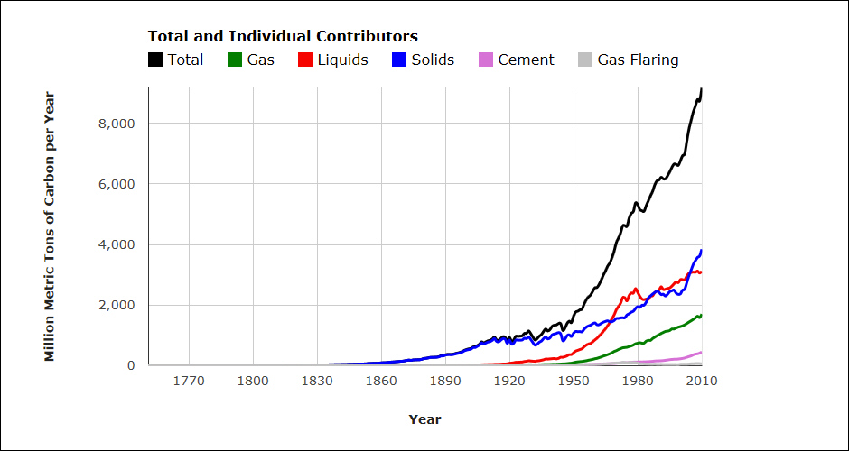
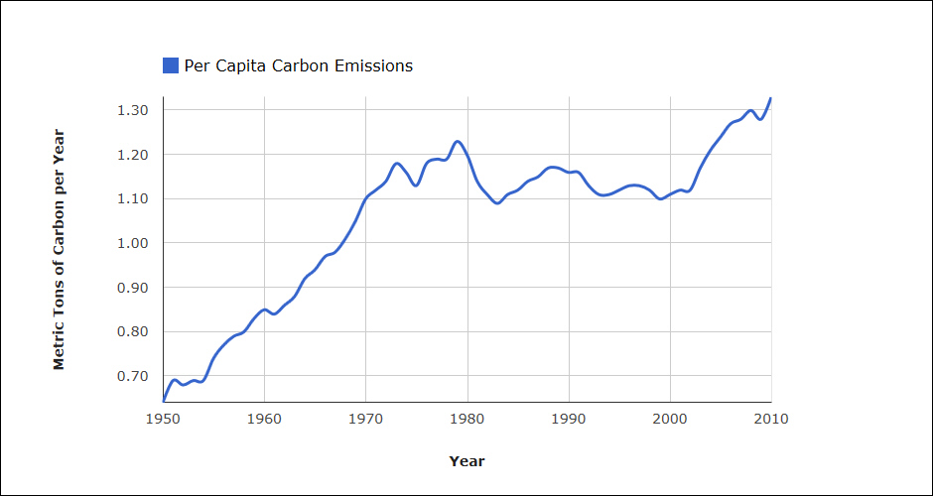
Background – Carbon Emissions
Excess GHG emissions globally due to industrialization and population growth
Driver behind many additional problems we are projected to face – climate change, ocean acidification, decreasing agricultural productivity, etc.
Concurrent with other major problems, including rising fuel prices (and eventual fossil fuel depletion)
About 25-30% of GHG emissions result from transportation sector

Slide 3
Background – Alternative Transportation Fuels
Ethanol: Energy/chemical intensive to produce, requires vast amounts of land for biofuel crops, and may raise food prices
Electricity: Low range, expensive, lack of supporting infrastructure
Hydrogen: Low range, expensive, safety concerns (hydrogen embrittlement)
Additionally, there is currently little research on applications of the above fuels in air and sea transportation

Slide 4
Fischer-Tropsch Process
Well established and understood process
Reacts carbon monoxide and hydrogen to produce hydrocarbon fuels and methanol
Typically yields longer chain alkanes suitable for diesel/jet fuel, but can be further refined into other products
Can be used to simultaneously reduce carbon emissions growth and produce low-cost transportation fuels

Slide 5
Implementation of F-T
Requires source of hydrogen and carbon monoxide – currently sourced from nonrenewable sources like coal, natural gas
Achieving carbon neutrality will require integration of renewable energies
  Feedstocks
  Manufacturing
  Transportation

Slide 6
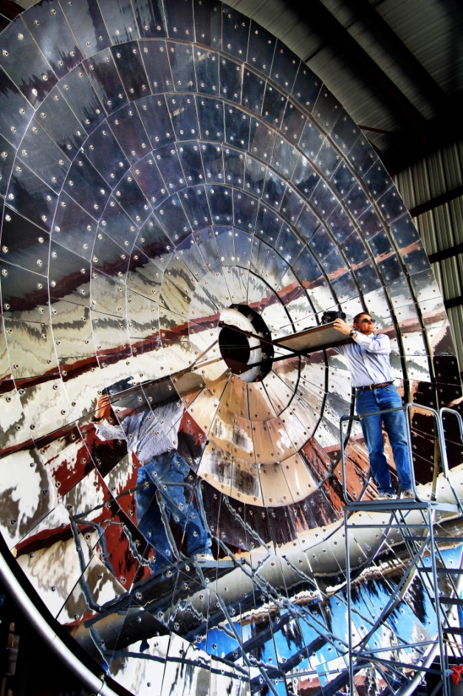
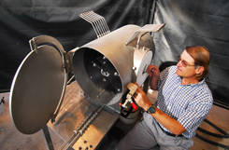
Solar Powered Production of F-T Feedstocks
Sandia Nat’l Labs “Sunshine to Petrol” project
  Harnesses solar energy to produce hydrogen from water and carbon monoxide from carbon dioxide

Slide 7
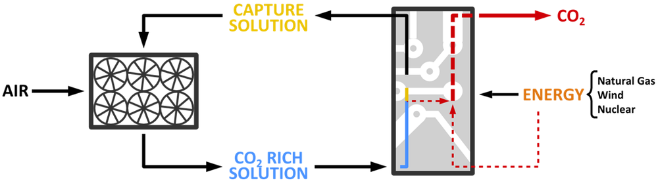
Isolating Carbon Dioxide
Can extract CO₂ from major polluters:
  Oil refining
  Coal/natural gas power stations
  Cement production and other manufacturing
Can extract CO₂ from air:
  “Direct Air Capture”
Source: Carbon Engineering, Ltd.

Slide 8
Environmental Benefits of Fuel Synthesis by F-T
Can be used to store excess energy generated by renewable sources to increase capacity factor
Mostly carbon neutral - reduction of GHG emissions growth
Easy to implement into existing infrastructure
  Gas stations
  Vehicles
  Petroleum refineries

Slide 9
Economic Benefits of Fuel Synthesis by F-T
May eventually prove to be cheaper than petroleum – no costs associated with exploration, extraction, transportation, and impurity refining
Can earn additional income through selling carbon credits
Decentralization of fuel production

Slide 10
Technological Challenges
F-T process requires high operating temperatures – may be overcome with solar concentration
Feedstock production technology is still undergoing testing
High initial startup costs
Large scale production of fuels using F-T process will require intricate integration of various renewable energies

Slide 11
References
Annual Global Fossil-Fuel Carbon Emissions - Graphics. (2014, March 3). Retrieved November 22, 2014, from http://cdiac.ornl.gov/trends/emis/glo_2010.html
Fischer-Tropsch Fuels. (2011, November 1). Retrieved November 22, 2014, from http://www.netl.doe.gov/publications/factsheets/rd/R&D089.pdf
Sandia's Sunshine to Petrol Project Seeks Fuel from Thin Air. (2007, December 5). Retrieved November 22, 2014, from https://share.sandia.gov/news/resources/releases/2007/sunshine.html
Reverse Combustion: Can CO2 Be Turned Back into Fuel? (2010, September 23). Retrieved November 22, 2014, from http://www.scientificamerican.com/article/turning-carbon-dioxide-back-into-fuel/
What is Air Capture? (n.d.). Retrieved November 22, 2014, from http://carbonengineering.com/air-capture/
The EU Emissions Trading System. (2014, May 12). Retrieved November 22, 2014, from http://ec.europa.eu/clima/policies/ets/index_en.htm

