Slide 1
Cryogenic Energy Storage
Daniel O’Grady

Slide 2
Outline
History of Cryogenics/Cryogenic Energy Storage (CES)
Process of CES
Advantages/disadvantages of CES
Current operating plant
Future plans

Slide 3
History of Cryogenics
1887 - Cailletet and Pictet liquefied oxygen
1892 – Sir James Dewar developed a vacuum- insulated vessel for storage of cryogenic fluids
1902 – Georges Claude developed the first air- liquefaction system using an expansion engine
1916 – First commercial American-made air liquefaction plant completed
1939 – First vacuum-insulated railway tank car built for transport of liquid oxygen
Notes:
Beginning of cryogenics as separate from refrigeration
This vessel, called the dewar, also led to the development of the thermos, as the manufacturer realized it could be used for storing warm milk over night for children
Was not patented
Dewars original 4 hours radiation shields 12 hours cooled necks 100 hours MLI 100 days IRAS 300 days probes 1000 days
https://www.cryogenicsociety.org/resources/cryo_central/history_of_cryogenics/

Slide 4
History of Cryogenics (continued)
1965 – Vapor cooled radiation shields
1970 – Vapor cooled necks
1975 – Multi Layer Installation (MLI)
1983 – Infrared Astronomical Satellite (IRAS)
2000 – Space probes

Slide 5
Liquid Air
78% Nitrogen, 21% Oxygen, 1% Argon
Boiling temperature of 78.8K at Atmospheric pressure
Dry air has a density of 1.225kg/m^3
Liquid air has a density of 870kg/m^3
Dry air can be cooled using a simple three stage process called the Hampson–Linde cycle

Slide 6
How does LAES Work?
Three step process
  Charging
  Storage
  Recovery
Capture of waste heat at all steps in the process
Coupled with other industrial processes to further increase efficiency
Notes:
This process is very similar to the concept of pumped hydro-storage. At times of excess electricity production electricity would be utilized to draw in and compress the local air this air liquefied air would then be stored until there was a peak demand for electricity.

Slide 7
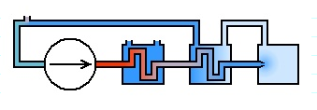
Charging (Hampson–Linde Cycle)
Notes:
In the above picture the air is first passed through a compressor, the circle with an arrow through it, In this process the air is increased above atmospheric pressures and becomes heated. The air is then passed through a heat exchanger, the first box, this bring the high pressure air down to atmospheric temperatures. The air is then passed through a second heat exchanger and bringing the high pressure air down to below atmospheric temperatures. Finally the high pressure air is allowed to expand through a nozzle. From thermodynamics it is known that this process of gas expansion results in a dramatic cooling of the gas. An example of this can be the air discharged from canned air to clean keyboards.
Note that not all of the air will be liquefied in the first pass through of the Hampson-Linde Cycle. The chilled air that is not liquefied is recycled into the second heat exchanger this helps with the efficiency of the overall proccess.
http://www.gizmology.net/liquid_air.htm

Slide 8
Storage
Stored in insulated tanks at atmospheric pressures
Potential to store up to GWth of liquefied air
Process is currently used to store liquid natural gas (LNG)
Cryogenic transportation is already established throughout the industry
Allows for the possibility of a mobile remote back-up power system
Notes:
Insulated tanks are a well developed technology that is implemented globally so there is essentially no risk in investment.

Slide 9
Recovery
At times of peak demand the liquefied air would be pumped through a heat exchanger
As the air is allowed to warm up it will rapidly boil and increase in pressure
The boiling air can then be used to spin a turbine and produce electricity

Slide 10
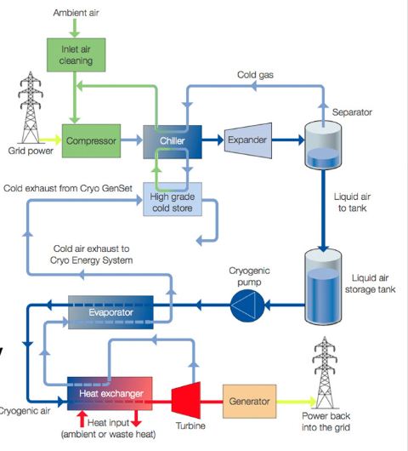

Slide 11
Advantages
Proven technology that has been around since the early 1900s
Regulations for Cryogenic storage already exist
Stored at low pressure
Non toxic and does not explode
Four times the energy density of regular air
No geology required
Notes:
1 low pressure storage allows the tanks to be cheap
2 even though the tanks have several layers of insulation they are still cheaper than high pressure tanks
3 by no geology it means that a mountain range is not requried like the pumped hydro, nor is a porous underground structure like the pumped air

Slide 12
Notes:
http://zebu.uoregon.edu/disted/ph162/l8.html

Slide 13
Disadvantages
Over long periods of time nitrogen can boil off resulting in an oxygen rich liquid
Efficiency is largely dependent on coupling with external sources.
25% efficient
Storage ranges from 2 - 20 hours

Slide 14
Pilot Plant
350 kW, 2.6 MWh storage capacity
Developed by the University of Leeds and Highview Power Storage
Operates in conjunction with a 80MW biomass power station in Slough, UK since 2010
Current efficiency of 15%
Virtual tour
Notes:
Low efficiency was due to the components used in construction of the plant. Engineers believe that the next system will have an efficiency of about 60%
The plant was equipped with a liquefier in 2011 making it a full LAES system
Plant was taken apart in 2014 and is currently being relocated at the university of Birmingham
http://www.highview-power.com/tour/

Slide 15
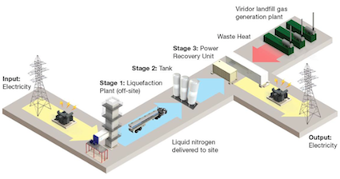
Future Plans
Highview Power Storage was recently selected by one of the UK to design a 5MW/15MWth LAES system
Plant will recycle all of its cold waste
Incorporated with a landfill gas generation plant
Notes:
Current design is to have the liquefaction plant offsite
http://www.modernpowersystems.com/features/featurehighview-prepares-for-the-next-step-in-liquid-air-technology-development-4824865/

Slide 16
References
http://www.modernpowersystems.com/features/featurehighview-prepares-for-the-next-step-in-liquid-air-technology-development-4824865/
http://zebu.uoregon.edu/disted/ph162/l8.html
http://www.gizmology.net/liquid_air.htm
https://www.cryogenicsociety.org/resources/cryo_central/history_of_cryogenics/
http://www.highview-power.com/tour/

