Slide 1
SuperCapacitors For Energy Storage
David Gardner-Dale
11/21/14
NPRE498

Slide 2
Overview
Introduction to capacitors
Current state of supercapacitor technology
Current applications
Future applications
Limitations
References

Slide 3
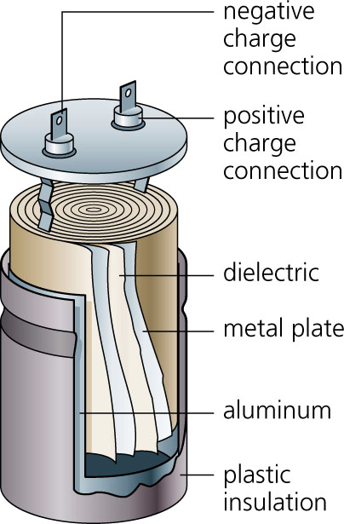
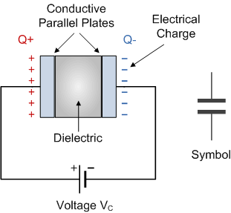
The Capacitor
Figure 1. A basic capacitor [1]
Figure 2. A common capacitor design [2]
Energy stored in an electric field between two conduction plates
Charges and discharges quickly
Long life, very low cycling losses

Slide 4
Supercapacitors
Electric Double-Layer Capacitors
Hybrid Capacitors
Pseudocapacitors

Slide 5
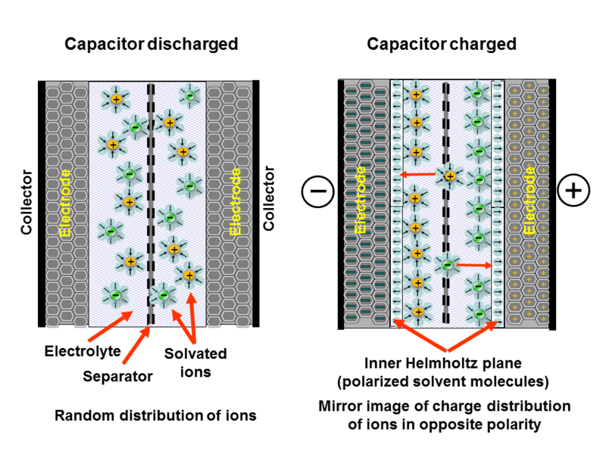
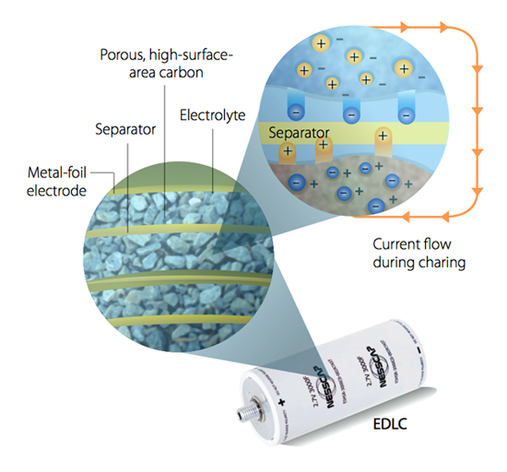
Electric Double Layer Capacitor
  EDL formed with electrode and electrolyte with solvent molecules between as dielectric.
  Store energy by adsorbing electrolyte ions onto the surface of the electrode
Figure 3. A
simplified EDL
capacitor [4]
Figure 4. An
example of EDLC
using highly porous
carbon as a
dielectric [6]
  Fast acting. Low energy potential, charge confined to surface

Slide 6
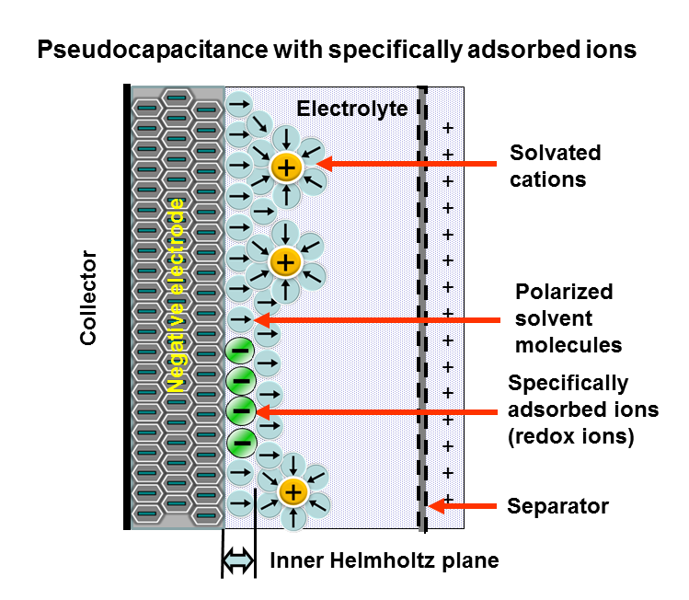
Pseudocapacitor
  Rely on redox reactions that take place at the electrode
  Electrode materials typically made up of transition metals, conducting polymers, or compound with O and N functional groups
  Higher Energy density but lower cycling life
Figure 5. Pseudocapacitor [4]

Slide 7
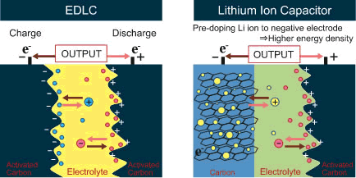
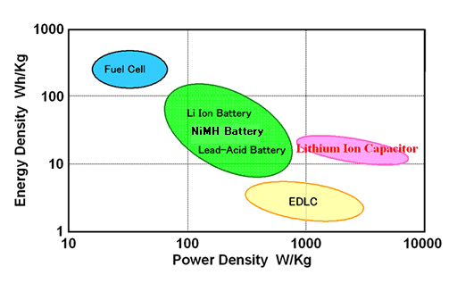
Hybrid capacitor
  A combination of EDLC and pseudocapacitors. Optimizes power density of EDLC with energy density of pseudocapacitor
  One common example is the Li ion capacitor which is a current leader in the field
Figure 6. A hybrid capacitor EDLC comparison [7]
Figure 7. Specific Energy and Power comparison [4]

Slide 8
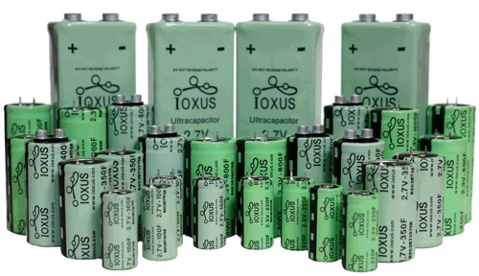
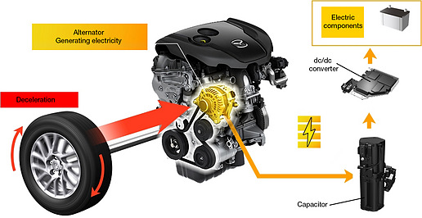
Current Applications
Due to very fast charging and discharge, supercapacitors make a great tool for regenerative breaking
Used in cars and with rail in tandem with diesel electric generators
In tandem with current batteries to improve lifetime
Used in grid applications to handle power fluctuations
Figure 8. Ioxus capacitors
Figure 9. Mazda’s regenerative breaking model [8]

Slide 9
Current Limitation
Motivation
Power capabilities
Environmentally components and raw materials
Cold weather performance
Energy Density
Research Focus
Graphene electrodes
Carbon nanotube electrodes

Slide 10
Potential Applications
EVs would benefit significantly from supercapacitors
  Easily handle high power demands that are bad for current Li-ion batteries
  Long cycle life would outlast EV itself, unlike current batteries
  Very fast charging competitive with gasoline refueling
Increasingly unstable grid leveled out by quick charge and discharge of supercapacitors
  The addition of intermittent renewables and grid connected EVs, destabilizes the grid
  Supercapacitors are a perfect fit to mitigate peaks and steady grid

Slide 11
Any Questions?

Slide 12
References
[1] http://www.electronics-tutorials.ws/capacitor/cap_1.html
[2] http://archive.news.softpedia.com/news/How-Capacitors-Work-82563.shtml
[3] Simon, Patrice, Yury Gogotsi, and Bruce Dunn. “Where Do Batteries End and Supercapacitors Begin?” Science 343, no. 6176 (March 14, 2014): 1210–11. doi:10.1126/science.1249625.
[4] wikipedia.org
[5] Huang, Yi, Jiajie Liang, and Yongsheng Chen. “An Overview of the Applications of Graphene-Based Materials in Supercapacitors.” Small 8, no. 12 (June 25, 2012): 1805–34. doi:10.1002/smll.201102635.
[6] http://www.i2bf.com/companies/16/
[7] www.jsrmicro.be
[8] http://articles.sae.org/11845/

