Slide 1
Aluminum Ion Batteries
Dimitri Kalinichenko

Slide 2
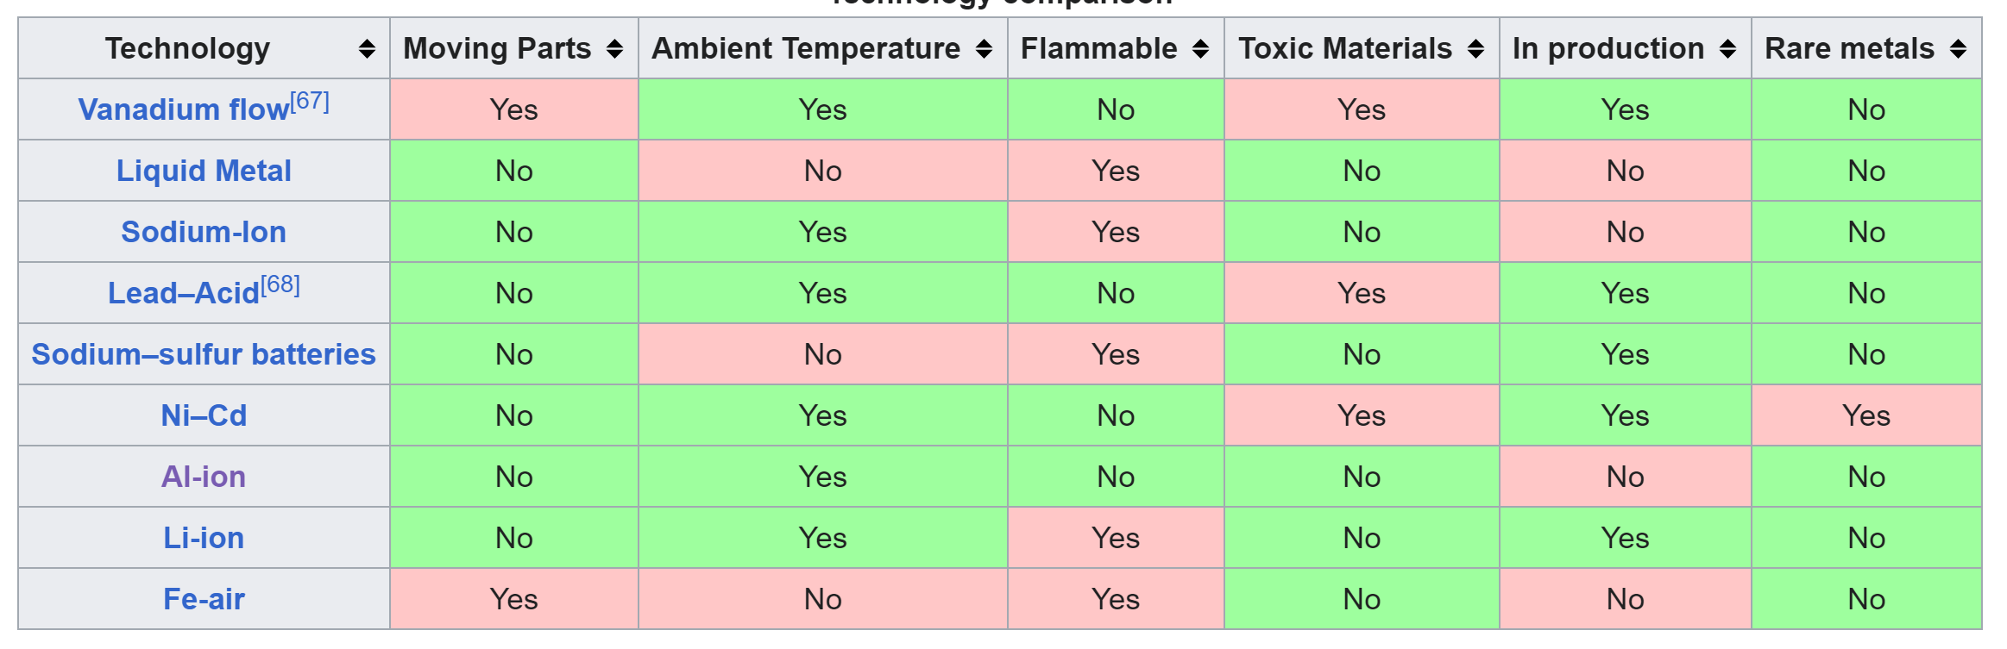
Motivation
Energy storage batteries are currently dominated by lithium-ion technology
However, there are problems:
  Lithium is flammable/highly reactive in water and air
  Lithium mining is resource intensive and arguably unsustainable
  Lithium is expensive – hard to make cost-effective grid scale batteries
Wikipedia, "Grid Energy Storage," [Online]. Available: https://en.wikipedia.org/wiki/Grid_energy_storage. [Accessed November 2023].
Nuclear, Plasma and Radiological Engineering,
University of Illinois at Urbana-Champaign

Slide 3
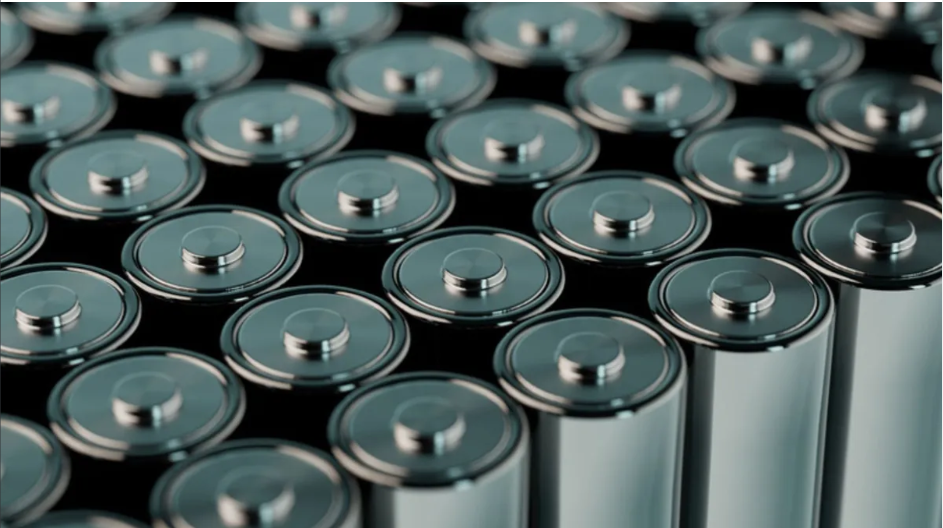
Aluminum-Ion Battery Concept
Aluminum is the most abundant metal on earth and relatively easily recyclable
The aluminum-ion has a 3+ charge instead of the 1+ of lithium-ions
  This enables theoretically higher energy density, as each charge carrier carries more charge
H0wever, the Al 3+ ion have slow moving transport and this has prevented their adoption
Additionally, electrode materials struggle to have reversible insertion of complex aluminum ions
S. Dua, "World’s first non-toxic aluminum-ion batteries developed," 2023. [Online]. Available: https://interestingengineering.com/innovation/worlds-first-non-toxic-aluminum-ion-batteries-aib-developed. [Accessed November 2023].
Nuclear, Plasma and Radiological Engineering,
University of Illinois at Urbana-Champaign

Slide 4
Solving the Challenges
Electrode material is being developed that can effectively handle complex aluminum ions with high reversibility
  Instead of graphite, an organic polymer is used for X-PVMPT electrodes
  X-PVMPT: cross-linked poly(3-vinyl-N-methylphenothiazine)
  Rather than use the positive ions, negative ions are used as charge carriers
    [Al₂CL₇]⁻ and [AlCl₄]⁻ are used for their higher potential difference enabling higher cell voltages
Performance:
167 mAh/g specific capacity vs. 120 mAh/g with graphite electrodes
  More aluminum ions can bind to the electrode => larger storage capacity
Better cyclability at faster rates
  Higher rates can put more stress on a battery and increase the risk of dendrite formation
  The battery can hold 88% capacity even after 5,000 cycles at a 10C rate (full charge/discharge in 6 minutes)
  At an 100C rate, 64 mAh/g can be cycled reversibly
  This enables the potential for fast charge and dicharge
Nuclear, Plasma and Radiological Engineering,
University of Illinois at Urbana-Champaign

Slide 5
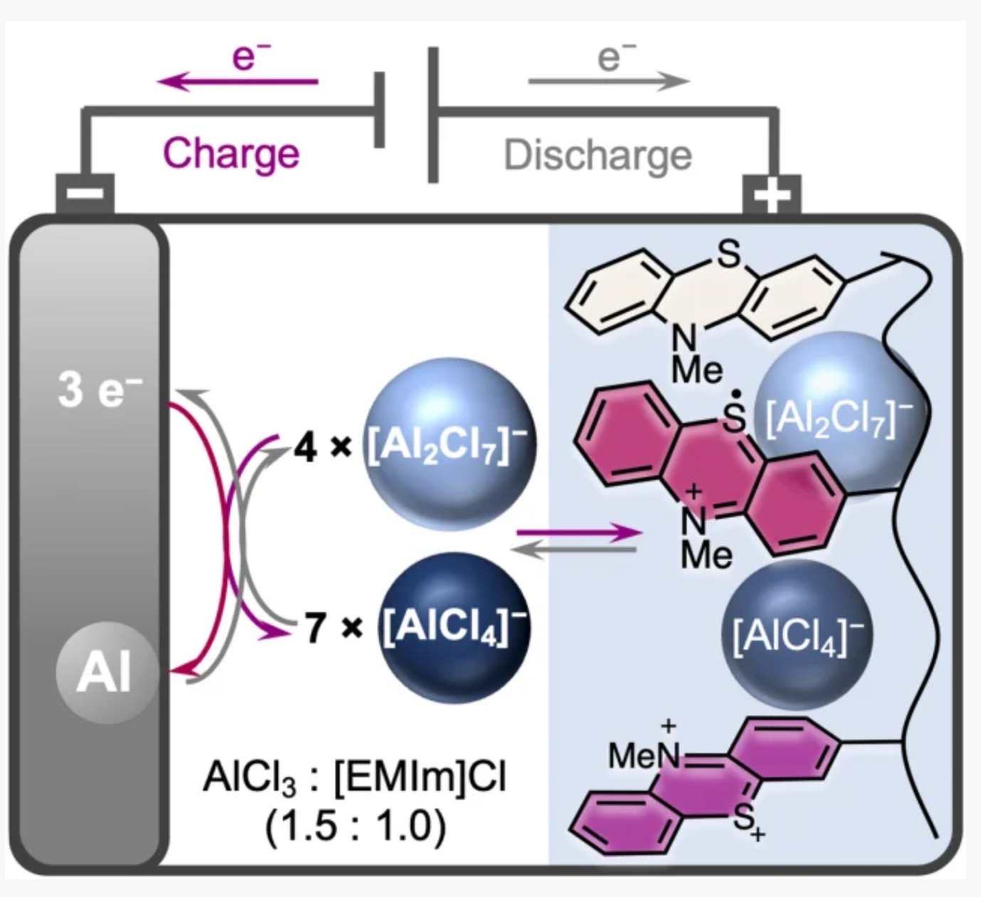
Solving the Challenges
Nuclear, Plasma and Radiological Engineering,
University of Illinois at Urbana-Champaign

Slide 6
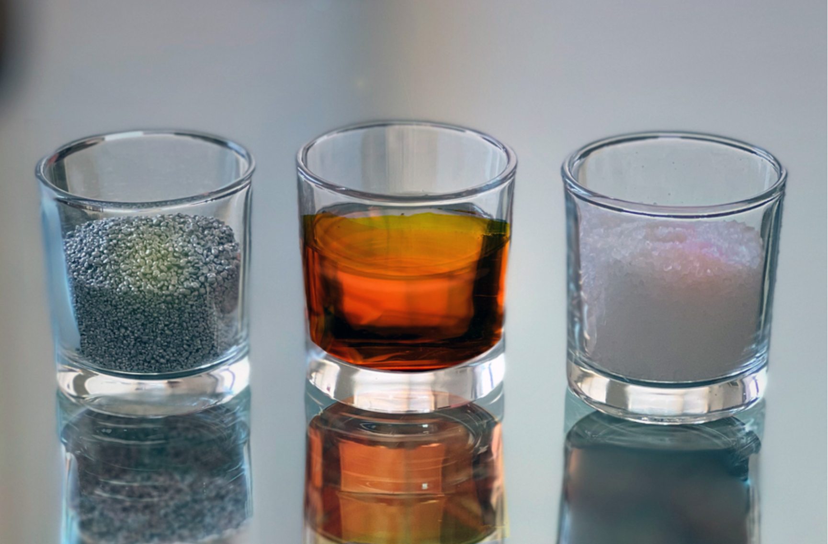
Solving the Challenges
Another proposed electrode material is sulfur, the cheapest non-metal
This concept uses a molten salt electrolyte with melting point near that of water
  Not the volatile, flammable organic liquids used in current batteries
Cheap ingredients:
  Sulfur is a common waste product
  Salts are widely available
Nuclear, Plasma and Radiological Engineering,
University of Illinois at Urbana-Champaign

Slide 7
Aluminum-Sulfur Battery Results
1/6th cost of lithium-ion
Can endure exceptionally high charging rates
Charge rate temperature dependent, rate at 110℃ 25 times faster than at 25℃
Molten salt good at preventing dendrite formation – further allows rapid recharge
  Some cells can be charged in less than a minute
Battery operation generates enough heat to keep salt molten, no need for external heating
Ideal size would be on order of tens of kWh
  Batteries could be used for fast-charging EV stations, as such high current needed that line supplying facility cannot keep up
Nuclear, Plasma and Radiological Engineering,
University of Illinois at Urbana-Champaign

Slide 8
Electrolytes for Aluminum-Ion
One electrolyte is the EMIm-based chloroaluminate ionic liquid
  EMIm: 1-ethyl-3-methylimidazolium
  Used with the X-PVPMT electrodes to allow for two-electron redox
  Considered the best electrolyte for AL-ion in terms of cost, electrochemical stability, and temperatures maintaining the electrolyte in liquid state
Another electrode design uses stable organic radicals containing a compound known as TEMPO
TEMPO: 2,2,6,6-tetramethylpiperidyl-1-oxy
The electrolytes for these batteries are water-based, making the batteries fire-retardant and air-stable
This allows for output voltages of 1.25 V with a capacity of 110 mAh/g over 800 cycles and 0.028% loss per cycle
This is 0.138 Wh/g, comparable to lithium-ion batteries that can have 0.050-0.260 Wh/g
Can also use molten salt electrolytes
Nuclear, Plasma and Radiological Engineering,
University of Illinois at Urbana-Champaign

Slide 9
Advantages of the Al-ion Battery
Aluminum is cheap, abundant, and easily recyclable
Aluminum is not reactive or flammable
The electrolyte is fire-retardant and air stable
Extremely high charge/discharge rates are possible with little capacity loss
Some electrolytes prevent dendrite formation
Comparable or higher energy storage density than Li-ion
Battery can be significantly cheaper than Li-ion and developed at larger scales
Main disadvantage: Not yet commercially available. The breakthroughs in electrolytes and electrodes that have enabled high storage capacity and fast charge/discharge have only occurred in labs this year, as late as July or even September in the case of X-PVMPT
Nuclear, Plasma and Radiological Engineering,
University of Illinois at Urbana-Champaign

Slide 10
References
[1] | Wikipedia, "Grid Energy Storage," [Online]. Available: https://en.wikipedia.org/wiki/Grid_energy_storage. [Accessed November 2023].
[2] | S. Dua, "World’s first non-toxic aluminum-ion batteries developed," 2023. [Online]. Available: https://interestingengineering.com/innovation/worlds-first-non-toxic-aluminum-ion-batteries-aib-developed. [Accessed November 2023].
[3] | D. L. Chandler, "A new concept for low-cost batteries," 2022. [Online]. Available: https://news.mit.edu/2022/aluminum-sulfur-battery-0824. [Accessed November 2023].
[4] | E. Osmanbasic, "Aluminum-Ion Batteries Get Major Capacity Boost," 2023. [Online]. Available: https://www.engineering.com/story/aluminum-ion-batteries-get-major-capacity-boost. [Accessed November 2023].
[5] | G. Studer, A. Schmidt, J. Büttner, M. Schmidt, A. Fischer, I. Krossing and B. Esser, "On a high-capacity aluminium battery with a two-electron phenothiazine redox polymer as a positive electrode," Energy & Environmental Science, no. 9, 2023.
[6] | Flux Power, "What is the Energy Density of a Lithium-Ion Battery?," 2020. [Online]. Available: https://www.fluxpower.com/blog/what-is-the-energy-density-of-a-lithium-ion-battery. [Accessed November 2023].
Nuclear, Plasma and Radiological Engineering,
University of Illinois at Urbana-Champaign

