Slide 1
Non-flammable electrolytes for Li-ion Batteries
Dong Ok Kim
NPRE 498 Fall 2023

Slide 2
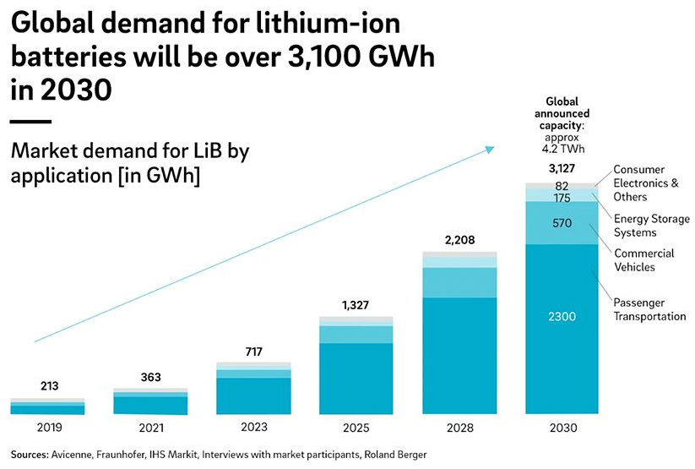
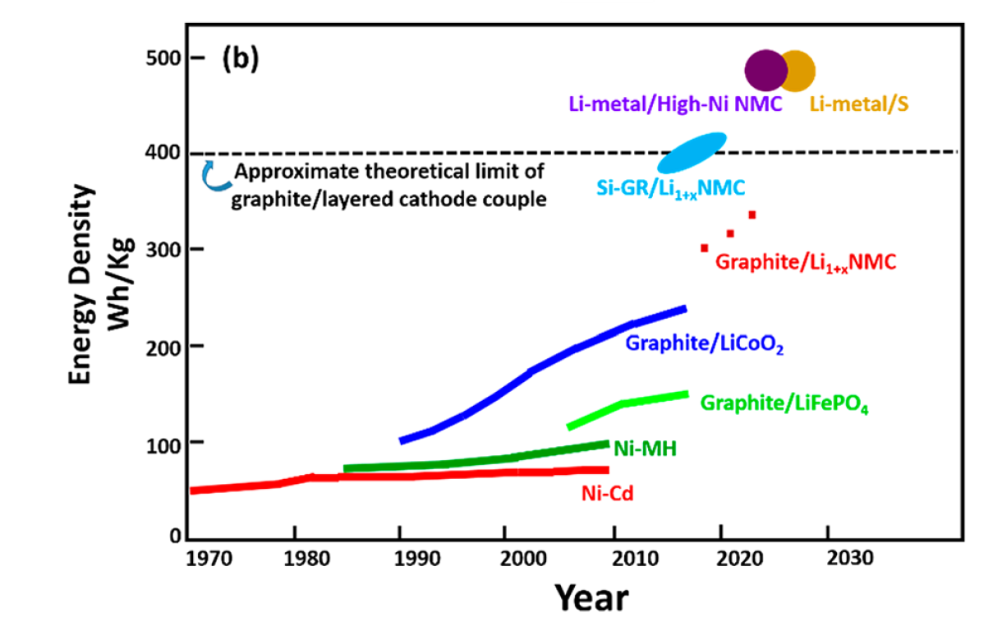
Li-ion Batteries
Chem. Rev. 2018, 118, 11433−11456

Slide 3
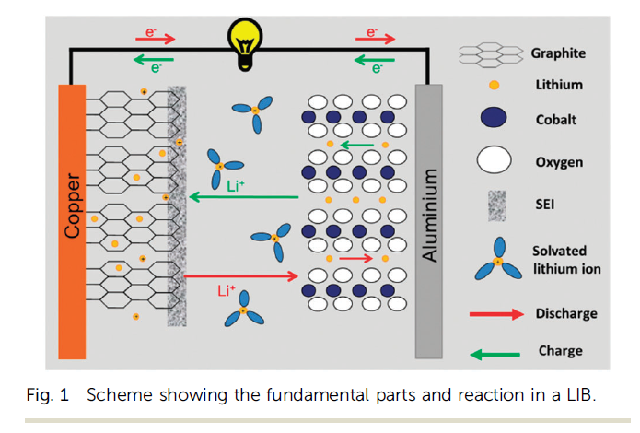
Li-ion Batteries
Physical Chemistry Chemical Physics 17, no. 43 (2015): 28441-28450.
Energies 2020, 13(19), 5117

Slide 4
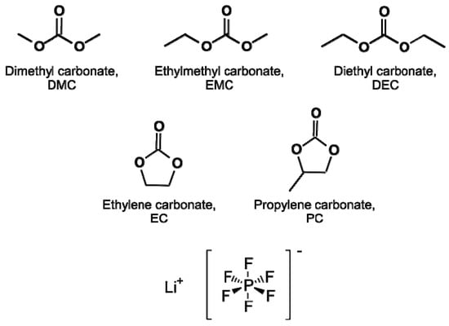
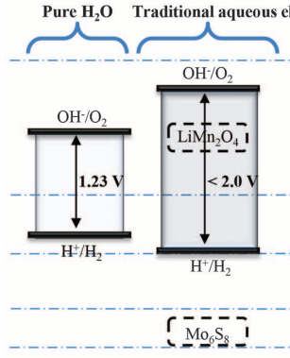
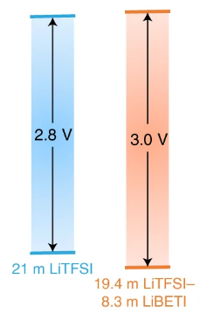
Conventional Electrolytes
Why non-aqueous?
Limitation on electrochemical window by oxygen evolution reaction and hydrogen reduction reaction
Non-aqueous, carbonate-based organic solvents
Pure H₂O
Traditional aqueous electrolyte
Non-aqueous electrolyte
Nature Materials volume 19, pages1006–1011 (2020)
Science350,938-943(2015)
Molecules 2017, 22(3), 403

Slide 5
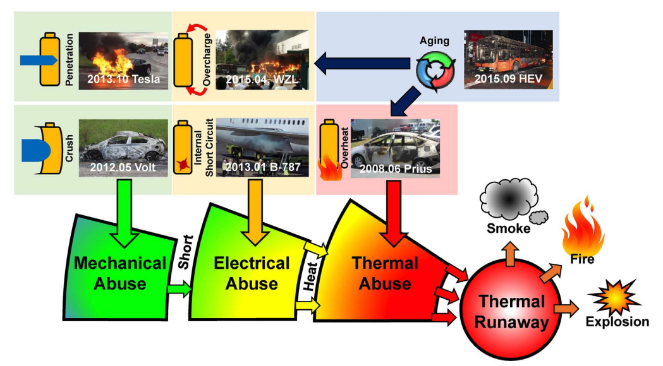
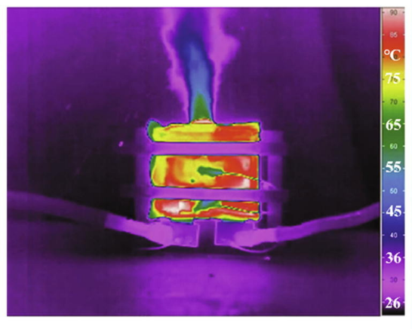
Safety Concerns
Energy Storage Materials 10 (2018) 246–267
Journal of Energy Chemistry 59 (2021) 83–99

Slide 6
Non-flammable Electrolytes
Flame Retardants
Concentrated Electrolytes
Ionic Liquids
Aqueous Electrolytes

Slide 7
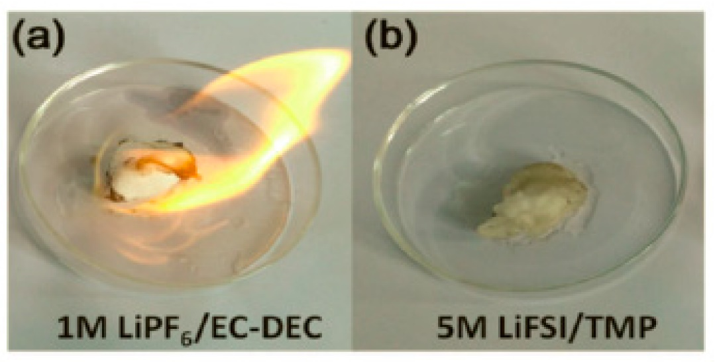
Flame Retardants
Phosphorous containing organic molecules
Good thermal stability, low toxicity and low volatility
Limitations
Doesn’t completely remove flammability from electrolytes
Not compatible with graphite electrode (poor oxidative stability)
Batteries 2019, 5(1), 19

Slide 8
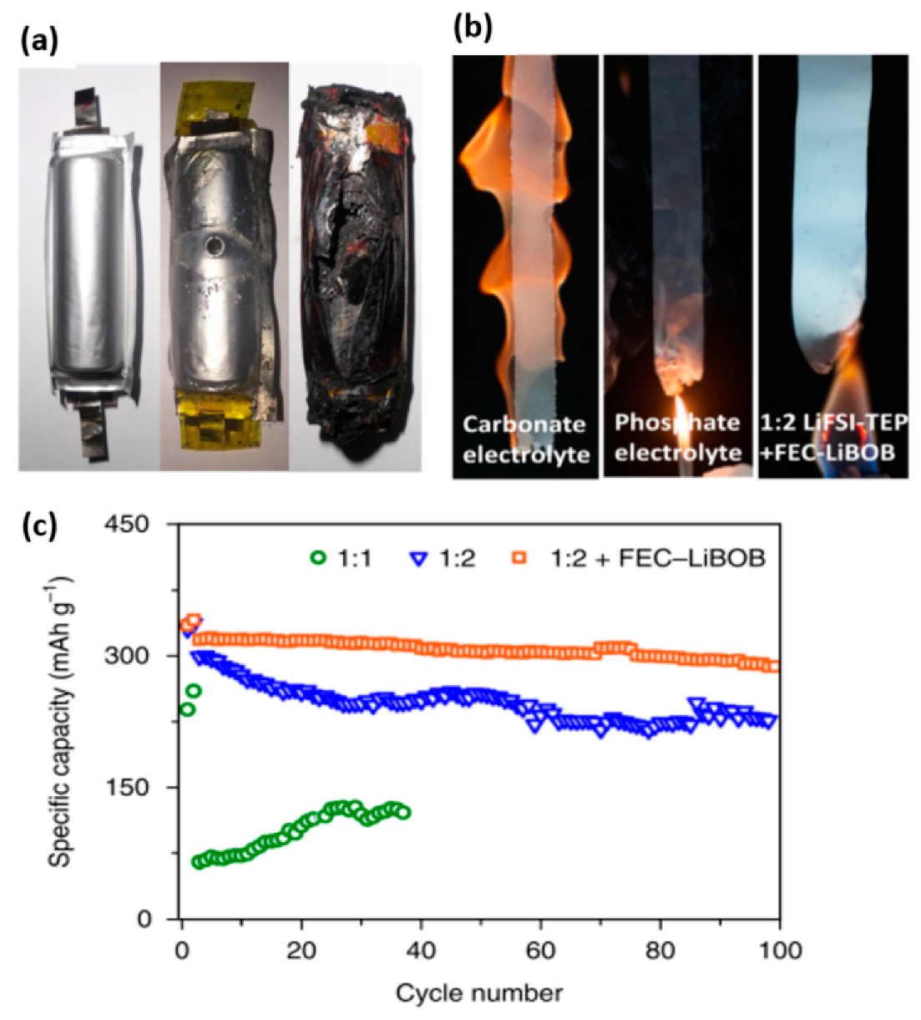
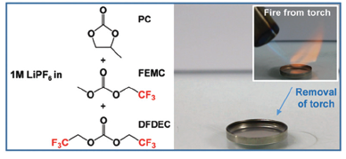
Flame Retardants
Fluorinated methyl group of a conventional organic molecules
Non-flammable after flame tests
Improvement in the battery performance overall
Limitations
High viscosity and low ionic conductivity
Expensive costs
Mater. Horiz., 2021, 8, 2913–2928
Batteries 2019, 5(1), 19

Slide 9
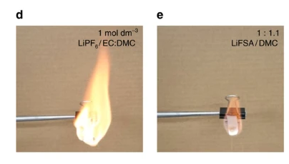
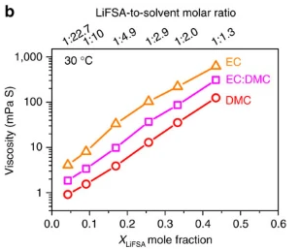
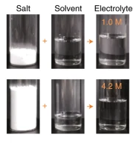
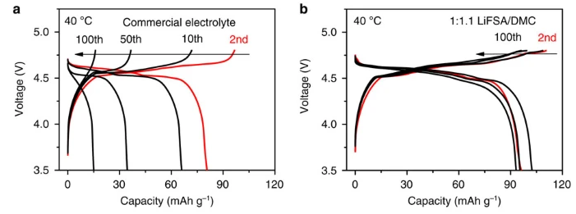
Highly concentrated electrolytes
Electrolyte with salt concentration higher than 4 M
Volatility and vapor pressure decrease
Significant amount of electrolyte is non-combustible salt
Improves battery performance overall
Limitations
High viscosity, poor wettability, high costs (due to expensive salt)
NATURE COMMUNICATIONS | 7:12032

Slide 10
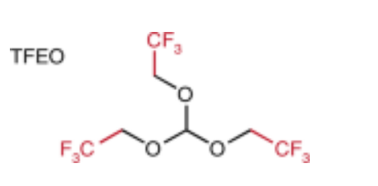
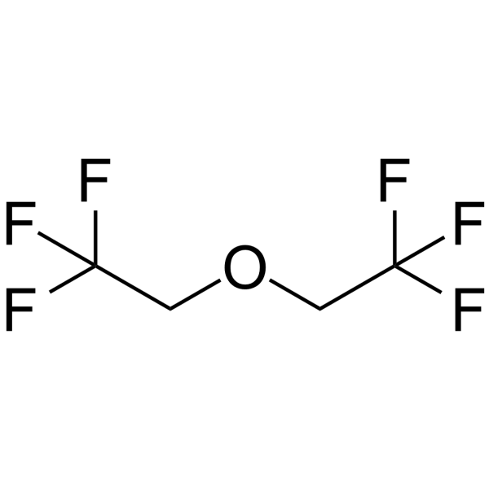
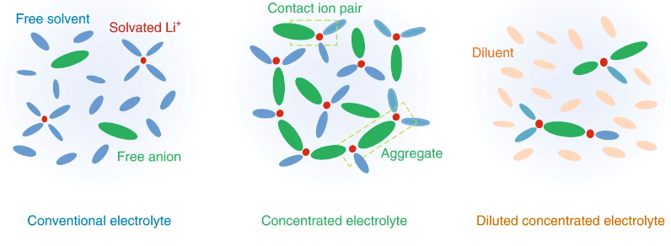
Diluted (localized) High Concentrated Electrolytes
Addition of inert diluent to the electrolyte
Usually hydrofluoroethers (HFEs)
The diluent itself does not dissolve the salt
Locally forms highly concentrated electrolyte structure
Compared to concentrated electrolyte:
Less salt needed for the same phenomena (more affordable)
Less viscous electrolyte
Limitations
HFEs can be flammable as well
HFEs are fluorinated molecules → environmental and economical issue
TFEO
BTFE
Nature Energy volume 4, pages269–280 (2019)
Adv.Mater.2018, 30, 170610

Slide 11
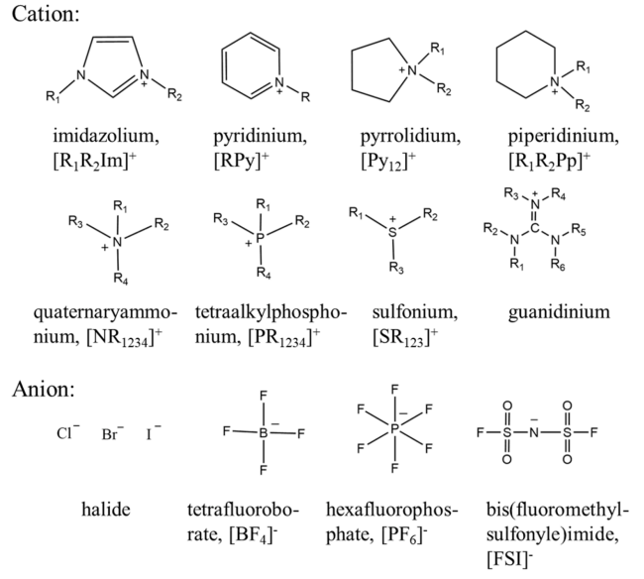
Ionic Liquids (ILs)
Molten salts with melting point (MP) below 100 ºC
Organic cation + inorganic/organic anion → weak coulombic interaction leading to low MP
Top Curr Chem (Z) (2017) 375:20

Slide 12
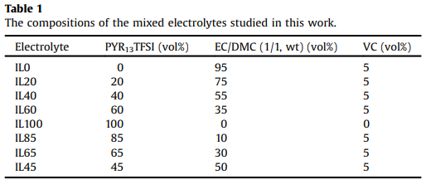
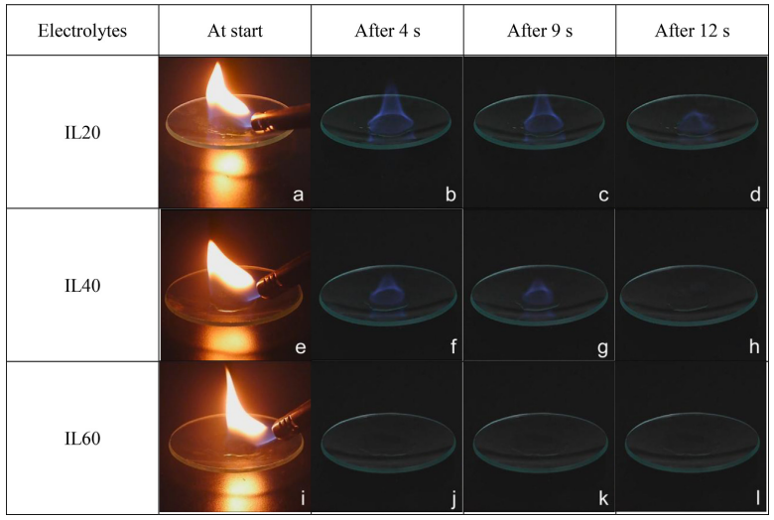
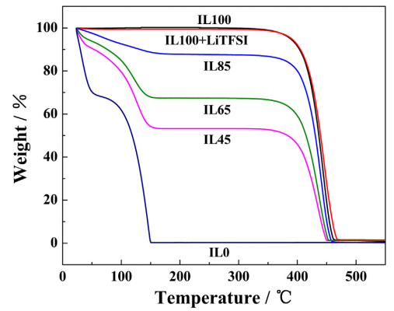
Ionic Liquids
Nonflammable and high thermal stability
Broad electrochemical window and high ionic conductivity
Limitations
Decomposition products are ignitable gases
High costs
Electrochimica Acta 148 (2014) 39–45

Slide 13
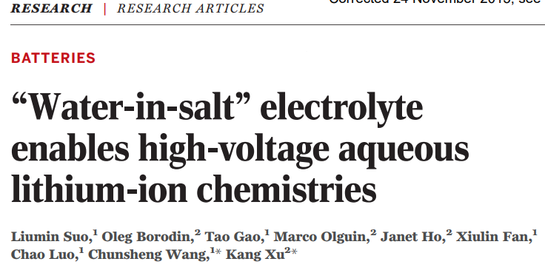
Aqueous Electrolytes (Water-in-Salt)
Groundbreaking study in 2015
Previous Aqueous battery: < 2.0 V
In 2015, the paper reported 3.0 V Aqueous battery
Pure H₂O
Traditional aqueous electrolyte
Science350,938-943(2015)

Slide 14
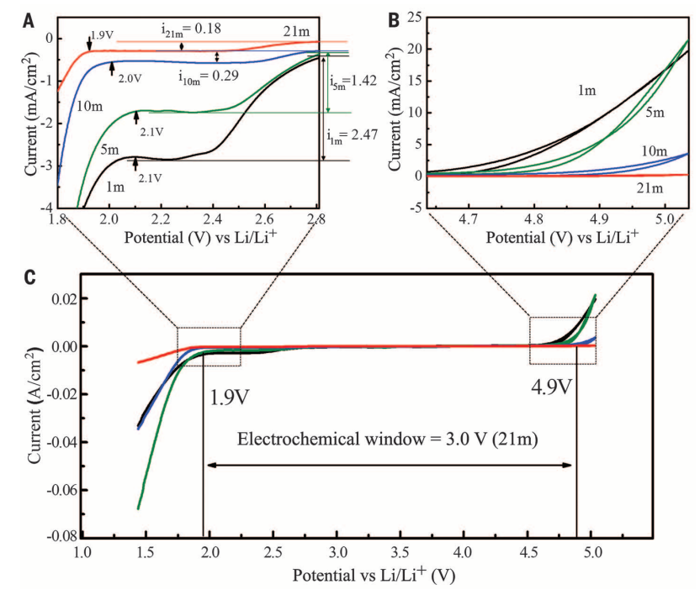
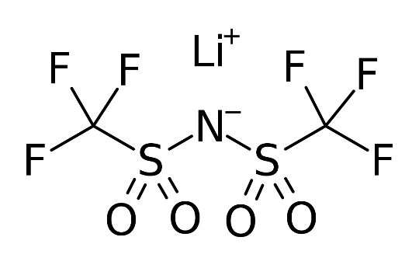
Aqueous Electrolytes (Water-in-Salt)
High concentrated aqueous electrolyte
Electrolyte composition: 20 m LiTFSI in water
Formation of inorganic-rich, stable electrode-electrolyte interface
Reduced electrochemical activity of water
Lithium bis(trifluoromethane sulfonyl)imide, LiTFSIç
Science350,938-943(2015)

Slide 15
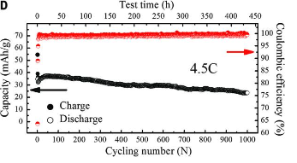
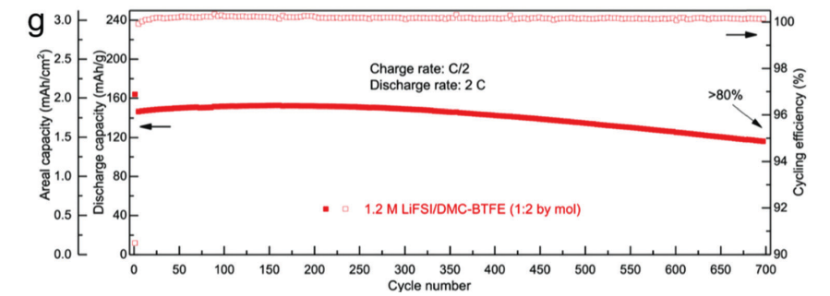
Aqueous Electrolytes (Water-in-Salt)
Limitations
Anode that can be used excludes energy-dens anode materials such as silicon, graphite, and Li metal leading to low capacity
Hydrogen evolution reaction happens at the anode and disrupts a stable interphase formation
Aqueous Electrolyte
Conventional Electrolyte
Science350,938-943(2015)
Chem. Soc. Rev., 2021, 50, 10486–10566

Slide 16
Conclusion
Conventional organic electrolytes for lithium-ion batteries involve numerous safety hazards such as thermal runaway
Studies have reported different types of non-flammable electolytes
Non-flammable additives
High concentration electrolyte
Ionic Liquids
Aqeuous electrolyte
Each method still invovles limitations that need improvement

Slide 17
Thank you
Any question?

