Slide 1
Electric Vehicle Integration into the Grid
Joseph Flanagan
11/17/14
NPRE 498-ES

Slide 2
Outline
Vehicle Electrification
Effect on electric grid
Vehicle to Grid
Demonstration projects
Lithium reserves

Slide 3

Electric Vehicles
Propelled by electric motor
Li-ion batteries to store energy
Improved efficiency and reduced greenhouse gas emissions
Tesla, Leaf, and Volt currently in production
Notes:
http://www.honda.com/newsandviews/article.aspx?id=7502-en

Slide 4
Impacts Assessment to the Current Grid
Pacific Northwest National Laboratory
Plug-in hybrid electric vehicles
  Can drive 33 miles on electricity
  Excess supplemented by gasoline engine
Vehicle Class | Energy Requirement (kWh/mile) | Battery Size (kWh)
Compact Sedan | 0.26 | 8.6
Mid-size Sedan | 0.30 | 9.9
Mid-size SUV | 0.38 | 12.5
Full-size SUV | 0.46 | 15.2
Notes:
Kintner-Meyer MCW, KP Schneider, and RG Pratt. 2007. "Impacts Assessment of Plug-in Hybrid Vehicles on Electric Utilities and Regional US Power Grids: Part 1: Technical Analysis." Online Journal of EUEC 1:paper # 04.

Slide 5
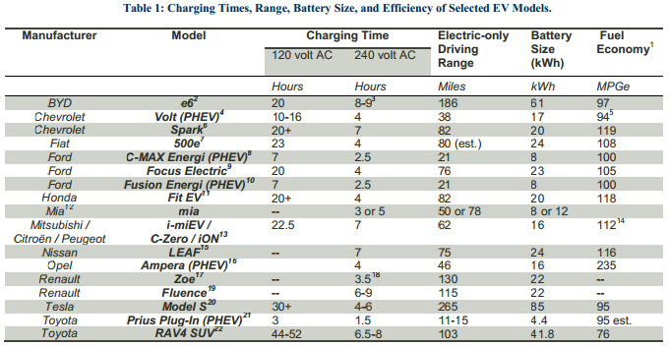
Impacts Assessment to the Current Grid
Notes:
http://assets.fiercemarkets.com/public/sites/energy/reports/evrgridreport.pdf

Slide 6
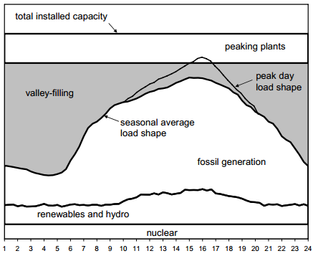
Valley Filling
Grid resources are not fully utilized
Capable of an increase of 910 billion kWh electrical generation (24% increase in generation)
Notes:
http://energyenvironment.pnnl.gov/ei/pdf/PHEV_Feasibility_Analysis_Part1.pdf

Slide 7
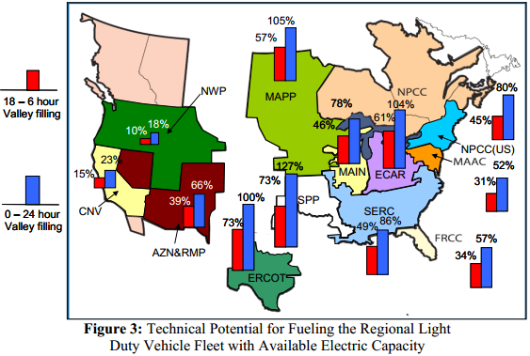
Current Grid Integration
Valley filling could support 73% of the US light duty vehicle fleet
43% if charged only from 6 pm
Displace 52% of oil imports
Notes:
LDV classification: cars, pickup trucks, SUVs, vans
http://energyenvironment.pnnl.gov/ei/pdf/PHEV_Feasibility_Analysis_Part1.pdf

Slide 8
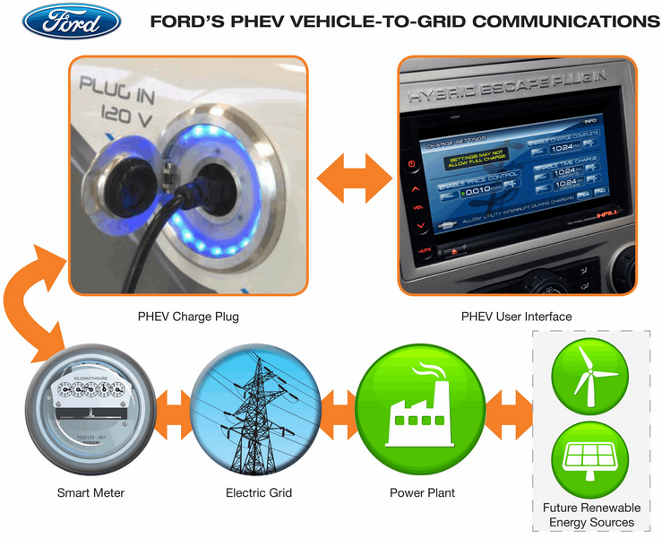
Vehicle-to-Grid (V2G) Concept
Electric vehicles as spinning reserves
Consider 1000 vehicles with 10 kWh batteries -> 10 MWh potential storage!
Notes:
http://www.sciencedaily.com/releases/2007/12/071203133532.htm
https://gigaom.com/2009/10/22/ford-aims-to-connect-its-plug-in-cars-with-smart-meters-by-2015/

Slide 9
V2G Benefits
Peak shaving and valley filling
Helps regulate the grid
Individuals can profit by supplying power at peak demand
Utilities don’t need to invest as heavily in peaking plants and storage
  Could be worth $4000/car to utilities
Notes:
http://www.sciencedaily.com/releases/2007/12/071203133532.htm

Slide 10

Current Projects
Pentagon purchased a $20 million pilot V2G-capable fleet
PJM and the University of Delaware
  Later partnered with Honda
PG&E and Google
Notes:
http://www.defense.gov/News/NewsArticle.aspx?ID=118971
http://www.pjm.com/markets-and-operations/advanced-tech-pilots.aspx?nrg&p=1
http://www.honda.com/newsandviews/article.aspx?id=7502-en
http://www.theguardian.com/environment/2009/jun/19/denmark-wind-electric-cars
http://www.prnewswire.com/news-releases/pge-teams-with-google-to-demonstrate-vehicle-to-grid-technology-at-the-companys-mountain-view-campus-58163877.html

Slide 11
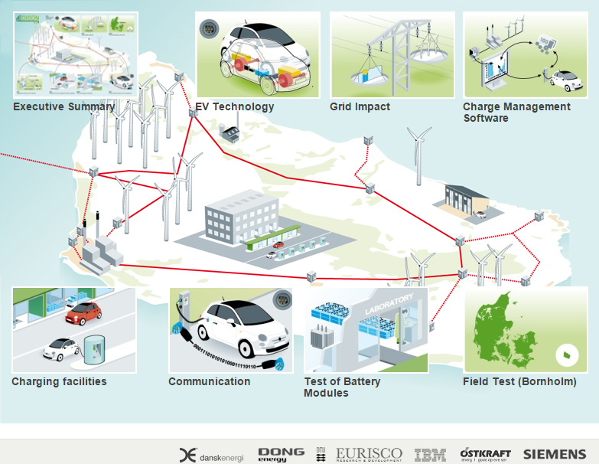
EDISON Project: Wind Power Integration in Denmark
Notes:
http://www.edison-net.dk/

Slide 12
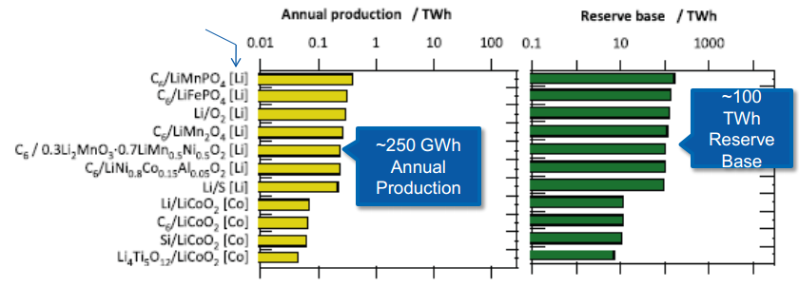
Lithium Supply
How much lithium is there?
  Yearly production: 35,000 tons
  Global reserves: 13,000,000 tons
  Global resources: 34,000,000 tons
Notes:
http://minerals.usgs.gov/minerals/pubs/commodity/lithium/mcs-2014-lithi.pdf
http://www.nrel.gov/vehiclesandfuels/energystorage/pdfs/52393.pdf
C. Wadia et al. Journal of Power Sources 196 (1022) 593-1598

Slide 13
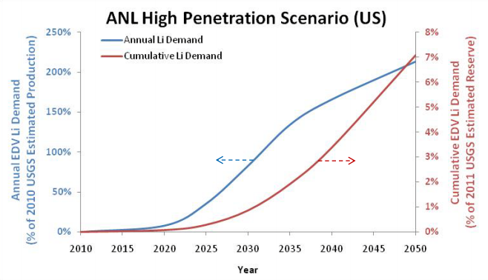
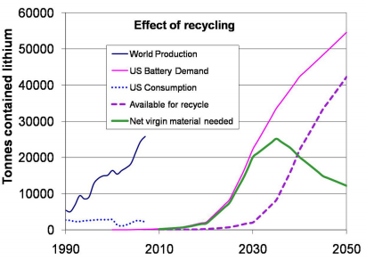
Lithium Supply
Lithium reserves should be able to support highly aggressive electric vehicle adoption
Will require a 7%/year increase in annual production
Notes:
L. Gaines et al., “Lithium-Ion Batteries: Possible Materials Issues,” ANL 2010
http://www.transportation.anl.gov/pdfs/B/626.PDF

Slide 14
Outlook
Electric vehicles are increasingly being adopted
  Huge, accessible energy storage base
V2G systems are currently being field-tested
Contingent on electric vehicle adoption
Improved battery technology will increase capacity and cycle life

Slide 15
Sources
Grid integration
  http://energyenvironment.pnnl.gov/ei/pdf/PHEV_Feasibility_Analysis_Part1.pdf
  http://assets.fiercemarkets.com/public/sites/energy/reports/evrgridreport.pdf
V2G
  http://www.sciencedaily.com/releases/2007/12/071203133532.htm
  http://www.udel.edu/V2G/index.html
Lithium resources
  USGS: http://minerals.usgs.gov/minerals/pubs/commodity/lithium/mcs-2014-lithi.pdf
  NREL: http://www.nrel.gov/vehiclesandfuels/energystorage/pdfs/52393.pdf
  ANL: http://www.transportation.anl.gov/pdfs/B/626.PDF

Slide 16
Sources
Demonstration Projects
  Denmark: http://www.edison-net.dk/
  Google: http://www.prnewswire.com/news-releases/pge-teams-with-google-to-demonstrate-vehicle-to-grid-technology-at-the-companys-mountain-view-campus-58163877.html
  Honda: http://www.honda.com/newsandviews/article.aspx?id=7502-en
  PJM: http://www.pjm.com/markets-and-operations/advanced-tech-pilots.aspx?nrg&p=1
  Pentagon: http://www.defense.gov/News/NewsArticle.aspx?ID=118971

