Slide 1
Enhancing Frequency Stability in High Renewable
Penetration using Flywheel Energy Storage System
Gener Atienza
November 19, 2025
NPRE 498 Energy Storage Engineering
Master of Engineering Energy Systems
University of Illinois Urbana-Champaign

Slide 2
Overview
Background Information
Frequency Stability in Power System
Impact of High Renewable Penetration in Frequency Stability
Potential solution, Flywheel Energy Storage System (FESS)
Technology Overview
Operating Principle and Components of FESS
Comparison of FESS vs BESS and FESS vs Peaking Plants
Case Study for Integrating FESS to Electric Grid
Commercial Grid Integration of FESS
Conclusion
Summary and key takeaways

Slide 3
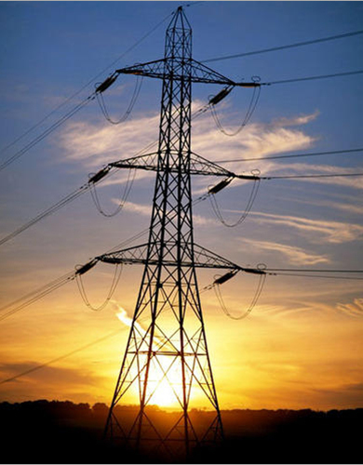

Power System Stability
Refers to the ability of an electric power system to remain in balance and continue operating normally after it experiences a disturbance
Power System Stability
Rotor Angle
Voltage
Frequency

Slide 4
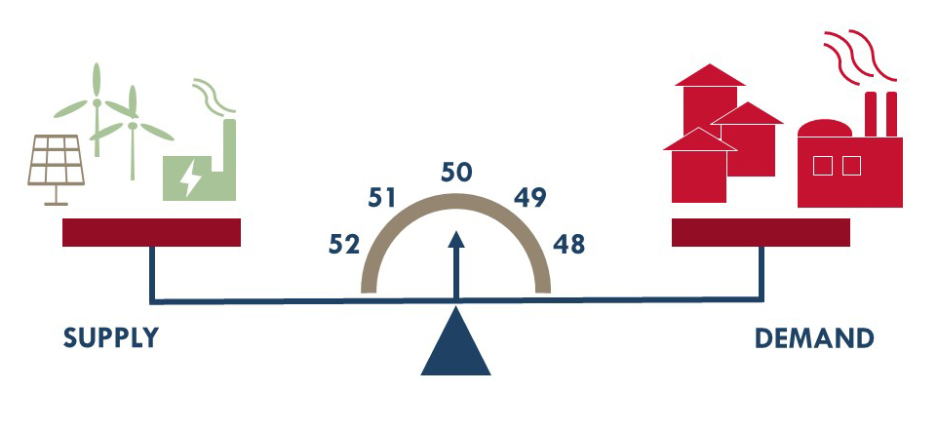
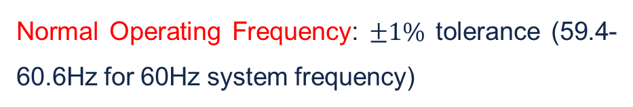
Frequency Stability in Power System
Frequency stability describes the power system’s ability to maintain the nominal frequency of the system following a disturbance between generation and load.
Normal Operating Frequency: $±1\%$ tolerance (59.4-60.6Hz for 60Hz system frequency)
Consequences of Frequency Instability:
  Damage to equipment
  Power quality issues
  System wide blackouts
  Economic impact
Generation and load demand in power system

Slide 5
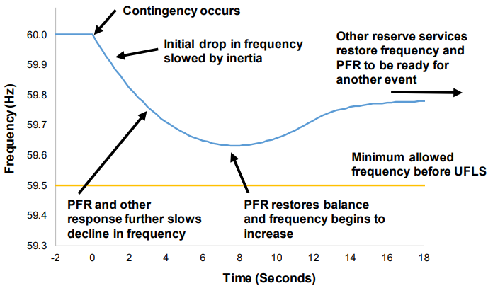
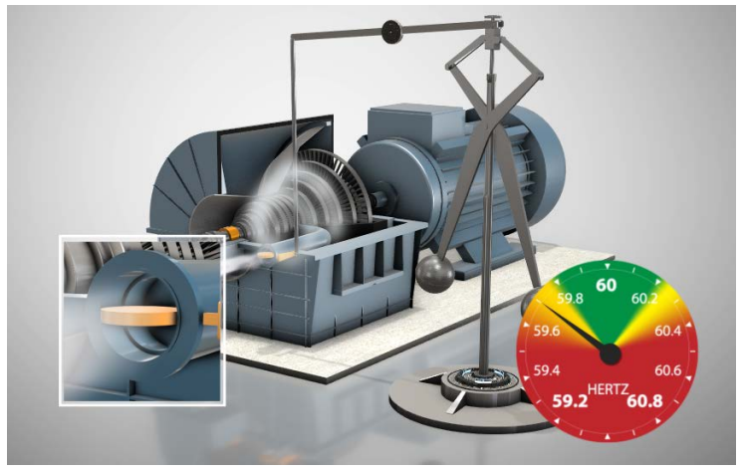
Illustrating the Role of Inertia and Primary Frequency Response
Inertia – resists sudden changes in grid frequency and slows the Rate-of-change-of-frequency (ROCOF)
PFR - Generators automatically adjust output to stabilize frequency
A successful recovery from a contingency event
Frequency drops and governor open
valves, increasing power
T. M. R. W. K. B. K. and M. O. Paul Denholm, “Inertia and Power Grid: A guide without the spin,” 2020. Accessed: Sep. 04, 2024. [Online]. Available: https://www.nrel.gov/docs/fy20osti/73856.pdf

Slide 6
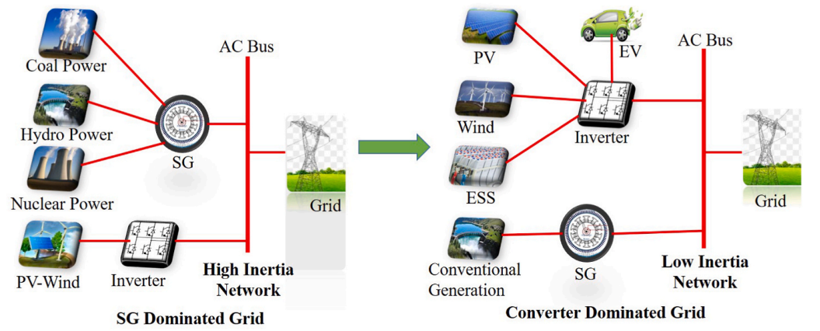
High Penetration of Inverter-Based Renewable Energy Sources
IEA forecasts that by 2028, solar and wind power will account for 95 % of global renewable energy growth, doubling their share of electricity generation to 25 %.
High penetration of inverter based renewable energy sources leads to several issues:
a. Intermittent and/or unpredictable output
b. Lack of inertia/grid stability
Grid transformation from high to low inertia network [1]

Slide 7
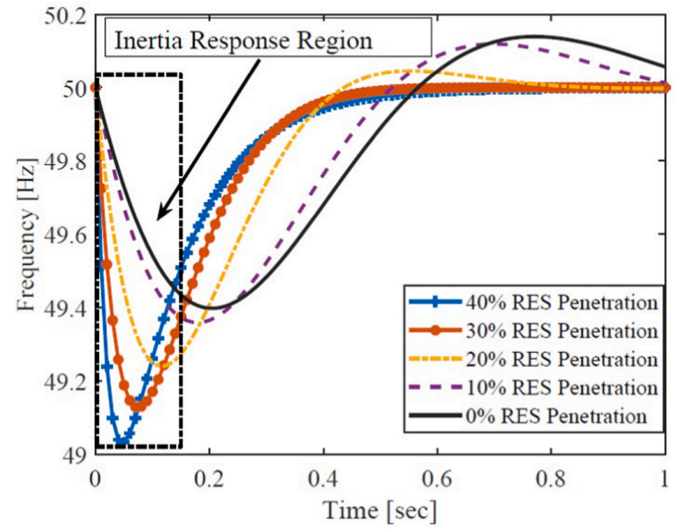
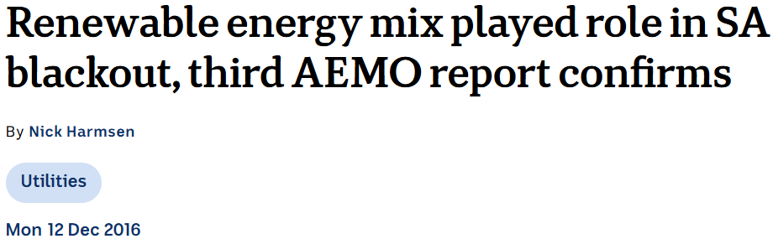
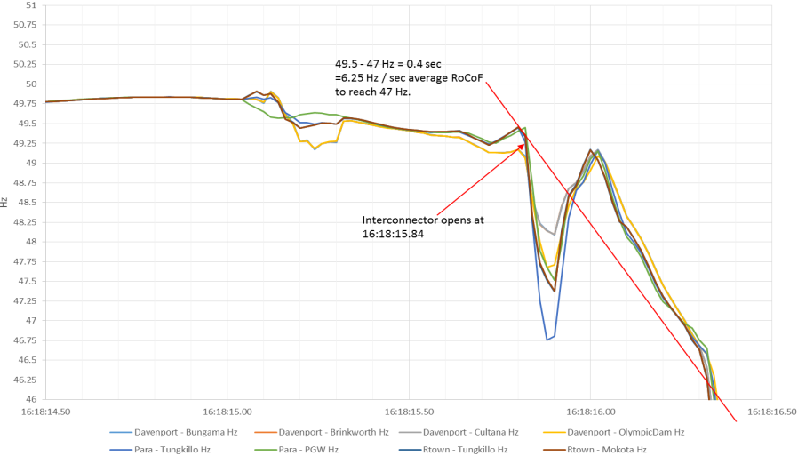
Impact of Renewable Penetration on Grid Frequency Response
As renewable penetration increases, the frequency reaches the nadir much faster. This leaves less time for primary control to act.
On September 28, 2016, a frequency collapse had been undergone due to the presence of a high renewable penetration and insufficient reserves
Impacts of penetration of RES to the
system frequency response

Slide 8
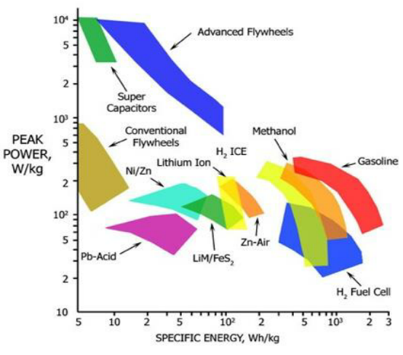
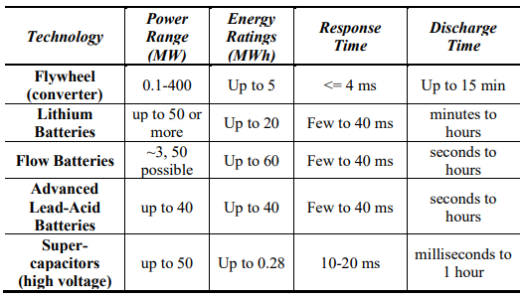
Potential Solution
Flywheel Energy Storage System is a potential solution
High specific power and capable of responding within approximately 4ms

Slide 9
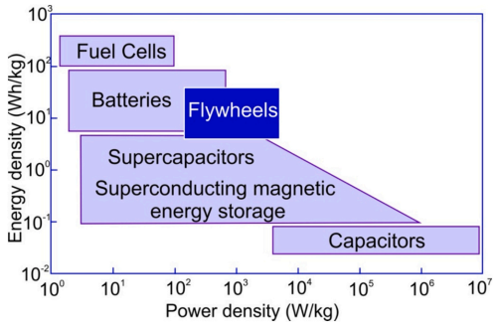
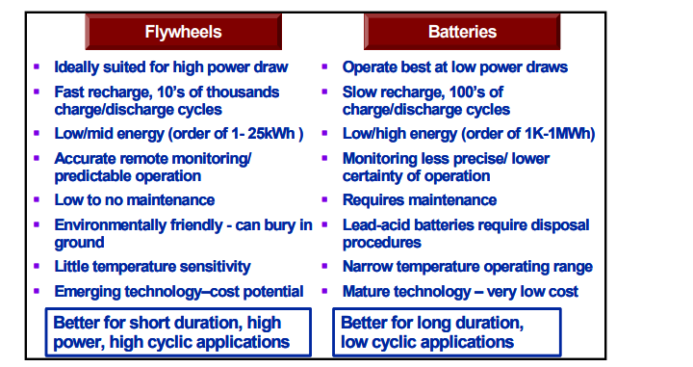
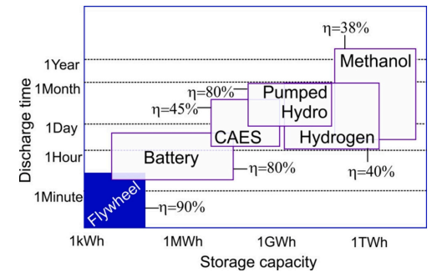
Comparison of FESS and BESS

Slide 10
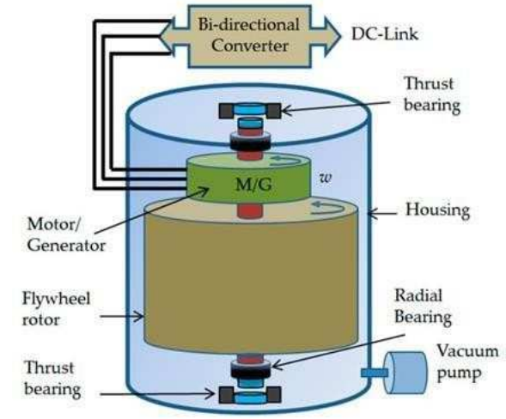
Components of Flywheel Energy Storage System Overview
Flywheel energy storage system stores energy in the form of kinetic energy, which is input or extracted in the form of electrical energy via a motor-generator unit.
$$KE=\frac{1}{2}Jω^{2}$$
Main Components:
a. Flywheel Rotor (Mechanical Storage Element) – heavy rotating mass that stores energy in the form of kinetic energy
b. Motor/Generator
  Motor mode: accelerates flywheel to store energy
  Generator mode: decelerated flywheel to release energy to the grid
c. Bi-directional converter (AC-DC-AC Converter) – includes rectifier, inverter and dc link enabling power exchange with grid
Overview of flywheel energy storage system
d. Bearing system - Supports the rotor and minimizes friction losses
e. Vacuum enclosure - to reduce air drag losses
S. S et al., "A Critical Analysis of Flywheel Energy Storage Role in Grid Stability and Frequency Regulation," 2024 10th International Conference on Electrical Energy Systems (ICEES), Chennai, India, 2024, pp. 1-7, doi: 10.1109/ICEES61253.2024.10776868.

Slide 11
FESS for Grid Frequency Stability
FESS enhances grid frequency stability by providing rapid power balancing during fluctuations of power supply and load demand.
How it works:
Absorbs power when supply > demand
Delivers power when demand > supply
Stabilizes fluctuations from renewable energy sources
Provides short-term reserve until slower power plants adjust

Slide 12
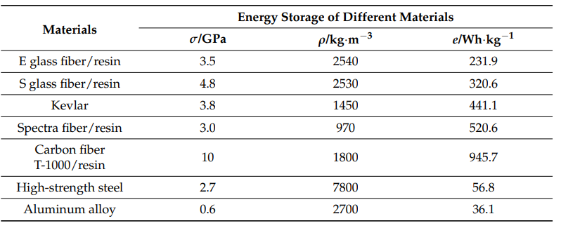

Choice of Materials for Flywheel Rotor
$$KE=\frac{1}{2}Jω^{2} e=\frac{σ^{2}}{3ρ}$$
S. S et al., "A Critical Analysis of Flywheel Energy Storage Role in Grid Stability and Frequency Regulation," 2024 10th International Conference on Electrical Energy Systems (ICEES), Chennai, India, 2024, pp. 1-7, doi: 10.1109/ICEES61253.2024.10776868.

Slide 13
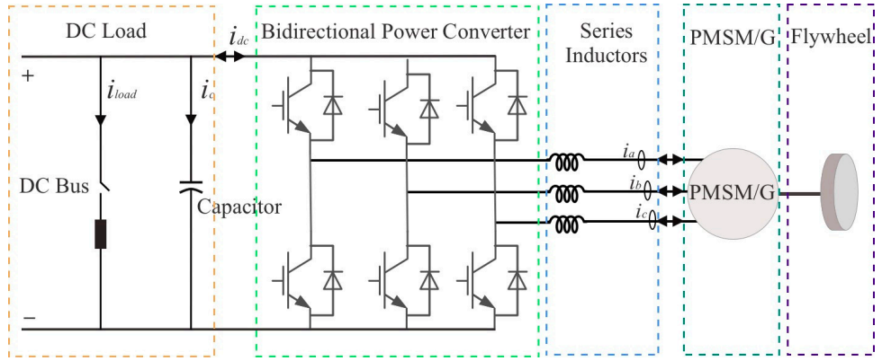
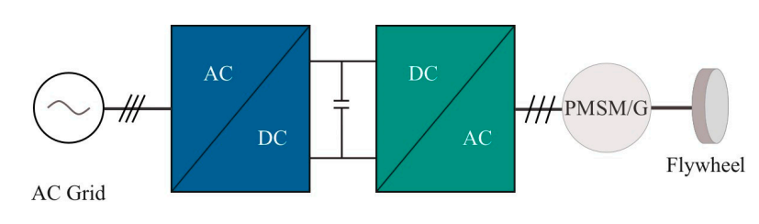
System Configuration of Flywheel Energy Storage System
Interconnection of FESS to electric grid
Circuit diagram of FESS
Xu, K.; Guo, Y.; Lei, G.; Zhu, J. A Review of Flywheel Energy Storage System Technologies. Energies 2023, 16, 6462. https:// doi.org/10.3390/en16186462

Slide 14
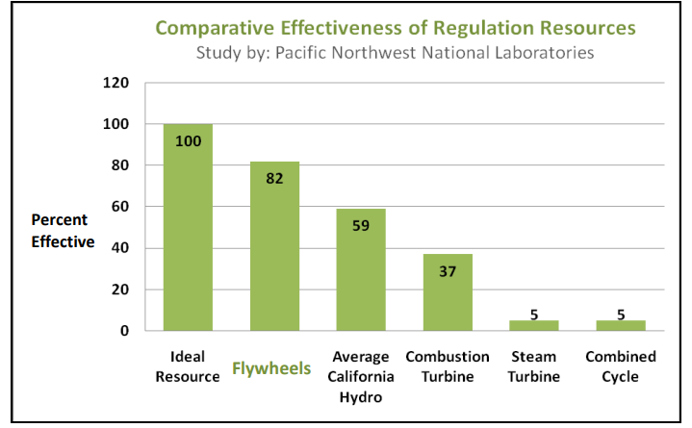
Comparative Effectiveness of Regulation Resources
Set-up: 20% renewable penetration
Key Findings:
1 MW of fast-response of FESS provides roughly the same regulation value as 2 MW of conventional resources in California.

Slide 15
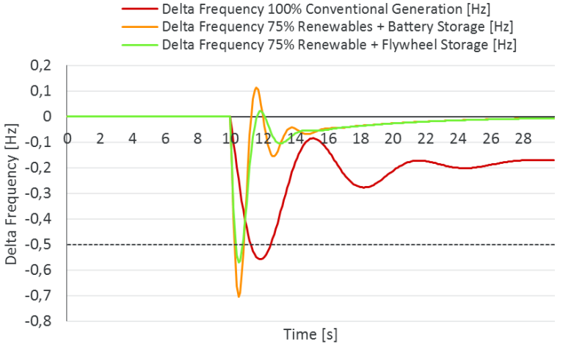
Comparison of Battery and Flywheel Energy Storage in Frequency Stability
Figure shows how fast response FESS technology can provide reliable and efficient solutions without having the need to operate too much synchronous generators to stabilize the grid frequency.
Comparison how Flywheel, Battery or conventional generator support the grid during a fault
vor dem Esche, R. (2017, July 11). Benefits of flywheels for short term grid stabilisation. https://doi.org/10.13140/RG.2.2.22669.84964

Slide 16

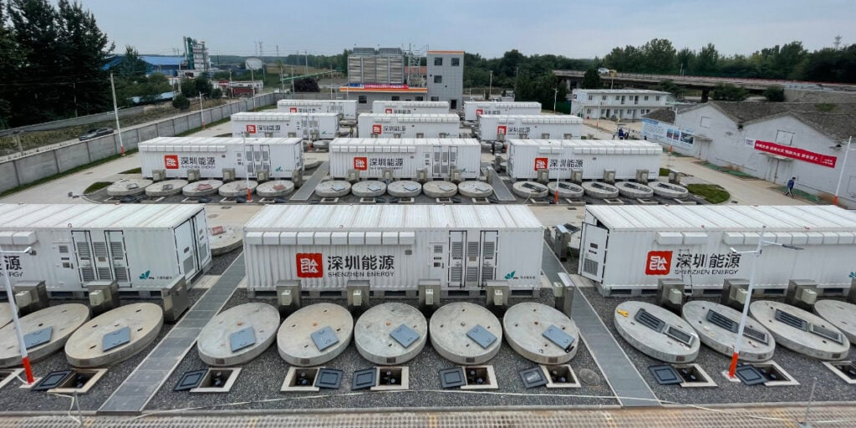
Commercial Application of Flywheel Energy Storage System
Beacon Power’s utility-scale 20 MW flywheel energy storage plant at the Humboldt Industrial Park in Hazle Township, Pennsylvania, for Hazle Spindle LLC. The plant provides frequency regulation services to the PJM Interconnection grid.
In Shanxi Province, China, Shenzhen Energy Group built a 30 MW flywheel facility with 120 high-speed magnetic levitation units, connected to the grid for frequency regulation.

Slide 17
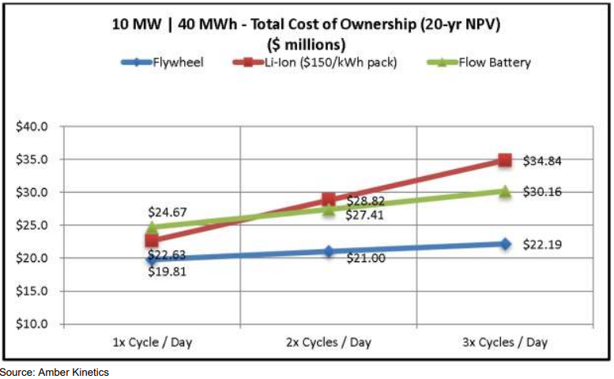
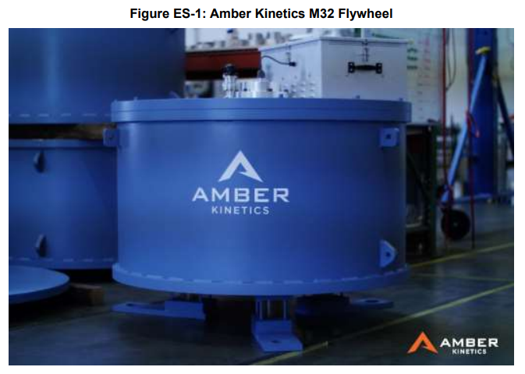
Commercial Application of Flywheel Energy Storage System
Amber Kinetics, Inc. is the first company to design a long-discharge duration kinetic energy storage system based on advanced flywheel technology (8kW for 4 hours)
Flywheels have very low maintenance costs and don’t wear out like batteries, their total lifetime cost is lower than batteries, especially if used multiple times per day
The higher the use, the better the economics.

Slide 18
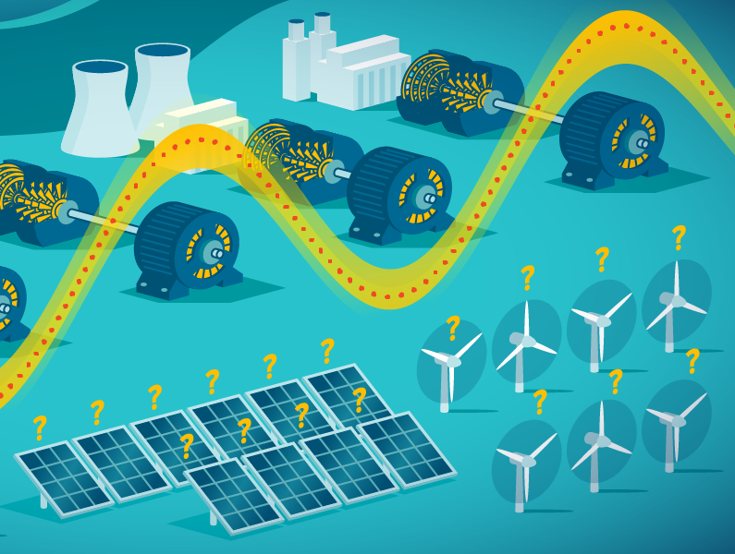
Conclusion
FESS offers inherent physical properties of grid inertia.
FESSs offer high specific power density and instantaneous response times
Hybrid storage integration by combining FESSs with complementary storage technologies
FESSs can play a significant role in the transition toward more sustainable and resilient electrical grids.

Slide 19
References
[1] Grider, T. (2021). Analysis of Flywheel Energy Storage Systems for Frequency Support (Master's thesis, Auburn University).
[2] Njoka, G. M., Mogaka, L., & Wangai, A. (2024). Impact of variable renewable energy sources on the power system frequency stability and system inertia. Energy Reports, 12, 4983–4997. https://doi.org/10.1016/j.egyr.2024.10.057
[3] Makolo, Peter, Ramon Zamora, and Tek-Tjing Lie. (2021). “The Role of Inertia for Grid Flexibility under High Penetration of Variable Renewables: A Review of Challenges and Solutions.” Renewable and Sustainable Energy Reviews 147: 111223. https://doi.org/10.1016/j.rser.2021.111223.
[4] Harmsen, N. (2017). AEMC says Australia's power system weakened by wind, solar. ABC News. https://www.abc.net.au/news/2017-03-24/aemc-says-australias-power-system-weakened-by-wind-solar/8381356
[5] S. S et al., "A Critical Analysis of Flywheel Energy Storage Role in Grid Stability and Frequency Regulation," 2024 10th International Conference on Electrical Energy Systems (ICEES), Chennai, India, 2024, pp. 1-7, doi: 10.1109/ICEES61253.2024.10776868
[6] Xu, K.; Guo, Y.; Lei, G.; Zhu, J. A Review of Flywheel Energy Storage System Technologies. Energies 2023, 16, 6462. https:// doi.org/10.3390/en16186462
[7] . M. R. W. K. B. K. and M. O. Paul Denholm, “Inertia and Power Grid: A guide without the spin,” 2020. Accessed: Sep. 04, 2024. [Online]. Available: https://www.nrel.gov/docs/fy20osti/73856.pdf
[8] Matos, C., Rosales-Asensio, E., Carta, J. A., & Cabrera, P. (2025). Flywheels in renewable energy systems: An analysis of their role in managing intermittency. Journal of Energy Storage, 122, 116674. https://doi.org/10.1016/j.est.2025.116674
[9] Ji, W., Hong, F., Zhao, Y., Liang, L., Du, H., Hao, J., Fang, F., & Liu, J. (2024). Applications of flywheel energy storage system on load frequency regulation combined with various power generations: A review. Renewable Energy, 223, 119975. https://doi.org/10.1016/j.renene.2024.119975
[10] Grider, T. (2021). Analysis of Flywheel Energy Storage Systems for Frequency Support (Master's thesis, Auburn University).
[11] vor dem Esche, R. (2017, July 11). Benefits of flywheels for short term grid stabilisation. https://doi.org/10.13140/RG.2.2.22669.84964

Slide 20
Thank You

