Slide 1
“Solid-State Batteries”
Department of Nuclear Plasma & Radiological Engineering
NPRE 498: Energy Storage Engineering
Fall 2024
Presented by: Harsh Thakur (hthakur3)
Date: 11/15/2024

Slide 2
Introduction
Definition: Solid-state batteries (SSBs) are energy storage devices that use a solid electrolyte instead of the conventional liquid electrolyte.
Background: First introduced in the 1990s as an advancement over traditional lithium-ion batteries.
Key Difference: Solid electrolytes improve battery safety and efficiency by eliminating risks associated with liquid electrolytes, such as leakage and flammability.
Applications: Widely used in electric vehicles, portable electronics, and medical devices due to their superior performance and safety.

Slide 3
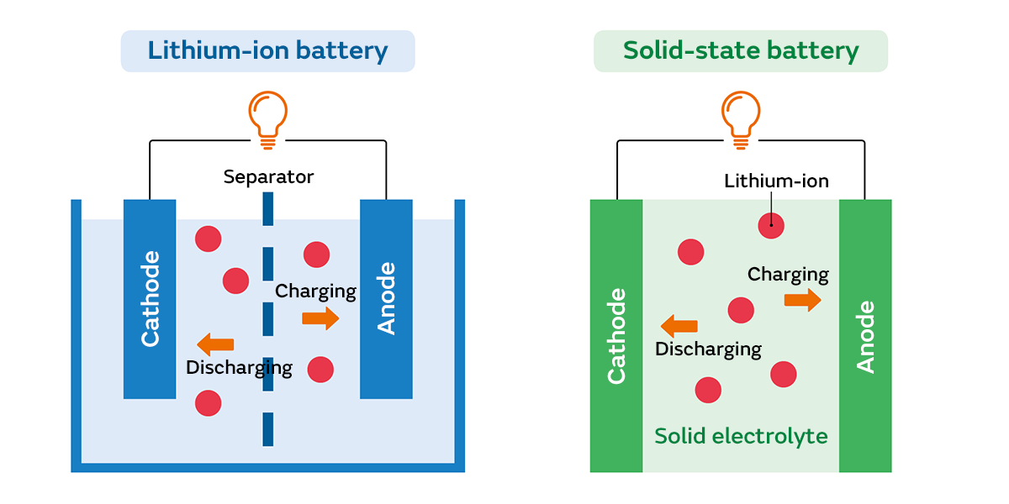
Difference between lithium ion and solid-state battery
Fig. Charging and discharging of battery
Accessed from “https://article.murata.com/en-us/article/basic-lithium-ion-battery-4” November(2024)

Slide 4
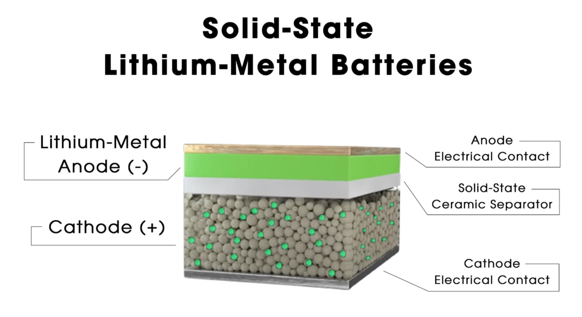
Working of Solid-State Battery
Cathode - LFP, NMC, LMO.
Anode- Pure lithium
Separator- generally ceramic or polymer
Fig. structure of sulfide based soil state battery
Accessed from “https://www.flashbattery.tech/en/how-solid-state-batteries-work/” November(2024)

Slide 5
Examples of SSBs
1. NASICON-type Batteries
Electrolyte: Sodium Super Ionic Conductor (Na₃Zr₂Si₂PO₁₂).
Features: High ionic conductivity and good thermal stability.
Applications: Used in energy storage systems due to their wide electrochemical stability window.
Accessed from “https://article.murata.com/en-us/article/basic-lithium-ion-battery-4” November(2024)

Slide 6
Examples of SSBs
2. Garnet-type Batteries
Electrolyte: Lithium Lanthanum Zirconium Oxide (LLZO).
Features: High chemical and mechanical stability.
Applications: Commonly used in electric vehicles (EVs) and other high-performance devices.
Accessed from “https://article.murata.com/en-us/article/basic-lithium-ion-battery-4” November(2024)

Slide 7
Examples of SSBs
3. Sulfide-based Solid-State Batteries
Electrolyte: Lithium Phosphorus Sulfide (Li₁₀GeP₂S₁₂).
Features: Extremely high ionic conductivity and good compatibility with lithium metal anodes.
Applications: Considered for EVs and grid storage.
Accessed from “https://article.murata.com/en-us/article/basic-lithium-ion-battery-4” November(2024)

Slide 8
Examples of SSBs
4. Perovskite-type Batteries
Electrolyte: Lithium Lanthanum Titanium Oxide (LLTO).
Features: High bulk ionic conductivity but challenges with grain boundary resistance.
Applications: Suitable for applications requiring high power density.
.
Accessed from “https://article.murata.com/en-us/article/basic-lithium-ion-battery-4” November(2024)

Slide 9
Examples of SSBs
5. LIPON-based Batteries
Electrolyte: Lithium Phosphorus Oxynitride (LIPON).
Features: Thin-film solid electrolyte with good stability and low electronic conductivity.
Applications: Used in microbatteries for medical devices and small electronic devices.
Accessed from “https://article.murata.com/en-us/article/basic-lithium-ion-battery-4” November(2024)

Slide 10
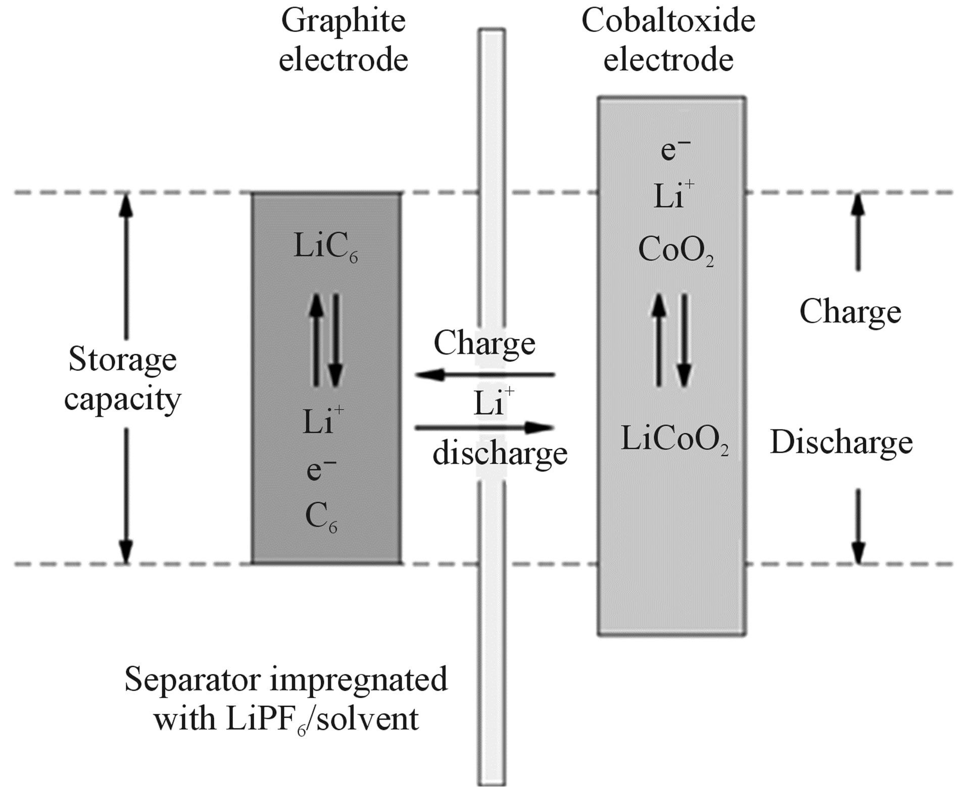
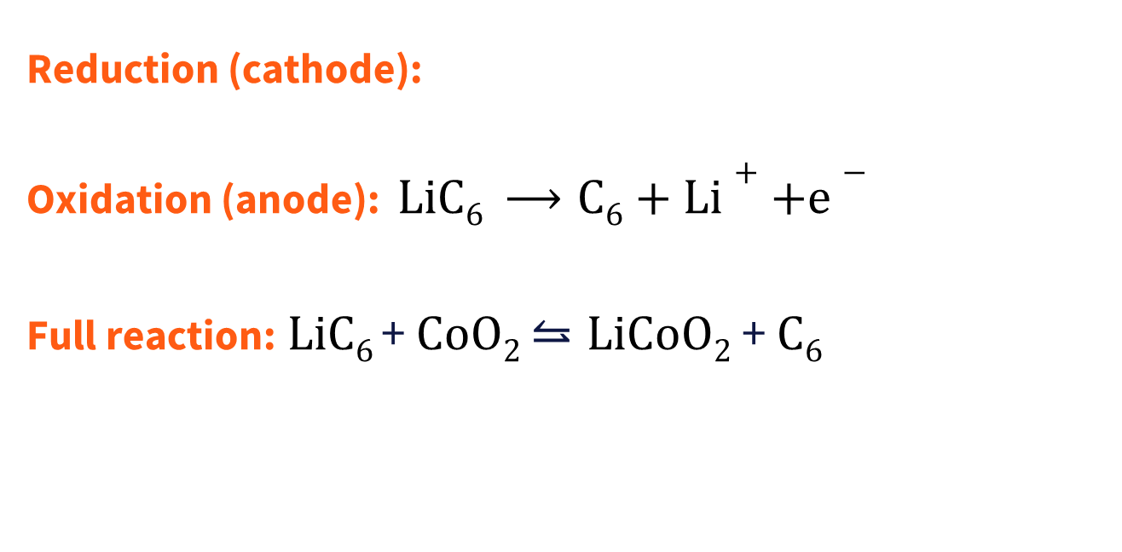
Solid-State Li-ion Battery Reaction
Reduction (cathode):
Oxidation (anode): $LiC6 ⟶C6+Li++e−$
Full reaction:$LiC6$+ $CoO2$ $⥦LiCoO2$ + $C6$
$$CoO2+Li+ +e−⟶LiCoO2$$
Notten, P. H. L., & Danilov, D. L. (2014). Battery modeling: a versatile tool to design advanced battery management systems. Advances in Chemical Engineering and Science, 04(01), 62–72. https://doi.org/10.4236/aces.2014.41009

Slide 11
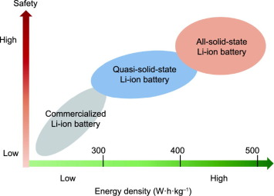
Advantages of SSEs
Safety: Non-flammable and thermally stable.
Performance: Higher energy density and minimal self-discharge.
Durability: Longer life cycles due to reduced dendrite formation.
Fig. shows overview of the evolution of battery technology.
Wang, C., & Sun, X. (2022). The promise of Solid-State batteries for safe and reliable energy storage. Engineering, 21, 32–35. https://doi.org/10.1016/j.eng.2022.10.008

Slide 12
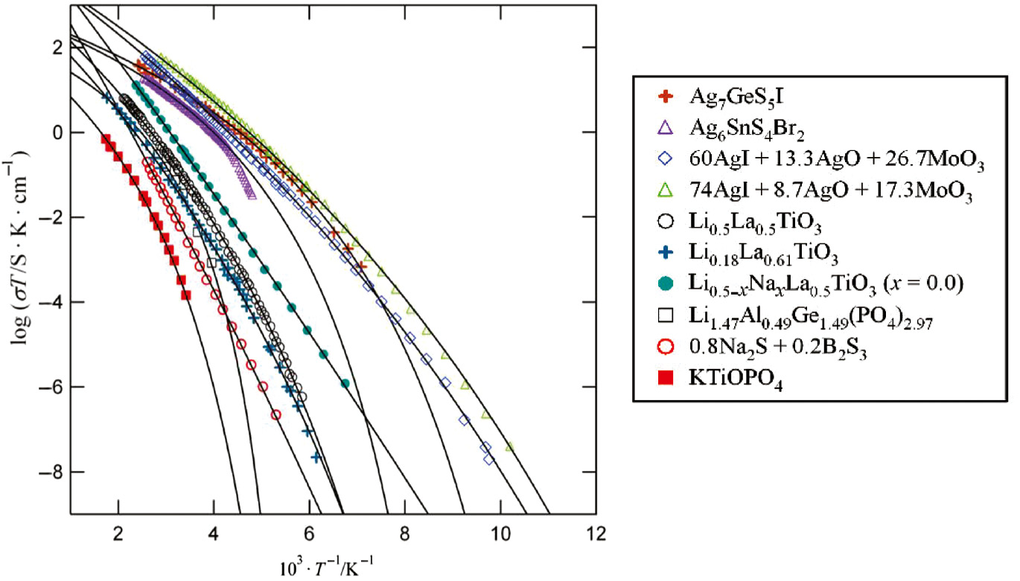
Ionic conductivity and Temperature
It is ability is to conduct electricity through the movement of ions.
Measuring unit: siemens per meter (S/m)
High ionic conductivity (10⁻ ¹ to 10⁻ ⁴ S/cm)
Low electronic conductivity (< 10⁻ ⁶ Scm)
Low activation energy (E_{a} < 0.3 eV)
Aniya, M. (2019). Bonding character and ionic conduction in solid electrolytes. Pure and Applied Chemistry, 91(11), 1797–1806. https://doi.org/10.1515/pac-2018-1220

Slide 13
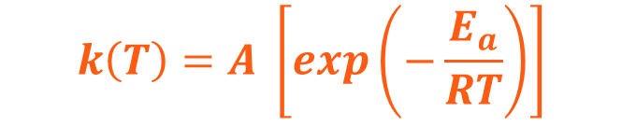
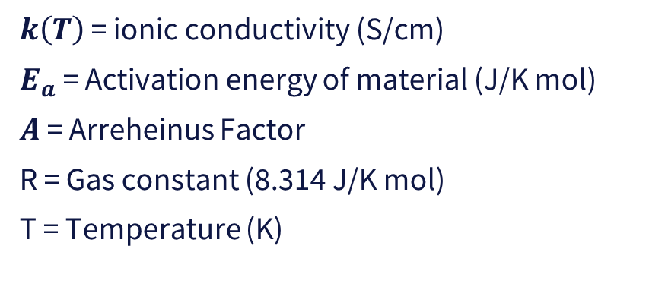
Vogel-Tamman-Fulcher equation
$$k\left(T\right)=A \left[exp\left(−\frac{E_{a}}{RT}\right)\right]$$
$k\left(T\right)$ = ionic conductivity (S/cm)
$E_{a}$= Activation energy of material (J/K mol)
$A$ = Arreheinus Factor
R = Gas constant (8.314 J/K mol)
T = Temperature (K)
Perrier, M., Besner, S., Paquette, C., Vallée, A., Lascaud, S., & Prud’homme, J. (1995). Mixed-alkali effect and short-range interactions in amorphous poly(ethylene oxide) electrolytes. Electrochimica Acta, 40(13–14), 2123–2129. https://doi.org/10.1016/0013-4686(95)00151-4

Slide 14
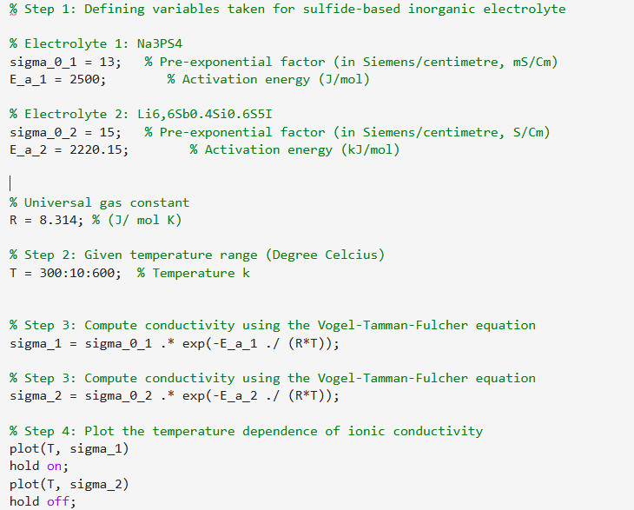
MATLAB program
Relationship between temperature and ionic conductivity

Slide 15
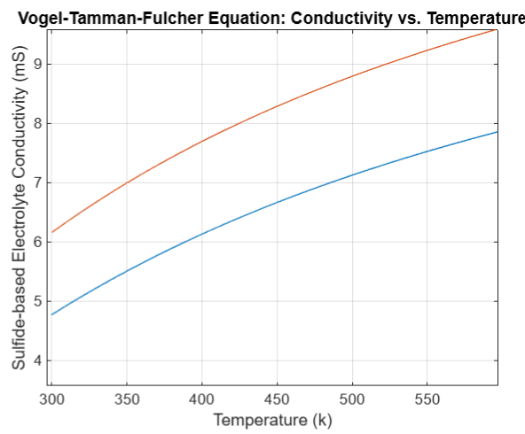
Result
Solid state electrolyte (sulfide based)
Ionic conductivity increases with temperature
Fig. Generated through MATLAB

Slide 16
Conclusion
1. Automotive Industry:
Seen as the future of electric vehicles (EVs) due to higher energy density.
2. Transportation Sector:
Suitable for heavy vehicles (trucks, buses, etc.) that require long range and high energy.
3. Future of Industrial Electrification:
If solid-state batteries become cost-competitive, they could revolutionize industrial applications by improving energy efficiency and reducing reliance on fossil fuels.

