Slide 1
Liquid Organic Hydrogen Carrier Distribution Network
Imran Haddish
NPRE 498

Slide 2
Content
What is an LOHC
Types of LOHC compounds
Overall benefits of an LOHC network
Integration with renewable energies
Mobile Applications
Shortcomings and future work

Slide 3
LOHC Compounds
Energy carrying compounds
Exists in an energy-rich and energy-lean state
Have high energy density
Easily stored under ambient conditions
Stored hydrogen is easily released in a catalytic dehydrogenation reaction

Slide 4
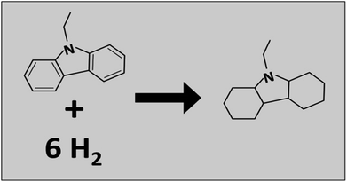
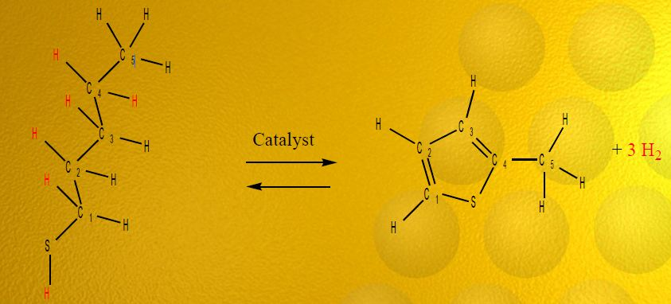
Types of LOHC Compounds
N-ethylcarbazole
Hydrnol (C5H12S (liquid) + Heat/Catalyst → 3H2 (gas) +C5H6S (liquid)

Slide 5
Hydrogenation & Dehydrogenation
Hydrnol can be made from:
  Feed stocks
    Sweet and sour crude oil
  Alcohols
    Ethanol from biomass
Hydrogenation (perhydro-N-ethylcarbazole)
  Hydrogen capacity of 5.8 wt%
  Reaction at 145 ºC & 70 bars
  Catalyzed with Ruthenium
Dehydrogenation (N-ethylcarbazole)
  Reaction at 215 ºC & ambient pressure
  Catalyzed with platinum or palladium

Slide 6
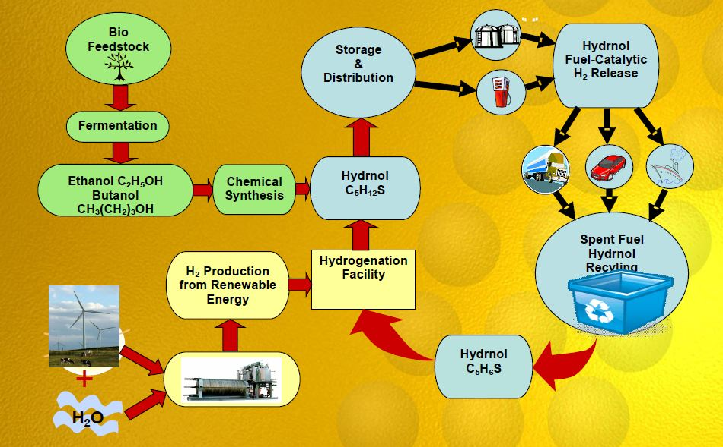
LOHC Cycle

Slide 7
Overall Benefits
Used in a cyclic manner (loading/un-loading)
Many physico-chemical similarities to diesel
  Preserve our current infrastructrue
  Introduce LOHC network gradually
Allows steady power delivery for intermittent power sources

Slide 8
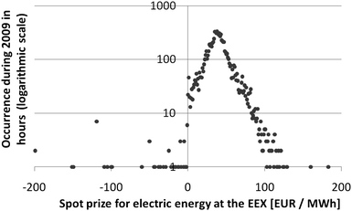
Integration with Renewable Energy Sources
Renewable energy sources suffer from negative prices
  When production is higher than demand, renewable energy is sold at negative prices
More high voltage lines and amplification are needed to expand renewable energy sources

Slide 9
LOHC Solution
  LOHC compounds can be utilized at the site of renewable energies or transported elsewhere
  Benefits of on-site utilization
    LOHC tanks store excess energy
    Hydrogenated compounds can generate power on-demand
    Energy can now be load-following
    No need for amplification of electric grid
    Higher stability

Slide 10
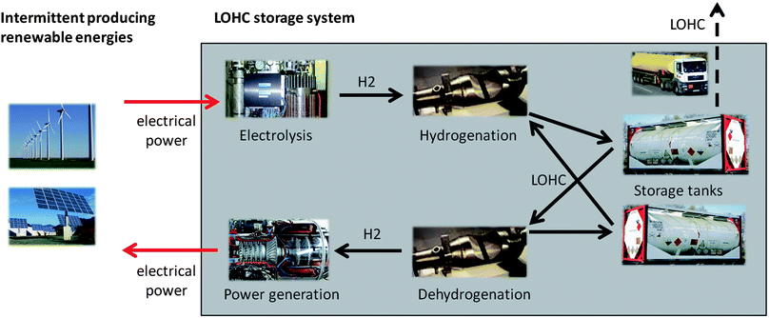
LOHC Solution

Slide 11
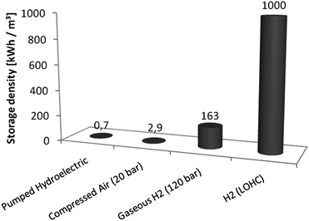
LOHC vs. Other Storage Methods
Hydroelectric storage
  Cheap but low storage density
  Space is running out
Gaseous hydrogen storage
  Higher storage density than hydroelectric but still relatively low
  Requires large amount of space
    People do not want to live near or above storage facilities
LOHC Storage
  Same tanks as fossil fuels
  Can be stored for long periods of time (Stable)

Slide 12
Mobile Applications
LOHC will provide a safer & more economical approach
Liquid hydrogen & compressed hydrogen
  Operate at extreme temperatures & pressures
  Conditions not common & potentially unsafe
  No established supply system

Slide 13
LOHC Based Vehicles
Attain same range and fuel capacity as gasoline
  100 liters of LOHC for 500 kilometers
Hydrogen extracted with catalytic device
  Requires heat to operate
Combustion Engine
  Burns hydrogen and supplies heat to catalytic device
Fuel Cell
  Hydrogen will need to be burned to maintain catalytic device temperature
    Reduces efficiency as 20% of hydrogen is burned

Slide 14
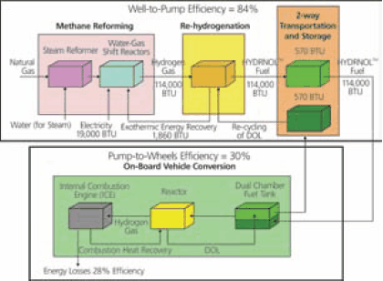
Hydrnol Efficiency
Model assumes internal combustion engine
Overall efficiency is 25%
  Higher than gasoline efficiency of 14%

Slide 15
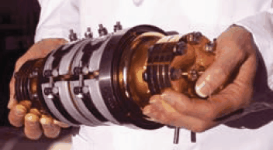
Catalytic Device
Keys to success
  High surface area
    Units consist of micro-channels, packed bed made out of embedded nano-size catalysts on porous substrates and nano-springs
  Stability of the catalyst

Slide 16
LOHC Vehicle Refueling
Rehydrogenation will generate around 600kW of heat
  Unsafe for gasoline station
    LOHC fuel can still be swapped at gasoline stations
  Forces rehydrogenation to occur at specialized facility
    Excess heat can be recycled
Facilities will need to be outfitted with return lines for dehydrogenated LOHC

Slide 17
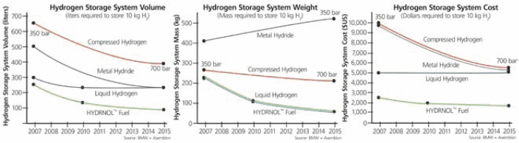
On-board Hydrogen Storage Systems

Slide 18
Overall Cost of Hydrnol
Installing LOHC pumps at gas station
  $200,000 to $300,000
Installing new LOHC fueling station
  $1 million to $4 million
Providing 70% of US population with LOHC fueling stations (12,000 stations)
  $24 billion

Slide 19
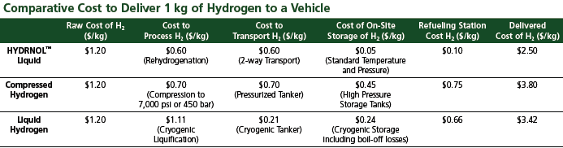
Delivery Cost of Hydrnol

Slide 20
Shortcomings of LOHC network
Required components are still in development
Some LOHC compounds are solid when 100% dehydrogenated
  Results in less efficiency by reducing capacity
Noble metals will increase the price of catalytic devices
There isn’t a solution to combine a fuel cell with LOHC storage

Slide 21
Sources
  http://www.prnewswire.com/news-releases/vision-licenses-organic-liquid-hydrogen-carrier-adds-fuel-to-its-line-of-hydrogen-solutions-plans-nationwide-roll-out-94816234.html
  https://netfiles.uiuc.edu/mmazzocc/shared/OVCR%20Files/Asemblon/Asemblon-ppt.pdf
  http://www.sigmaaldrich.com/technical-documents/articles/material-matters/introducing-hydrnol.html
  http://www.hydrogencarsnow.com/blog2/index.php/hydrogen-fuel-distribution/asemblon-hydrnol-hydrogen-carrier-will-reduce-infrastructure-costs/
  http://pubs.rsc.org/en/content/articlehtml/2011/ee/c1ee01454d

