Slide 1


Repurposing Electric Vehicle Battery
Fall 2024
NPRE 498 Energy Storage Systems
James Tang
Notes:
My term paper is on “Topic”

Slide 2

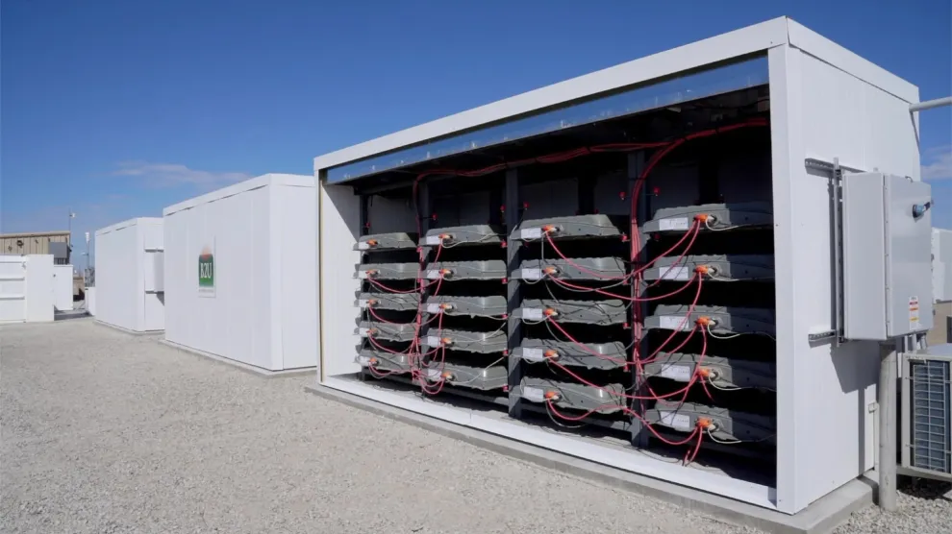
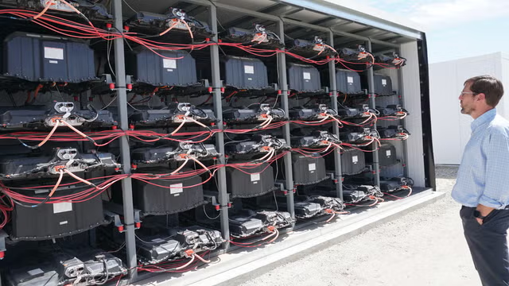
Overview
Background Information
Adoption of electric vehicle (EV) and energy storage system (ESS)
Issues caused by the growing adoption
Potential solution, EV battery repurposing
Technology Overview
Reverse battery supply chain
Steps to repurpose a EV battery
Pros and cons
Limitations and challenges
Conclusion
Summary and key takeaways
ELECTRICAL & COMPUTER ENGINEERING
GRAINGER ENGINEERING

Slide 3
Background Information
ELECTRICAL & COMPUTER ENGINEERING
GRAINGER ENGINEERING

Slide 4
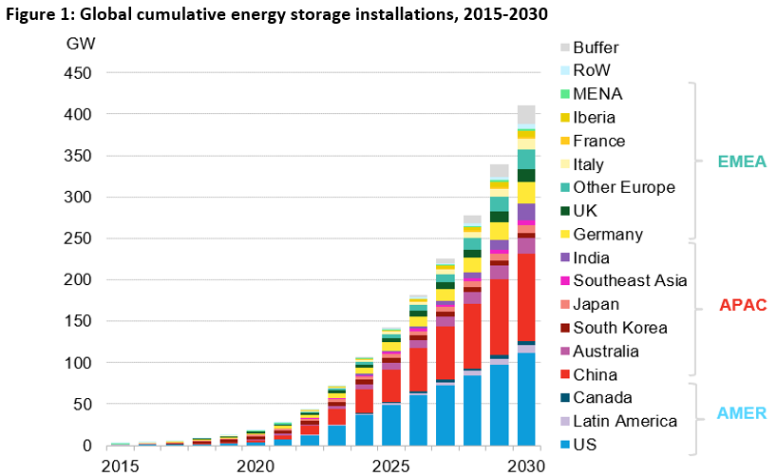
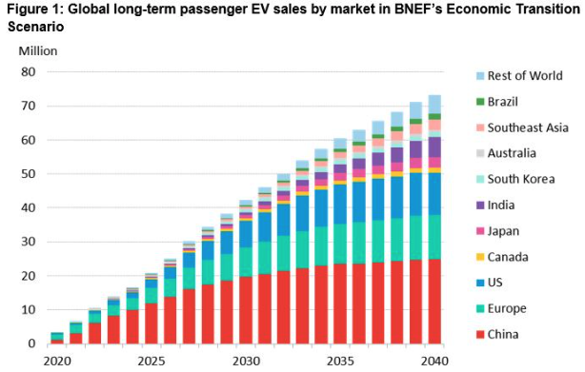
Trend
Growing adoption of EV and ESS
Global energy storage market is estimated to grow 15-fold, from 27 GW / 56 GWh in 2021 to 411 GW / 1194 GWh in 2030. The largest power markets in the world, like China, the US, and the EU, have all passed legislation to incentivizes energy storage.
Global passenger EV sales are expected to exceed 30 million in 2027 and grow to 73 million per year in 2040. As part of the Advanced Clean Cars II regulations, all new passenger vehicles sold in California will be zero-emission vehicles (ZEV) by 2035.
ELECTRICAL & COMPUTER ENGINEERING
GRAINGER ENGINEERING

Slide 5
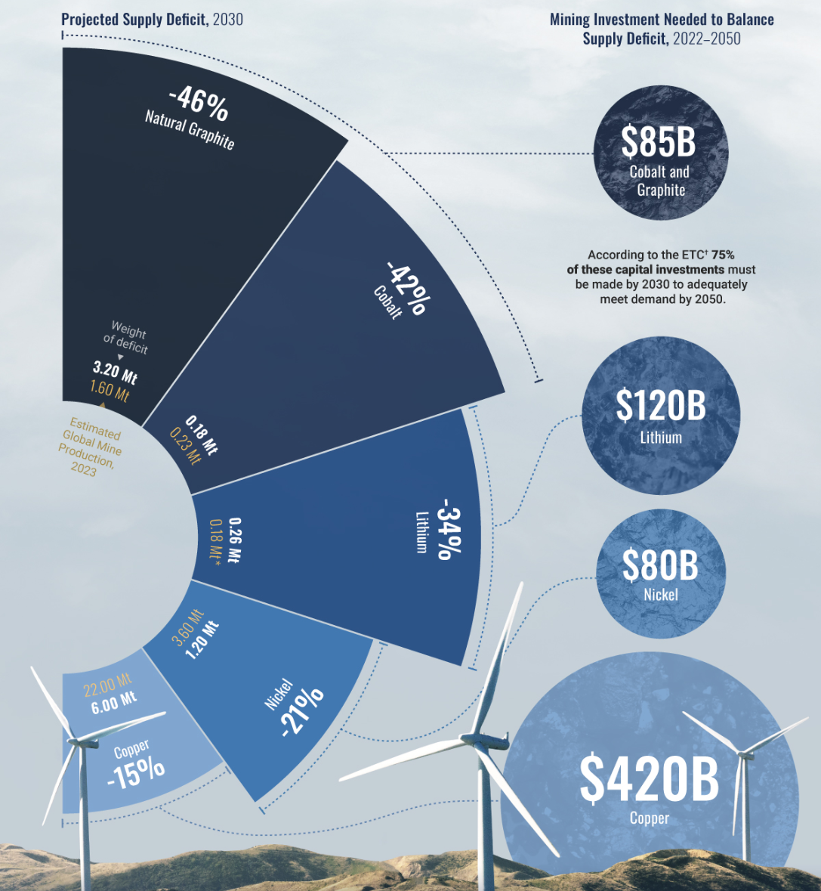
Problem
Rapid growth of EV and ESS adoption can lead to several significant issues
As the world accelerates in clean energy transition, the demand for clean energy materials is projected to grow by more than 400% by 2030.
Depletion of precious metals(batteries), such as lithium, nickel, and cobalt, and rare-earth elements (electric motors) such as neodymium and samarium.
Environmental concerns caused by increased mining activities.
Geopolitical tensions and supply chain vulnerability due to the concentration of extracting and processing in a few countries.
ELECTRICAL & COMPUTER ENGINEERING
GRAINGER ENGINEERING

Slide 6
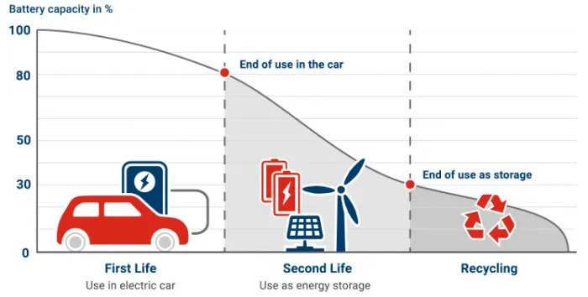
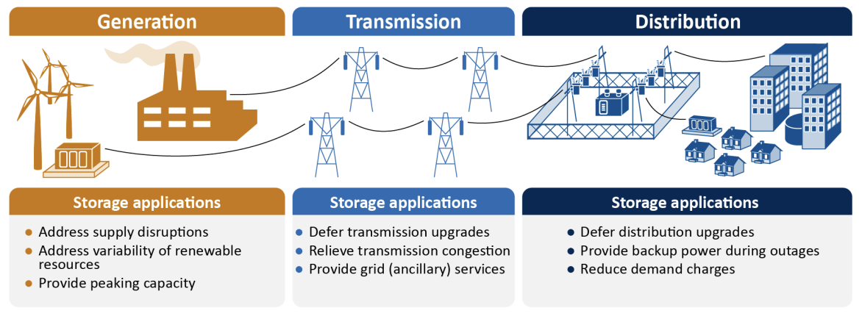
Solution
Repurposing EV battery is a potential solution
EV batteries that have the potential to provide service after reaching their end-of-life, which is about 80% of their original battery capacity, are known as Second Life Batteries (SLB).
Possible SLB applications include grid-scale ESS, residential and industrial ESS, stand-alone microgrid, and others such as EV charging stations and electric golf carts and machinery.
ELECTRICAL & COMPUTER ENGINEERING
GRAINGER ENGINEERING

Slide 7
Technology Overview
ELECTRICAL & COMPUTER ENGINEERING
GRAINGER ENGINEERING

Slide 8
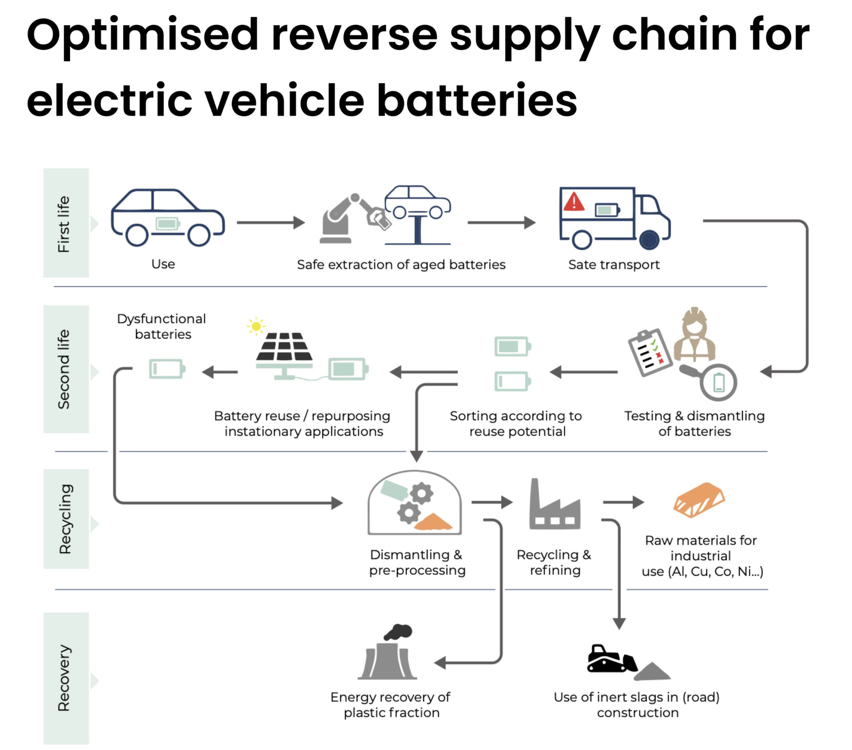
Technology Overview
Four Steps of Battery Repurposing
Assess the state of health of the battery
Evaluate the battery’s viability for a second life
Decide on a configuration
Reassemble the battery pack in the new configuration
ELECTRICAL & COMPUTER ENGINEERING
GRAINGER ENGINEERING

Slide 9
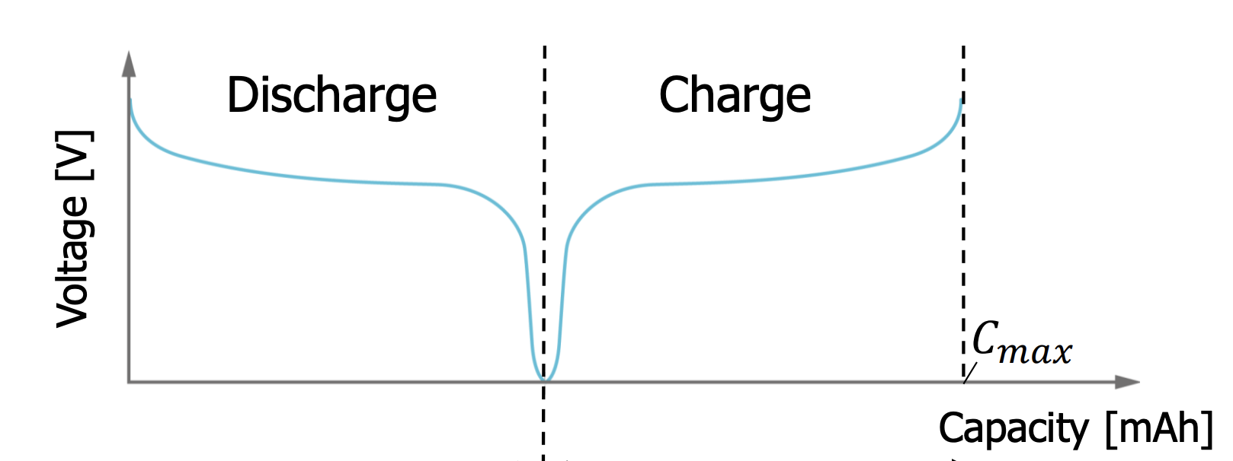
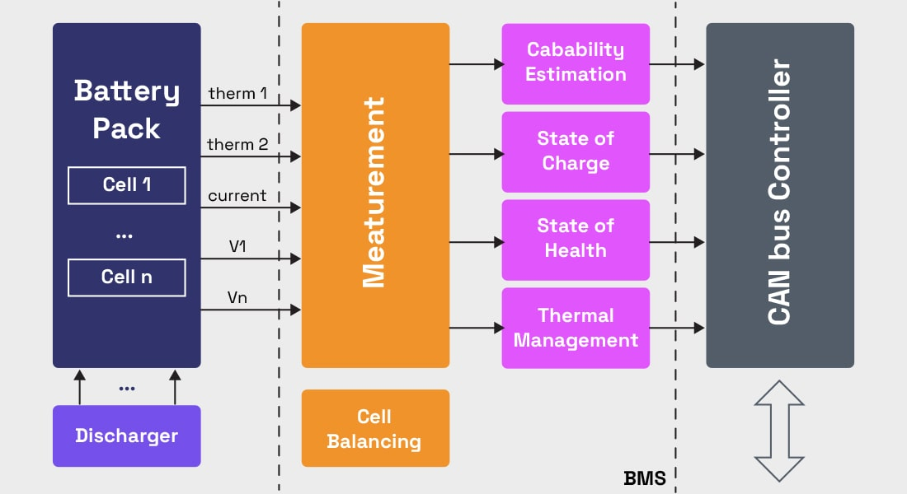
Four Steps of Battery Repurposing
Step 1: Assess Battery State of Health
Obtain battery information including state of health (SOH), state of charge (SOC) and capacity, charging and discharging rates (C rate), voltage and current range, and distance driven of EV.
Method 1: From EVs’ battery management systems (BMS), digital labels, or battery passports. The method is straightforward but can be inaccurate.
Method 2: Test battery pack through cycling, include capacity and internal resistance tests. The second method is required when third-party repurposing companies have difficulty accessing battery information after batteries are removed from the vehicles.
ELECTRICAL & COMPUTER ENGINEERING
GRAINGER ENGINEERING
Notes:
https://bacancysystems.com/blog/components-of-battery-management-system

Slide 10
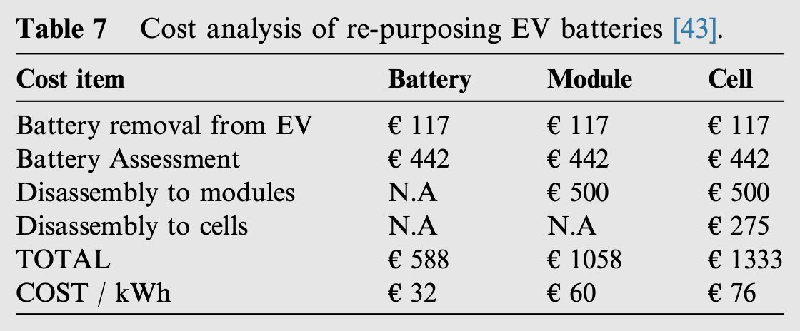
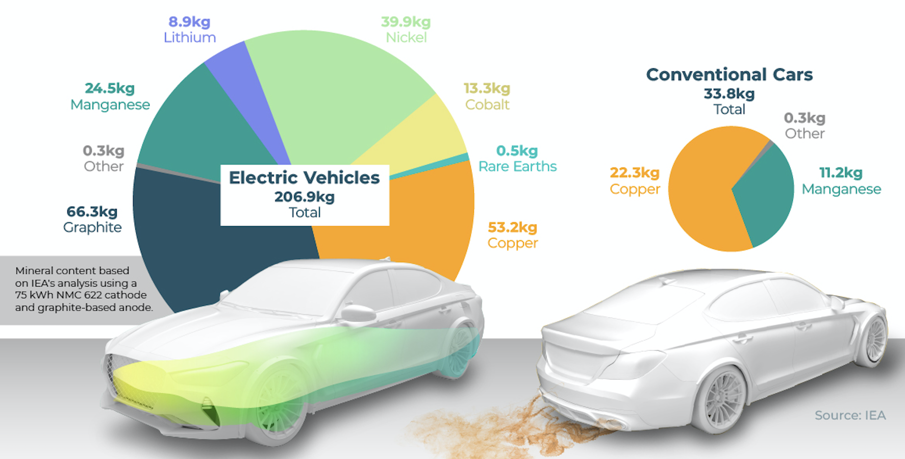
Four Steps of Battery Repurposing
Step 2: Evaluate Second Life Viability
Determine how batteries can best be repurposed, considering characteristics including capacity, power, weight, volume, possible configuration, thermal management, and cost.
Consideration 1: The deeper the disassembly level, the higher the cost.
Consideration 2: If additional battery cells are incorporated to achieve a higher capacity, the battery will be heavier. The extra weight wouldn’t matter for a stationary application but would significantly impact those of mobile device or vehicle.
ELECTRICAL & COMPUTER ENGINEERING
GRAINGER ENGINEERING

Slide 11
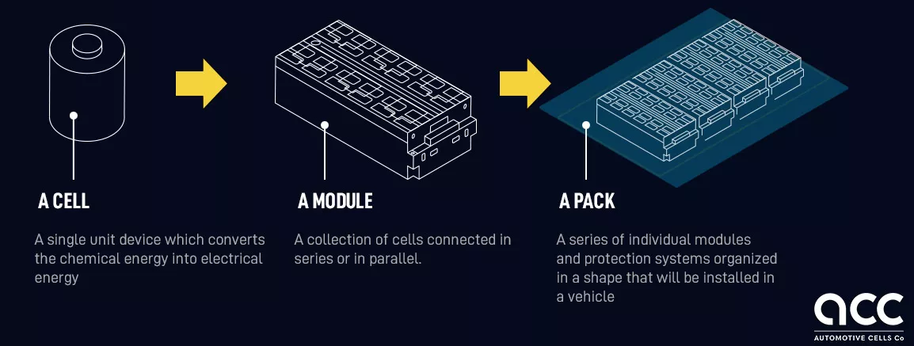
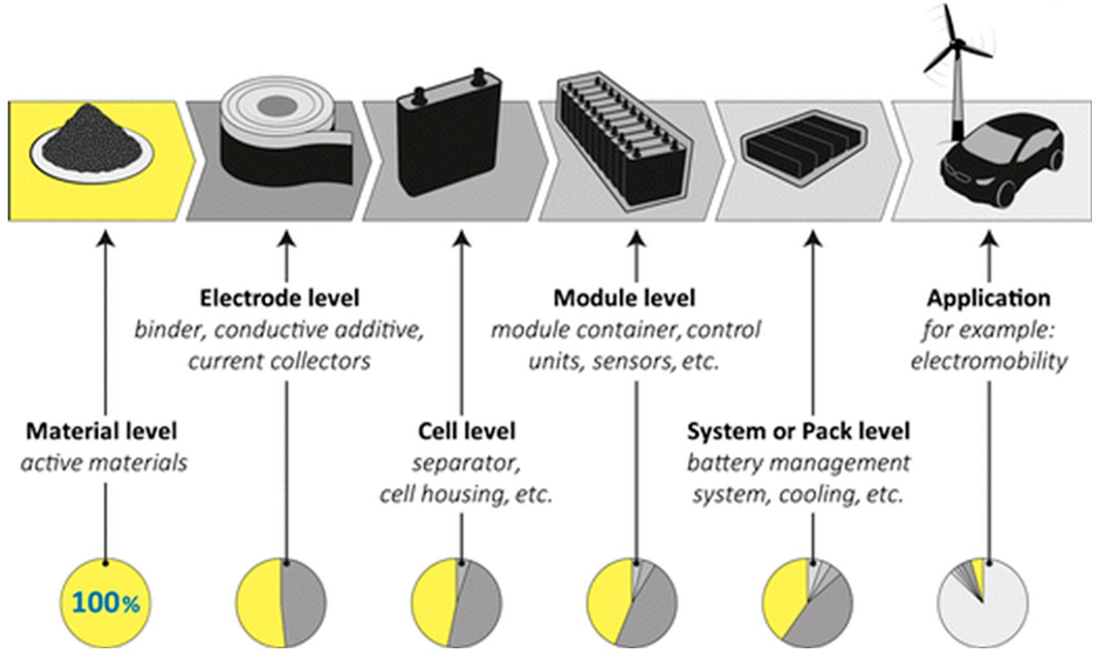
Four Steps of Battery Repurposing
Step 3/4: Decide a Configuration and Reassemble
Ensure every reasseunit have similar characteristics since battery performance is affected by the worst performing pack, module, or cell.
Battery pack: Requires the least amount of disassembly, making it suitable when a large battery capacity is necessary, such as grid services.
Battery modules: Simpler to repair and more reliable than pack stacking because modules with poor performance can be swapped out or removed before creating a new battery.
Battery cells: Most reliable and flexible in size, making it useful for small electronic devices. However, it can damage more cells during disassembly and generate more waste as many battery components are no longer used.
ELECTRICAL & COMPUTER ENGINEERING
GRAINGER ENGINEERING

Slide 12
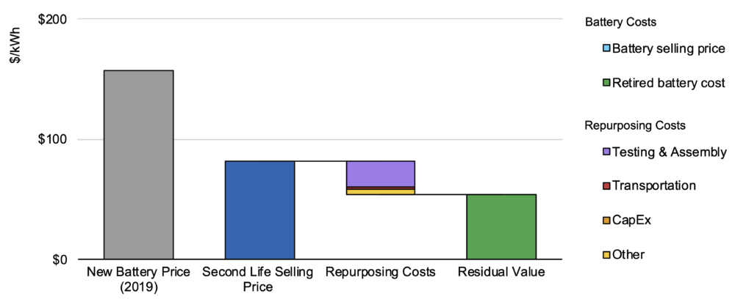
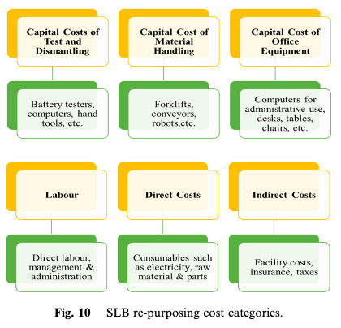
Pros and Cons
Reduced Cost
The SLBs are typically 30-70% less expensive than new batteries, significantly reducing upfront inventory, warranty and replacement, and other costs.
However, SLBs may fit fewer usable kilowatt-hours into the same container, increasing balance-of-system costs, construction costs, and siting requirements. (Could the opposite be true?)
Reduced Demand, Waste and Emissions
EV battery repurposing reduces the need of raw materials extraction and refinement, making it part of the EV battery circular economy (reuse, repurpose, and recycle) and reducing carbon intensity.
Reduced Performance
SLBs can have higher SOC minimums, lower SOC minimums, faster self-discharge rate, and shorter lifetime etc.
ELECTRICAL & COMPUTER ENGINEERING
GRAINGER ENGINEERING

Slide 13
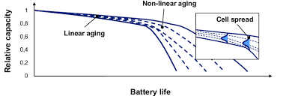
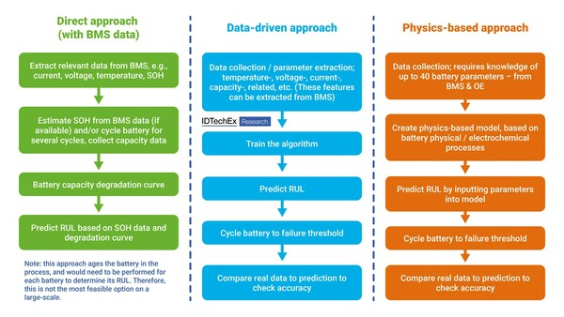
Limitations and Challenges
Technical Challenges
SLB modelling can be difficult due to the missing of historical data of the first-life operation, the nonlinear degradation when batteries drop below 70% of original energy capacity, and variance in battery model and state.
It is challenging to to balance the operation of different batteries, detect end-of-life failures, and isolate the malfunctioning modules.
Lack Intentional Designing for Disassembly
Disassembly can be difficult due to strong adhesives, specific tooling, and complicated designs. Multi-life battery systems makes disassembly faster, safer, and more accessible.
ELECTRICAL & COMPUTER ENGINEERING
GRAINGER ENGINEERING

Slide 14
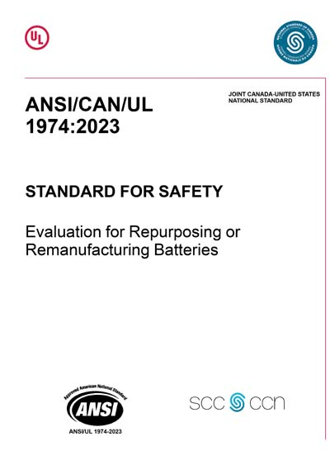
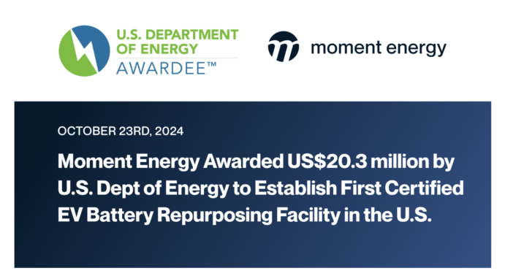
Limitations and Challenges
Lack Standardization in Policy and Process
Policies in warranty, insurance, ownership of batteries, access to battery data, and permitting are often unclear.
Specific processes, especially safety requirements, can vary depending on battery type, access to proprietary software, configuration, and application.
Lack Access to Battery Design and Operation Information
Battery design and BMS software and hardware are often confidential. Access to accurate and reliable BMS makes testing of batteries removed from a vehicle more quick, reliable and affordable.
Some repurposing companies work with selective car makers to design plug and play ESS based on specific shapes, sizes and dimensions.
ELECTRICAL & COMPUTER ENGINEERING
GRAINGER ENGINEERING

Slide 15
Conclusion
ELECTRICAL & COMPUTER ENGINEERING
GRAINGER ENGINEERING

Slide 16
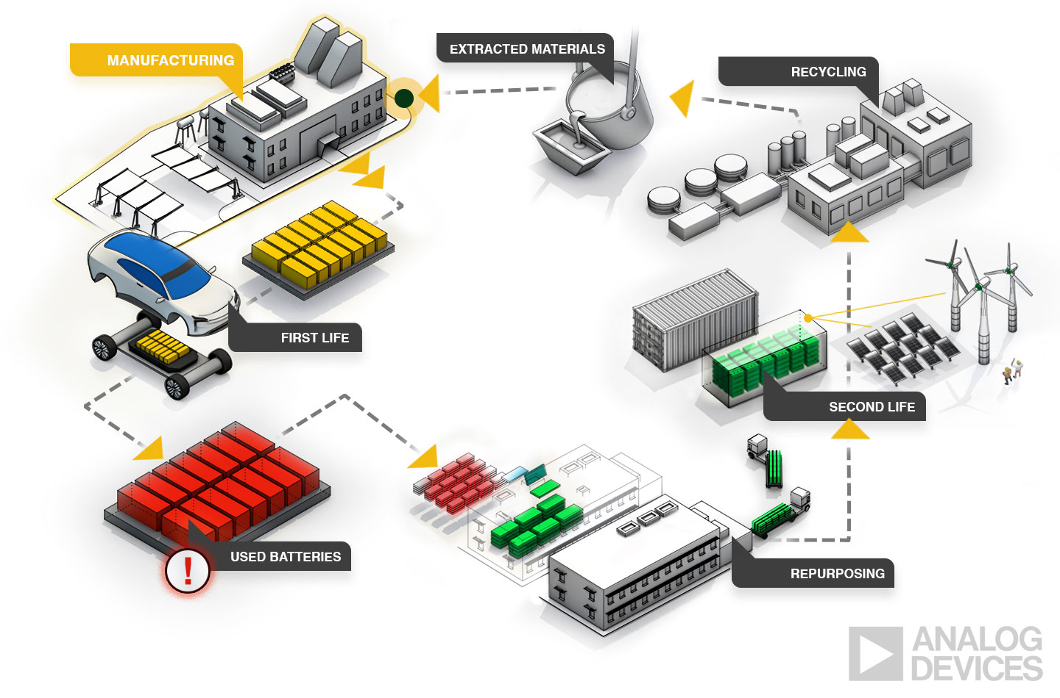
Summary and Key Takeaways
EV battery repurposing has the potential to mitigate the high demand for critical minerals
The demand for critical minerals is growing at an unprecedented pace as the clean energy transition accelerates.
EV batteries can be repurposed through the process of (1) assessing the state of health, (2) evaluating second life viability, (3) deciding on a configuration, and (4) reassembling.
Aside from reducing raw material extraction and refinement, SLBs can reduce cost, waste, and carbon footprint.
In addition to the technical challenges, the lack of (1) intentional designing for disassembly, (2)standardization in policy and process, and (3) access to battery design and operation information have to be addressed to improve accessibility, safety, and viability of EV battery repurposing.
ELECTRICAL & COMPUTER ENGINEERING
GRAINGER ENGINEERING

Slide 17
Thank You
ELECTRICAL & COMPUTER ENGINEERING
GRAINGER ENGINEERING

Slide 18
References
Ambrose, Hanjiro. “The Second-Life of Used EV Batteries.” The Equation, 27 May 2020, blog.ucsusa.org/hanjiro-ambrose/the-second-life-of-used-ev-batteries/.
Balaraman, Kavya. “California Project Is Second in US to Employ Used EV Batteries to Sell Power to the Grid: B2U.” Utility Dive, 14 Nov. 2023, www.utilitydive.com/news/b2u-california-project-used-honda-ev-batteries-energy-storage/699749/.
BatteryBits Editors. “Opportunities and Challenges of Second-Life Batteries.” Medium, BatteryBits (Volta Foundation), 27 Jan. 2024, medium.com/batterybits/opportunities-and-challenges-of-second-life-batteries-f1f62fa846a5.
California Air Resources Board. “Cars and Light-Trucks Are Going Zero - Frequently Asked Questions | California Air Resources Board.” Ww2.Arb.ca.gov, ww2.arb.ca.gov/resources/documents/cars-and-light-trucks-are-going-zero-frequently-asked-questions.
EVBoosters. “The Optimised Reverse Supply Chain for EV Batteries.” EVBoosters, 14 Mar. 2024, evboosters.com/ev-charging-news/the-optimised-reverse-supply-chain-for-ev-batteries/.
Grandi, Tessa Di . “Visualized: The EV Mineral Shortage.” Visual Capitalist, 8 Feb. 2023, www.visualcapitalist.com/sp/how-mineral-supply-will-change-ev-forecasts/.
Gu, Xubo, et al. “Challenges and Opportunities for Second-Life Batteries: Key Technologies and Economy.” Renewable & Sustainable Energy Reviews, vol. 192, 1 Mar. 2024, pp. 114191–114191, https://doi.org/10.1016/j.rser.2023.114191.
Haram, Mohammed Hussein Saleh Mohammed, et al. “Feasibility of Utilising Second Life EV Batteries: Applications, Lifespan, Economics, Environmental Impact, Assessment, and Challenges.” Alexandria Engineering Journal, vol. 60, no. 5, 1 Oct. 2021, pp. 4517–4536, www.sciencedirect.com/science/article/pii/S1110016821001757?via%3Dihub, https://doi.org/10.1016/j.aej.2021.03.021.
Lumkong, Daniella, and Sheila Davis. Info Sheet: Electric Vehicle Battery Repurposing and Second Life. 3 June 2024.
Selin Oğuz. “Visualized: Projected Supply Deficits for Key Energy Transition Metals.” Visual Capitalist, 7 Oct. 2024, www.visualcapitalist.com/sp/visualized-projected-supply-deficits-for-key-energy-transition-metals/.
“The Global Fight for Critical Minerals Is Costly and Damaging.” Nature, vol. 619, no. 7970, 19 July 2023, pp. 436–436, www.nature.com/articles/d41586-023-02330-0#:~:text=An%20abundance%20of%20critical%20minerals, https://doi.org/10.1038/d41586-023-02330-0.
ELECTRICAL & COMPUTER ENGINEERING
GRAINGER ENGINEERING

