Slide 1
University of Illinois at Urbana-Champaign
NPRE 498: Energy Storage Systems
Professor Magdi Ragheb
Fall 2024
Using Concentrated Solar Power (CSP) to Power a Hydrogen Production and Distribution Hub
by
Joseph Bailey
bailey40@illinois.edu
4 December 2024

Slide 2


Outline
Background and Motivation
Concentrated Solar Power (CSP)
Hydrogen Production
Combining CSP with H2 Production
Performance Analysis
Economic Analysis
Future Research Opportunities
NPRE 498 FALL 2024 – Using Concentrated Solar Power to Power a Hydrogen Production and Distribution Hub

Slide 3
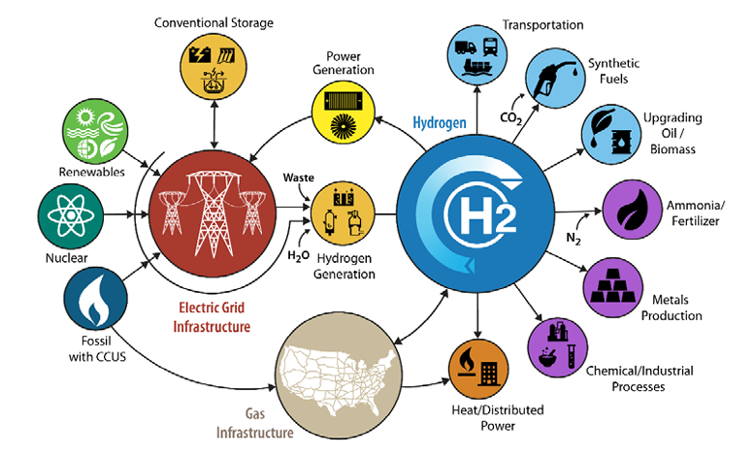
Background and Motivation
Global energy demand is rising, and the need for clean energy solutions is critical. Hydrogen is a versatile energy carrier that can address hard-to-decarbonize sectors such as industrial processes, heavy transportation, and long-term energy storage.
Concentrated Solar Power (CSP) is uniquely positioned to support hydrogen production through high-temperature applications, providing firm, renewable power that can enhance hydrogen generation efficiency.
The U.S. aims to scale clean hydrogen production from 10 MMT in 2030 to 50 MMT by 2050, potentially reducing greenhouse gas emissions by 10% relative to 2005 levels. (USDOE)
DOE H2@Scale Vision¹
¹ U.S. Department of Energy. (2024, May). Hydrogen and Fuel Cell Technologies Office Multi-Year Program Plan. https://www.energy.gov/sites/default/files/2024-05/hfto-mypp-2024.pdf.
NPRE 498 FALL 2024 – Using Concentrated Solar Power to Power a Hydrogen Production and Distribution Hub

Slide 4
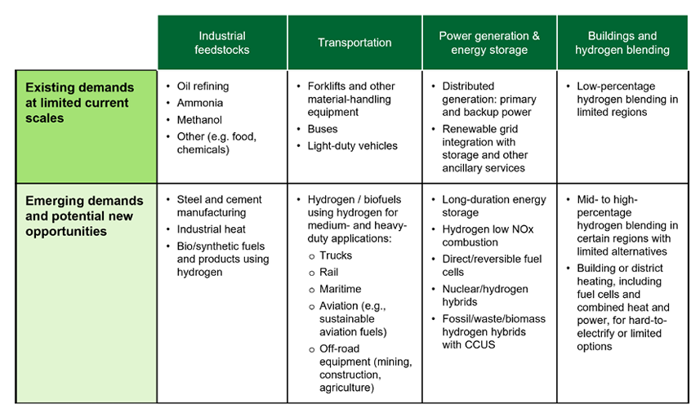
Background and Motivation
Existing and Emerging Hydrogen Demand¹
¹ U.S. Department of Energy. (2024, May). Hydrogen and Fuel Cell Technologies Office Multi-Year Program Plan. https://www.energy.gov/sites/default/files/2024-05/hfto-mypp-2024.pdf.
NPRE 498 FALL 2024 – Using Concentrated Solar Power to Power a Hydrogen Production and Distribution Hub

Slide 5
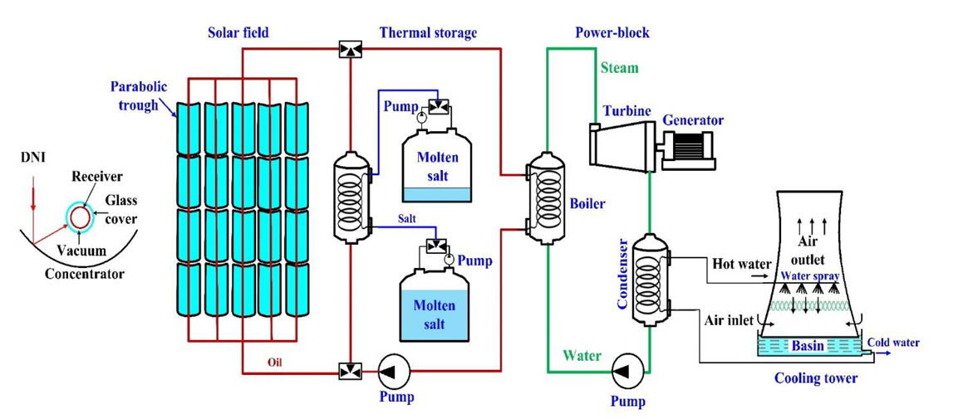
CSP Overview
Parabolic Trough CSP System with Molten Salt TES¹
CSP focuses sunlight using mirrors onto a receiver. The concentrated heat is transferred via a heat transfer fluid (HTF) to drive a power block, producing electricity.
Main components include solar field, receiver, and thermal energy storage (TES).
¹ Abdul Hai Alami, et al., Concentrating solar power (CSP) technologies: Status and analysis, International Journal of Thermofluids, Volume 18, 2023, 100340, ISSN 2666-2027, https://doi.org/10.1016/j.ijft.2023.100340.
NPRE 498 FALL 2024 – Using Concentrated Solar Power to Power a Hydrogen Production and Distribution Hub

Slide 6
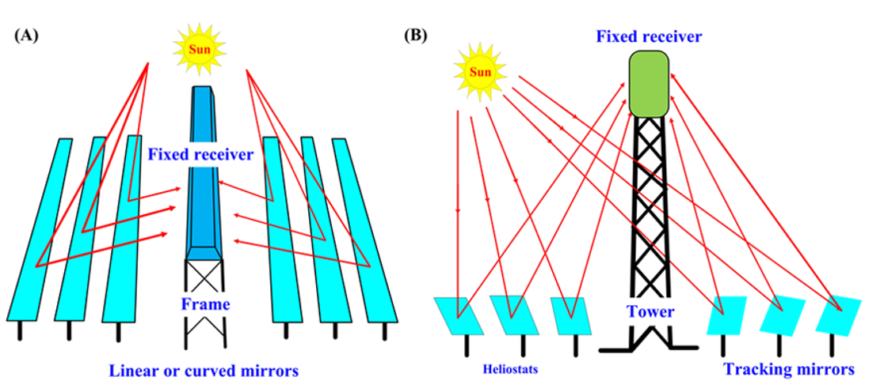
CSP Overview
Other CSP Systems (A) Linear Fresnel Reflectors and (B) Solar Tower¹
¹ Abdul Hai Alami, et al., Concentrating solar power (CSP) technologies: Status and analysis, International Journal of Thermofluids, Volume 18, 2023, 100340, ISSN 2666-2027, https://doi.org/10.1016/j.ijft.2023.100340.
NPRE 498 FALL 2024 – Using Concentrated Solar Power to Power a Hydrogen Production and Distribution Hub

Slide 7
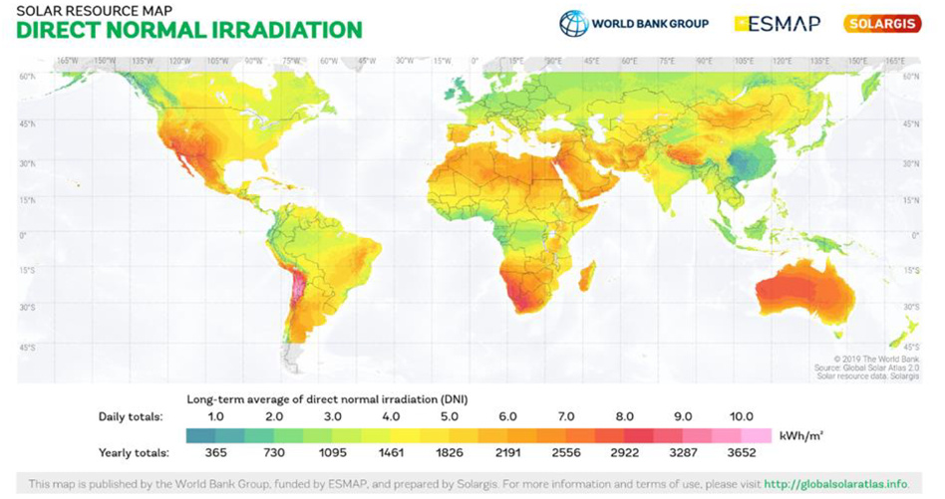
Advantages of CSP
CSP with TES provides dispatchable power, reducing reliance on fossil fuels – it is a firm renewable power.
Ideal for high-temperature applications such as industrial processes and hydrogen production.
It is suitable for regions with high solar direct normal irradiance (DNI) giving it global deployment potential
Global DNI Map¹
¹ Abdul Hai Alami, et al., Concentrating solar power (CSP) technologies: Status and analysis, International Journal of Thermofluids, Volume 18, 2023, 100340, ISSN 2666-2027, https://doi.org/10.1016/j.ijft.2023.100340.
NPRE 498 FALL 2024 – Using Concentrated Solar Power to Power a Hydrogen Production and Distribution Hub

Slide 8
CSP Comparison
Technology | Efficiency (%)
Parabolic Trough | 40
Linear Fresnel | 38
Solar Tower | 45
Efficiency (%)
¹ Abdul Hai Alami, et al., Concentrating solar power (CSP) technologies: Status and analysis, International Journal of Thermofluids, Volume 18, 2023, 100340, ISSN 2666-2027, https://doi.org/10.1016/j.ijft.2023.100340.
² R.P. Merchán, et al., High temperature central tower plants for concentrated solar power: 2021 overview, Renewable and Sustainable Energy Reviews, Volume 155, 2022, 111828, ISSN 1364-0321, https://doi.org/10.1016/j.rser.2021.111828.
NPRE 498 FALL 2024 – Using Concentrated Solar Power to Power a Hydrogen Production and Distribution Hub

Slide 9
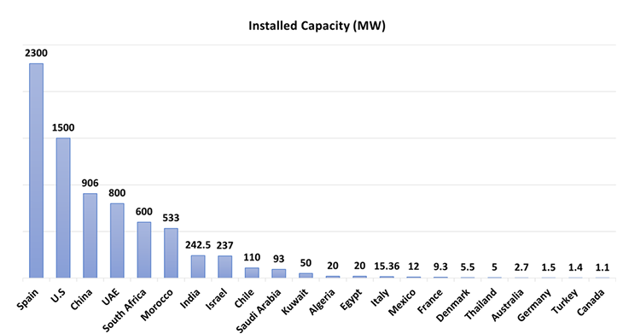
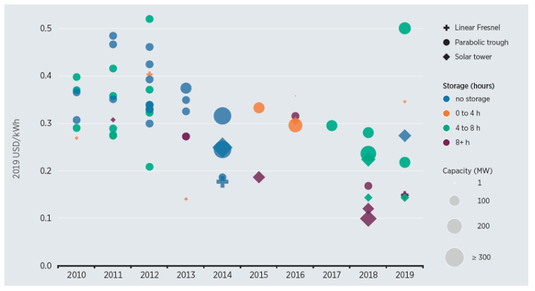
Global CSP Landscape
CSP capacity leaders include Spain, U.S., and China.
Future trends suggest global capacity growth and cost reductions improving the levelized cost of electricity (LCOE).
This suggests a growing role of CSP in the clean energy transition and opportunity as hydrogen hubs globally.
2023 Installed Capacity by Country¹
LCOE Versus CSP Commissioning Year²
¹ Abdul Hai Alami, et al., Concentrating solar power (CSP) technologies: Status and analysis, International Journal of Thermofluids, Volume 18, 2023, 100340, ISSN 2666-2027, https://doi.org/10.1016/j.ijft.2023.100340.
² R.P. Merchán, et al., High temperature central tower plants for concentrated solar power: 2021 overview, Renewable and Sustainable Energy Reviews, Volume 155, 2022, 111828, ISSN 1364-0321, https://doi.org/10.1016/j.rser.2021.111828.
NPRE 498 FALL 2024 – Using Concentrated Solar Power to Power a Hydrogen Production and Distribution Hub

Slide 10
Methods of Hydrogen Production
Method | Overview
Proton-Exchange Membrane (PEM) and Alkaline Electrolysis | Operate at moderate temperatures (~50-80ºC) Splits water into hydrogen and oxygen using electricity Efficiency: ~52%¹
Solid Oxide Electrolyzer Cell (SOEC) - High Temperature Electrolysis | Uses steam (650-1000ºC) Improves efficiency by reducing electricity demand and leverages thermal energy Efficiency: ~75%²
Thermochemical Splitting (Sulfur-Iodine (SI) Cycle) | Relies on redox cycles using concentrated solar heat. Efficiency: ~52%¹
Plasmolysis | Uses plasma to split water vapor. Still in R&D Efficiency: ~79%¹
¹ Muhammad Younas, et al., An Overview of Hydrogen Production: Current Status, Potential, and Challenges, Fuel, Volume 316, 2022, 123317, ISSN 0016-2361, https://doi.org/10.1016/j.fuel.2022.123317.
² Wendt, D. S. (2022). High-temperature steam electrolysis: Development and cost analysis. Idaho National Laboratory. Retrieved November 24, 2024, from https://www.hydrogen.energy.gov/docs/hydrogenprogramlibraries/pdfs/review22/ne003_wendt_2022_p-pdf.pdf.
NPRE 498 FALL 2024 – Using Concentrated Solar Power to Power a Hydrogen Production and Distribution Hub

Slide 11
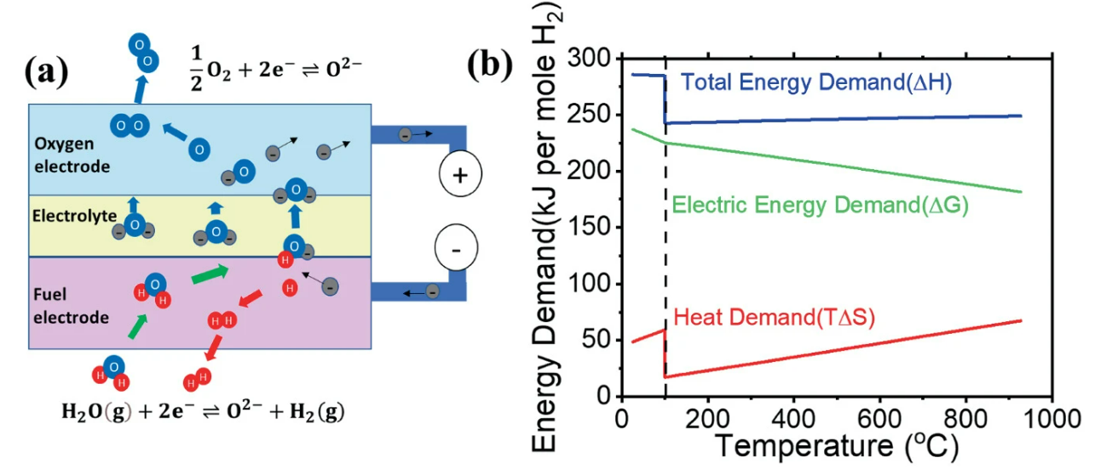
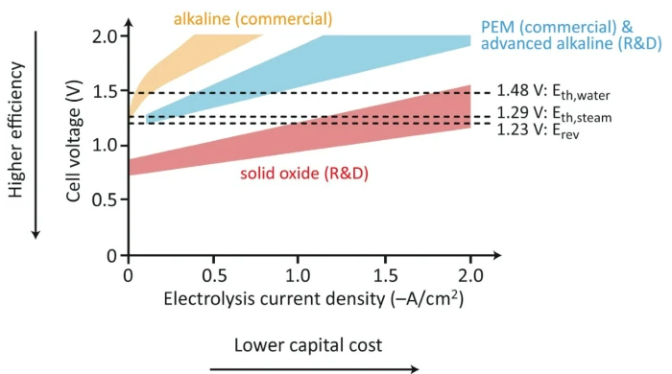
Advantages/Disadvantages – SOEC
Advantages
  Operate at high temperatures (650–1000°C), enabling efficiencies of >75%.
  Abundant materials – do not require precious metals – less expensive to scale compared to PEM and Alkaline electrolysis.
  Cost reduction potential - costs are high due to limited industrial-scale implementations.
Disadvantages
  High operating temperature accelerates material degradation.
  High initial costs (currently non-commercial)
(a) SOEC Schematic and (b) Energy Demand as a Function of Temperature¹
Typical Performance Range of Electrolysis Tech¹
¹ Laguna-Bercero, M.A., Wang, Y., Zhou, XD., Zhu, L. (2023). Fundamentals of Solid Oxide Electrolysis Cells (SOEC). In: Laguna-Bercero, M.A. (eds) High Temperature Electrolysis. Lecture Notes in Energy, vol 95. Springer, Cham. https://doi.org/10.1007/978-3-031-22508-6_2
NPRE 498 FALL 2024 – Using Concentrated Solar Power to Power a Hydrogen Production and Distribution Hub

Slide 12
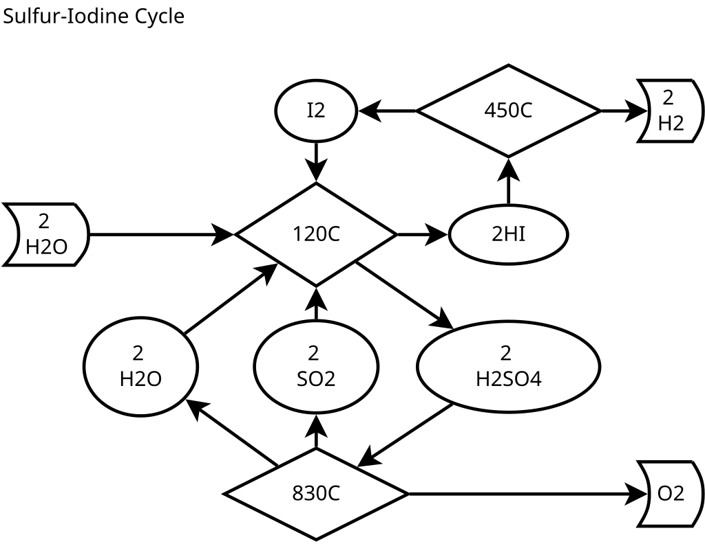
Advantages/Disadvantages – SI Cycle
Advantages ¹
  All fluid (l,g) process and well suited to continuous production
  High thermal efficiency (~50%)
  Closed system without byproducts or effluents (aside from O₂ and H₂)
Disadvantages ¹
  Very high temperatures required (>850ºC) – a challenge for CSP
  Corrosive agents require advanced materials – I, HI, SO₂, H₂SO₄)
Sulfur-Iodine Cycle¹
¹ “Sulfur-iodine cycle" Wikipedia, Wikimedia Foundation. https://en.wikipedia.org/wiki/Sulfur%E2%80%93iodine_cycle.
NPRE 498 FALL 2024 – Using Concentrated Solar Power to Power a Hydrogen Production and Distribution Hub

Slide 13
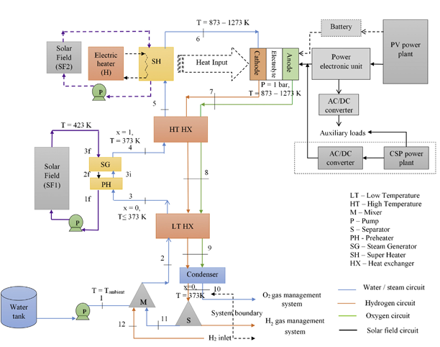
CSP for High-Temperature Hydrogen Concept - SOEC
CSP system provides 700-1000ºC for high temperature steam required for SOEC high-temperature electrolysis efficiency.
Electrical efficiency for SOEC is ~75%²
CSP can supply ~80% of the heat requirements.
With CSP TES this will provide stable, all day, hydrogen production.
Assuming optimal efficiency, 3000-5000kg of H₂ per day for a 100 MW CSP system.
SOEC and CSP Integration Concept¹
¹ Deepak Yadav, Rangan Banerjee, Economic assessment of hydrogen production from solar driven high-temperature steam electrolysis process, Journal of Cleaner Production, Volume 183, 2018, Pages 1131-1155, ISSN 0959-6526, https://doi.org/10.1016/j.jclepro.2018.01.074
² Wendt, D. S. (2022). High-temperature steam electrolysis: Development and cost analysis. Idaho National Laboratory. Retrieved November 24, 2024, from https://www.hydrogen.energy.gov/docs/hydrogenprogramlibraries/pdfs/review22/ne003_wendt_2022_p-pdf.pdf.
NPRE 498 FALL 2024 – Using Concentrated Solar Power to Power a Hydrogen Production and Distribution Hub

Slide 14
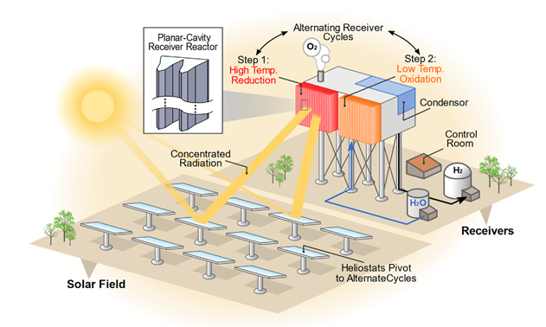
CSP for High-Temperature Hydrogen Concept – SI Cycle
CSP systems (particularly solar tower) are well suited to provide temperatures required for the SI cycle.
SI cycle has a thermal to hydrogen efficiency of 40-50% depending upon reactor design and operating conditions.
Limited electrical input required – mainly for auxiliary systems.
With CSP TES this will provide stable, all day, hydrogen production.
Assuming optimal efficiency, 3000-5000kg of H₂ per day for a 100 MW CSP system.
2-step Thermal Chemical Splitting and CSP Integration Concept¹ (Note: 3rd lower temp step required for SI Cycle)
¹ Zhiwen Ma, et. al., System and technoeconomic analysis of solar thermochemical hydrogen production, Renewable Energy, Volume 190, 2022, Pages 294-308, ISSN 0960-1481, https://doi.org/10.1016/j.renene.2022.03.108
NPRE 498 FALL 2024 – Using Concentrated Solar Power to Power a Hydrogen Production and Distribution Hub

Slide 15
Performance Analysis – H₂ Production / Day by System
System | H2 Production Rate (kg/day) by Thermal Energy Fraction (%) Used
 | 20% | 40% | 60% | 80% | 100%
SOEC | 5,040 | 10,080 | 15,120 | 20,160 | 25,200
SI Cycle | 3,931 | 7,862 | 11,794 | 15,725 | 19,656
Assumptions:
CSP System Losses:
Optical losses: 10%
Thermal losses: 15%
TES losses: 5%
Combined CSP efficiency: 70%
Process Efficiency / Rate:
SI Cycle: 52% / 40 kWh/kg
SOEC: 75% / 45 kWh/kg
Downtime and Maintenance:
Ao: 90% (10% downtime)
CSP Thermal Input:
100 MW Thermal Capacity
24-hour generation (TES)
NPRE 498 FALL 2024 – Using Concentrated Solar Power to Power a Hydrogen Production and Distribution Hub

Slide 16
Performance Analysis - Electricity Production / Day
System | Electrical Production Rate (MWh/day) by Thermal Energy Fraction (%) Used
 | 80% | 60% | 40% | 20% | 0%
My CSP | 484 | 363 | 242 | 121 | 0
Assumptions:
CSP System Losses:
Optical losses: 10%
Thermal losses: 15%
TES losses: 5%
Combined CSP efficiency: 70%
Power Block Efficiency:
Modern CSP with Steam Rankine Cycle: 40%
Downtime and Maintenance:
Ao: 90% (10% downtime)
CSP Thermal Input:
100 MW Thermal Capacity
24-hour generation (TES)
NPRE 498 FALL 2024 – Using Concentrated Solar Power to Power a Hydrogen Production and Distribution Hub

Slide 17
Performance Analysis - Overall Efficiency
Combined CSP electrical and hydrogen production efficiency and reflects the percentage of CSP energy converted to usable outputs.
Variances primarily driven by H2 process efficiency differences as electrical efficiency capped due to fixed power block efficiency.
  Note: using this CSP system for electrical generation only will have an overall efficiency of 25%
Combined H2 and Electrical production results in higher system efficiency.
System | Overall Efficiency by Thermal Energy Fraction (%) Used for H2 Production
 | 20% | 40% | 60% | 80% | 100%
SOEC | 30% | 34% | 38% | 43% | 47%
SI Cycle | 27% | 28% | 30% | 31% | 33%
NPRE 498 FALL 2024 – Using Concentrated Solar Power to Power a Hydrogen Production and Distribution Hub

Slide 18
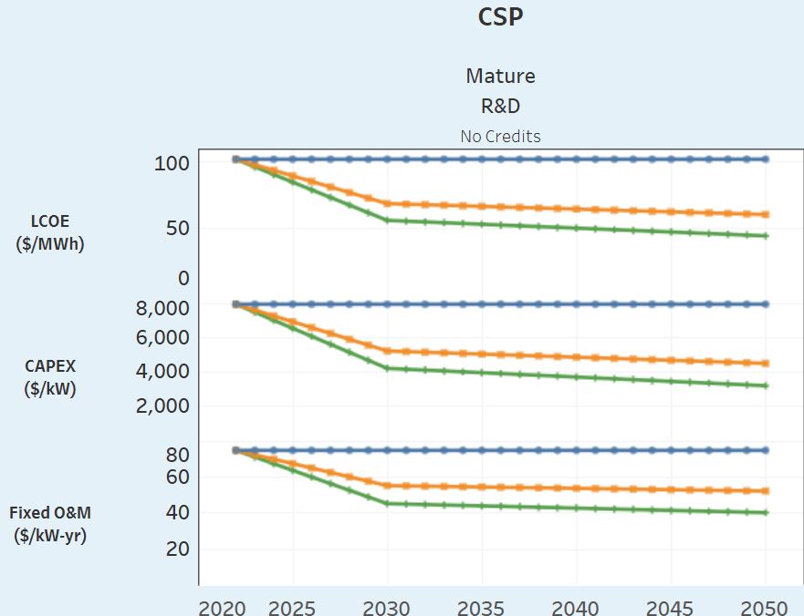
Simple CSP-SOEC Economic Analysis - Assumptions
20-year lifespan
CSP and electrical analysis using 2030 values
  Size: 100 MW
  LCOE: 55.1 $/MWh
  CAPEX: 4165 $/kW
  Fixed O&M: 45 $/kW-yr
SOEC costs
  CAPEX: 2000 $/kW (2020) and 300 $/kW¹
    Assume 2030 is linear – 1433 $/kW
  Fixed O&M: 9.4 $/kW-yr
    3% of CAPEX assumed
  Mass flow rate: 45 kWh/kg¹
NREL CSP Cost Value Projections through 2050¹
¹ National Renewable Energy Laboratory. Concentrating Solar Power. Annual Technology Baseline. https://atb.nrel.gov/electricity/2024/concentrating_solar_power.
² Saarikoski, A. (2022). A techno-economic analysis of a pressurized high-temperature solid oxide electrolysis system (Master’s thesis). School of Engineering, Advanced Energy Solutions Programme, Aalto University. https://aaltodoc.aalto.fi/server/api/core/bitstreams/65d697af-a2e9-4f5e-ad81-31b67db5d4fb/content.
NPRE 498 FALL 2024 – Using Concentrated Solar Power to Power a Hydrogen Production and Distribution Hub

Slide 19
Simple CSP-SOEC Economic Analysis – LCOE/LCOH
Values | Values by Thermal Energy Fraction (%) Used for H2 Production
 | 20% | 40% | 60% | 80% | 100%
CSP Cost Over Lifetime | $506.5B | $506.5B | $506.5B | $506.5B | $506.5B
CSP Electricity Produced (MWh-lifetime) | 3,532,032 | 2,649,024 | 1,766,016 | 883,008 | 0
CSP LCOE /$kWh (1-X% Thermal Capacity) | $0.11 | $0.11 | $0.11 | $0.11 | N/A
SOEC Scale (kW) | 9.5 | 18.9 | 28.4 | 37.8 | 47.3
SOEC Cost Over Lifetime | $15.3M | $30.6M | $46.0M | $61.3M | $76.6M
SOEC H2 Produced (kg-lifetime) | 36,792,000 | 73,584,000 | 110,376,000 | 147,168,000 | 183,960,000
SOEC LCOH $/kg (using X% Thermal Capacity) | $3.17 | $3.17 | $3.17 | $3.17 | $3.17
NPRE 498 FALL 2024 – Using Concentrated Solar Power to Power a Hydrogen Production and Distribution Hub

Slide 20

Future Research Opportunities
CSP Advancements
  High-temperature CSP materials
  Improved TES systems
  Hybrid CSP systems (PV and Wind)
H2 Production Advancements
  SOEC enhanced stack durability
  SOEC thermal-electrical efficiency improvements
  Investigate alternative cycles beyond SI
  Improve thermochemical reactor designs for scalability and efficiency
  Explore alternatives (e.g. Plasmolysis)
  Model, survey, and catalog CAPEX and OPEX
CSP-H2 Integration
  Control algorithms to optimize energy allocation between electricity and H2 production dynamically
  Grid balancing and hydrogen generation
  Pathways to reduce LCOH < $2/kg
  Cost reductions in TES, electrolyzers, and CSP components
  Identify regions with high DNI for optimal CSP-H2 deployment
NPRE 498 FALL 2024 – Using Concentrated Solar Power to Power a Hydrogen Production and Distribution Hub

Slide 21

Q&A
Questions or comments? (Contact: Bailey40@illinois.edu)
NPRE 498 FALL 2024 – Using Concentrated Solar Power to Power a Hydrogen Production and Distribution Hub

Slide 22


