Slide 1
Metal-Air Batteries: Types, Applications, and Challenges
NPRE 498 Energy Storage Systems
Marta Baginska
12.07.2011

Slide 2
Outline
Introduction
  Scope of the presentation: Where do metal-air batteries fit in?
  General characteristics of metal-air batteries
  Factors the affect performance
  Air electrode requirements
Zinc-Air Batteries
  Characteristics
  Chemistry
  Types (primary and refuelable)
Lithium-Air Batteries
  Characteristics
  Extent of rechargeability
  Current issues and challenges
Conclusions

Slide 3
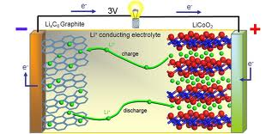
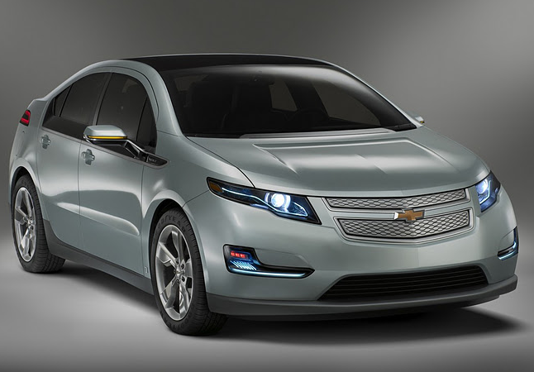
Current Energy Outlook
Advanced electronic equipment has been developing at a rapid pace, resulting in an ever-increasing demand for high energy density and high power density power sources.
Li-ion technologies are currently the hope for meeting many of these demands, i.e, electric vehicles.
The energy density of Li-ion batteries is limited by the intercalation chemistry of the electrodes.

Slide 4
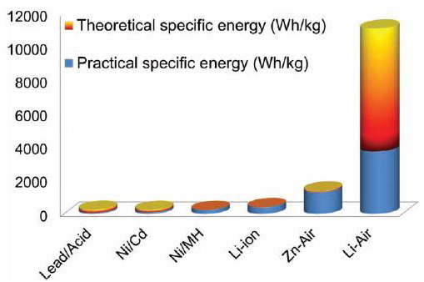
Current Battery Outlook
Metal-air batteries have garnered much attention recently as a possible alternative, due to their extremely high energy density compared to that of other rechargeable batteries:

Slide 5
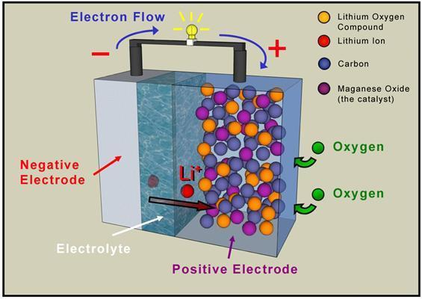
Metal-Air Battery Concept
This high specific energy density is a result of the coupling of a reactive metal anode to an air electrode, thus providing a battery with an inexhaustible cathode reactant.

Slide 6
Metal-Air Batteries
The major advantages and disadvantages are summarized below..
Advantages | Disadvantages
High energy density | Dependent on environmental conditions: Drying out limits shelf life once opened to air Electrolyte flooding limits power output
Flat discharge voltage
Long shelf life (dry storage)
Non toxic (on metal use basis) | Limited power density
Low cost (on metal use basis) | Limited operating temperature range

Slide 7
Metal-Air Battery Properties
Typically divided into two categories based on electrolyte type: (i) aqueous or (ii) non-aqueous.
Can be primary, secondary, or ‘refuelable’.
A variety of metals have been considered for use:
Metal/air battery | Calculated OCV, V | Theoretical specific energy, Wh/kg
 |  | Incl. oxygen | Excluding oxygen
Li/O₂ | 2.91 | 5200 | 11140
Na/O₂ | 1.94 | 1677 | 2260
Ca/O₂ | 3.12 | 2990 | 4180
Mg/O₂ | 2.93 | 2789 | 6462
Zn/O₂ | 1.65 | 1090 | 1350

Slide 8
Factors That Affect Performance
Most metals are unstable in water and react with the electrolyte to corrode the metal, resulting in self-discharge.
Electrode polarization: sharp voltage drop-off with increasing current because of oxygen diffusion limitations, making metal-air batteries more suited to low-power applications rather than high-power.
Electrode carbonation: Absorption of CO₂ (since the cell is an open system), results in crystallization of carbonate in the air electrode, clogging pores and decreasing performance.
Water transpiration: Movement of water vapor either into or out of the cell.
  Excessive water loss can lead to drying of the cell and premature failure.
  Excessive gain of water can dilute the electrolyte.

Slide 9
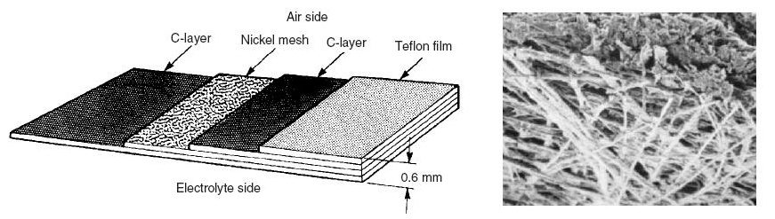
Air Electrode Requirements
Cathode must be able to sustain an oxygen reduction reaction (and oxidation if battery is rechargeable).
Cathode must be highly porous.
Catalysts are typically incorporated into the carbon layer.

Slide 10
Outline
Introduction
  Scope of the presentation
  General characteristics of metal-air batteries
  Factors the affect performance
  Air electrode requirements
Zinc-Air Batteries
  Characteristics
  Chemistry
  Types (Primary and ‘rechargeable’)
Lithium-Air Batteries
  Characteristics
  Extent of rechargeability
  Current issues and challenges
Conclusions and perspective

Slide 11
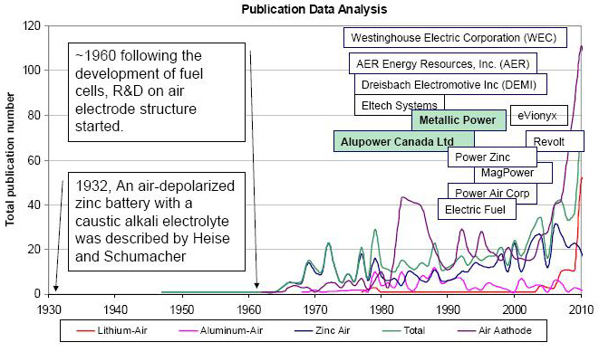
History of Metal-Air Batteries
Zinc was the first metal implemented in metal-air batteries.
Zinc is stable in aqueous and alkaline electrolytes without significant corrosion.
c

Slide 12
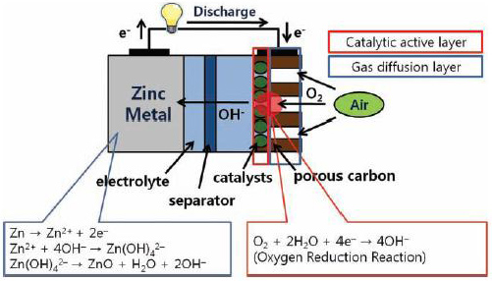
Zn-Air Chemistry
Schematic representation of Zn-air cell operation:
Zincate anion

Slide 13


Zn-Air Applications
Commercial, primary Zn-air batteries have been used for many years:
  Initially used as large batteries for applications such as railroad signaling, remote communications, and ocean navigational units requiring long term, low rate discharge.
  With the development of thin electrodes, used in small, high capacity primary cells, such as for hearing aids, small electronics, and medical devices.

Slide 14
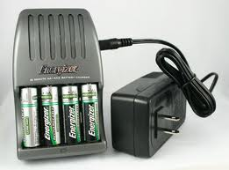
Are Zn-Air Cells Rechargeable?
Not really. Not electrically anyhow… why?
Problems of dendrite formation, non-uniform zinc deposition, limited solubility of the reaction products..
One of the decomposition products of zincate is ZnO, a white solid powder that acts as an insulator.
But they are refuelable!

Slide 15
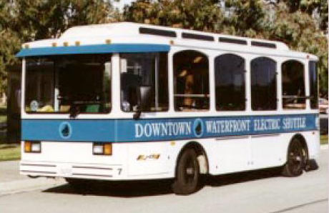
Refuelable Zn-Air Cells
Santa Barbara Municipal Transit District “Downtown Waterfront Electric Shuttle”
Powered by refuelable Zn-air cells.
Road test underscored potential of such vehicles.
  250 mile range between refueling
  Rapid refueling (10 minutes)
  Highway safe acceleration

Slide 16
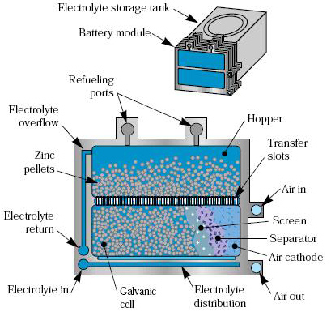
Refuelable Zn-Air Cells

Slide 17
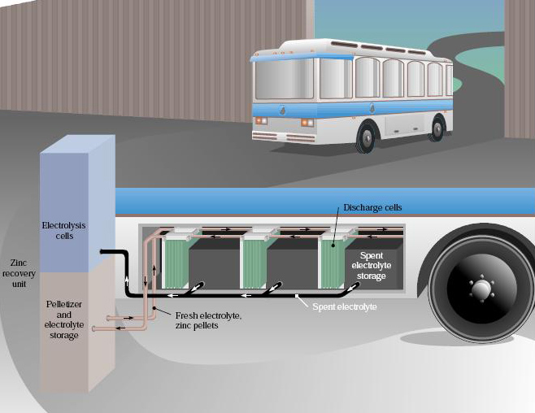
Refuelable Zn-Air cells

Slide 18
Update 7 Years Later..
Despite this novel design and successful roadside demonstration, why have battery-electric busses failed to achieve meaningful market presentation?
The busses suffered from:
  Reliability issues:
    Inconsistent performance
    Sensitivity to temperature
  Performance issues:
    Marginal hill climbing
  Life-cycle cost issues:
    Battery was maintenance intensive

Slide 19
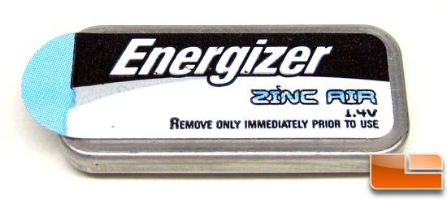
Zn-Air Summary
Primary Zn-air batteries have been very successful commercially.
To take the technology to the next level, i.e, developing secondary, electrically rechargeable batteries, or using Zn-air technologies for vehicle propulsion, significant challenges must still be overcome:
  Understand the chemistry of the zincate anion in an alkaline solution.
  Develop stable bifunctional catalysts for both the oxygen reduction reaction and oxygen evolution reaction.
  The air electrode should be optimized to reduce internal resistance.

Slide 20
Outline
Introduction
  Scope of the presentation: Where do metal-air batteries fit in?
  General characteristics of metal-air batteries
  Factors the affect performance
  Air electrode requirements
Zinc-Air Batteries
  Characteristics
  Chemistry
  Types (Primary and ‘rechargeable’)
Lithium-Air Batteries
  Characteristics
  Extent of rechargeability
  Current issues and challenges
Conclusions and Future Perspective

Slide 21

Why Li-Air?
Extremely high specific capacity of Li anode material (3842 mAh g^{‑1} for lithium, vs. 815 mAh g⁻¹ for Zinc)
The couple voltage of Li-O₂ in alkaline electrolytes is 2.91 V (compared to 1.65 for Zn-O₂)
The Li-air battery, when fully developed, could have practical specific energies of 1000-3000 Wh kg⁻¹
Li-air cell IS electrically rechargeable, (far more so than the Zn-air battery.)

Slide 22
Not So Fast Though…
Currently, Li-air batteries are still in the opening development stage, and their actual parameters fall far short of the theoretical values.
Li-air cell capacity fades twice as fast after 50 cycles (compared to 25% capacity fade after 300 cycles for an ordinary Li-ion cell).
 | Li-air | Li-ion
Specific Energy | 362 Wh kg⁻¹ (lab model!) | 200 Wh kg⁻¹
Specific Power | ~ 0.46 mW g⁻¹ | 42 mW g⁻¹ (when discharged at 0.2C)

Slide 23
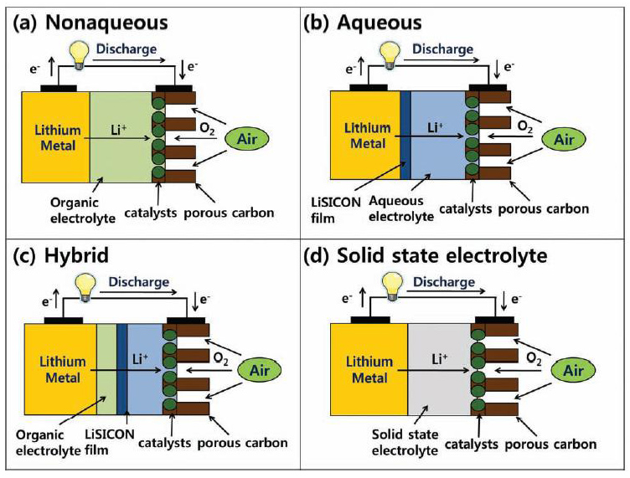
Li-Air Cell Architectures

Slide 24
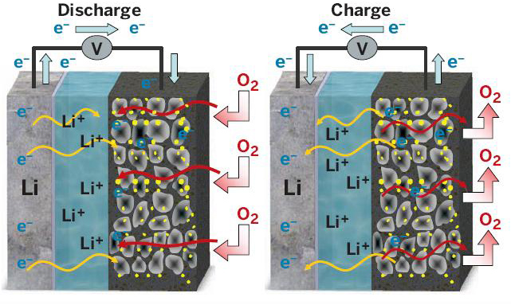
Secondary Li-Air Cells
How are Li-air cells rechargeable?
In 2006, Bruce et al. demonstrated that Li₂O₂ is formed on charging and decomposes according to the reaction below:
Li^{(s)} → Li⁺ + e⁻ (anode reaction)
Li⁺ + ½O₂ + e⁻ → ½Li₂O₂ (cathode reaction)
Li⁺ + e⁻ + ¼O₂ → ½Li₂O (cathode reaction)
Li₂O₂ → O₂ + 2Li⁺ + 2e⁻

Slide 25
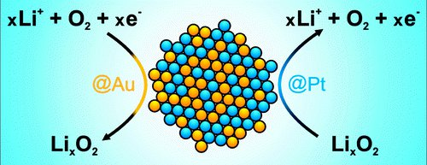
Electrocatalysts
Critical challenges that limit the practical use of this technology currently include:
  Sluggish oxygen reduction reaction (ORR) kinetics (during discharging).
  Sluggish oxygen evolution reaction (OER) kinetics (during charging).
Currently, these reactions are too slow for practical applications in electric vehicles.
As a result, a lot of effort has been put into developing effective, bifunctional, electrocatalysts for the ORR and OER.
ORR
OER

Slide 26
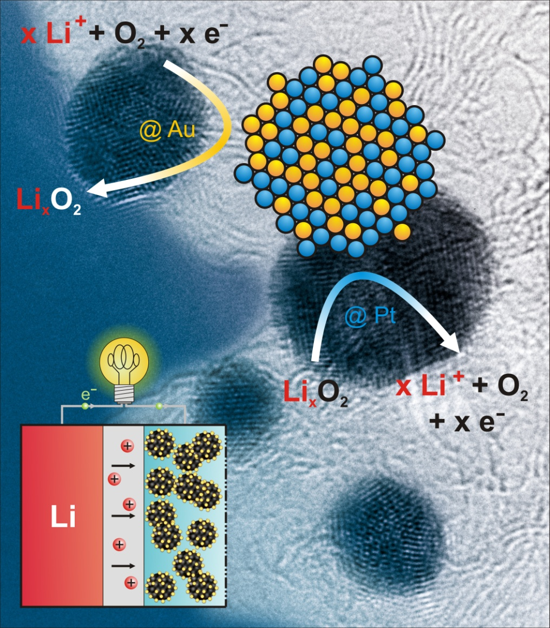
Recent Advances in Electrocatalysts (1)
In a recently published paper (2010), Lu et al. have shown, Pt/Au nanoparticles applied to a carbon cathode were shown to strongly enhance the kinetics of the ORR and OER, with Au enhancing the ORR, and Pt enhancing the OER.
Li-air batteries built with this catalyst boasted the highest cell efficiency reported for a Li-air cell with an efficiency of 77%.

Slide 27
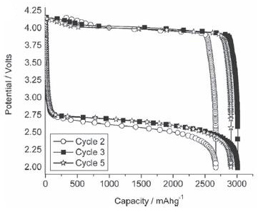
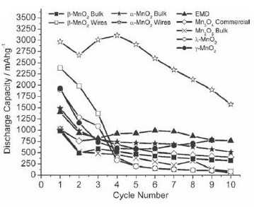
Recent Advances in Electrocatalysts (2)
Bruce et al. has also been developing catalysts to improve ORR and OER kinetics.
They have been particularly successful with various nano-structured manganese oxide catalysts.

Slide 28
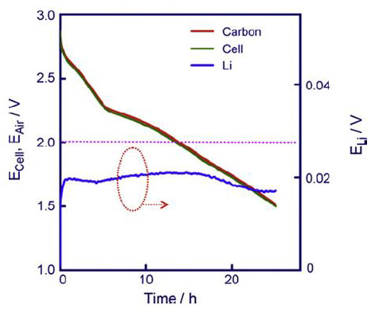
Air Cathode Challenges
Cathode reaction delivers most of the energy, and because most of the cell voltage drop occurs at the air cathode.
It is thought that non-aqueous Li-air energy falls far short of the theoretical values because the discharge terminated well before all of the pores in the air electrode are filled with Lithium oxides.
How can this be combatted?
  Develop new cathode materials that can accommodate large amounts of oxides.
  Including additives that improve the solubility of the precipitates.
  Develop catalysts that alter the morphology of lithium-oxide deposits.

Slide 29
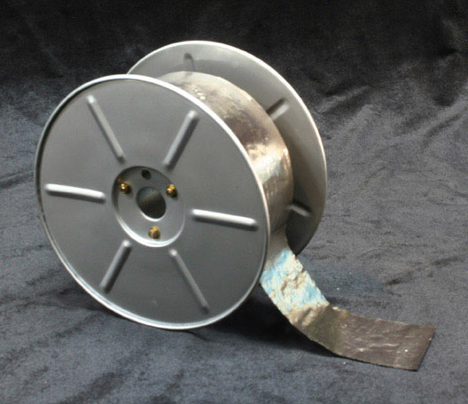
Li-Metal Anode Challenges
Lithium metal anodes are the anodes of choice for Li-air cells because of their high energy density compared to Lithium intercalation anodes.
Implementation of Li-metal anodes is associated with:
  Dendrite formation (which can lead to dangerous battery shorts)
  Electrolyte incompatibility (which results in resistive films forming on the anode surface)
How to combat this?
Incorporating a solid polymer electrolyte,
  Inert to Lithium metal
  Conducts Li-ions
  Prevents dendrite formation

Slide 30

Electrolyte Challenges
Non-Aqueous
Aqueous
Li-battery grade electrolytes are quite volatile!
Solutions?
Developing hydrophobic electrolytes with low volatility
Developing compound electrolytes
  (i.e, electrolytes with multiple layers with different properties)
Major challenge is related to the prevention of water and oxygen access to the Li-metal.
Solutions?
One such potential solution was the LiSICON porous glass concept, which makes Li-metal stable in water
Durability and manufacturing the film in large quantities may become an additional challenge.

Slide 31
Summary & Conclusions
Metal-air batteries offer great benefits if they can be harnessed to their fullest potential.
Recap of Zn-air vs. Li-air:
Important to continue development of both systems!
Zn-air | Li-air
Stable towards moisture, can be assembled outside of glovebox. | Not moisture-stable, increasing cost and manufacturing complexity.
Zinc metal and aqueous electrolytes are inexpensive | Lithium and non-aqueous electrolytes are costly
Technology is closer to or already in practical applications. | Still in research phase
Poor reversibility of reactions | Reversible reactions (and improving!)
Low operating potential | Highest operating potential

Slide 32
References
[1] J. Lee, S. Tai Kim, R. Cao, N. Choi, M. Liu, K.T. Lee, J. Cho, Advanced Energy Materials 2011, 1, 34-50.
[2] R.P. Hamlen, T.B. Atwater, in Handbook of Batteries, Mcgraw-hill2004, 38.1-38.53.
[3] K.M. Abraham, Ecs2008, 67-71.
[4] W. Qu, 'The Development of Materials and Components for Metal-air Battery Applications at NRC', 2011.
[5] 'Powering Future Vehicles with the Refuelable Zinc/Air Battery', Lawrence Livermore National Laboratory, < www.llnl.gov/str/pdfs/10_95.1.pdf>, 1995.
[6] P. Griffith, 'Don't Give up on the Battery-Electric Bus Just Yet...' Electric Bus Workshop, 2002.
[7] A. Kraytsberg, Y. Ein-Eli, Journal of Power Sources 2011, 196, 886-893.
[8] T. Ogasawara, A. Débart, M. Holzapfel, P. Novák, P.G. Bruce, J. Am. Chem. Soc. 2006, 128, 1390-1393.
[9] S.J. Visco, B.D. Katz, Y.S. Nimon, L.C. De Jonghe, Protected Active Metal Electrode and Battery Cell Structures with Non-aqueous Interlayer Architecture, n.d., U.S. Patent 7282295.
[10] M. Jacoby, Chemical & Engineering News 2010, 29-31.
[11] A. Débart, J. Bao, G. Armstrong, P.G. Bruce, Journal of Power Sources 2007, 174, 1177-1182.

