Slide 1
Energy Storage Units in Electricity Resource Planning
Miao Lu

Slide 2
Content Overview
Load Models
Economic Dispatch
Disturbance and Recovery
Demand-Side Management
Energy Storage Units
Unit Scheduling
Charge & Discharge Constraints

Slide 3
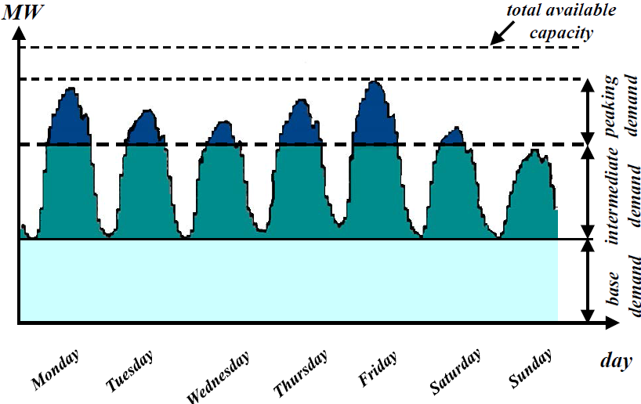
Chronological Load Model
Load is modeled as the sum of individual demands
It specifies the load at every hour of the period
Distinguishes peak and off-peak conditions

Slide 4
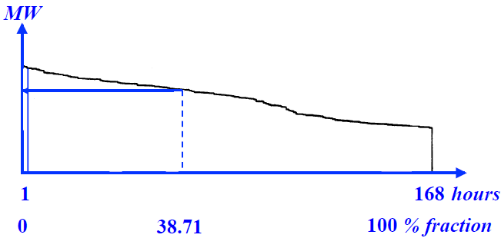
Load Duration Curve (LDC) Model
Sorts the chronological loads in order of decreasing magnitude
Quantify the total energy required in terms of the area under the curve

Slide 5
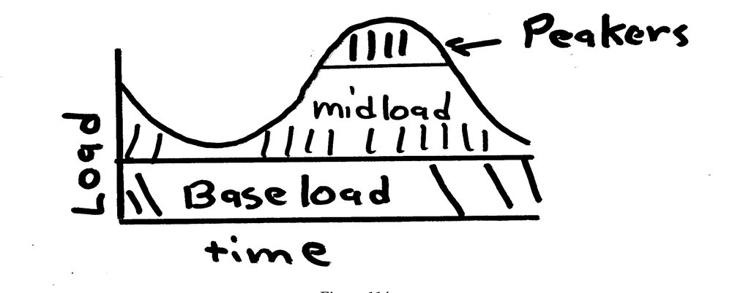
Economic Dispatch
Economic dispatch determines the best way to minimize the generator operating costs
total generation = total load + losses

Slide 6
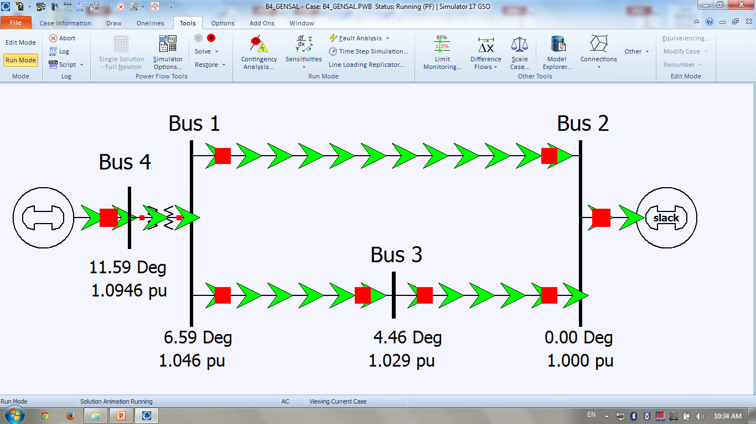
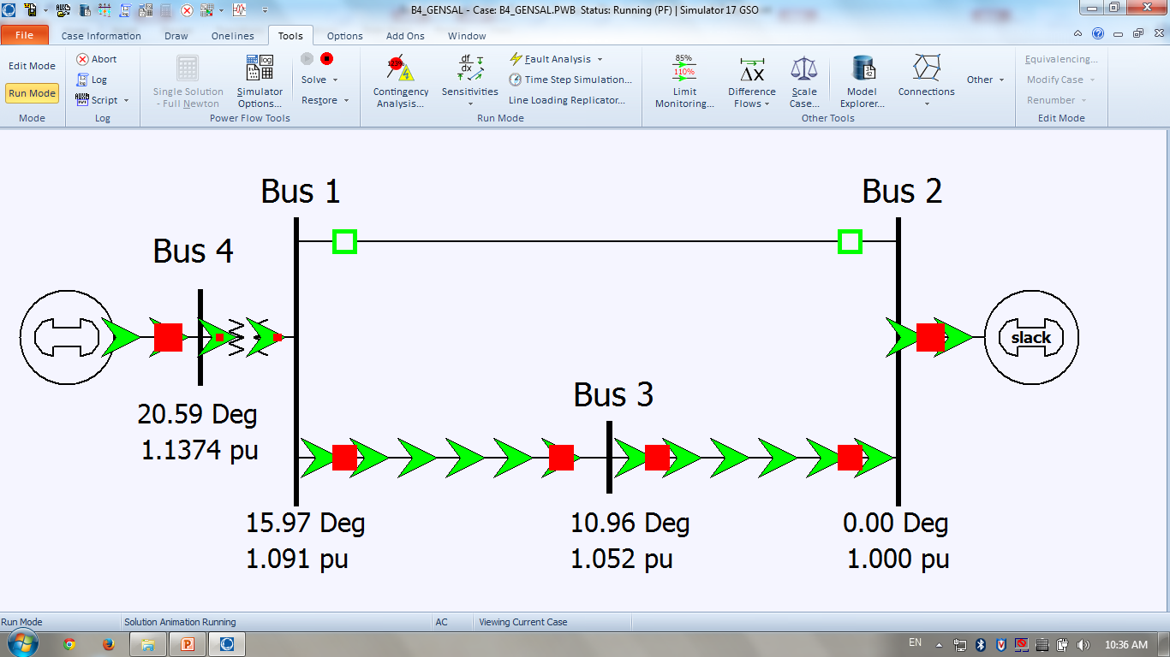
Power Grid Disturbance
An example of simple 4-bus system
Disturbance occurs between bus 1 and bus 2
Power output has to increase elsewhere in the network to make up the losses

Slide 7
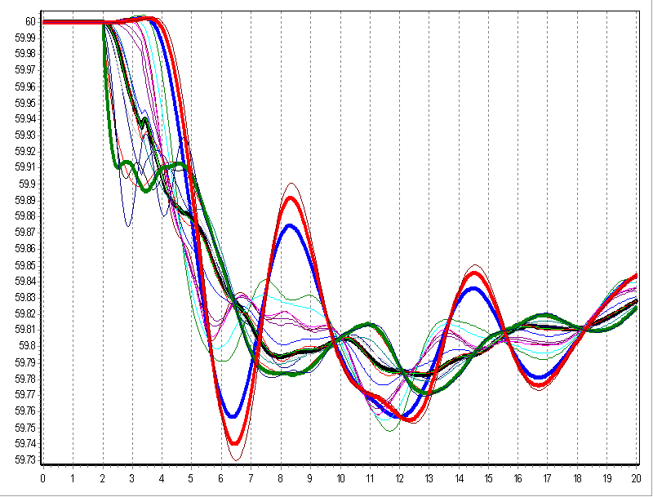
Power Grid Disturbance
Frequency changes as a result of sudden generation loss

Slide 8
Frequency Response
Initially the system frequency will decrease as energy stored in the rotating masses is transformed into electric energy
Within seconds governors respond, increasing power output
Usually the cost of producing electricity will be increased because the dispatch is no longer optimal

Slide 9
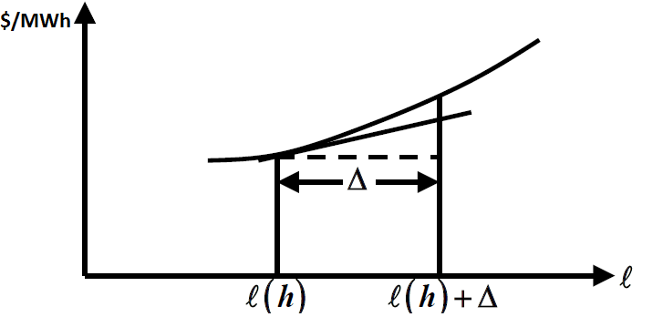
Marginal Cost Curve
Plots the incremental $/MWh as a function of MW
Generators have limits on the minimum and maximum amount of power they can produce

Slide 10
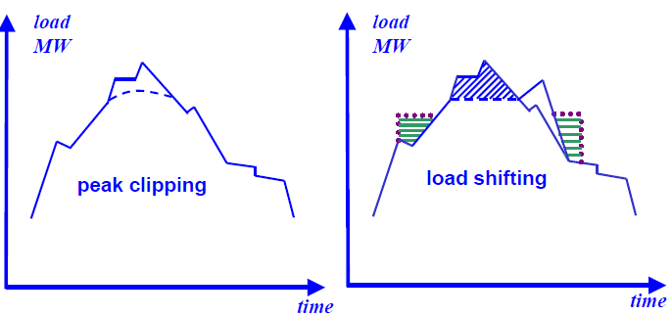
Demand-Side Management (DSM)
Implementation of programs that modify the demand of the system
Focus to strategically reduce electricity demand at the time of peak loads to minimize production costs

Slide 11
Energy Storage Units
Used to minimize total production costs
Two options are possible:
  Replace expensive thermal units serving the peak load
  Reliability in case of sudden forced outage in other units

Slide 12
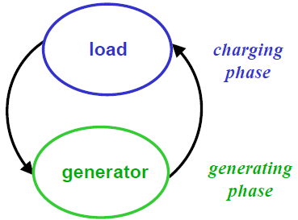
Energy Storage Unit Scheduling
Operation of an energy storage unit is a cycle consisting of two phases
  Charging phase
  Generating phase

Slide 13
Energy Storage Unit Scheduling
Power generated from the storage units is used to displace more expensive thermal units used during peak load
The excess energy available from the less costly generation units is used for charging the storage units, for later use

Slide 14
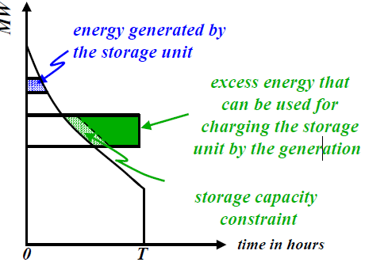
Charge-Discharge
The amount of energy that can be used for charging is limited by charging capacity

Slide 15
Energy Storage Constraints
Energy stored is a function of efficiencies
Es=nc*nt*Ec
Es: Energy Stored
nc: Efficiency of the charging
nt: Efficiency of the transmission network
Ec: Expected energy for charging

Slide 16
Discharge Constraint
Et=ns*Ec
ns=ng*nc*nt^2
ng: Efficiency of the generation phase
nc: Efficiency of the charging phase
nt: Efficiency of the transmission network
ns: the overall efficiency of the storage–generation cycle
Ec: Expected energy for charging

Slide 17
Questions

Slide 18
References
http://energystorage.org/system/files/resources/eac_nationalgridenergystoragestrategy_jan2014.pdf
http://energy.gov/sites/prod/files/2013/12/f5/Grid%20Energy%20Storage%20December%202013.pdf
http://www.sandia.gov/ess/publications/SAND2012-9422.pdf
https://courses.engr.illinois.edu/ece588/handouts/files/Lecture%2012-%20Analysis%20of%20Storage.pdf

