Slide 1
Buoyancy Energy Systems
Albert Seo
December 03, 2025

Slide 2
Outline
What is Buoyancy Energy System Technology (BEST)?
Buoyancy Energy Storage Advantages & Disadvantages
Buoyancy Recipients – Design and Consideration
Buoyancy Compression Gas Characteristics
Buoyancy Energy System Costs and LCOE
Buoyancy Energy System Global Potential
Comparison to Conventional Storage Technologies
Alternative Applications of BEST
Future Considerations & Areas of Research
NPRE 498 – Fall 2025

Slide 3
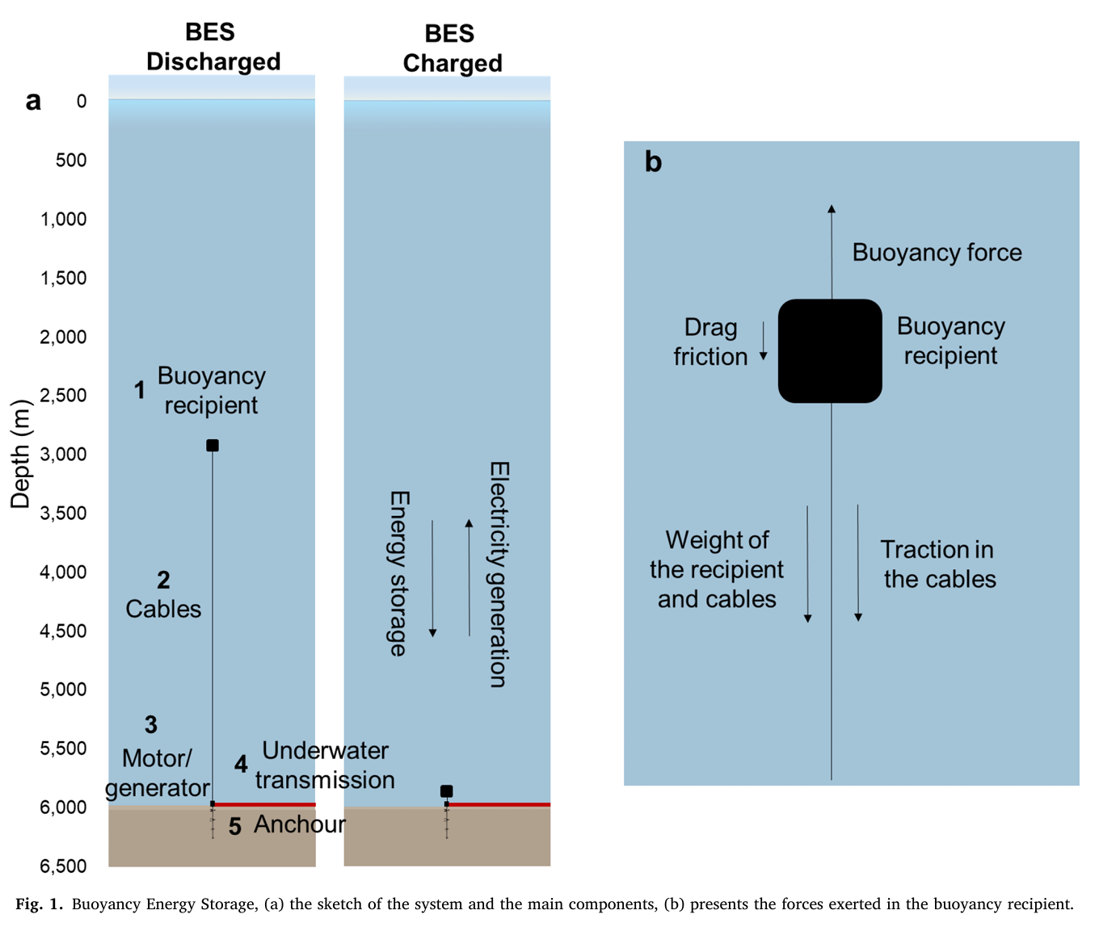
What is Buoyancy Energy System Technology (BEST)
Buoyancy Energy System is a renewable energy storage solution for islands and coastal regions that lack access to conventional storage solutions like battery storage or pumped hydro
The buoyancy recipient is the mass (energy) carrier responsible for storing and releasing energy
(Hunt et al., 2021)
NPRE 498 – Fall 2025

Slide 4
What is Buoyancy Energy System Technology (BEST)
$$F_{b}=ρ_{f}V_{f}g$$
The buoyancy force is derived from Archimedes’ principle, and is proportional to the submerging fluid density, volume displacement, and gravitational constant.
The energy and power can be derived from calculating the volume displacement of the buoyancy recipient and calculating the height per unit time (velocity) of the buoy ascent.
Drag force acts as energy loss and is minimized by limiting buoy ascend speed to <10 mm/s.
$$E_{b}=F_{b}h=ρ_{f}V_{f}gh$$
$$P\left(MW\right)=v∗\left(V_{f}∗\left(ρ_{s}−ρ_{c}\right)−m\right)∗g∗e∗{10}^{−6}$$
$$D=0.5 ρ_{s}u^{2}c_{d}A$$
NPRE 498 – Fall 2025

Slide 5
Buoyancy Energy Storage Advantages & Disadvantages
Advantages
Minimal emissions during commissioning and operation, low net environmental impact
Simple design, high energy density, high efficiency
Does not rely on a thermochemical or thermodynamic cycle; no disruption to surrounding environment and ecology
Disadvantages
Still a novel technology with high capital costs for construction, especially in deep seawater locations
Troubleshooting underwater systems is a complex and expensive endeavour
Limited to weekly energy charge/discharge cycles
NPRE 498 – Fall 2025

Slide 6
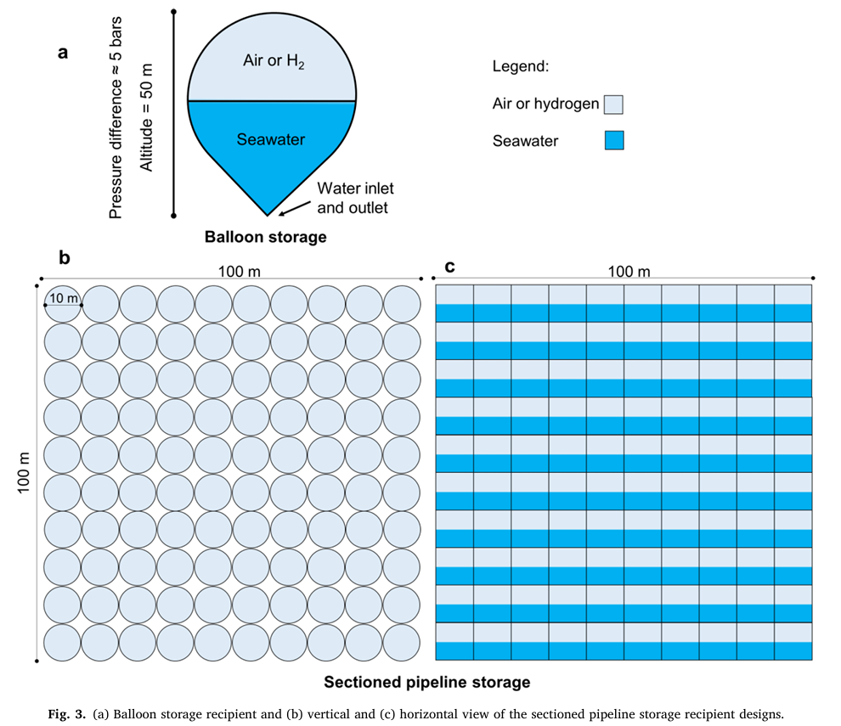
Buoyancy Recipients – Design and Consideration
Geometry
Balloon – simple construction, pressure gradient causes high pressure difference and susceptibility to implosions
Sectioned Pipeline – Also relatively simple construction, greater sustain against high pressure
Conical with helical groove – Allows for faster ascent rate (more power) while minimizing drag force
Material
Plastics (HDPE), PVC
Outer coating (silicon spray)
Gas Solubility and Envelope
Gas storage vessel is not sealed due to extreme pressure differences in underwater conditions. This results in substantial gas solubility between seawater and compressed gas. The addition of a water-repelling envelope is required to prevent compressed gas from contacting seawater.
(Hunt et al., 2021)
NPRE 498 – Fall 2025

Slide 7
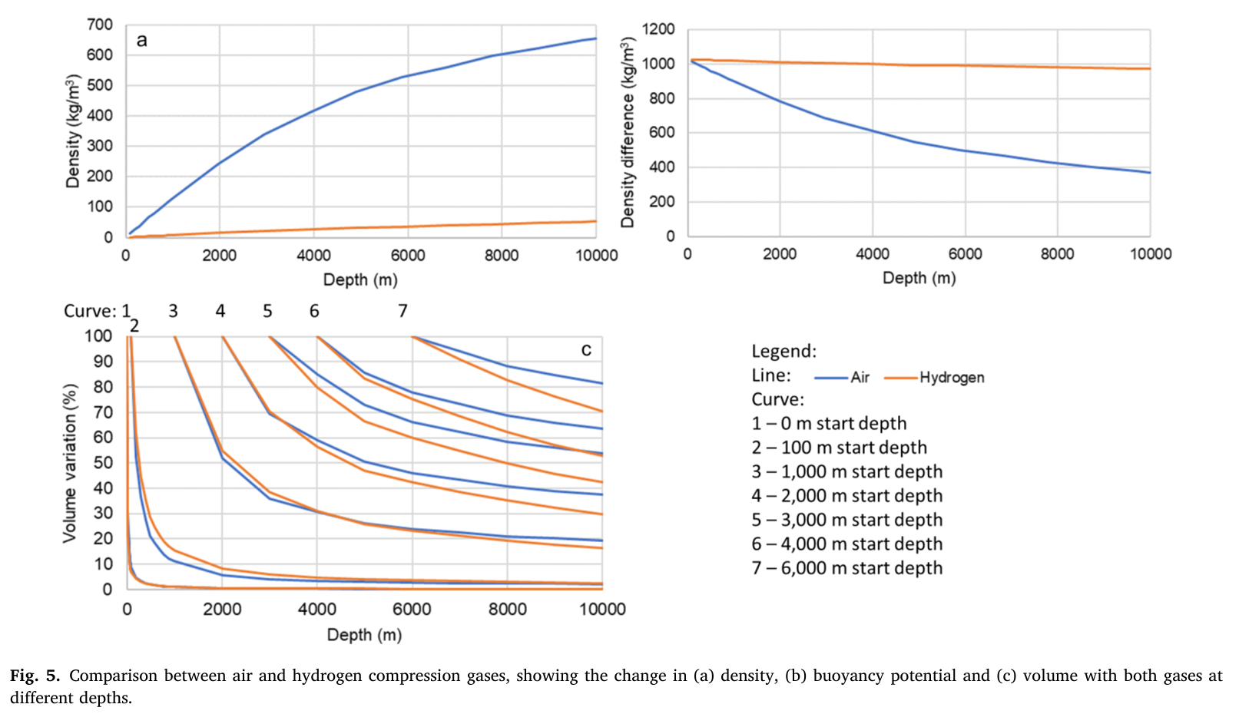
Buoyancy Compression Gas Characteristics
Low density compressed gas results in higher buoyant forces and efficiencies
Compressed gas density varies with ocean depth; higher depth also significantly reduces volume displacement, reducing energy storage potential
The ideal gas has linear, almost stagnant density curve with respect to depth, while maintaining minimal volume variation
Air vs. Hydrogen
Hydrogen is preferred for deep sea storage
(Hunt et al., 2021)
NPRE 498 – Fall 2025

Slide 8
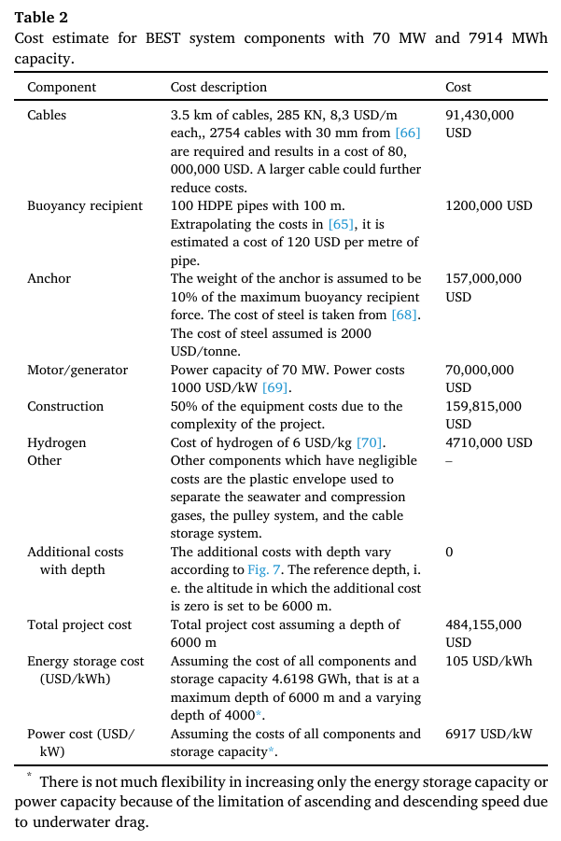
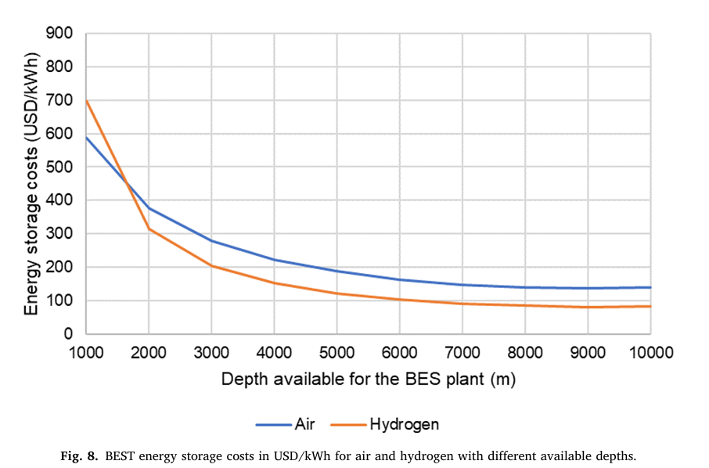
Buoyancy Energy System Costs and LCOE
(Hunt et al., 2021)
An ideal operation variation would be between 3,000m to 10,000 m depth
NPRE 498 – Fall 2025

Slide 9
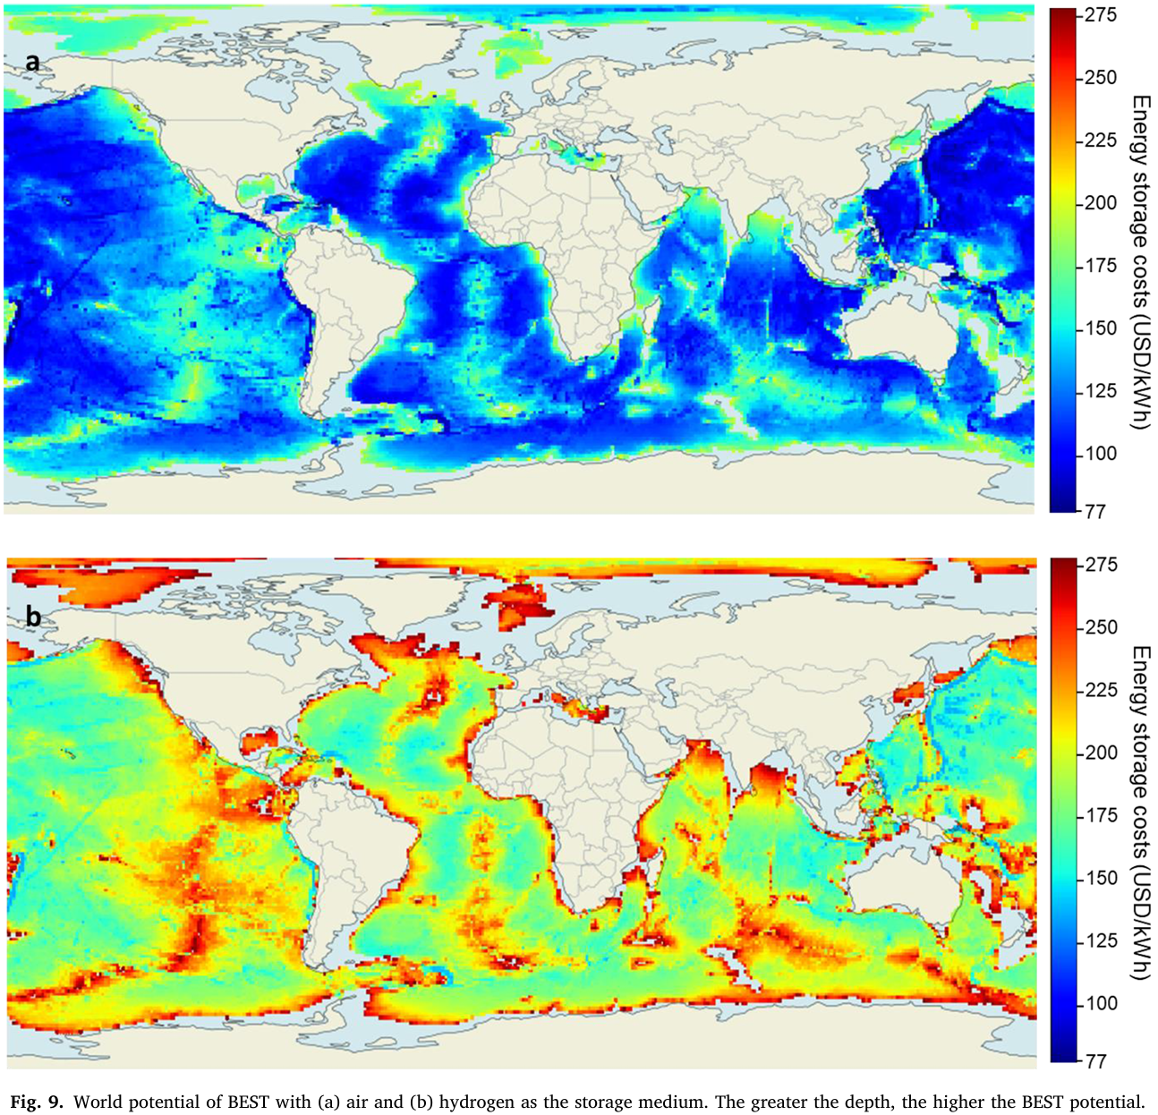
Buoyancy Energy System Global Potential
Highest potential at oceanic islands and coastal countries – Japan, Phillipines, Australia, Honduras, Brazil, etc
Greatest pairing with offshore wind farms due to synergistic wind power time series of weekly cadence
However, typical offshore wind farms do not operate in deep ocean depths due to prohibitive anchoring costs
(Hunt et al., 2021)
NPRE 498 – Fall 2025

Slide 10
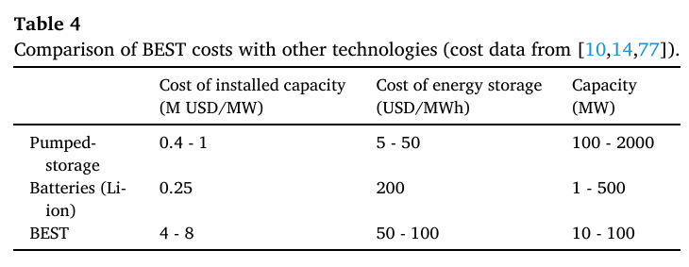
Comparison to Conventional Storage Technologies
Highest cost per installed power capacity, but may have room for improvement from learning curve
BEST has cheaper cost of energy storage compared to Li-ion batteries, but more expensive than pumped storage
BEST plants are designed for small utility-scale implementation, often paired with renewable energy sources to address intermittency
Combination of BEST with Li-ion battery storage to handle hourly/daily cycles is the most optimal plant operating design
Estimated 49.6 cents/kWh can be achieved with higher learning curves
(Hunt et al., 2021)
NPRE 498 – Fall 2025

Slide 11
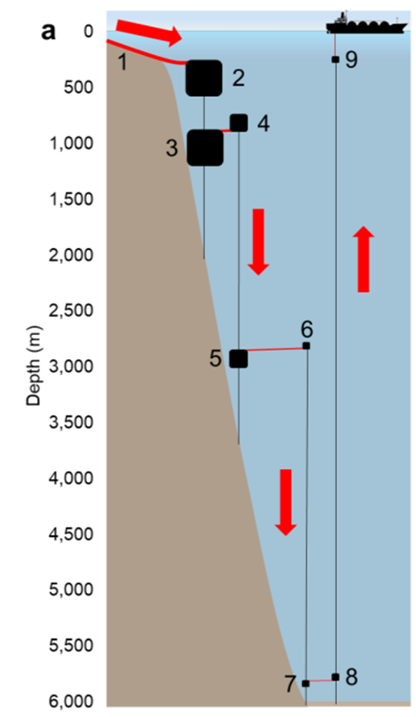
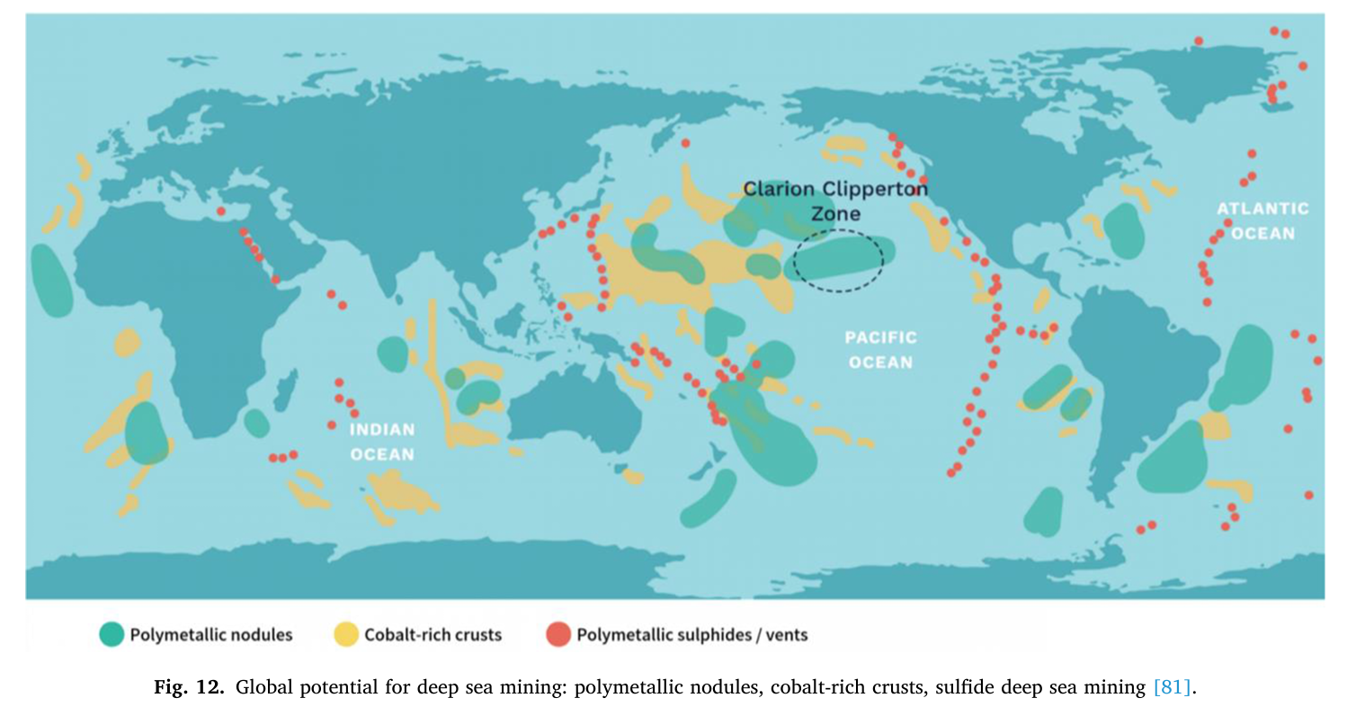
Alternative Applications of BEST
Hydrogen compression
Compressed hydrogen up to 600 bar using ocean pressure gradient. Estimated LCOS of $2,617/m^3; conventional hydrogen compression is estimated $85,948/m^3 – 33-fold increase
Deep Sea Mining Energy Reserve
Frequency Response and Power Balancing
(Hunt et al., 2021)
(Hunt et al., 2021)
NPRE 498 – Fall 2025

Slide 12
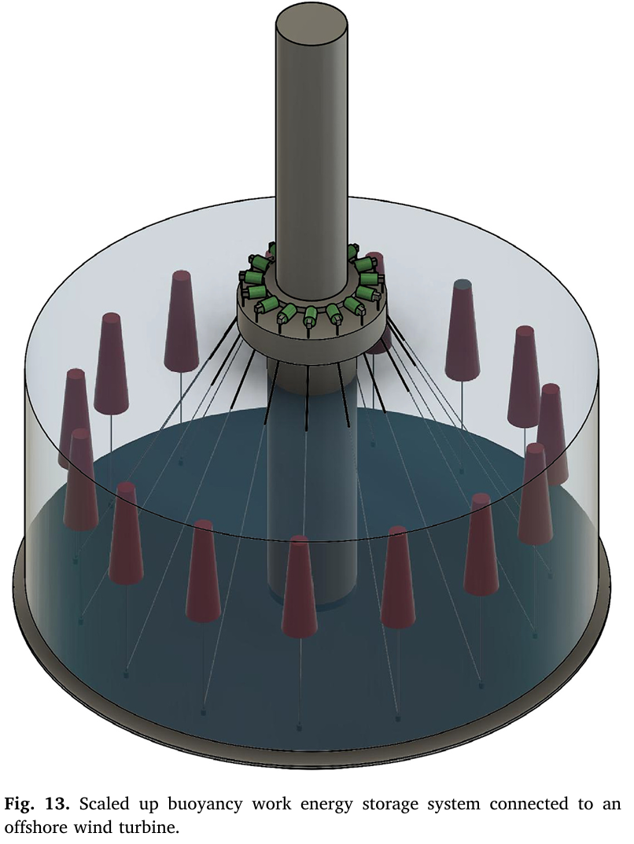
Future Considerations & Areas of Research
No current commercial implementation of technology
Case study potentials – high cost of conventional power and high penetration of inverter-based resources, with a lack of geographical advantage for pumped hydro – can drive a higher demand to explore Buoyancy Energy Storage
Material science and design optimization; deep sea construction technology breakthroughs; lowering capital costs
Environmental concerns and aquatic life impact
(Alami et al., 2023)
NPRE 498 – Fall 2025

Slide 13
References
Alami, A. H. (2015). Experimental assessment of Compressed Air Energy Storage (CAES) system and buoyancy work energy storage (BWES) as cellular wind energy storage options. Journal of Energy Storage, 1, 38–43. https://doi.org/10.1016/j.est.2015.05.004
Alami, A. H., & Bilal, H. (2013). Experimental evaluation of a buoyancy driven energy storage device. Advanced Materials Research, 816–817, 887–891. https://doi.org/10.4028/www.scientific.net/amr.816-817.887
Alami, A. H., Ayoub, M., Yasin, A., Alashkar, A., Aljaghoub, H., & Alabdalla, S. A. (2023). Performance assessment of buoyancy work energy storage system with various buoy materials, coatings, and gasses. Journal of Energy Storage, 72, 108524. https://doi.org/10.1016/j.est.2023.108524
Bassett, K., Carriveau, R., & Ting, D. S. ‐K. (2016). Experimental analysis of Buoyancy Battery Energy Storage System. IET Renewable Power Generation, 10(10), 1523–1528. https://doi.org/10.1049/iet-rpg.2016.0033
Hunt, J. D., Zakeri, B., de Barros, A. G., Filho, W. L., Marques, A. D., Barbosa, P. S., Schneider, P. S., & Farenzena, M. (2021). Buoyancy Energy Storage Technology: An energy storage solution for islands, coastal regions, offshore wind power and hydrogen compression. Journal of Energy Storage, 40, 102746. https://doi.org/10.1016/j.est.2021.102746
NPRE 498 – Fall 2025

Slide 14
Thank You
Questions?
Albert Seo
donguns2@illinois.edu
NPRE 498 – Fall 2025

