Slide 1
Supercapacitors
A Functional Future
Sheel Shah NPRE498ESU

Slide 2
Overview
The idea is simple.
Supercapacitors are just high-capacitance electrochemical capacitors.

Slide 3
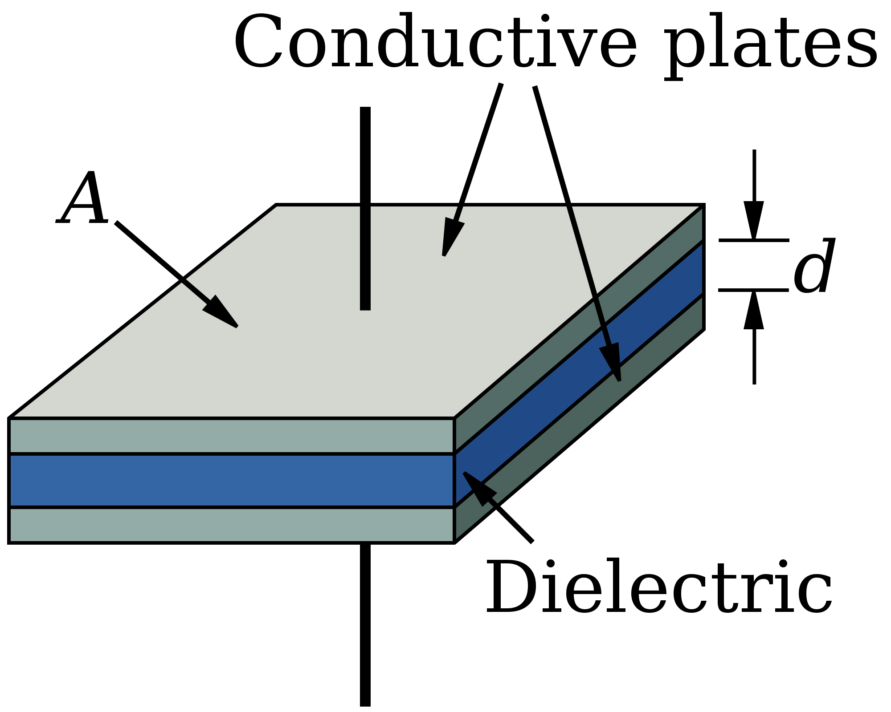
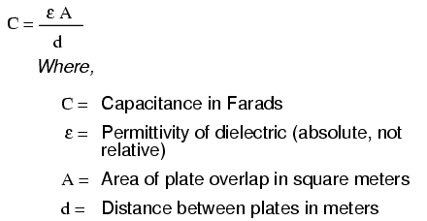
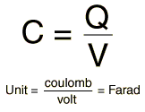
Basic Anatomy of a Capacitor
2 Terminal Electrical component
Usage: Store energy in an electric field.
Potential Difference across the two plates develop a static electric field across the dielectric, in turn causing positive charge to collect on one plate and negative on the other

Slide 4
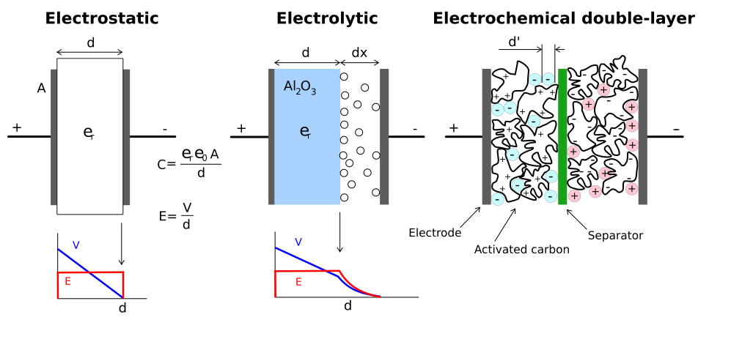
What makes a supercapacitor
The only change is it stores energy electrostatically by polarizing an electrolytic solution

Slide 5
History
In 1957, General Electric developed the Double Layer Capacitor using the porous electrode
In 1966, Standard Oil rediscovered this effect and licensed to NEC in 1978 for computer memory storage and SRAM chips(Think Panasonic Goldcaps)
In 1982, Pinnacle Research Institute developed one with low internal resistance
In 1992, Maxwell Technologies took over development
In 1994, The age of modern SuperCaps (EHEC) was initiated by David Evans

Slide 6
Motivation for Energy Storage device
Storage Needs
No Chemical Rxn
High Power Storage
With recent development on high-power applications in renewables and electronics. The need to store and discharge energy quickly is growing
Unlike batteries, no chemical reaction takes place when storing and discharging so Supercaps can go through hundreds of thousands of charging cycles with no degradation
Holding large amounts of current in a small volume containment shows a potential for the future

Slide 7
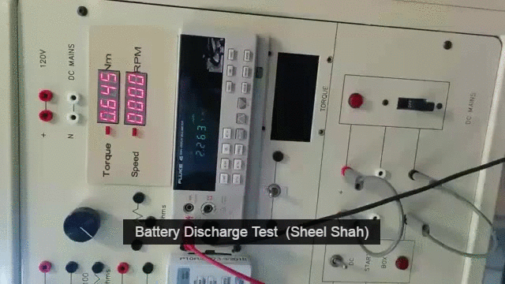
Battery Discharge

Slide 8
SuperCap Versus Conventional Batteries
100x shorter than electrochemical cell
Redox reaction across double layers
High Power Density
Large Ranges of Temperature
Cycle Life restricted to about 1000 discharge/charge cycles
Electrolyte acts as medium of transfer so each discharge and charge cycle requires a chemical reaction
Lower Power Density

Slide 9
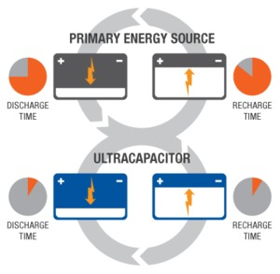

Slide 10
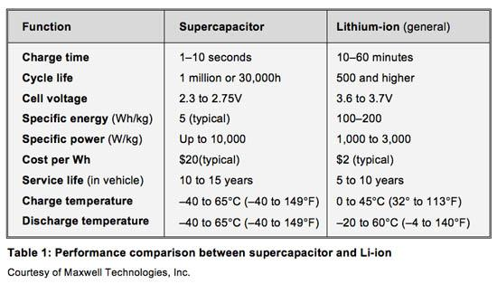

Slide 11
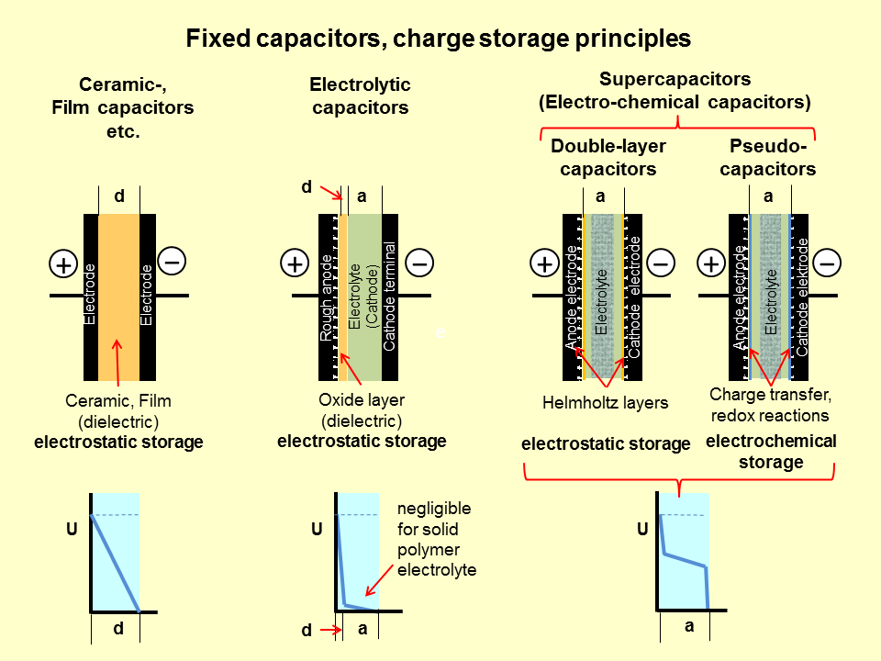

Slide 12
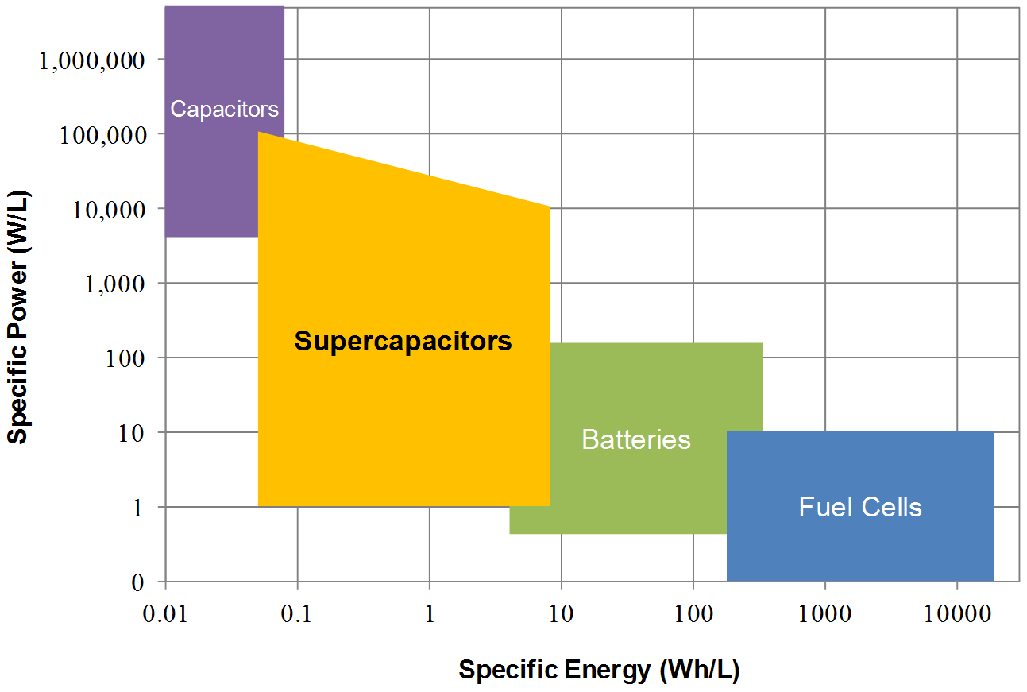

Slide 13
Applications

Slide 14
Typical Need
When you’ve got too much energy to store in a capacitor for a short period of time and you have no time to charge a battery.

Slide 15
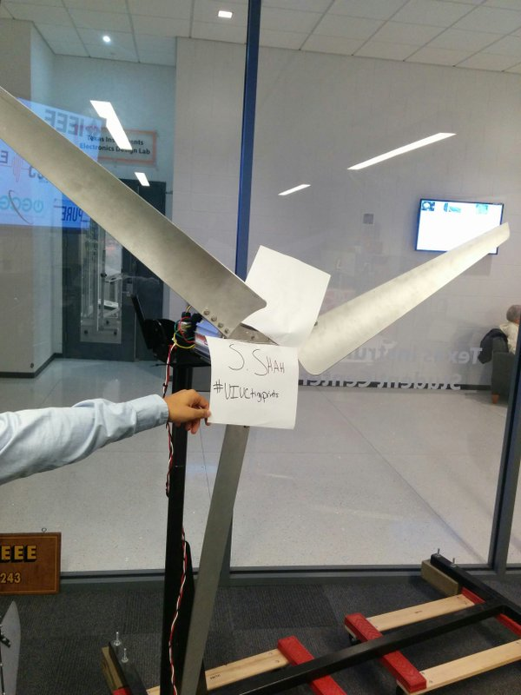
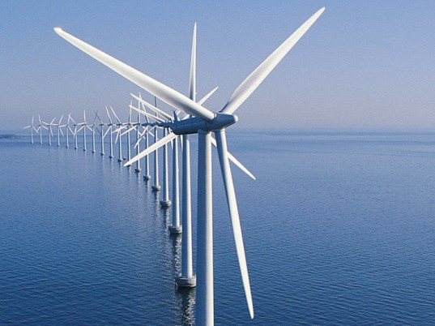
Wind turbines
Renewables
Notes:
Large super capacitors help smooth out the intermittent power supplied by the wind

Slide 16
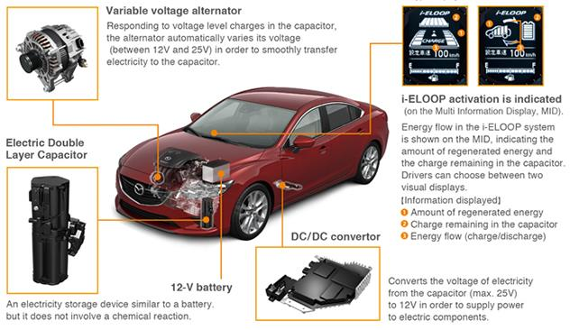
Regenerative Braking
Notes:
where the energy a vehicle would normally waste when it comes to a stop is briefly stored and then reused when it starts moving again

Slide 17
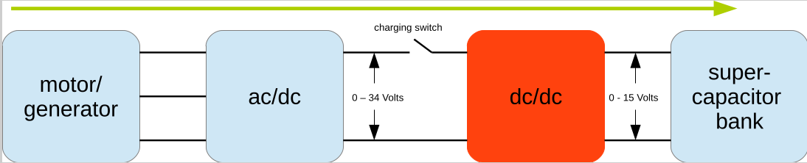
Motors (Electric Vechicles)

Slide 18
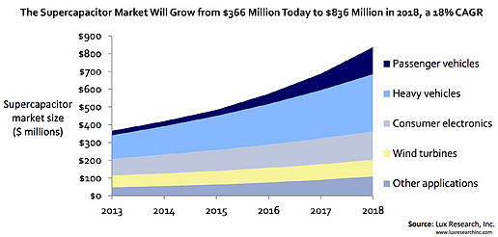
Market trends

Slide 19
Experiments
And beyond

Slide 20
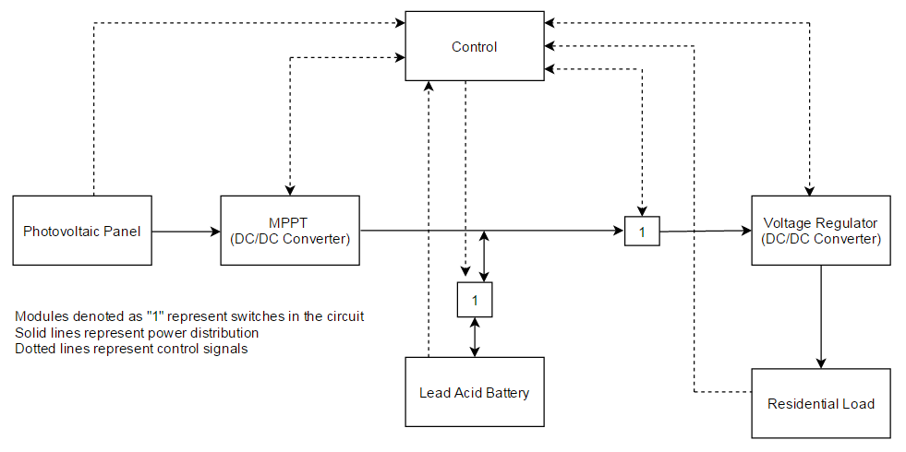
What We’re doing
Energy Storage
Energy Storae

Slide 21
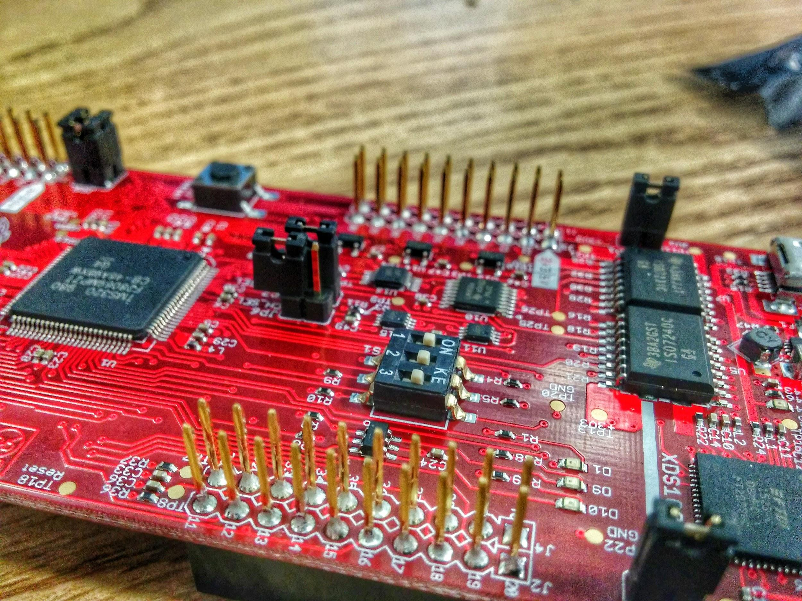
Control PCB

Slide 22
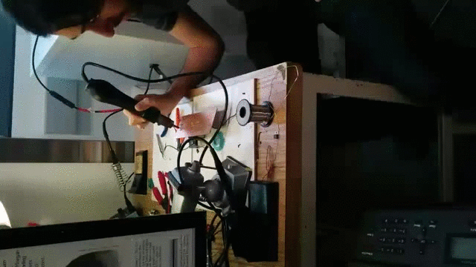
Mini Protoype SuperCap Bank Construction

Slide 23
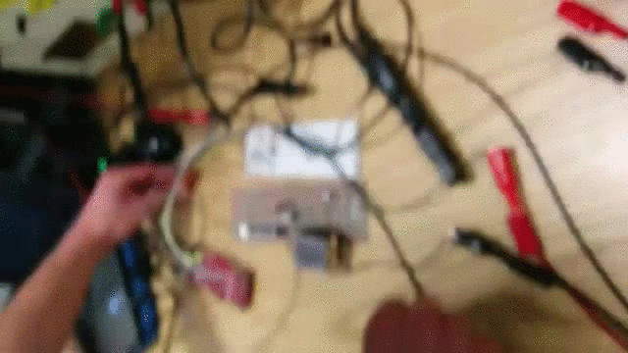
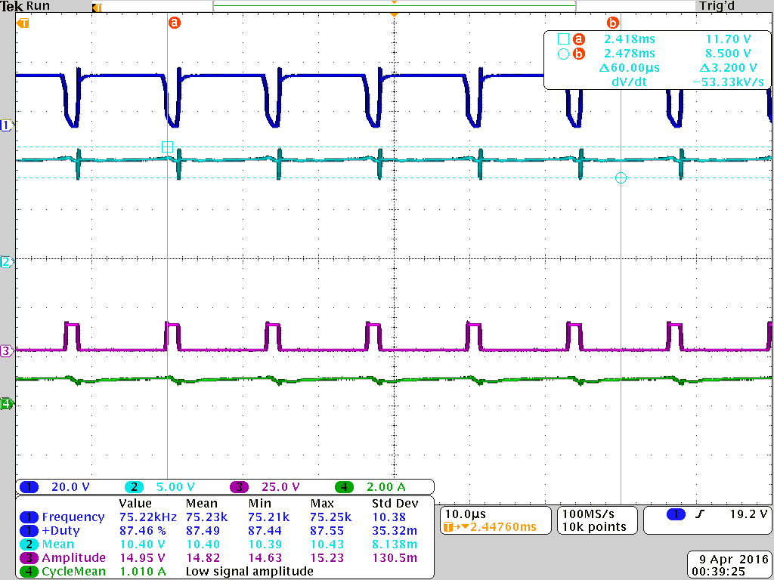
SuperCap Bank Test for Correct Current and Voltage Regulation
Experimental Set up Waveforms

Slide 24
References & Adaptations
[1]B. Hauke, Basic Calculation of a Buck Converter’s Power Stage, 1st ed. Texas: Texas Instruments, 2011, pp. 2-6.
[2]T. Instruments, TMS320F2806x Piccolo Microcontrollers, 4th ed. Texas: TexasInstruments, 2010, pp. 12-30.
[3] Linear Technology, ”LTC6101/LTC6101HV 1 6101fh: High Voltage, High-Side Current Sense Amplifier in SOT-23”, Linear Technology, 2013.
[4] Universal Power Group, ”UPG No. 45977 - UB12500 Sealed Lead Acid Battery”, Universal Power Group, Texas, 2013.
[5] Texas Instruments, ”Designing DC/DC converters based on ZETA topology”, Texas Instruments, Texas, 2010.
[6] http://www.maxwell.com/products/ultracapacitors/
[7] http://www.cap-xx.com/wp-content/uploads/2015/04/Ragone-Plot-All-Energy-Devices-colour-blocks.png
[8] http://www.explainthatstuff.com/how-supercapacitors-work.html

