Slide 1
Energy Storage Hazards and Emergency Response
By: Nick Kut

Slide 2
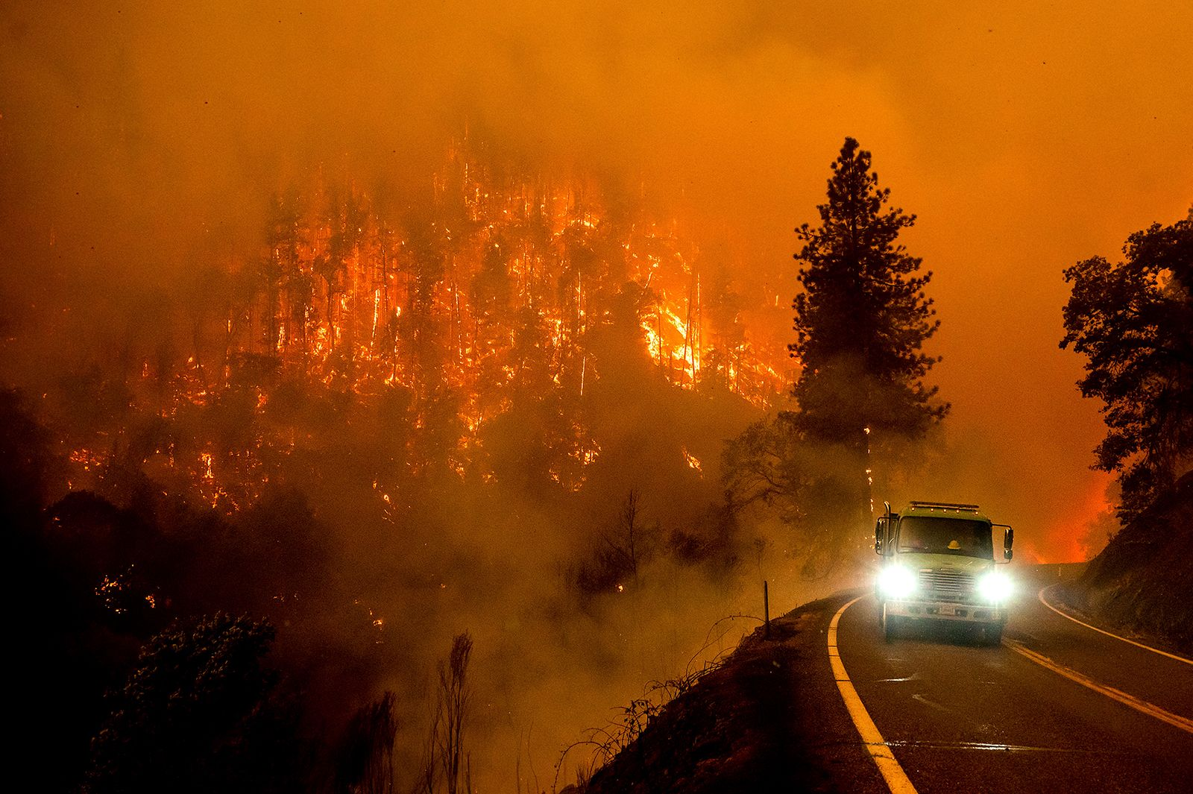
Introduction
Ensuring safety in energy storage is vital
Technologies like hydrogen and lithium-ion batteries bring incredible benefits, but pose potential risks like fires or leaks
Other hazards exist, such as wildfires caused by electrical equipment and potential dam failures in pumped storage
Acceptance of new energy storage systems depends on robust safety measures and quick emergency responses

Slide 3
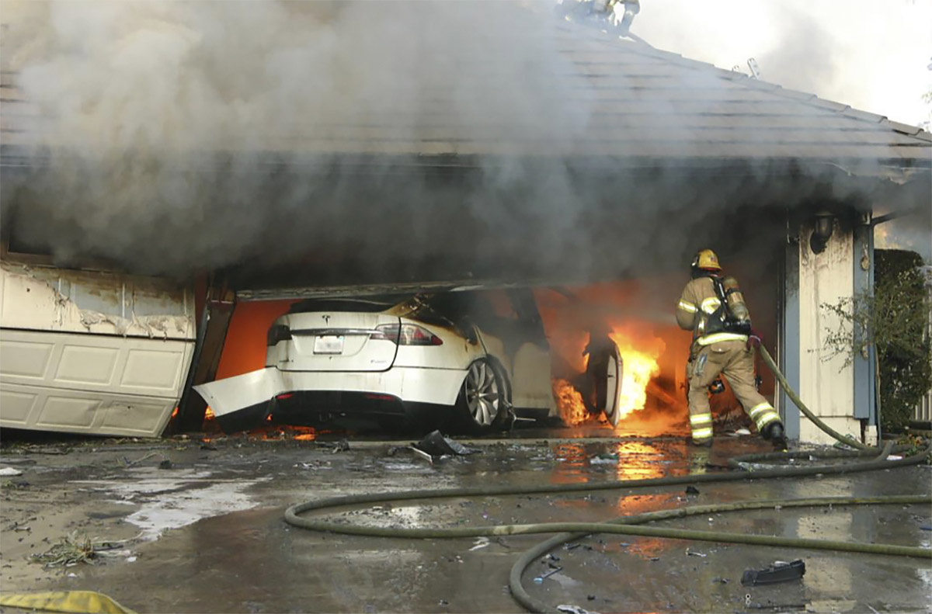
Focus: Hydrogen and Li-ion Energy Storage
Hydrogen
Hydrogen Production Hazards
Hydrogen Storage Hazards (BLEVE)
Hydrogen Vehicles
Li-ion Energy Storage
Industrial Energy Storage
Home Energy Storage
Li-ion Vehicles

Slide 4
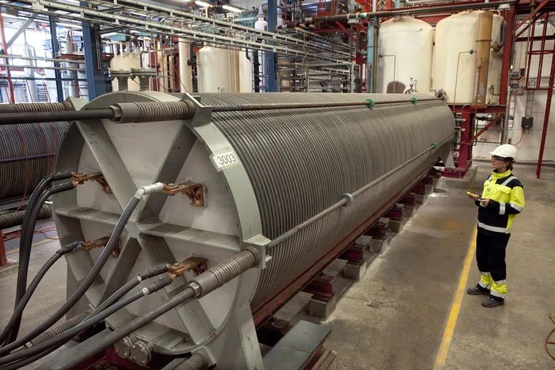
Hydrogen Production Hazards with Electrolysis
Hydrogen is flammable, odorless
Oxygen must be separated out, has its own hazards
If using seawater, chlorine gas may be produced
Air monitoring is crucial for leaks
High likelihood of container corrosion

Slide 5
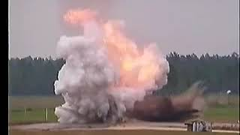
Hydrogen Storage Hazards (BLEVE)
BLEVE- Boiling Liquid Expanding Vapor Explosion

Slide 6
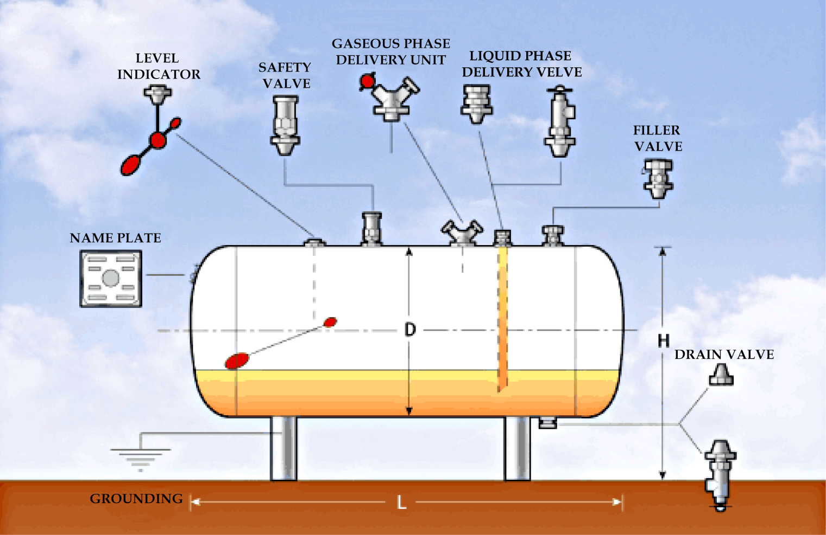
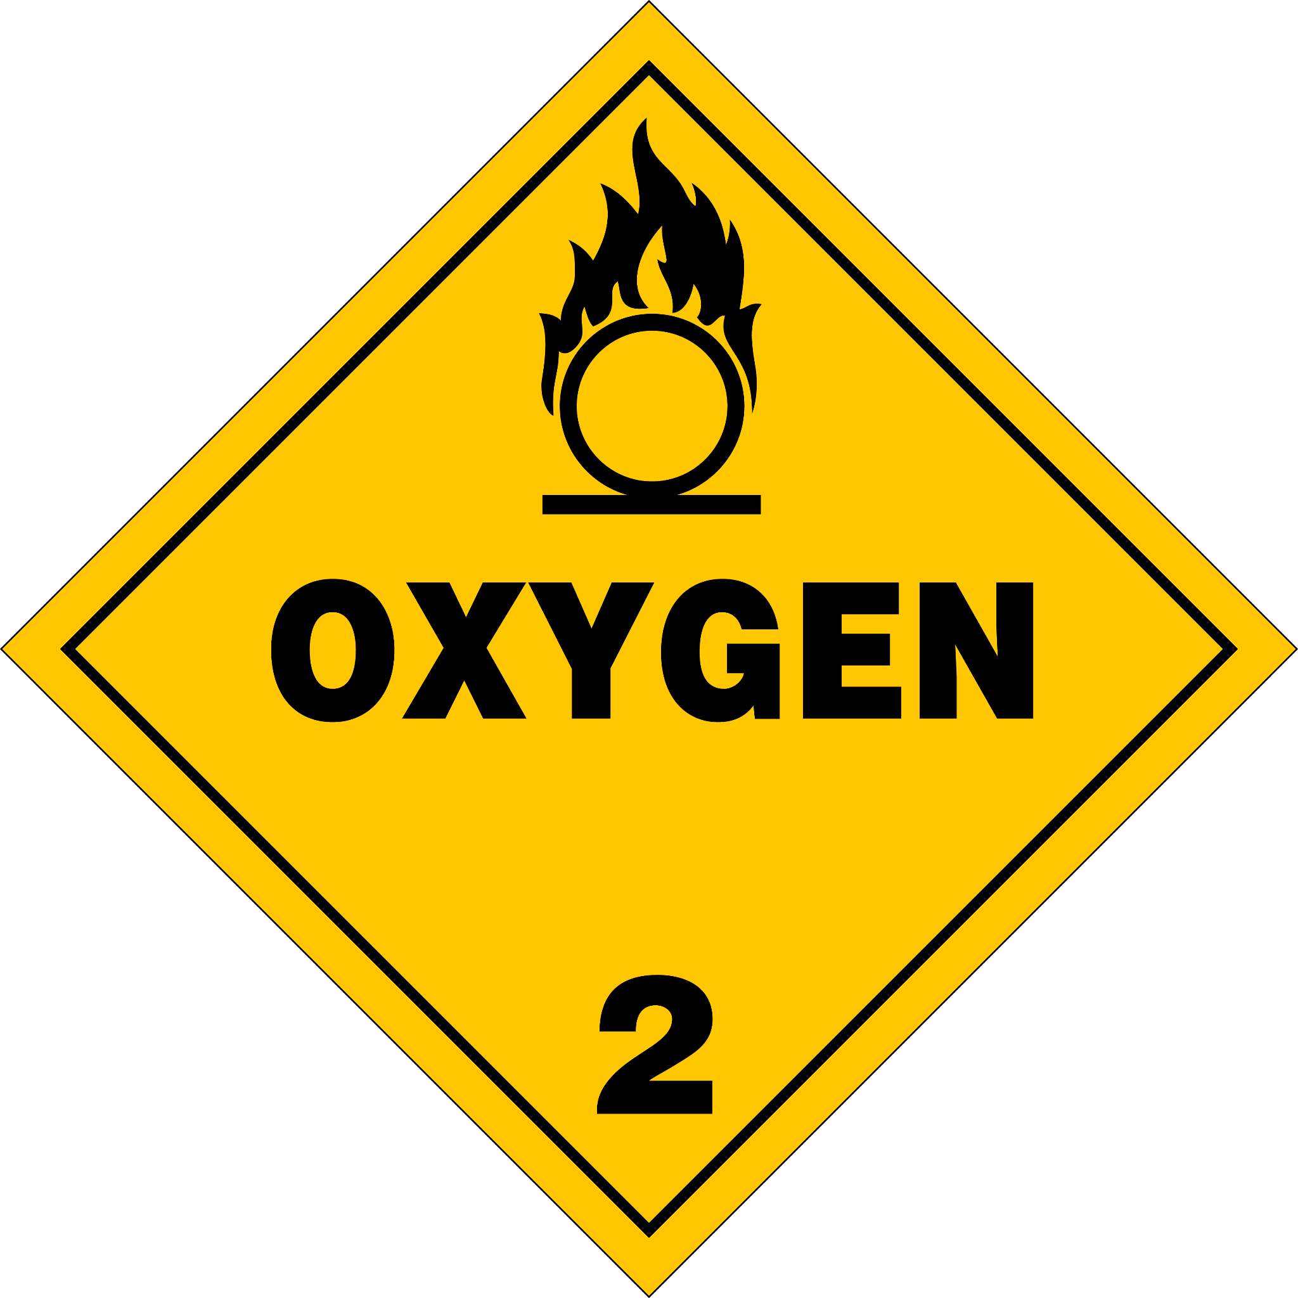
How do we mitigate BLEVEs/Ruptures?
Pressure Relief Valves (PRVs)
On-site Industrial Fire Department
Paint Schemes (White Paint on Pressure Vessels)
Regular Inspections
Hazard Analysis (ie. ensure hydrogen & oxygen stored separate)
Evacuation Plan
Placards

Slide 7
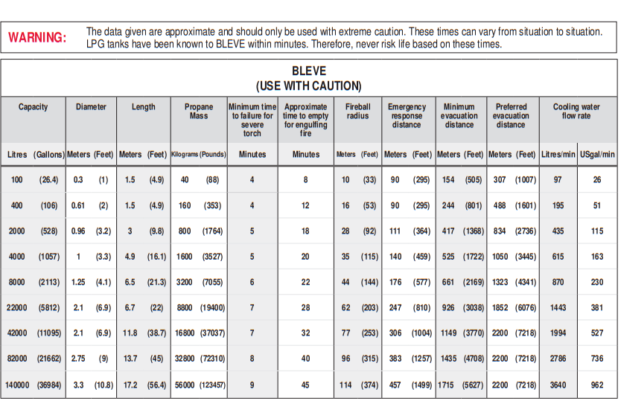
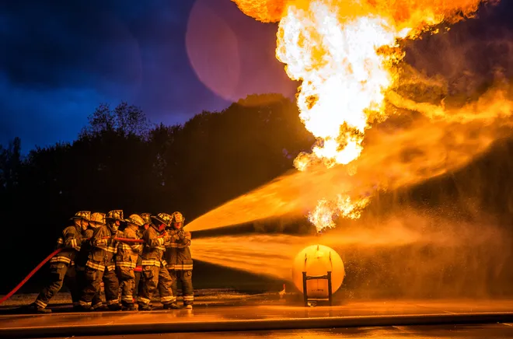
BLEVE Emergency Response
LPG Firefighting Training
Emergency Response Guidebook

Slide 8
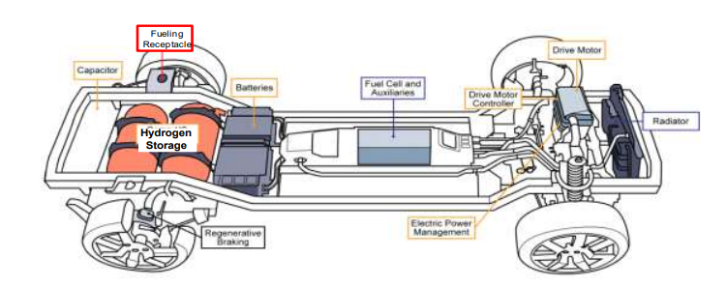
Hydrogen Vehicle Hazards
Rupture of hydrogen storage, high voltage lines, battery failure, capacitor discharge

Slide 9
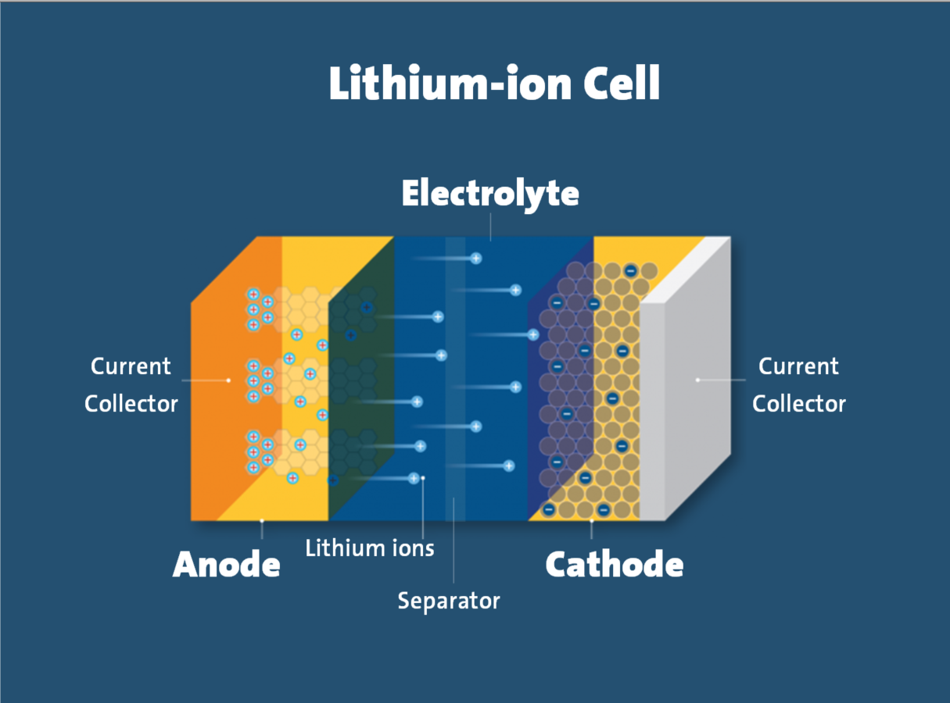
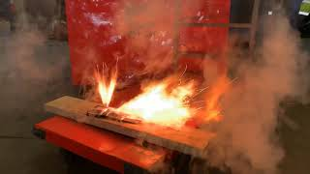
Li-ion Batteries - Why do they catch on fire?

Slide 10
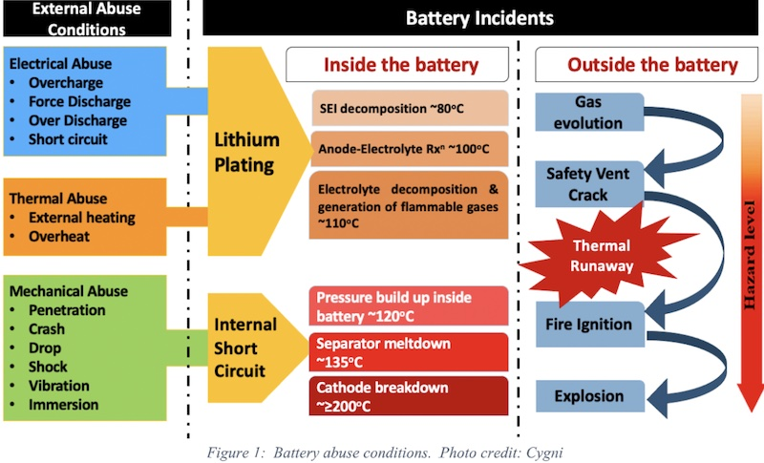
Li-ion Battery Hazards Analysis and Mitigation
Hazards
Fires and toxic gas production
Electrical hazards
Mitigation
Fire Suppression System
Cooling/temp system
Isolation
Protection from mechanical stress

Slide 11
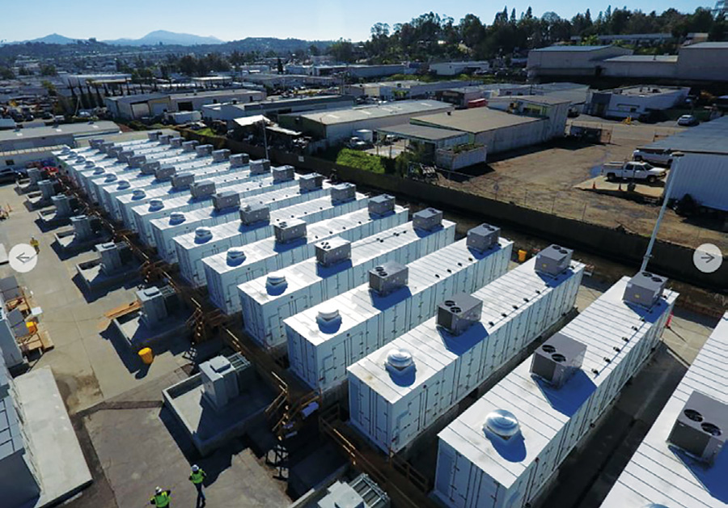
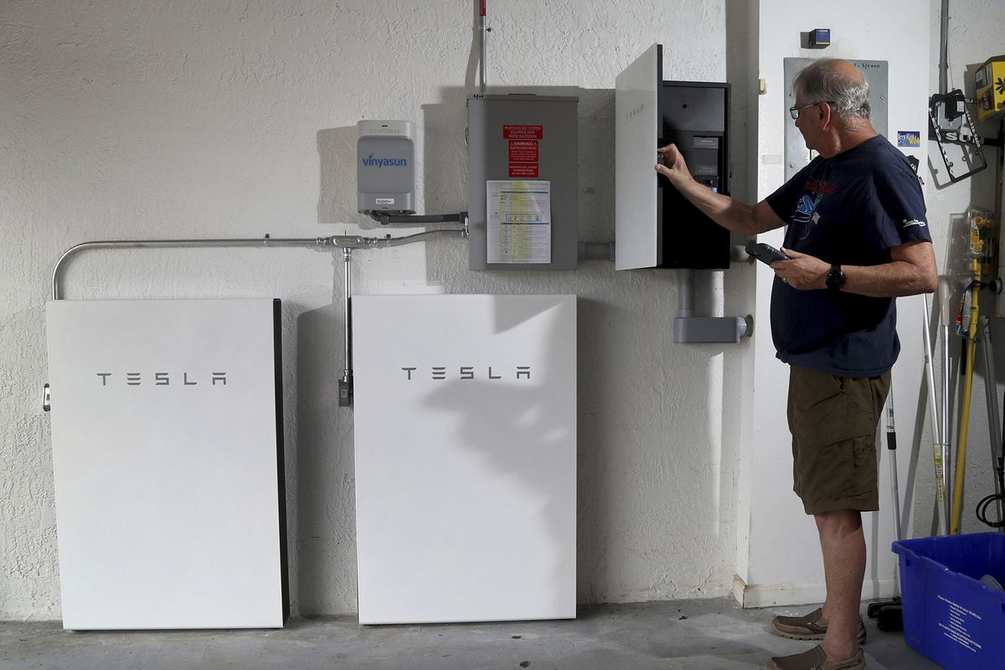
Industrial vs Residential Hydrogen Storage
Industrial: More Energetic, Frequent Inspections, Greater Safety Measures
Home: Less Energetic, Not Regularly Inspected, Liable to Misuse by Homeowner

Slide 12
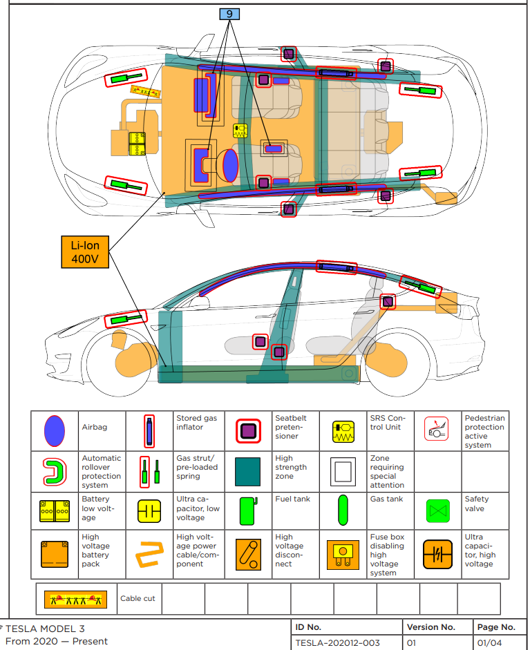
Li-ion Vehicle Hazards and Emergency Resources
Fire, high voltage lines, battery failure, capacitor discharge, extrication challenges
NFPA has Emergency Guidebooks, information not fully standardized
NFPA Electric Guidebooks

