Slide 1
Roadway Kinetic Energy Harvesting Technologies
Olivia Evans
NPRE 498

Slide 2
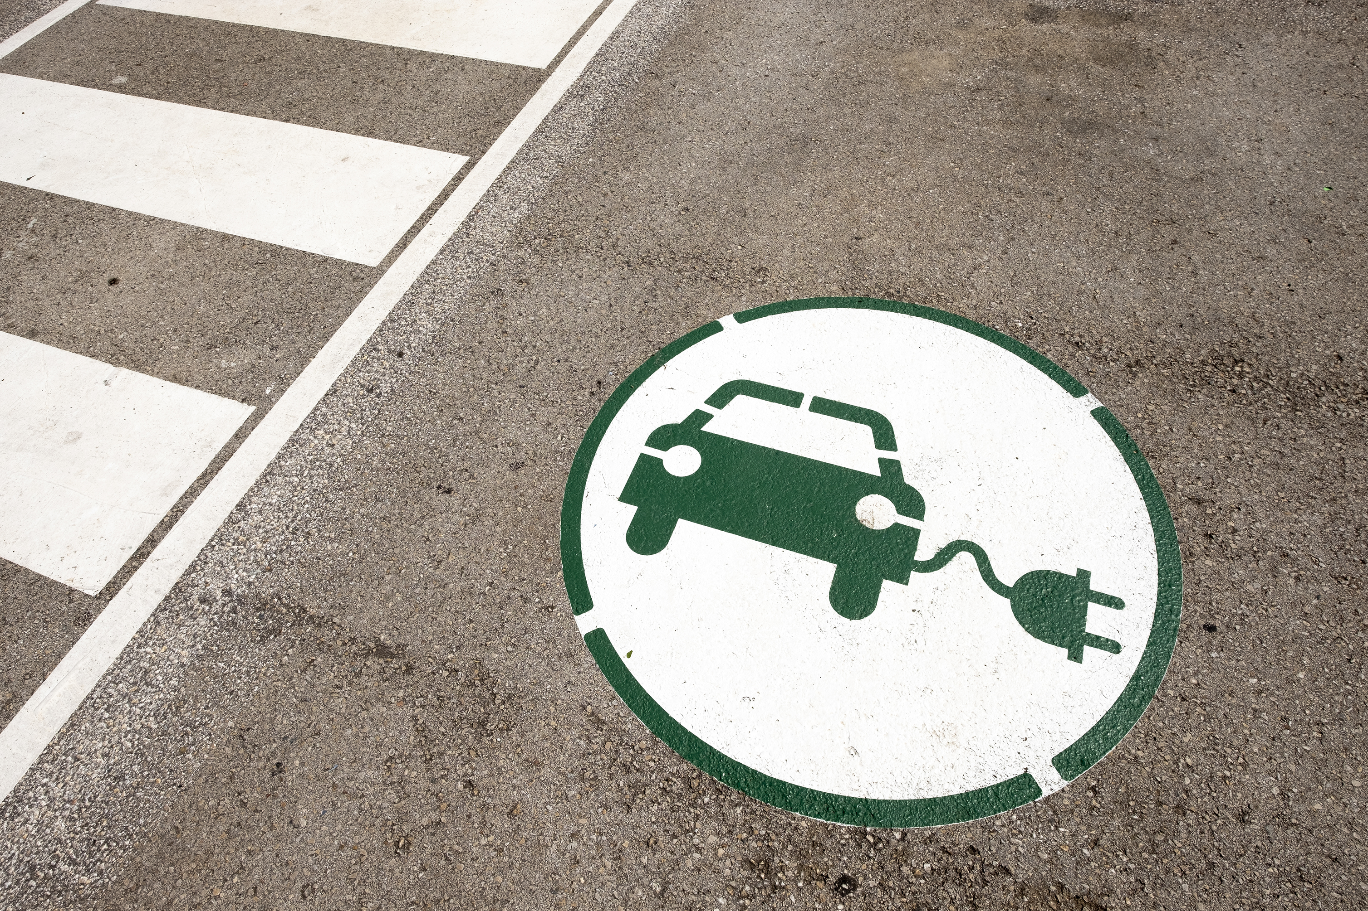
What Is Roadway Energy Harvesting?
Captures mechanical energy from vehicles and converts it into electricity
Integrates sensors and energy devices into pavement or roadway structure
Supports smart-city and transportation infrastructure
Why It Matters
Renewable and continuously available where
traffic exists
Enables off-grid devices
Enhances safety and urban data collection

Slide 3
Types of Harvesting Methods
Three Major Energy Sources:
Mechanical energy from vehicle motion
Pavement heat
Solar radiation
Technology Categories:​
Piezoelectric​
Electromagnetic​
Hydraulic

Slide 4
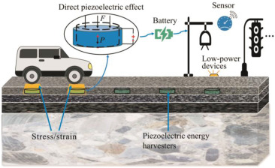
Piezoelectric Energy Harvesting
How It Works
Piezoelectric wafers embedded in pavement
  Piezoelectric material converts mechanical energy into electrical energy
  Material examples: lead zirconate titanate, polyvinylidene fluoride, quartz, barium titanate
Vehicle weight compresses the material
→ generates voltage
Energy stored using supercapacitors
or rechargeable batteries
Notes:
Piezoelectric materials have a non-centrosymmetric crystal structure.
When stressed, the charge centers shift, causing surfaces of the material to become electrically charged.
This produces a voltage that can be collected.

Slide 5
Performance & Findings​
Example: ~40 mAh generated in <1 hour​
LCOE: $35.66–$106.97 per kWh (5–15 year lifespan)​
Another estimate: $27.90 per kWh (10 years)​
Typical output: 2–100 mW per module​
Challenges​
Low energy output​
Expensive materials and installation​
Long-term durability under stress
Notes:
Levelized Cost of Energy

Slide 6
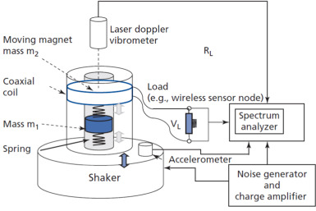
Electromagnetic Generators
Operating Principle
Based on Faraday's Law: vehicle motion moves a magnet relative to a coil
Vertical motion → rotational or linear generator systems

Slide 7
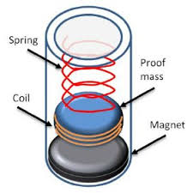
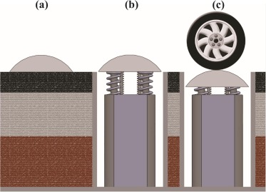
Performance​
Higher power density than piezoelectric​
Typical output: 1–30 W per vehicle pass
Design Examples
Car-arm systems
Roller mechanisms
Rack-and-pinion designs
Pinion-bevel gear configurations

Slide 8
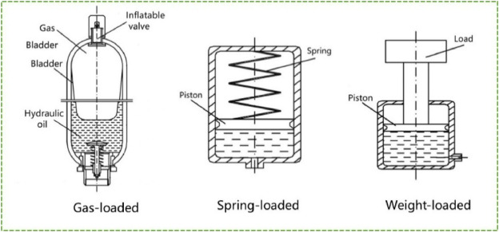
Hydraulic Systems
Concept
Converts pavement deformation into hydraulic pressure
Pressure drives a small generator (servo-hydraulic systems)
Examples
Sustained-release electromechanical floor systems
Hybrid mechanical, electrical
generation using pistons
Key Uses
Self-powered traffic management
systems
Embedded roadway power modules
Notes:
A servo-hydraulic generator uses:
A hydraulic pump (pressurized by pavement)
A hydraulic motor or turbine
A generator hooked to the motor

Slide 9

Applications​
Infrastructure​
Smart roads and intelligent transportation systems​
Traffic flow and speed monitoring​
Real-time road condition sensing

Slide 10


Power Uses​
Street lights and traffic lights​
Tunnel ventilation power​
Off-grid sensor networks​
Snow/ice melt systems for winter safety
Data Uses​
Traffic pattern analysis​
Vehicle counts and behavior modeling​
​

Slide 11
Benefits
Renewable and continuously available where vehicles pass
Low maintenance once installed
Not visually intrusive
Scales with vehicle speed : higher speed = more power
Minimal discomfort or disturbance to passengers
Supports distributed energy generation for smart infrastructure

Slide 12
Challenges & Limitations
High initial installation cost
Not competitive with grid electricity
  Grid: $0.15–$0.30/kWh
  Harvesters: $27–$107/kWh
Durability issues in extreme weather & high-load conditions
Efficiency limitations depending on design
Output strongly depends on traffic volume
Requires energy storage systems (batteries/supercapacitors)

Slide 13
Real-World Demonstrations
Examples
Israel: Innowattech piezoelectric roadway pilots
China: High-traffic walkway piezoelectric tiles
South Korea: Electromagnetic roadway strips in test beds
United States: Research trials and limited small-scale installations
Outcomes
Effective for small loads (lights, sensors)
Not sufficient for large-scale grid replacement
Promising for intelligent roadway infrastructure

Slide 14

Environmental & Sustainability Impact
Reduces reliance on grid electricity for roadway systems
Enables self-sustaining, off-grid sensors
Supports smart cities and automated traffic systems
Helps lower carbon footprint of lighting and monitoring infrastructure

Slide 15
Future Research Directions
Stronger, more durable piezoelectric ceramics
Higher-efficiency electromagnetic mechanisms
Improved hydraulic/electromechanical conversion
New pavement materials optimized for energy transfer
Scaled-up prototypes and long-term field trials
Integration with IoT, wireless data transmission & smart networks

Slide 16
Summary
Roadway energy harvesting is promising for micro-power applications
Piezoelectric, electromagnetic, and hybrid systems show diverse capabilities
Current limitations are cost, durability, and efficiency
Best suited for lighting, sensors, traffic monitoring, and smart-road systems
Continued research is expanding practical viability

Slide 17
References
[1]Nurettin Sezer, Muammer Koç, A comprehensive review on the state-of-the-art of piezoelectric energy harvesting, Nano Energy, Volume 80, 2021, 105567, ISSN 2211-2855, https://doi.org/10.1016/j.nanoen.2020.105567.
[2]Covaci C, Gontean A. Piezoelectric Energy Harvesting Solutions: A Review. Sensors (Basel). 2020 Jun 21;20(12):3512. doi: 10.3390/s20123512. PMID: 32575888; PMCID: PMC7349337.
[3] Mohammadreza Gholikhani, Reza Nasouri, Seyed Amid Tahami, Sarah Legette, Samer Dessouky, Arturo Montoya, Harvesting kinetic energy from roadway pavement through an electromagnetic speed bump, Applied Energy,Volume 250,2019,Pages 503-511,ISSN 0306-2619,https://doi.org/10.1016/j.apenergy.2019.05.060.
[4]https://cait.rutgers.edu/generating-power-every-time-you-hit-the-road/
[5] Zhuojun Jiang, Changyuan Jia, Peng Zheng, Yuchen Gong, Ning Li, Ammar Ahmed, Zutao Zhang, Dabing Luo,A transverse deceleration energy harvester based on a sliding plate for self-powered applications in near-zero energy road tunnels,Sustainable Cities and Society,Volume 84,2022,104014,ISSN 2210-6707,https://doi.org/10.1016/j.scs.2022.104014.
[6]https://repositorio-aberto.up.pt/bitstream/10216/121972/2/347546.pdf
[7] https://www.reuters.com/article/business/environment/israeli-company-turns-traffic-into-energy-source-idUSTRE52945S/
[8]Gyeong Ju Song, Jae Yong Cho, Kyung-Bum Kim, Jung Hwan Ahn, Yewon Song, Wonseop Hwang, Seong Do Hong, Tae Hyun Sung,Development of a pavement block piezoelectric energy harvester for self-powered walkway applications,Applied Energy,Volume 256,2019,113916 ISSN 0306-2619, https://doi.org/10.1016/j.apenergy.2019.113916.
[9] https://gizmodo.com/south-korea-testing-recharging-roads-for-its-public-t-5489918
[10] https://www.fhwa.dot.gov/publications/research/ear/13094/index.cfm
[11] https://rosap.ntl.bts.gov/view/dot/53558/dot_53558_DS1.pdf

Slide 18
Thank you

