Slide 1
Flow Cell Batteries
By Perren Delaney

Slide 2


History of Flow Cell Battery

Slide 3
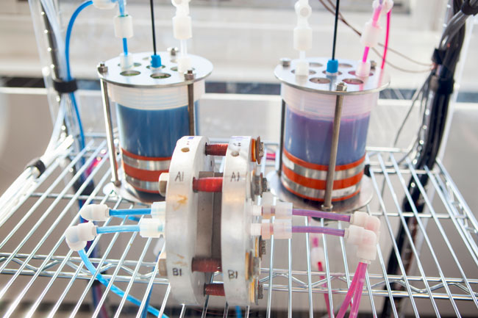
What is a Flow Battery Cell?
A flow battery is a fully rechargeable electrical energy storage device where fluids containing the active materials are pumped through a cell, promoting reduction/oxidation on both sides of an ion-exchange membrane, resulting in an electrical potential.

Slide 4
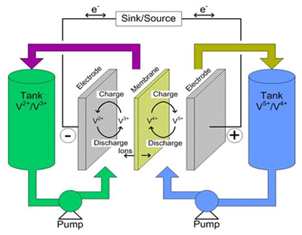
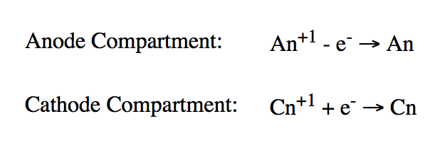
How Does A Flow Battery Work?

Slide 5
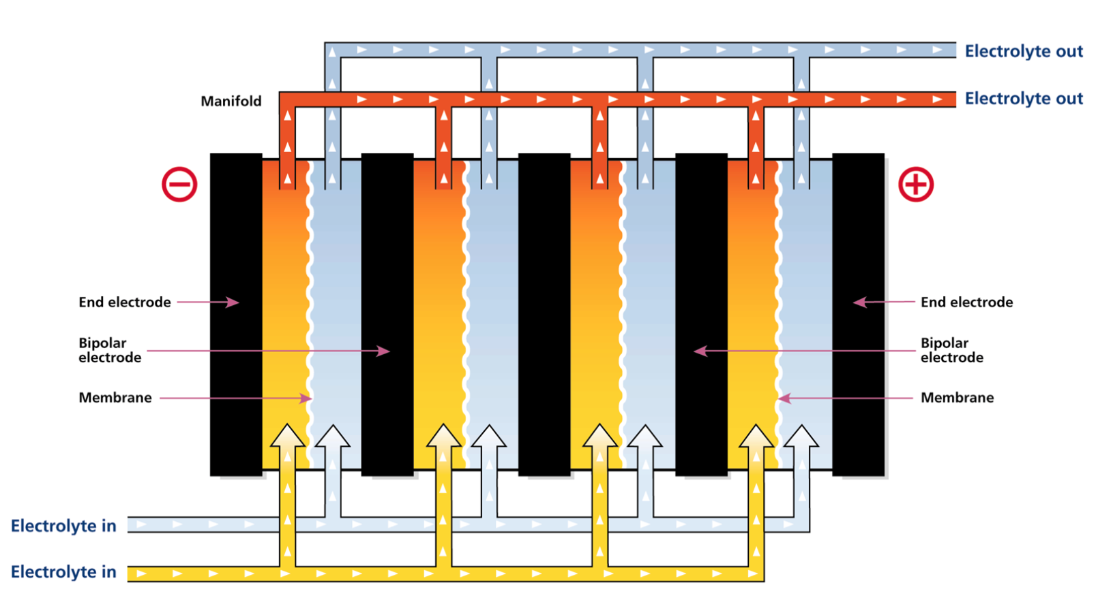
Cross Section – Flow Cell Battery

Slide 6
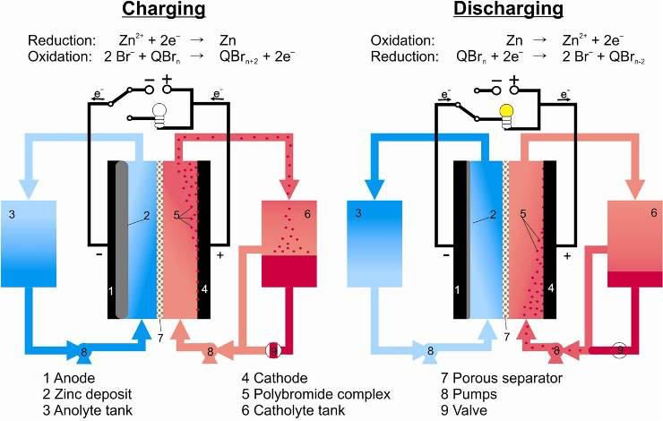
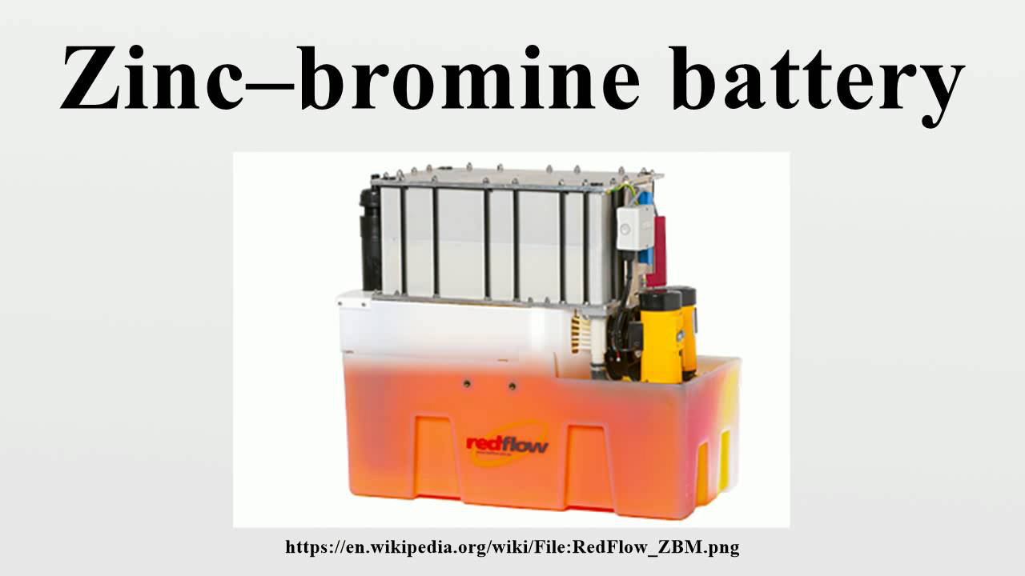
Zinc-Bromine Battery

Slide 7
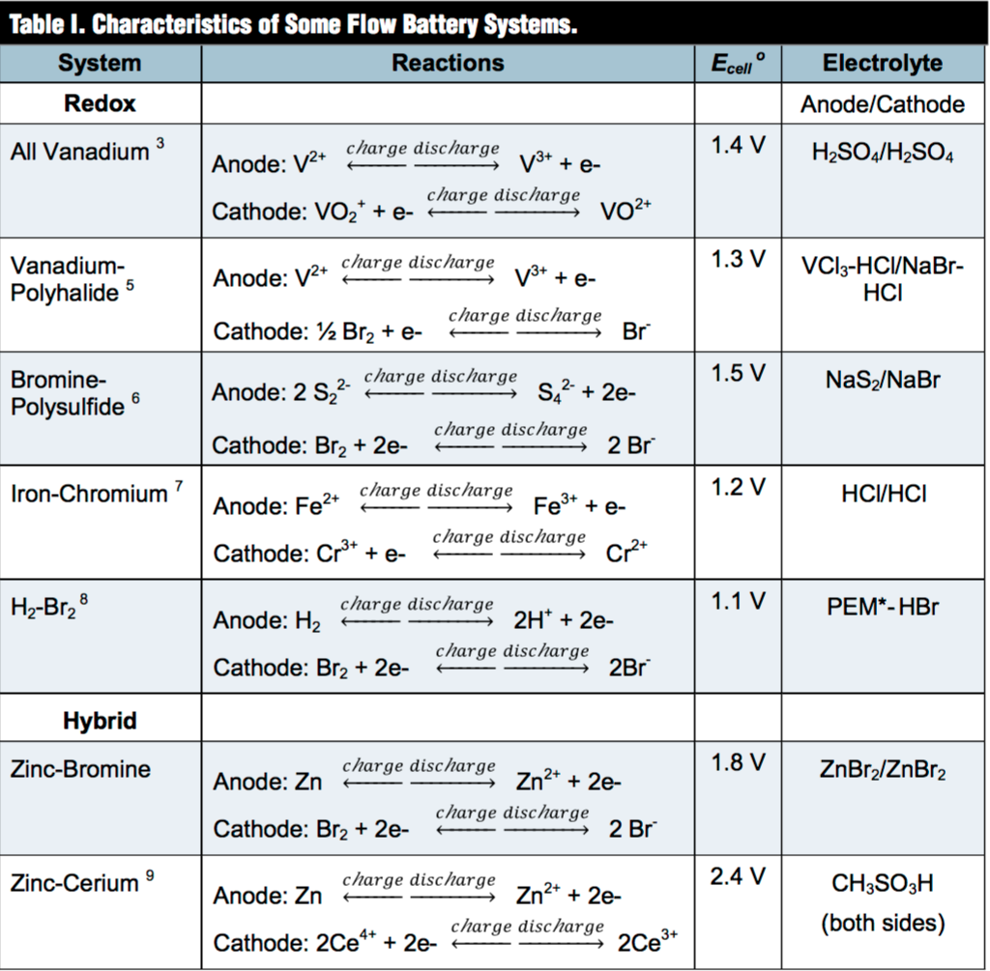
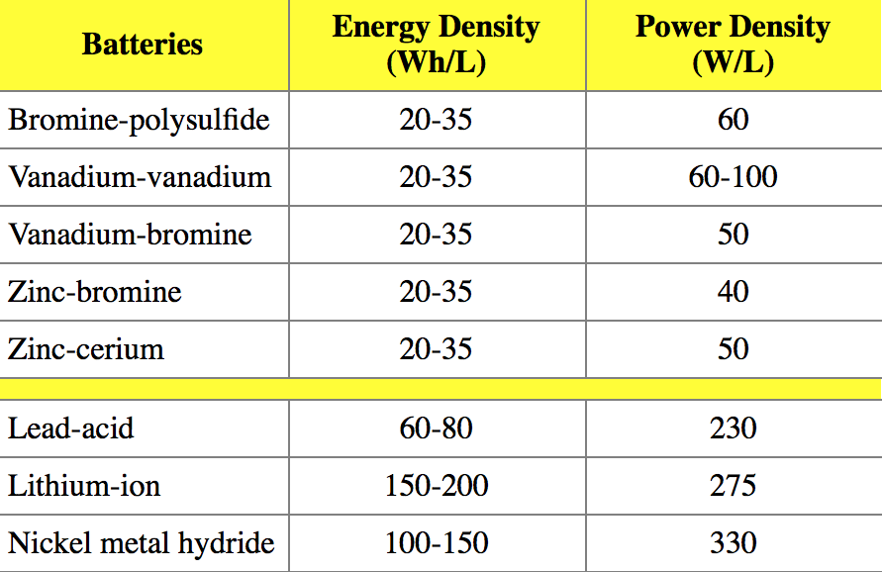
Flow Cell Batteries

Slide 8
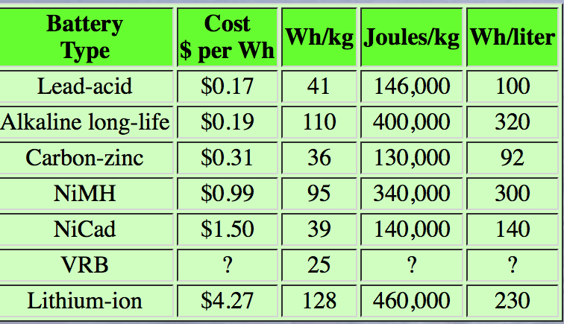

Slide 9
Flow Cell Battery- Benefits
Long service life
No standby loss
Low maintenance
Recyclability & Safety
Charging characteristics
Modularity

Slide 10
Flow Cell Battery – Disadvantages
Complex
Low energy density
Not commercially to date

Slide 11
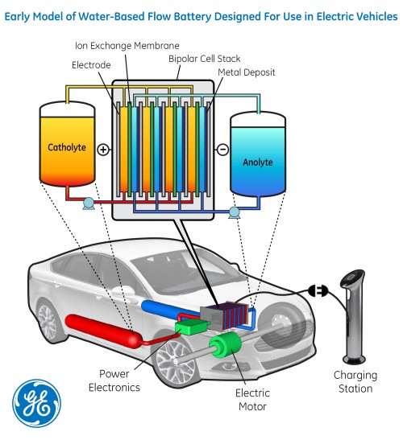
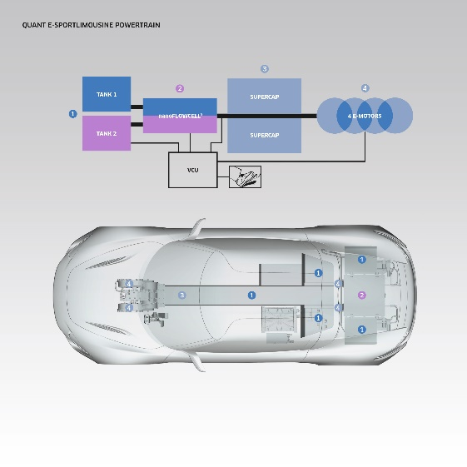
Flow Cell Batteries in
Modern Applications

Slide 12
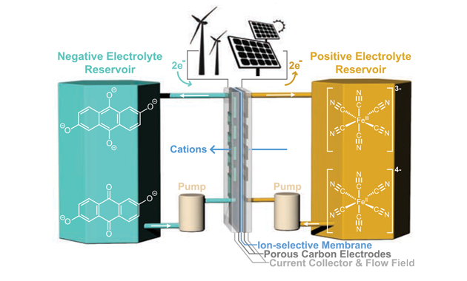
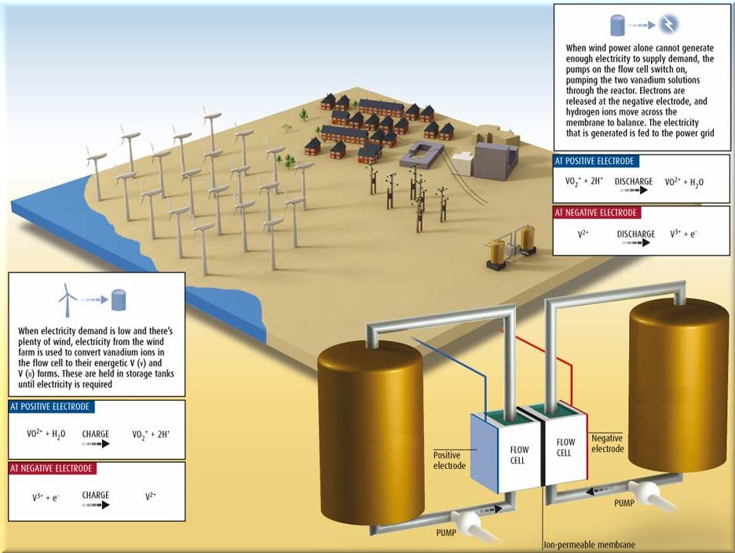
Flow Cell Batteries in
Modern Applications

Slide 13
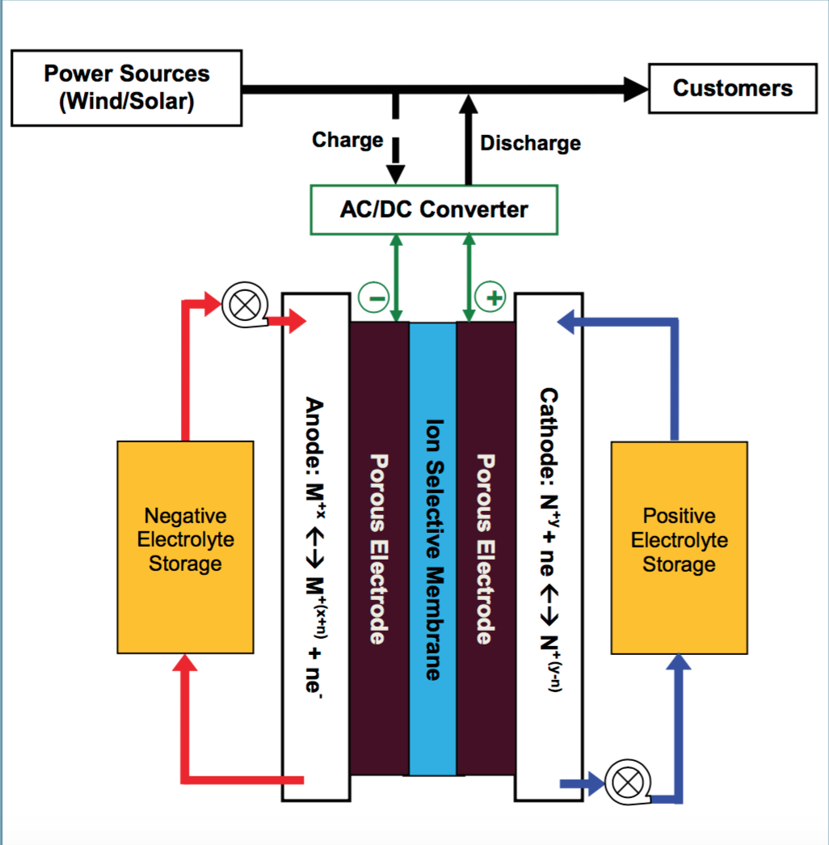
Flow Cell Batteries in
Modern Applications

Slide 14

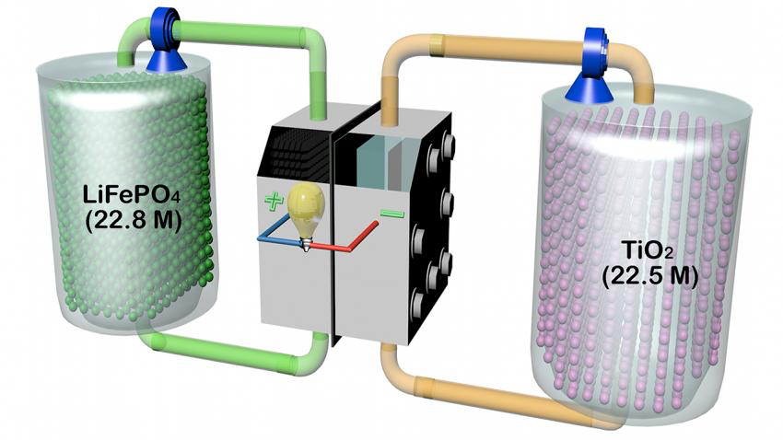
Future of Flow Cell Batteries

