Slide 1
Sulfur Based Thermochemical cycles for Hydrogen Production
Peter Ota

Slide 2
Content Overview
Thermochemical Cycles
Heat sources for thermochemical cycles
Iodine-Sulfur cycle
Bromine-Sulfur hybrid cycle
Hybrid sulfur cycle
Conclusion

Slide 3
Thermochemical Cycles
Combine heats source with chemical reactions to split water into hydrogen and oxygen
The chemical compounds used to separate hydrogen and oxygen are recycled
Temperatures between 750°C and 1000°C are optimal for thermochemical cycles
Can reach an efficiency of 50% (electrolysis hydrogen production efficiency ≈ 20-40%)
Sulfur based cycles are the most promising with current technology

Slide 4
Heat sources
Nuclear Heat
  Current commercial reactors have a maximum temperature of ~700°C which is less than required for Thermochemical cycles
  New high temperature reactors would be required
Concentrated Solar Power
  Only other carbon neutral source that can reach temperatures above 800°C
  No current solar plants used to create hydrogen using thermochemical cycles

Slide 5
Iodine-Sulfur cycle
Hydrogen
Oxygen
Heat
Efficiency of 30-50%
Heat is used to separate hydrogen from iodine & Oxygen from Sulfuric acid
400°C
900°C
H₂
Rejected Heat
½O₂
2HI
H₂SO₄
I₂
SO₂ + H₂O
Iodine
Circulation
Sulfur
Circulation
2HI + H₂SO₄
I₂
SO₂ + H₂O
I₂ + H₂O + SO₂
H₂O

Slide 6
Bromine-Sulfur Hybrid cycle
Hydrogen
Oxygen
Electricity
Heat
Efficiency of 40%
electrolysis is used to remove hydrogen from bromine
The sulfur loop is identical to the sulfur-Iodine cycle
900°C
H₂
Rejected Heat
½O₂
2HBr
H₂SO₄
Br₂
SO₂ + H₂O
Bromine
Circulation
Sulfur
Circulation
2HBr + H₂SO₄
Br₂
SO₂ + H₂O
Br₂ + H₂O + SO₂
H₂O

Slide 7
Hybrid Sulfur Cycle
Efficiency of 40-50%
Developed by Westinghouse in 1976
Uses electrolysis and thermochemical reactions
Outperforms the Sulfur-Bromine hybrid cycle without using a Halogen
Hydrogen
Oxygen
H₂SO₄
H₂ + H₂SO₄
H₂SO₄
Sulfur
Circulation
Electrolysis
2H₂O + SO₂
H₂O + SO₂ + ½O₂
H₂O + SO₂
Electricity
H₂O
Heat (>800°C)

Slide 8
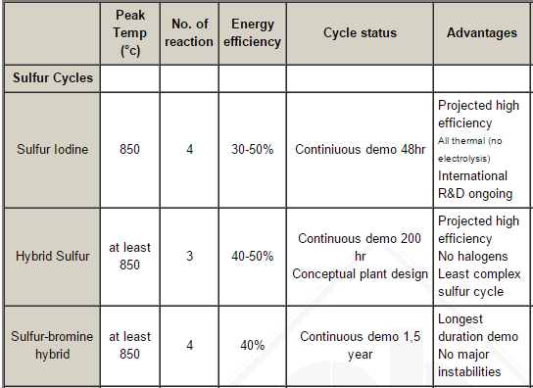
Status of thermochemical cycles
Westinghouse stopped research of the Hybrid-Sulfur cycle when oil prices dropped in 1986
General Atomics, Sandia national labs and University of Kentucky lead research in the united states

Slide 9
Conclusion
Sulfur-Iodine cycle is the most efficient Halogen cycle
Sulfur-Hybrid cycle is the most efficient hybrid cycle
All of the sulfur thermochemical cycles are more efficient than just electrolysis
A new reactor or solar thermal plant would be required for commercial hydrogen creation

Slide 10
References
Ragheb, M. “Thermochemical Iodine Sulfur for Hydrogen Production,” Sept. 26, 2014.
Perret, R. “Solar Thermochemical Hydrogen Production Research,” may, 2011
“Nuclear Hydrogen R&D Plan,” Mar. 2004, Department Of Energy, http://www.hydrogen.energy.gov/pdfs/nuclear_energy_h2_plan.pdf
http://www.ika.rwth-aachen.de/r2h/index.php/HT_Reactor_Associated_to_Thermo-chemical_Cycles

