Slide 1
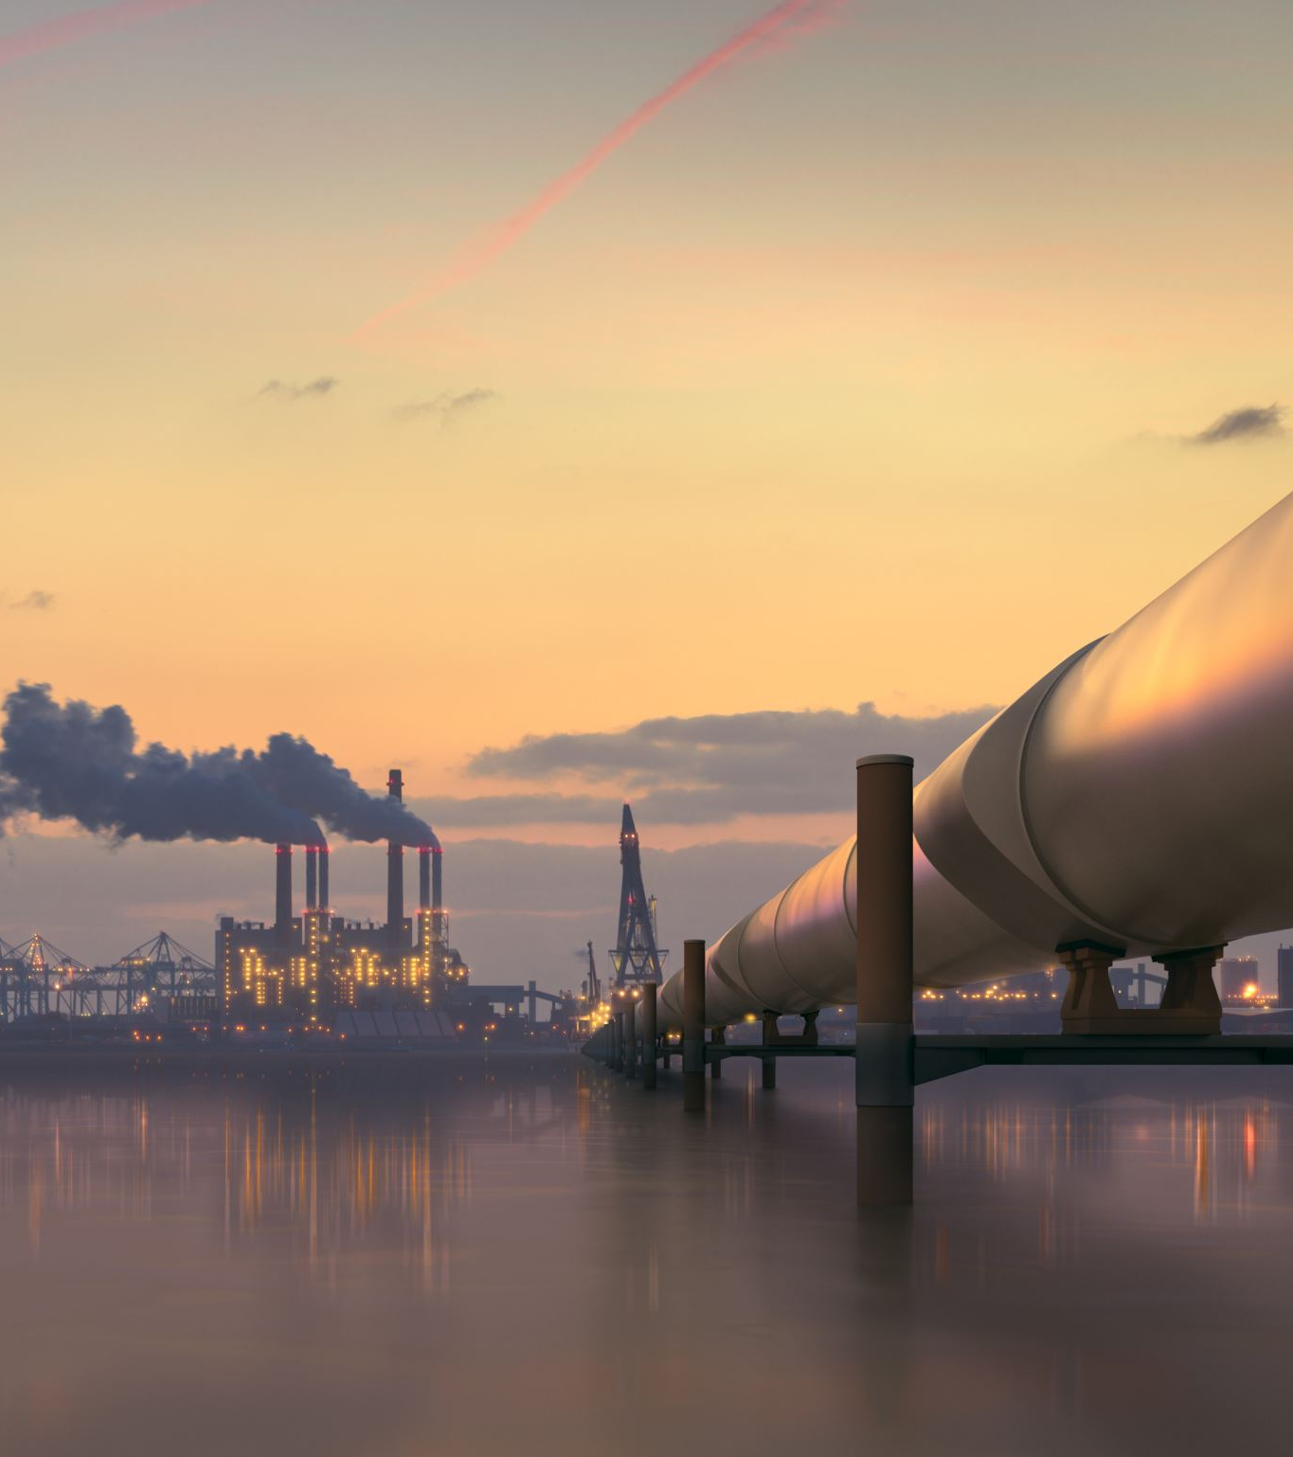
NUCLEAR HYDROGEN PRODUCTION
Clean, Large-Scale H₂ for the Energy Transition
Name- Raj Mohite

Slide 2
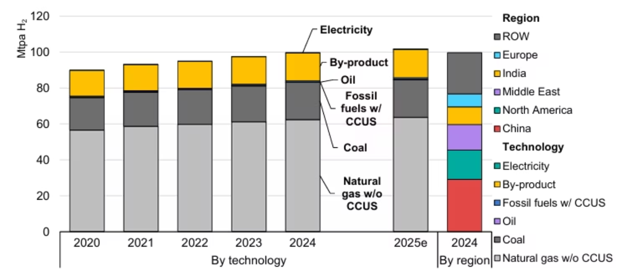
Current Energy Trends: The Push Towards Decarbonization
Global hydrogen demand today: ~70–115 Mt/year (mostly for ammonia, refining, methanol)
Current production dominated by low-cost fossil routes
(natural gas + coal)
96% produced from fossil fuels → ~830 Mt CO₂/year
Gray hydrogen (SMR + coal gasification): 10–19 t CO₂ per t H₂
Clean hydrogen (<1 kg CO₂/kg H₂) is <1% of total production
Energy transition requires massive decarbonization of hard-to-abate sectors (steel, cement, heavy transport, chemicals)
Fig 1. Hydrogen production by technology and by region

Slide 3
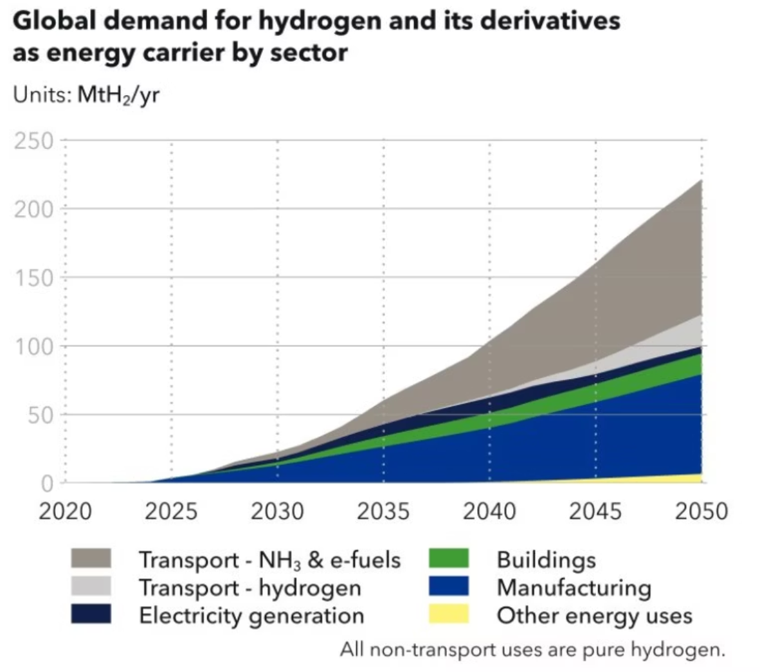
Hydrogen Demand to Reach Net-Zero 2050: A Critical Component
Hydrogen demand is projected to grow 5–7 times by 2050, according to the Hydrogen Council and IEA, becoming a cornerstone of the energy transition.
Clean hydrogen must supply a significant portion—20–25%—of final energy in net-zero scenarios.
Achieving this requires approximately 220 Mt/year of zero- or low-carbon hydrogen production by 2050.
Nuclear power, alongside renewables, stands as one of the few scalable and dispatchable low-carbon sources capable of meeting this immense demand.
Fig 2. Global hydrogen demand

Slide 4
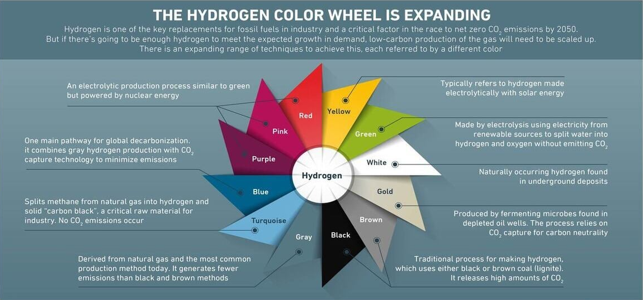
Hydrogen Production Routes – Overview (Color Wheel)
Fig.3 Hydrogen color wheel

Slide 5
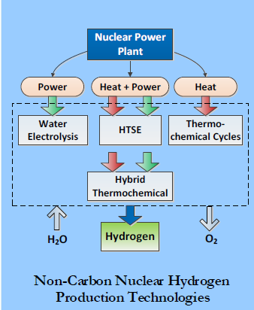
Why Nuclear Hydrogen is Beneficial
Zero operational CO₂ emissions
High capacity factor (>90%) → stable, predictable production (vs intermittent renewables)
Uses both electricity and high-temperature heat (cogeneration) → higher overall efficiency
Large-scale centralized production → lowest distribution costs
Existing nuclear fleet can start immediately using off-peak power
Advanced reactors (SMRs, HTGRs) ideally suited for dedicated hydrogen plants
Enhances grid stability when coupled with electrolyzers
Fig 4. Non-Carbon Nuclear Hydrogen Production Technologies

Slide 6
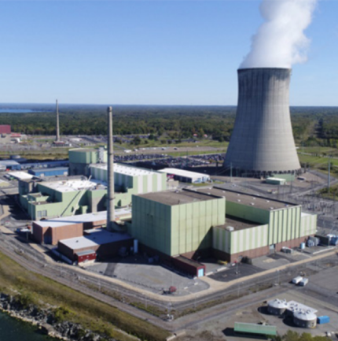
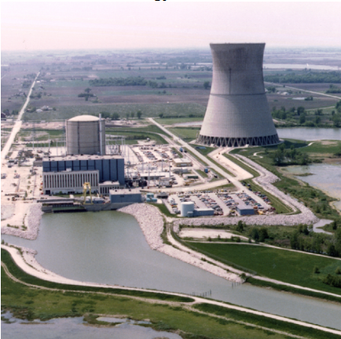
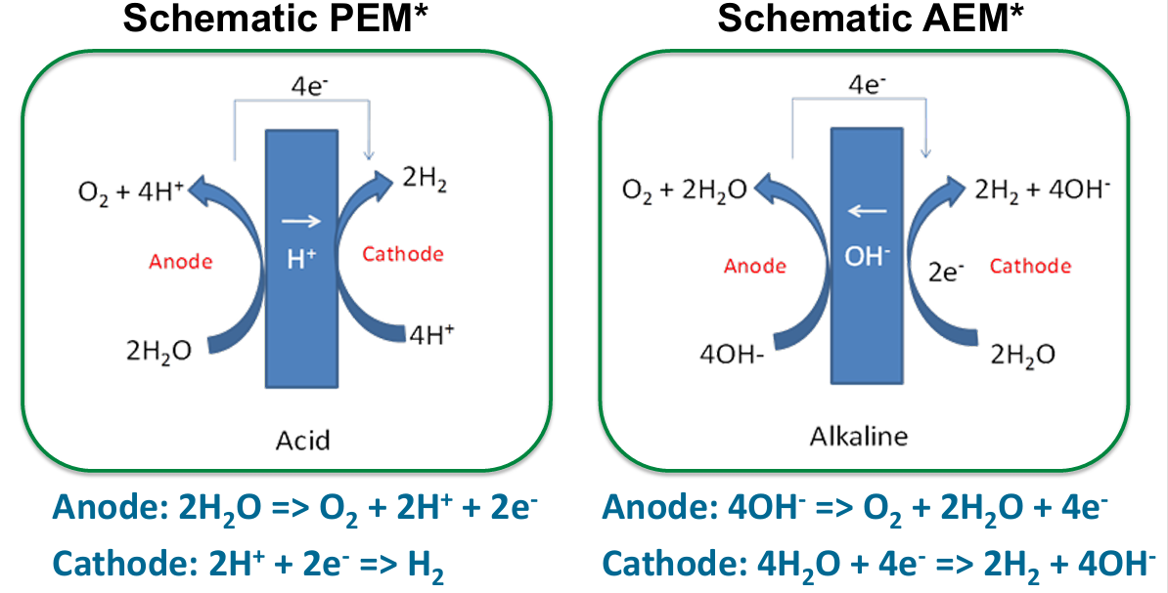
Nuclear Hydrogen Production Technologies
1. Low-Temperature Electrolysis (current reactors)
  PEM, AEM
  Uses electricity only (LWRs, SMRs)
  Proven, commercially available
Core Principle- Uses electricity only to split liquid water into H₂ and O₂ at 50–100 °C.
Fig. 5 Nine Mile Point Nuclear Power Station (Oswego, New York)
Fig. 6 Davis-Besse Nuclear Power Station
Fig. 7 Low temperature electrolysis using PEM and AEM

Slide 7
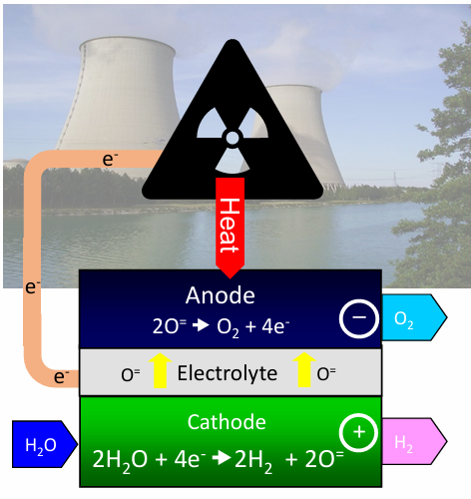
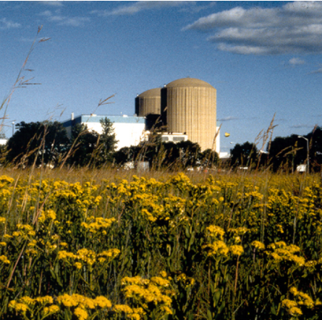
Nuclear Hydrogen Production Technologies
2. High-Temperature Steam Electrolysis (HTSE)
  Operates at 700–900 °C → ~30–40% less electricity needed
  Needs high-temperature heat source (HTGR, VHTR, advanced SMRs)
Core Principle
HTSE is still electrolysis (splitting water with electricity), but instead of feeding liquid water at 60–100 °C (like normal PEM or Alkaline electrolyzers), you feed superheated steam at 700–900 °C. At these high temperatures, thermodynamics dramatically reduces the electricity needed.
Fig. 8 High temperature steam electrolysis
Total energy for splitting water = ΔH (enthalpy)
ΔH = Electrical energy (ΔG) + Thermal energy (TΔS)
As temperature increases → ΔG decreases (Gibbs free energy)
Therefore, less electrical energy is needed
Fig. 9 Prairie Island Nuclear Generating Plant (Red Wing, Minnesota)

Slide 8
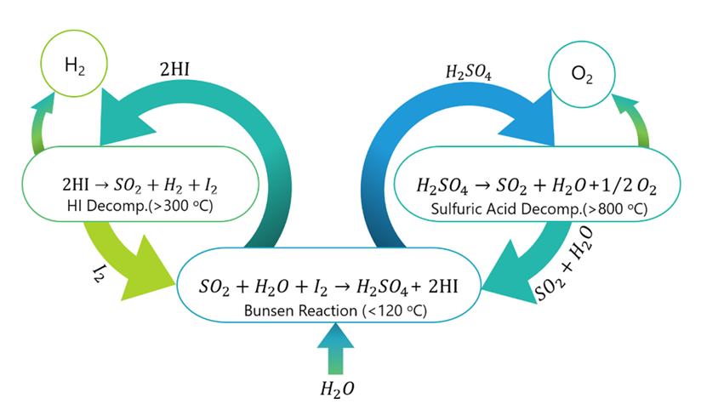
Nuclear Hydrogen Production Technologies
3. Thermochemical Cycles (e.g., Sulfur-Iodine)
  Purely thermal water splitting at 800–1000 °C
  Highest theoretical efficiency (>50%)
  Still R&D/demonstration stage
Core principle
Thermochemical cycles split water into H₂ and O₂ using only high-temperature heat (no electricity or very little). They work like a chemical “heat engine” that uses heat from a nuclear reactor (800–1000 °C) to drive a closed loop of reactions. At the end of the loop, the chemicals are fully regenerated and the only net outputs are hydrogen and oxygen.
Three main reactions (closed loop):
H₂SO₄ → SO₂ + H₂O + ½ O₂ (850–900 °C) Sulfuric acid decomposes
and releases oxygen
I₂ + SO₂ + 2 H₂O → 2 HI + H₂SO₄ (120 °C) Bunsen reaction (exothermic)
2 HI → I₂ + H₂ (400–500 °C) Hydrogen iodide
decomposes → hydrogen is released
Net result: H₂O → H₂ + ½ O₂
All chemicals (I₂, H₂SO₄, HI, SO₂) are recycled → nothing is consumed except water and heat.
Fig. 10 Sulfur-Iodine thermochemical cycle

Slide 9
How do the three processes compare with each other?
Feature | Low-Temp Electrolysis | HTSE (High-Temp Electrolysis) | Thermochemical Cycles
Main input | Electricity only | Electricity + heat | Heat only (or tiny electricity)
Operating temperature | 60–100 °C | 700–900 °C | 800–1000 °C
Electricity needed | 50–60 kWh/kg H₂ (Source) | 32–40 kWh/kg H₂ (Source) | 0–5 kWh/kg H₂
Theoretical efficiency | ~70% | ~90–95% | >50% (realistic 45–55%)
Best reactor match | Any nuclear plant | HTGR, MSR | VHTR, Gen-IV HTGR
Maturity (2025) | Commercial | Demonstration | Lab → large demo

Slide 10
Challenges
Process | #1 Challenge | #2 Challenge
Low-temp Electrolysis | High electricity consumption (50–60 kWh/kg) → expensive H₂ unless using very cheap off-peak nuclear power (Source) | Limited heat integration
HTSE (SOEC) | SOEC materials corrosion & degradation at 700–900 °C (chromium volatilization, electrode delamination) | High stack system cost (Around $1235/kW) (Source)
S-I Thermochemical | Materials corrosion (HI/H₂SO₄) | Chemical separation complexity
All processes | Nuclear-chemical safety licensing | Hydrogen infrastructure gap

Slide 11

Future Pathways (Beyond Electrolysis & Thermochemical)
Radiolysis: Direct water splitting using gamma radiation (research stage)
Photo-electrochemical + nuclear heat/electricity hybrids
Fusion-neutron-driven hydrogen production (long-term)
Direct use of spent fuel heat for thermochemical cycles (conceptual)
Nuclear-driven methane pyrolysis (turquoise hydrogen)

Slide 12
Conclusion
Nuclear-Powered Hydrogen: The Missing Scale for Net-Zero 2050
Clean hydrogen is essential to decarbonise steel, ammonia, shipping, aviation and heavy industry
Only nuclear delivers firm, high-capacity-factor, zero-carbon energy at the scale needed (hundreds of Mt/year)
Timeline to commercial reality
  Today → 2030: Low-temperature electrolysis using existing reactors (already operating in the USA)
  2030–2040: HTSE + SMRs/HTGRs → 30–40 % lower electricity demand
  2040+: Thermochemical cycles → lowest-cost clean hydrogen on the planet
Final message Nuclear hydrogen is not a competitor to green hydrogen, it is the indispensable complement that provides the volume, reliability and affordability the world actually needs.

Slide 13
Sources
1. Author(s). (2025). Title of article. Journal Name, Volume(Issue), pages. https://doi.org/10.1007/s44373-025-00043-9
(Ghezel-Ayagh, A., & co-authors. (2024). Title of paper. U.S. Department of Energy. Retrieved from https://www.hydrogen.energy.gov/docs/hydrogenprogramlibraries/pdfs/review24/ta039_ghezel-ayagh_2024_o.pdf?sfvrsn=af10c194_3
2. International Energy Agency. (2025). Global Hydrogen Review 2025. Retrieved from https://iea.blob.core.windows.net/assets/12d92ecc-e960-40f3-aff5-b2de6690ab6b/GlobalHydrogenReview2025.pdf
3. Author(s). (2020). Title of article. Journal Name, Volume(Issue), pages. https://doi.org/10.1016/S0016-2361(20)32321-8
U.S. Department of Energy. (2022, March). HTE workshop — Strategic analysis. Retrieved from https://www.energy.gov/sites/default/files/2022-03/HTE%20Workshop-Strategic%20Analysis.pdf
4. International Atomic Energy Agency. (n.d.). Nuclear hydrogen production. Retrieved from https://www.iaea.org/topics/non-electric-applications/nuclear-hydrogen-production
5. U.S. Department of Energy. (n.d.). 3 nuclear power plants gearing clean hydrogen production. Retrieved from https://www.energy.gov/ne/articles/3-nuclear-power-plants-gearing-clean-hydrogen-production
6. Bender, M. (2018). HydroGEN: Low-Temperature Electrolysis. U.S. Department of Energy. Retrieved from https://www.hydrogen.energy.gov/docs/hydrogenprogramlibraries/pdfs/review18/pd148_bender_2018_o.pdf?Status=Master
7. SWZ Maritime. (2022, June 15). Hydrogen at risk of being the great missed opportunity of the energy transition! SWZ Maritime. Retrieved from https://swzmaritime.nl/news/2022/06/15/hydrogen-at-risk-of-being-the-great-missed-opportunity-of-the-energy-transition/
8. MHI Spectra. (n.d.). The colors of hydrogen: Expanding ways of decarbonization. Retrieved from https://spectra.mhi.com/the-colors-of-hydrogen-expanding-ways-of-decarbonization
9. Author(s). (2020). Title of article. Journal Name, Volume(Issue), pages. https://doi.org/10.1016/S0360-3199(20)33319-X

