Slide 1
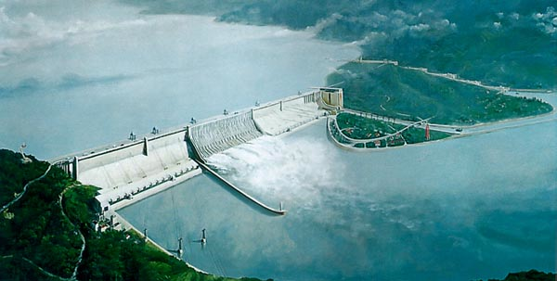
Three Gorges Dam
Ryan Switts
NPRE 498
December 6, 2010

Slide 2
History of Hydropower
Used as far back as 2000 years ago by Greeks to grind wheat
Evolution to modern hydropower turbine began with Bernard Forest de Belidor in the mid 1700s
World’s first hydroelectric power plant began operating in Appleton, Wisconsin in 1882
By 1889, 200 electric plants in the U.S. used water-power for at least some generation
Now, hydropower represents 19% of total electricity production

Slide 3
Three Gorges Dam--History
First proposed in 1919 in order to protect against flooding and aid in economic growth
Gained support of Mao Zedong in the 1950’s—was more popular because of recent floods
Due to political unrest, any progress was delayed till 1979
After 10 years of testing and with the Chinese government suppressing the high amount of controversy surrounding the project, construction began in 1992

Slide 4
Problems caused by Construction
1.2 Million citizens needed to be relocated, number might rise to 5 million and higher
Dam is situated on a fault line—changes in water level may lead to severe earthquakes
Up to 283 landslide-prone areas may experience increased geological activity
May flood up to 1300 archaeological sites in the area

Slide 5
Benefits
Limited capability of flood control
Higher water levels upstream of the dam will make transportation easier and safer
The normally lower water levels during the dry season can be kept constant—also making transportation easier
Can supply approximately 3% of China’s energy needs
Will have a total energy generating capacity of 22.4 GW

Slide 6
General Information
Contains 26 generating units, each with a rated power of 700 MW, and will have 6 more units installed to bring the total capacity to 22.4 GW
The dam is 1.5 miles long and 610 feet high
The reservoir is 410 miles long and 574 feet deep, and 299 feet above ‘river level’
Total cost of $37 billion

Slide 7
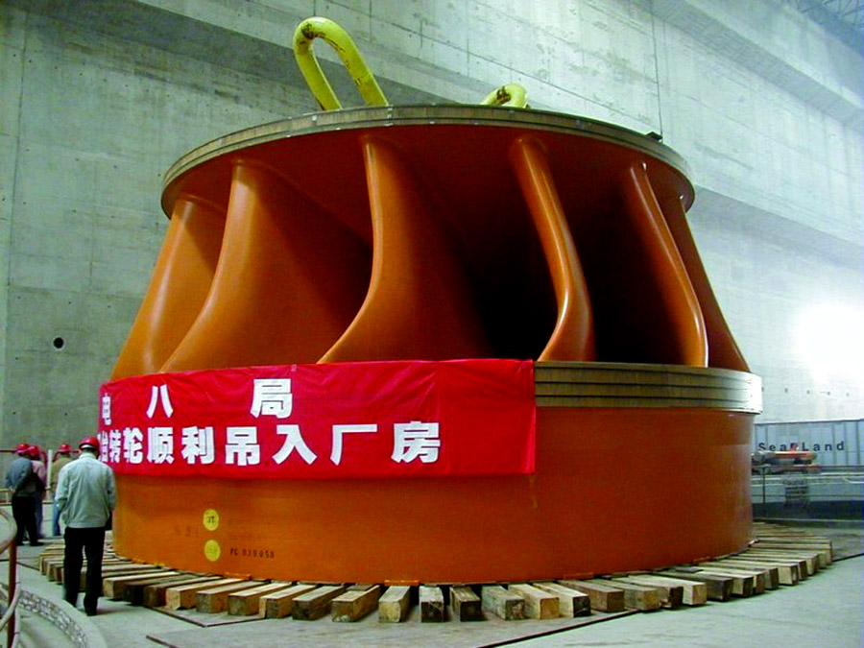
Francis Turbine
Typed of turbine used
Each is vertically mounted in a tunnel—water flowing sometimes close to 80 mph through the tunnel turns them at a rate of 75 rpm
Each has an inside diameter of 60 feet, an outside diameter of 70 feet, and is 11 feet from top to bottom
Efficiency over 94%

Slide 8
PowerTransmission
There are three 500 kV DC transmission lines and a 500 kV AC transmission line that will transfer power out of the Three Gorges Dam—
HVDC Three Gorges-Shanghai (3,000 MW)
HVDC Three Gorges-Changzhou (3,000 MW)—553 miles
HVDC Three Gorges-Guangdong (3,000 MW)—584 miles
HVAC Three Gorges-Central China Grid (12,000 MW)

Slide 9
Advantages and Disadvantages of HVDC
Higher power transfers over longer distances with fewer lines are possible with HVDC
Much more efficient than AC for both underground and underwater power transmission
Interconnections can be made between asynchronous networks—act as a ‘firewall’ against cascading outages
Higher converter station costs

Slide 10
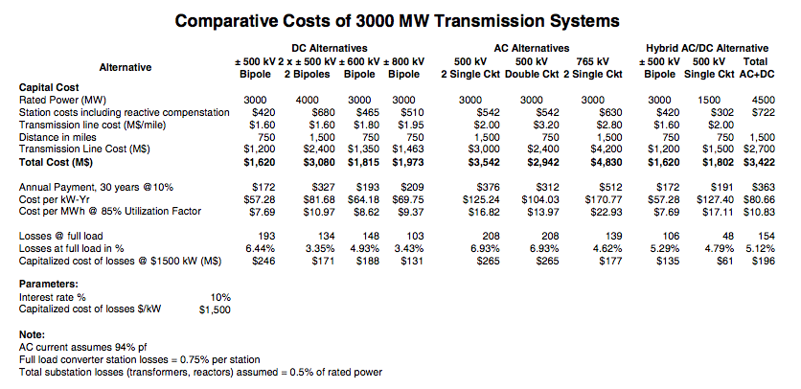
High Voltage DC versus AC

Slide 11
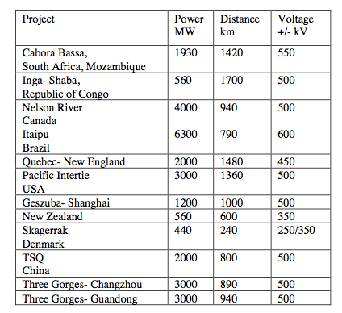
HVDC
Important for utilizing renewable energies, since areas abundant in these are often far removed from areas of high energy consumption.

Slide 12
References
Garcia, Honey. (24 Mar. 2010). “Three Gorges Dam: Renewable Energy Source or Recipe for Disaster?” Ecoseed. 2 Dec. 2010, http://www.ecoseed.org/en/water-power/large-hydropower/article/65-large-hydropower/6683-three-gorges-dam--renewable-energy-source-or-recipe-for-disaster-
Livescience staff. (26 Oct. 2010). “China’s Three Gorges Dam Finally Filled.” Livescience. 3 Dec 2010, http://www.livescience.com/technology/etc/three-gorges-dam-reaches-capacity-china-101026.html
“Flood Control Capacity of Three Gorges Dam Limited.” (23 Jul. 2010). Economictimes. 2 Dec 2010, http://economictimes.indiatimes.com/news/news-by-industry/et-cetera/Flood-control-capacity-of-Chinas-Three-Gorges-dam-limited/articleshow/6204806.cms
Watts, Jonathan. (22 Jan. 2010). “Three Gorges Dam May Force Relocation of a further 300,000 People.” Guardian. 3 Dec. 2010, http://www.guardian.co.uk/environment/2010/jan/22/wave-tidal-hydropower-water
Hydroelectric Power Water Use. USGS. 4 Dec. 2010, http://ga.water.usgs.gov/edu/wuhy.html
History of Hydropower. EERE. 4 Dec. 2010, http://www1.eere.energy.gov/windandhydro/hydro_history.html
Three Gorges Dam Hydroelectric Power Plant, China. Power-Technology. 1 Dec. 2010, http://www.power-technology.com/projects/gorges/
China’s Three Gorges Dam. Mount Holyoak. 1 Dec. 2010, http://www.mtholyoke.edu/~vanti20m/classweb/website/home.html
Bahrman, Michael. (1 Nov. 2006). “HVDC Transmission.” 2 Dec. 2010, http://www.scribd.com/doc/37191385/Panel-02-1-Overview-of-HVDC-Transmission
Bahrman. (20 Nov. 2008). “HVDC Transmission Overview.” 3 Dec. 2010, http://nomoretowers.org/Documents/HVDC%20Transmission%20Overview.pdf
“The Three Gorges Dam.” (14 August 2008). PA Pundits—International. 5 Dec. 2010, http://papundits.wordpress.com/2008/08/14/the-three-gorges-dam-part-3/

