Slide 1
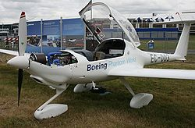
Fuel Cell Airplane
Sarika Malani
NPRE 498

Slide 2
Outline
History
Conventional Commercial Aircraft
Hydrogen Powered Aircraft
Hydrogen Fuel Cell
Proton-Exchange Membrane Fuel Cell
Disadvantages
Advantages
Theator Aircraft
DLR-H2
Boeing Phantom Eye
References

Slide 3
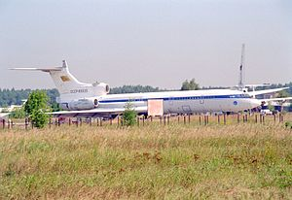
History
Lockheed CL-400 Suntan:
  Skunk Work’s highly secretive prototype reconnaissance aircraft
  Faster and higher altitude aircraft to replace the U-2
  Would use liquid nitrogen as the fuel
  Cancelled in 1958 due to budget constraints, inability to achieve sufficient range, and considered too dangerous
Tu-155:
  Built in 1989 by Russian manufacturer Tupolev
  First experimental aircraft in the world operating on liquid hydrogen
    Used liquid hydrogen and later liquefied natural gas
    Used cryogenics to store the fuel
    Fuel tank located in the air-blown rear compartment

Slide 4

History Cont.
Boeing Research & Technology Europe (BR&TE) flight tested a civilian aircraft running on a fuel cell in February and March 2008
Lange Aviation GmbH made a hydrogen powered plane from the Antares DLR-H2 airplane
Boeing unveils a hydrogen powered UAV in July 2010
In 2011, AeroVironment Global Observer is installed with a hydrogen fueled generator and liquid hydrogen fuel tanks
  Could be powered for up to a week in the stratosphere
  January 2011 – reached an altitude of 5000 ft for 4 hours
  April 1st, 2011 – first complete aircraft crashed after 18 hours
  December 2012 – program closed by Pentagon
  February 6, 2014 – AeroVironment teamed with Lockheed Martin to sell the Global Observer to international clients, which may compete with Boeing’s
  Phantom Eye

Slide 5
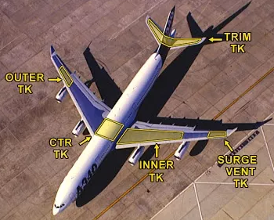
Conventional Commercial Aircraft
Jet fuel is a type of aviation fuel used in aircraft which are powered by gas turbine engines
Three types:
  Jet A (kerosene type)
  Jet A-1 (kerosene type)
  Jet B (naphtha type – 30% kerosene, 70% gasoline)
Kerosene type jet fuel has between 8 and 16 carbon atoms per molecule
Naphtha type jet fuel has between 5 and 15 carbon atoms per molecule
Jet A and Jet A-1 are the most commonly
used in commercial aviation
Jet A-1 has a lower freezing point than Jet-A
and an anti-static additive
Jet B is used for enhanced cold-weather
performances. Used in military aircraft
Wings are used for storing fuel

Slide 6
Hydrogen Powered Aircraft
An aircraft that uses hydrogen fuel as a power source
Three options for hydrogen usage:
  Can be burned in some kind of jet engine
  Can be burned in a different internal combustion engine
  Can be used to power a fuel cell to generate electricity to power a propeller

Slide 7
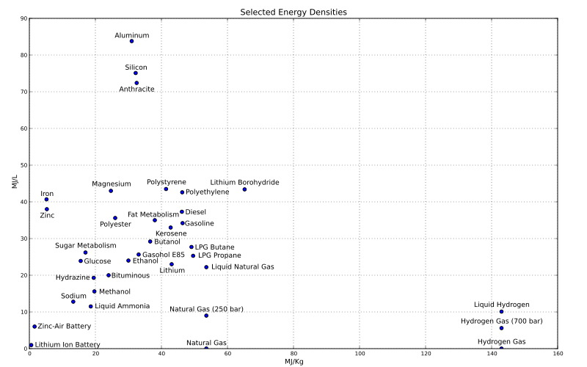
Why use hydrogen?
Energy Density
Specific Energy

Slide 8
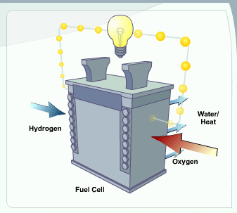
Hydrogen Fuel Cell
Uses hydrogen (or hydrogen rich fuel) and oxygen to create electricity
More energy efficient than combustion engines
The hydrogen can come from a variety of source, such as renewables
If pure hydrogen is used in the fuel cell, then the only byproducts are water and heat, thus eliminating emissions concerns

Slide 9
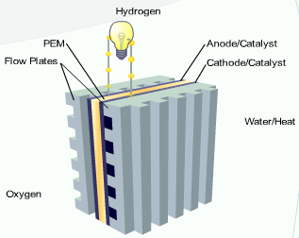
Proton-Exchange Membrane
Fuel Cells
Also known as a Polymer Electrolyte Membrane fuel cell
PEM fuel cell consists of an electrolyte membrane between an anode and cathode
The PEM is a thin, solid, organic compound which conducts charged ions but not electrons
The anode is the electron at which oxidation (loss of electrons) takes place
The cathode is the electron at which reduction (gaining of electrons) takes place
The flow plates channel the hydrogen and oxygen at the electrodes, channel water and heat away from the fuel cell, and conduct electrons from the anode to the circuit and from the circuit back to the cathode

Slide 10
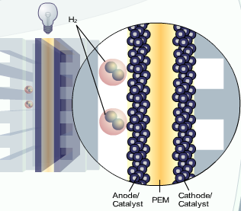
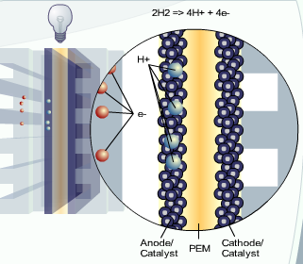
Proton-Exchange Membrane
Fuel Cells Cont.
The hydrogen fuel is channeled to the anode
The catalyst separates the negatively charged electrons from the positively charged protons

Slide 11
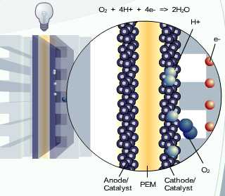
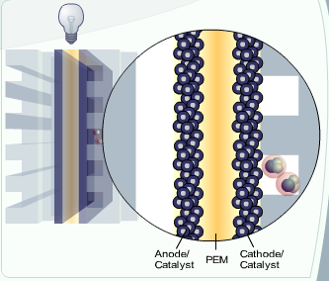
Proton-Exchange Membrane
Fuel Cells Cont.
The protons pass through the membrane and the electrons do not
The electrons must flow around the membrane, which forms an electrical current
At the cathode, the electrons and protons combine with oxygen to form H₂O and heat

Slide 12
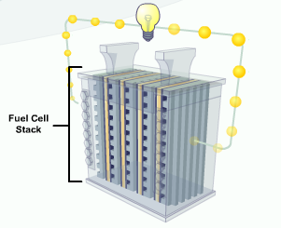
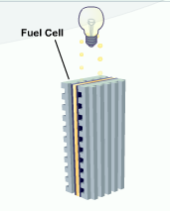
Proton-Exchange Membrane
Fuel Cells Cont.
The amount of power produced by a fuel cell depends on a few factors:
  Fuel cell type
  Cell size
  Operating temperature
  Pressure of the gasses supplied to the cell
A single fuel cell produces less than 1.16 V, therefore individual fuel cells are combined in series to form a fuel cell stack, thus increasing the amount of electricity generated

Slide 13
Disadvantages
Containing the hydrogen at high pressure requires a heavy container which is not feasible
Carbon fiber tanks are often used, but can only sustain a pressure of 350 bar
Four times the volume of kerosene based jet fuel for the same amount of energy
Highly volatile, therefore cannot store the fuel in the wings. Must be store in the fuselage of the plane, which lowers performance

Slide 14
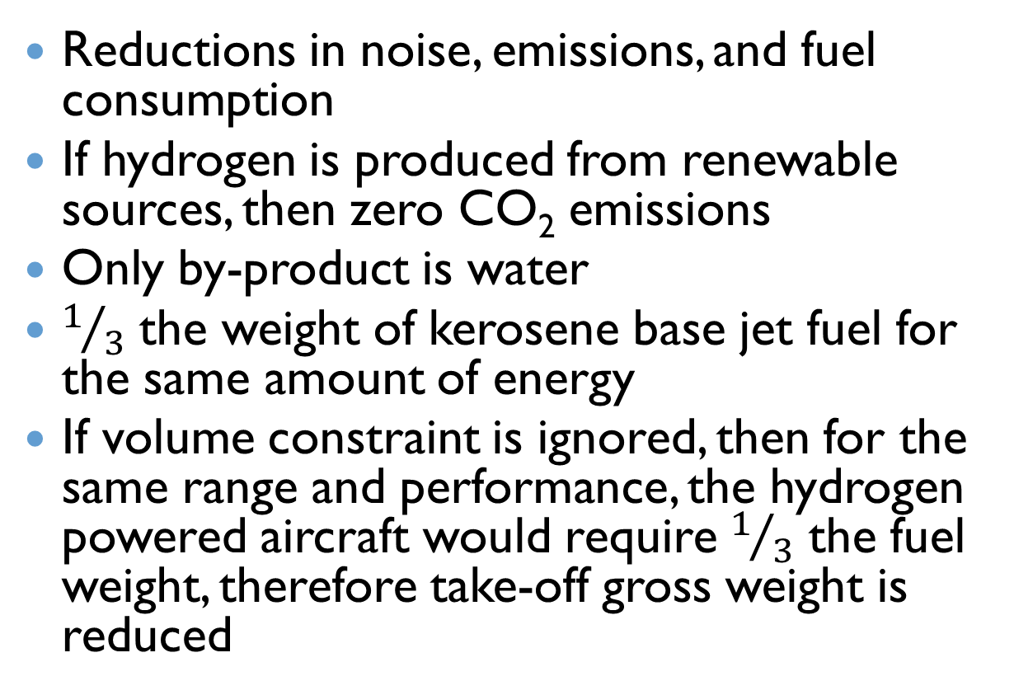
Advantages
Reductions in noise, emissions, and fuel consumption
If hydrogen is produced from renewable sources, then zero CO₂ emissions
Only by-product is water
$1/3$ the weight of kerosene base jet fuel for the same amount of energy
If volume constraint is ignored, then for the same range and performance, the hydrogen powered aircraft would require $1/3$ the fuel weight, therefore take-off gross weight is reduced

Slide 15
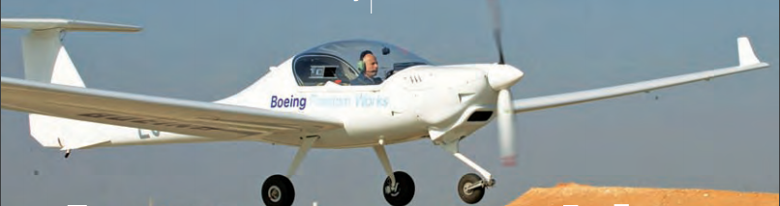
Theator Aircraft
BR&TE used the airframe of a 2-seater Dimona airplane
53.5 ft wingspan, modified to include a PEM fuel cell and lithium-ion battery hybrid system to power an electric motor coupled to a conventional propeller
Climbed to an altitude of 3,000 feet above sea level using a combination of battery power and power generated by hydrogen fuel cells
Flew straight and level at 60 mph for 20 minutes solely on power generated by hydrogen fuel cells
Required 45 kW to take off and 20 kW to stay airborne

Slide 16
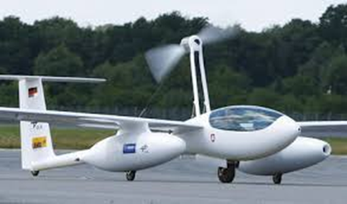
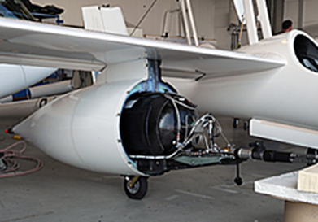
DLR-H2
Developed by DLR Institute for Technical Thermodynamics in collaboration with BASF fuel cells and Serenergy A/S
Airframe is based on the Antares 20E motor glider, with a 65.6 ft wing span
Uses a high temperature PEM fuel cell, which is connected to the propulsion motor such that the motor controller can take in and control voltages from 188 to 400 V
Cruising range of 470 miles with a flight time of 5 hours
Delivers up to 25 kW and requires 10 kW during level flight (with the fuel cell operating at 52% efficiency)
Total efficiency of the system is 44%
Two additional load carriers are slung under the specially reinforced wings to accommodate the fuel cell and the hydrogen supply

Slide 17
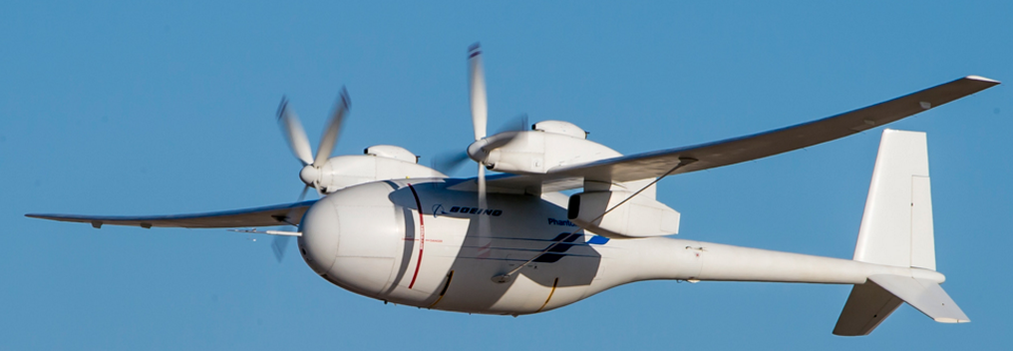

Boeing Phantom Eye
High altitude, long endurance liquid hydrogen powered unmanned aerial vehicle
Technical specifications:
  Wingspan: 150 ft
  Cruise speed: 172 mph
  Altitude: 65,000 ft
  Endurance: 4 days at 65,000 ft
  Take off gross weight: 9,800 lbs
  Max speed: 230 mph
  Engines: 2 2.3L 150 hp
Completed first autonomous flight on June 4, 2012
Flew its sixth flight test in mid-December 2013, surpassing its endurance high mark, flying longer than 5 hours
Flew its ninth test flight in 2014, flying for 8-9 hours at 54,000 feet and then placed in storage
Has met NASA safety criteria

Slide 18
References
Dmitriy Komissarov, Tupolev Tu-154, the USSR's Medium-Range Jet Airliner, (Hinckley, UK, 2007), 48–50. ISBN 1-85780-241-1
http://www.spacedaily.com/reports/AeroVironment_Global_Observer_Stratospheric_Unmanned_Aircraft_System_Completes_Initial_Flight_Testing_999.html
http://www.gizmag.com/global-observer-uav-first-hydrogen-powered-flight/17602/
https://www.flightglobal.com/news/articles/aerovironment-teams-with-lockheed-martin-on-global-observer-395675/
Koehler, Tom. "A Clean, Green Science Machine." Nature 519.7543 (2008): 261. Web.
Renouard-Vallet, Gwenaelle, et al. "Fuel Cells For Civil Aircraft Application: On-Board Production Of Power, Water And Inert Gas." Chemical Engineering Research & Design: Transactions Of The Institution Of Chemical Engineers Part A 90.1 (2012): 3-10. Academic Search Complete. Web.
"Fuel Cells Power First Takeoff For DLR's Antares Aircraft." Fuel Cells Bulletin 2009.9 (2009): 3. Academic Search Complete. Web.
http://www.dlr.de/en/desktopdefault.aspx/tabid-5105/8598_read-18278/8598_page-2/
https://www.cgabusinessdesk.com/document/aviation_tech_review.pdf
https://www.quora.com/Where-is-fuel-in-a-passenger-aircraft-stored-and-what-is-the-typical-capacity
https://www.fueleconomy.gov/feg/fcv_PEM.shtml
http://www.boeing.com/defense/phantom-eye/

