Slide 1
Solid State Storage Batteries
NPRE 498: Energy Storage Engineering
December 8, 2025
Selvin Tobar

Slide 2
Introduction
Theory
Advantages
Applications
Conclusion/Future Uses
NPRE 498: Solid State Storage Batteries

Slide 3
Introduction
Why Energy Storage Matters
  Growing energy demand
    Data centers, electric vehicles
    U.S. annual electricity consumption will increase in 2025 and 2026, surpassing all-time high reached in 2024¹
  Safety concerns in conventional Li-ion batteries
    Volatile and flammable liquid electrolytes
  Need for higher energy density
    Energy per unit volume of the battery [ Joule/m³]
NPRE 498: Solid State Storage Batteries
Notes:
https://www.eia.gov/todayinenergy/detail.php?id=65264
1. According to the U.S energy Information adminstration

Slide 4
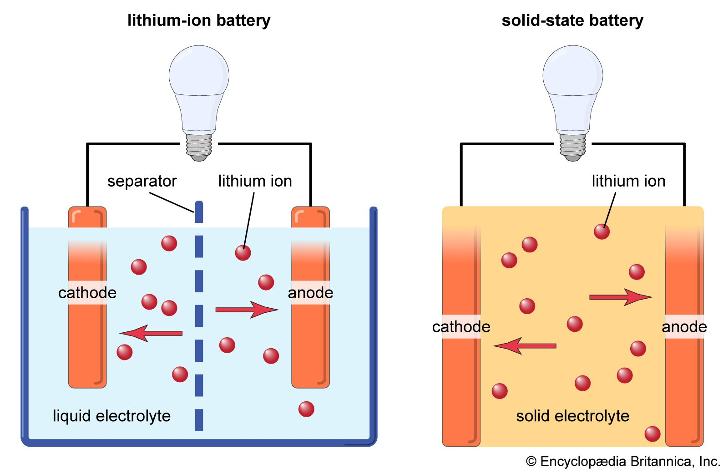
Introduction
What are Solid-State Batteries?
  Use solid electrolytes in place of a liquid- or gel-type electrolyte commonly used in Li-ion batteries
    Advantages
      Safety
      Energy density
      Cycle Life
    Disadvantages
      Low ionic conductivity
      Manufacturing scalabilty
Battery Design Comparison²
NPRE 498: Solid State Storage Batteries
Notes:
2. Volle, Adam. "solid-state battery". Encyclopedia Britannica, 19 Mar. 2025, https://www.britannica.com/technology/solid-state-battery. Accessed 19 November 2025.

Slide 5
Introduction
Theory
Advantages
Applications
Conclusion/Future Uses
NPRE 498: Solid State Storage Batteries

Slide 6
Theory: Battery Charging and Discharging
Batteries
  Electrolyte: A medium (solvent or solid) that conduct ions
  Cathode/Anode: Stores and releases lithium ion
    Charging: Cathode releases electrons and ions
    Discharging: Anode releases electrons and ions
Battery Design Comparison²
NPRE 498: Solid State Storage Batteries
Notes:
During a discharge of electricity, the chemical on the anode releases electrons to the negative terminal and ions in the electrolyte through what’s called an oxidation reaction. Meanwhile, at the positive terminal, the cathode accepts electrons, completing the circuit for the flow of electrons.

Slide 7
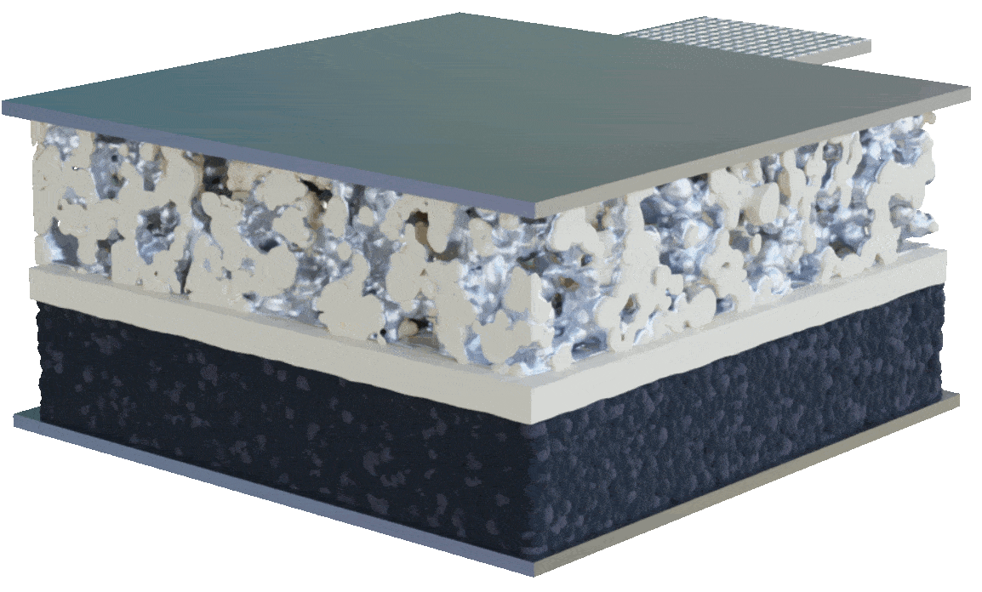
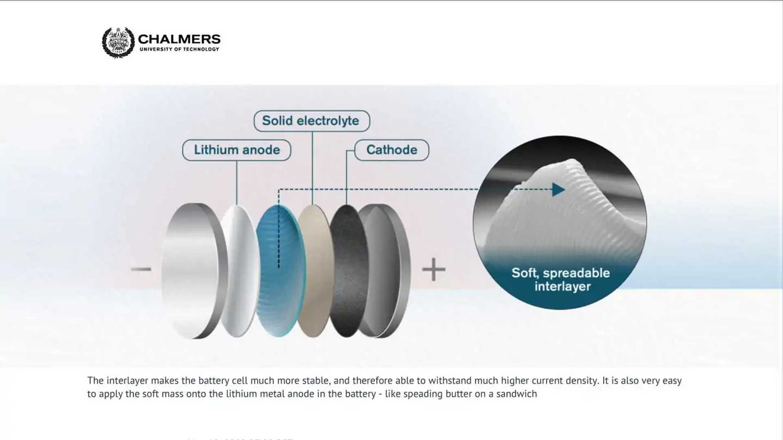
Theory: Components of a Solid-State Battery
Solid State Electrolyte
  Use a crystalline structure to create low-energy pathways for ions to move under the influence of an electric field
    Ceramics: High ion conductivity, but can be brittle
    Polymers: Flexible, but lower conductivity
    Glassy Material: High conductivity, but reactive with moisture
NPRE 498: Solid State Storage Batteries
Notes:
Bridgelall, R. (2024). Scientometric Insights into Rechargeable Solid-State Battery Developments. World Electric Vehicle Journal, 15(12), 555. https://doi.org/10.3390/wevj15120555

Slide 8
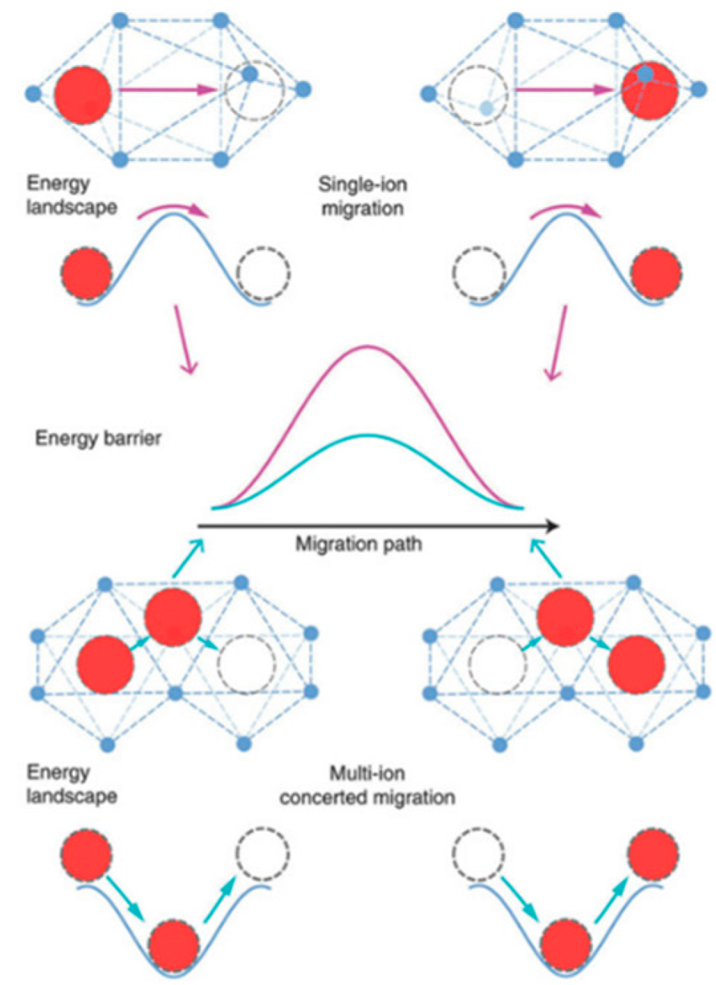
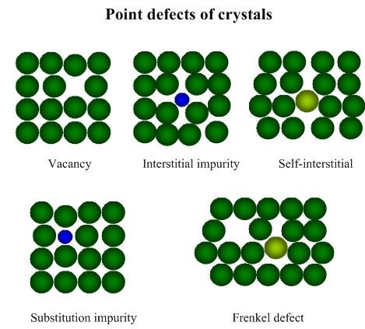
Theory: Li-ion Transport Mechanism in ISEs
Inorganic Solid Electrolytes
  Li-ion transport is primarily determined by the defects within the ceramic crystals
    Point defects, Stoichiometric, Vacancy and Interstitial defects
  Li-ion occupies a stable site in the lattice, thermal energy lets it hop over an energy barrier to a neighboring vacant site or interstitial site
NPRE 498: Solid State Storage Batteries
Notes:
Inorganic consist of halides, sulfides, and ceramics (phosphates and oxide-based) electrolytes.
Ai, S., Wu, X., Wang, J., Li, X., Hao, X., & Meng, Y. (2024). Research Progress on Solid-State Electrolytes in Solid-State Lithium Batteries: Classification, Ionic Conductive Mechanism, Interfacial Challenges. Nanomaterials, 14(22), 1773. https://doi.org/10.3390/nano14221773
Mbayachi, V. B., Ionic transport mechanisms in inorganic solid electrolytes, Materials Today: Proceedings, 2025.

Slide 9
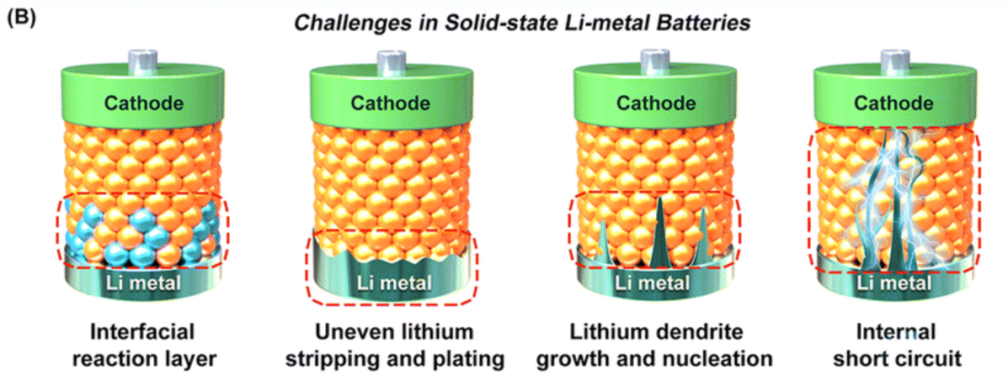
Theory: Key Challenges
High interfacial resistance and poor ionic conductivity at room temperature
  Opposition to flow (electrical current) that occurs at the boundary where two materials meet
High manufacturing/sintering temperatures to produce
Li dendrite; branched structures of lithium metal that form on the surface of a batteries negative electrode during charging and discharging
NPRE 498: Solid State Storage Batteries
Notes:
Sintering: a manufacturing process that uses heat and pressure to fuse powdered ceramic or inorganic materials into a dense, solid electrolyte without melting them
Li, W.; Li, M.; Ren, H.; Kim, J. T.; Li, R.; Sham, T.-K.; Sun, X. “Nitride solid-state electrolytes for all-solid-state lithium metal batteries.” Energy & Environmental Science, 2025, 18, 4521-4554. DOI: 10.1039/D4EE04927F.

Slide 10
Introduction
Theory
Advantages
Applications
Conclusion/Future Uses
NPRE 498: Solid State Storage Batteries

Slide 11
Advantages
Non-flammable and thermally stable
Higher energy density and minimal self charge
Lower carbon footprint due to reduced use of materials
Shorter charging time
Smaller volume compared to the anode in a traditional Li-ion battery
  Elimination of a separator
NPRE 498: Solid State Storage Batteries

Slide 12
Introduction
Theory
Advantages
Applications
Conclusion/Future Uses
NPRE 498: Solid State Storage Batteries

Slide 13
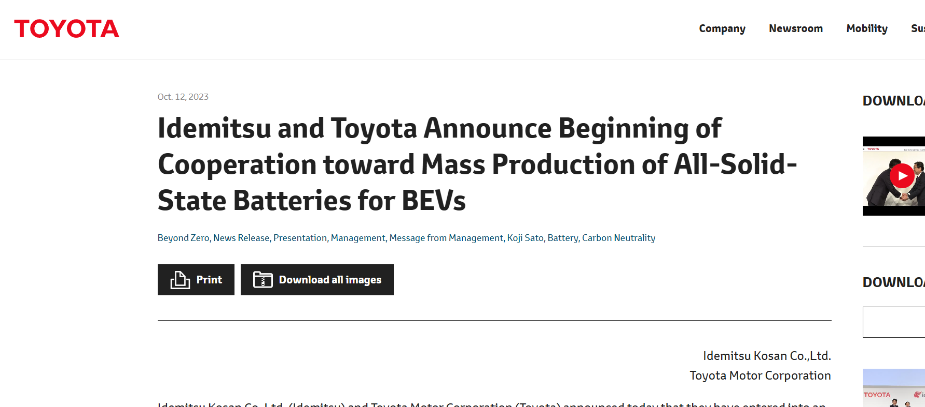
Application: Idemitsu and Toyota
NPRE 498: Solid State Storage Batteries

Slide 14
Application: Idemitsu and Toyota
Seek to ensure successful commercialization of all solid-state batteries in 2027-28 followed by full-scale mass production
Sulfide Solid Electrolyte
  Characterized by softness and adhesiveness to other materials
NPRE 498: Solid State Storage Batteries

Slide 15
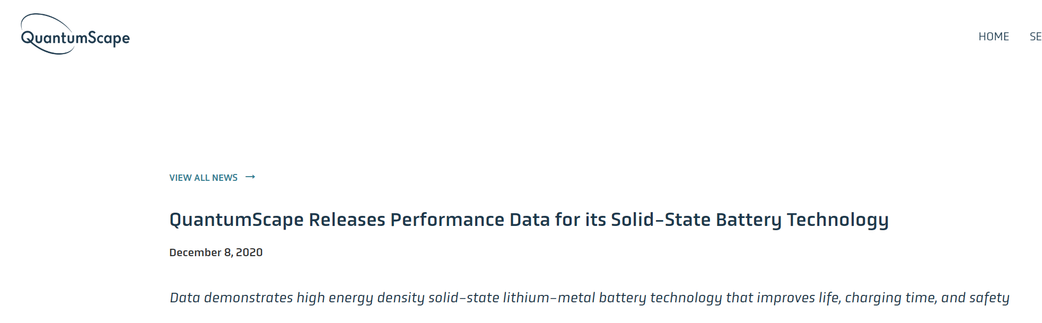
Application: QuantumScape
NPRE 498: Solid State Storage Batteries

Slide 16
Application: QuantumScape
QuantumScape’s solid-state battery is designed to enable up to 80% longer range compared to today’s lithium-ion batteries
15-min charge to 80% capacity
Lasting hundreds of thousands of miles in a wide range of temperatures up to (-30 degrees Celsius)
NPRE 498: Solid State Storage Batteries

Slide 17
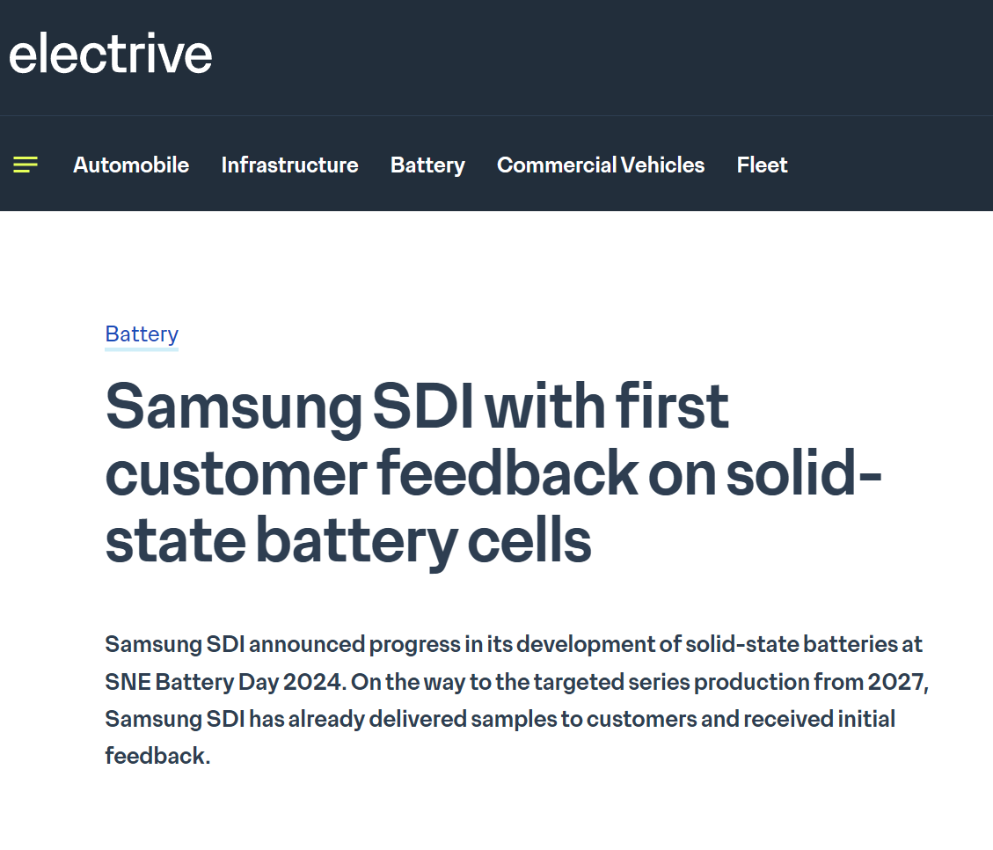
Application: Samsung SDI
NPRE 498: Solid State Storage Batteries

Slide 18
Application: Samsung SDI
Start mass production in 2027
“We have delivered samples to customers from the end of last year (2023) and have received positive feedback”
Aiming to achieve a volumetric density of 900 watt-hours per litre and an energy density that is 40% higher than that of prismatic cells
NPRE 498: Solid State Storage Batteries

Slide 19
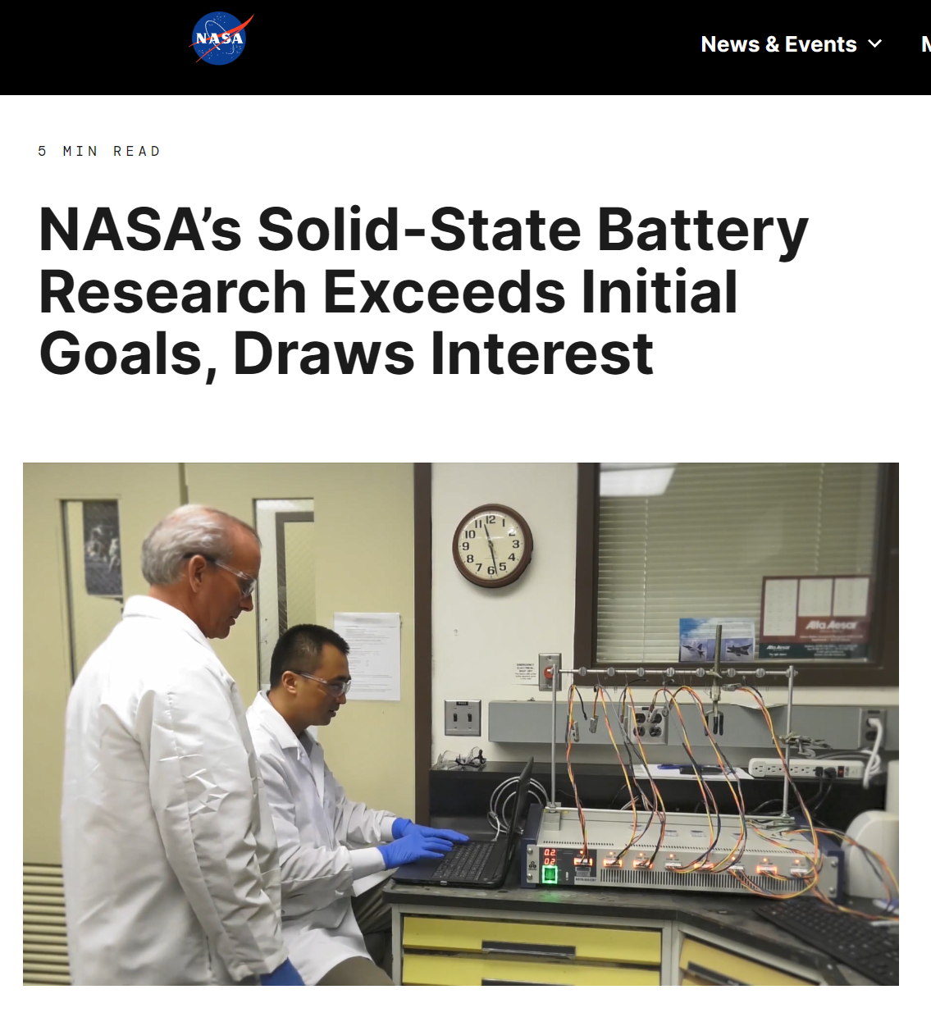
Application: NASA
NPRE 498: Solid State Storage Batteries

Slide 20
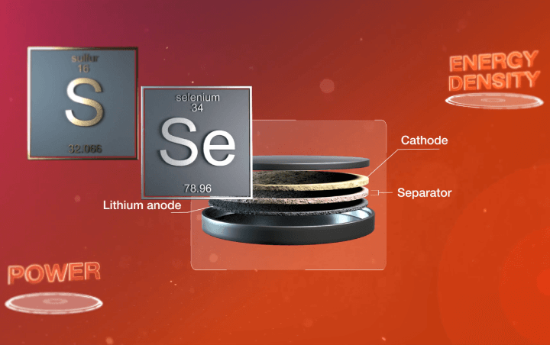
Application: NASA
Use of SSBs for aviation applications such as electric propelled aircrafts and advanced air mobility
SABERS (Solid-state Architecture Batteries for Enhanced Rechargeability and Safety)
  500 watts-hour per kilogram – double that of an electric car
  Operate in temperatures nearly twice as hot as Li-ion batteries
  without as much cooling technology
NPRE 498: Solid State Storage Batteries

Slide 21
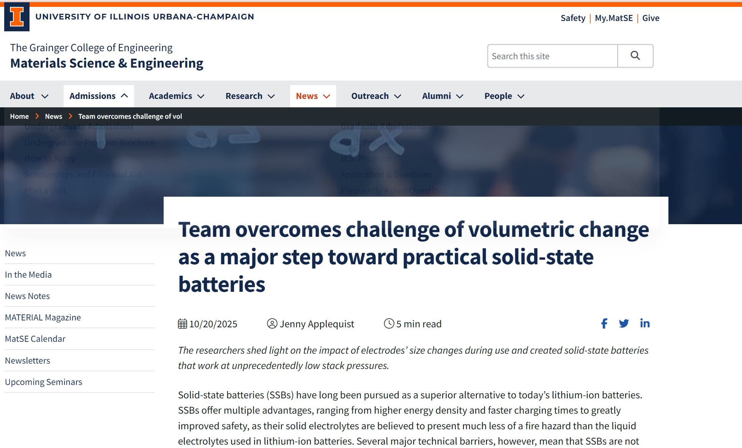
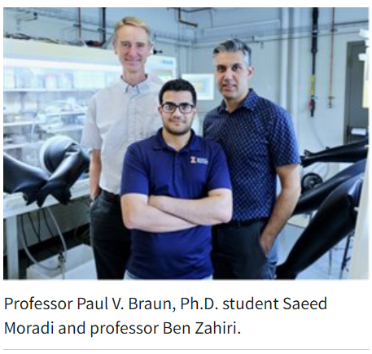
Application: UIUC
NPRE 498: Solid State Storage Batteries
Notes:
https://matse.illinois.edu/news/78312

Slide 22
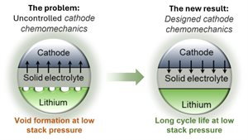
Application: UIUC
Cathode/Anode electrodes are made from solid materials, and their volumes change as lithium is transferred back and forth between charging and discharging cycles, previously not an issue in liquid electrolyte
Previous solution: Applying enormous pressure (80 MPa) to keep everything in contact
  Not practical for real world application (1-2 MPa)
Discovered solution: Chemomechanical nature of component’s expansion and contraction, can be designed such that the changing components operate in concert
  Cathode’s chemomechanics strongly impacts cycling performance of the anode
NPRE 498: Solid State Storage Batteries
Notes:
The cathode and anode electrodes in batteries are made from solid materials, and their volumes change as lithium is transferred back and forth between them during the charge and discharge cycles. In the batteries widely available today, the electrolyte that conducts lithium ions between the two electrodes is a liquid, so the electrodes’ changing sizes generally aren’t a problem. In an SSB, however, the cathode, the anode and the electrolyte are all solids.
chemomechanical nature of components’ expansion and contraction – meaning the ways in which changes in chemistry affect mechanical forces – can be designed such that the changing components operate in concert.

Slide 23
Introduction
Theory
Advantages
Applications
Conclusion/Future Uses
NPRE 498: Solid State Storage Batteries

Slide 24
Conclusion/Future Uses
  Solid-state batteries are the future for the battery industry with their favorable properties and advantages over the traditional Lithium-ion battery
  Development is still ongoing, and full-scale production is not expected till 2027 possibly into the 2030s
  The applications of solid-state batteries ranges from electric vehicles to large-scale energy storage systems (airplanes/spacecrafts)
  There are still many challenges ahead, such as cost and scalability, but the perspectives are positive overall, and many companies are investing into researching the best materials to use
NPRE 498: Solid State Storage Batteries

Slide 25
References
Li, W.; Li, M.; Ren, H.; Kim, J. T.; Li, R.; Sham, T.-K.; Sun, X. Nitride Solid-State Electrolytes for All-Solid-State Lithium Metal Batteries. Energy Environ. Sci. 2025, 18, 4521–4554. https://doi.org/10.1039/D4EE04927F.
U.S. Energy Information Administration. “Today in Energy: After more than a decade of little change, U.S. electricity consumption is rising again.” https://www.eia.gov/todayinenergy/detail.php?id=65264.
University of Illinois Urbana-Champaign, Department of Materials Science and Engineering. “News: Team overcomes challenge of volumetric change as a major step toward practical solid-state batteries.” https://matse.illinois.edu/news/78312.
Toyota Motor Corporation. “Toyota Corporate Newsroom: Idemitsu and Toyota Announce Beginning of Cooperation toward Mass Production of All-Solid-State Batteries for BEVs.” https://global.toyota/en/newsroom/corporate/39865919.html.
QuantumScape Corporation. “QuantumScape Releases Performance Data for Its Solid-State Battery Technology.” Press Release, 2020.
https://ir.quantumscape.com/resources/press-releases/news-details/2020/QuantumScape-Releases-Performance-Data-for-its-Solid-State-Battery-Technology/default.aspx.
Electrive. “Samsung SDI with First Customer Feedback on Solid-State Battery Cells.” Aug 5, 2024.
https://www.electrive.com/2024/08/05/samsung-sdi-with-first-customer-feedback-on-solid-state-battery-cells/.
Ai, S.; Wu, X.; Wang, J.; Li, X.; Hao, X.; Meng, Y. Research Progress on Solid-State Electrolytes in Solid-State Lithium Batteries: Classification, Ionic Conductive Mechanism, Interfacial Challenges. Nanomaterials 2024, 14(22), 1773. https://doi.org/10.3390/nano14221773.
Mbayachi, V. B. Ionic Transport Mechanisms in Inorganic Solid Electrolytes. Mater. Today Proc. 2025.
Bridgelall, R. Scientometric Insights into Rechargeable Solid-State Battery Developments. World Electr. Veh. J. 2024, 15(12), 555. https://doi.org/10.3390/wevj15120555.
Volle, A. Solid-State Battery. Encyclopædia Britannica, March 19, 2025. https://www.britannica.com/technology/solid-state-battery.
NPRE 498: Solid State Storage Batteries

Slide 26
Questions?

