Slide 1
Latest Tesla Battery Design
April 23rd, 2021
Shashank Subramaniam (srs14@Illinois.edu)
Candidate for M.Eng in Energy Systems
Nuclear, Plasma, and Radiological Engineering Department
University of Illinois at Urbana-Champaign

Slide 2
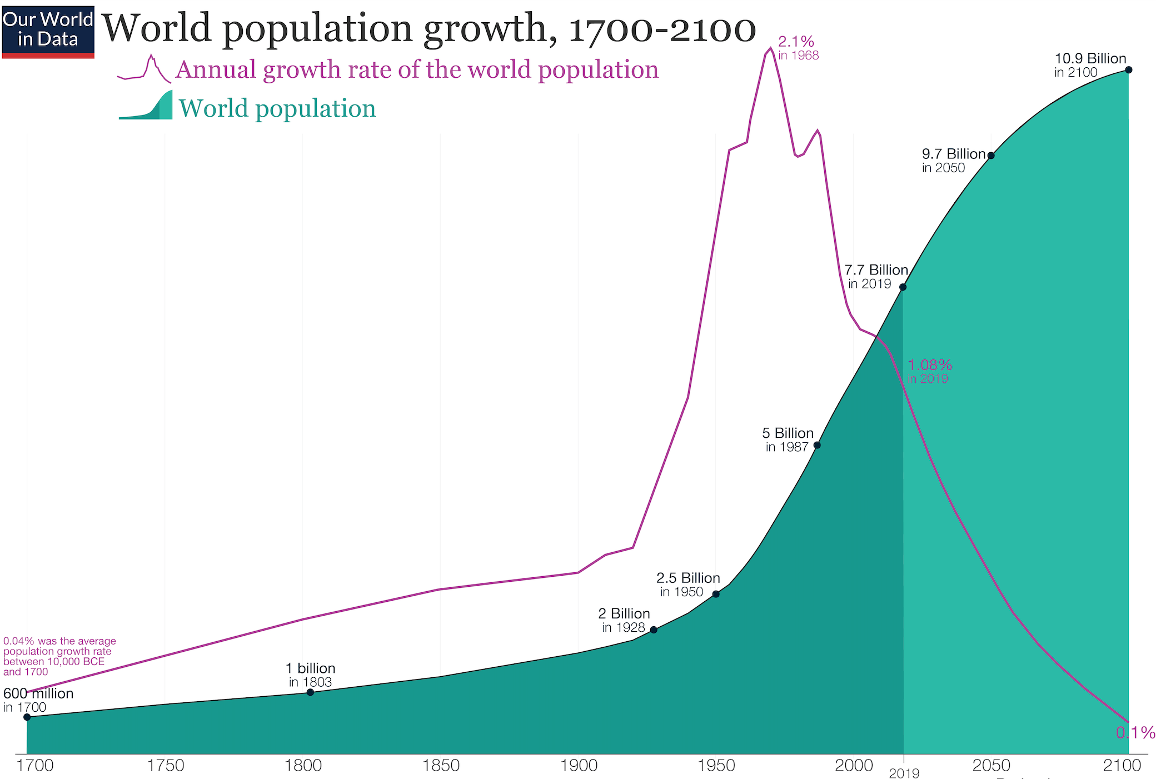
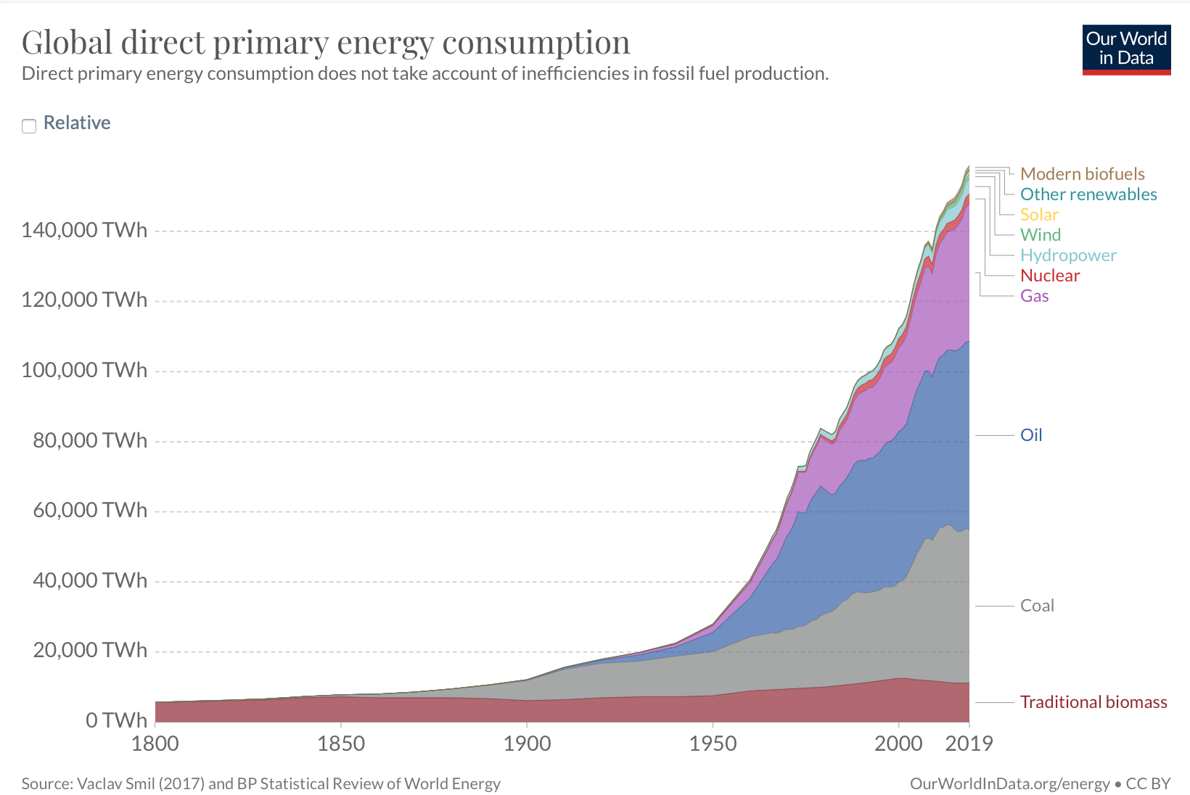
A Growing World Population Requires More and More Energy to Function
https://ourworldindata.org/world-population-growth-past-future
https://ourworldindata.org/grapher/global-primary-energy?time=earliest..latest
Notes:
The world population has grown exponentially since the start of the 20th century. Currently sits around 7.8 billion and is expected to surpass 11 billion by the end of the century.
Historically, as the world population has skyrocketed, so has the world’s energy use.
In order to meet the rising demand for energy, we’ve historically turned to fossil fuels such as coal, oil, and more recently, natural gas.
This is a problem, because combusting fossil fuels releases Carbon Dioxide into the atmosphere.

Slide 3
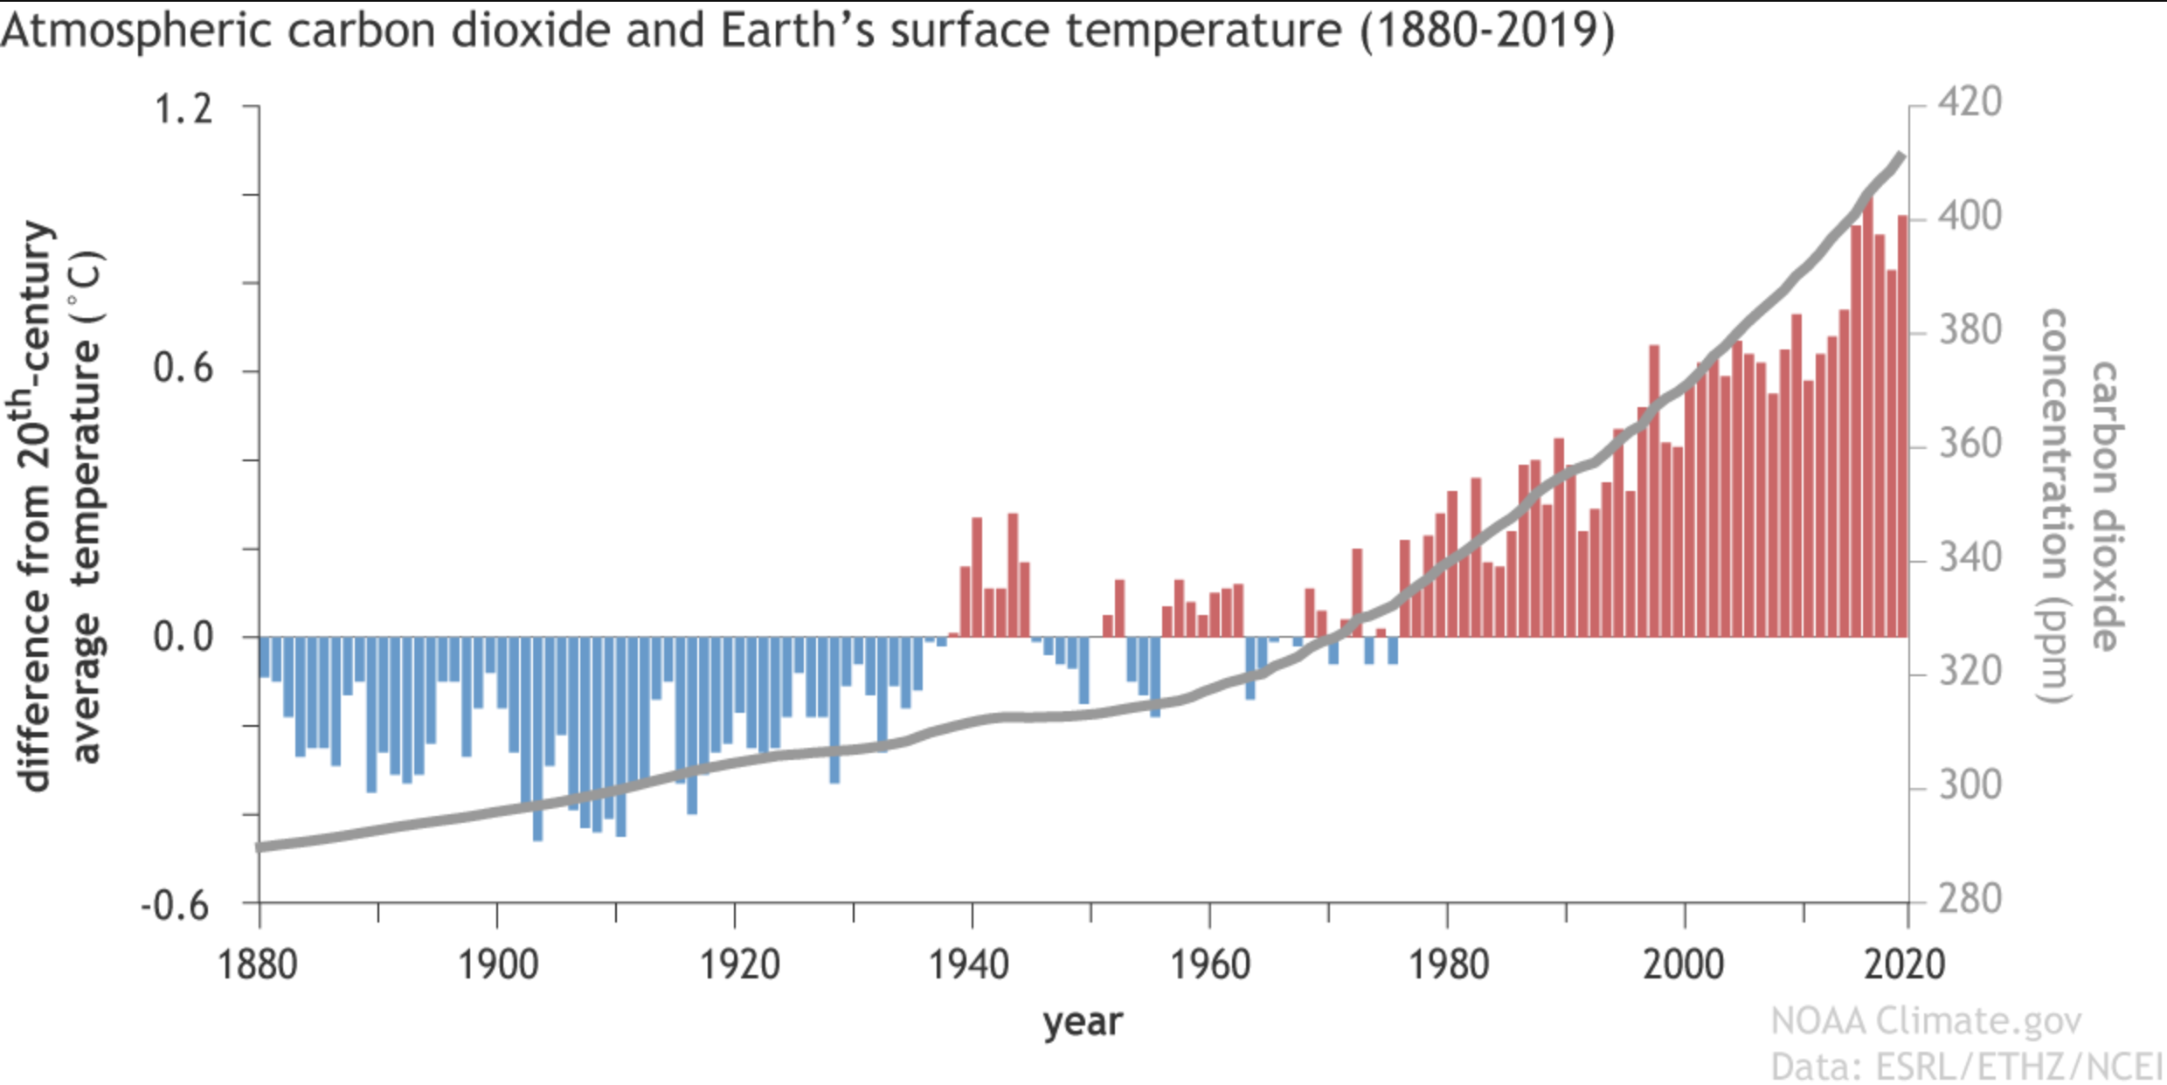
Reliance on Non-Renewable Energy Has Led to Drastic Climate Change
Consequences:
  Increasing Frequency of Severe Storms (Hurricanes, Tornadoes)
  Hotter Summers + Colder Winters
  Melting Ice Caps/Rising Sea Levels
https://www.climate.gov/news-features/climate-qa/if-carbon-dioxide-hits-new-high-every-year-why-isn%E2%80%99t-every-year-hotter-last
Notes:
The result has been historical highs in average global temperatures
Data published by the National Oceanic & Atmospheric Administration shows a correlation between CO2 emissions and rising global average temperatures
Drastically shifting weather patterns: Severe storms (hurricanes/tornadoes), droughts, melting ice caps/rising sea levels, and hotter, drier summers combined with increasingly colder winters
The question is, what an we do to slow down climate change? Answer: Reduce Emissions.

Slide 4
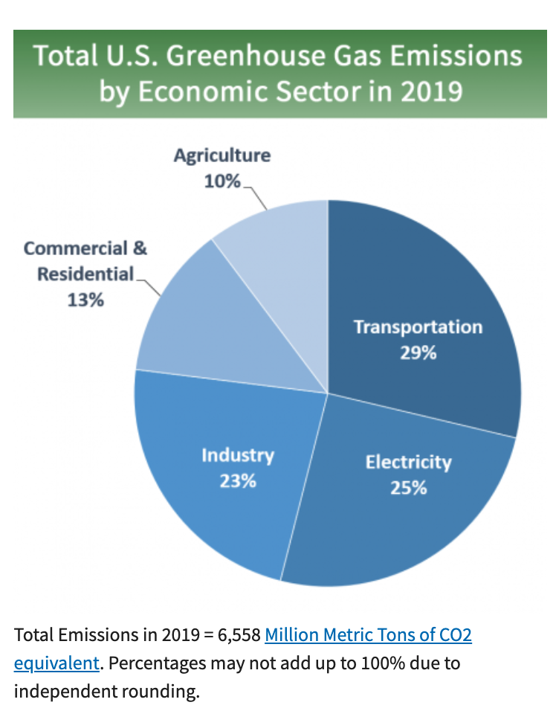
Motivation for Electric Vehicles
https://www.epa.gov/ghgemissions/sources-greenhouse-gas-emissions#:~:text=In%202019%2C%20greenhouse%20gas%20emissions,of%20U.S.%20greenhouse%20gas%20emissions.
Notes:
This plot is published by the EPA for the year 2019
Provides a breakdown of emissions by economic sector
29% comes from transportation – This is specifically on-road, propulsion-related emissions; not full life cycle (raw materials extraction/refinement and vehicle construction)
Takeaway: we can significantly reduce transportation carbon emissions by creating zero-carbon propulsion systems for electric vehicles.

Slide 5
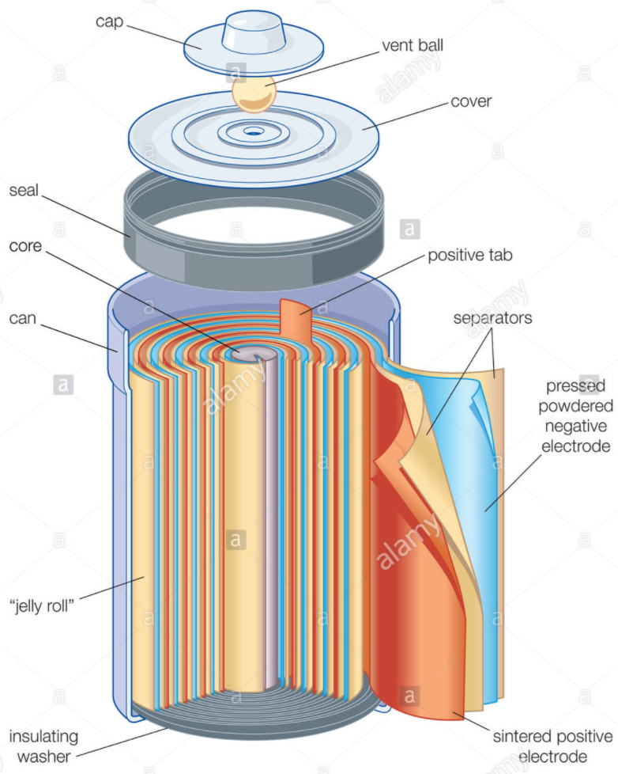
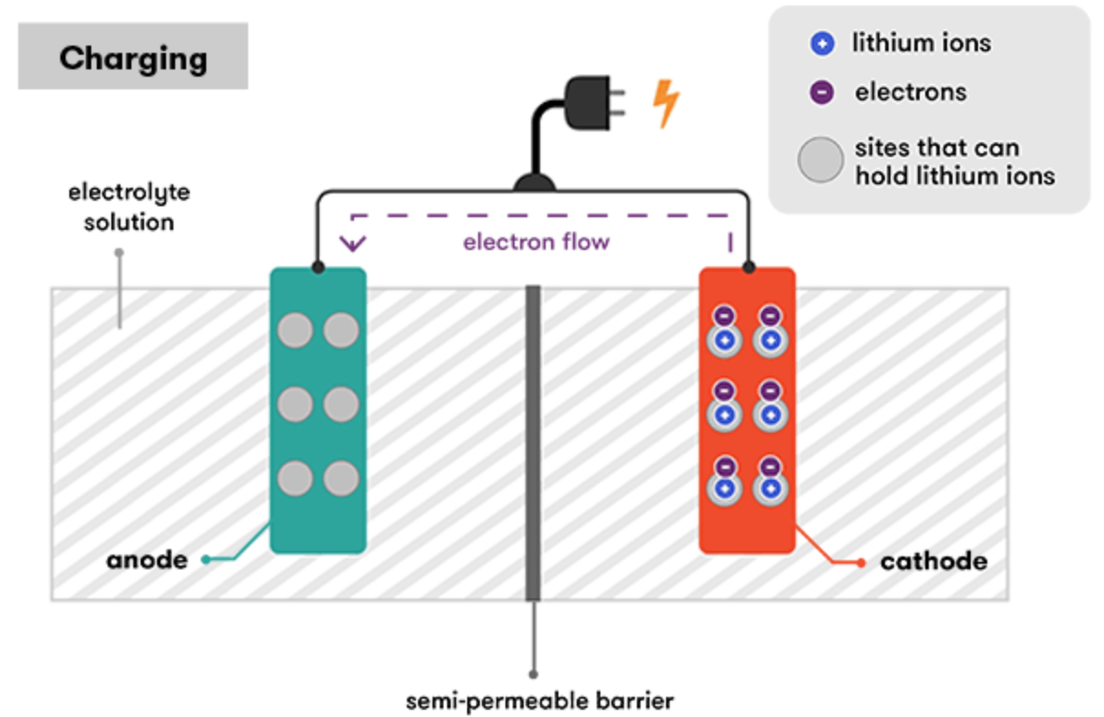
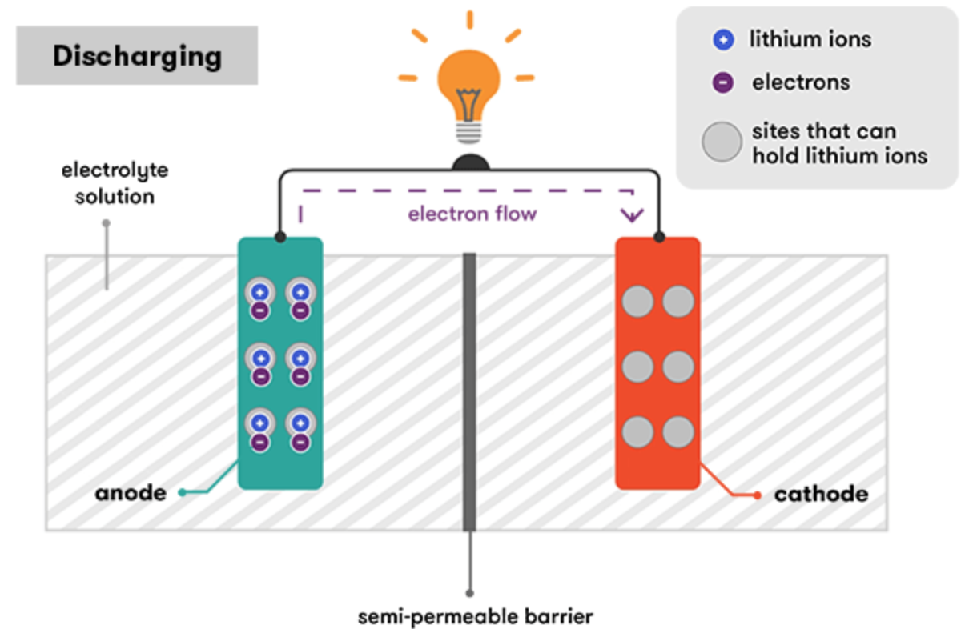

How Do Batteries Work?
https://www.science.org.au/curious/technology-future/lithium-ion-batteries

Slide 6
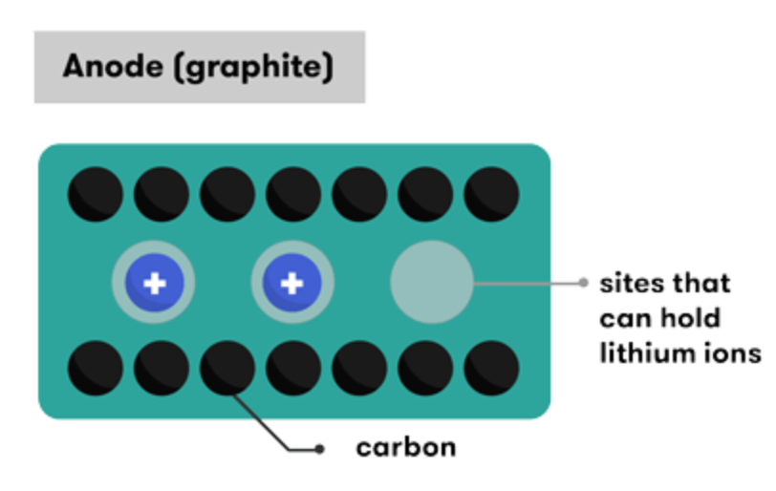



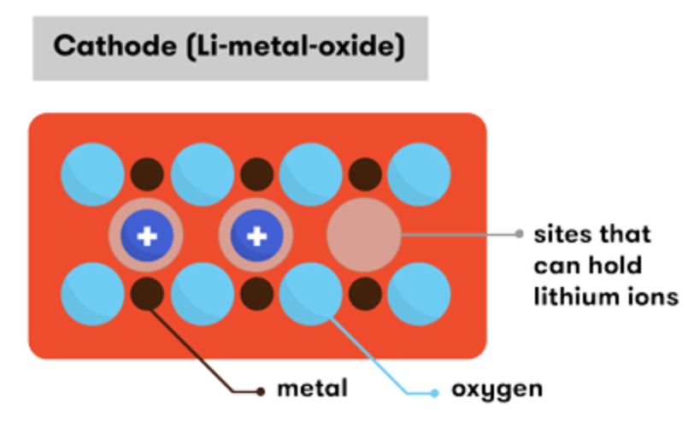
Electrode Half Reactions
Common Type of Li Battery: Lithium Cobalt (LiCoO₂)
Anode:
Cathode:
Overall:
https://www.science.org.au/curious/technology-future/lithium-ion-batteries

Slide 7
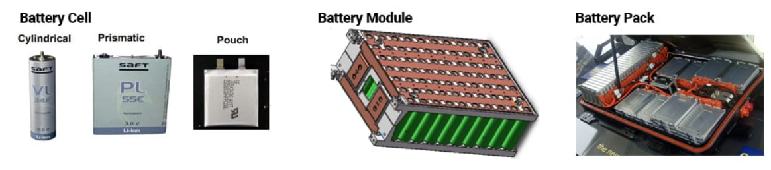
Uses for Lithium ion Batteries:
Electronics
Backup Energy Storage – to supplement solar/wind/geothermal systems
Automobiles
Benefits:
Portable Design
Scalable Sizes and form factors
Rechargeability
Higher energy/power density than other types (such as lead acid)
Notes:
Batteries are valuable because they are a portable means of energy storage.
Wide variety of applications in electronics (phones, laptops, etc…), stand-alone, on-site storage systems to supplement utility-scale energy technologies, and of course in electric vehicles.
Design is portable and modular
Variety of form factors
Scalable – cylinder -> battery module -> battery pack

Slide 8
Desired Characteristics of EV Batteries
Rechargability
High Power- and Energy-Density
Low Weight
Long Lifetime of Use
  Minimum 10 years (~150,000 miles or ~5,000 charge cycles)

Slide 9
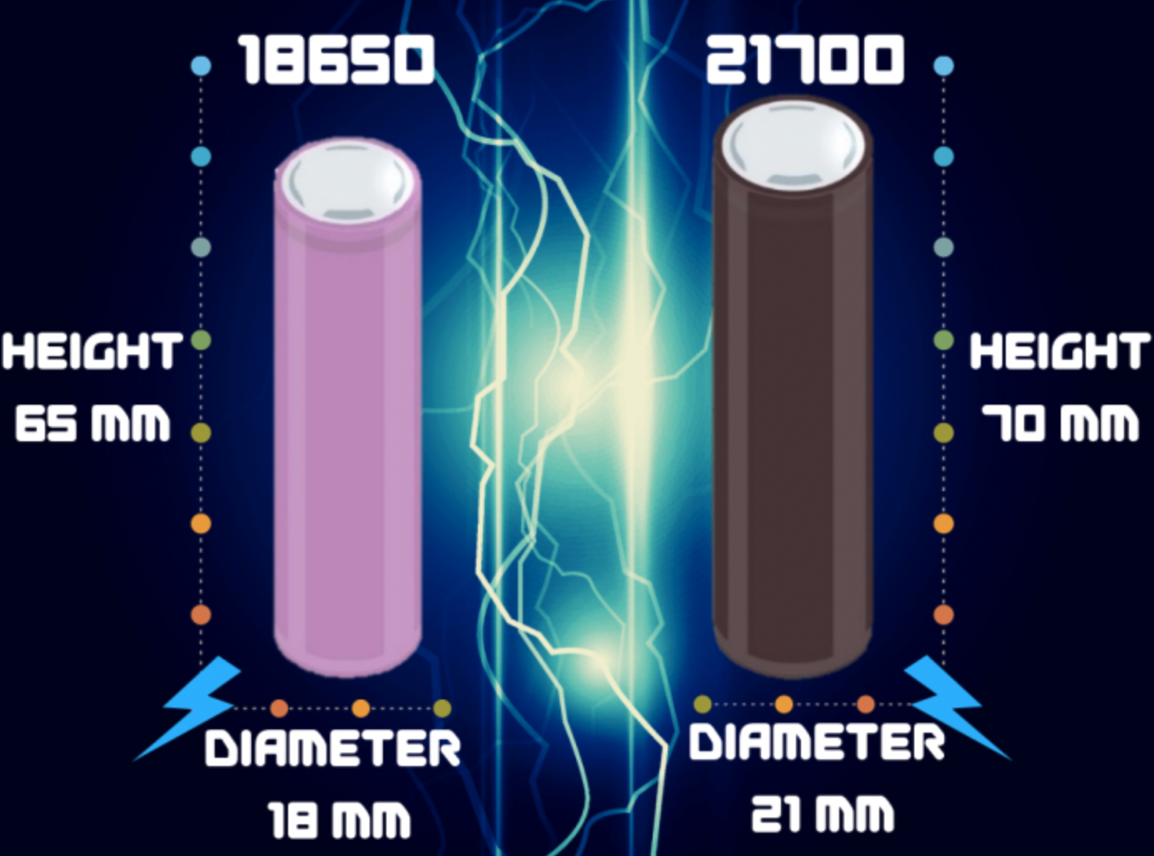
Tesla Battery Design
 | Diameter (mm) | Height (mm) | Volume (cm³ or mL) | Mass (g) | Voltage (V) | Charge Capacity (mAh) | Energy Capacity (Wh, Voltage x Charge Capacity) | Energy Density (Wh/L) | % Increase in Energy Density | Specific Energy (Wh/kg) | % Increase in Specific Energy
Previous: 18650 Cylinder | 18 | 65 | 16.45 | 45 | 3.7 | 3,400 | 12.58 | 765 | --- | 280 | ---
Current: 21700 Cylinder | 21 | 70 | 24.245 | 66 | 3.7 | 5,750 | 21.275 | 877.5 | 14.7% | 322 | 15%
https://www.sciencedirect.com/science/article/pii/S0378775320309186

Slide 10
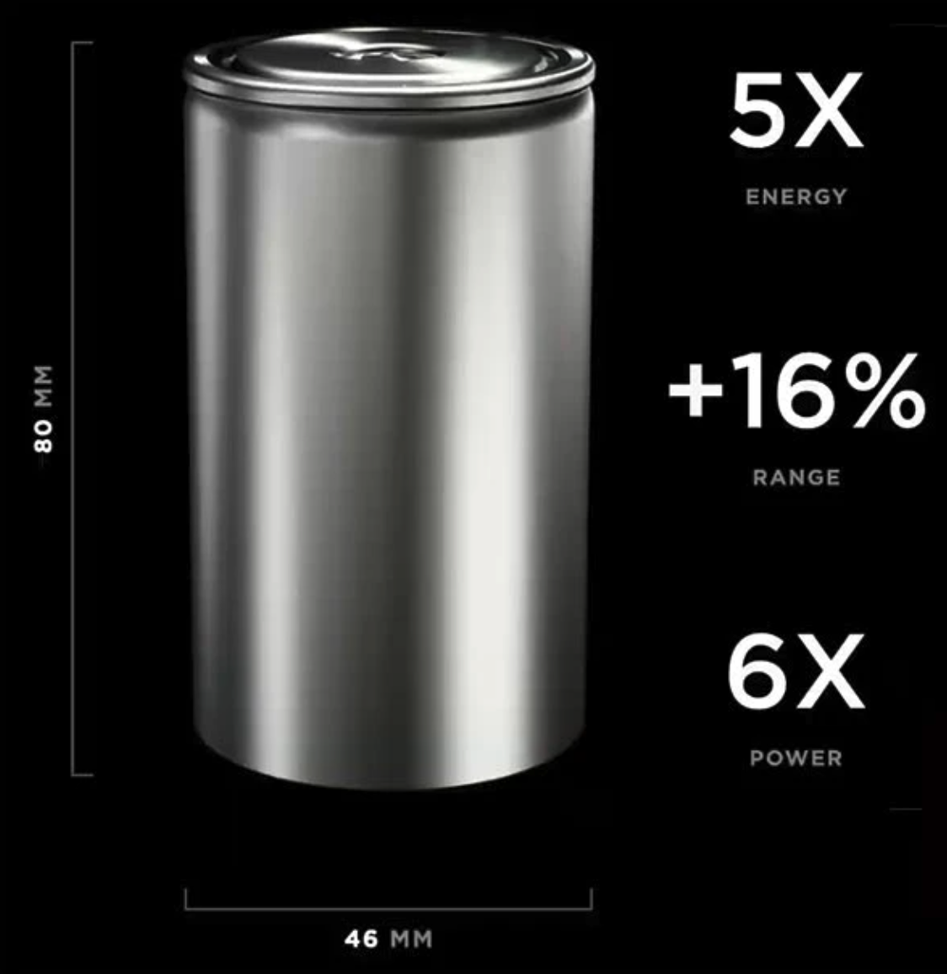
Future Tesla Battery Design: 4680 Cylinder
Estimated vehicle range: 520 miles for a full pack of 960 ‘4680’ cells
(Vs. ~400 miles for current Model S)
https://www.futurecar.com/4282/A-Closer-Look-at-Teslas-New-4680-Cell-Battery-Pack#:~:text=The%204680%20batteries%20are%20expected,longer%20features%20any%20individual%20modules.

Slide 11
Energy Capacity Comparison:
2170 vs. 4680
Cell Model | Charge Capacity (mAh) | Voltage (V) | Energy Capacity Per Cell (Wh) | Number of Cells per Pack | Total Energy Capacity per Vehicle (kWh) | % Increase in Energy Capacity
2170 | 5,000 | 3.7 | 21.275 | 4,416 (Model 3/Y) | 93.95 | ---
4680 | Est. ~30,000 | 3.7 | 111 | 960 | 106.56 | 13.4%

Slide 12
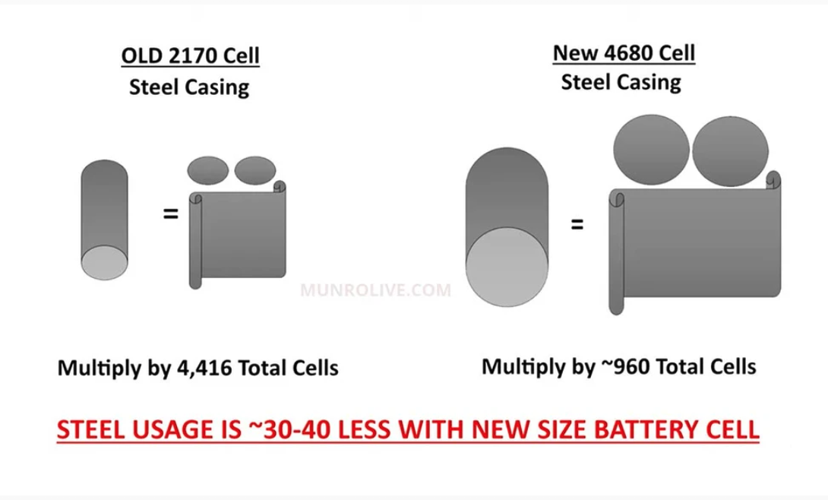
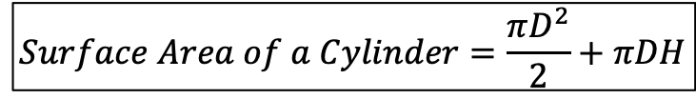
Larger Battery = Less Steel
Benefits:
Cheaper manufacturing
  Reduced steel usage for individual cells
    (Analogy: 2 Pop Tarts are cheaper to package than just one)
$$Surface Area of a Cylinder=\frac{πD^{2}}{2}+πDH$$
Model | Height (mm) | Diameter (mm) | # Cells per Battery Pack | Total Area of Steel Battery Casing per vehicle (m³) | % Reduction
2170 | 70 | 21 | 4,416 | .02345 | ---
4680 | 80 | 46 | 960 | .01429 | 39.07%
Notes:
Fewer component-to-component interfaces = fewer opportunities for failure (i.e. loss of contact, overheating, etc…)
This mitigates issues with poor contact or corroding in cell-to-module or module-to-module contacts

Slide 13
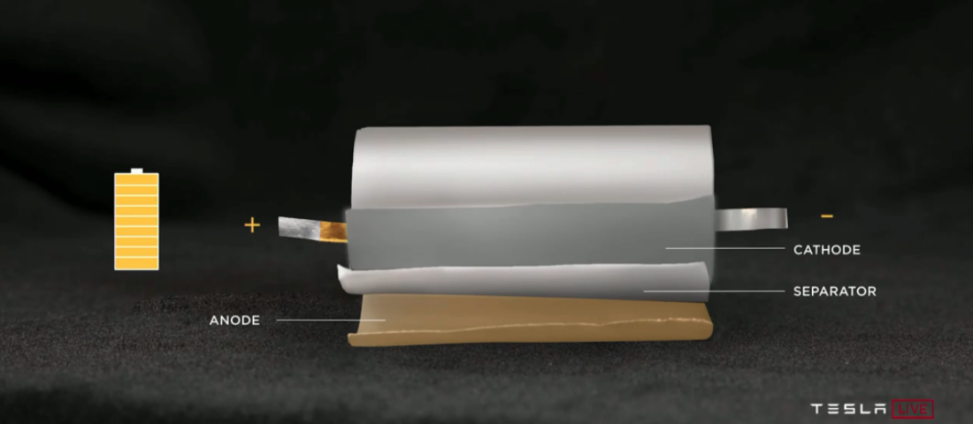
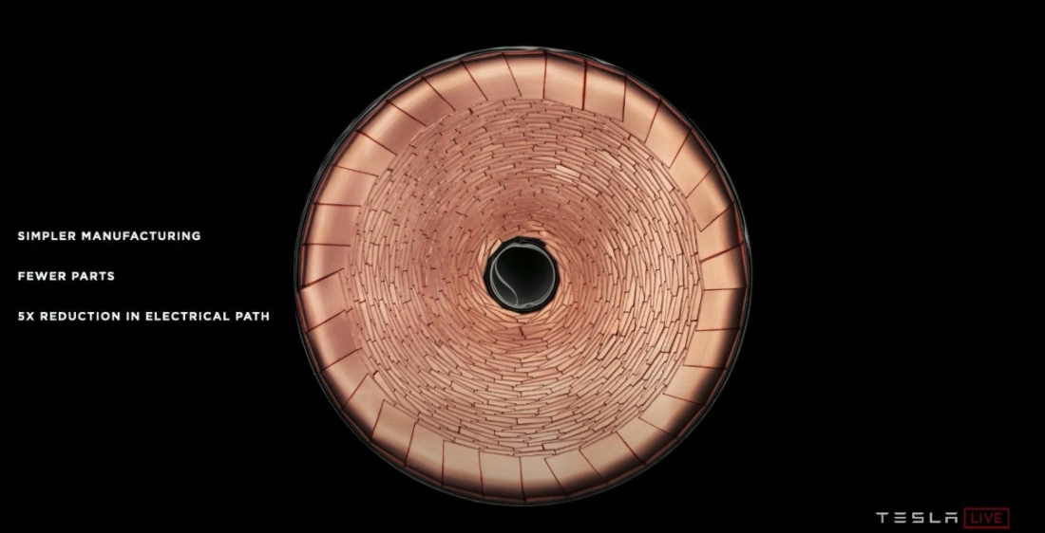
New Cell Design for Simpler Manufacturing
Fewer component-to-component interfaces = fewer opportunities for failure (i.e. loss of contact, overheating, etc…)
Traditional Battery
Tabless 4680 Battery!
Tabs are fast to corrode
Prone to overheating
Presents an entry point for oxygen if contact is severed (fire hazard)
Easy Welding for better electrical contact
Tighter seal against air entry
Better thermal management
https://techcrunch.com/2020/09/22/tesla-introduces-its-tabless-battery-design-on-the-road-to-10-terawatt-hours-of-production/?guccounter=1
Notes:
Tesla took foils and laser patterned them, enabling dozens of connections into the active material through a shingled spiral.
The allows for fewer parts, a shorter electrical path for ion diffusion, and overall, simpler manufacturing.

Slide 14
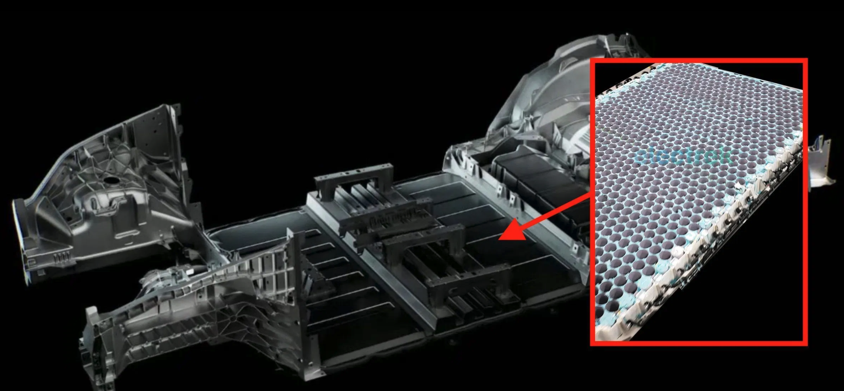
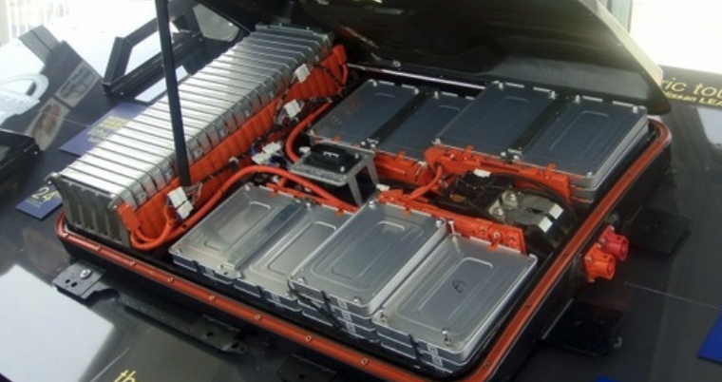
One Single Battery Pack
Benefits:
  Fewer parts (no need for module casings any more)
Fewer component-to-component interfaces = fewer opportunities for failure (i.e. loss of contact, overheating, etc…)
https://electrek.co/2021/01/19/tesla-structural-battery-pack-first-picture/
Notes:
Fewer component-to-component interfaces = fewer opportunities for failure (i.e. loss of contact, overheating, etc…)
This mitigates issues with poor contact or corroding in cell-to-module or module-to-module contacts

Slide 15
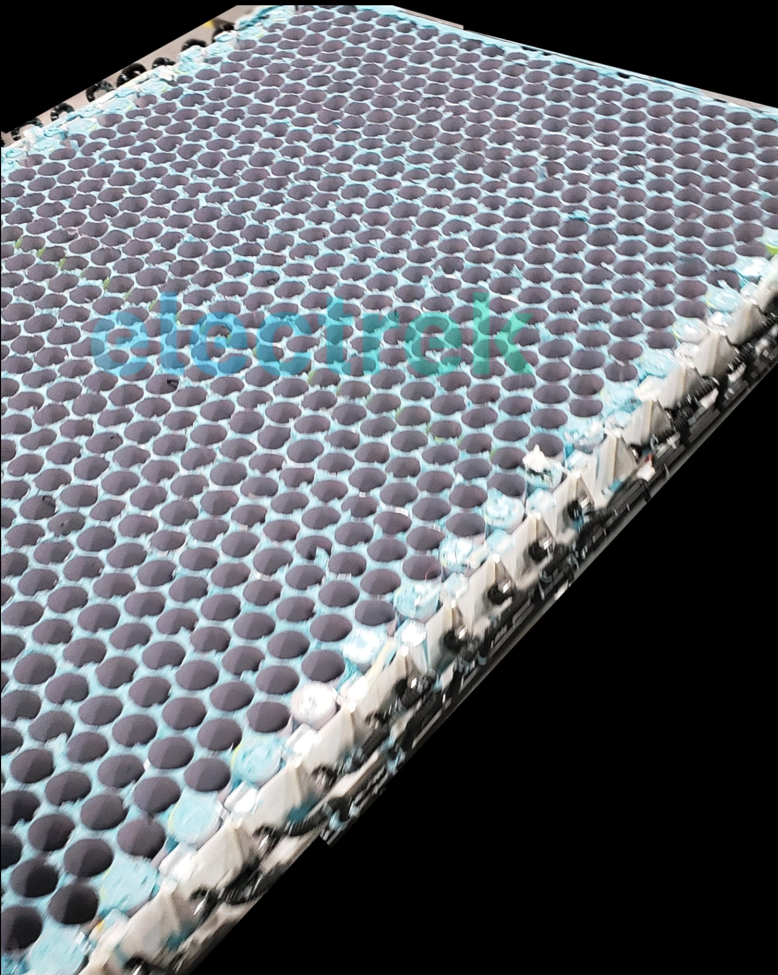
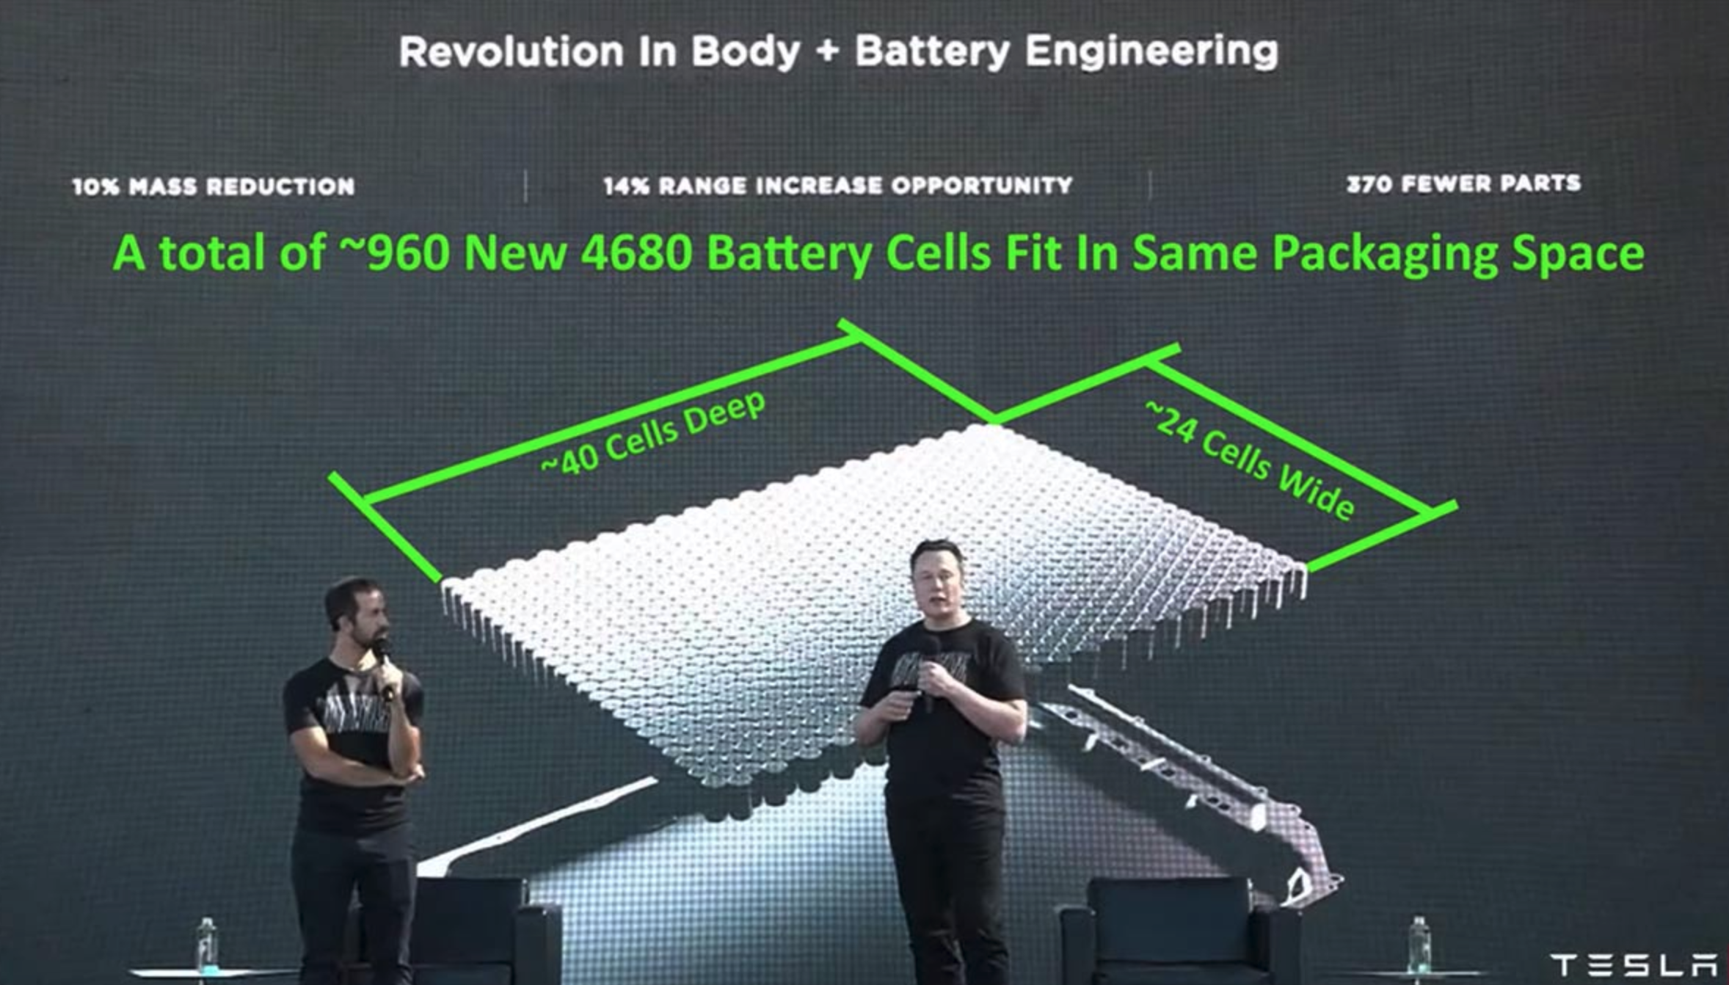
New Battery Pack Architecture
https://electrek.co/2021/01/19/tesla-structural-battery-pack-first-picture/

Slide 16
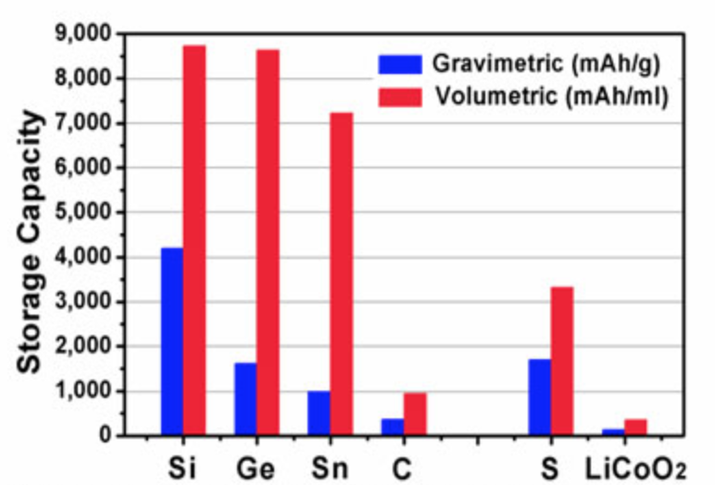
Future Expectations
Revamped Cathode Design (Cost Reduction)
  Nickel-Cobalt-Aluminum (NCA, LiNiCoAlO₂): 15% Co, 5% Al, 80% Ni
  Cobalt: $45,000/ton, 7.1 million tons known reserves
  Nickel: $30,000/ton, 300 million tons known reserves
Revamped Anode Design (Performance Improvement)
  Traditional: LiC₆ (~370 mAh/g)
  Future(?): Li₂₂S₅ (~4,200 mAh/g)
    Li₂₂S₅: Undesired Volume Expansion + Faster Degradation
https://gcep.stanford.edu/research/factsheets/liionbattery_selfhealingpolymers.html

Slide 17
References
https://ourworldindata.org/world-population-growth-past-future
https://ourworldindata.org/grapher/global-primary-energy?time=earliest..latest
https://www.climate.gov/news-features/climate-qa/if-carbon-dioxide-hits-new-high-every-year-why-isn%E2%80%99t-every-year-hotter-last
https://www.epa.gov/ghgemissions/sources-greenhouse-gas-emissions#:~:text=In%202019%2C%20greenhouse%20gas%20emissions,of%20U.S.%20greenhouse%20gas%20emissions.
https://www.science.org.au/curious/technology-future/lithium-ion-batteries
https://www.sciencedirect.com/science/article/pii/S0378775320309186
https://www.futurecar.com/4282/A-Closer-Look-at-Teslas-New-4680-Cell-Battery-Pack#:~:text=The%204680%20batteries%20are%20expected,longer%20features%20any%20individual%20modules.
https://techcrunch.com/2020/09/22/tesla-introduces-its-tabless-battery-design-on-the-road-to-10-terawatt-hours-of-production/?guccounter=1
https://electrek.co/2021/01/19/tesla-structural-battery-pack-first-picture/
https://gcep.stanford.edu/research/factsheets/liionbattery_selfhealingpolymers.html

Slide 18
Questions?

