Slide 1



Methane and Hydrogen
Storage for Clean Energy Integration
Fall 2024
NPRE 498 Energy Storage Systems
Sristi Shreya

Slide 2
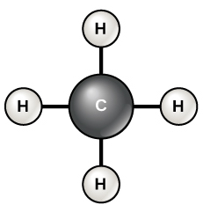

Methane and hydrogen are critical energy carriers for supporting clean energy adoption.
Why storage matters?
Enables renewable energy integration, stabilizes the grid, and supports clean fuel adoption.
Hydrogen
Methane
Energy density of 55.5 MJ/kg; supports electricity generation, heating, and industry.
GWP 25x higher than CO₂, requiring strict emission control.
Energy density of 120 MJ/kg; ideal for zero-emission fuel cells and grid storage.
Produces only water vapor when burned, ensuring zero carbon emissions.
Energy Potential
Environmental Impact

Slide 3




Types of Storage Technologies
Geological Storage
Compressed Gas Storage
Liquefied Gas Storage
Materials-Based Storage
Hydrogen stored at 350–700 bar; methane at ~250 bar.
Requires specialized tanks resistant to corrosion and high pressure.
Hydrogen liquefied at -253°C; methane at -162°C.
Reduces gas volume but requires cryogenic cooling systems.
MOFs: Porous materials capable of gas adsorption through physisorption.
Carbon Nanotubes: Stabilize hydrogen-methane mixtures.
Depleted gas reservoirs, salt caverns, and aquifers offer large-scale storage.

Slide 4
Technological Advancements in Gas Storage
01
02
03
MOF Enhancements
Nanomaterials Research
Hybrid Storage Systems
Development of next-generation MOFs with increased storage efficiency.
Carbon nanotubes and graphene oxide show improved gas adsorption properties.
Combining materials enables gas storage under moderate pressure and temperature conditions.
Advancements

Slide 5
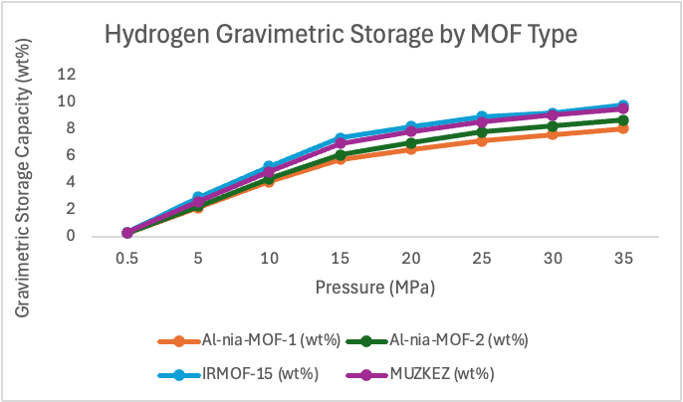
What Are MOFs?
Metal-organic frameworks (MOFs) are porous materials with large internal surface areas.
Hydrogen Storage Capacity:
Al-nia MOF-2: Up to 3.09 wt% hydrogen at
25 MPa.
MOFs offer tunable chemistry to optimize
gas adsorption.
Applications:
Hydrogen fuel cells for EVs.
Industrial hydrogen storage for energy grids
and power plants.
[4]Fig.: Hydrogen gravimetric storage capacities (wt%) of various MOFs under different pressures, showing how MOF advancements improve gas adsorption performance.

Slide 6
Methane Storage Potential
Methane as an Energy Carrier:
Widely used due to its compatibility with existing gas infrastructure.
Storage Efficiency:
Al-nia MOF-2 achieves 0.016 kg/L methane storage at 25 MPa.
Improvements in material design could further enhance methane storage.
Real-World Use Cases:
Natural gas storage and distribution.
Methane-powered fuel cells and industrial processes.
[4]Fig.: Methane storage performance (gravimetric and volumetric) at increasing pressures, highlighting efficiency gains with advanced MOFs.

Slide 7



Mixed-Gas Storage (H₂ + CH₄)
Why Combine Hydrogen and Methane?
Reduces gas separation costs and simplifies storage.
Allows hydrogen-methane blends to be transported via natural gas pipelines.
Storage Capacity
Graphene-based MOFs store up to 14.0 wt% in mixed H₂-CH₄ gas storage.
Hydrogen stabilizes methane, reducing storage pressure.
Infrastructure Compatibility
Existing natural gas pipelines and terminals can store and transport blended gases.

Slide 8
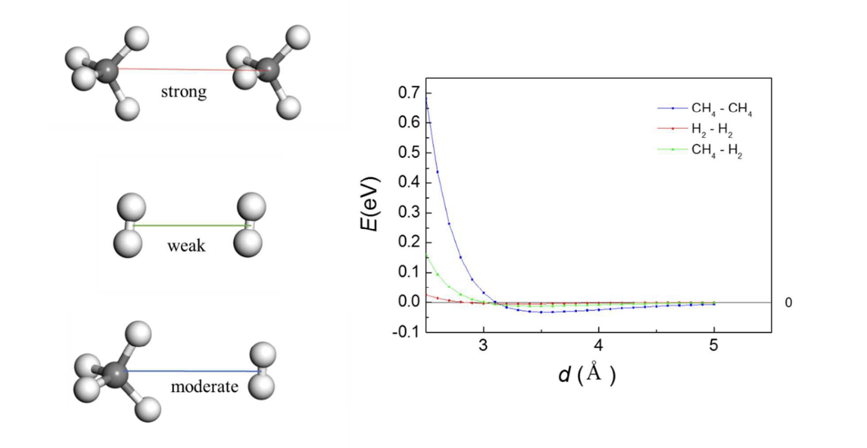
[5]Fig.: The interaction energy graph highlights the stability of CH₄-H₂ bonds compared to CH₄-CH₄ and
H₂-H₂, explaining why mixed-gas storage outperforms single-gas systems.

Slide 9

Environmental Impact Analysis
Methane Emissions:
Methane has a GWP 25x higher than CO₂.
Significant leaks occur during methane production, transport, and storage.
Hydrogen’s Environmental Impact:
Hydrogen emits no CO₂ when used in fuel cells.
Electrolysis-powered hydrogen has minimal environmental impact.
Challenges in Hydrogen Production:
Steam Methane Reforming (SMR) without CCS produces 10–12 kg of CO₂ per kg of hydrogen.
Hydrogen leakage must be minimized to avoid indirect warming effects.

Slide 10
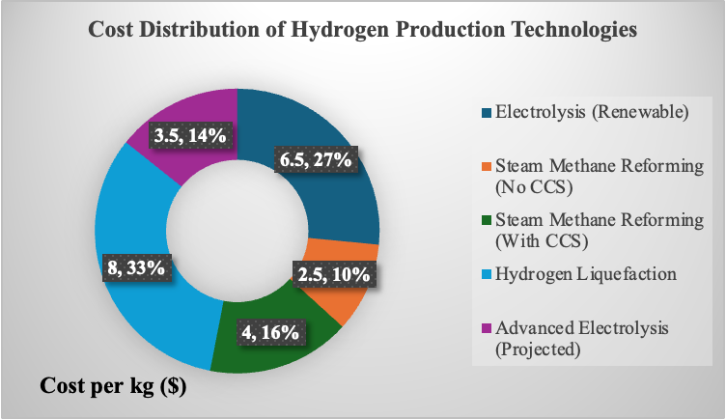
Hydrogen Production and Storage Costs
Production Costs:
Green Hydrogen: $3–$8 per kg (electrolysis).
Steam Methane Reforming (SMR): $2.5–$4.5 per kg
(with carbon capture and storage, CCS).
Storage Costs:
Compressed Gas Tanks: $300–$600 per kg of hydrogen stored.
Liquefaction: $1,000–$2,000 per ton due to cryogenic cooling requirements.
Cost Reduction Potential:
MOF-based systems reduce storage costs by enabling gas storage at lower pressures.
Expanding CCS technology will also lower emissions and reduce total costs.
[1]Fig.: Hydrogen production costs by method, showing the economic feasibility of processes like SMR, electrolysis, and liquefaction.

Slide 11
Economic Feasibility of Hydrogen and Methane Storage
Production Cost Trends:
  Green hydrogen production costs are declining due to technological advancements.
  Methane storage costs remain competitive due to established infrastructure.
Market Investments:
  Global investments in hydrogen infrastructure are rising rapidly.
  Government subsidies and industry collaborations are accelerating progress.
Scaling Challenges:
  High capital costs for building hydrogen storage infrastructure.
  Standardization and international cooperation remain essential.

Slide 12




Conclusions
Key Insights
Technological Advancements
Graphene-based MOFs enable mixed gas storage.
Al-nia MOF-1 and MOF-2 outperform traditional MOFs.
Hydrogen and methane are critical for clean energy.
MOFs enhance storage efficiency and sustainability.
Environmental Benefits
Economic and Considerations
Hydrogen produces zero carbon emissions.
Methane storage reduces global warming impacts.
Clean energy infrastructure investment is essential.
Industry-government collaboration drives progress.

Slide 13
References
[1]Buscheck, T. A., Goodman, A., Lackey, G., Camargo, J. D. T., Huerta, N., Haeri, F., Freeman, G. M., & White, J. A. (2024). Underground storage of hydrogen and hydrogen/methane mixtures in porous reservoirs: Influence of reservoir factors and engineering choices on deliverability and storage operations. International Journal of Hydrogen Energy, 49(2024), 1088–1107.
[2]Li, Q., & Thonhauser, T. (2012). A theoretical study of the hydrogen-storage potential of (H₂)₄CH₄ in metal-organic framework materials and carbon nanotubes. Journal of Physics: Condensed Matter.
[3]Harrison, D., Welchman, E., & Thonhauser, T. (2018). H4-Alkanes: A new class of hydrogen storage material? Journal of Materials Chemistry A.
[4]Granja-DelRío, A., & Cabria, I. (2024). Grand Canonical Monte Carlo simulations of hydrogen and methane storage capacities of two novel Al-nia MOFs at room temperature. International Journal of Hydrogen Energy.
[5]Xue, Q., Wu, M., Zeng, X. C., & Jena, P. (2018). Co-mixing hydrogen and methane may double the energy storage capacity. Journal of Materials Chemistry A.

Slide 14
Thank you
Questions?☺

