Slide 1
Hydrogen Fuel-based transportation System
Narasimha Rao Talluri
NPRE 498 (Energy Storage systems)
UIN:658106196
Date: Dec-06-2023

Slide 2
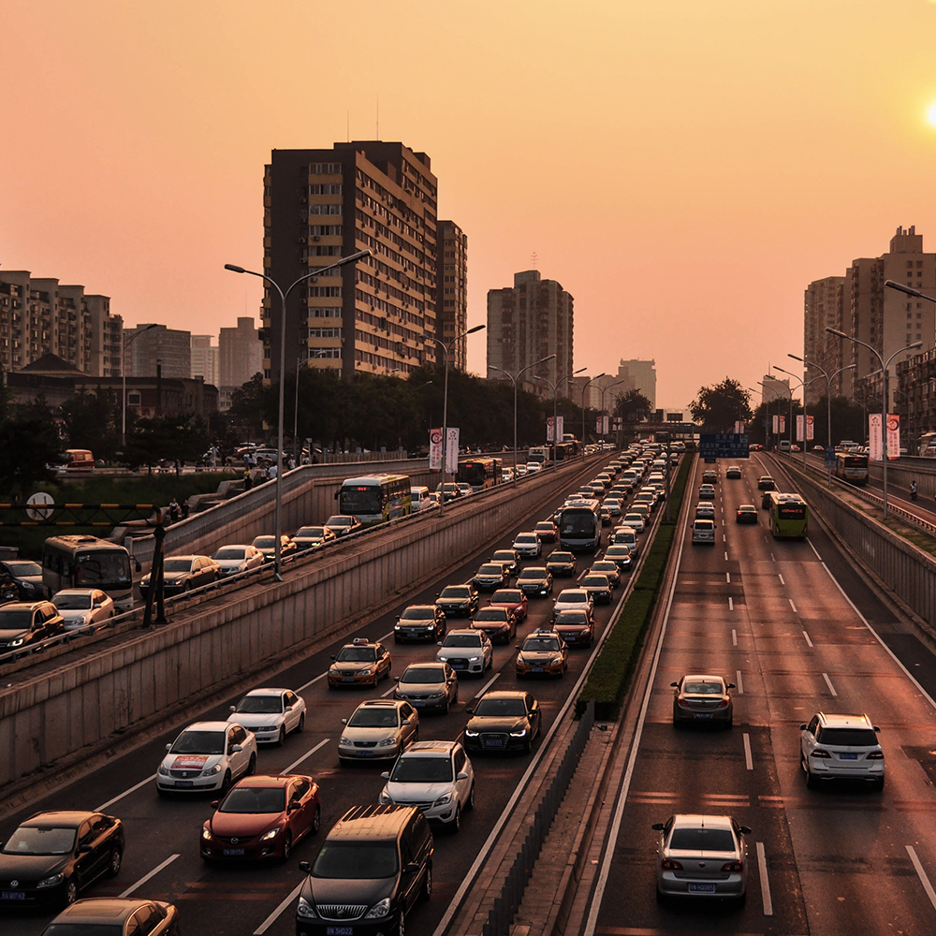
Agenda
Importance of sustainability
Types of hydrogen
Hydrogen Production
Fuel cell and internal combustion engine
Comparison to Chicago Transit Fleet

Slide 3

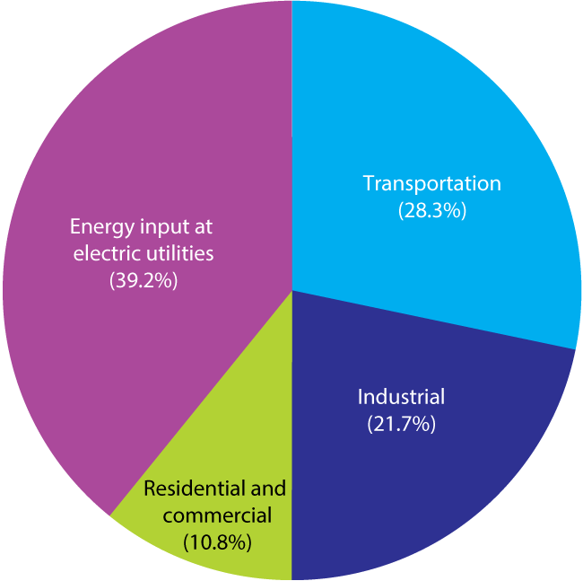
Introduction
To mitigate climate change we need more clean sources of energy,
IPCC sets a goal to limit our atmospheric temperature rise by 1.5°C by 2050.
Transportation is one of the major sector which contributes to global warming, it encounters for 28% energy consumption.
We need more cleaner fuels for transportation, especially for larger cities which uses mor public transport.

Slide 4
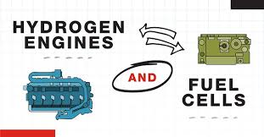
Methods to use hydrogen as a fuel for transportation
We have mainly two methods available in today’s market
1) Use H2 for internal combustion engine
2) Use H2 powered fuel cell to drive vehicles.
Use Hydrogen

Slide 5
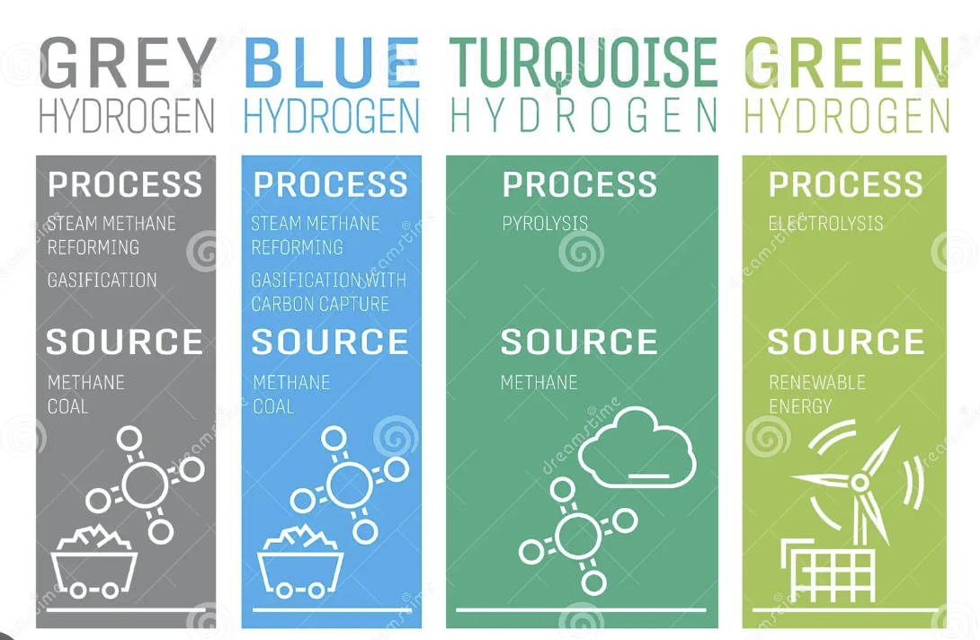
Types of Hydrogen

Slide 6
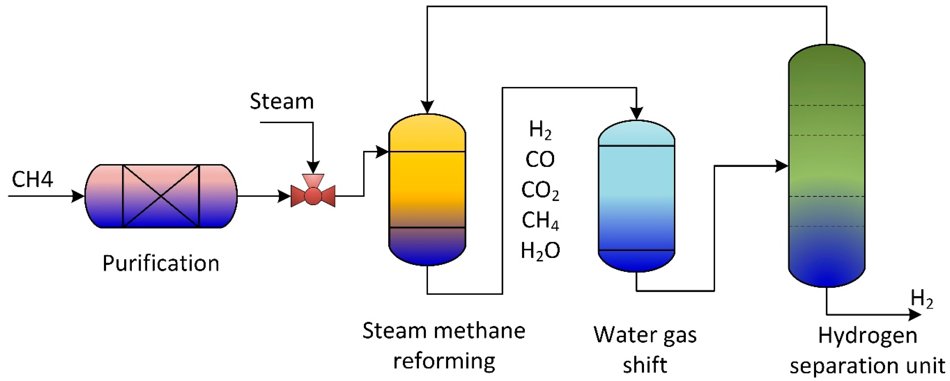
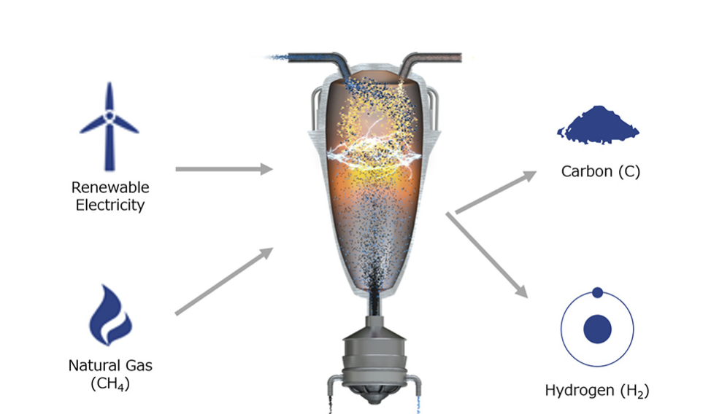
Types
Blue Hydrogen
Turquoise Hydrogen
Uses methane as a source to produce H2 by using SMR and Water gas shift reactions along with a carbon capture and sequestration method
Uses pyrolysis to heat methane in the absence of oxygen to produce hydrogen and carbon black.
6

Slide 7
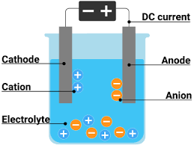
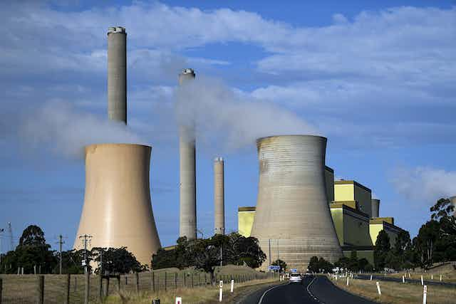
Grey Hydrogen
Green Hydrogen
This method uses electricity or heat produced from conventional energy sources to produce Hydrogen
Uses Renewables energy as a source to split the water molecule to hydrogen and oxygen

Slide 8
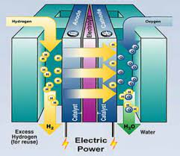
Hydrogen Fuel cell
Fuel inlet is Hydrogen as a gas
Platinum coated with carbon as cathode and Anode
Polymer electrolyte as membrane
Cell potential is 1.23V
Outlet or byproduct is just water
H2→2H+ + 2e−
2H+ + 2e− + 1/2O2→H2O
H2 + 1/2O2 H2O

Slide 9
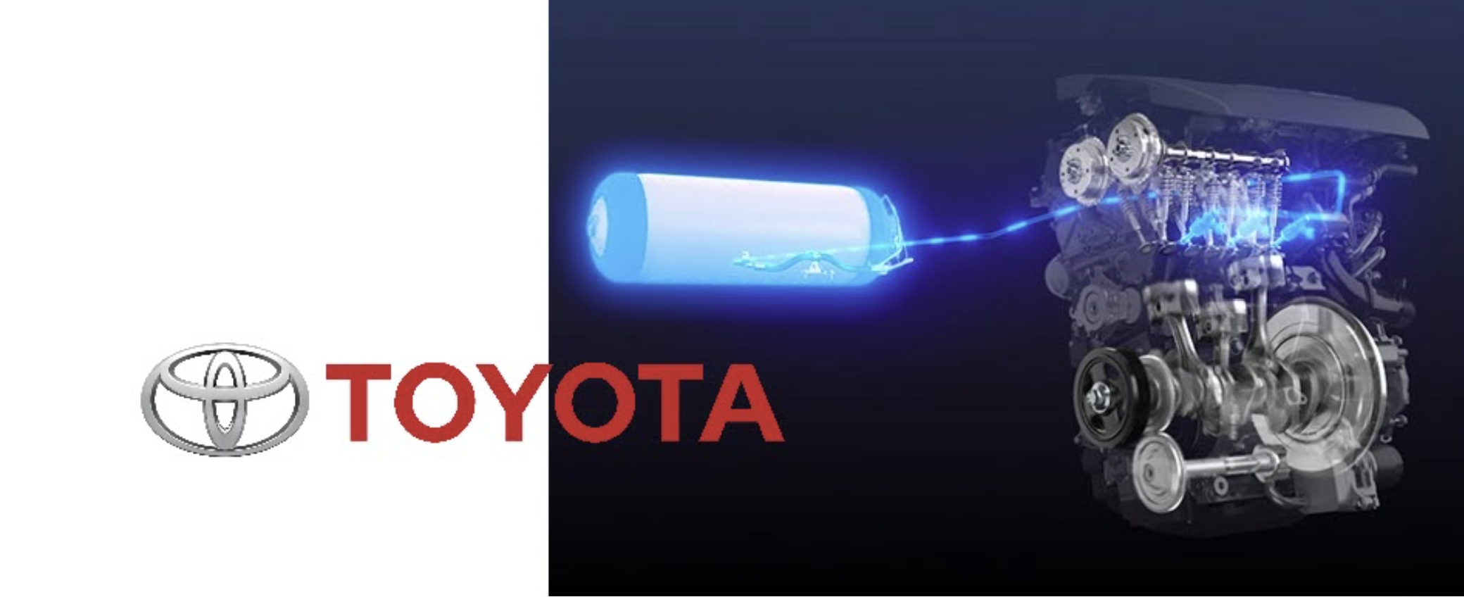
Hydrogen internal combustion engine
Uses either gaseous or liquid hydrogen as a fuel to deliver power
It doesn’t produce any CO2 since it doesn’t involve any carbon atoms
The main problem is with the nitrogen.
At the high temperatures of combustion, the nitrogen in the air reacts with oxygen to form nitrogen dioxides.
Toyota is moving more towards hydrogen than electric vehicles using batteries.

Slide 10
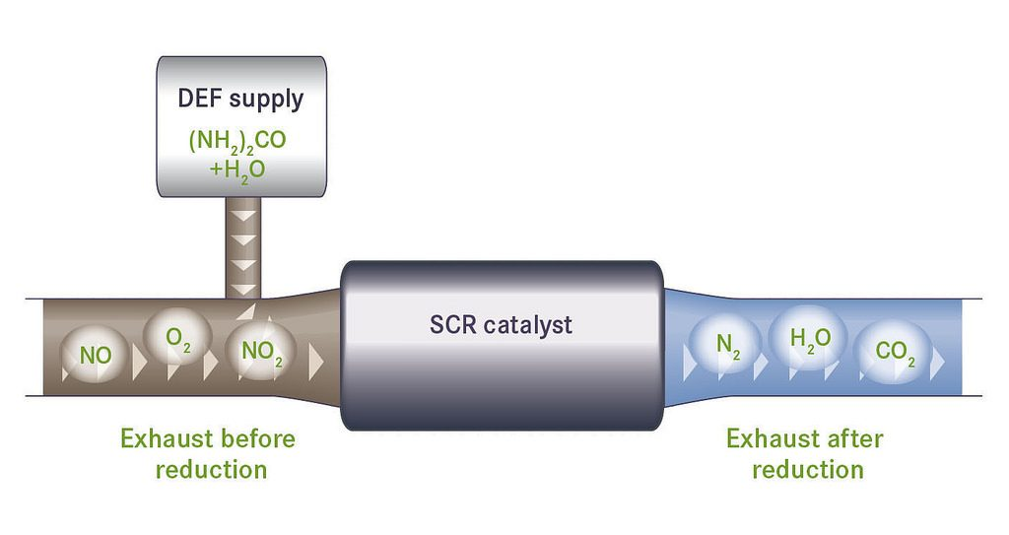
Selective Catalytic Reduction
SCR is a technology that uses a urea-based diesel exhaust fluid (DEF) and a catalytic converter to significantly reduce oxides of nitrogen (NOx) emissions
DEF-32.5% high purity urea and 67.5% deionized water.
Catalyst- Titanium Oxide
The NH3 is then used in conjunction with the SCR catalyst and converts the NOx to harmless nitrogen (N2) and water (H2O).

Slide 11
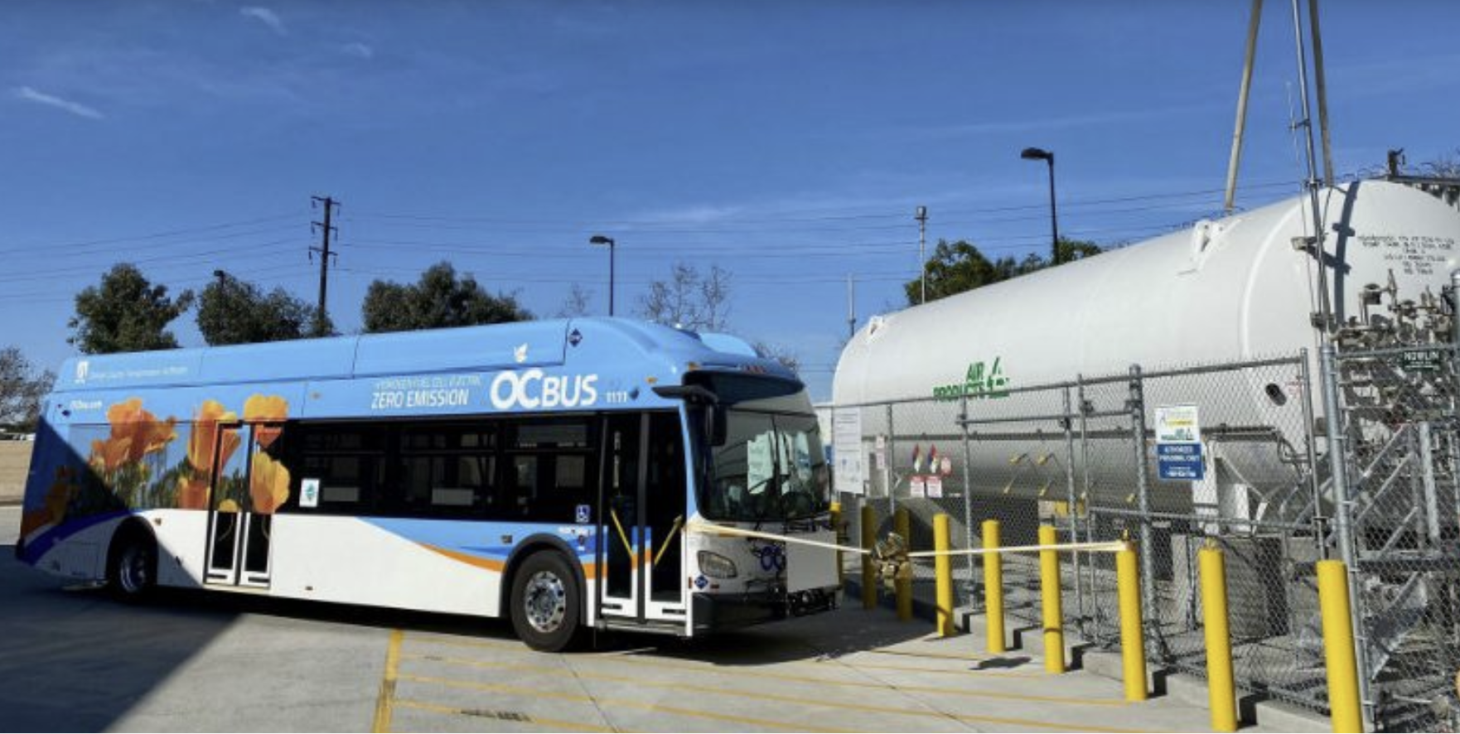
Comparison to Chicago Transit
In total Chicago has 1800 buses running 24 hours
In total Chicago has a transport of 4000km per day.
On an average H2 fuel cell vehicle has 10mpKg
We need around 250 Kg of H2 to run the fleet.

Slide 12
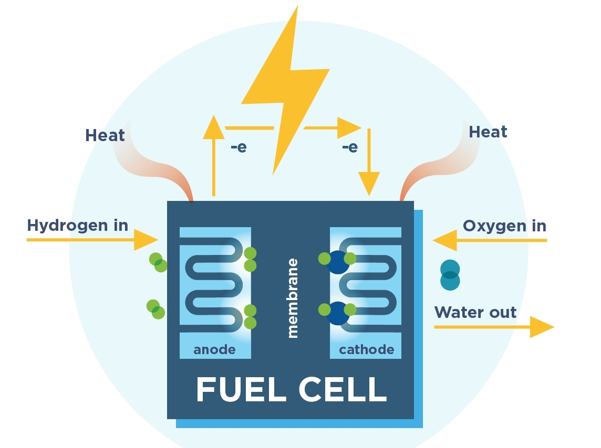
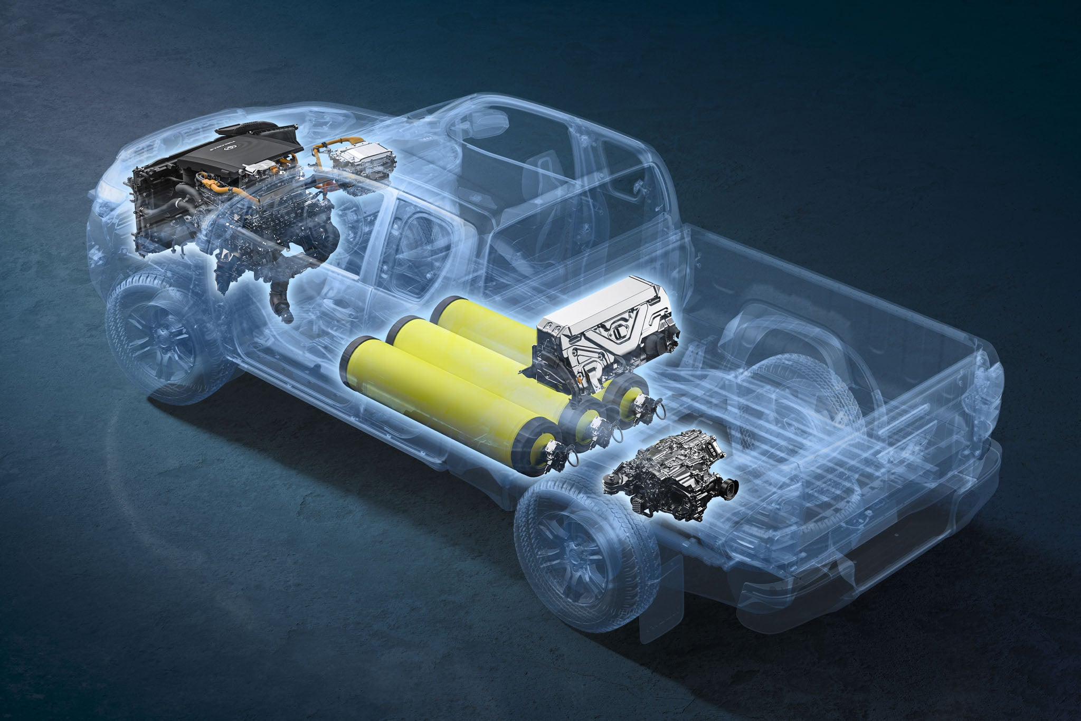
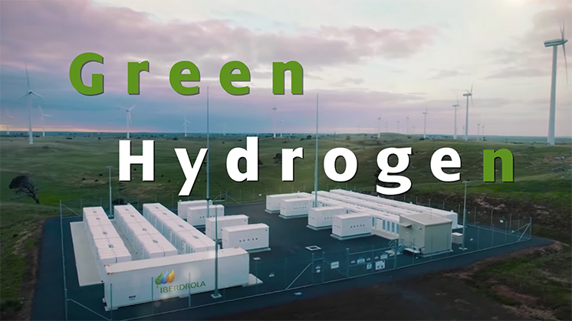
Summary
Hydrogen is a great source of fuel for us to fight against climate change.
More green energy is required to make it environmentally friendly.
Governments should bring out more policies and incentives on Hydrogen Transportation

Slide 13

Thank you
Narasimha Rao
nt20@illinois.edu

