Slide 1
Tesla Batteries
Alex Lopez

Slide 2
Timeline
July 2003- Tesla Motors is incorporated
February 2004 – Elon Musk becomes chairman of Tesla, investing $7.5 million
September 2008 – Deliveries of the first Tesla electric vehicle, the Tesla Roadster, begin
June 2009 – Tesla gets $465 million loan from US Department of Energy
August 2013 – Tesla Model S deliveries begin
February 2014 – Tesla announces Gigafactory project
August 2014 – Tesla joins China Unicom to build 400 charging stations in 120 cities
March 2015- Tesla opens 1st solar powered supercharger
November 2015 – Tesla Model X deliveries begin
March 2016 – Unveil of Tesla Model 3

Slide 3
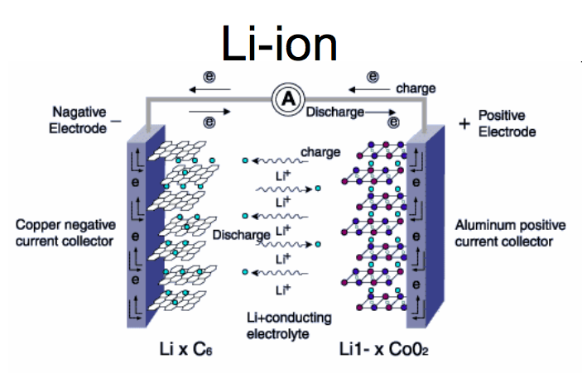
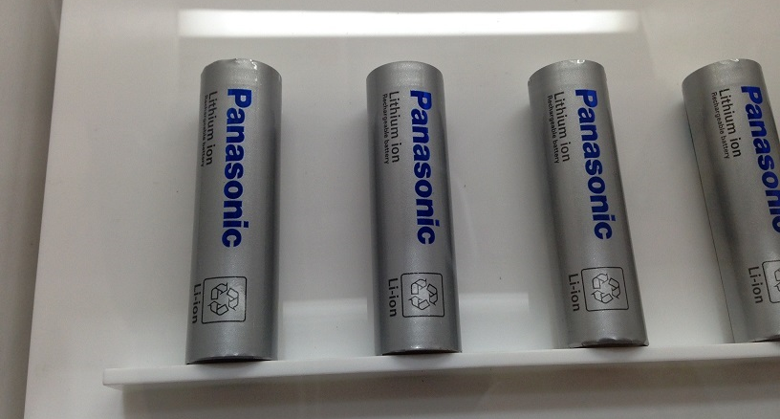
Lithium-ion Battery
Panasonic currently supplies Tesla with the Li-ion batteries
Each battery has two electrodes: The Anode and Cathode
Use 6,000-8,000 Li-ion cells per battery
Price of Li-ion battery expected to fall below $100 per kWh by the end of the century
Notes:
Currently, Panasonic is Tesla’s Lithium-ion battery supplier.
Apposed to using one big Li-ion battery or a few large Li-ion batteries, Tesla uses 6,000-8,000 Lithium-ion cells per battery. They use a modified version of a Lithium-ion 18650 cell.
When the battery is charging, Lithium ions pass through the cathode, go through the electrolyte, and will then be stored in the anode. When the battery is discharging the ions will leave the anode and pass back through the electrolyte and then through the cathode where the the electrical energy will be transformed into mechanical energy via the motor.
With the help of mass production, the price of Lithium-ion batteries is expected to fall below $100 per kWh by the end of the century

Slide 4
Lithium-ion Battery Advantages
High energy density
Rechargeable
Low maintenance
Lightweight
Long life cycle

Slide 5
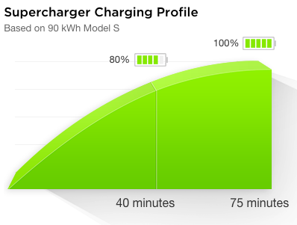
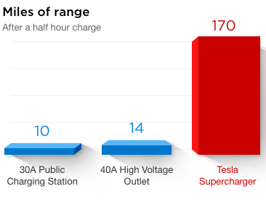
Charging
3,628 Superchargers at 613 stations
Superchargers deliver up to 120 kW of DC power
The Model S can charge up to 170 miles in 30 minutes
46 Superchargers in Illinois at 8 stations
Notes:
There are 3,628 Superchargers at 613 stations between the US, Europe, and Eastern Asia. There are 46 superchargers in Illinois at 8 different stations including 8 in Champaign.
Superchargers can deliver up to 120 kW of DC power to the battery.
For example the Tesla Model S can charge up to 170 miles in 30 minutes.
As the battery nears full charge, the car’s onboard computer gradually reduces the current to in order to balance cell voltage.

Slide 6
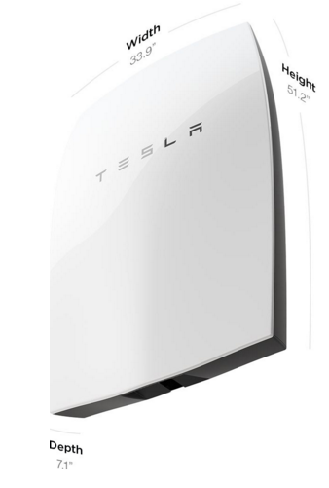
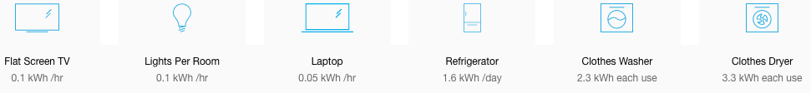
Powerwall
A rechargeable lithium-ion battery for
residential or industrial level
Has a 6.4 kWh energy storage capacity
Multiple batteries may be installed
together for home or industries that
need more energy
Notes:
The powerwall is a rechargeable lithium-ion battery designed to store energy at a residential and industrial level.
It consists of a Lithium-ion battery pack with a liquid thermal control system that can store up to 6.4 kWh.
The powerwall can be integrated with the local grid and solar panels.
The whole system when set up would include solar panels, an inverter to convert between DC and AC, a meter for measuring battery charge.
For homes or buildings that need more energy then what one powerwall can produce, multiple powerwall batteries can be installed together.

Slide 7
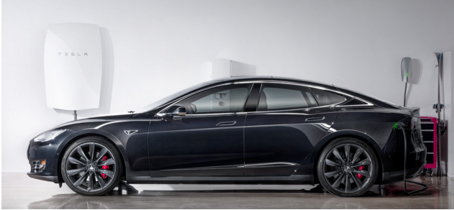
Powerwall Benefits
Increasing self-consumption of solar power generation
Load shifting
Back-up power
92% Efficiency
Notes:
The main benefits of the powerwall will be solar power generation, load shifting, emergency backup power, and its efficiency of 92%.
The powerwall can also store surplus solar energy not used at the time it is generated and use that energy later when the sun is not shining.
With load shifting, the battery can charge from the grid during low rate periods when demand for electricity is lower and discharge during more expensive rate periods when electricity demand is higher.
The battery will also serve a fully functional back up generator in the case of a blackout.

Slide 8
Gigafactory
Located in Sparks, Nevada
Cell production expected by 2017
Gigafactory will reach full capacity by 2020 and will cover 10 million square feet
At full capacity it will produce more Li-ion batteries annually than were produced worldwide in 2013
It will attempt to achieve net zero energy using solar, wind, and geothermal power
Notes:
The gigafactory will be located just east of Reno in Sparks, Nevada. The building is still under construction as of now, but cell production there is expected to start by late 2017.
Full capacity is expected by 2020. The final footprint of the building will cover 10 million square feet.
At full capacity, the gigafactory will produce more Lithium-ion batteries annually than were produced worldwide in 2013. This will be necessary as Tesla projects a production rate of around 500,000 cars per year by the end of the century.
The gigafactory will use solar, wind, and geothermal power to hopefully create a net zero energy building.

Slide 9
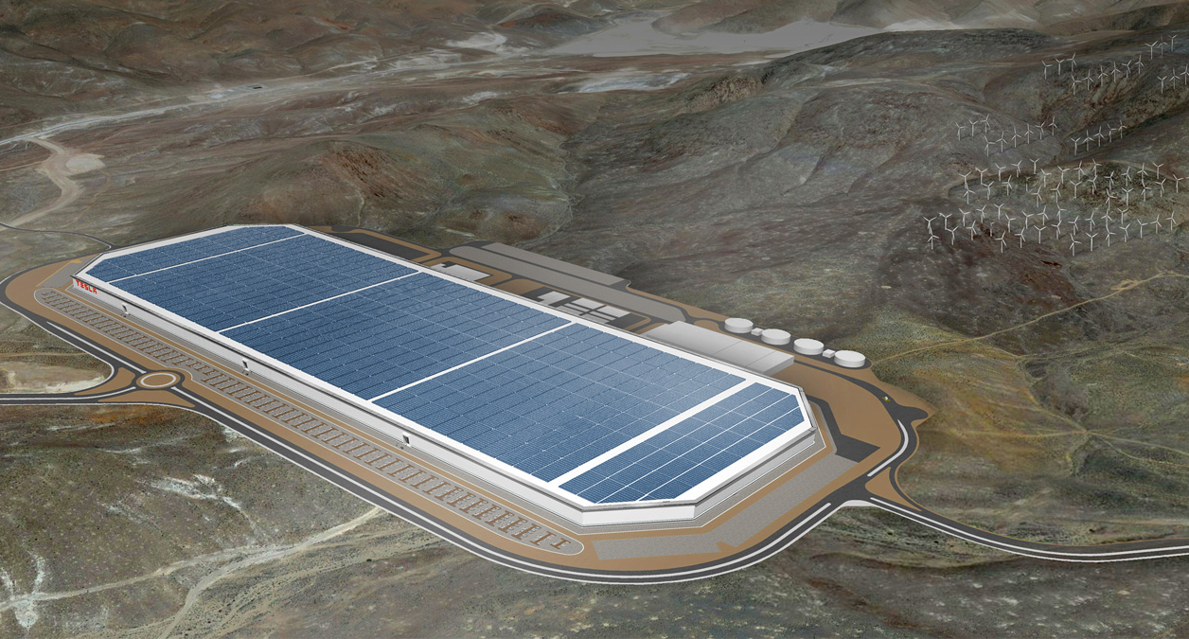
Gigafactory

Slide 10
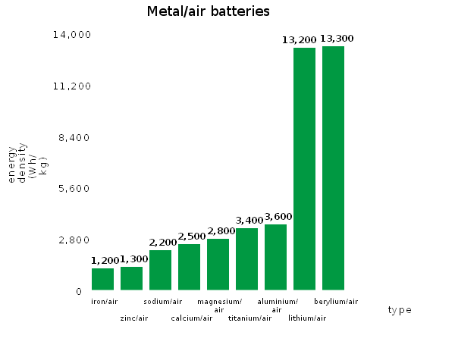
Future of Tesla Batteries
Tesla wants to pair metal-air and Li-ion batteries
A metal-air cell will use an anode made from pure metal, a cathode of air, and a liquid electrolyte
Pros: Physically lighter then a Li-ion battery and has a higher energy density then a Li-ion battery
Cons: Poor life cycle and poor energy efficiency
Energy density of
Li-ion battery range
from 300-700 Wh/kg

Slide 11
References
http://mragheb.com/NPRE%20498ES%20Energy%20Storage%20Systems/Nickel%20Cadmium%20and%20Lithium%20Ion%20Batteries.pdf
http://mragheb.com/NPRE%20498ES%20Energy%20Storage%20Systems/Powerwall%20and%20Powerpack%20Tesla%20Batteries.pdf
https://www.teslamotors.com/presskit/teslaenergy
https://www.teslamotors.com/powerwall
https://forums.teslamotors.com/forum/forums/tesla-timeline-0
http://www.hybridcars.com/tesla-projects-battery-costs-could-drop-to-100kwh-by-2020/
https://gigaom.com/2013/09/24/whats-a-metal-air-battery-and-why-is-tesla-interested-in-it/

