Slide 1
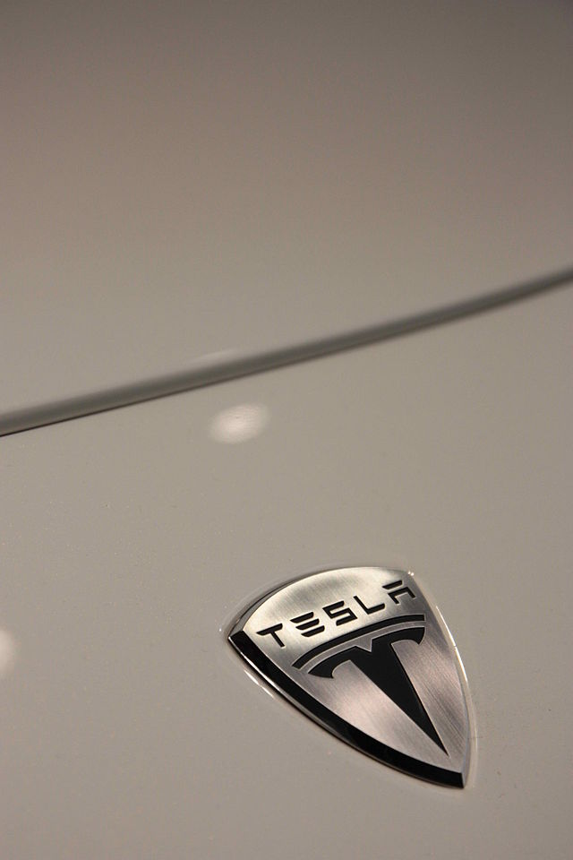
How Tesla is defining the future for Electric Vehicles
Abhijit Limaye
MS Bioenergy
University of Illinois at Urbana-Champaign
alimaye2@illinois.edu

Slide 2
Timeline
July 2003 – Martin Eberhard and Marc Tarpenning incorporated Tesla Motors.
February 2004 – Elon Musk financed US $7.5 million.
July 2006 – Tesla Roadster All electric Sports Car was revealed to public in California, but the sales began in February 2008.
December 2007 – Ze’ev Drori became the CEO.
October 2008 – Elon Musk took over Drori as the CEO.
2010 – Upgraded Roadster 2.5 was released.
2012 – Production of Roadster model was stopped as contract with Lotus ended.
June 2012 – Model S Luxury Sedan was launched
Early 2015 – Model X to be launched, Model 3 to be launched in 2017.

Slide 3
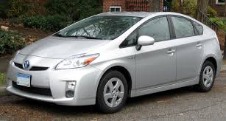
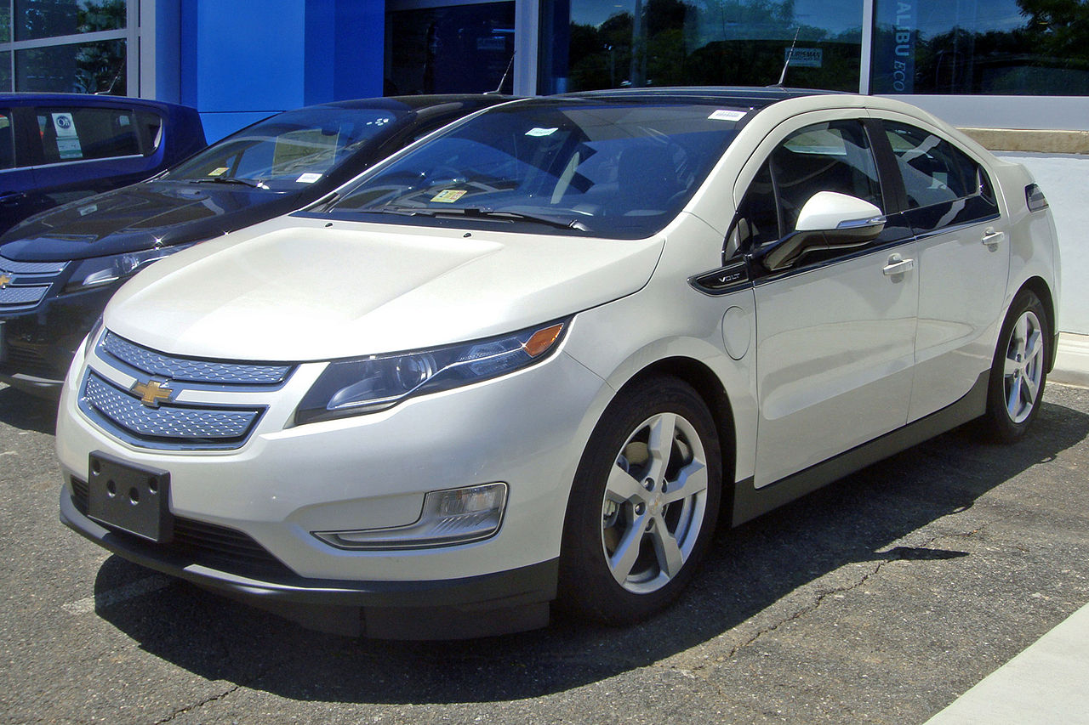
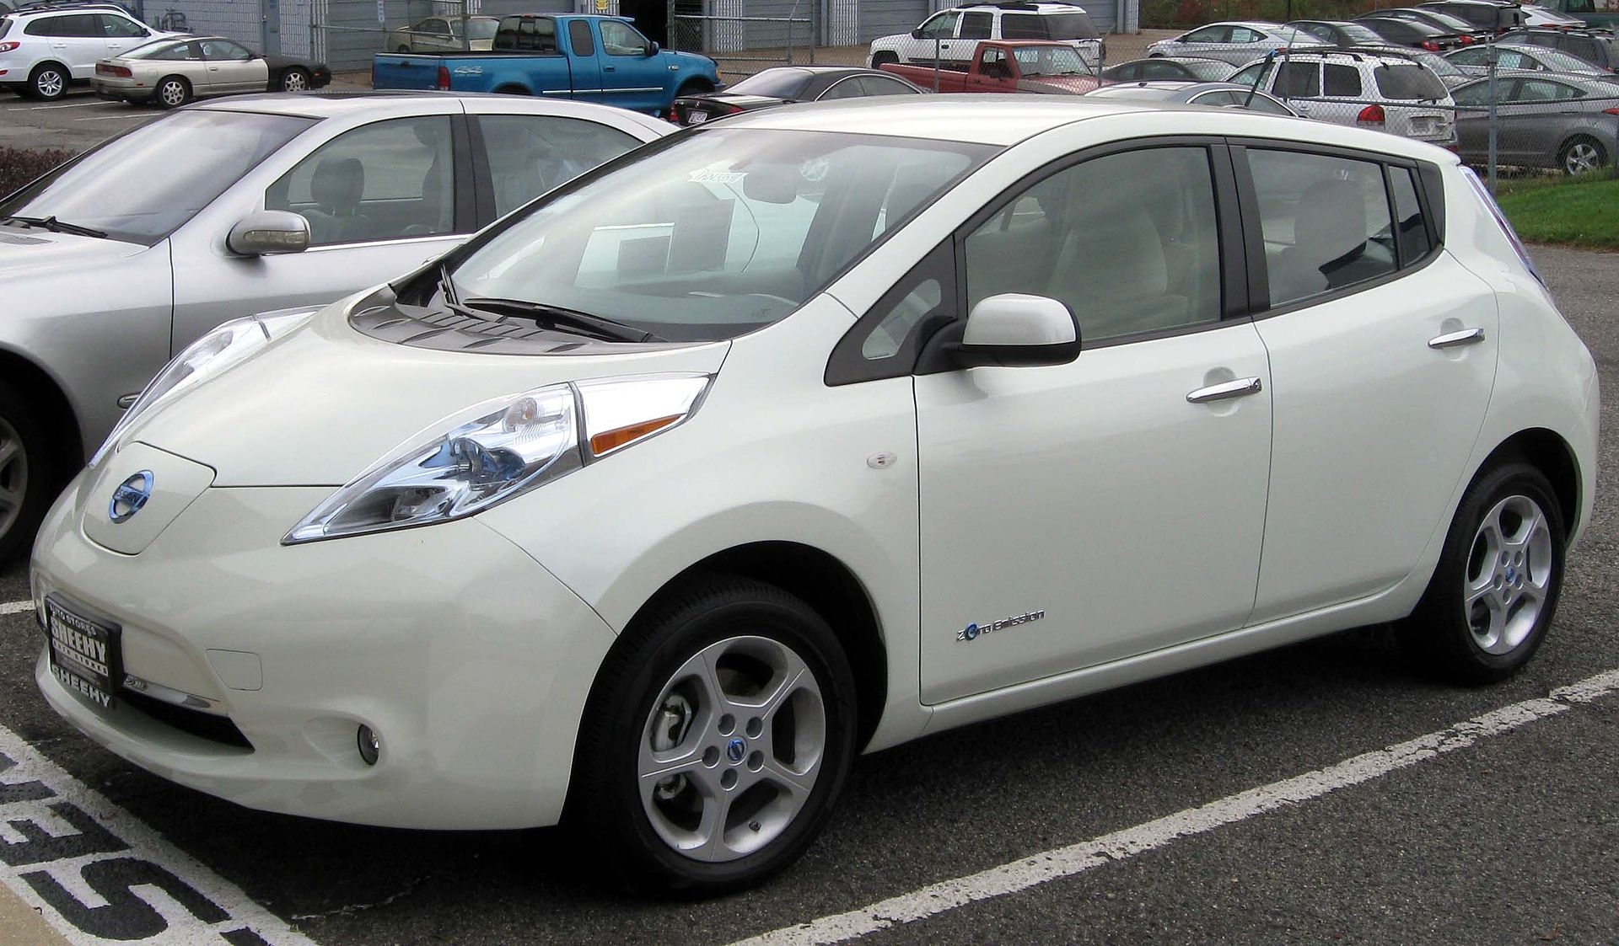
Electric Vehicles
Hybrid Electric Vehicles (HEV’s) – Toyota Prius
Pure Electric Vehicles (EV’s) – Nissan Leaf, TESLA
Plug-in Hybrid Electric Vehicles (PHEV’s) - Chevrolet Volt
Parallel Hybrids – Electric motor and Combustion engine are coupled to wheels through the transmission
Series Hybrids – Extended Range Electric Vehicles (EREV’s)

Slide 4
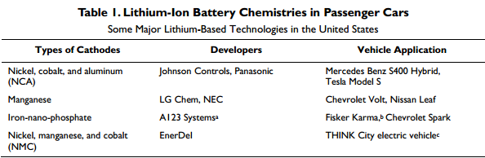
Technology
Lithium-Ion Batteries - Advantages
High Energy and Power Density – Ragone plot.
Lithium is a lightweight metal, thus can be fabricated into large battery packs.
Reusable and can be extracted from used batteries and recycled!
Source: Battery manufacturing for hybrid and electric vehicles. Bill Cannis. 2013.

Slide 5
Manufacturing of a Battery
Lithium is mainly mined in Chile, South America and powdered into Lithium Carbonate.
Powder or Ingots are shipped to Tier 2 suppliers, who convert it back to Lithium metal in the form of long sheets
(1.5 miles) and cut into cells.
Shipped to Tier 1 suppliers who spray molten metals and establish cathode and anode, along with other components.
Manufacturers or automakers assemble the individual cells → Tesla motors.

Slide 6
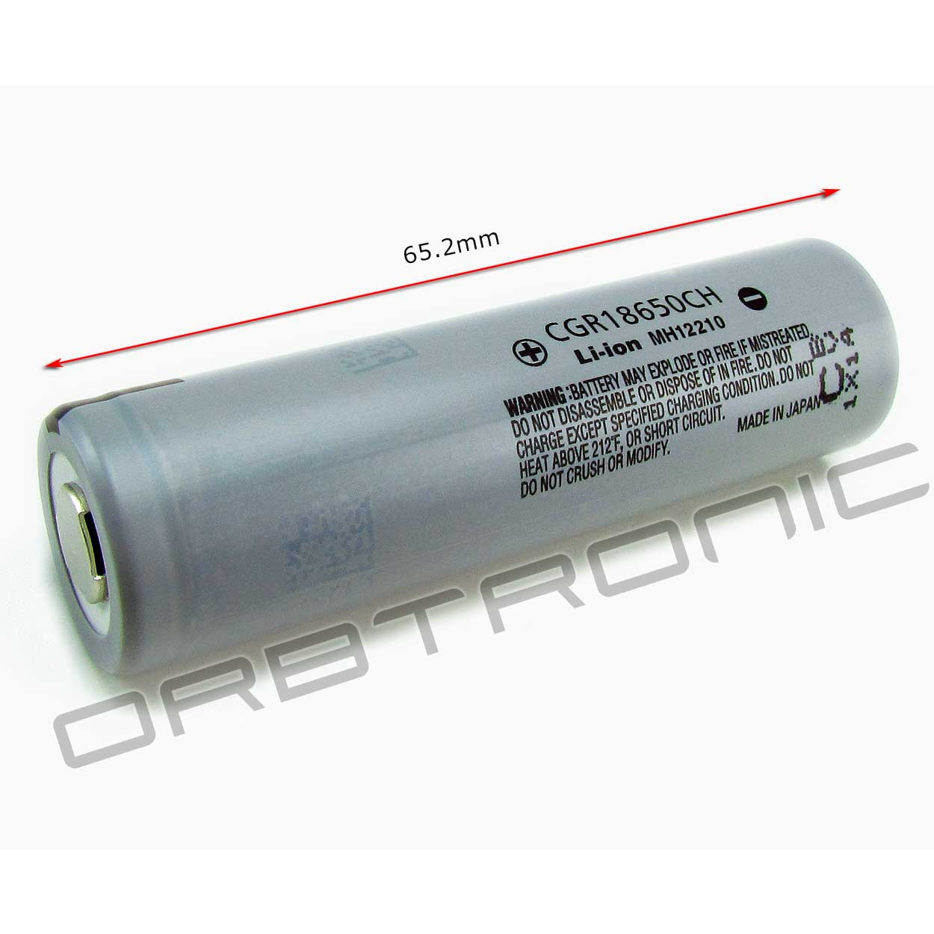
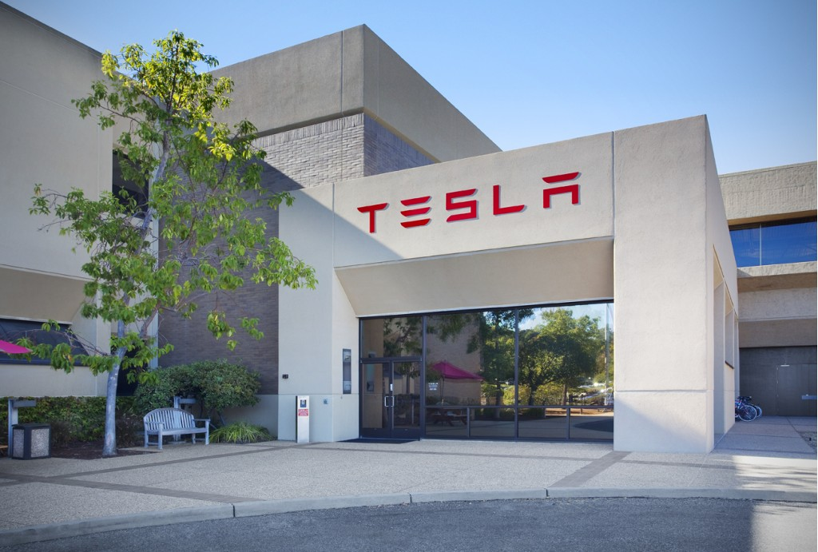
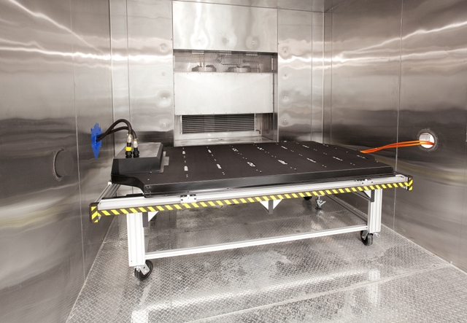
Tesla Batteries
Does not use single-purpose large format cells, but instead uses 6,831 -18650 commodity cells.
Thus cost of making batteries is reduced – It charges $200 more for 85kWh than 60 kWh battery.
Tesla motors – Palo Alto, California facility Li-Ion Cell Li-Ion Battery pack in Environmental test chamber

Slide 7
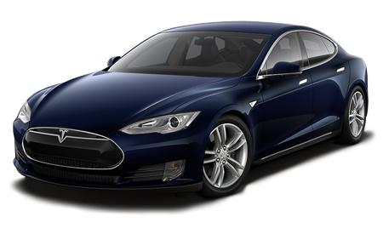
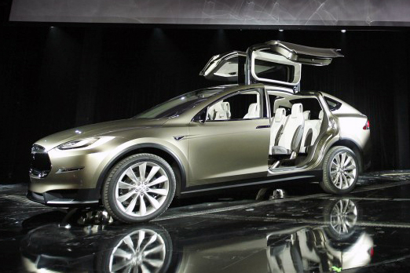
Models
Features | Model S (60 kWh) | Model X (60 kWh) | Model E(3)
Miles per charge | 215 | 225 | 200
Power in HP | 380 | 380 | 380
0-60 mph | 5.9 sec | <5 sec | 4.4 sec
Price | $63,570 | Not known | $40,000

Slide 8
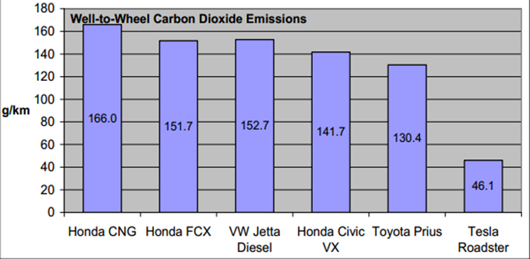
Zero Tailpipe Emissions

Slide 9
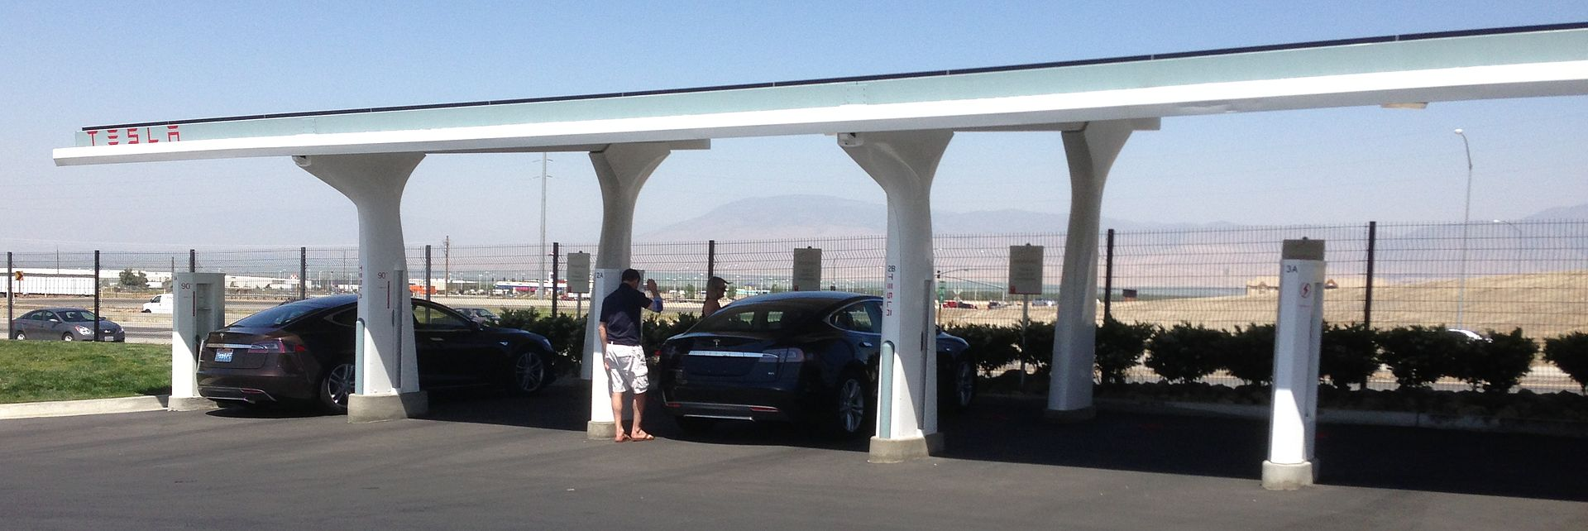
Super Charging Stations
480 volt, 120 kW DC - 200 Stations throughout the world.
150 miles -20 Minutes, 200 miles – 30 minutes.
Solar Car Port systems– Solar City
Supercharger rapid charging system, Tejon Ranch, California.

Slide 10
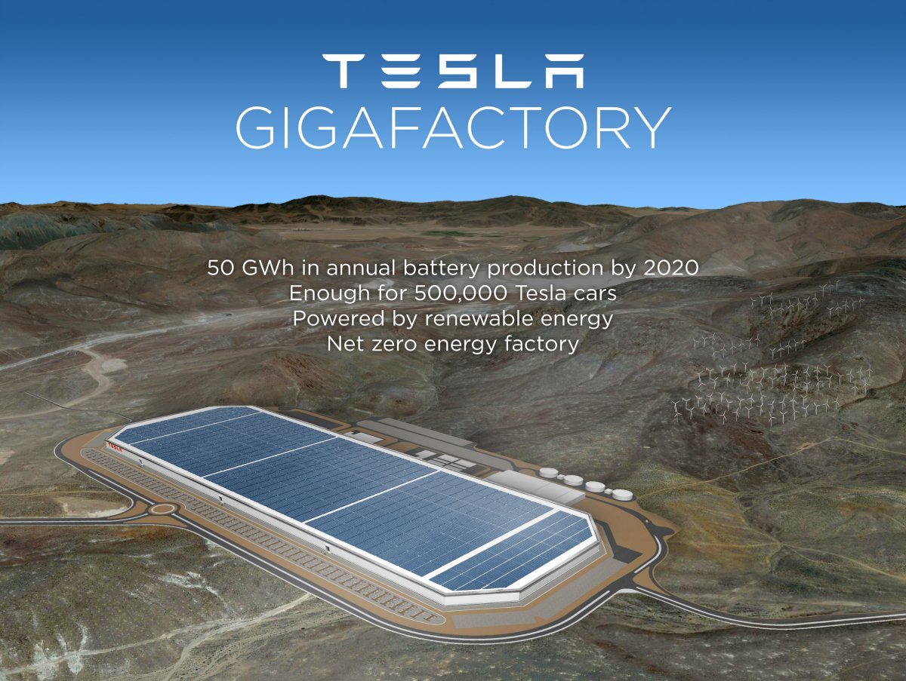
Future
A MoU with Panasonic, which will build a Gigafactory battery manufacturing plant in Nevada by 2020, which will reduce Tesla Motors’ battery costs by 30 percent. It will employ about 6,500 people with capital cost of US $6 Billion.
Battery swapping stations in California – 90 second operation which would allow customers to exchange the battery for about US $60- $80, and swap back to the one that you own in your return journey.

Slide 11
References
http://www.teslamotors.com/supercharger
Battery Manufacturing for Hybrid and Electric Vehicles: Policy Issues. Bill Cannis. Congressional Research Service (2013).
https://en.wikipedia.org/wiki/Tesla_Motors
A new Car, A New grid. Larry Dickerman and Jessica Harrisson. (2010).
IEEE Power and Energy Magazine (2010).
21st Century Electric Cars – Tesla Motors. Martin Eberhard and Marc Tarpenning. (2006).

Slide 12
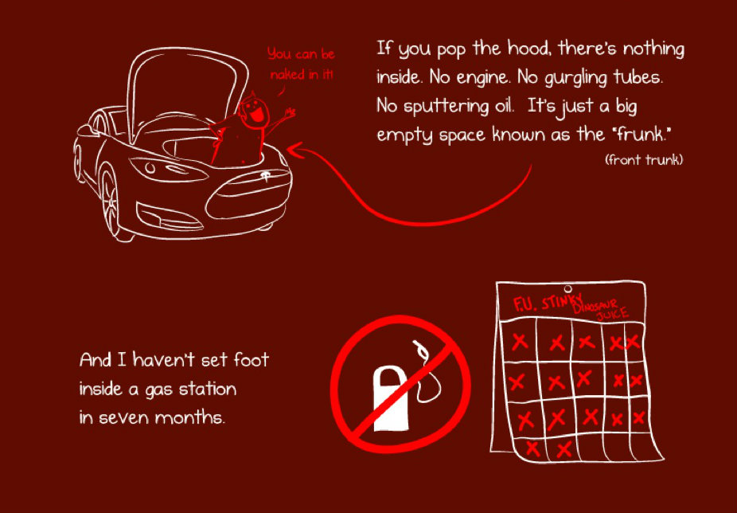
Thank You
Abhijit Limaye
alimaye2@illinois.edu

