Slide 1


Flow Batteries
Thomas Ruane
toruane2@Illinois.edu
Professor Ragheb
NPRE498

Slide 2
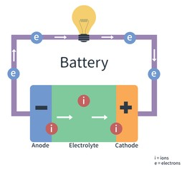
Traditional Battery
Stores chemical energy and converts this into electrical energy
The chemical reactions require the electrons to flow from the one material to the next, through an external circuit
The flow of electrons cause a current that performs work
Ions flow opposite the electrons in an electrolyte solution that touches both the anode and the cathode
Energy depends on electrode material and electrolyte solution

Slide 3
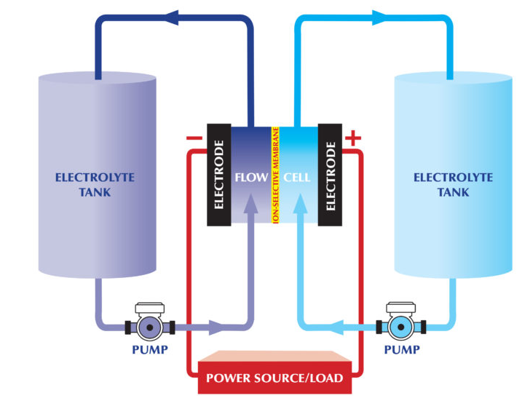
Flow Battery
Electrochemical cell in which components are dissolved in liquid and are pumped through flow cell.
Must be powered by external power to create voltage differential and to power the pumps.
Used like either a fuel cell or rechargeable battery
Main variation in the fact that the ionic solution is not stored in the flow cell.

Slide 4
Advantages of the Flow Battery
Separation of the power and energy requirements
Electrodes can be designed to have optimal power performance
More stable as electrodes are not physically or chemically changing, therefore it is safer
Quick response times, low maintenance
Cost target of $100-200/kWh
Instant recharge possible by changing liquid

Slide 5
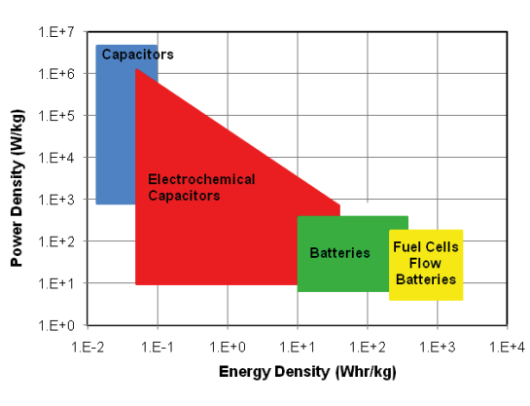

Power Density vs Energy Density for Energy Storage Devices
z

Slide 6
Disadvantages of the Flow Battery
Low voltages when compared to Li-ion (1.5 V v 3 V)
Extra power required for pumps in electrolyte storage tanks
Specific capacity is lower than traditional batteries
Technology is not as researched
Low charge and discharge rates
Generally have lower efficiency

Slide 7

History of the Flow Battery
Charles Renard build the flow battery for the La France airship in 1884.
  Powered by Zinc-Chlorine flow battery power
German scientist patents a titanium-chlorine and hydrochloric acid procedure that stores electrical energy in liquid
NASA continues research during Apollo Era for ion and chromium redox flow battery that would be used for a moon base
In 1984, Australian scientists from the University of New South Wales built the first vanadium redox flow battery.

Slide 8
Flow Battery Composition

Slide 9
Flow Battery Composition
External tanks store solution that is then pumped through cell
Each cell has ion-permeable membrane
Cells set can be in series to increase Voltage, and in parallel to increase current
Chemical reactions occur at the anode and cathode to produce and accept electrons

Slide 10
Electrode/Membrane Design and Composition
Electrode
It is important for the electrodes to have as much surface area as possible
  Graphite, carbon fiber, nickel, metal foams
Design considers:
  Electrode size
  Catalytic activity
  Wetting
Membrane Separator
Nafion is most common
Cationic/Anionic exchange membranes considered for:
  Ion diffusion rate
  Ion selectivity rate
  Mechanical properties such as strength and durability

Slide 11
Types of Flow Batteries

Slide 12
Reduction-Oxidation Flow Battery (Fuel Cell)
Reversible cell in which electrochemical components are dissolved in the electrolyte
Most common out of all flow batteries
Examples:
  NASA Helios battery (H2/O2)
  European Patent Organization (H01M8/18C4)
  Vanadium
  Polysulfide Bromide (Regenesys)
  Uranium

Slide 13
Hybrid Flow Batteries
  One or more electroactive components are deposited as a solid layer.
  One battery electrode and one fuel cell electrode
  Limited by the surface area of the electrodes
  Ex:
    Zinc bromide
    Zinc Cerium
    Lead Acid
    Iron Salt

Slide 14
Membraneless Flow Battery
Relies on laminar flow where the two solution streams pass in parallel, but rarely mix
Reduces cost and increases reliability as membranes are often the most expensive and least reliable components of other flow batteries due to hydrobromic acid destroying the membrane
Examples:
  Liquid bromine flow over graphite cathode
  Hydrobromic acid flows under porous anode
  Hydrogen gas flows across anode

Slide 15
Applications of Flow Batteries

Slide 16
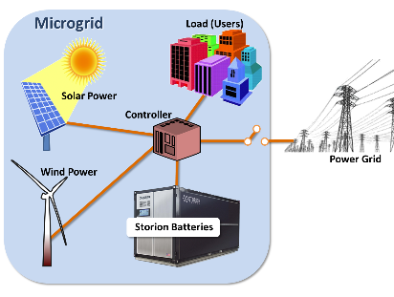
Use in Electric Grid
Load balancing
  Stores excess power during off-peak hours
Storing Energy from renewables during peak hours
Peak shaving

Slide 17
Use in Electric Vehicles
By replacing the electrolyte, the vehicle can be recharged instantly
Low carbon0zerio emission urban transport
However, the lower energy capacity has a slightly lower range for the vehicle

Slide 18
New Flow Battery Technology

Slide 19
USC Loker Hydrocarbon Research Institute
Key innovation uses iron sulfate solution and Anthraquinone disulfonic acid
  Iron sulfate is a cheap, abundant product from the mining industry
  Could produce at $66/kWhr
Can help solve the renewable energy storage issues
  Storing 20% of todays solar and wind energy requires 700 GWhr of storage
  1 GWhr can power 700,000 homes for an hour
  Longer life than lithium ion, safer and cheaper than other flow based batteries

Slide 20
References
https://www.science.org.au/curious/technology-future/batteries#:~:text=Essentials,be%20used%20to%20do%20work.
https://www.powermag.com/flow-batteries-energy-storage-option-for-a-variety-of-uses/
https://www.sciencemag.org/news/2018/10/new-generation-flow-batteries-could-eventually-sustain-grid-powered-sun-and-wind
https://flowbatteryforum.com/what-is-a-flow-battery/
https://news.usc.edu/166306/flow-battery-renewable-energy-electricity-storage-usc-study/
https://www.vanadiumcorp.com/news/industry/electric-vehicle-applications-of-flow-batteries-2/
https://codibly.com/news-insights/flow-batteries-what-you-need-to-know/#:~:text=There%20are%20three%20types%20of,electrolyte%20flows%20through%20the%20electrodes.
http://large.stanford.edu/courses/2011/ph240/garg1/docs/fal10_p054-056.pdf

