Slide 1

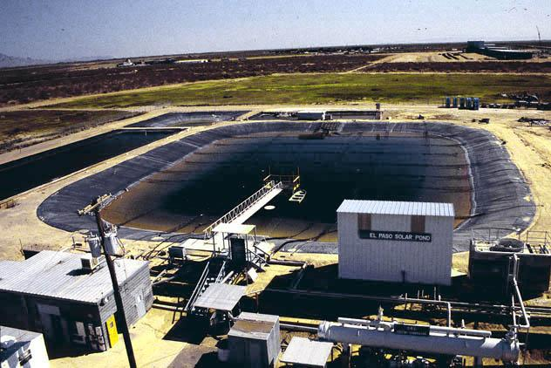
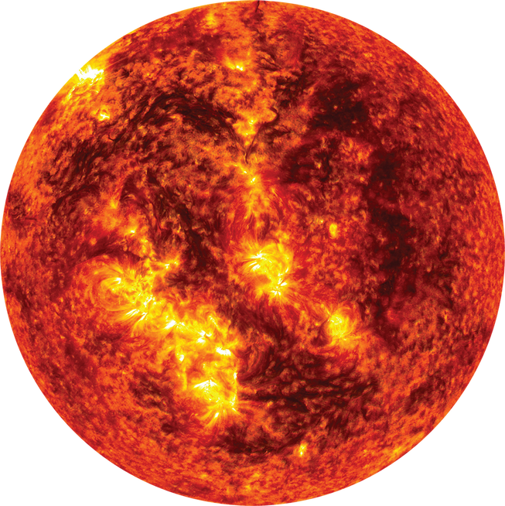

Solar Pond for Desalination
Trang Ngo, Master of Engineering,
Department of Electrical & Computer Engineering, UIUC
1

Slide 2


Outline
  Introduction & Types
  Working principle of salt gradient solar pond
  Solar pond for desalination
    Electricity production processes
    Desalination processes
  Some examples
2

Slide 3

Introduction of Solar Pond
“A solar pond is simply a pool of saltwater that collects and stores solar thermal energy.
The attractiveness of solar ponds is that it is a low-cost method of harnessing and storing solar energy which is renewable.”
  Stuti Surani, Progress of Solar Pond Technology - Bhuj and earlier projects, Energy Storage Engineering course, UIUC.
3

Slide 4
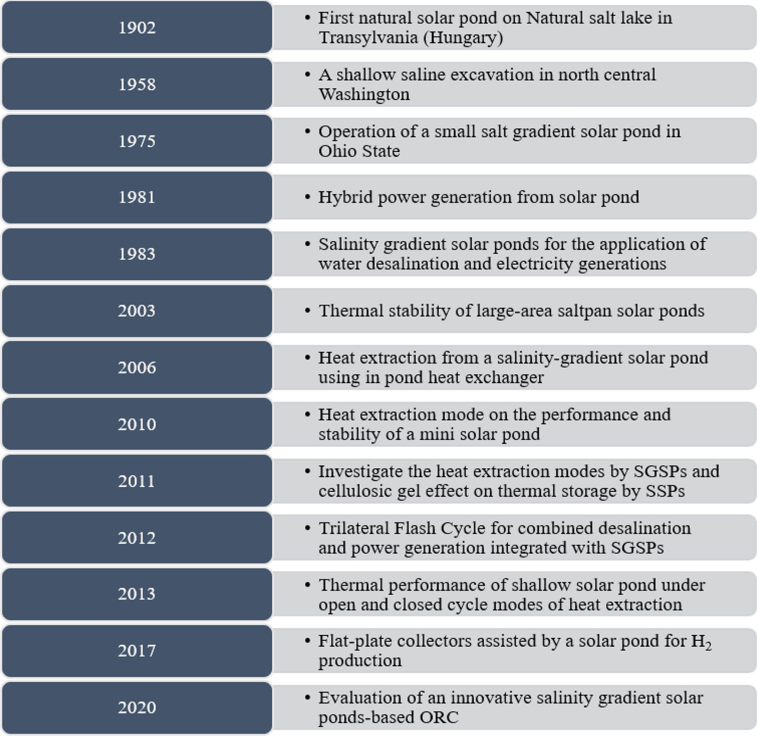
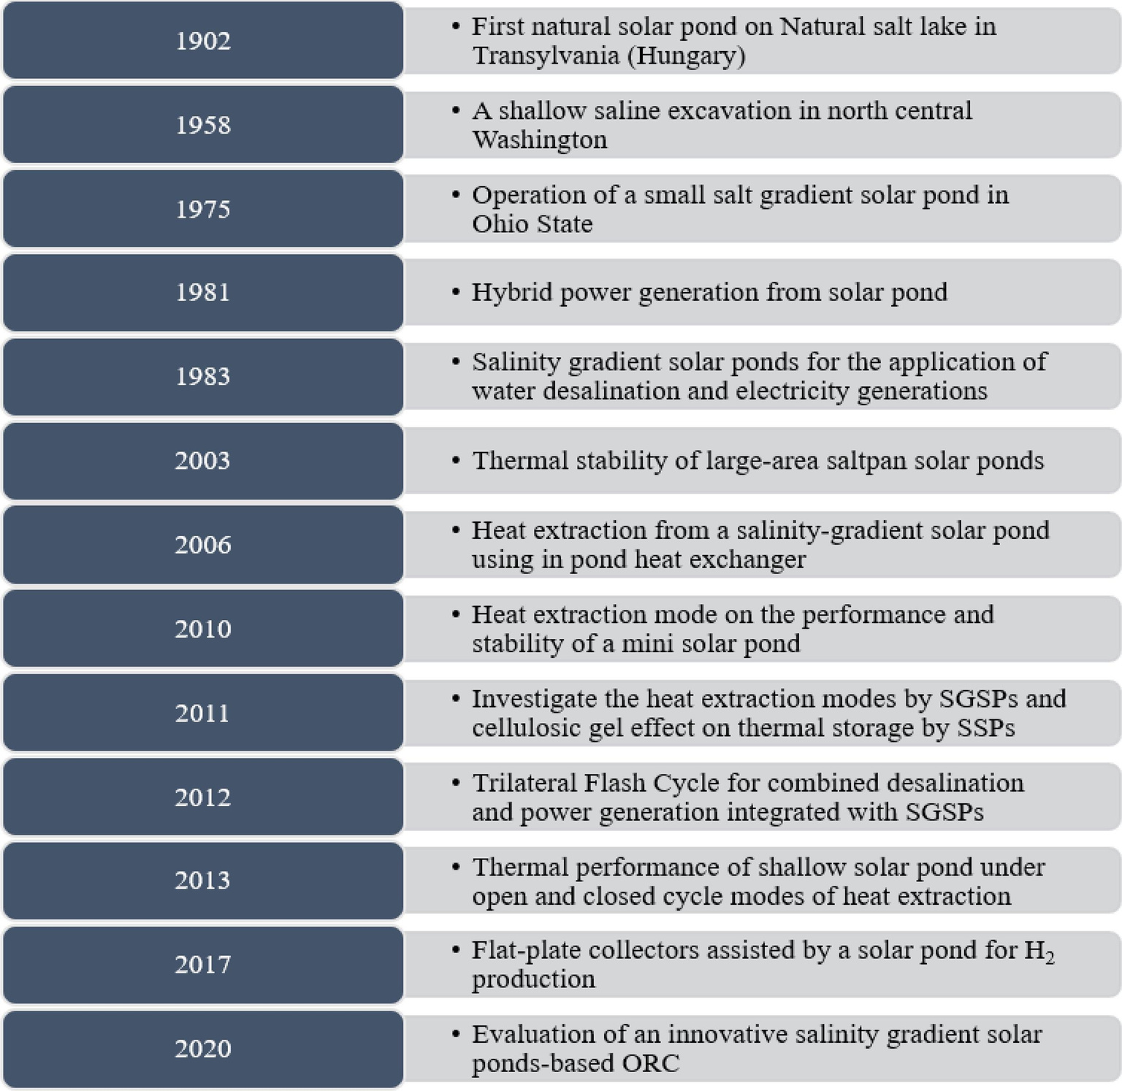
Development of Solar Pond
  Muhammad Tawalbeh, Rana Muhammad Nauman Javed, Amani Al-Othman, Fares Almomani, Salinity gradient solar ponds hybrid systems for power generation and water desalination, Energy Conversion and Management, Volume 289, 2023, 117180, ISSN 0196-8904, https://doi.org/10.1016/j.enconman.2023.117180.
4

Slide 5
Types
  Salt gradient solar ponds (SGSPs)
  Sallow solar ponds (SSPs)
  Solar gel ponds (SGPs)
  Equilibrium solar ponds (ESPs)
  Membrane solar ponds (MSPs)
  Partitioned solar ponds (PSPs)
  Muhammad Tawalbeh, Rana Muhammad Nauman Javed, Amani Al-Othman, Fares Almomani, Salinity gradient solar ponds hybrid systems for power generation and water desalination, Energy Conversion and Management, Volume 289, 2023, 117180, ISSN 0196-8904, https://doi.org/10.1016/j.enconman.2023.117180.
5

Slide 6
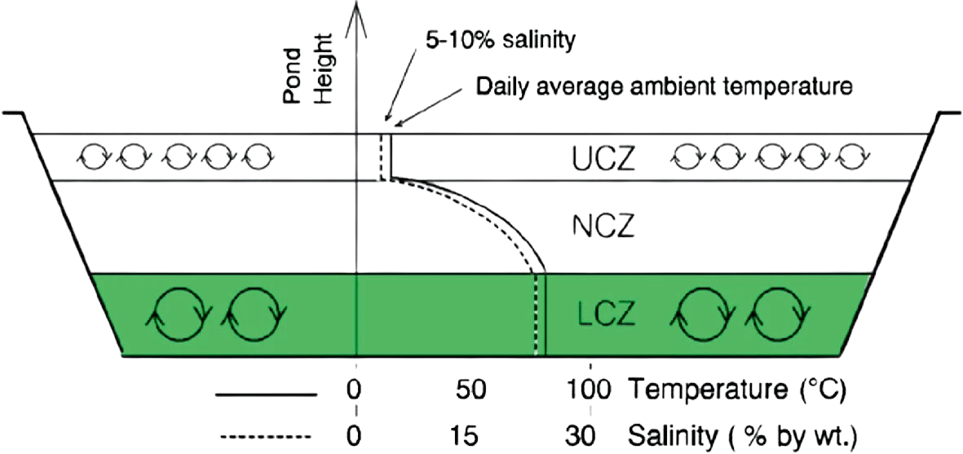


Salt gradient solar ponds (SGSPs)
Infrared light
Ultraviolet & visible light
  Singh R, Tundee S, Akbarzadeh A (2011) Electric power generation from solar pond using combined thermosyphon and thermoelectric modules. Sol Energy 85:371–378
6

Slide 7
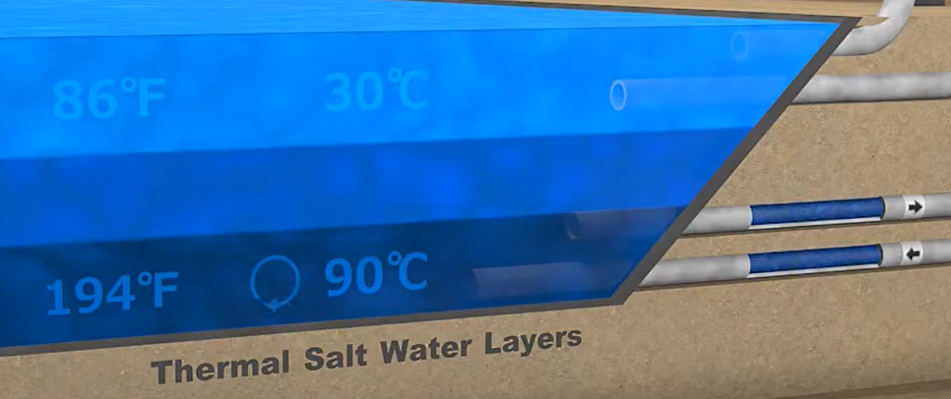
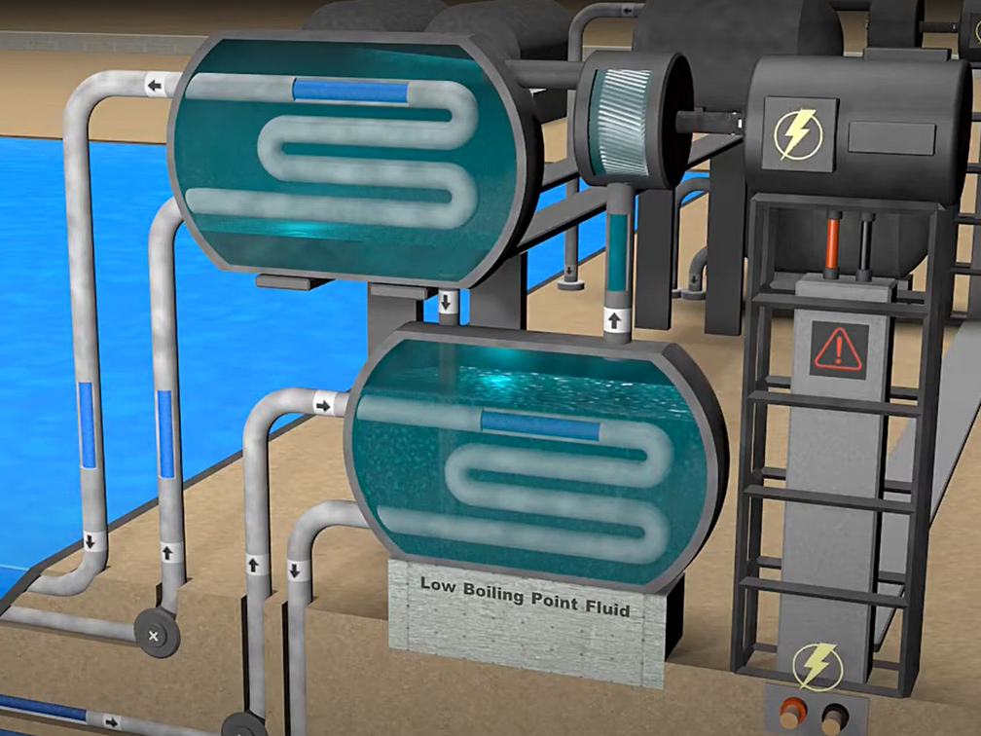

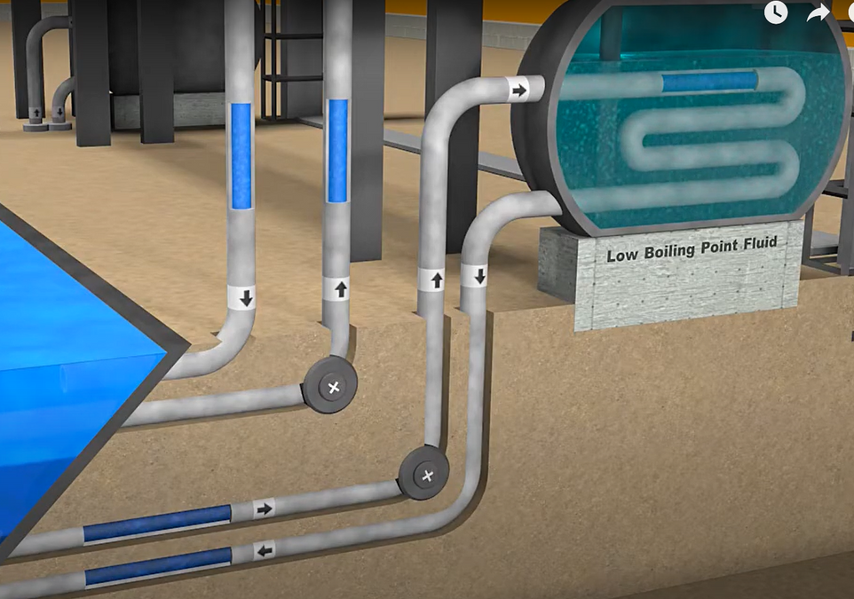
Salt gradient solar ponds (SGSPs)
  Solar Pond Animation, https://www.youtube.com/watch?v=qn5DZ2CQQEs
7

Slide 8
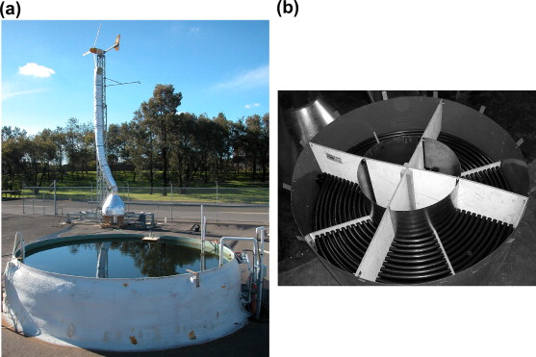
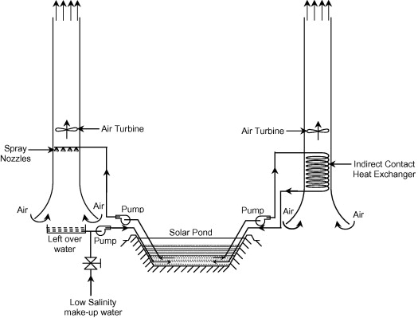
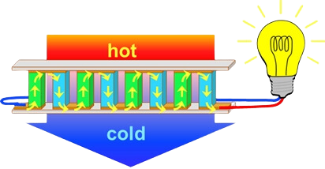
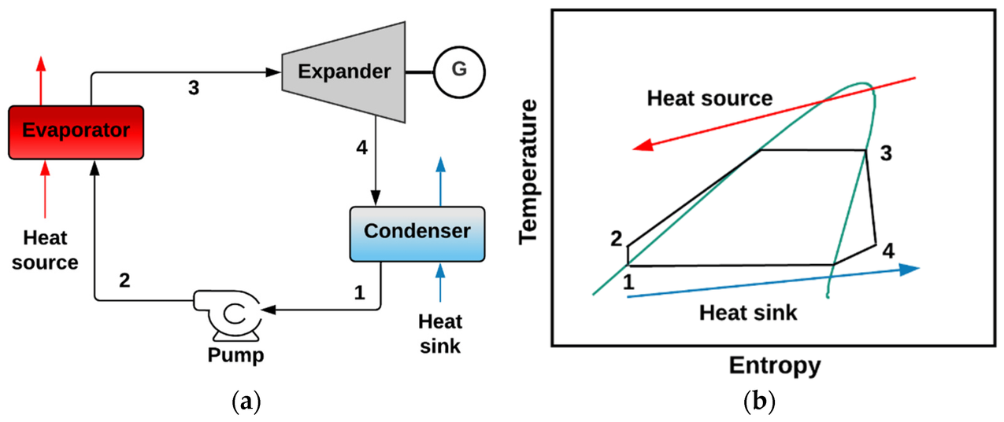
Some electricity production processes
from solar pond
Organic Rankine cycle (ORC)
Solar chimney integrated with an air turbine
Thermoelectric generators
  Muhammad Tawalbeh, Rana Muhammad Nauman Javed, Amani Al-Othman, Fares Almomani, Salinity gradient solar ponds hybrid systems for power generation and water desalination, Energy Conversion and Management, Volume 289, 2023, 117180, ISSN 0196-8904, https://doi.org/10.1016/j.enconman.2023.117180.
8

Slide 9
Some desalination processes
  Thermal:
    Vaporization-based: Multistage flash distillation (MSF), multi-effect distillation (MED), and thermal vapor compression (TCV)
    Evaporation-based: Membrane distillation (MD), humidification dehumidification (HDH), and adsorption desalination (AD)
  Mechanical: reverse osmosis (RO) membrane
  Electrical: electrodialysis/electrodialysis reversal (ED/EDR) and capacitive ionization (CDI)
  Muhammad Tawalbeh, Rana Muhammad Nauman Javed, Amani Al-Othman, Fares Almomani, Salinity gradient solar ponds hybrid systems for power generation and water desalination, Energy Conversion and Management, Volume 289, 2023, 117180, ISSN 0196-8904, https://doi.org/10.1016/j.enconman.2023.117180.
9

Slide 10
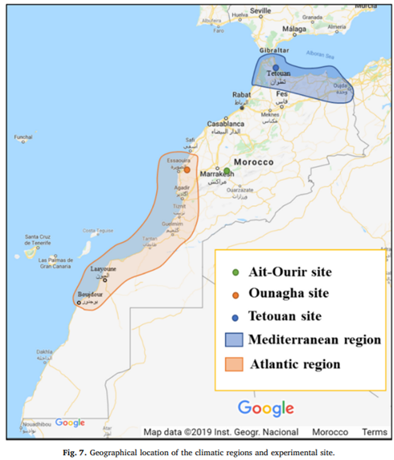
An example from the Mediterranean & Atlantic region
1. El Mansouri, Abdelfattah, M. Hasnaoui, A. Amahmid, and Safae Hasnaoui. "Feasibility analysis of reverse osmosis desalination driven by a solar pond in Mediterranean and semi-arid climates." Energy Conversion and Management 221 (2020): 113190.
10

Slide 11
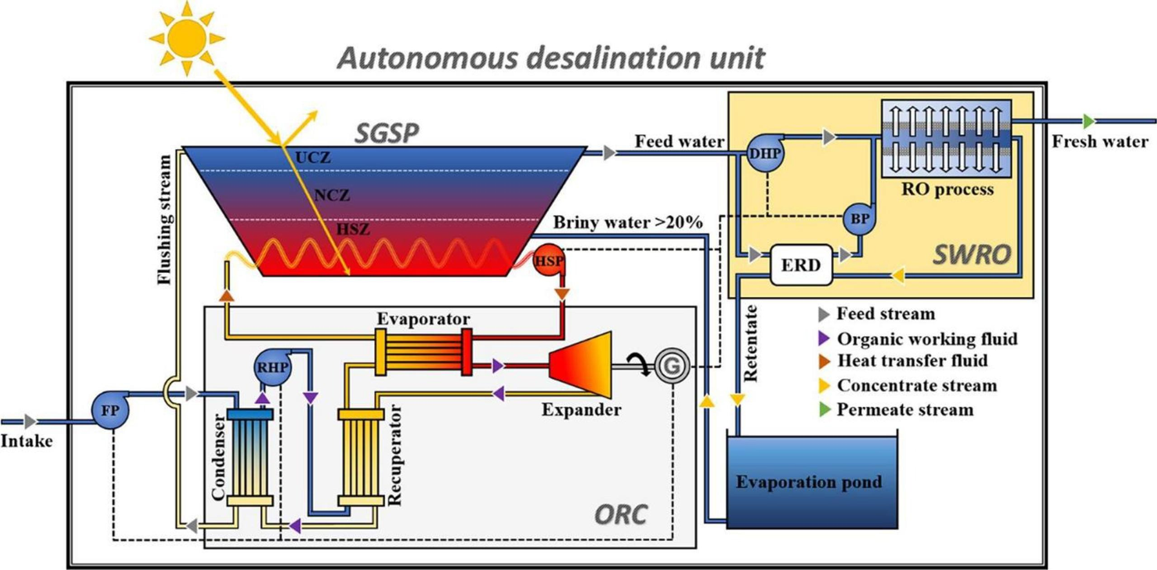
An example from the Mediterranean & Atlantic region
1. El Mansouri, Abdelfattah, M. Hasnaoui, A. Amahmid, and Safae Hasnaoui. "Feasibility analysis of reverse osmosis desalination driven by a solar pond in Mediterranean and semi-arid climates." Energy Conversion and Management 221 (2020): 113190.
11

Slide 12
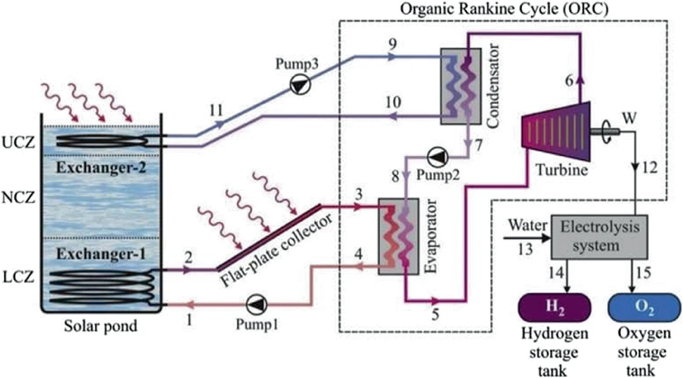
Organic Rankine cycle (ORC)
Started in Israel in the 1970s, ORC is a successful concept to produce electricity from solar ponds.
ORC is the Rankine cycle based on organic fluids having low boiling points such as propane, isobutane, and R134a.
In the closed cycle, the working fluid is expanded in the turbine, condensed in the condenser, and finally pumped into the boiler.
Examples:
  5 MW-250,000 m2 solar pond at Beith Ha’arava, Israel
  15 kW-1600 m2 solar pond at Alice Springs, Australia
  150 kW-7000 m2 solar pond at EinBokek, Israel
  70 kW-3350 m2 solar pond at El Paso, USA.
  Mittal, Gaurav & Singh, Gaurav & Singh, Desh & Kumar, Navneet. (2021). A Review of Electric Power Generation from Solar Ponds Using Organic Rankine Cycle and Air Turbine. 10.1007/978-981-33-6695-4_18.
  Singh R, Tundee S, Akbarzadeh A (2011) Electric power generation from solar pond using combined thermosyphon and thermoelectric modules. Sol Energy 85:371–378
12

Slide 13
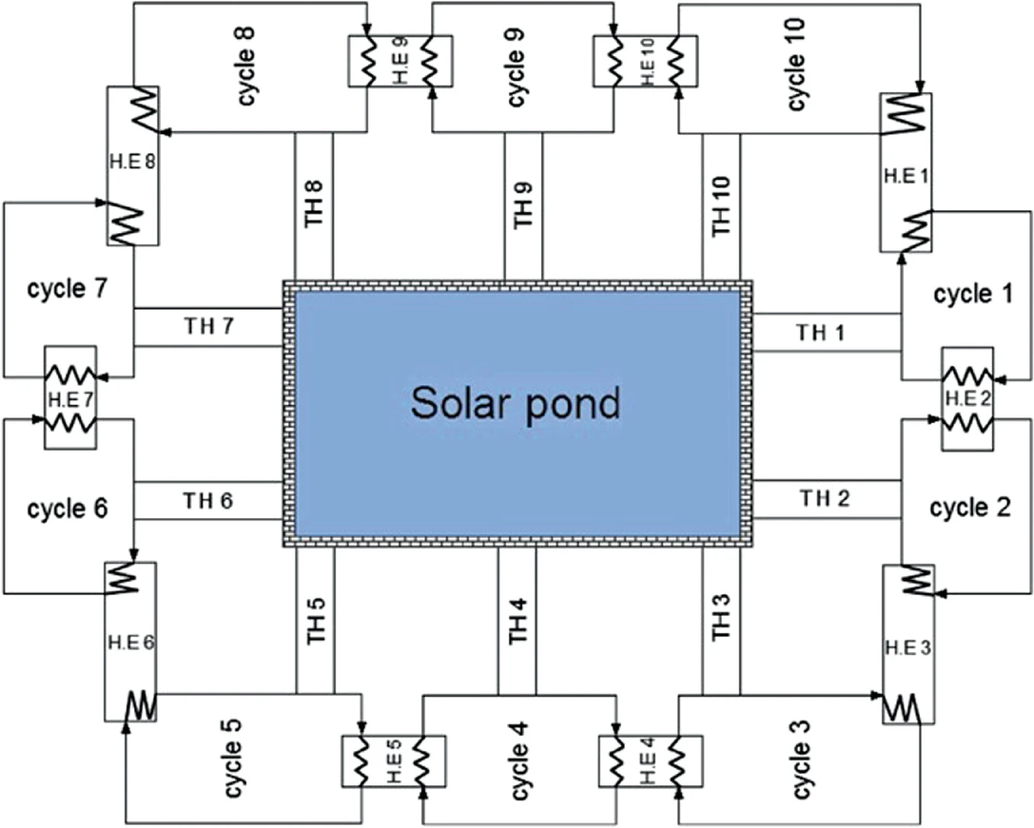
Organic Rankine cycle (ORC)
Multiple ORC units connected with solar pond by using multiple thermosyphons. TH indicates thermosyphon and HE are regenerative heat exchangers
1. Ziapour BM, Shokrnia M, Naseri M (2016) Comparatively study between single-phase and two-phase modes of energy extraction in a salinity-gradient solar pond power plant. Energy 111:126–136
13

Slide 14
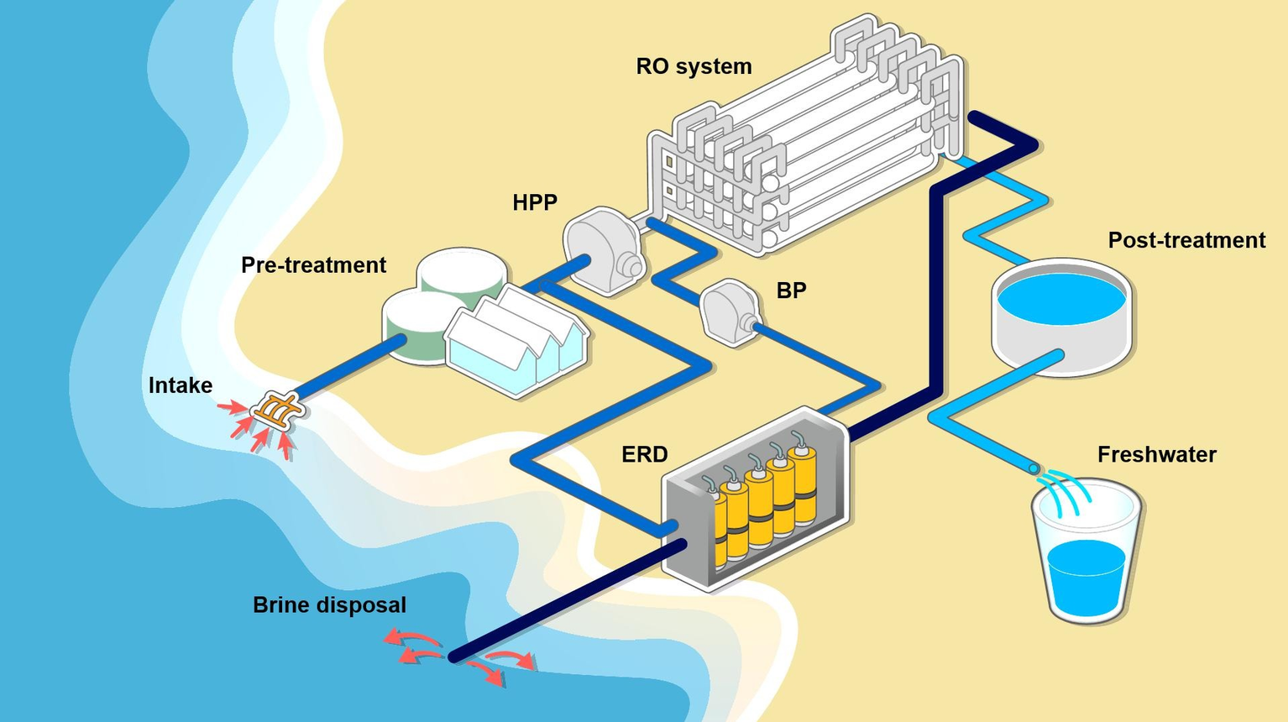
Seawater reverse osmosis (SWRO) desalination
Scheme of a typical SWRO desalination process. A pre-treated feed is supplied to the RO system with pressurization by HPP and BP, and the hydraulic pressure in the concentrate is recovered by ERD. RO: reverse osmosis. HPP: high-pressure pump. BP: booster pump. ERD: energy recovery device.
1. Jungbin Kim, Kiho Park, Dae Ryook Yang, Seungkwan Hong, A comprehensive review of energy consumption of seawater reverse osmosis desalination plants, Applied Energy, Volume 254, 2019, 113652, ISSN 0306-2619, https://doi.org/10.1016/j.apenergy.2019.113652.
14

Slide 15
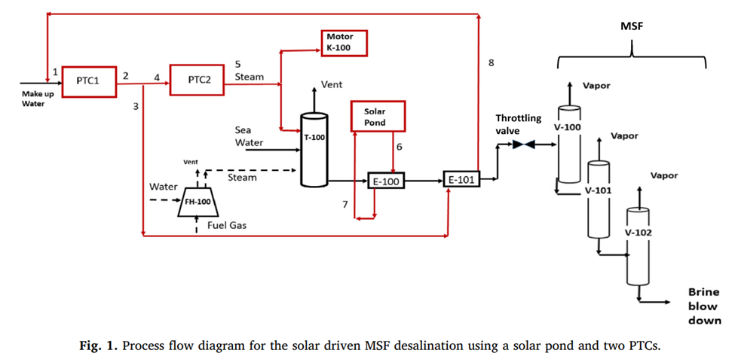
An example from UAE
  Solar pond + parabolic trough for electricity production
  MSF process for desalination
  Amani Al-Othman, Muhammad Tawalbeh, Mamdouh El Haj Assad, Tartela Alkayyali, Ahmed Eisa, Novel multi-stage flash (MSF) desalination plant driven by parabolic trough collectors and a solar pond: A simulation study in UAE, Desalination, Volume 443, 2018, Pages 237-244, ISSN 0011-9164, https://doi.org/10.1016/j.desal.2018.06.005.
15

Slide 16
Advantages/Disadvantages
Advantages
  Cheap
  Simple
  Suitable for large-scale
  Environmentally safe
  Can be year-round operation
Disadvantages
  Low efficiency
  Need much land
  Need maintenance cost for the surface layer
16

Slide 17

Thank You
17

