Slide 1
Urea as an Energy Carrier
Paean or Pee-On?
Presentation by
Gilbert “Bert” Stunkard
NPRE 498 ES
November 29, 2010

Slide 2
Urea as an energy carrier
Urea as a hydrogen carrier
Direct Urea fuel-cell
Urea Production/Manufacture
Urea: Vision, Economics, Advantages, Disadvantages
Direct Ammonia Fuel Cell

Slide 3
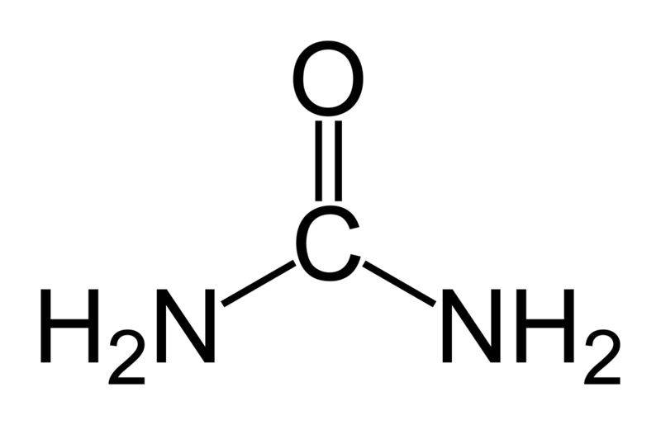
Urea properties
Source: en.wikipedia.org/wiki/urea¹

Slide 4
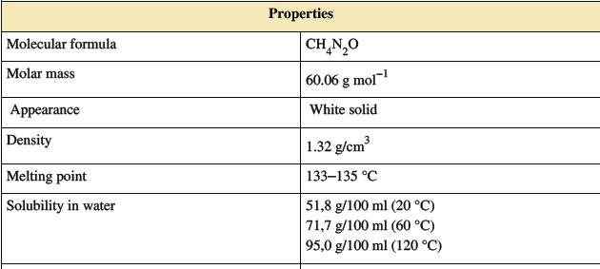
Urea properties
Source: en.wikipedia.org/wiki/urea

Slide 5
Urea as a Hydrogen Carrier
0.33 M Urea, inexpensive Ni catalyst, electrochemical oxidation.
Claim this is the first technology that directly converts urea to hydrogen.
Bryan K. Boggs, Rebecca L. King, Gerardine G. Botte* ,“Urea electrolysis: direct hydrogen production from urine”, in Chem. Commun., 2009, 4859-4861. (Dept. of Chemical and Biomolecular Engineering, Ohio University, Athens OH)²

Slide 6
Urea as a Hydrogen Carrier
CO₂ is actually captured at potassium carbonate K₂CO₃.
OH⁻ provided as potassium hydroxide (KOH).
Nitrogen at the anode, hydrogen at the cathode.

Slide 7
Urea as a Hydrogen Carrier
Explored Ni, Pt, Pt-Ir, Rh catalysts
Nickel oxyhyrdoxide modified nickel electrodes (NOMH) electroplated on Ni foil, Ni gauze, Ti Foil, Ti gauze yield higher current densities than M/Ni (metallic substrate) electrodes

Slide 8
Urea as a Hydrogen Carrier
Nickel in hydroxide media converts to Ni(OH)₂ (Ni²⁺) and NiOOH (Ni³⁺)
Ionic nickel probably enhances electrochemical oxidation
Absorption of urea on NiOOH surface likely rate limiting step.

Slide 9
Urea as a Hydrogen Carrier
Requires electric energy to release hydrogen
1.4 [v] achieved experimentally (0.37 [v] required theoretically) vs 2.0 [v] for hydrogen
Experimentally requires 30 % less energy than electrolytic hydrogen (theoretically could use 70% less)

Slide 10
Urea as a hydrogen carrier
Research project was to remediate urea containing waste water from urea manufacture or to use urine or biomass produced urea as fuel

Slide 11
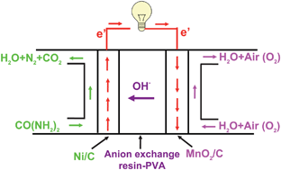
Direct Urea Fuel Cell
Rong Lan, Shanwen Tao*, and John T. S. Irvine, “A direct urea fuel cell – power from fertiliser and waste”, in Energy. Environ. Sci. 2010, 3, 438-441. (Herriot Watt University, Edinburgh. University of St. Andrews, Fife, UK).³
Again, claim first time achievement

Slide 12
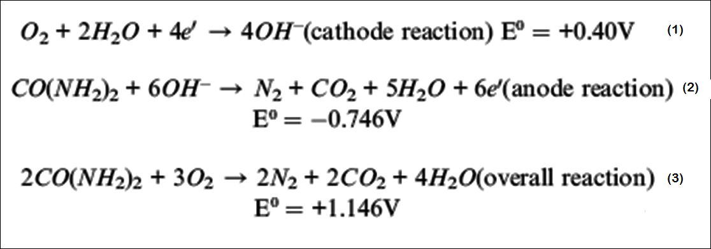
Direct Urea Fuel Cell

Slide 13
Direct Urea Fuel Cell
Theoretical open circuit voltage (OCV): 1.146 [v] at room temperature (H2/O2 fuel cell is 1.23 [v]).
Theoretical maximum efficiency is 102.9% at room temperature (vs 83 % for H₂).
Positive entropy change of reaction 3. Absorbs heat from ambiance and converts to electricity.

Slide 14
Direct Urea Fuel Cell –
Technical Challenges
Hydrolysis of urea produces ammonia. Reaction of urea with oxygen produces CO₂.
Not compatible with acidic Nafion membrane and other proton exchange membrane fuel cell (PEMFCs) mebranes.

Slide 15
Direct Urea Fuel Cell –
Technical Challenges
Alkaline membranes based on ammonia quaternary salts are CO2 compatible and introduction of CO2 at cathode can improve performance, allowing use of wet air.
Amberlite IRA 78 Hydroxide, a styrene-divinyl benzene resin
(R)_{n}~N⁺(CH3)₃ OH⁻

Slide 16
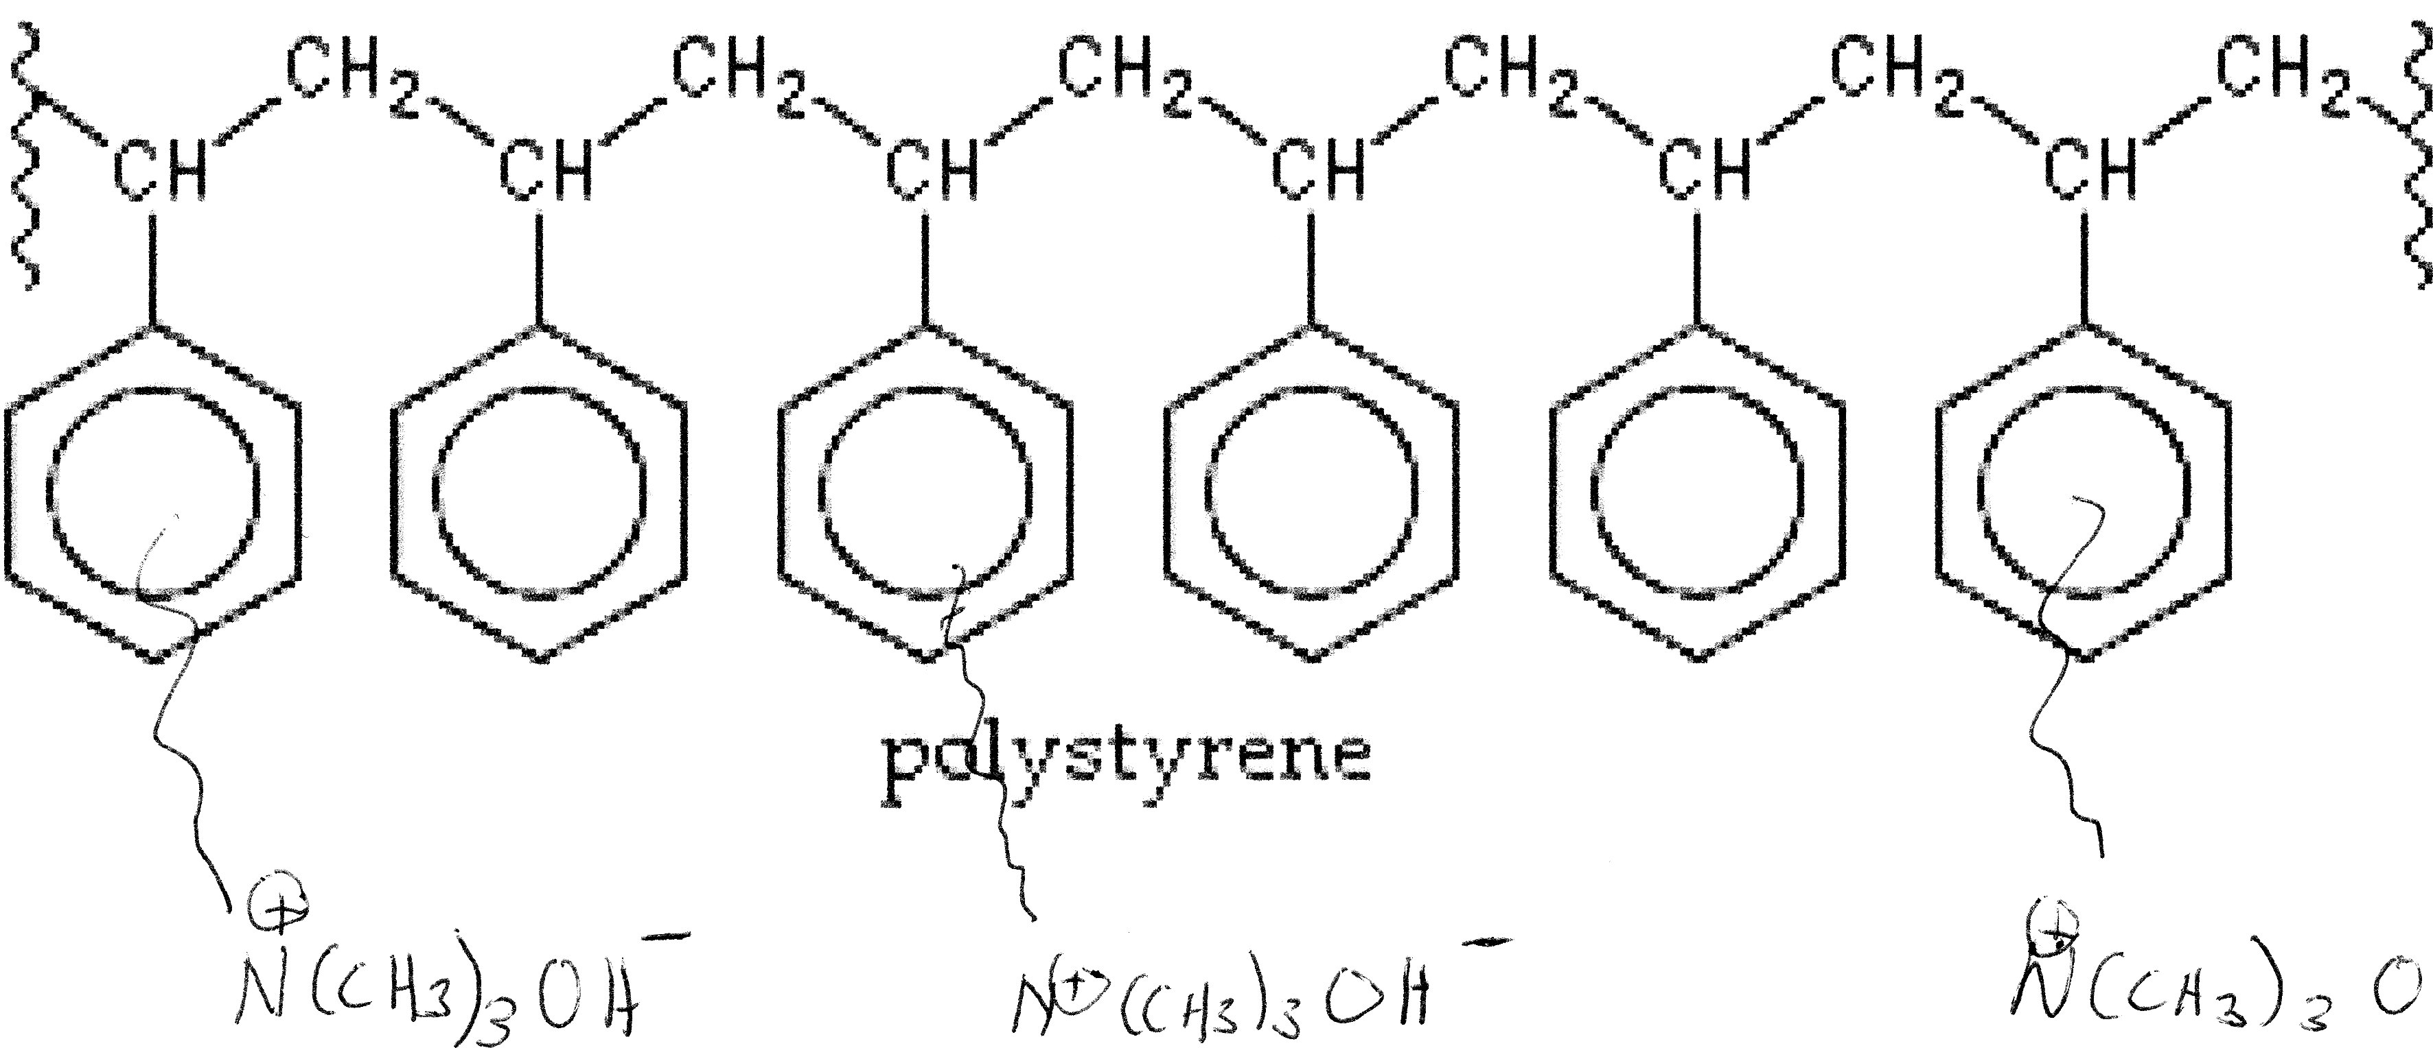
Urea Fuel Cell – Tech Challenges
Divinylbenzene crosslinks make a 3-D network resin
Polystyrene graphic: http://en.wikipedia.org/wiki/Polystyrene
Quaternary ammonium hydroxide groups added by presenter

Slide 17
Direct Urea Fuel Cell –
Technical Challenges
AER: Membrane: Amberlite IRA78, hydroxide form, 60/40 with (poly vinyl alcohol) PVA MW 50,000.
Current Collectors: Carbon papers (Toray 090, water proofed for anode, plain for cathode, E-TEK).
Low cost catalyst like nickel, silver, MnO₂ are stable in the alkaline membrane environment

Slide 18
Direct Urea Fuel Cell –
Two different anodes
Pt/C (30 wt % , E-TEK 0.6 mg/cm²).
Ni/C (Nano size nickel mixed with carbon 50/50 wt %, ~20 mg/cm²).

Slide 19
Direct Urea Fuel Cell –
Three different cathodes
Pt/C (30 wt % , E-TEK 0.6 mg/cm²).
Ag/C (Nano size silver mixed with carbon 50/50 wt %, ~20 mg/cm²).
MnO₂/C (Nano size MnO₂ mixed with carbon 20 wt % MnO₂, ~20 mg/cm²).

Slide 20
Direct Urea Fuel Cell –
Three grades urea
ACS grade, various concentrations
Commercial Ad-Blue (32.5 wt % urea) from a local garage.
Human urine (source not revealed)

Slide 21
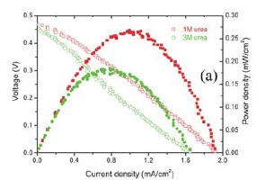
Direct Urea Fuel Cell
Ni/C – MnO2/C Fuel cell performance, room temperature (O₂)

Slide 22
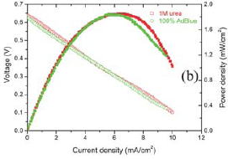
Direct Urea Fuel Cell
Ni/C – MnO₂/C Fuel cell performance, 50º C, O₂

Slide 23
Direct Urea Fuel Cell –
Performance Issues
Higher urea concentrations (3,5 M) decreased voltage.
Urea molecules are large: high concentration may cause slow diffusion at the anode thus increasing polarization loss.
Elevated temperature benefits all anode and cathode types.

Slide 24
Direct Urea Fuel Cell –
Performance Issues
Ni/C Anode, MnO₂ cathode: slightly higher voltage and power density than Ag/C cathode.
At 50º C, Ni/C, MnO₂ (using O₂) cell outperformed all Pt/C cell at room temperature (using air).

Slide 25
Direct Urea Fuel Cell – Performance of Ad-Blue
AdBlue (32.5%, ~5 M) ironically had higher voltages and power densities than comparable urea solutions (0.3 mW/cm² versus 0.2 mW/cm₂)
Dilute Ad-blue gave better performance than pure Ad-Blue.
10% Ad-Blue highest current and power densities

Slide 26
Direct Urea Fuel Cell
Research project was to remediate urea containing waste water from urea manufacture or to use urine or biomass produced urea as fuel

Slide 27
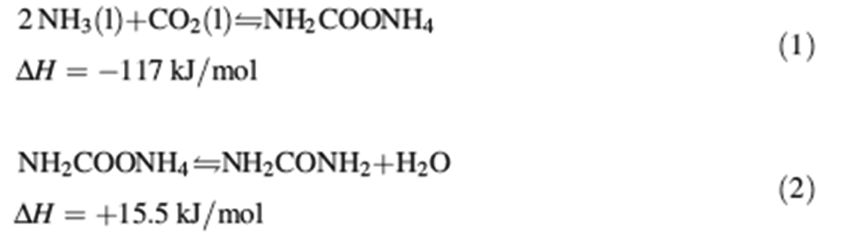
Urea – Manufacture⁴
Basaroff reactions:
NH2COONH4: ammonium carbamate
Requires ammonia
Ammonia requires hydrogen

Slide 28
Urea – Manufacture⁴
Basaroff reactions:
Step 2 is the dehydration of ammonium carbamate to urea at increased temperature and pressure

Slide 29
Urea Manufacture⁴
Hydrogen plant, ammonia plant, urea plant usually integrated on a single site
Hydrogen plant usually employs steam reformation of methane
Carbon dioxide goes to urea plant
Hydrogen goes to ammonia plant, where nitrogen and hydrogen are reacted over iron catalysts (Haber process)

Slide 30
Urea Manufacture⁴
Integrated plant optimizes energy transfer and waste recycle
Incomplete utilization of ammonia and carbon dioxide on each pass requires stripping of product from reactants and recycle of reactants
Wastewater is high in urea (~2%), chemical hydrolysis returns ammonia and carbon dioxide to reactor

Slide 31
Urea – Manufacture⁴

Slide 32
Urea – Manufacture⁴
Carbamate solution is corrosive (carbamate is an electrolyte)
Urea is not corrosive
Heat exchange critical to process efficiency
Carbamate solutions are most destructive to heat exchangers

Slide 33
Urea Vision
Urea less toxic than ammonia or methanol
Urea less combustible, less explosive than hydrogen, ammonia, or methanol
Urea easier to transport than anhydrous ammonia or hydrogen

Slide 34
Urea Vision
Green hydrogen + waste carbon dioxide = urea
Initiate distribution via existing agricultural and Ad-blue© suppliers
Ad-Blue: a 32.5% solution of urea and deionized water used for nitrogen oxides removal from diesel exhaust⁵

Slide 35
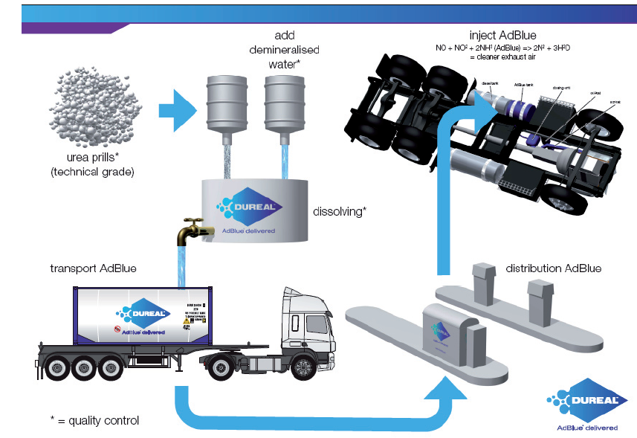
Urea Vision⁵
Source: BP/Dureal “Guide to Ad-Blue”, 2010

Slide 36

Urea Vision
Agricultural urea granules are treated with formaldehyde⁴
Urea prills have problems with dust and moisture absorption⁴
Ad-Blue freezes at -11º C (12º F)⁵
Urea solutions slowly decompose to ammonia and isocyanuric acid.⁴

Slide 37
Urea: Energy density comparison

Slide 38
Urea – Cost Comparison
Substance | Price^{t} ( ¢/kg) | Gravimetric Energy Density* (MJ/kg) | Energy Cost (¢/MJ) | Gravimetric Energy Density (kW.hr/kg) | Energy Cost (¢/kW.hr)
Methanol | 44.5 | 22.66 | 1.96 | 6.278 | 7.07
Liquid NH₃ | 45.0 | 22.48 | 2.00 | 6.244 | 7.21
Urea | 38.0 | 10.536 | 3.61 | 2.9267 | 13.0
^{t} October prices from www.icis.com, prices at plant
*Calculated from heats of combustion found in CRC Handbook Online

Slide 39
Urea Economics
Conversion of natural gas to urea => 55% energy efficiency. ³
Efficiency of fuel cell yet to be determined, optimized, or perfected
With 50% fuel-cell efficiency, overall efficiency would be ~25%.
Comparable to LNG fired internal combustion engine.

Slide 40
Urea Economics
Urea must become comparable in price (based on MJ/kg) to methanol or ammonia.
Urea fuel-cell efficiency would need to exceed methanol or ammonia fuel cell efficiency
Otherwise confined to niches where flammability of methanol or toxicity of ammonia present problems.

Slide 41
Ammonia as energy carrier
No need to make urea
CO₂ can be sequestered at hydrogen plant
Carbon neutral: green hydrogen + atmospheric nitrogen = ammonia
Ammonia fuel cells have head start. First direct ammonia fuel cell was 1969.⁶
Potential to make ammonia electrolytically from just water and nitrogen.

Slide 42
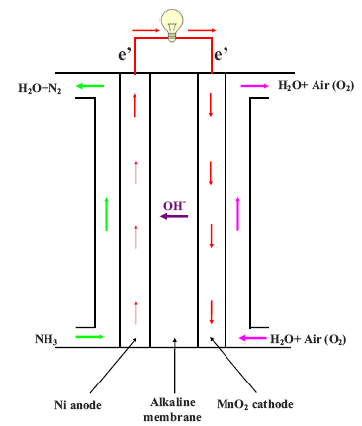
Ammonia Fuel Cell
Rong Lan and Shanwen Tao*, “Direct Ammonia Alkaline Anion-Exchange Membrane Fuel Cells”, in Electrochemical and Solid-State Letters, 13(8) B83-B86 (2010). Heriot-Watt University, Edingburgh, UK, Department of Chemistry.⁶

Slide 43

Ammonia Fuel Cell

Slide 44
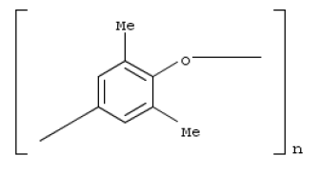

Ammonia Fuel Cell - Membrane
Membrane: Chloroacetyl poly(2,6-dimethyl-1,4-phenylene oxide) (CPPO) blended 50/50 with Polyvinyl alcohol (PVA) 50K M.W. for strength.
S
Structures: SCIFINDER/CAS Chemical Substance Registry, RN 24938-67-8, RN 79-04-8

Slide 45
Ammonia Fuel Cell - Electrodes
Anode: Cr-decorated Ni (CDN) molar ratio 97.7:2.3 Ni/Cr. 50/50 wt % CDN/Carbon, 10 mg/cm².
Cathode: MnO₂/C (20 wt % MnO₂) cathode, 20 mg/cm².
Also tested PtRu/C anode with Amberlite IRA400/PVA membrane

Slide 46
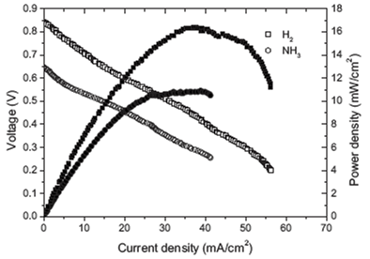

Ammonia Fuel Cell
Reference: 6

Slide 47
Ammonia Fuel Cell
Claim maximum power density of 16 mW/cm² with CPPO membrane at voltage of ~0.85 [v] using pure oxygen.⁶ (Some conflict with plot in previous slide).
1.17 [v] is theoretical maximum

Slide 48
Urea as hydrogen carrier²
Hydrogen carrier – requires electricity to free hydrogen from urea
Experimental cell only uses 30 % less energy than freeing hydrogen from water
Theoretically limited to 70% less energy than freeing hydrogen from water
Process development is for remediation of urea production wastewater or urine as fuel

Slide 49
Urea Fuel Cell
Urea less toxic than ammonia, less flammable than methanol
Urea likely more expensive fuel than ammonia or methanol
Urea is not carbon neutral
Urea requires ammonia to make, ammonia requires hydrogen

Slide 50
Further research
Urea fuel cell improvement for use with urea waste or biomass derived urea
Ammonia more promising than urea as energy carrier
Ammonia fuel cell improvement
Possible electrolytic production of ammonia from water and atmospheric nitrogen

Slide 51
References
(1) “Urea”, http://en.wikipedia.org/wiki/Urea
(2) Bryan K. Boggs, Rebecca L. King, Gerardine G. Botte* ,“Urea electrolysis: direct hydrogen production from urine”, in Chem. Commun., 2009, 4859-4861. (Dept. of Chemical and Biomolecular Engineering, Ohio University, Athens OH)
(3) Rong Lan, Shanwen Tao*, and John T. S. Irvine, “A direct urea fuel cell – power from fertiliser and waste”, in Energy. Environ. Sci. 2010, 3, 438-441. (Herriot Watt University, Edinburgh. University of St. Andrews, Fife, UK).

Slide 52
References
(4) Josef H. Meesen, “Urea”, in Ullman’s Encyclopedia of Industrial Chemistry, 2010, Wiley-VCH Verlag & Co. KGaA, Weinheim, 10.1002/ 14356007.a27_333.pub2.
(5) BP and Dureal “Ab-Blue Handbook”, 2010
(6) Rong Lan and Shanwen Tao*, “Direct Ammonia Alkaline Anion-Exchange Membrane Fuel Cells”, in Electrochemical and Solid-State Letters, 13(8) B83-B86 (2010). Heriot-Watt University, Edingburgh, UK, Department of Chemistry.

Slide 53
Additional references
Hazel Muir, “Pee Power”, in New Scientist, 207(2774), 21 August, 2010, 27-39.
Dr. Carl Feickert, “Hydrogen production from waste stream urea recover”, ERDC-CERL, Champaign, IL Branch.
George Marnellos and Michael Stoukides, “Ammonia synthesis at atmospheric pressure”, in Science, 282, 1998, 98-100. Covers electrolytic ammonia preparation at atmospheric pressure and room temperature via hydrogen and nitrogen.

